Slide 1


Uncertainty Analysis in
Integrated Assessment Models
Model Uncertainty Project
PIAMDDI Workshop
December 14, 2013
Kenneth Gillingham and William Nordhaus
Yale University

Slide 2
Goals of MUP
What we plan to accomplish:
A systematic study of uncertainty in a set of IAMs
  Determine the differences among models in the uncertainties
  Provide benchmark estimates for major parameters
  Highlight areas where reducing uncertainties would have a high payoff
Classical statistical (forecast) errors of IAM projections

Slide 3
Overview of Progress to Date
Gather models/modelers who can perform uncertainty experiments (August 2011)
Feasibility study of key uncertain variables and key output variables (Spring/Summer 2012)
Developed “Two-track Procedure” and worked with modelers on calibration runs (Fall 2012/Spring 2013)
Collated and analyzed calibration runs (Summer 2013-present)
Developed/compiled PDFs (Fall 2013-present)

Slide 4
Contributing Modeling Teams
MIT IGSM
JGCRI GCAM
EPRI MERGE
Yale DICE
Tol/Antoff FUND
FEEM WITCH
  In feasibility study: PHOENIX and PAGE

Slide 5
Feasibility Study
We analyzed several sensitivity runs:
  An emission pulse
  Reduce world output by one-time pulse
  Increase world GDP growth (total factor productivity growth)
  Change climate sensitivity (TSC)
  Increase population growth
  Carbon tax (AM3ND1 AMPERE scenario)
Our findings and discussion at Snowmass led us to focus on three: TFP growth, population growth, TSC
  For all three, a baseline and carbon tax run

Slide 6
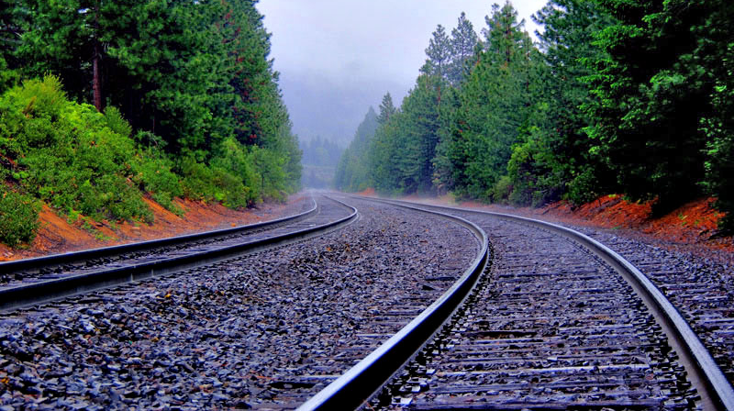
Two-track Procedure
To quantify uncertainties:
Model runs for uncertain variables on a grid of values
Harmonize PDFs of uncertain variables

Slide 7
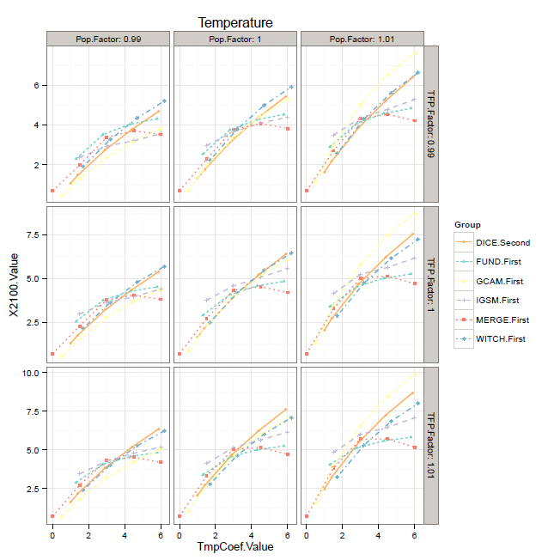
Display Results:
Lattice Graph

Slide 8


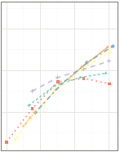

Lattice Graph
Center Box

Slide 9
Temperature
Results
(so far)

Slide 10
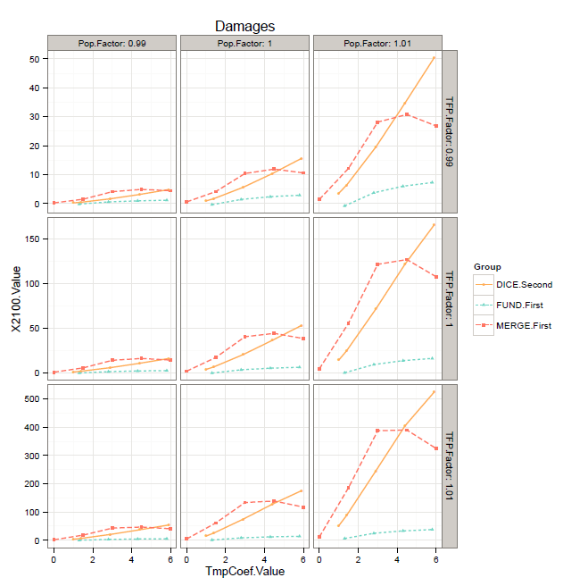
Damages

Slide 11
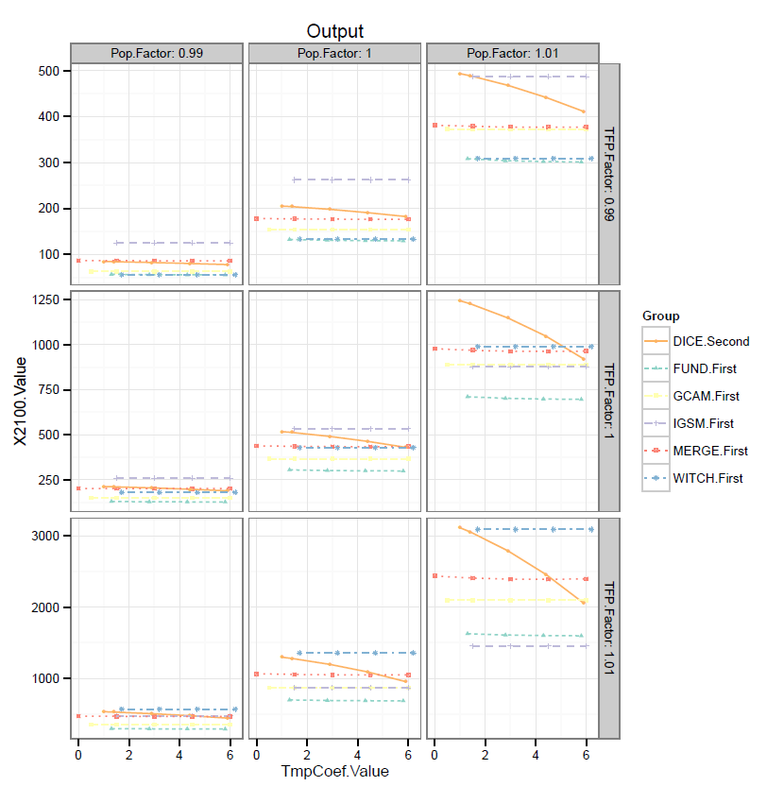
Model Runs
Output

Slide 12
PDF Harmonization
Population Growth
  Have PDFs from IIASA’s demography group
  IIASA level is much lower than UN or Berkeley estimates
Total factor productivity
  Developing an expert elicitation
  Have run 2 pilots so far
Temperature Sensitivity
  Basing our PDF on the recent literature
  Hosted Yale Workshop on Uncertainty in Climate Sensitivity
  In combining PDFs, room for methodological improvements

Slide 13
Next Steps
Final set of model runs
  To assure consistency across the models
  Currently developing protocol for these runs
Complete preparation of PDFs
  Currently reviewing other population PDFs
  Economic growth survey to go out in winter 2013, followed by phone calls to survey-takers
  Currently reviewing IPCC PDFs and deciding on our approach
Bring the Two Tracks together!
  PDFs of key output variables

