Slide 1
The Hector Model: current status and future plans
Corinne A. Hartin
Ben Bond-Lamberty
Leon Clarke
Joint Global Change Research Institute
December 13, 2013

Slide 2
Model: motivation for Hector
Fast executing simple global climate model
  an adaptive-timestep solver
  object-oriented coupler - easily swap in and out model components
  Interactive carbon chemistry in surface ocean
  Reproduce first-order responses of carbon and energy budgets from observations and GCMs
MAGICC in particular has been heavily used across many scientific and policy communities & many strengths
  old difficult code to work with
  not open source, legal encumbrances unclear
Notes:
Constraint on components we want instantaneous execution
Several decades MAGICC has been the community standard. Strengths, comprehensive climate model, fast, long history and literature supporting it. From our point of view has a few issues particularly b/c GCAM is open source

Slide 3
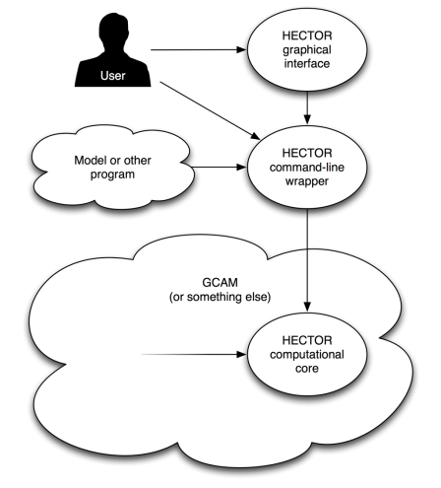
Model: Hector and its uses
Develop a free, open source, object-oriented, community model
Stand-alone
  Explore science issues
  Climate sensitivity analyses
Coupled to another model (e.g. GCAM)
Notes:
We are moving in this direction. Recently we started working with a graduate student, Adria, from UMD. AS well as a lot of collaboration with Penn State, which will continue to build in the near future.

Slide 4
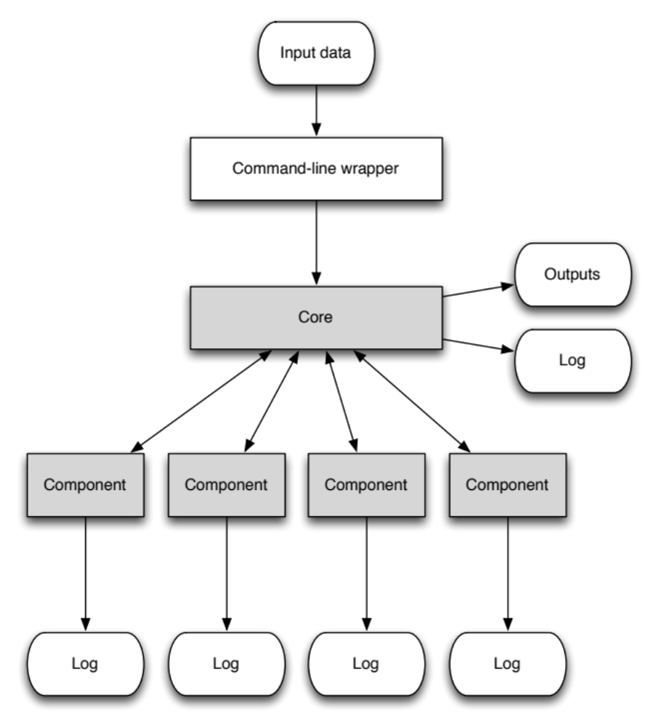
Model: open and object –oriented architecture
Input data are routed to model components via the model core
Components can be enabled/disabled via input
Components can be swapped in and out
New Component
Notes:
Swap in and out components
Modular architecture

Slide 5
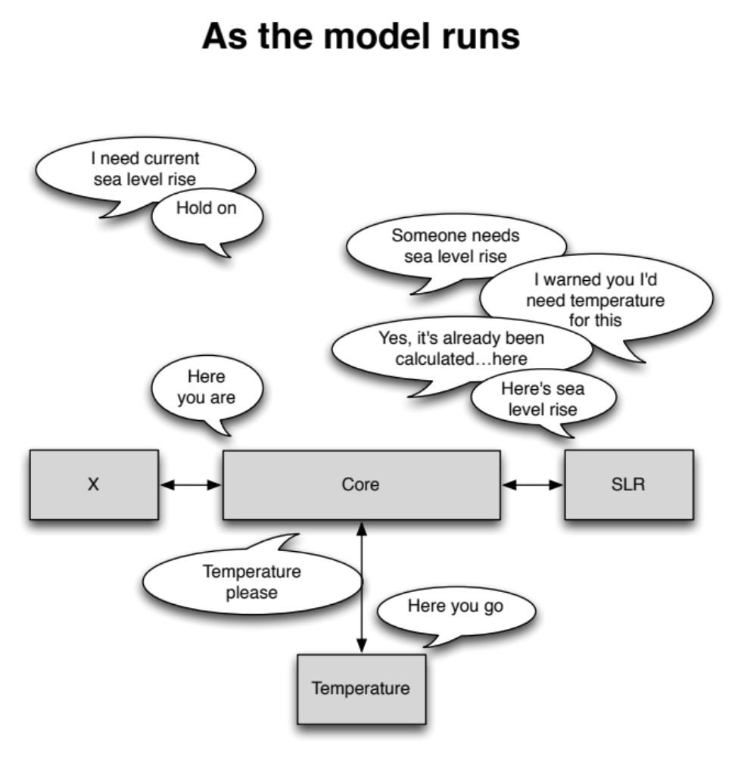
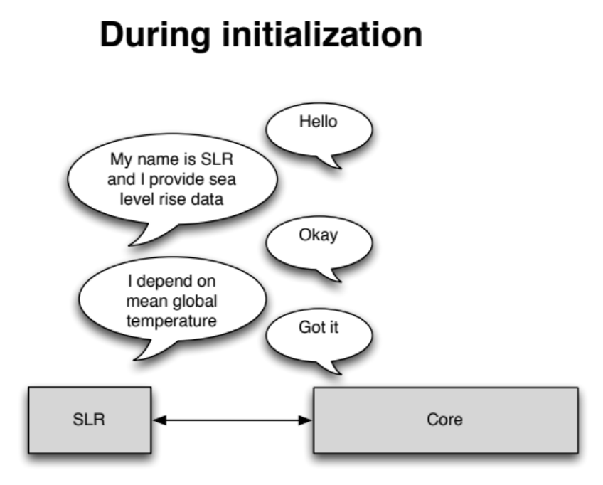
Model: components
Components have a defined interface (API)
They register their dependencies and capabilities with the core
  e.g., sea level rise depends on temperature
Core orders components by their dependencies
Components query the core for data
  Core routes request to appropriate component
Notes:
Executed in order
Dependencies imply an execution order

Slide 6
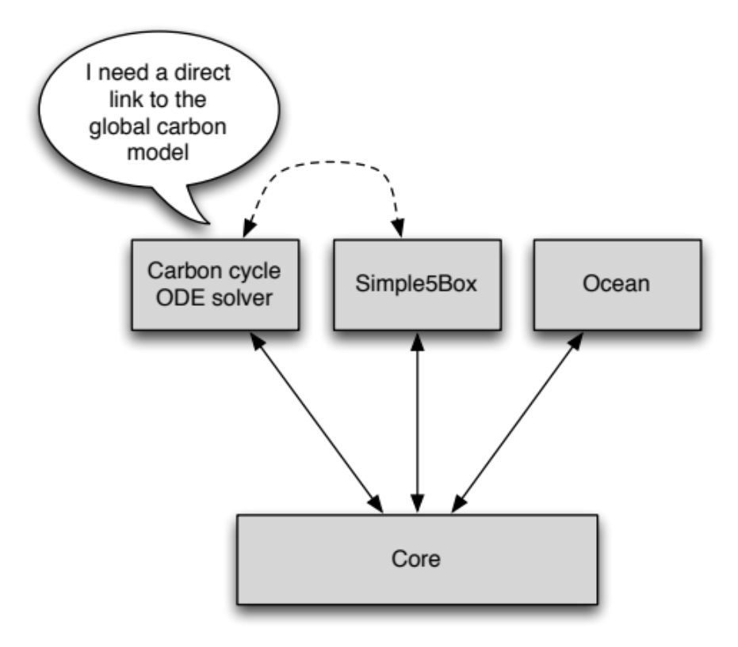
Model: spinup
As in many models, the carbon cycle is optionally brought to equilibrium before the main simulation starts
This simply means turning off all anthropogenic contributions - mostly important to the carbon cycle
run the model until Δc_{i} < ε for some small ε
Notes:
These initial carbon values are used to spin up the system. We turn off all anthropogenic components and allow the system to ocme into equilibrium, where the change in Carbon is less than some specific epsilon value.

Slide 7
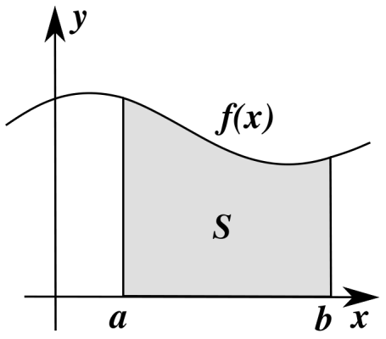
Model: carbon cycle solver
The solver uses the GNU ordinarily differential equation (ODE) package
  Runge-Kutta with adaptive step size
The carbon model is called to calculate derivatives of the carbon pools as necessary to evolve solution from t to t+½ to t+1
Right now, this is overkill—we are always advancing one time step
helps ocean deal with high-emissions scenarios, and lays the foundation for variable time steps in the future

Slide 8
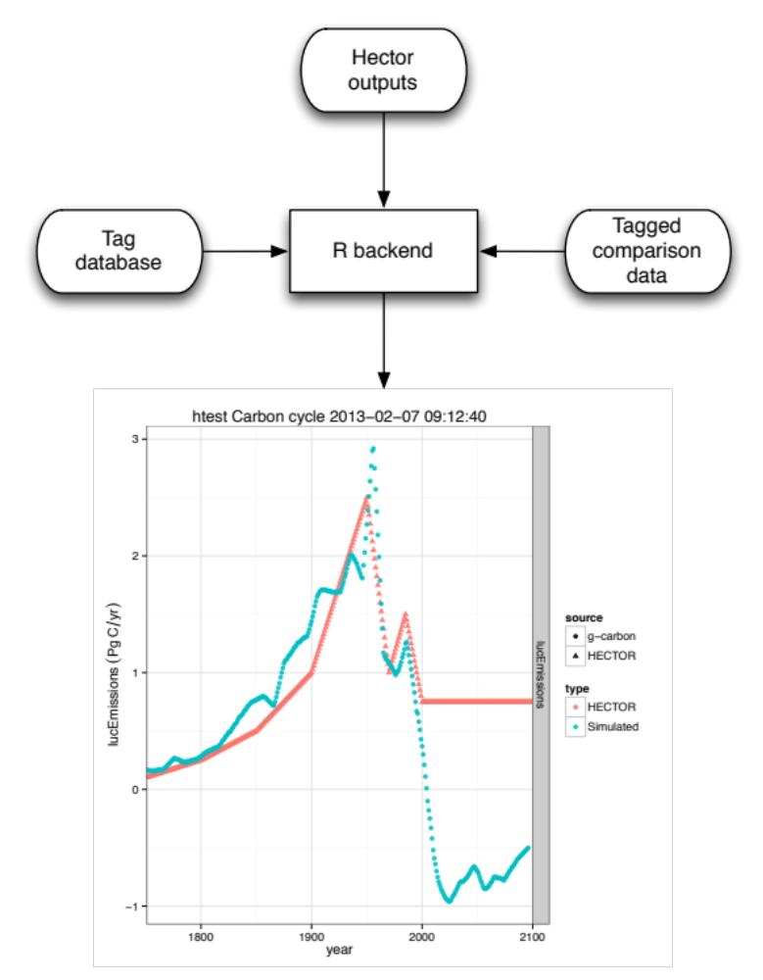
Backend system: structure
The primary model output to date is a text data stream (table)
R script matches these data to a wide variety of comparison data, based on a tag database
  e.g. atmospheric CO₂ (datum) for RCP4.5 (case)
Diagnostic plots for components or specific data are then saved

Slide 9
Science: overview
Atmosphere (C)
Vegetation (C)
Low Latitude Surface (C)
High Latitude Surface (C)
Detritus
(C)
Intermediate Ocean (C)
Deep Ocean (C)
Soil
(C)
Notes:
Hector is made up of 3 carbon components! 1 atmosphere box, 3 land boxes, vegetation, detritus and soil and 4 ocean boxes, high and low latitude, intermediate and deep. All boxes contain an initial carbon value.

Slide 10
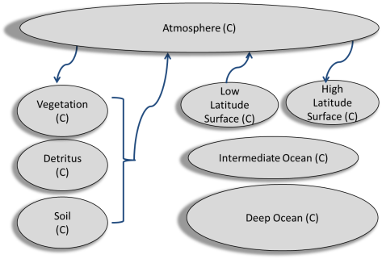
Science: atmosphere
Well mixed globally averaged atmosphere
Forced with emissions from IPCC scenarios
  CO₂
  BC/OC
  CH₄/N₂O
  Stratospheric H₂O
  26 halocarbons
  Sulphate aerosols
  Volcanic emissions
  include both indirect and direct effects on radiative forcing
Notes:
CO2 is the only one to interact with the land and ocean

Slide 11
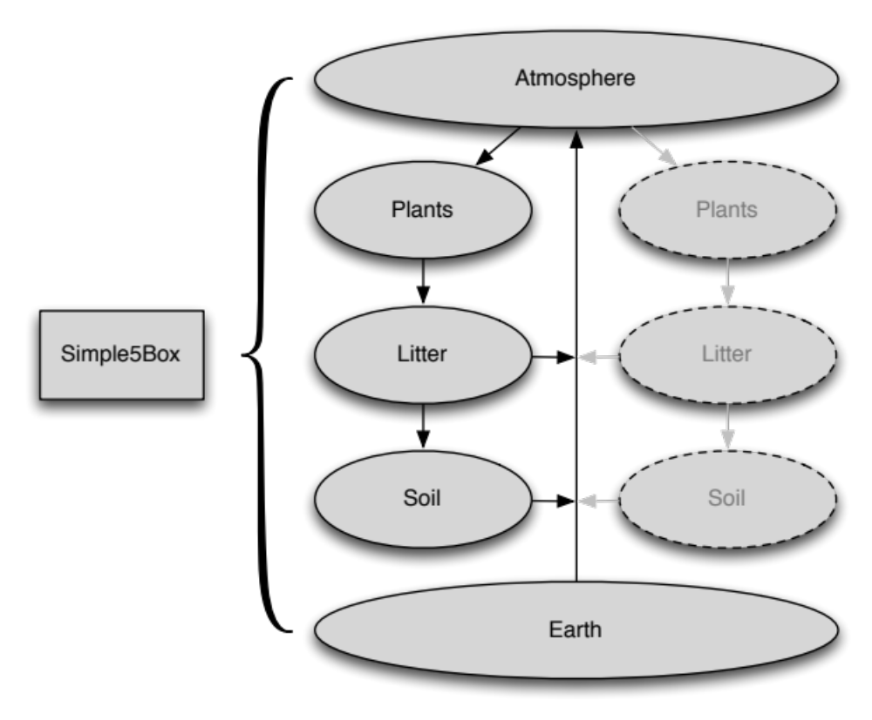
Science: land
A classic simple design: five boxes
NPP, R_{H}, litter fluxes scaled by global temperature and CO₂
Continual mass balance to check for ‘leaks’
Notes:
Earth starts at 0 and becomes negative as carbon is “mined” from the earth.
As of now only global averaged. Would like to split into high- and low-latitudes, matching ocean design
Net primary production and heterotrophic respiration

Slide 12
Science: ocean
Atmosphere (C)
4 boxes
  2 surface – 100m
  Intermediate – 1000m
  Deep – 3777m
Advection and water mass exchange
Heat uptake in surface boxes → atmospheric temperature
Carbon chemistry in surface boxes → atmosphere-ocean flux
Low Latitude Surface (C)
High Latitude Surface (C)
Intermediate Ocean (C)
Deep Ocean (C)
Notes:
High latitude makes up 15% and simulates the subpolar gyres, while the low latitude makes up 85% of the ocean.
Carbon exchange between the surface boxes, uptake by the cold high latitude box and release of CO2 by the warm low latitude box.
Advection of carbon between the boxes. Sinking in the high latitudes to deep ocean, upwelling from deep to intermediate to surface. And a surface return flow from the low latitude to the high latitude. We aren’t explicitly modeling diffusion. Diffusion becomes more computationally demanding and has been shown to overestimate the ocean carbon sink.

Slide 13
Results
Model | Model
BCC-CSM | HadGEM2-ES
BNU-ESM | INMCM4
CanESM2 | IPSL-CM5A-LR
CESM1-BGC | IPSL-CM5A-MR
CNRM-CM5 | IPSL-CM5B-LR
GFDL_ESM2M | MIROC-ESM
GFDL-ESM2G | MIROC-ESM-CHEM
GISS-E2-H-CC | MPI-ESM-LR
GISS-E2-R-CC | MPI-ESM-MR
HadGEM2-CC | NorESM1-ME
Comparisons with:
MAGICC 6
Comparisons with CMIP5 – Coupled Model Intercomparison Project
  models that have included biogeochemistry
Atmosphere, Ocean, and Land observations

Slide 14
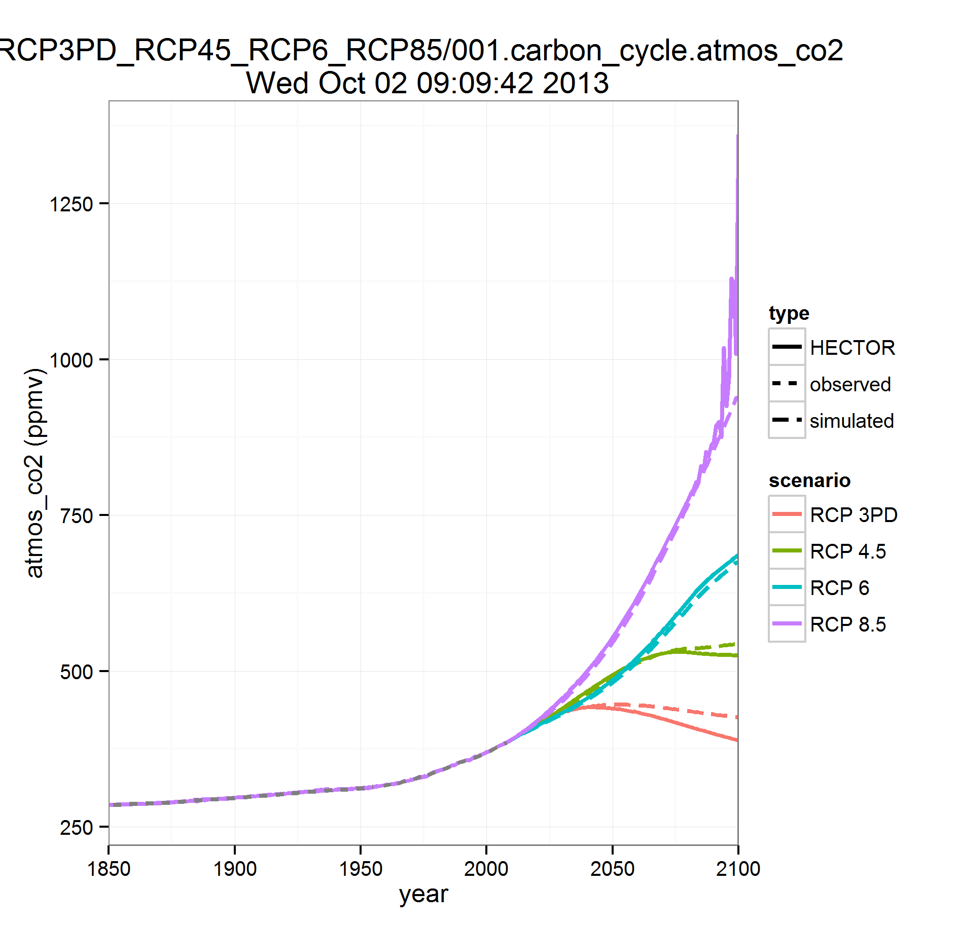
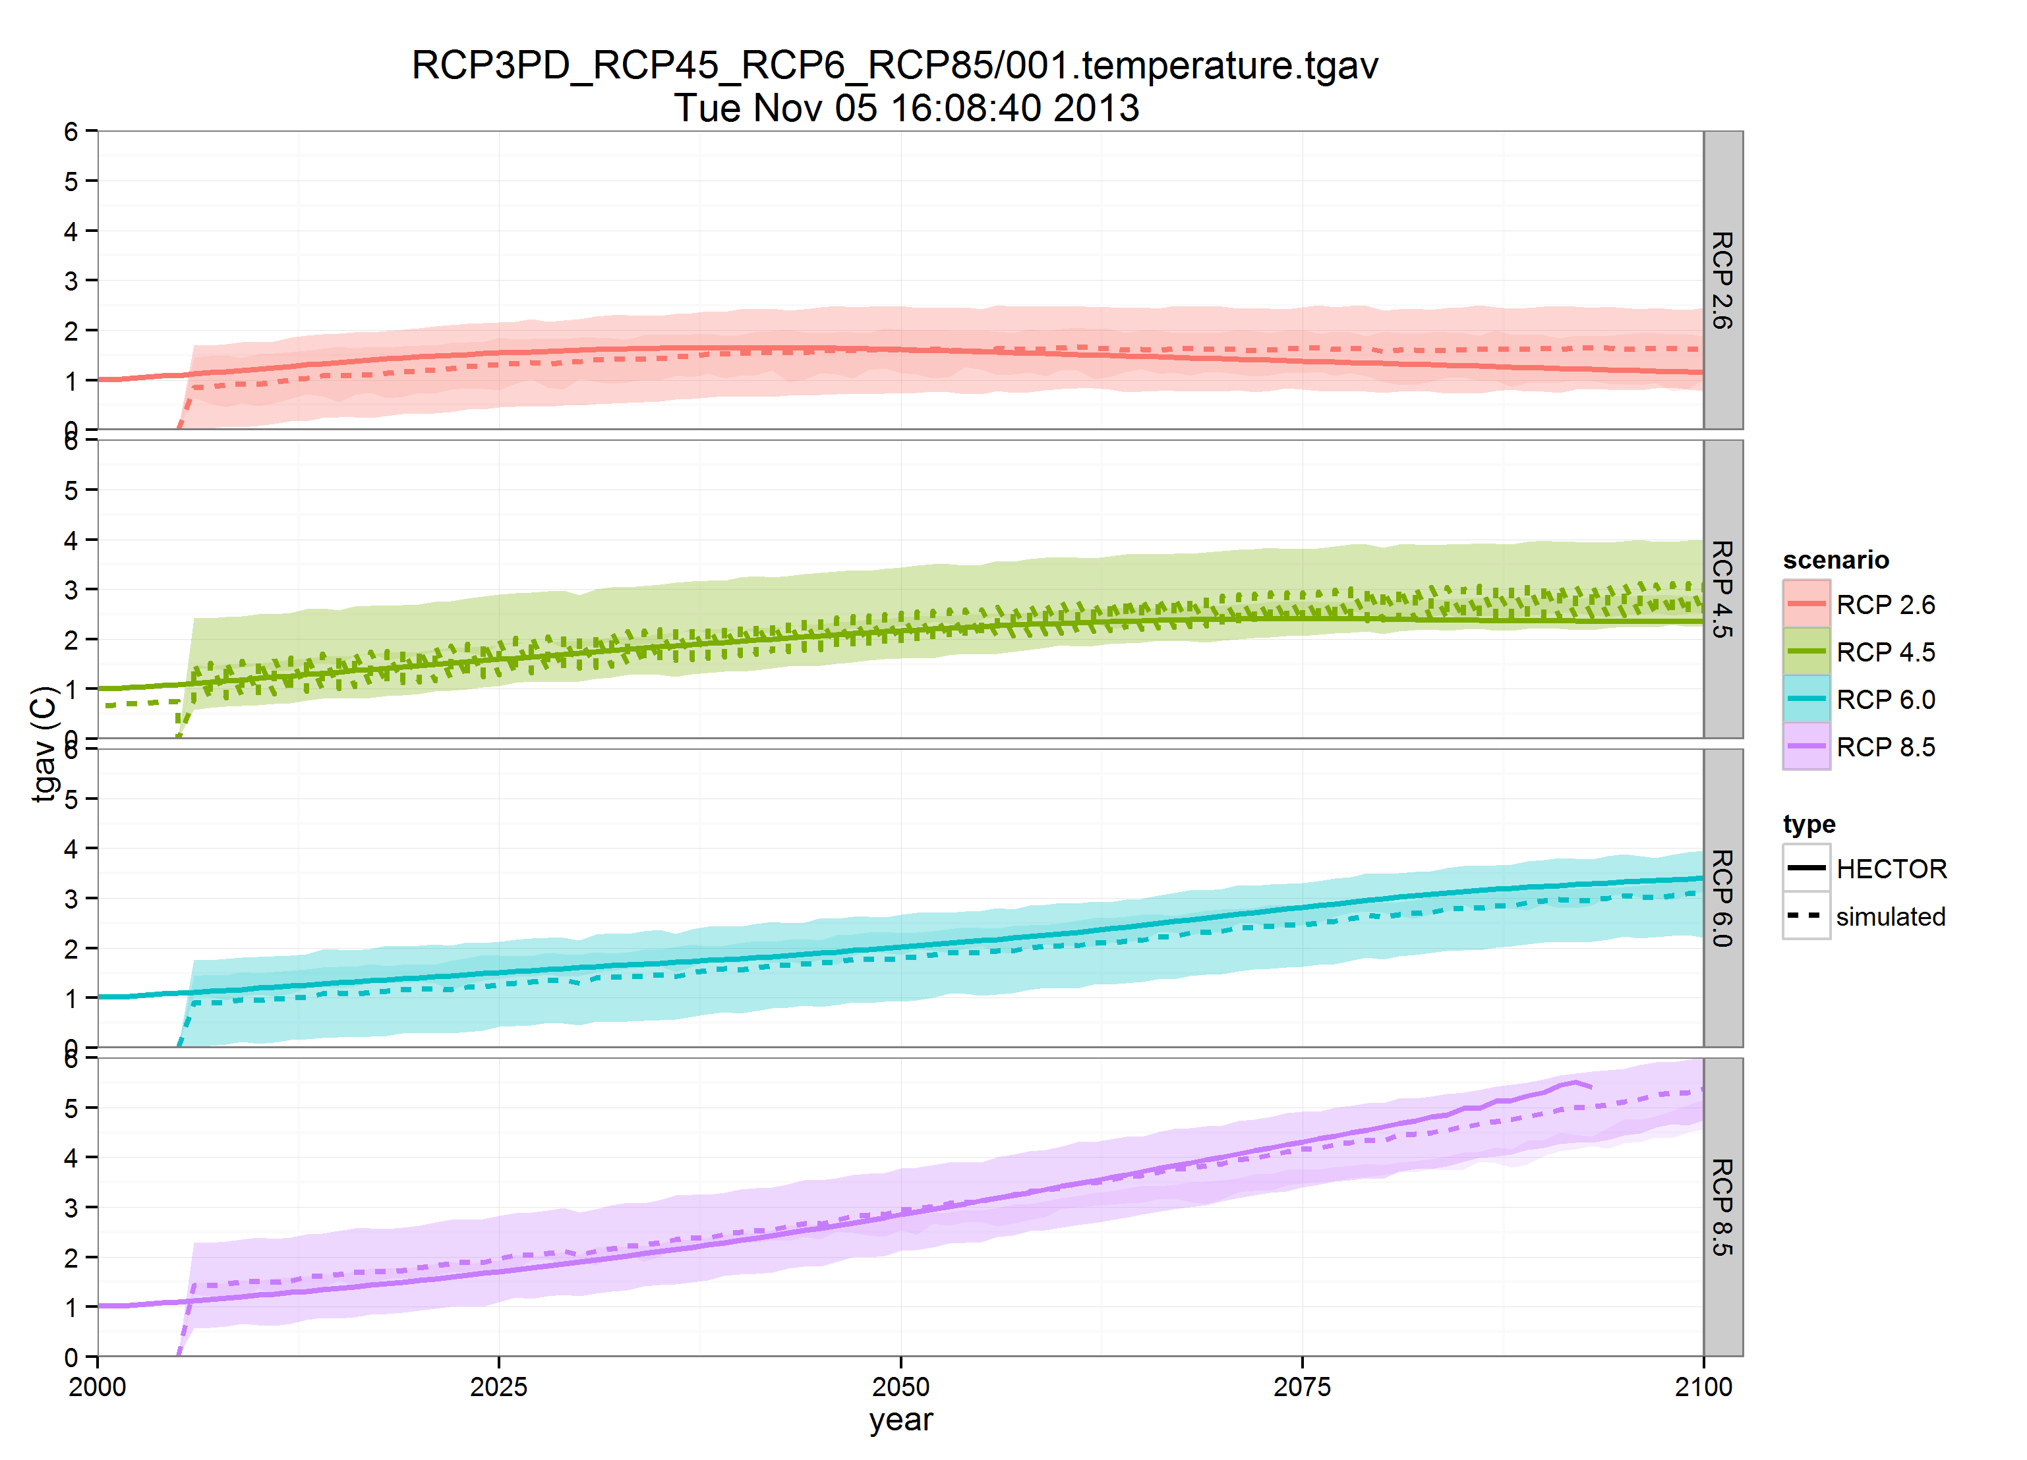
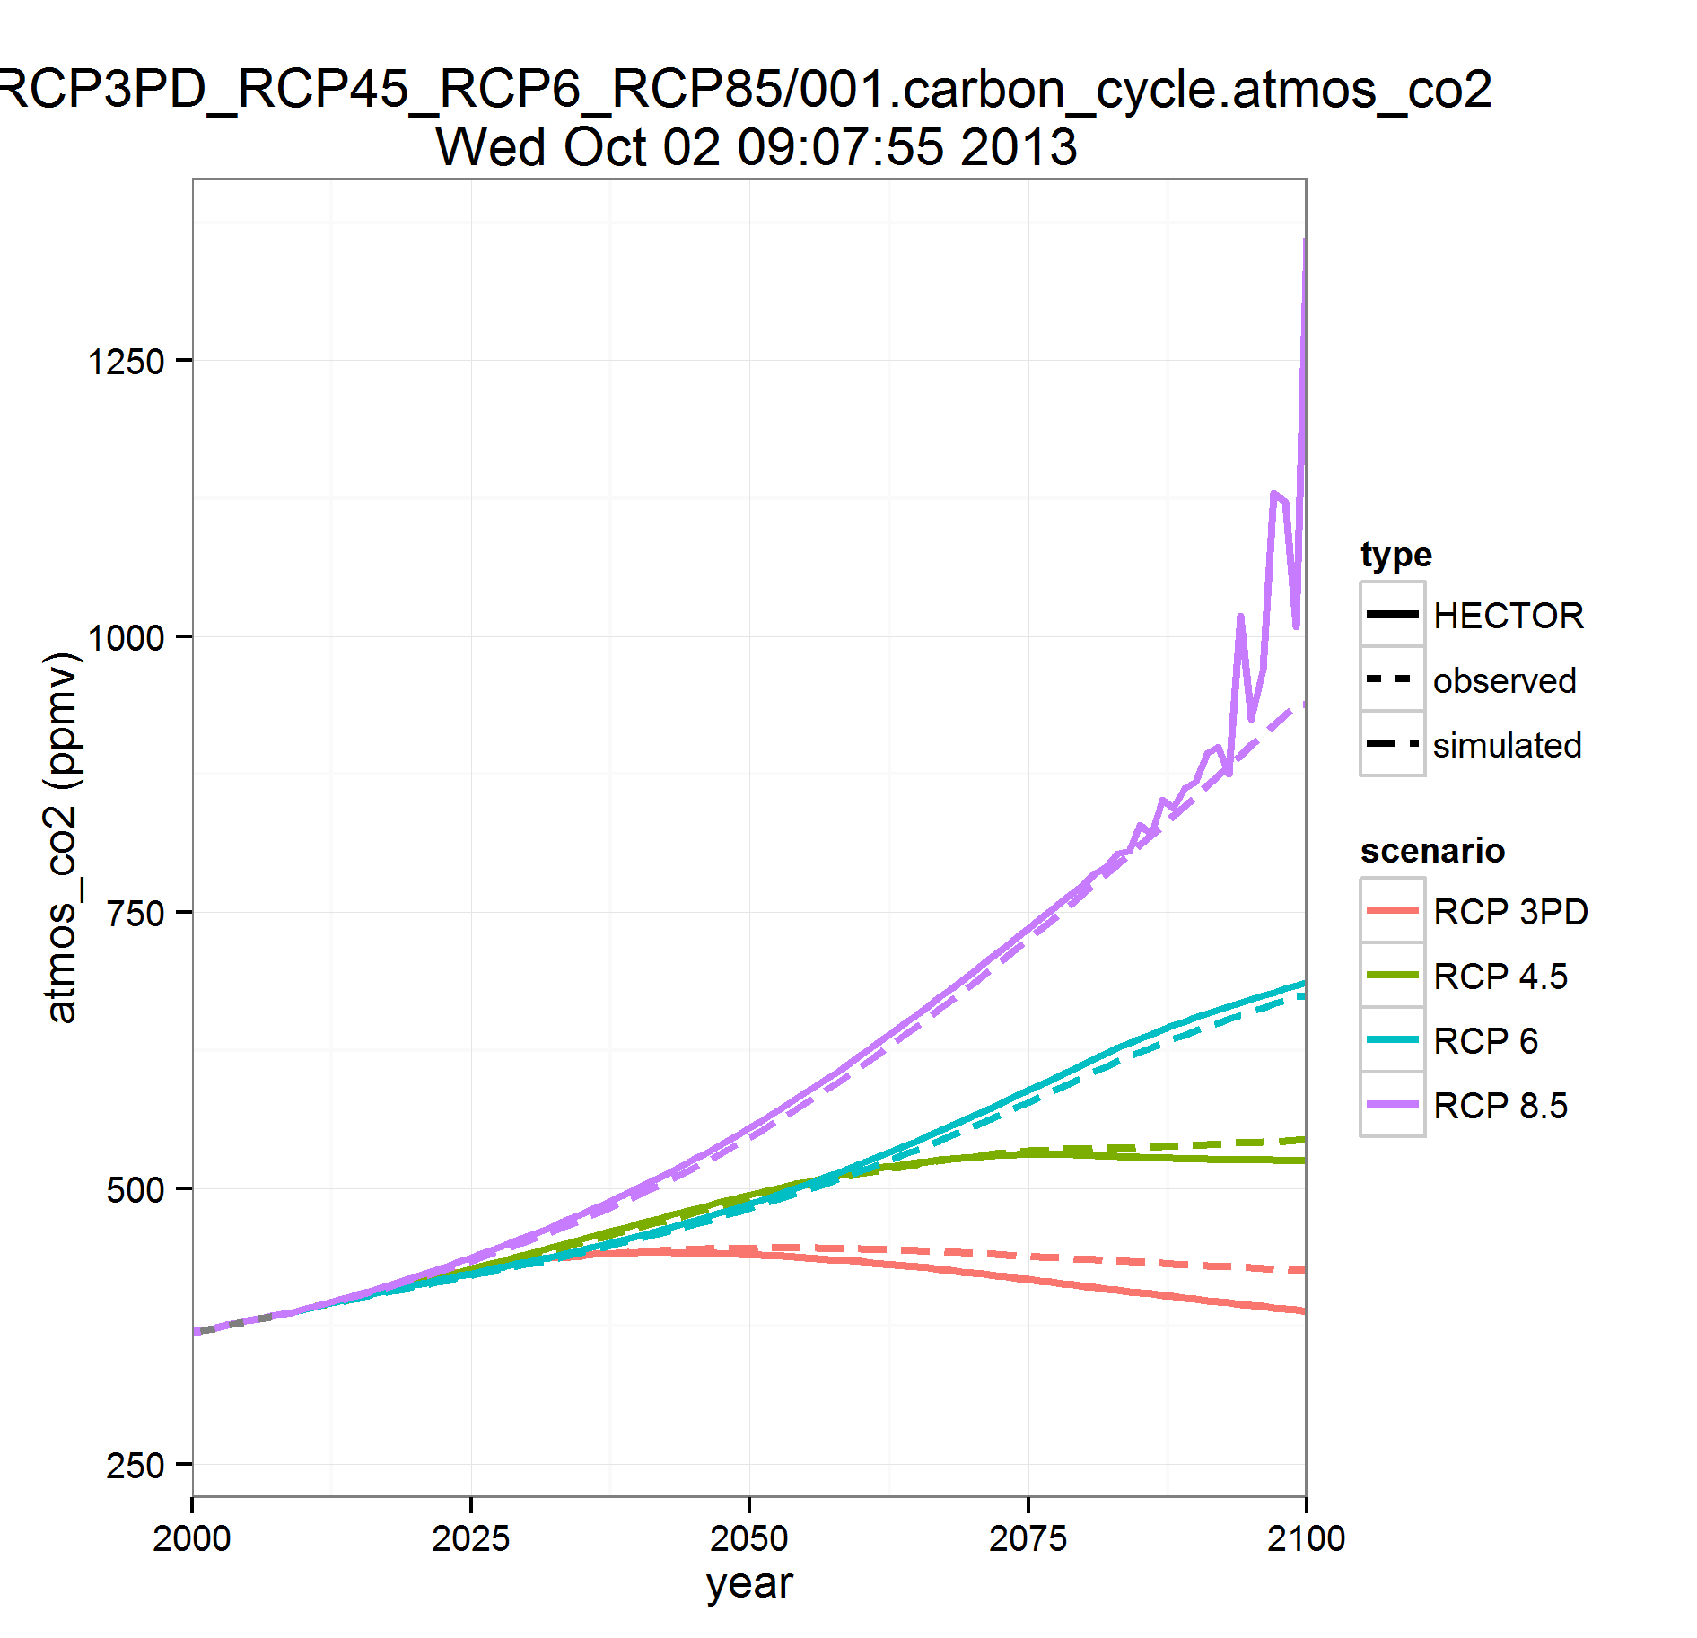
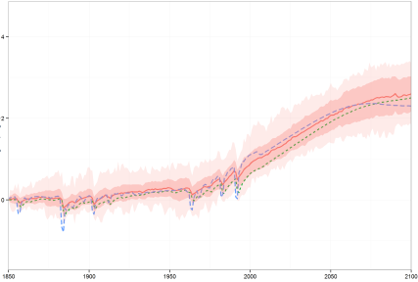
Results: atmosphere
Global Temperature Change (°C)
Atmospheric CO₂ Hector vs. MAGICC
Global Temperature Change (°C) RCP 4.5
Atmospheric CO₂ Hector vs. MAGICC6
4
CMIP5 average
Hector
2
PgC/yr
RCP2.6
RCP2.6
RCP4.5
RCP4.5
RCP6.0
0
MAGICC 6
RCP6.0
RCP8.5
RCP8.5
1850
1900
1950
year
2000
2050
2100
ΔT = λ* RF – ΔF
λ = climate feedback/sensitivity
RF = radiative forcing
ΔF = Ocean Heat Flux
Notes:
Notice we have included volcanic emissions
We have the capacity to compare to all RCP cases, however due to time I will only show output from RCP 4.5
We force hector to match the atmospheric obs record. Aany residual carbon is sent to the deep ocean. We have the option to turn this feature on or off
Atmospheric CO2 compared to MCAGICC6 for 4 RCP scenarios. We have the option of constraining the model to observations (as done here). If we zoom in to the end of the simulation, we see a slight divergence between MAGICC and Hector. Most notable is how Hector becomes unstable at high CO2 values. These seems to be a reoccurring problem in simple models at high CO2. We think introducing a variable time step will help solve this problem. This way we aren’t lover loading the system with one big pulse of CO2. We have the capability to do this with our adaptive time step and are currently investigating this.

Slide 15
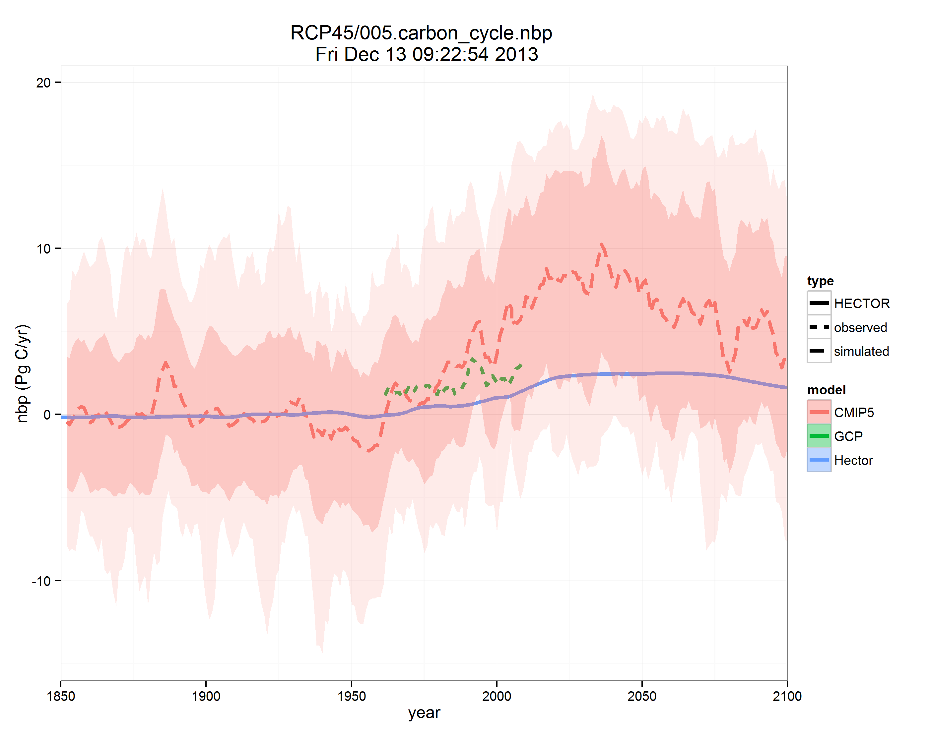
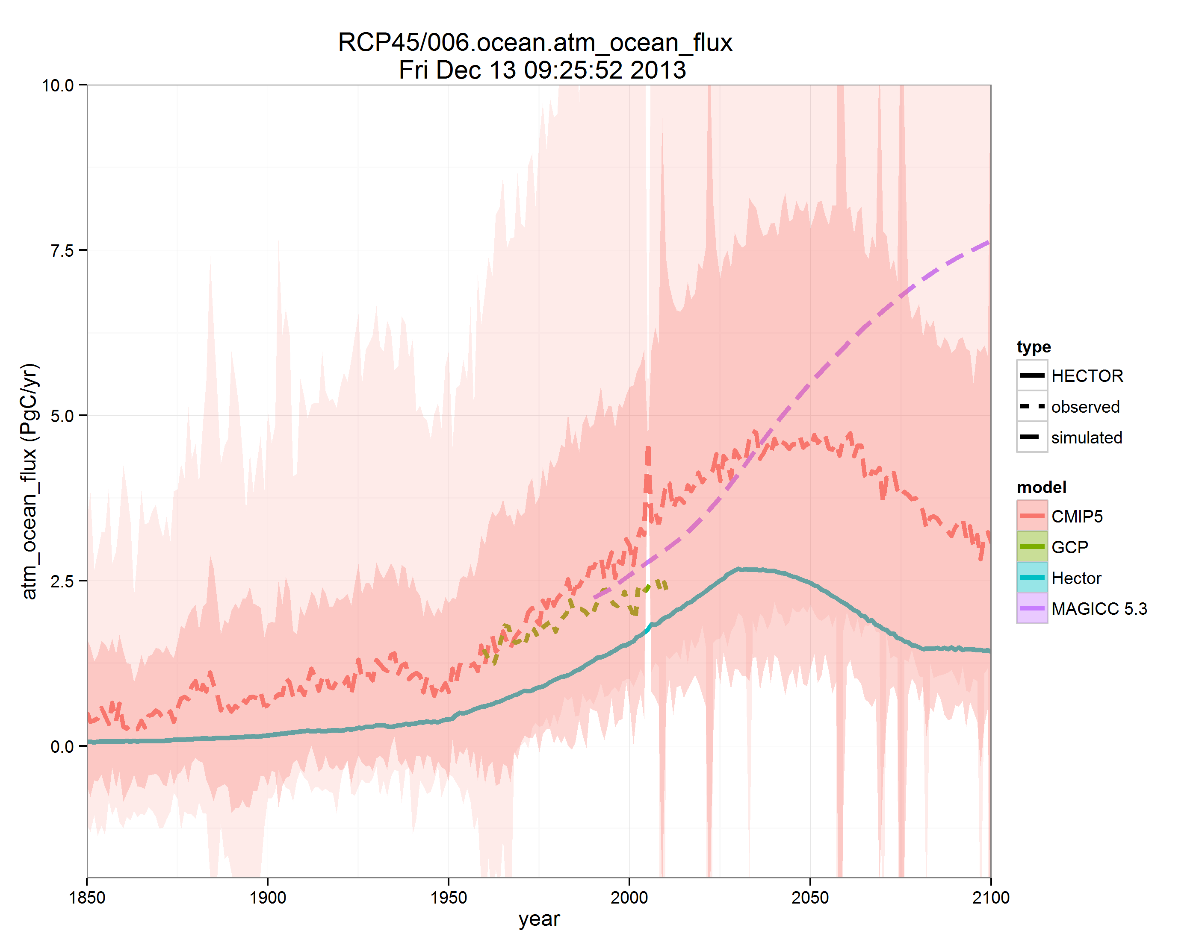
Results: carbon fluxes
Atmosphere-Land Flux
Atmosphere-Ocean Flux
20
10
MAGICC
CMIP5 median
7.5
10
Hector
5.0
CMIP5 median
PgC/yr
0
PgC/yr
Observations
LeQuere et al. (2009)
2.5
Hector
-10
0
Observations
LeQuere et al. (2009)
1850
1900
1950
year
2000
2050
2100
1850
1900
1950
year
2000
2050
2100
F =k αΔpCO₂
(Takahashi et al., 2009 )
k = gas transfer velocity (wind speed)
α = solubility of CO₂ (T&S)
ΔF = NPP – rH – luc_emissions
NPP = net primary production
rH = heterotrophic respiration
luc = land use change emissions
Notes:
Carbon fluxes between the atmosphere and land and atmosphere and ocean

Slide 16
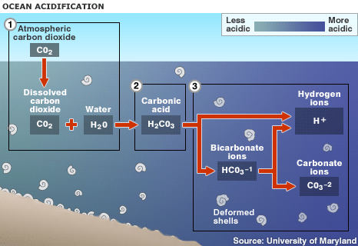
Science: ocean chemistry
  Active carbon chemistry calculated in surface
  Non-linear system
    pCO₂, Alkalinity, pH
    DIC – HCO₃⁻, CO₃²⁻, CO₂
    Aragonite and calcite saturations
    Revelle Factor - buffering capacity
  Zeebe and Wolf-Gladrow, 2001
pCO₂
pH
Ar & Ca saturations
Notes:
One of the unique aspects of this model is that we actively solve for the carbon chemistry in the surface boxes. CO2 uptake in the surface ocean is nonlinear and governed by the dissociation of CO2 in seawater. At higher concentrations CO2 becomes less soluble. Typically other models have used, linear equations are used to fit to a nonlinear system, impulse response functions and then back track calculations of carbon chemistry. Hector calculates these parameters that are directly tied to temperature, atmospheric CO2, carbon within the ocean.
Once dissolved in seawater, CO₂ reacts with water, H₂O, to form carbonic acid, H₂CO_{3:} CO₂ ₊ H₂O ↔ H₂CO₃. Carbonic acid dissolves rapidly to form H+ ions (an acid) and bicarbonate, HCO³⁻(a base). Seawater is naturally saturated with another base, carbonate ion (CO₃⁻²) that acts like an antacid to neutralize the H+, forming more bicarbonate. The net reaction looks like this: CO₂ + H₂O + CO₃⁻²→ 2HCO³⁻
As carbonate ion gets depleted, seawater becomes undersaturated with respect to two calcium carbonate minerals vital for shell-building, aragonite and calcite.
We use ALK and DIC as our input parameters and are able to calculate the others.

Slide 17
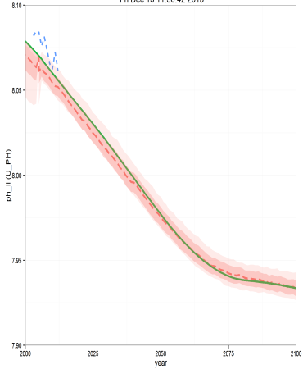
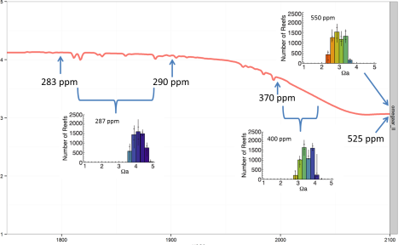

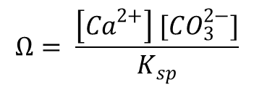
Results: ocean chemistry
pH Low Latitude
RCP 4.5
Aragonite Saturation (Ω) Low Latitude RCP 4.5
8.10
5
Observations
HOTS
4
8.05
$$Ω$$
3
Hector
CMIP5
2
8.00
Ricke et al, 2013
1
1900
2000
2100
1800
year
7.95
$$Ω= \frac{\left[{Ca}^{2+}\right] [{CO}_{3}^{2−}]}{K_{sp}}$$
7.90
2000
2025
2050
2075
2100
year
pH = -log [H⁺]
Notes:
pH in the low latitude box. Tracks CMIP5 and observations very well. We can see that under RCP 4.5 scenario, pH is projected to decrease 0.2, implications for calcifying organisms.
Product of calcium and carbonate ions in solution divided by the solubility of aragonite (T&S). Future saturations are projected to decrease, putting a strain on these calcifying organisms.
Now aragonite saturations out of the range of preindustrial conditions. We are unsure what this could possibly do these calcifying organisms, especially the coral reefs.

Slide 18
Conclusions and Future Directions
Simple climate box-model
  Open-source, community model
  Quick run times
  Simulates the general trends of MAGICC6 and CMIP5
  Interactive carbon chemistry in the surface ocean - feedback on climate
PSU Collaboration - Klaus Keller and Chris Forest
  Community model
    Engage students and post-docs
  Develop new components (to be switched in and out)
    Sea-ice
    Diffusive ocean - with more complex heat uptake
    Sea-level rise
  Detailed model-model comparisons
  Increase latitudinal resolution
  Varying albedo on both land and ocean
  Organic carbon in ocean
  MCMC wrapper

Slide 19
Acknowledgments
Pralit Patel, Robert Link, Steve Smith, Adria Schwarber – JGCRI
  Computer science and model development
Klaus Keller and Chris Forest and others at Penn State
  model feedback and ideas
DOE - IARP
EPA
Notes:
Integrated assessment research program

