Slide 1
Summary of Previous PIAMDDI Research
Adaptation and Innovation (joint with Qing Miao)
  Key findings: Natural disasters, including flooding and droughts, spur technical innovations that can reduce the risks of future disasters
  Implications for climate models
    Damages are potentially endogenous: society’s ability to adapt to climate change will improve over time, but not until the initial impacts of climate change have been felt
    Over time, impact of temperature changes may be reduced by technological change
Cost Savings from CDM wind projects (joint with Tian Tang)
  Key findings: Experience reduces the cost of wind energy. This effect is largest with repeated collaborations between project developers and manufacturers
  Implications for climate models
    Sheds light on the mechanisms through which technology transfer can reduce the costs of a technology
    Modeling the mechanisms of technological change and the agents involved are important

Slide 2
Next Steps
What are the benefits of risk-mitigating innovation?
  Having shown a link between disasters and innovation, we next ask what impact risk-mitigating innovations have on disaster outcomes
    Part of Qing Miao’s dissertation, supported by PIAMDDI renewal
  We extend the existing research on disaster resilience, which focuses on income and institutions, to consider the role of a society’s learning and innovative capacity.
    Unlike local adaptations and institutions, risk-mitigating knowledge can be a global good

Slide 3
Estimation Challenges and Preliminary Results
Estimation:
  impact_{e,i,t} = f(magnitude_{e,i,t}, knowledge_{i,t}, experience_{i,t}, controls_{i,t})
Main challenge:
  Not all natural disasters have deaths or damages associated with them
  However, these are not missing at random: more likely to be missing for smaller disasters
  As a result, using a selection model to consider both the probability of reported deaths or damages and the actual impact
  Previous literature ignores this selection problem
Initial results using earthquakes:
  Experience and own-country knowledge stocks can help reduce fatalities for larger earthquakes
  Effect stronger in developed countries
  Little evidence of knowledge spillovers: foreign knowledge has little effect

Slide 4
Effect of knowledge and experience in earthquakes with magnitudes > 5
 |  | OLS | Tobit | Censored Normal | Heckman Selection
Assumption |  | missing deaths =0 |  | missing deaths <= 9
magnitude |  | 1.266*** | 2.249*** | 1.716*** | 2.506***
 |  | (0.180) | (0.229) | (0.211) | (0.381)
focal depth |  | -0.00341*** | -0.0121*** | -0.00884*** | -0.0118***
 |  | (0.00106) | (0.00322) | (0.00213) | (0.00362)
Ln (population exposure) |  | 0.110*** | 0.344*** | 0.246*** | 0.349***
 |  | (0.0238) | (0.0993) | (0.0669) | (0.0766)
l. lnGDP |  | 0.648 | 0.185 | 1.269 | 1.635
 |  | (1.283) | (2.143) | (1.512) | (2.276)
(l. lnGDP2)^2 |  | -0.0139 | 0.0188 | -0.0547 | -0.0758
 |  | (0.0774) | (0.133) | (0.0940) | (0.140)
l. political right |  | 0.147** | 0.246** | 0.155** | 0.237**
 |  | (0.0602) | (0.105) | (0.0763) | (0.0993)
l. mortality rate of children under 5 |  | 0.0851* | 0.150** | 0.0862* | 0.129*
 |  | (0.0442) | (0.0727) | (0.0473) | (0.0762)
l. openness |  | -0.0163** | -0.0175 | -0.0193* | -0.0283*
 |  | (0.00814) | (0.0181) | (0.0114) | (0.0152)
l. experience stocks |  | -0.436*** | -0.528*** | -0.473*** | -0.638***
 |  | (0.105) | (0.185) | (0.130) | (0.225)
l. building knowledge |  | -0.179*** | -0.364*** | -0.201** | -0.309*
 |  | (0.0665) | (0.114) | (0.0897) | (0.160)
Constant |  | -17.00*** | -29.96*** | -25.18*** | -35.08***
 |  | (5.861) | (10.22) | (7.035) | (10.65)
Observations |  | 858 | 858 | 858 | 858
Robust standard errors in parentheses
*** p<0.01, ** p<0.05, * p<0.1
Experience stock : cumulative counts of earthquakes measuring 5+ in a country;

Slide 5
Next Steps
Extend analysis to other sectors
  Initial work focuses on earthquakes, as the data are best there
  Qing plans to extend the work to flooding as part of her dissertation
  Would like to extend into the agricultural sector, but will require collaboration from experts in agricultural economics who are part of the PIAMDDI team to help identify additional data sources and estimation issues unique to the agriculture sector
Potential data sources
  Patents
    However, patenting is mostly recent & unable to match to specific crops

Slide 6

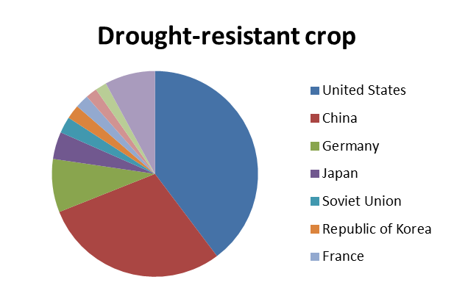

Global Patenting Trend - drought-resistant crop
Notes:
Global patents on drought-mitigating technologies have been quite constant in the first 20 years and then start increase rapidly since the mid of 1990. This large increase can be due to the awareness of climate change.
In term of the global share, United States, Japan, Germany and China seem to take a leading role.

Slide 7
Next Steps
Extend analysis to other sectors
  Initial work focuses on earthquakes, as the data are best there
  Qing plans to extend the work to flooding as part of her dissertation
  Would like to extend into the agricultural sector, but will require collaboration from experts in agricultural economics who are part of the PIAMDDI team to help identify additional data sources and estimation issues unique to the agriculture sector
Potential data sources
  Patents
    However, patenting is mostly recent & unable to match to specific crops
  Potential US data on specific crops
    USDA Animal and Plant Health Inspection Service (APHIS) database
      Records all biotech seed trials in US
      However, only one drought-resistant seed as moved on to commercialization
    USDA Current Research Information System (CRIS)
      Searchable by keyword, so can obtain information on specific crops
      However, only publicly funded research

Slide 8
Next Steps
Are there international spillovers to adaptation R&D?
  Unlike mitigation, many adaptation efforts are of a local nature
  Risk-mitigating innovation may also be specialized to fit the needs of a local market
    Seems particularly important for agriculture
    Will use patent citation data to explore whether the knowledge spillovers from risk-mitigating innovation are comparable to those from emission-mitigating innovation
Integrating endogenous adaption into an IA model?
  We will provide guidance to IA modelers who wish to incorporate endogenous adaptation into their models
  Possible research questions:
    What are the benefits to increasing risk-mitigating R&D before impacts occur (e.g. via government-funded R&D)?
    By how much does endogenous risk-mitigation technology reduce estimated climate impacts?

