Slide 1
A New Perspective on Climate-Induced Migration:
Feedback from Labor and Housing Markets
Qin Fan
California State University, Fresno
Karen Fisher-Vanden
Pennsylvania State University
H. Allen Klaiber
Ohio State University
PIAMDDI Project Meeting
Stanford University, Stanford, California
December 14, 2013

Slide 2
Research Approach
Population Shares (MSA)
Aggregation (region)
Econometric
Model:
Residential
Sorting Model
(RUM)
Regional US
Computable General
Equilibrium
(CGE Model)
Convergence
Changes in labor wages (region)
Disaggregation (MSA)
Changes in housing prices (region)
Disaggregation (MSA)

Slide 3
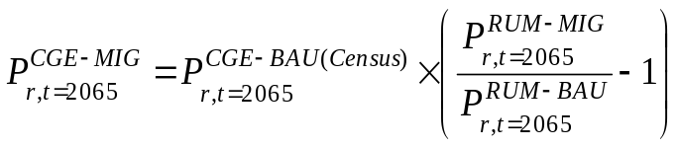


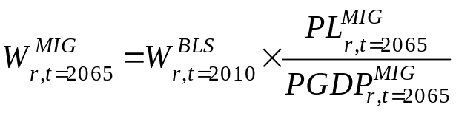

Incorporating Empirical Results into Integrated Assessment Model (IAM)
Develop a U.S. regional CGE model based on the modeling framework of Rutherford (2006) and Sue Wing (2007).
Endogenize labor wages
Changes in the growth rate of labor wages
RUM
Regional Population shares
CGE
Annual Mean Temperature (F)
Annual extreme heat days
Annual extreme cold days
The climate projections are derived from WCRP's CMIP3 multimodel dataset (source: SCRIPPS Institution of Oceanography).
IPCC low-emission B1 and high-emission A2 scenarios.

Slide 4
Findings from previous work
Preference heterogeneity in temperature extremes is associated with household demographics.
Wage effect on household location choice tends to dominate climate effects for working-age population, while retirees place a higher value on amenity including moderate weather.
The population share in the Northeast increases, while the population share in the South drops under changes in climate.
Endogenizing labor wages dampens regional economic impacts from climate-induced migration.
What if housing price is endogenous?

Slide 5
Aggregation of housing related commodities
Aggregation of the dwelling sector
#37(construction of new residential permanent site single-and multi-family structures);
#38(construction of other new residential structures);
#40(maintenance and repair construction of residential structures).
Housing(g): housing related commodities
/dwelling/
5

Slide 6
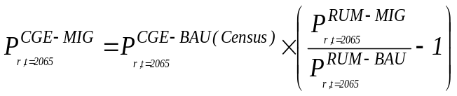

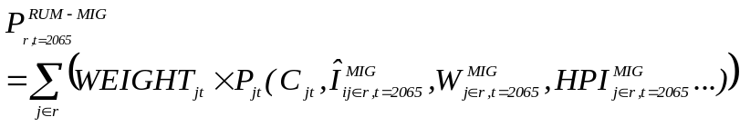
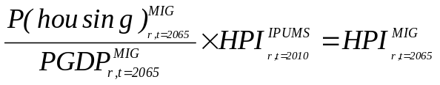

Incorporating Empirical Results into IAM
Endogenize housing price index (HPI)
Changes in housing price index
RUM
Regional Population shares
CGE
$$S_{r,t}=s_{r,t}Y_{r,t}=Y_{r,t}−{VCC}_{r,t}$$
Household consumption
FHEO
σ_{FHEO} = 0.3
Food
Housing (H₁)
Energy
Other₁
……….
Other₁₅
σ_{F} = 0.7
σ_{E} = 0.7
pa | Armington aggregate prices
vdpm | Domestic consumption demand
vipm | Imported consumption demand
r | Region
h | Households
S | Private savings
s | Exogenous savings’ rate
Y | Household income
VCC | Household consumption
F₁
……….
F₁₀
E₁
……….
E₅
MPSGE i:pa(r,housing)q:(vdpm(r,housing,h)+sum(trd,vipm(r,housing,trd,h)))

Slide 7

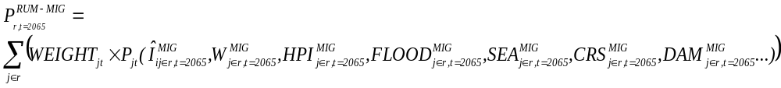



Flood-induce migration and IAM
RUM
Regional Population shares
CGE
Housing market
Labor market
$$S_{r,t}=s_{r,t}Y_{r,t}=Y_{r,t}−{VCC}_{r,t}$$
Climate Model
Mitigation and adaptation policies (e.g. National Flood Insurance Program’s Community Rating System (CRS), flood control dams)
High risk flood zone
Sea level rise

Slide 8
Findings
Wealthier people are less sensitive to flood risk.
Individuals highly value resilient communities in their location decisions and are willing to pay for local projects targeting at mitigating flood risk.
Individuals value both structural (dams) and non-structural (e.g. hazard information disclosure, flood warning and dam and levee safety) in their location decisions.
Body of water (e.g. lakes, river, ponds, ocean, etc.) as a measure of amenity is perceived positively in people’s location choice. After public information on flood risk is disclosed, the magnitude of positive effects becomes smaller.
6

Slide 9
Future Directions
Connect our model with climate model to simulate regional economic impacts under changes in future climate (e.g. frequency of heavy rainfall, flood risk and sea level rise.
Conduct welfare analysis.
Simulate welfare effect under different policy scenarios (e.g. NFIP’s CRS programs, flood-control structures).
7

Slide 10
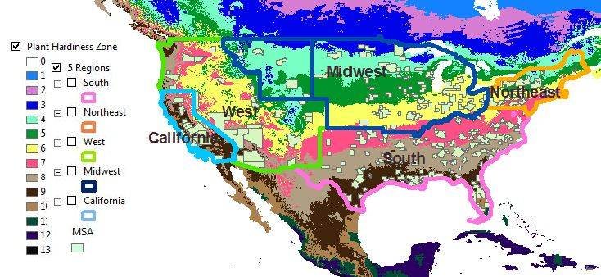
Appendix A—Climate Regions and MSAs

Slide 11
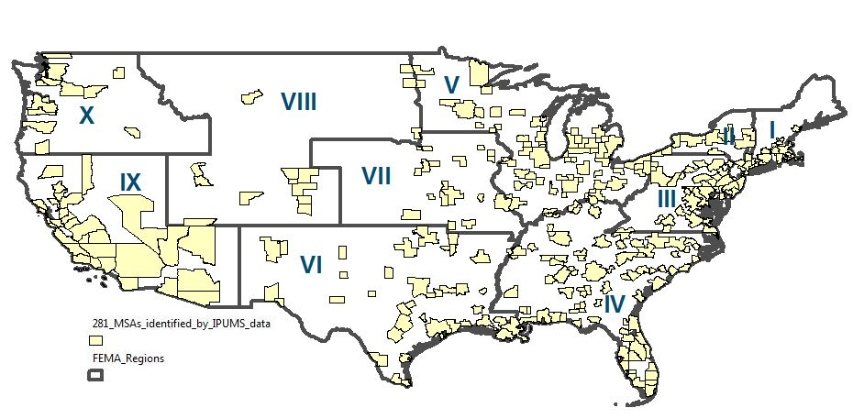
Appendix B—10 FEMA Regions

Slide 12
Appendix C—Community Rating System (CRS) by Activity
Public Information (Series 300)
This series credits programs that advise people about the flood hazard, flood insurance, and ways to reduce flood damage. These activities also provide data needed by insurance agents for accurate flood insurance rating.
Mapping and Regulations (Series 400)
This series credits programs that provide increased protection to new development. These activities include mapping areas not shown on the FIRM, preserving open space, enforcing higher regulatory standards, and managing storm water. The credit is increased for growing communities. These activities work toward the first and second goals of the CRS, damage reduction and accurate insurance rating.
Flood Damage Reduction (Series 500)
This series credits programs for areas in which existing development is at risk. Credit
is provided for a comprehensive floodplain management plan, relocating or retrofitting
flood prone structures, and maintaining drainage systems. These activities work toward
the first goal of the CRS, damage reduction.
Flood Preparedness (Series 600)
This series credits flood warning, levee safety, and dam safety programs. These activities work toward the first and third goals of the CRS, damage reduction and hazard awareness.

Slide 13
Appendix D--1st stage sorting model (one example with flood and CRS total credit)
Table 1: Parameter Estimates from First-Stage Sorting Model v5 (I=1,820,691, J=281) (multinomial logit)
variables | estimate | std. err.
predicted income | 1 | 0.0073
Age-x-flood | -0.0001 | 0
Age-x-CRS | 0.0002 | 0
College graduate-x-flood | 0.0001 | 0
College graduate-x-CRS | 0.0001 | 0
White-x-flood (Asian and other races are omitted) | 0.0001 | 0
White-x-CRS | -0.0002 | 0
Black-x-flood | 0.0002 | 0
Black-x-CRS | -0.0004 | 0
Hispanic-x-flood | 0 | 0
Hispanic-x-CRS | 0 | 0
FEMAI-x-flood (birth region FEMA VII is omitted) | 0.0009 | 0
FEMAII-x-flood | 0.0008 | 0
FEMAIII-x-flood | 0.0001 | 0
FEMAIV-x-flood | 0.0004 | 0
FEMAV-x-flood | 0.0009 | 0
FEMAVI-x-flood | 0.0011 | 0
FEMAVIII-x-flood | 0.0004 | 0
FEMAIX-x-flood | 0.0014 | 0
FEMAX-x-flood | 0.0004 | 0
M_macro | -2.1145 | 0.0017
Note: flood—Area of high risk flood zone in square miles. CRS—CRS total credit point (we run several variants of models to separate CRS categories by activity, this model focuses on CRS total credit point).

Slide 14

Appendix E—2nd stage sorting model (one example with flood and CRS total credit)
MSA fixed effects from the 1st stage + | Coef. | Std. Err.
Heavy rainfall (1991-2000) | -0.01002189 | (0.0159)
Ln(construction) | .85410244** | (0.4238)
Ln(production) | 0.13296909 | (0.2129)
Ln(service) | 2.3218927*** | (0.5237)
Annual snowfall | 0.00400159 | (0.0028)
waterarea-x-crs300 | .00010064** | (0.00004)
Culture | .75463965*** | (0.1800)
July humidity | -.01245706** | (0.0059)
Area of high risk flood zone (sq. mi.) | -0.00852015 | (0.0208)
CRS total credit | .00033064*** | (0.0052)
Number of flood control dams | .01651718*** | (0.00008)
_cons | -5.9277742*** | (1.6602)
Note: crs300 represents CRS series 300, which categorizes public Information. This series credits programs advise people about the flood hazard, flood insurance, and ways to reduce flood damage. These activities also provide data needed by insurance agents for accurate flood insurance rating.

Slide 15
Appendix F—combined results from the 1st and 2nd stages
Variables | Coefficients from 2-step sorting model | MWTP
CRS series300 | 0.0011 | $37
CRS series 400 | 0.00045 | $16
CRS series 500 | 0.0002 | $7
CRS series 600 | 0.0013 | $44
CRS total credit | 0.0002 | $7
Number of flood control dams | 0.01652 | $574

Slide 16
Appendix F—Flood Risk and CRS Credit by FEMA region

