Slide 1

Incorporating Water in Integrated Assessment Models
Jim Shortle
Karen Fisher-Vanden
Ian Sue Wing
Doug Wrenn
Aaron Cook

Slide 2
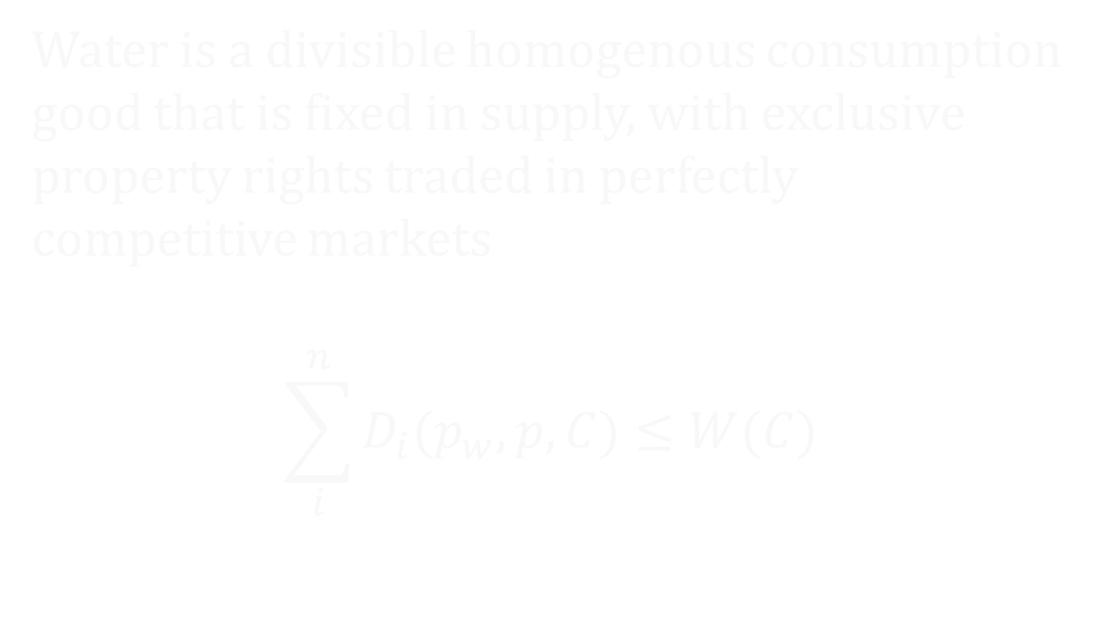
Simple Water-Economy Model
Water is a divisible homogenous consumption good that is fixed in supply, with exclusive property rights traded in perfectly competitive markets
$$\sum_{i}^{n}{D_{i}(p_{w},p,C)≤W(C)}$$

Slide 3
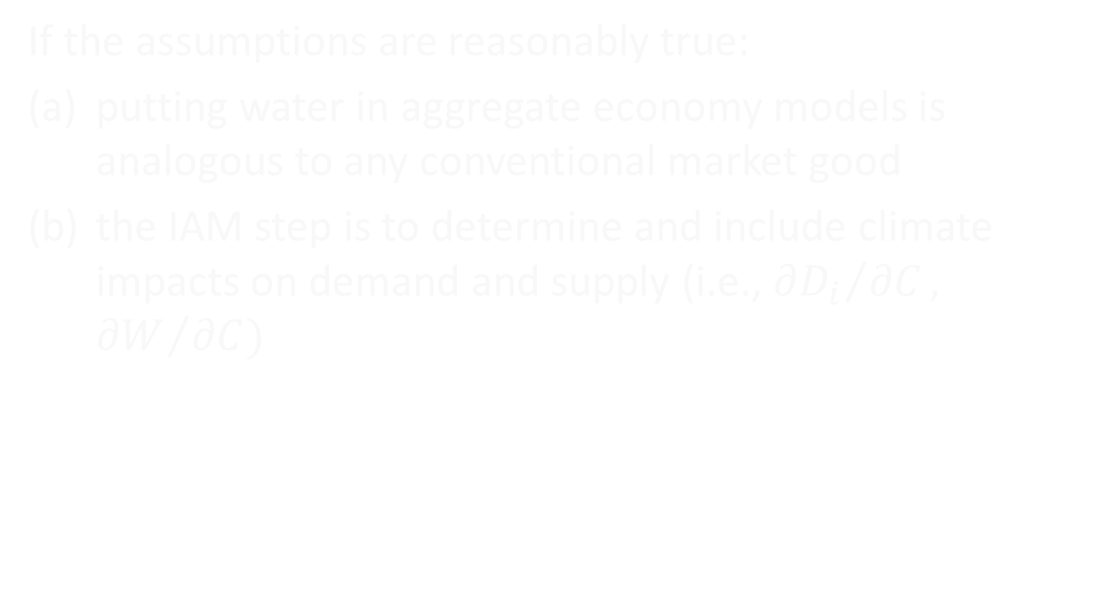
Simple Water-Economy Model
If the assumptions are reasonably true:
putting water in aggregate economy models is analogous to any conventional market good
the IAM step is to determine and include climate impacts on demand and supply (i.e., ${∂D_{i}}/{∂C},$ ${∂W}/{∂C)}$

Slide 4
Modeling Challenges
Stochasticity
  Supply and demand have stochastic elements
  Both, but especially supply, are issues for climate change impacts and adaptation
  Water management institutions and costs often driven by supply variability
  Contingent commodities?
  Multi-attribute commodities?

Slide 5
Modeling Challenges
Instream Services
  Much of the economic and ecological value of water comes from flow and quality dependent nonconsumptive instream ecosystem services (fishing, swimming, boating, aquatic habitat, etc.)
  These are public or quasi-public goods that are difficult to incorporate in conventional economic equilibrium models
  Household production functions?
  Ecological production functions?
  Water quality-economy relationships?
  Nonmarket management institutions?

Slide 6
Modeling Challenges
Heterogeneity
  Sources of supply, uses, institutions, economic dependence & risks, climate impacts vary greatly
  Model aggregation can remove/hide significant local and regional impacts/adaptations
  What are the optimal IAM scales for credible water impact/adaptation assessment?
    Types of impacts?
    Economy characteristics?

Slide 7
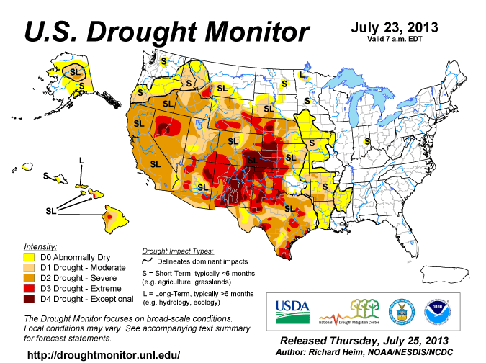
Uncertain Water Availability
36 states had water
shortages in
2013
Water availability is uncertain
Climate change compounds uncertainty
We
have going for us in all of

