Slide 1
Climate Change and Energy:
Integrated Assessment of the
Intensive and Extensive Margins
Erin Mansur, Dartmouth
Ian Sue Wing, Boston University

Slide 2
Climate Impacts on Energy:
A Roadmap
Empirical
Modeling
Demand
Supply
Demand
Supply
Intensive
Margin
Intensive
Margin
Extensive
Margin
Intensive
Margin
Extensive
Margin
Extensive
Margin
Intensive
Margin
Extensive
Margin
(1)
What is the impact of temperature change on the demand for energy (electricity)?
(2)
What is the impact of temperature change on adaptation via adoption of air conditioners?
(3)
What is the impact of runoff change on hydro-power supply?
(4)
What is the economic effect of climate-induced changes in electricity demand?

Slide 3
The Demand Side Intensive Margin
(Lots of work, past and present)

Slide 4
Energy Demand & Climate Change
Consumers may respond to climate change either along the intensive or extensive margin
Understanding technology adoption (i.e., the extensive margin) is key in modeling adaptive behavior
The short run response to weather (the intensive margin) also matters
  Even here, the technology available affects how elastic will be demand response

Slide 5
Potential Methods to Measure Energy Expenditures and Climate
Ideal data
  Info on how a household consumes energy in multiple climates
  But technology, demographics, prices, and preferences change faster than the climate
Methods
  Cross-sectional Climate Data
  Time series and Panel Data on Weather

Slide 6
Cross Section
Variation in climate can be informative of both the intensive and extensive margins
  Multiple households with similar observable characteristics but located in different climates
  Vaage (2000); Mansur et al. (2008)
Main concern is omitted variable bias
  Unobservable household characteristics correlated with climate
  Albouy et al. (2012) and northern households to be less heat-tolerant than southern household

Slide 7
Cross Sectional Literature
Vaage (2000)
  Discrete-continuous choice modeling in Norway
  Choice of heating (wood/oil/electricity)
  Control for household characteristics and fuel prices
  Indicator of relative climate
  Warmer households are less likely to choose all fuels, and spend 30 percent less on fuel
Mansur, Mendelsohn, and Morrison (2008)
  Discrete-continuous choice modeling in US
  Indentify fuel selection using prices of all fuel options
  Energy expenditures increase with climate change
    Warmer climate results in more homes heat with electricity
    Warmer summers result in more electricity consumption
    Warmer winters will result in less natural gas consumption
    $57 Billion annually for a 5⁰C increase

Slide 8
Issues with Cross Section Approach
Unobservable differences may be correlated with climate
  Sorting (e.g., households with lower disutility for extreme heat sort into warmer climates)
  Estimates of sensitivity to temperatures are biased towards zero if households do not always maintain a constant interior temperature
Ignores cost of transition
Long run equilibrium inference
  To be indicative of long run, requires that variables (like weather and prices) in the sample year equal their respective expected distributions for each market or geographic region

Slide 9
Intensive Margin: Weather Data
Examine how energy consumption responds to weather shocks
  Reduced-form, short run response
  E.g, Deschênes and Greenstone (2011) and Auffhammer and Aroonruengsawat (2011)
Estimates may overstate the damages from climate change
  Households adapt to a gradually changing environment in ways they could not in short run

Slide 10
Panel Data Literature
Henley and Peirson (1994,97,98): UK household panel data from a residential electricity pricing study that occurred from April 1989 to March 1990
  Price elasticity affected by weather
Asadoorian et al. (2008): China electricity demand and appliance choice using panel data by province and year (1995 to 2000)
Eskeland and Mideksa (2010) and De Cian et al. (2007) use panel data from 31 European countries from 1995 to 2005
  E&M instrument for prices using per-kWh value added tax rate
  DC uses Arellano-Bond estimator

Slide 11
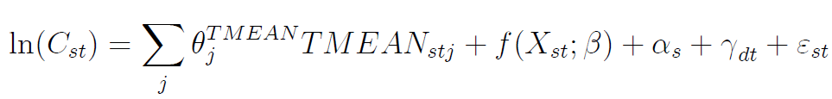
Deschênes and Greenstone (2011)
Explain variation in state-level annual panel data of residential energy consumption using flexible functional forms of daily mean temperatures
Data
  EIA State Energy Data System (Annual BTUs)
  National Climatic Data Center (Ave daily temp)
Control for precipitation, income & population

Slide 12
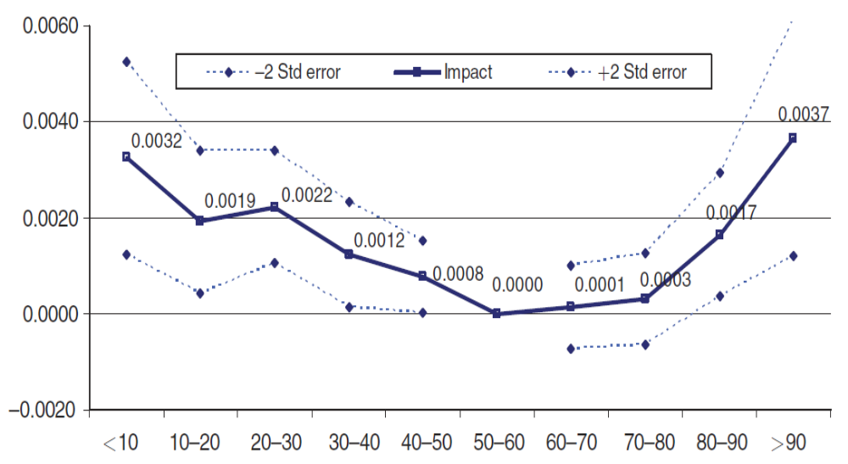
Deschênes and Greenstone (2011), Figure 3
The Estimated Relative Impact of a Single Day in a given mean temperature (⁰F) bin (Relative to a Day in the 50-60⁰F Bin) on Log Annual Residential Energy Consumption.

Slide 13
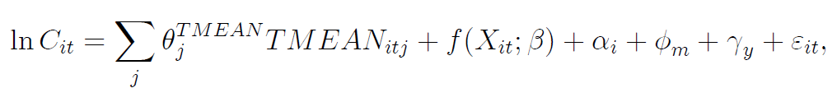
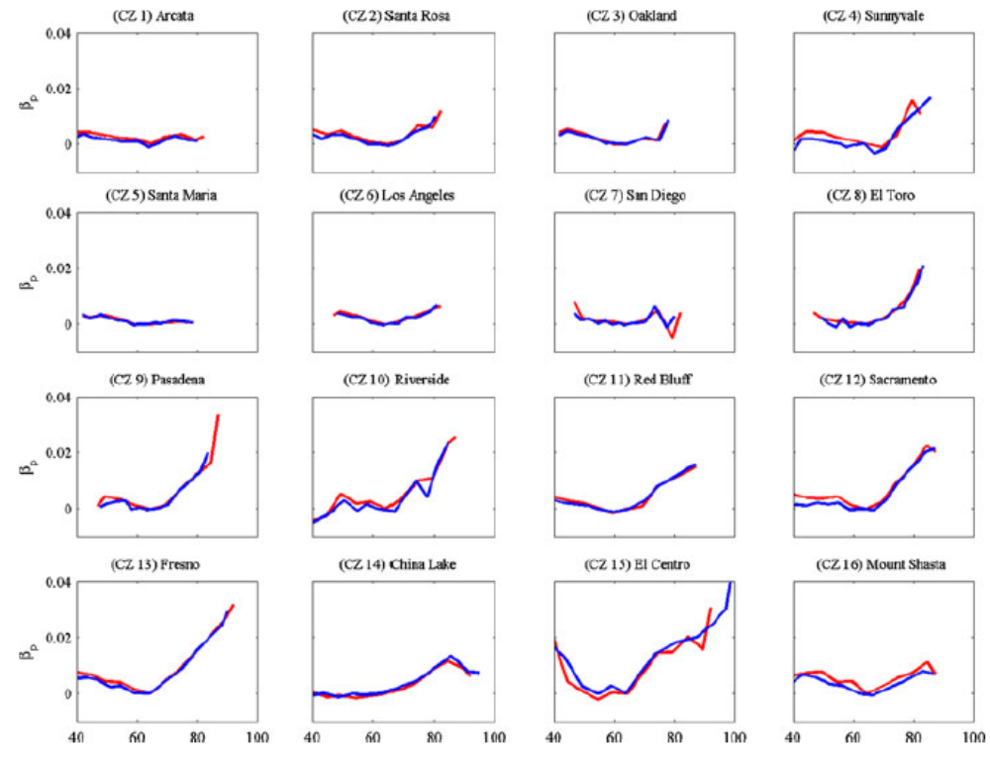
Auffhammer and Aroonruengsawat (2011)
California household-level electricity billing data
Model similar to D&G
Include precipitation and retail electricity price controls

Slide 14
Extensive Margin: Air Conditioning
Biddle (2008)
  From 1955 to 1980, AC penetration in the US went from 2% to 50%
  Cross sectional study of 1960, 1970 and 1980 censuses
  Standard Metropolitan Statistical Area Data
    Control for income, CDD, HDD, wind speed, relative humidity, electricity prices, other home characteristics
  Also looks at household level data to better understand role of demographics (SMSA F.E. so no climate variation)

Slide 15
The Demand Side Extensive Margin
(A world of possibilities)

Slide 16
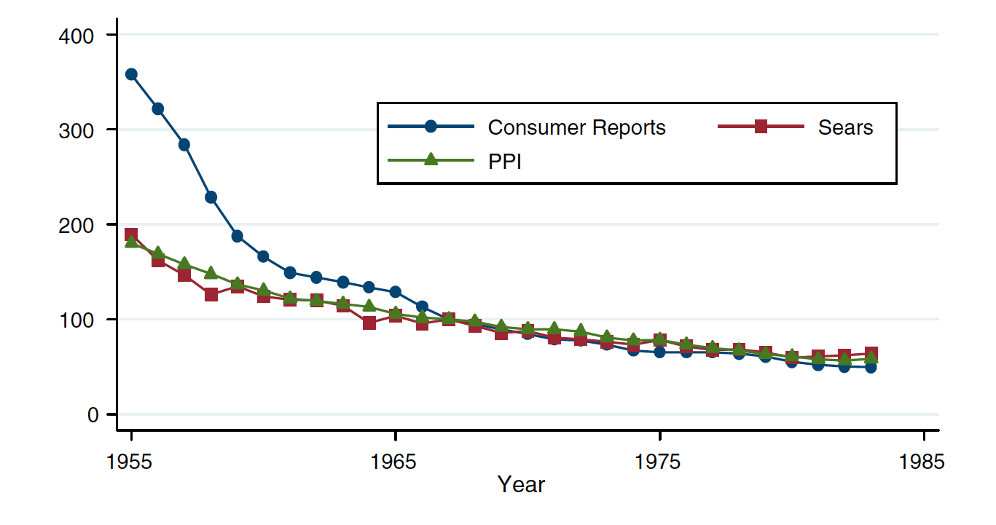
Price of Room Air Conditioners 1955-1985

Slide 17
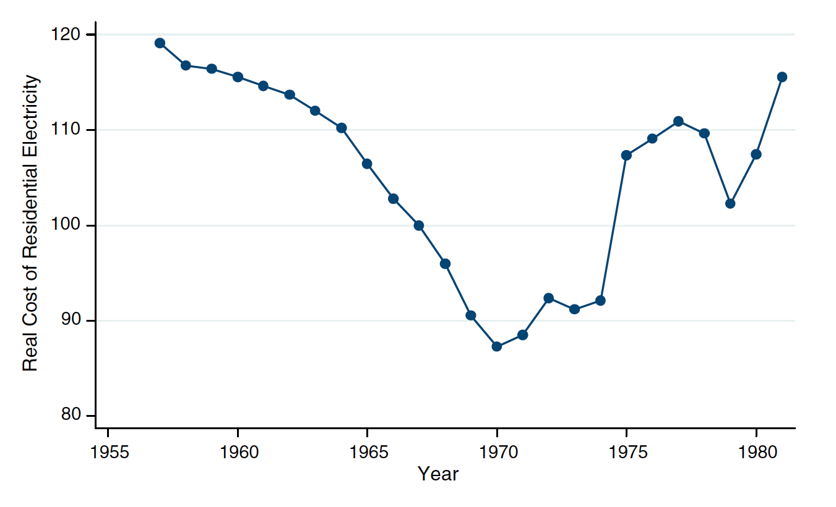
Real Electricity Rate Index 1957-1982

Slide 18
Drivers Beyond Prices
As of 1920s Americans had experienced air conditioners in movie theatres and stores
High level of enthusiasm for the technology but virtually none installed them in homes
Shift in home design from owner to developer accelerated diffusion
1957 Change in regulation which allowed air conditioners to be included in FHA approved mortgages

Slide 19
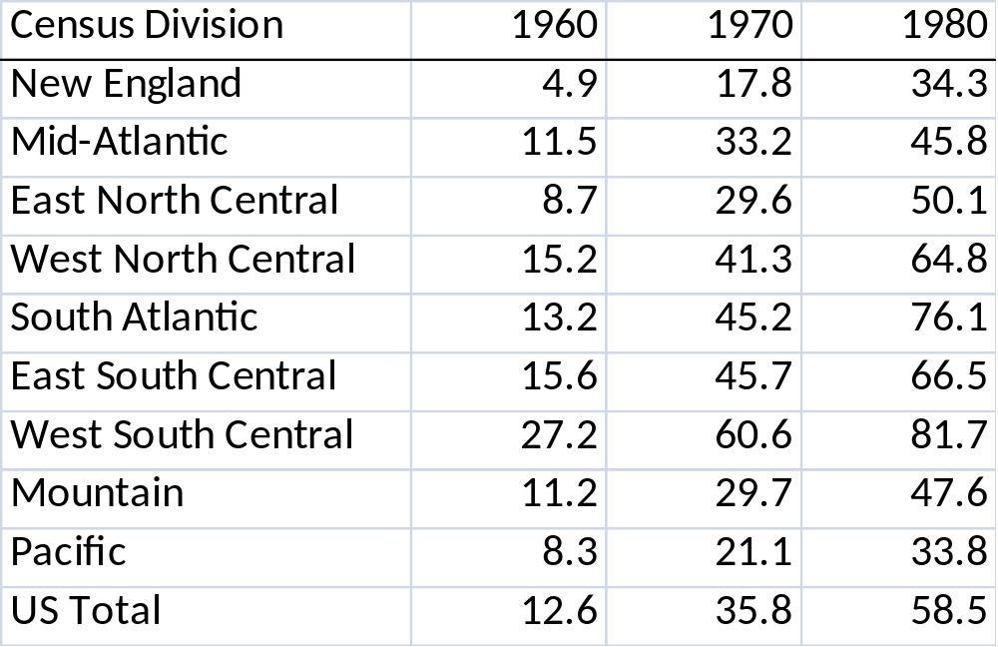
Penetration of Air Conditioners
Table of Percentage of Occupied Housing Units with Some AC
Source: Census of Housing, 1960, 1970, and 1980.

Slide 20
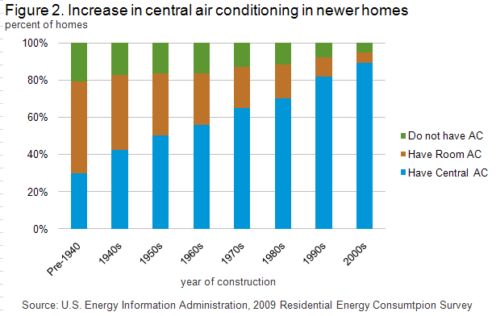
Significant amount of retrofitting.

Slide 21
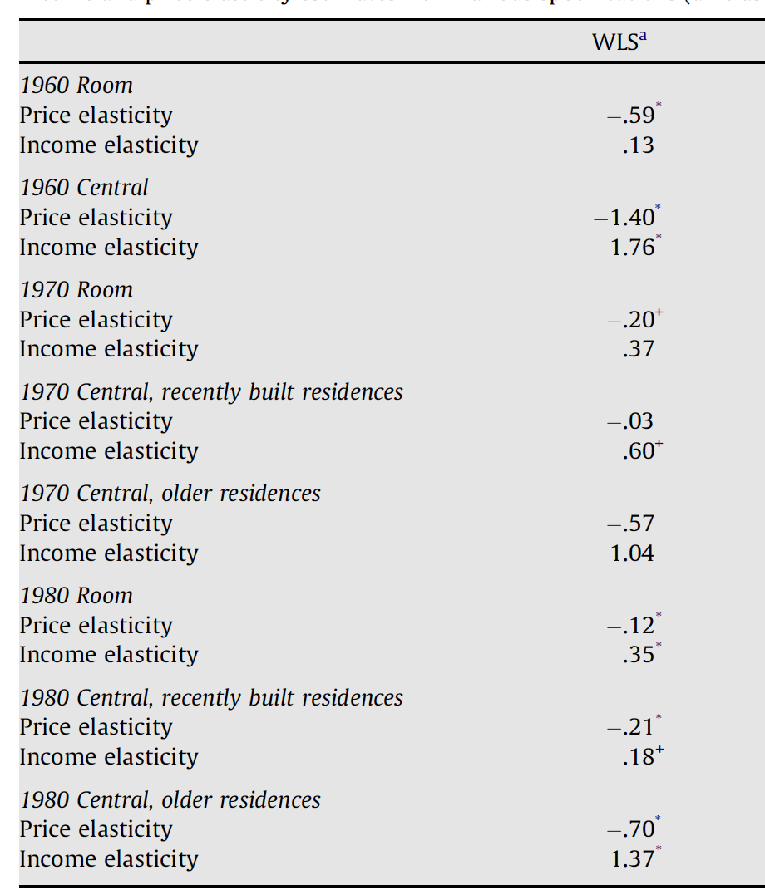
Estimated Elasticities vary significantly

Slide 22
Technology Adoption as Climate Adaptation: Evidence from US Air Conditioning Penetration
Would like to identify for policy makers and integrated assessment modelers a reduced-form, long run response coefficient
In learning about the extensive margin, its important to keep in mind that capital investments are being made in the context of a continuously changing and uncertain climate
  How we would adapt in a stable system might look very different
We seek to develop a response surface that captures both the intensive and the extensive margins which could be incorporated into IAMs

Slide 23
Preliminary work using Census
For each census tract, we know the share of households that have central AC, or any AC, in 1970 and 1980.
Match with county weather data of previous decade (GLDAS 3-hour temperature and humidity forcings)
Regress AC share on flexible function of climate variables, controlling for tract demographics

Slide 24
The Supply Side Intensive Margin
(Just getting going)

Slide 25
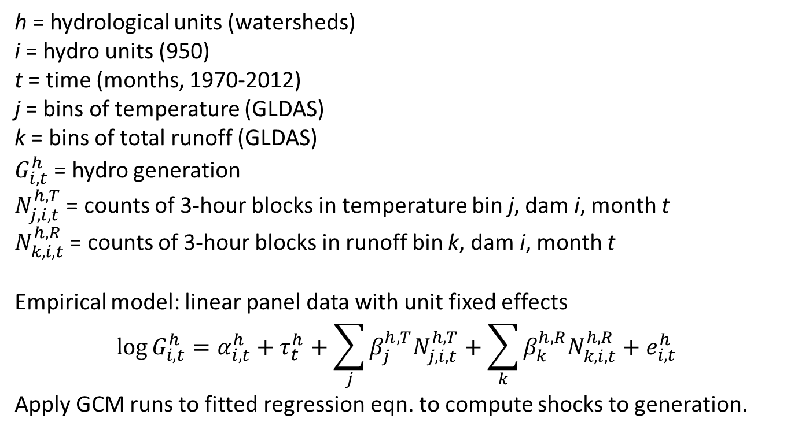
Climate Change Impacts on U.S. Hydroelectric Supply
h = hydrological units (watersheds)
i = hydro units (950)
t = time (months, 1970-2012)
j = bins of temperature (GLDAS)
k = bins of total runoff (GLDAS)
$G_{i,t}^{h}$ = hydro generation
$N_{j,i,t}^{h,T}$ = counts of 3-hour blocks in temperature bin j, dam i, month t
$N_{k,i,t}^{h,R}$ = counts of 3-hour blocks in runoff bin k, dam i, month t
Empirical model: linear panel data with unit fixed effects
$$\log{G_{i,t}^{h}}=α_{i,t}^{h}+τ_{t}^{h}+\sum_{j}{β_{j}^{h,T}N_{j,i,t}^{h,T}}+\sum_{k}{β_{k}^{h,R}N_{k,i,t}^{h,R}}+e_{i,t}^{h}$$
Apply GCM runs to fitted regression eqn. to compute shocks to generation.

Slide 26
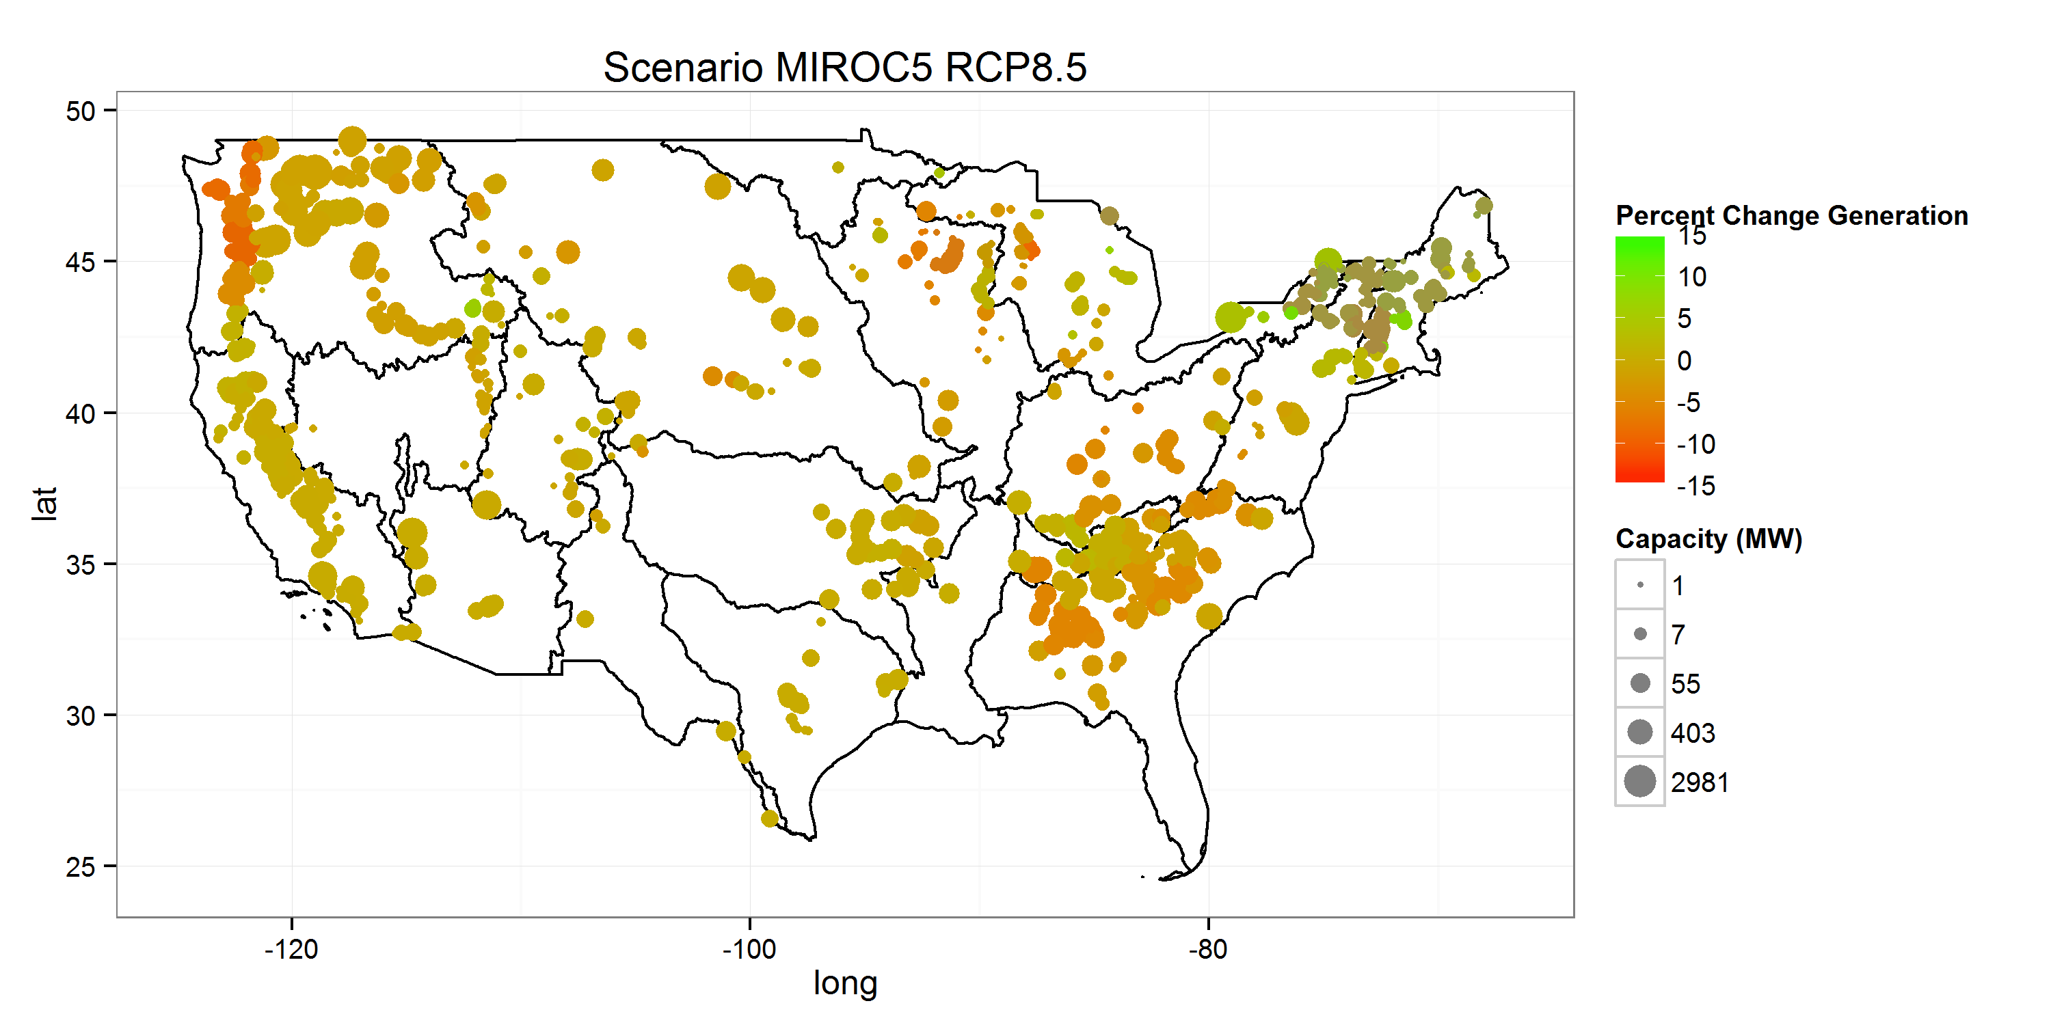
Generation Impacts of Changes in Runoff and Temperature

Slide 27

Modeling
(We can do this. Just give us the shocks!)

Slide 28
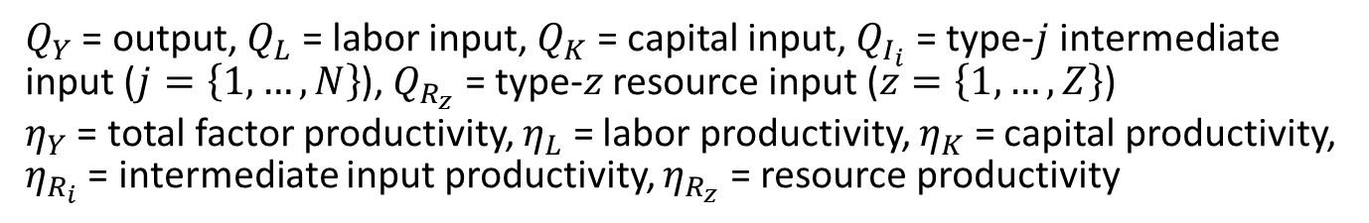
Modeling Impacts:
A Production Function Approach
IP: Intermediate input productivity shock (> 1)
IS: Intermediate input supply shock (<1)
LS: Labor supply shock (<1)
RP: Resource productivity shock (>1)
LP: Labor productivity shock (>1)
RS: Resource supply shock (<1)
$$Q_{Y}=η_{Y}⋅F\left[η_{L}Q_{L},η_{K}Q_{K},η_{I_{1}}Q_{I_{1}},…,η_{I_{N}}Q_{I_{N}},η_{R_{1}}Q_{R_{1}},…,η_{R_{Z}}Q_{R_{Z}}\right]$$
YP: Output productivity shock (< 1)
KS: Capital supply shock (>1)
KP: Capital productivity shock (>1)
$Q_{Y}$ = output, $Q_{L}$ = labor input, $Q_{K}$ = capital input, $Q_{I_{i}}$ = type-$j$ intermediate input ($j=\left\{1,…,N\right\}$), $Q_{R_{z}}$ = type-$z$ resource input ($z=\left\{1,…,Z\right\}$)
$η_{Y}$ = total factor productivity, $η_{L}$ = labor productivity, $η_{K}$ = capital productivity, $η_{R_{i}}$ = intermediate input productivity, $η_{R_{z}}$ = resource productivity

Slide 29
The Intensive Margin (Easy)
Climate induced increases in electricity demand
  Biased technological retrogression in an intermediate input to producers’ cost functions and consumers’ expenditure functions
Climate induced reductions in hydropower supply
  Decline in endowment of “fixed factor” input to technology-specific cost function

Slide 30
The Extensive Margin (Hard)
Demand side
  No residential capital in a social accounting matrix!
  AC has to be introduced via either capital goods industry or some “private households” dummy sector
Supply side
  We need to understand the impact of climate on energy production capacity additions
  More econometric work necessary to understand the effects of weather shocks as a component on demand on the propensity to construct new electric power units

Slide 31
Summary
(Much to be done)

Slide 32
Climate Impacts on Energy:
A Roadmap
Empirical
Modeling
Demand
Supply
Demand
Supply
Intensive
Margin
Intensive
Margin
Extensive
Margin
Intensive
Margin
Extensive
Margin
Extensive
Margin
Intensive
Margin
Extensive
Margin
(1)
What is the impact of temperature change on the demand for energy (electricity)?
(2)
What is the impact of temperature change on adaptation via adoption of air conditioners?
(3)
What is the impact of runoff change on hydro-power supply?
(4)
What is the economic effect of climate-induced changes in electricity demand?

