Slide 1
Chapter 10

Slide 2
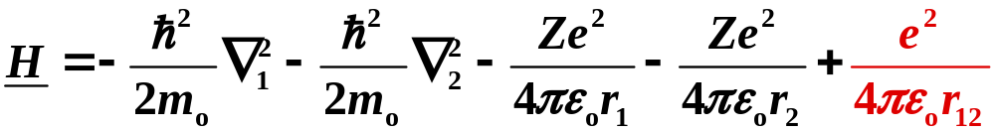
Ground State of the He Atom – 1s State
First order perturbation theory
Neglecting translation of the entire atom.
kinetic energies
attraction of electrons
to nucleus
electron – electron repulsion
1 - electron 1
2 - electron 2
r₁ - distance of 1 to nucleus
r₂ - distance of 2 to nucleus
r₁₂ - distance between two electrons
Copyright – Michael D. Fayer, 2018
Notes:
2
2
2

Slide 3
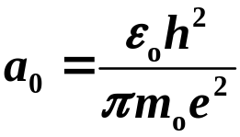



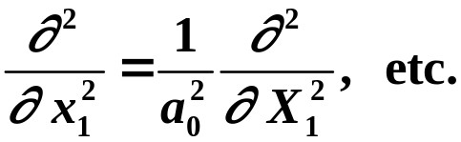
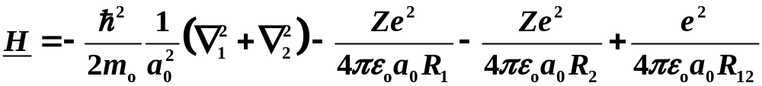
Substituting
Bohr radius
Distances in terms of Bohr radius
spatial derivatives in units of Bohr radius
Gives
Copyright – Michael D. Fayer, 2018
Notes:
3
3
3

Slide 4
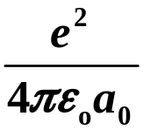
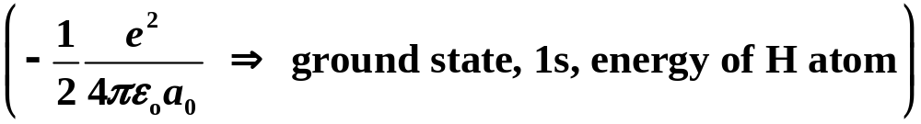
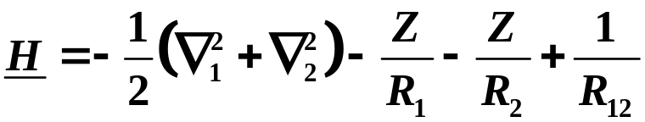
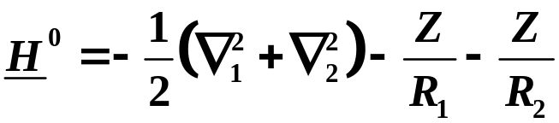
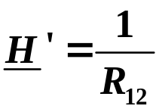
In units of
(Nothing changed. Substitutions
simplify writing equations.)
Take
Zeroth order Hamiltonian.
No electron – electron repulsion.
Perturbation piece of Hamiltonian.
Electron – electron repulsion.
Copyright – Michael D. Fayer, 2018
Notes:
4
4
4

Slide 5



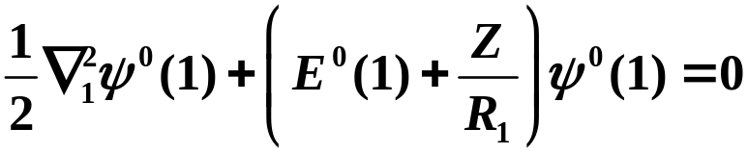
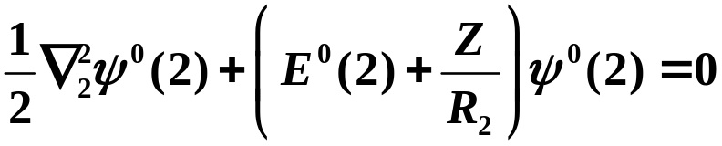
Need solutions to zeroth order equation
Take
and
H⁰ has terms that depend only on 1 and 2. No cross terms. Can separate
zeroth order equation into
These are equations for hydrogen like atoms with nuclear charge Z.
Copyright – Michael D. Fayer, 2018
Notes:
5
5
5

Slide 6
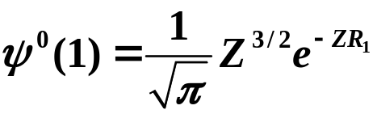

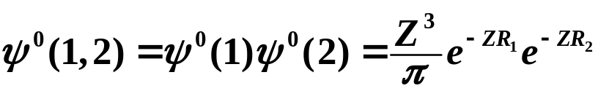

For ground state (1s)
Hydrogen 1s wavefunctions for electrons 1 and 2
but with nuclear charge Z.
The zeroth order solutions are
product of 1s functions
sum of 1s energies with
nuclear charge Z
Copyright – Michael D. Fayer, 2018
Notes:
6
6
6

Slide 7


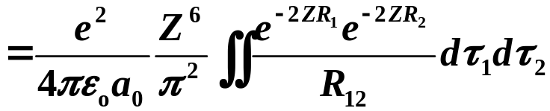


Correction to energy due to electron – electron repulsion
expectation value of perturbation piece of H
Electron – electron repulsion depends
on the distance between the two electrons.
spherical polar coordinates
Copyright – Michael D. Fayer, 2018
Notes:
7
7
7

Slide 8


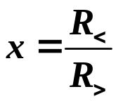
This is a tricky integral.
The following procedure can be used in this and analogous situations.
γ is the angle between the two vectors
R₁ and R₂.
1 e ⁻
R₁
+
γ
R₂
2 e ⁻
Let R> be the greater of R₁ and R₂
R< be the lesser of R₁ and R₂
Then
Copyright – Michael D. Fayer, 2018
Notes:
8
8
8

Slide 9
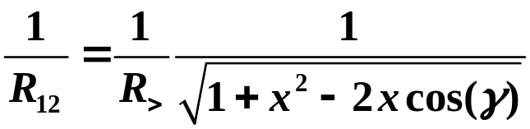
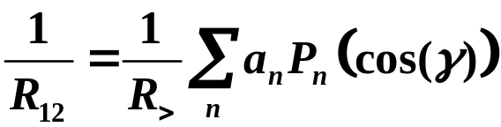

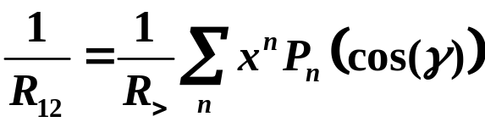
Expand in terms of Legendre polynomials (complete set of functions in cos(γ)).
The a_{n} can be found.
Therefore
Copyright – Michael D. Fayer, 2018
Notes:
9
9
9

Slide 10






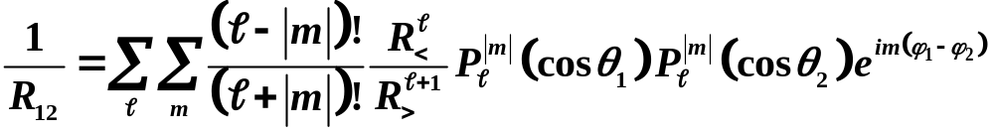
Now express the
1 e ⁻
in terms of the
R₁
+
the absolute angles of the vectors
rather than the relative angle.
R₂
2 e ⁻
The position of the two electrons can be written in terms of the
Spherical Harmonics, the solutions to the Φ(φ) and Θ(θ) equations in the H atom.
Complete set of angular functions.
The result is
Copyright – Michael D. Fayer, 2018
Notes:
10
10
10

Slide 11




Here is the trick.
The ground state hydrogen wavefunctions (or any s orbits) involve
1s wavefunctions have spherical harmonics with
These are constants. Each is just the normalization constant.
A constant times any spherical harmonic except the one with,
which is a constant, integrated over the angles, gives zero.
Therefore, only the term in the sum survives when doing
integral of each term in the sum.
The entire sum reduces to
for 1s state or any s states.
For other states, limited number of terms. Group theory. Full rotation group.
Integral of product of three functions. Direct product of representations of
function must contain totally symmetric rep. Formulas exist.
Copyright – Michael D. Fayer, 2018
Notes:
11
11
11

Slide 12
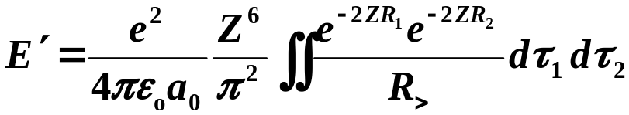
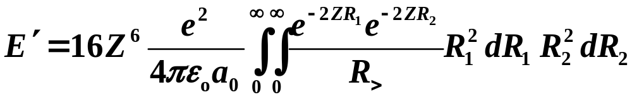

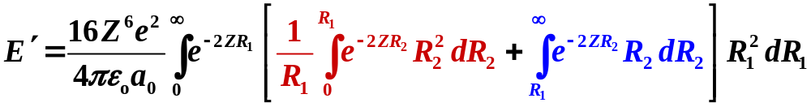

Then
The integral over angles yields 16π².
This can be written as
Copyright – Michael D. Fayer, 2018
Notes:
12
12
12

Slide 13
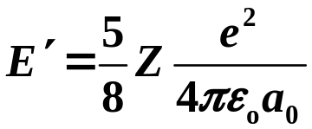
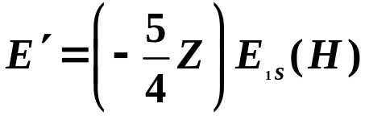
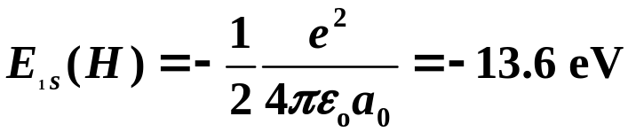
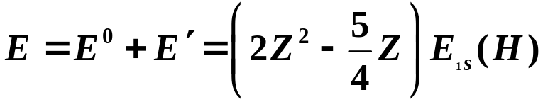
Doing the integrals yields
Putting back into normal units
Therefore,
negative number
Electron repulsion raises the energy.
For Helium, Z = 2, E = -74.8 eV
Copyright – Michael D. Fayer, 2018
Notes:
13
13
13

Slide 14
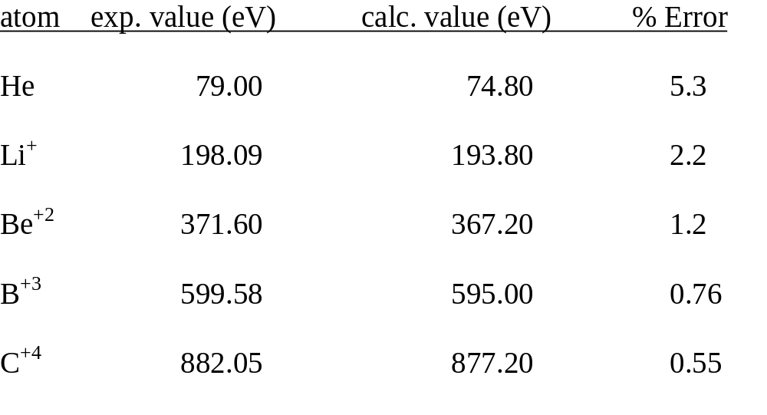
Experimental values are the sum of the first and second ionization energies.
Ionization energy positive. Binding energy negative.
Copyright – Michael D. Fayer, 2018
Notes:
14
14
14

Slide 15


The Variational Method
The Variational Theorem:
If φ is any function such that
(normalized)
and if the lowest eigenvalue of the operator H is E₀,
then
The expectation value of H or any operator for any function is always
greater than or equal to the lowest eigenvalue.
Copyright – Michael D. Fayer, 2018
Notes:
15
15
15

Slide 16





Proof
Consider
The true eigenkets of H are
Expand in terms of the
orthonormal basis set
Copyright – Michael D. Fayer, 2018
Notes:
16
16
16

Slide 17
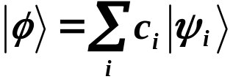
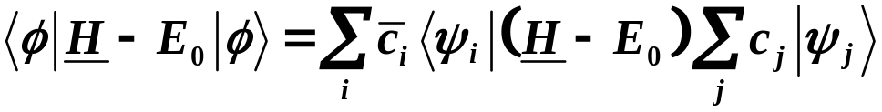

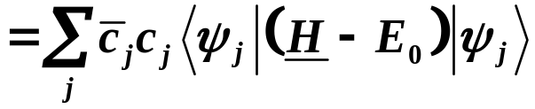
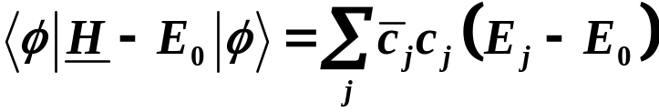
Expansion in terms of the eigenkets of H.
Substitute the expansion
The are eigenkets of (H – E₀). Therefore, the double sum collapses
into a single sum.
Operating H on returns E_{j}.
Copyright – Michael D. Fayer, 2018
Notes:
17
17
17

Slide 18



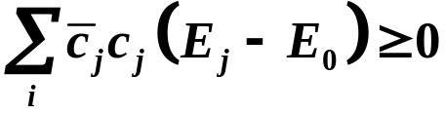




A number times its complex conjugate is positive or zero.
An eigenvalue is greater than or equal to the lowest eigenvalue.
Then,
and
Therefore,
The lower the energy you
calculate, the closer it is to
the true energy.
Finally
The equality holds only if , the function is the lowest eigenfunction.
Copyright – Michael D. Fayer, 2018
Notes:
18
18
18

Slide 19



Using the Variational Theorem
Pick a trial function
normalized
Calculate
J is a function of the λ’s.
Minimize J (energy) with respect to the λ’s.
The minimized J - Approximation to E₀.
The φ obtained from minimizing with respect to the λ’s - approximation to .
Method can be applied to states above ground state with minor modifications.
Pick second function normalized and orthogonal to first function.
Minimize. If above first calculated energy, approximation to next highest energy.
If lower, it is the approximation to lowest state and initial energy is approx.
to the higher state energy.
Copyright – Michael D. Fayer, 2018
Notes:
19
19
19

Slide 20
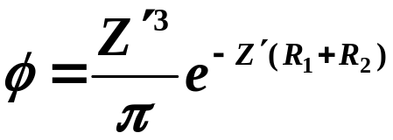

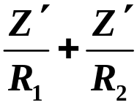
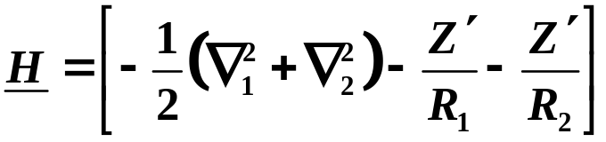
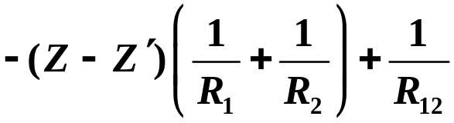
Example - He Atom
Trial function
The zeroth order perturbation function but with a variable.
Writing H as in perturbation treatment after substitutions
Rewrite by adding and subtracting
Copyright – Michael D. Fayer, 2018
Notes:
20
20
20

Slide 21
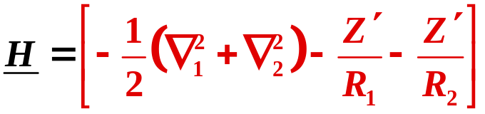


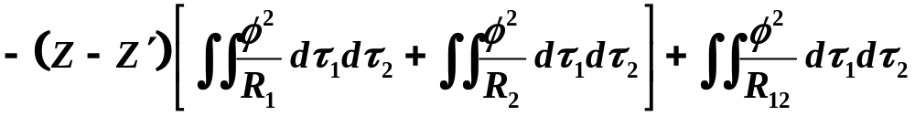

Want to calculate
using H from above.
The terms in red give
Zeroth order perturbation energy with
Therefore,
These two integrals have the same value; only difference
is subscript.
Copyright – Michael D. Fayer, 2018
Notes:
21
21
21

Slide 22
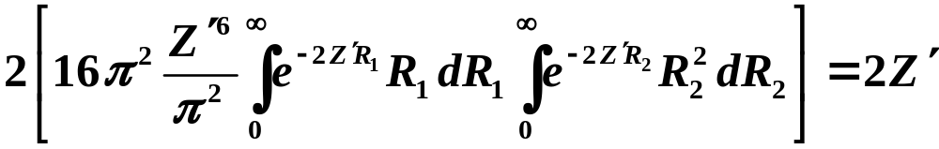
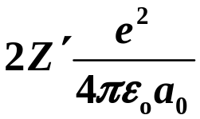

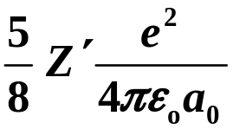
For the two integrals in brackets, performing integration over angles gives
after doing the integrals
over distance.
In conventional units
The last term in the expression for J
was evaluated in the perturbation problem
except .
The result is (in conventional units)
Copyright – Michael D. Fayer, 2018
Notes:
22
22
22

Slide 23
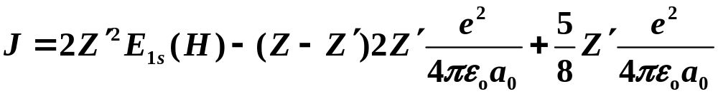
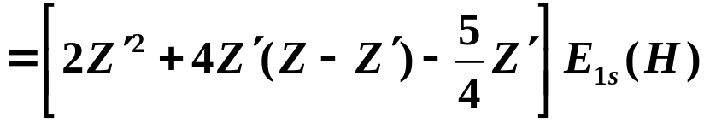
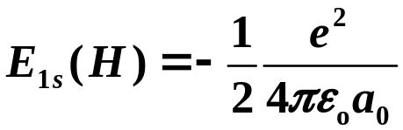
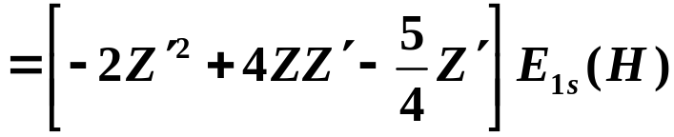
Putting the pieces together yields
Copyright – Michael D. Fayer, 2018
Notes:
23
23
23

Slide 24

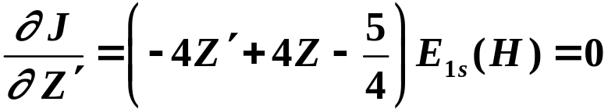
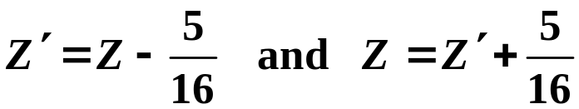
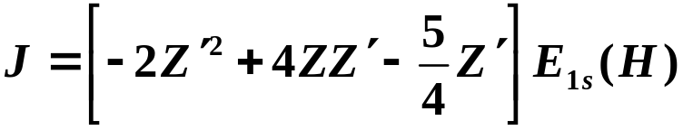

To get the best value of E for the trial function φ,
minimize J with respect to .
Solving for yields
Using this value to eliminate Z in the expression for J
yields
This is the approximate energy of the ground state of the He atom (Z = 2)
or two electron ions (Z > 2).
Copyright – Michael D. Fayer, 2018
Notes:
24
24
24

Slide 25
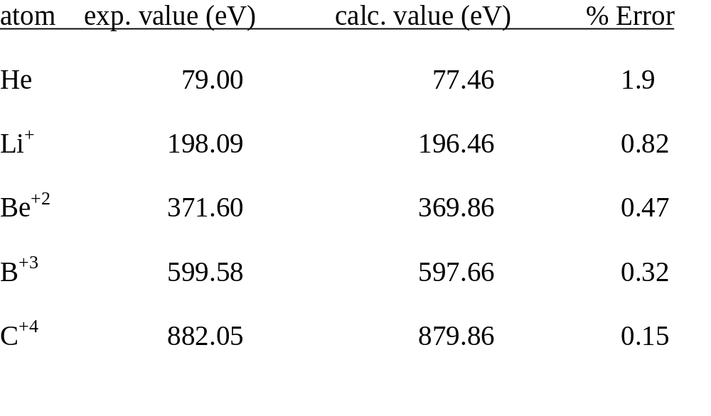
He perturbation theory value – 74.8 eV
Copyright – Michael D. Fayer, 2018
Notes:
25
25
25

