Slide 1
Chapter 12

Slide 2
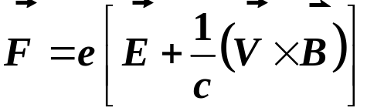
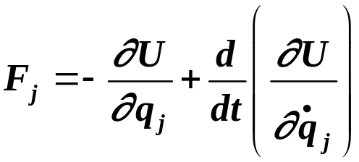
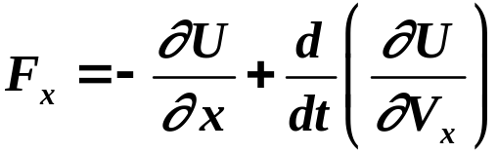
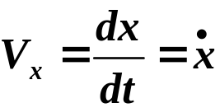
Absorption and Emission of Radiation:
Time Dependent Perturbation Theory Treatment
Want Hamiltonian for Charged Particle in E & M Field
Need the potential U.
Force on Charged Particle:
Force (generalized form in Lagrangian mechanics)
j^{th} component:
U is the potential
q_{j} are coordinates
Example:
since:
Copyright – Michael D. Fayer, 2018
Notes:
2
2
2

Slide 3

Use the two equations for F to find U,
the potential of a charged particle in an E & M field
Once we have U, we can write:
Where H' is the time dependent perturbation
Use time dependent perturbation theory.
Copyright – Michael D. Fayer, 2018
Notes:
3
3
3

Slide 4

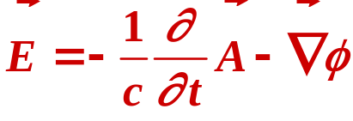
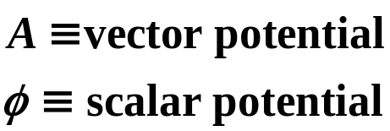
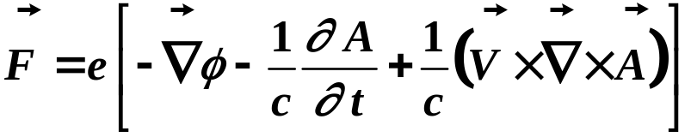
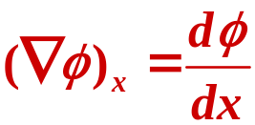
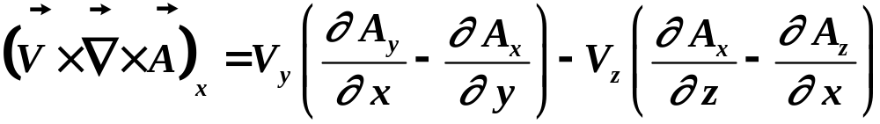
Using the Standard Definitions from Maxwell’s Eqs.
Force on Charged Particle:
Then:
Components of F, F_{x}, etc…
Copyright – Michael D. Fayer, 2018
Notes:
4
4
4

Slide 5
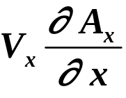
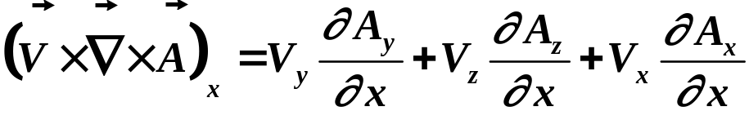
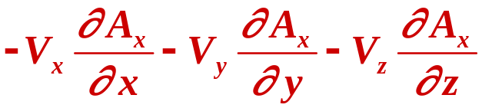
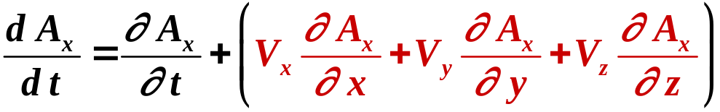
Adding and Subtracting
Total time derivative of A_{x} is
Due to explicit variation of
A_{x} with time.
Due to motion of particle -
Changing position at which A_{x} is evaluated.
Copyright – Michael D. Fayer, 2018
Notes:
5
5
5

Slide 6
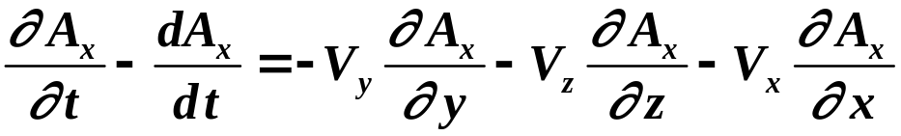
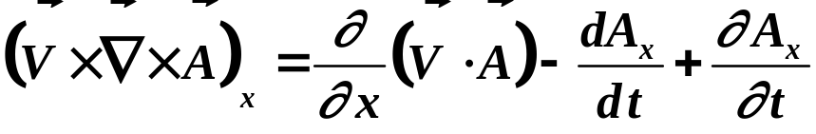
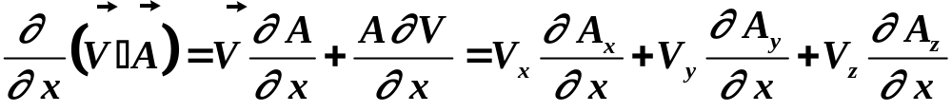
Then:
Using this
Since:
0
Copyright – Michael D. Fayer, 2018
Notes:
6
6
6

Slide 7
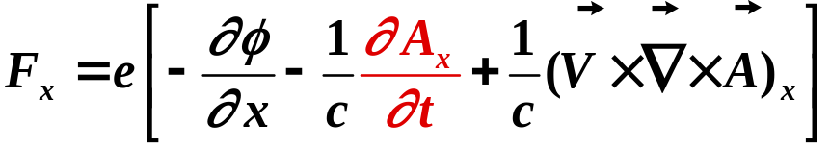
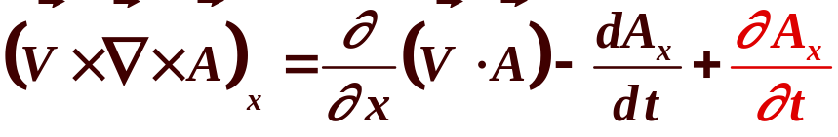
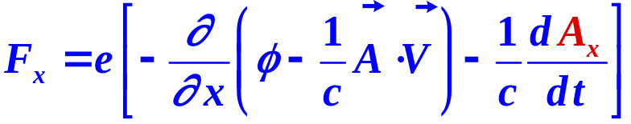
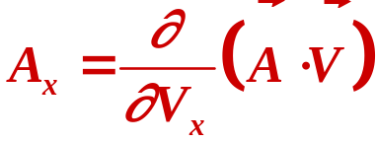
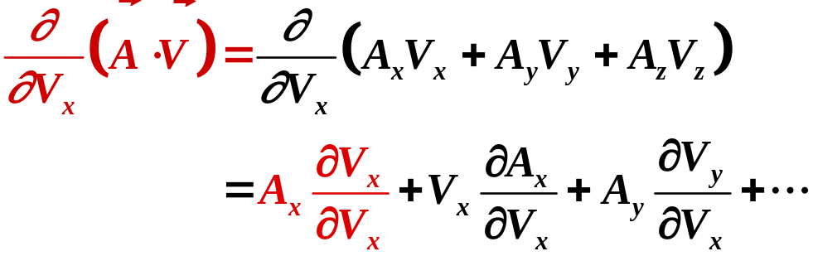
Substituting these pieces into equation for F_{x}
cancels
Then
substitute
because
A not function of V &
V_{y} V_{z} independent of V_{x}
1 + 0 + 0 + 0
Copyright – Michael D. Fayer, 2018
Notes:
7
7
7

Slide 8
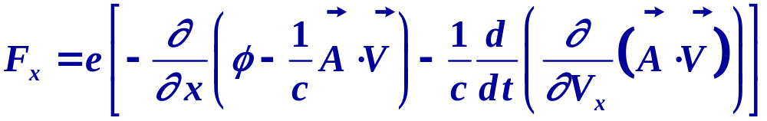
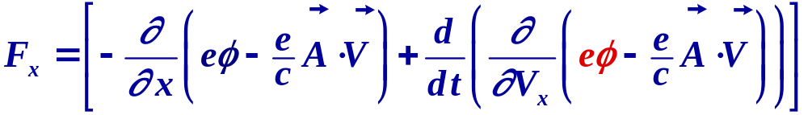
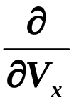
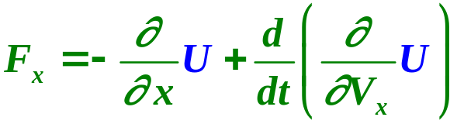
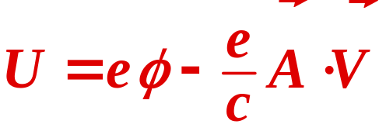
Therefore
Since φ is independent of V, can add in.
Goes away when taking
The general definition of F_{x} is:
U ➔ potential
Therefore:
Copyright – Michael D. Fayer, 2018
Notes:
8
8
8

Slide 9
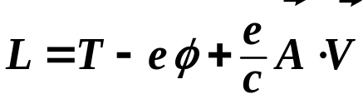
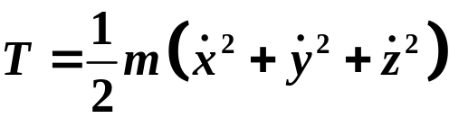
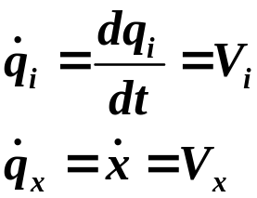
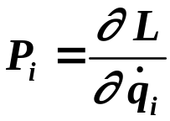
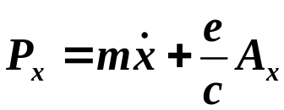
Legrangian:
L = T – U
T ≡ Kinetic Energy
For charged particle in E&M Field:
The i^{th} component of the momentum is give by
where:
Therefore,
Copyright – Michael D. Fayer, 2018
Notes:
9
9
9

Slide 10

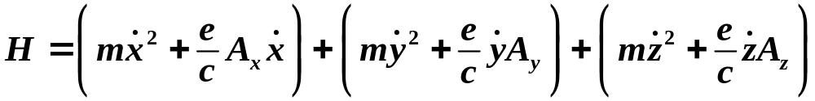
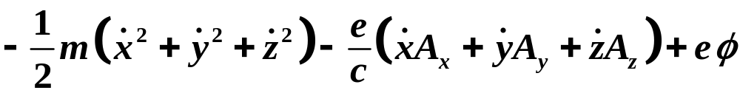
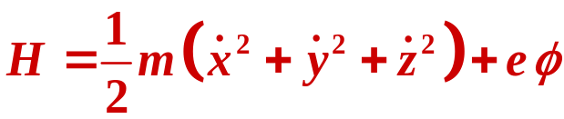
The classical Hamiltonian:
( , etc.)
Therefore
This yields:
Copyright – Michael D. Fayer, 2018
Notes:
10
10
10

Slide 11
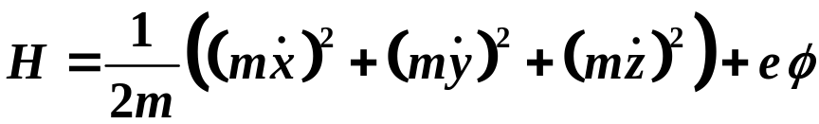
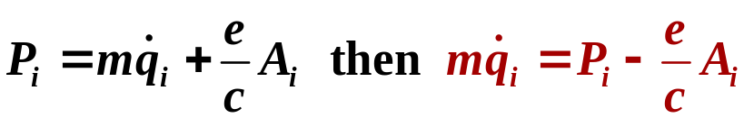
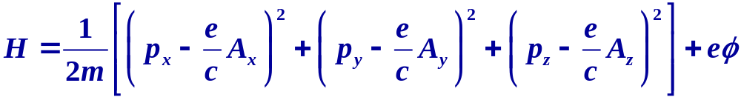
Want H in terms of momentum P_{x}, P_{y}, P_{z}
since we know how to go from classical momentum to QM operators.
Multiply by m/m
Using:
Classical Hamiltonian for a charged particle in any combination of
electric and magnetic fields is:
Copyright – Michael D. Fayer, 2018
Notes:
11
11
11

Slide 12
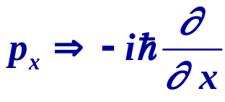
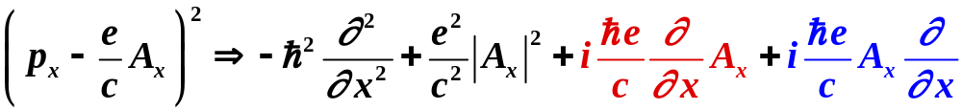
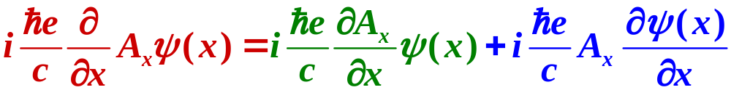
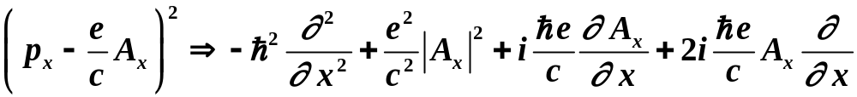
QM Hamiltonian
Make substitution:
Then the term:
Same. Pick up
factor of two
The operator operates on a function, ψ.
Using the product rule:
Copyright – Michael D. Fayer, 2018
Notes:
12
12
12

Slide 13
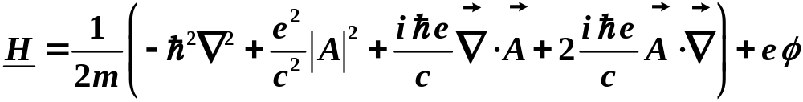
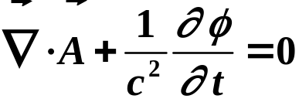


The total QM Hamiltonian in three dimensions is:
This is general for a charged particle in
any combination of electric and magnetic fields
For light ➔ E & M Field
φ = 0 (no scalar potential)
And since
(Lorentz Gauge Condition)
Then:
Weak field approximation: is negligible
Copyright – Michael D. Fayer, 2018
Notes:
13
13
13

Slide 14
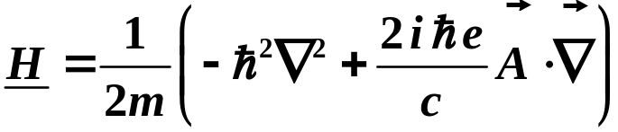
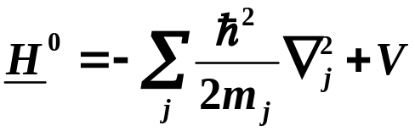
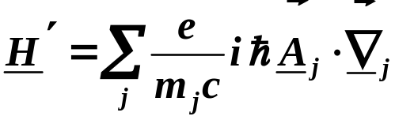

Therefore, for a weak light source
kinetic energy of particle
For many particles interacting through a potential V,
add potential term to Hamiltonian.
Combine potential energy term with kinetic energy term to get normal
many particle Hamiltonian for an atom or molecule.
Time independent
The remaining piece is time dependent portion due to light.
The total Hamiltonian is
Use H⁰ + H' in time dependent perturbation calculation.
Copyright – Michael D. Fayer, 2018
Notes:
14
14
14

Slide 15
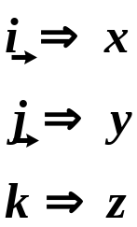
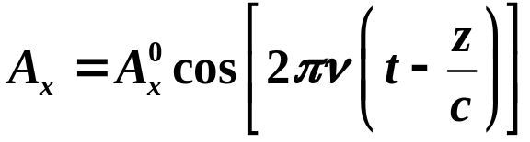

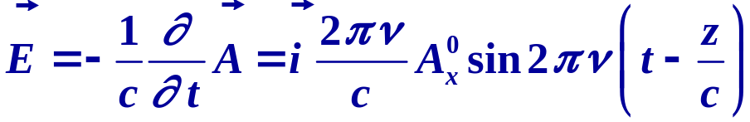
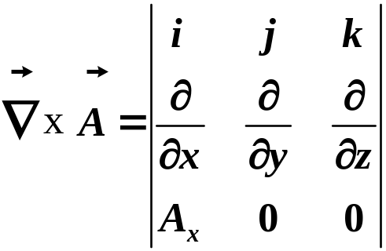


E & M Field → Plane wave propagating in z direction (x-polarized light)
unit vectors
with
vector potential
To see this is E & M plane wave, use Maxwell's equations
Equal amplitude fields,
perpendicular to each other,
propagating along z.
Copyright – Michael D. Fayer, 2018
Notes:
15
15
15

Slide 16


To use time dependent perturbation theory we need:
Dipole Approximation:
Most cases of interest, wavelength of light much larger
than size of atom or molecule
part of a cycle
of light
molecule
Take A_{x} constant spatially → two particles in different parts of molecule will
experience the same A_{x} at given instant of time.
Copyright – Michael D. Fayer, 2018
Notes:
16
16
16

Slide 17






Dipole Approximation:
Pull A_{x} out of bracket since it is constant spatially
doesn’t operate on time dependent part of ket, pull
time dependent phase factors out of bracket.
Need to evaluate
Can express in terms of x_{j} rather then
Copyright – Michael D. Fayer, 2018
Notes:
17
17
17

Slide 18








First for one particle can write following equations:
complex conjugate of
Schrödinger equation
Left multiply (1) by
Left multiply (2) by
Subtract
Copyright – Michael D. Fayer, 2018
Notes:
18
18
18

Slide 19




Transpose
Integrate
This is what we want.
Need to show that it is equal to
Copyright – Michael D. Fayer, 2018
Notes:
19
19
19

Slide 20







Integrate right hand side by parts:
and collecting terms
Because wavefunctions vanish at infinity, this is 0, so we have:
using product rule
2nd and 4th terms cancel
Integrating this by parts → equals second term
Copyright – Michael D. Fayer, 2018
Notes:
20
20
20

Slide 21



Therefore, finally, we have:
This can be generalized to more then one particle by summing over x_{j}.
Substituting into
gives
with:
Operator – (charge × length) - dipole
x-component of "transition dipole."
Copyright – Michael D. Fayer, 2018
Notes:
21
21
21

Slide 22



Absorption & Emission Transition Probabilities
Equations of motion
of coefficients
Time Dependent Perturbation Theory:
Take system to be in state at t = 0
C_{n}=1 C_{m≠n}=0
Short time → C_{m≠n} ≈ 0
Using result for E&M plane wave:
No longer coupled equations.
Transition dipole bracket.
Copyright – Michael D. Fayer, 2018
Notes:
22
22
22

Slide 23



For light of frequency ν:
vector potential
Therefore:
note sign difference
Copyright – Michael D. Fayer, 2018
Notes:
23
23
23

Slide 24

Multiplying through by dt, integrating and
choosing constant of integration such that C_{m} = 0 at t = 0
note sign differences
Rotating Wave Approximation
Consider Absorption E_{m} > E_{n}
E
m
This term large, keep.
Drop first term.
E
n
(E_{m} – E_{n} – hν) → 0
as
Copyright – Michael D. Fayer, 2018
Notes:
24
24
24

Slide 25





For Absorption – Second Term Large → Drop First Term
Then,
Probability of finding system in as a function of frequency, ν →
Using the trig identities:
Get:
energy difference between two eigenkets of H⁰
amount radiation field is off resonance.
Copyright – Michael D. Fayer, 2018
Notes:
25
25
25

Slide 26



energy difference between two eigenkets of H⁰
amount radiation field is off resonance.
Plot of C_{m}*C_{m} vs ΔE:
Maximum at ΔE=0
Maximum probability ∝ t ² – square of time light is applied.
Probability only significant for width ~4π/t
1 ps → 67 cm⁻¹
Determined by uncertainty principle. For square pulse: ΔνΔt = 0.886
1 ps → 30 cm⁻¹ from uncertainty relation
Copyright – Michael D. Fayer, 2018
Notes:
26
26
26

Slide 27




The shape is a square of zeroth order spherical Bessel function.
t increases → Height of central lobe increases, width decreases.
Most probability in central lobe
10 ns pulse → Width ~0.03cm⁻¹, virtually all probability
→ ➔ Dirac delta function δ(ΔE=0) ; hν = (E_{m} - E_{n})
Total Probability → Area under curve
Probability linearly proportional to
time light is applied.
Copyright – Michael D. Fayer, 2018
Notes:
27
27
27

Slide 28



Since virtually all probability at ΔE = 0,
evaluate (in Q) at frequency
Therefore:
Related to intensity of light
as shown below.
transition dipole bracket
Probability increases linearly in t.
Can’t let get too big if time dependent perturbation theory used.
Limited by excited state lifetime.
Must use other methods for high power, “non-linear” experiments (Chapter 14).
Copyright – Michael D. Fayer, 2018
Notes:
28
28
28

Slide 29





I.
Poynting vector:
For plane wave:
Intensity → time average magnitude of Poynting vector
Average sin² term over t from 0 to 2π → 1/2
Therefore:
and
Linear in intensity.
Linear in time.
Copyright – Michael D. Fayer, 2018
Notes:
29
29
29

Slide 30


This is the big result.
Linear in intensity.
Linear in time.
Transition dipole bracket for x polarized light.
Can have light with polarizations x, y, or z, i. e., I_{x}, I_{y}, I_{z}
Then:
x_{mn}, y_{mn}, and z_{mn} are the transition dipole brackets for
light polarized along x, y, and z, respectively
Copyright – Michael D. Fayer, 2018
Notes:
30
30
30

Slide 31





Another definition of “strength” of radiation fields
radiation density:
average
Then
Isotropic radiation
For isotropic radiation
Copyright – Michael D. Fayer, 2018
Notes:
31
31
31

Slide 32


Einstein “B Coefficients” for absorption and stimulated emission
Probability of transition taking place in unit time (absorption)
for isotropic radiation
where
transition dipole bracket
Copyright – Michael D. Fayer, 2018
Notes:
32
32
32

Slide 33


For emission (induced, stimulated) everything is the same except
keep first exponential term in expression for probability amplitude.
E
stimulated emission
m
need radiation field
Previously, initial state called n.
Now initial state m, final state n.
E_{m} > E_{n}.
E
n
Rotating wave approximation. Keep this term.
Einstein B coefficient for absorption
equals B coefficient for stimulated emission.
Copyright – Michael D. Fayer, 2018
Notes:
33
33
33

Slide 34


Restrictions on treatment
Left out spontaneous emission
Treatment only for weak fields
Only for dipole transition
Treatment applies only for
If transition dipole brackets all zero
Higher order terms lost when we took vector potential
constant spatially over molecule:
Lose → Magnetic dipole transition
Electric Quadrupole
Magnetic Quadrupole
Electric Octapole
etc…
Only important if dipole term vanishes.
Copyright – Michael D. Fayer, 2018
Notes:
34
34
34

Slide 35




Einstein “A coefficient” – Spontaneous Emission
,
Einstein B Coefficients
induced
emission
absorption
Want:
spontaneous emission coefficient
N_{m} = number of systems (molecules) in state of energy E_{m} (upper state)
N_{n} = number of systems (molecules) in state of energy E_{n} (lower state)
At temp T, Boltzmann law gives:
Copyright – Michael D. Fayer, 2018
Notes:
35
35
35

Slide 36



At equilibrium:
rate of downward transitions = rate of upward transitions
spontaneous emission stimulated emission absorption
Using
Solving for
Copyright – Michael D. Fayer, 2018
Notes:
36
36
36

Slide 37





Then:
Take “sample” to be black body, reasonable approximation.
Planck’s derivation (first QM problem)
Gives
Spontaneous emission – no light necessary,
I = 0, ν ³ dependence.
Copyright – Michael D. Fayer, 2018
Notes:
37
37
37

Slide 38

Spontaneous Emission:
ν ³ dependence
No spontaneous emission - NMR
ν ≅ 10⁸ Hz
Optical spontaneous emission
ν ≅ 10¹⁵ Hz
Typical optical spontaneous emission time, 10 ns (10⁻⁸ s).
NMR spontaneous emission time – 10¹³ s (>10⁵ years).
Actually longer, magnetic dipole transition much weaker than
optical electric dipole transition.
Copyright – Michael D. Fayer, 2018
Notes:
38
38
38

Slide 39



Quantum Treatment of Spontaneous Emission (Briefly)
Radiation Field → Photons
same as Harmonic Oscillator kets
Number operator
number of photons in field
Absorption:
annihilation operator
Removes photon – probability proportional to bracket squared
∝ n ∝ intensity
need photons for absorption
Copyright – Michael D. Fayer, 2018
Notes:
39
39
39

Slide 40



Emission
one more photon in field
creation operator
Probability ∝ n + 1
when n very large n >> 1, n ∝ Intensity
However, for
n = 0
Still can have emission from excited state in absence of radiation field.
QM E-field operator:
Even when no photons, E-field not zero. Vacuum state. All frequencies have
E-fields. “Fluctuations of vacuum state.”
Fourier component at induces spontaneous emission.
Copyright – Michael D. Fayer, 2018
Notes:
40
40
40

