Slide 1
Chapter 13

Slide 2

Matrix Representation
Matrix Rep. Same basics as introduced already.
Convenient method of working with vectors.
Superposition Complete set of vectors can be used to
express any other vector.
Complete set of N orthonormal vectors can form other complete sets of
N orthonormal vectors.
Can find set of vectors for Hermitian operator satisfying
Eigenvectors and eigenvalues
Matrix method Find superposition of basis states that are
eigenstates of particular operator. Get eigenvalues.
Copyright – Michael D. Fayer, 2018
Notes:
2
2
2

Slide 3
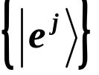
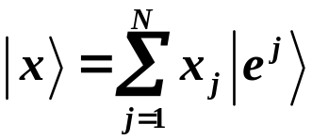

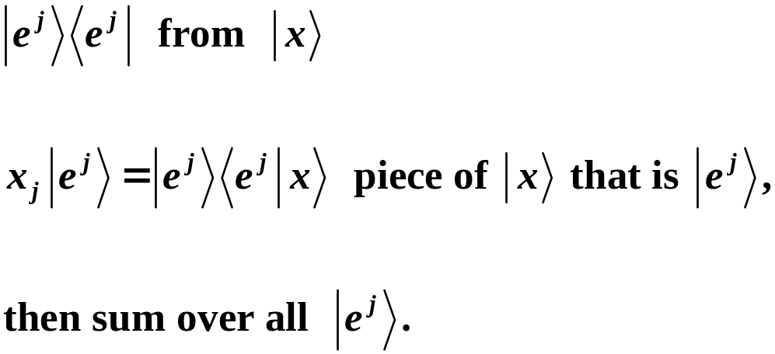
Orthonormal basis set in N dimensional vector space
basis vectors
Any N dimensional vector can be written as
with
To get this, project out
Copyright – Michael D. Fayer, 2018
Notes:
3
3
3

Slide 4

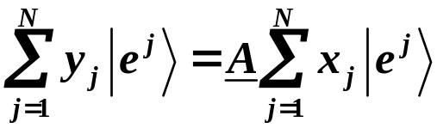
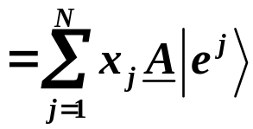

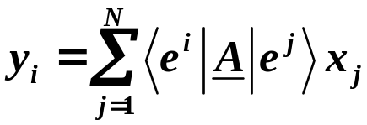

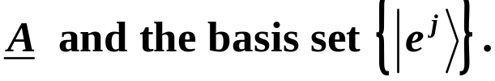
Operator equation
Substituting the series in terms of bases vectors.
Left mult. by
The N² scalar products
N values of j for each y_{i}; and N different y_{i}
are completely determined by
Copyright – Michael D. Fayer, 2018
Notes:
4
4
4

Slide 5

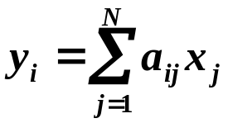

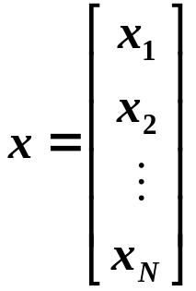
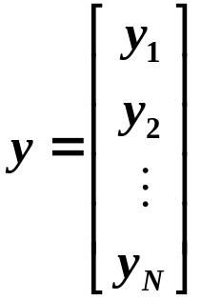
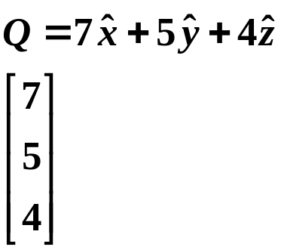

Writing
Matrix elements of A in the basis
gives for the linear transformation
Know the a_{ij} because we know A and
In terms of the vector representatives
vector
vector representative,
must know basis
(Set of numbers, gives you vector
when basis is known.)
The set of N linear algebraic equations can be written as
double underline means matrix
Copyright – Michael D. Fayer, 2018
Notes:
5
5
5

Slide 6

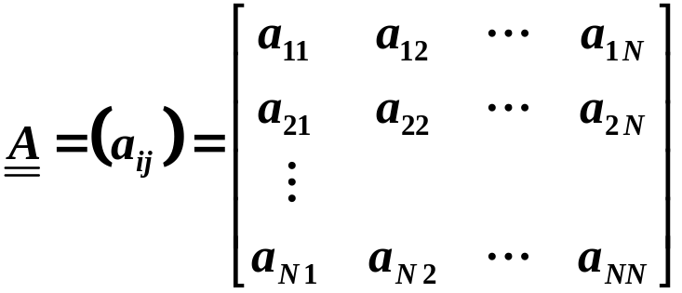
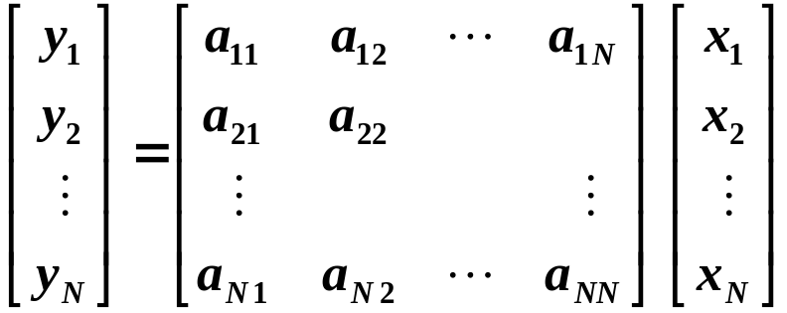
array of coefficients - matrix
The a_{ij} are the elements of the matrix .
vector representatives in particular basis
The product of matrix and vector representative x
is a new vector representative y with components
Copyright – Michael D. Fayer, 2018
Notes:
6
6
6

Slide 7


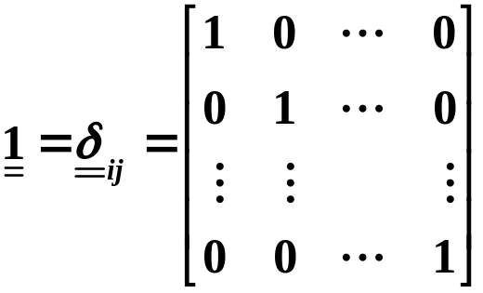
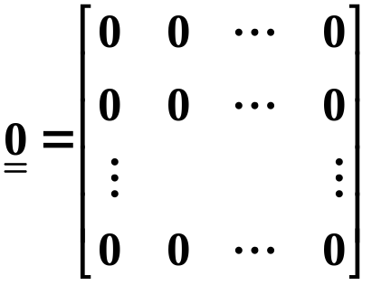
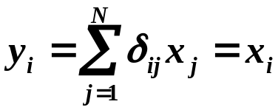


Matrix Properties, Definitions, and Rules
Two matrices, and are equal
if a_{ij} = b_{ij}.
The unit matrix
The zero matrix
ones down
principal diagonal
Gives identity transformation
Corresponds to
Copyright – Michael D. Fayer, 2018
Notes:
7
7
7

Slide 8


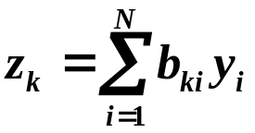




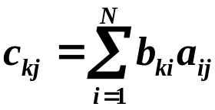
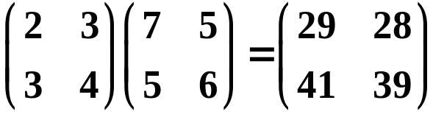
Matrix multiplication
Consider
operator equations
Using the same basis for both transformations
has elements
Example
Law of matrix multiplication
Copyright – Michael D. Fayer, 2018
Notes:
8
8
8

Slide 9




Multiplication Associative
Multiplication NOT Commutative except in special cases.
Matrix addition and multiplication by complex number
Copyright – Michael D. Fayer, 2018
Notes:
9
9
9

Slide 10







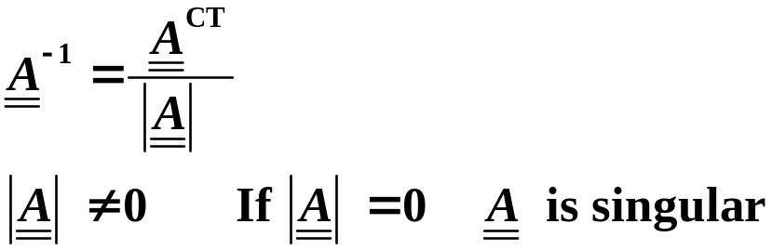
Reciprocal of Product
For matrix defined as
Transpose
interchange rows and columns
Complex Conjugate
complex conjugate of each element
Hermitian Conjugate
complex conjugate transpose
Inverse of a matrix
inverse of
identity matrix
transpose of cofactor matrix (matrix of signed minors)
determinant
Copyright – Michael D. Fayer, 2018
Notes:
10
10
10

Slide 11






Rules
transpose of product is product of transposes in reverse order
determinant of transpose is determinant
complex conjugate of product is product of complex conjugates
determinant of complex conjugate is
complex conjugate of determinant
Hermitian conjugate of product is product of
Hermitian conjugates in reverse order
determinant of Hermitian conjugate is complex conjugate
of determinant
Copyright – Michael D. Fayer, 2018
Notes:
11
11
11

Slide 12







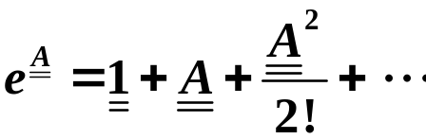
Definitions
Symmetric
Hermitian
Real
Imaginary
Unitary
Diagonal
Powers of a matrix
Copyright – Michael D. Fayer, 2018
Notes:
12
12
12

Slide 13
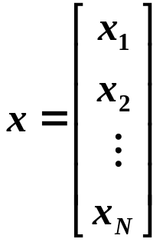



Column vector representative one column matrix
vector representatives in particular basis
then
becomes
row vector transpose of column vector
transpose
Hermitian conjugate
Copyright – Michael D. Fayer, 2018
Notes:
13
13
13

Slide 14
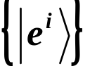

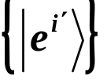
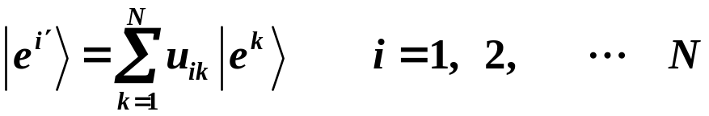
Change of Basis
orthonormal basis
then
Superposition of can form N new vectors
linearly independent
a new basis
complex numbers
Copyright – Michael D. Fayer, 2018
Notes:
14
14
14

Slide 15






New Basis is Orthonormal
if the matrix
coefficients in superposition
meets the condition
is unitary – Hermitian conjugate = inverse
Important result. The new basis will be orthonormal
if , the transformation matrix, is unitary (see book
and Errata and Addenda, linear algebra book ).
Copyright – Michael D. Fayer, 2018
Notes:
15
15
15

Slide 16



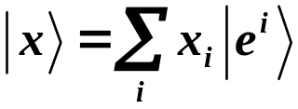
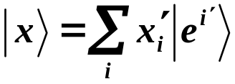


Unitary transformation
substitutes orthonormal basis for orthonormal basis .
Vector
vector – line in space (may be high dimensionality
abstract space)
written in terms of two basis sets
Same vector – different basis.
The unitary transformation can be used to change a vector representative
of in one orthonormal basis set to its vector representative in another
orthonormal basis set.
x – vector rep. in unprimed basis
x' – vector rep. in primed basis
change from unprimed to primed basis
change from primed to unprimed basis
Copyright – Michael D. Fayer, 2018
Notes:
16
16
16

Slide 17

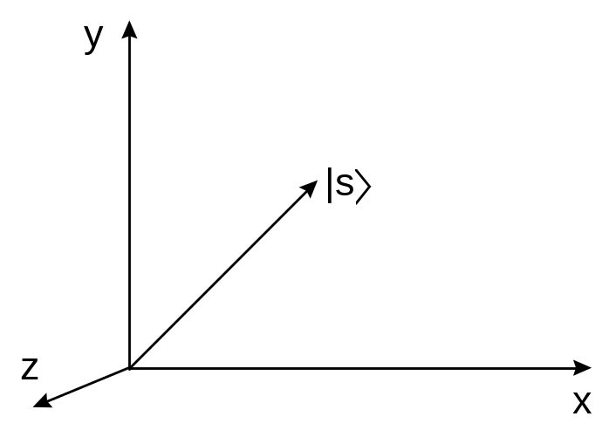


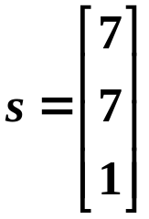
Example
Consider basis
Vector - line in real space.
In terms of basis
Vector representative in basis
Copyright – Michael D. Fayer, 2018
Notes:
17
17
17

Slide 18


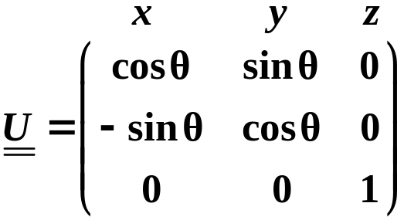
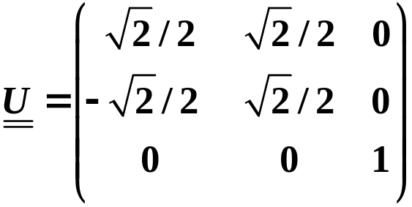
Change basis by rotating axis system 45° around .
Can find the new representative of , s'
is rotation matrix
For 45° rotation around z
Copyright – Michael D. Fayer, 2018
Notes:
18
18
18

Slide 19
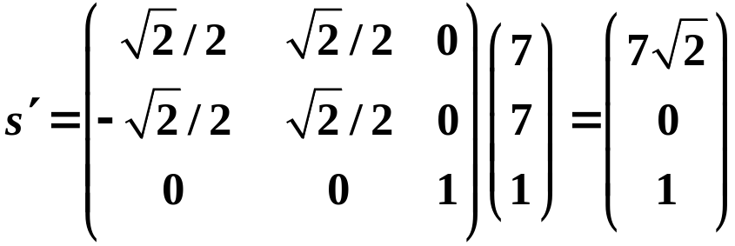
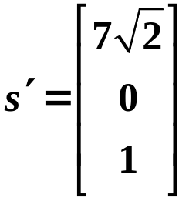

Then
vector representative of in basis
Same vector but in new basis.
Properties unchanged.
Example – length of vector
Copyright – Michael D. Fayer, 2018
Notes:
19
19
19

Slide 20
Can go back and forth between representatives of a vector by
change from unprimed
to primed basis
change from primed
to unprimed basis
components of in different basis
Copyright – Michael D. Fayer, 2018
Notes:
20
20
20

Slide 21
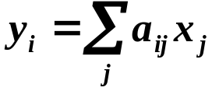




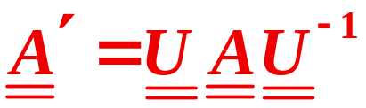
Consider the linear transformation
operator equation
In the basis can write
or
Change to new orthonormal basis using
or
with the matrix given by
Because is unitary
Copyright – Michael D. Fayer, 2018
Notes:
21
21
21

Slide 22
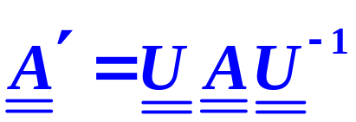
Extremely Important
Can change the matrix representing an operator in one orthonormal basis
into the equivalent matrix in a different orthonormal basis.
Called
Similarity Transformation
Copyright – Michael D. Fayer, 2018
Notes:
22
22
22

Slide 23







In basis
Go into basis
Relations unchanged by change of basis.
Example
Can insert between because
Therefore
Copyright – Michael D. Fayer, 2018
Notes:
23
23
23

Slide 24
Isomorphism between operators in abstract vector space
and matrix representatives.
Because of isomorphism not necessary to distinguish
abstract vectors and operators
from their matrix representatives.
The matrices (for operators) and the representatives (for vectors)
can be used in place of the real things.
Copyright – Michael D. Fayer, 2018
Notes:
24
24
24

Slide 25


Hermitian Operators and Matrices
Hermitian operator
Hermitian operator Hermitian Matrix
+ - complex conjugate transpose - Hermitian conjugate
Copyright – Michael D. Fayer, 2018
Notes:
25
25
25

Slide 26

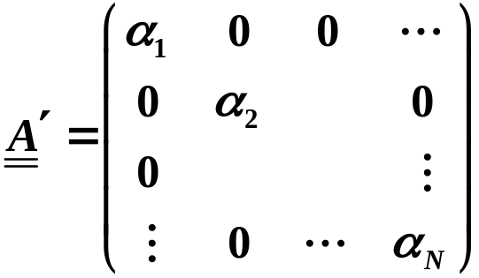


Theorem (Proof: Powell and Craseman, P. 303 – 307, or linear algebra book)
For a Hermitian operator A in a linear vector space of N dimensions,
there exists an orthonormal basis,
relative to which A is represented by a diagonal matrix
.
The vectors, , and the corresponding real numbers, α_{i}, are the
solutions of the Eigenvalue Equation
and there are no others.
Copyright – Michael D. Fayer, 2018
Notes:
26
26
26

Slide 27
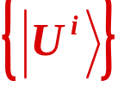

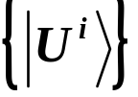
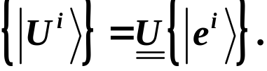

Application of Theorem
Operator A represented by matrix
in some basis . The basis is any convenient basis.
In general, the matrix will not be diagonal.
There exists some new basis eigenvectors
in which represents operator and is diagonal eigenvalues.
To get from to
unitary transformation.
Similarity transformation takes matrix in arbitrary basis
into diagonal matrix with eigenvalues on the diagonal.
Copyright – Michael D. Fayer, 2018
Notes:
27
27
27

Slide 28


Matrices and Q.M.
Previously represented state of system by vector in abstract vector space.
Dynamical variables represented by linear operators.
Operators produce linear transformations.
Real dynamical variables (observables) are represented by Hermitian operators.
Observables are eigenvalues of Hermitian operators.
Solution of eigenvalue problem gives eigenvalues and eigenvectors.
Copyright – Michael D. Fayer, 2018
Notes:
28
28
28

Slide 29






Matrix Representation
Hermitian operators replaced by Hermitian matrix representations.
In proper basis, is the diagonal Hermitian matrix and
the diagonal matrix elements are the eigenvalues (observables).
A suitable transformation takes (arbitrary basis) into
(diagonal – eigenvector basis)
Diagonalization of matrix gives eigenvalues and eigenvectors.
Matrix formulation is another way of dealing with operators
and solving eigenvalue problems.
takes arbitrary basis into eigenvectors.
Copyright – Michael D. Fayer, 2018
Notes:
29
29
29

Slide 30

All rules about kets, operators, etc. still apply.
Example
Two Hermitian matrices
can be simultaneously diagonalized by the same unitary
transformation if and only if they commute.
All ideas about matrices also true for infinite dimensional matrices.
Copyright – Michael D. Fayer, 2018
Notes:
30
30
30

Slide 31
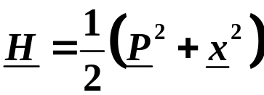
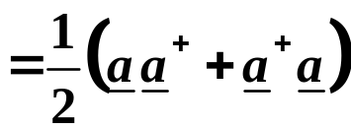



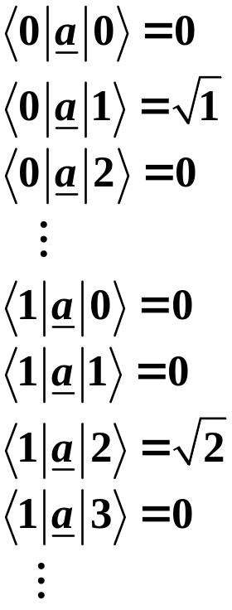
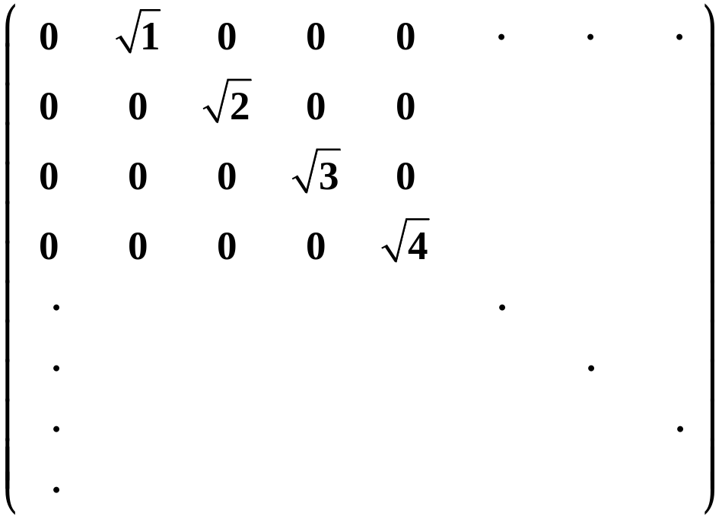
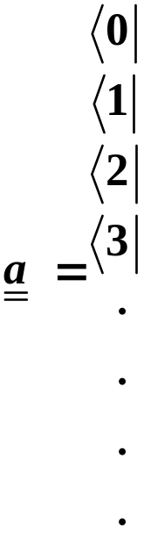
Example – Harmonic Oscillator
Have already solved – use occupation number representation kets and bras
(already diagonal).
matrix elements of a
Copyright – Michael D. Fayer, 2018
Notes:
31
31
31

Slide 32
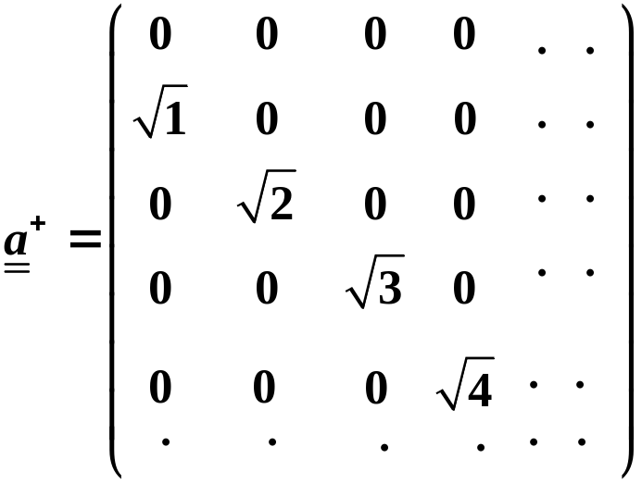
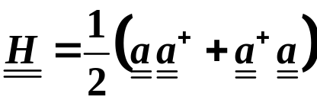
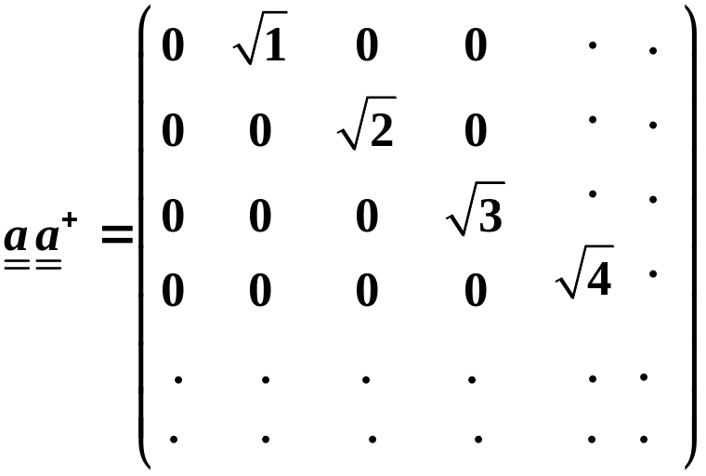
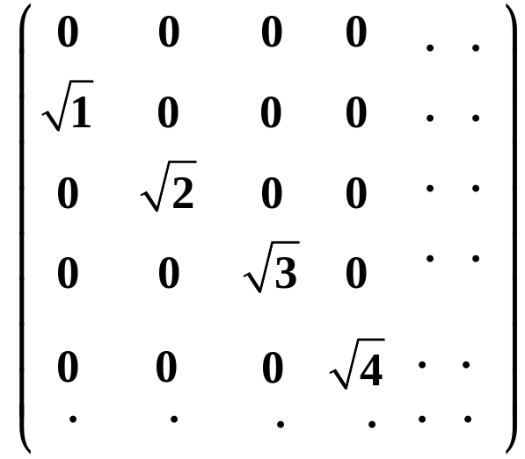
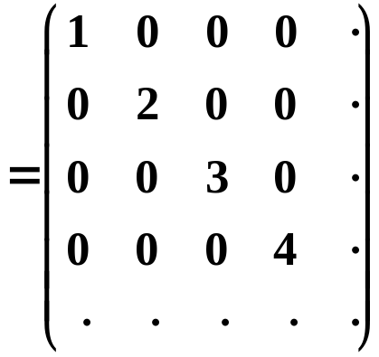
Copyright – Michael D. Fayer, 2018
Notes:
32
32
32

Slide 33



Copyright – Michael D. Fayer, 2018
Notes:
33
33
33

Slide 34





Adding the matrices and and multiplying by ½ gives
The matrix is diagonal with eigenvalues on diagonal. In normal units
the matrix would be multiplied by .
This example shows idea, but not how to diagonalize matrix when you
don’t already know the eigenvectors.
Copyright – Michael D. Fayer, 2018
Notes:
34
34
34

Slide 35




Diagonalization
Eigenvalue equation
eigenvalue
matrix representing
operator
representative of
eigenvector
In terms of the components
This represents a system of equations
We know the a_{ij}.
We don't know
α - the eigenvalues
u_{i} - the vector representatives,
one for each eigenvalue.
Copyright – Michael D. Fayer, 2018
Notes:
35
35
35

Slide 36



Besides the trivial solution
A solution only exists if the determinant of the coefficients of the u_{i} vanishes.
know a_{ij}, don't know α's
Expanding the determinant gives N^{th} degree
equation for the unknown α's (eigenvalues).
Then substituting one eigenvalue at a time into
system of equations, the u_{i}
(eigenvector representatives) are found.
N equations for u's gives only N - 1 conditions.
Use normalization.
Copyright – Michael D. Fayer, 2018
Notes:
36
36
36

Slide 37






Example - Degenerate Two State Problem
Basis - time independent kets orthonormal.
α and β not eigenkets.
Coupling γ.
These equations define H.
The matrix elements are
And the Hamiltonian matrix is
Copyright – Michael D. Fayer, 2018
Notes:
37
37
37

Slide 38







The corresponding system of equations is
These only have a solution if
the determinant of the coefficients vanish.
Make into determinant.
Subtract λ from the diagonal
elements.
Take the
matrix
Expanding
2γ
Dimer Splitting
E₀
Excited State
Energy Eigenvalues
Ground State
E = 0
Copyright – Michael D. Fayer, 2018
Notes:
38
38
38

Slide 39






To obtain Eigenvectors
Use system of equations for each eigenvalue.
Eigenvectors associated with λ₊ and λ₋.
and are the vector representatives of and
in the
We want to find these.
Copyright – Michael D. Fayer, 2018
Notes:
39
39
39

Slide 40






First, for the
eigenvalue
write system of equations.
Matrix elements of
The matrix elements are
The result is
Copyright – Michael D. Fayer, 2018
Notes:
40
40
40

Slide 41



An equivalent way to get the equations is to use a matrix form.
Substitute
Multiplying the matrix by the column vector representative gives equations.
Copyright – Michael D. Fayer, 2018
Notes:
41
41
41

Slide 42




The two equations are identical.
Always get N – 1 conditions for the N unknown components.
Normalization condition gives necessary additional equation.
Then
and
Eigenvector in terms of the
basis set.
Copyright – Michael D. Fayer, 2018
Notes:
42
42
42

Slide 43







For the eigenvalue
using the matrix form to write out the equations
Substituting
These equations give
Using normalization
Therefore
Copyright – Michael D. Fayer, 2018
Notes:
43
43
43

Slide 44



Can diagonalize by transformation
diagonal not diagonal
Transformation matrix consists of representatives of eigenvectors
in original basis.
complex conjugate transpose
Copyright – Michael D. Fayer, 2018
Notes:
44
44
44

Slide 45





Then
Factoring out , one from each matrix.
after matrix multiplication
more matrix multiplication
diagonal with eigenvalues on diagonal
Copyright – Michael D. Fayer, 2018
Notes:
45
45
45

