Slide 1
Chapter 14

Slide 2
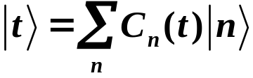

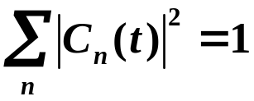

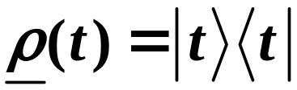

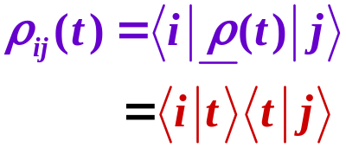
Density Matrix
State of a system at time t:
Contains time dependent
phase factors.
Density Operator
We’ve seen this before, as a “projection operator”
Can find density matrix in terms of the basis set
Matrix elements of density matrix:
Copyright – Michael D. Fayer, 2018
Notes:
2
2

Slide 3











Two state system:
Calculate matrix elements of 2×2 density matrix:
Time dependent phase
factors cancel. Always
have ket with its complex
conjugate bra.
Copyright – Michael D. Fayer, 2018
Notes:
3
3

Slide 4
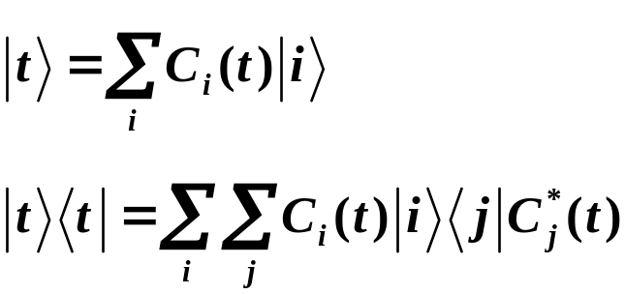
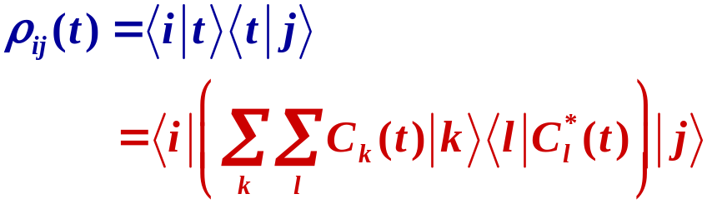

In general:
ij density matrix element
Copyright – Michael D. Fayer, 2018
Notes:
4
4

Slide 5
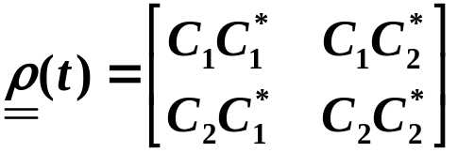
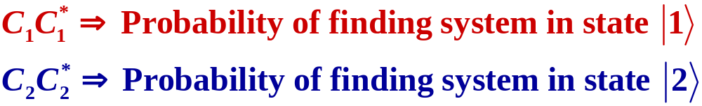
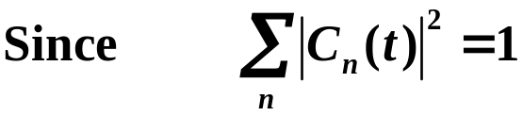


2×2 Density Matrix:
Diagonal density matrix elements ⇒ probs. of finding system in various states
Off Diagonal Elements ⇒ “coherences”
trace = 1 for any
dimension
(trace – sum of diagonal matrix elements)
And
Copyright – Michael D. Fayer, 2018
Notes:
5
5

Slide 6

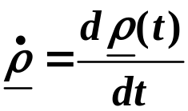
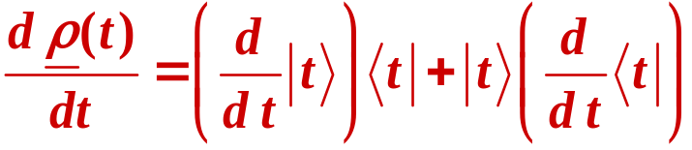

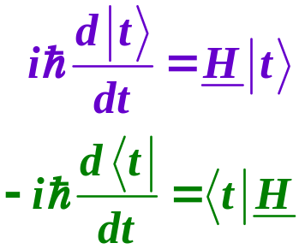
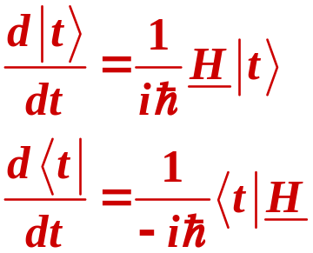
Time dependence of
product rule
Using Schrödinger Eq. for time derivatives of
Copyright – Michael D. Fayer, 2018
Notes:
6
6

Slide 7
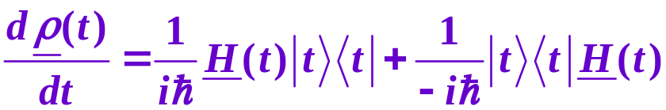
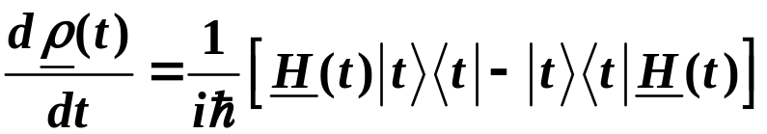
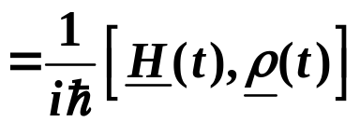
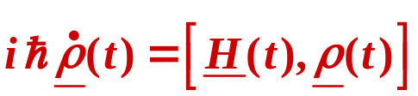
Substituting:
density operator
Therefore:
The fundamental equation of the density matrix representation.
Copyright – Michael D. Fayer, 2018
Notes:
7
7

Slide 8
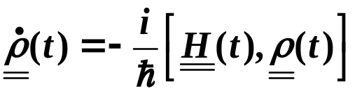

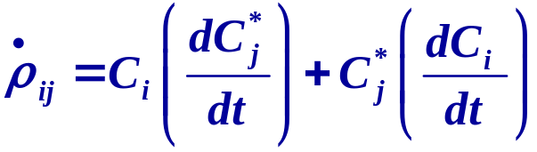
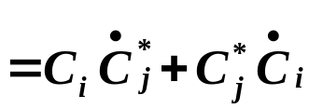
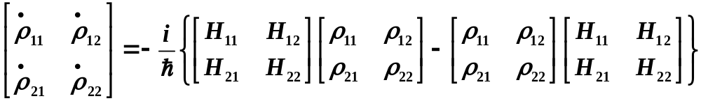
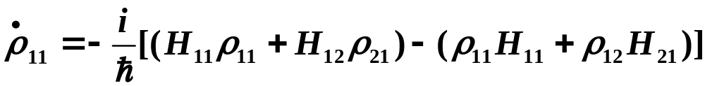
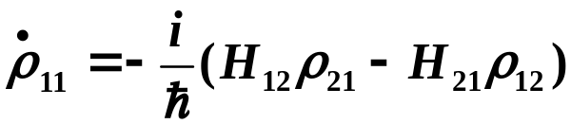
Density Matrix Equations of Motion
time derivative of
density matrix elements
by product rule
For 2×2 case, the equation of motion is:
Copyright – Michael D. Fayer, 2018
Notes:
8
8

Slide 9
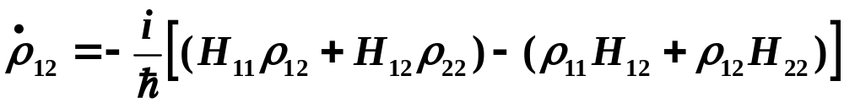
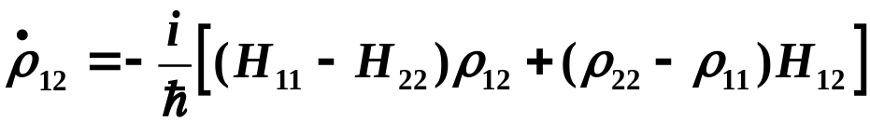
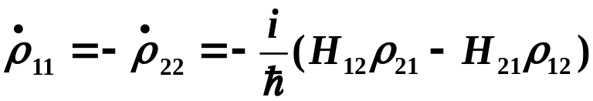

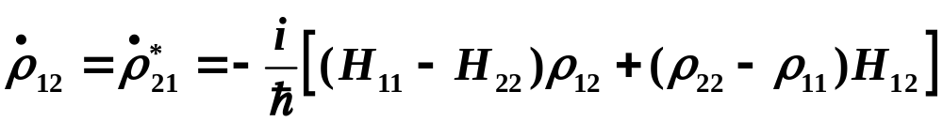

Equations of Motion – from multiplying of matrices for 2×2:
for 2x2 because
for any dimension
Copyright – Michael D. Fayer, 2018
Notes:
9
9

Slide 10




In many problems:
time
independent
time
dependent
e.g., Molecule in a radiation field:
(orthonormal)
(time dependent phase factors)
Copyright – Michael D. Fayer, 2018
Notes:
10
10

Slide 11
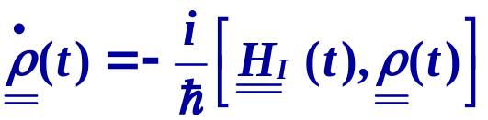



For this situation:
time evolution of density matrix elements, C_{ij}(t), depends only on
⇒ time dependent interaction term
See derivation in book – and lecture slides.
Like first steps in time dependent perturbation theory
before any approximations.
In absence of , only time dependence from time dependent phase factors
from . No changes in magnitudes of coefficients C_{ij} .
Copyright – Michael D. Fayer, 2018
Notes:
11
11

Slide 12








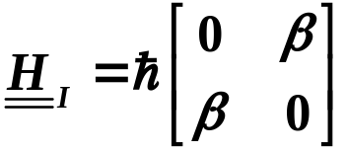
Time Dependent Two State Problem Revisited:
Previously treated in Chapter 8 with Schrödinger Equation.
Because degenerate states, time dependent phase factors cancel
in off-diagonal matrix elements – special case.
In general, the off-diagonal elements have time dependent phase factors.
Copyright – Michael D. Fayer, 2018
Notes:
12
12

Slide 13
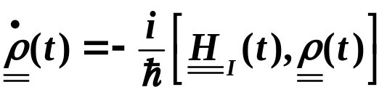
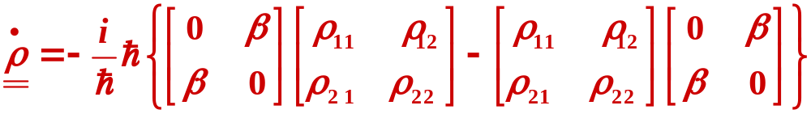
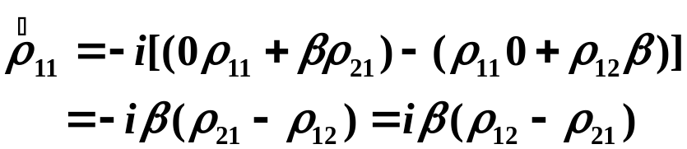
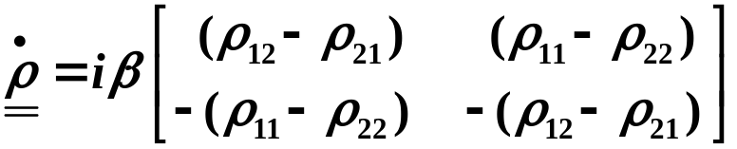
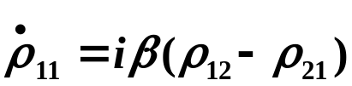
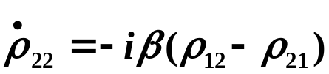
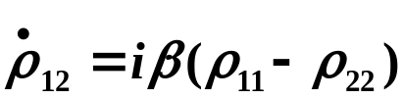
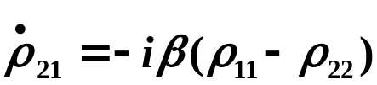
Use
Multiplying matrices and subtracting gives
Equations of motion of density matrix elements:
Probabilities
Coherences
Copyright – Michael D. Fayer, 2018
Notes:
13
13

Slide 14
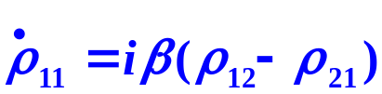
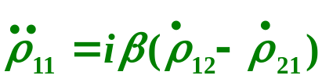
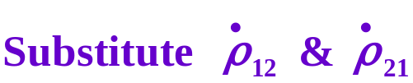
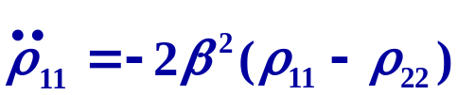

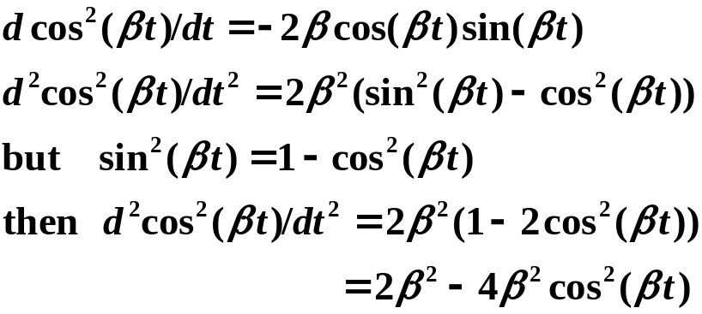

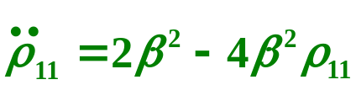


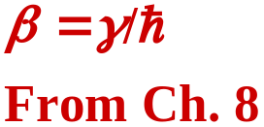

Using
Take time derivative
Using Tr ρ = 1, i.e.,
and
For initial condition at t = 0.
Same result as Chapter 8 except obtained probabilities directly.
No probability amplitudes.
Copyright – Michael D. Fayer, 2018
Notes:
14
14

Slide 15
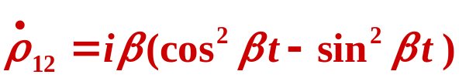
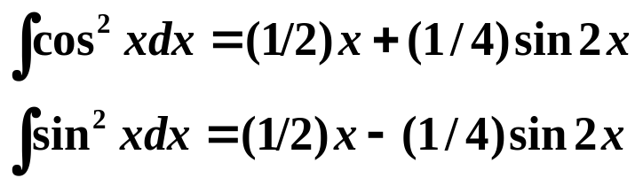

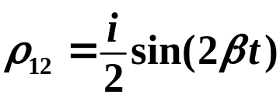

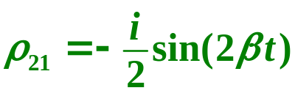
Can get off-diagonal elements
Substituting:
Copyright – Michael D. Fayer, 2018
Notes:
15
15

Slide 16
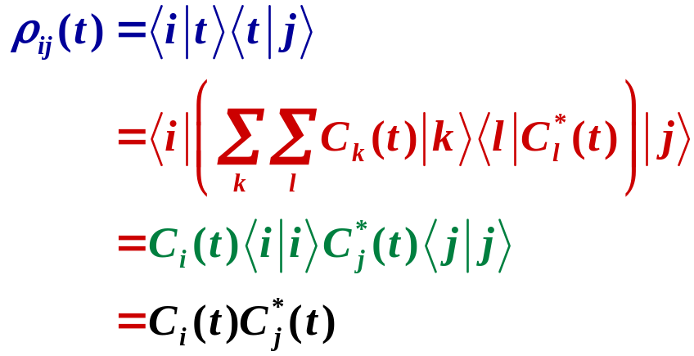

Density matrix elements have no time dependent phase factors.
time dependent phase factor in ket, but
its complex conjugate is in bra. Product
is 1. Kets and bras normalized, closed
bracket gives 1.
ij density matrix element
Time dependent coefficient, but no phase factors.
Copyright – Michael D. Fayer, 2018
Notes:
16
16

Slide 17
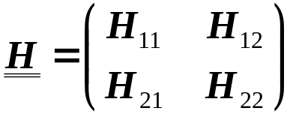


Can be time dependent phase factors in density matrix equation of motion.
For two levels, but the same in any dimension.
s – spatial
no time dependent phase
factor
time dependent phase factor
if E₁ ≠ E₂.
Therefore, in general, the commutator matrix,
when you multiply it out,
will have time dependent phase factors if E₁ ≠ E₂.
Copyright – Michael D. Fayer, 2018
Notes:
17
17

Slide 18







Expectation Value of an Operator
Matrix elements of A
Derivation in book and see lecture slides
Expectation value of A is trace of the product of density matrix with
the operator matrix .
Important: carries time dependence of coefficients.
Time dependent phase factors may occur in off-diagonal matrix elements of A.
Copyright – Michael D. Fayer, 2018
Notes:
18
18

Slide 19









Example: Average E for two state problem
E
E = 0
Time dependent phase factors cancel
because degenerate. Special case.
In general have time dependent phase factors.
Only need to calculate the
diagonal matrix elements.
Copyright – Michael D. Fayer, 2018
Notes:
19
19

Slide 20





Proof that only need consider
when working in basis set of eigenvectors of H₀.
Working with basis set of eigenkets of time independent piece of Hamiltonian,
H₀, the time dependence of the density matrix depends only on the time
dependent piece of the Hamiltonian, H_{I}.
Total Hamiltonian
time independent
Use
as basis set.
Copyright – Michael D. Fayer, 2018
Notes:
20
20
20

Slide 21





Time derivative of density operator (using chain rule)
(A)
Use Schrödinger Equation and its complex conjugate
(B)
Substitute expansion into derivative terms in eq. (A).
(C)
(B) = (C)
Copyright – Michael D. Fayer, 2018
Notes:
21
21
21

Slide 22








Using Schrödinger Equation
Right multiply top eq. by .
Left multiply bottom equation by .
Gives
Using these see that the 1st and 3rd terms
in (B) cancel the 2nd and 4th terms in (C).
(B)
(C)
Copyright – Michael D. Fayer, 2018
Notes:
22
22
22

Slide 23





After canceling terms, (B) = (C) becomes
Consider the ij matrix element of this expression.
The matrix elements of the left hand side are
In the basis set of the eigenvectors of H₀,
H₀ cancels out of equation of motion of density matrix.
Copyright – Michael D. Fayer, 2018
Notes:
23
23
23

Slide 24








Proof that
=
Expectation value
complete orthonormal basis set.
Matrix elements of A
Copyright – Michael D. Fayer, 2018
Notes:
24
24
24

Slide 25





note order
Then
Matrix multiplication, Chapter 13 (13.18)
like matrix multiplication but only diagonal elements –
j on both sides.
Also, double sum. Sum over j – sum diagonal elements.
Therefore,
Copyright – Michael D. Fayer, 2018
Notes:
25
25
25

Slide 26







Coherent Coupling by of Energy Levels by Radiation Field
Two state problem
radiation
field
NMR – 2 spin states, magnetic transition dipole
In general, if radiation field frequency is near ΔE, and other transitions
are far off resonance, can treat as a 2 state system.
Copyright – Michael D. Fayer, 2018
Notes:
26
26

Slide 27




Molecular Eigenstates as Basis
Interaction due to application of optical field (light) on or near resonance.
Copyright – Michael D. Fayer, 2018
Notes:
27
27
27

Slide 28









take out time dependent phase factors
μ is value of
transition dipole bracket,
Note – time independent
kets. No phase
factors. Have taken
phase factors out.
Take μ real (doesn’t change results)
Define Rabi Frequency, ω₁
Then
Copyright – Michael D. Fayer, 2018
Notes:
28
28
28

Slide 29





General state of system
Blue diagonal
Red off-diagonal
Copyright – Michael D. Fayer, 2018
Notes:
29
29
29

Slide 30








Equations of Motion of Density Matrix Elements
Treatment exact to this point (expect for dipole approx. in μ).
Copyright – Michael D. Fayer, 2018
Notes:
30
30
30

Slide 31



Rotating Wave Approximation
Put this into equations of motion
Will have terms like
Terms with off resonance → Don’t cause transitions
Looks like high frequency Stark Effect
→ Bloch – Siegert Shift
Small but sometimes measurable shift in energy.
Drop these terms!
Copyright – Michael D. Fayer, 2018
Notes:
31
31
31

Slide 32





With Rotating Wave Approximation
Equations of motion of density matrix
These are the
Optical Bloch Equations for optical transitions
or just the Bloch Equations for NMR.
H₁ – oscillating magnetic field of applied RF.
μ_{m} – magnetic transition dipole.
Copyright – Michael D. Fayer, 2018
Notes:
32
32
32

Slide 33




Consider on resonance case
ω = ω₀
Equations reduce to
All of the phase factors = 1.
These are IDENTICAL to the degenerate time dependent 2 state problem
with β = ω₁/2.
Copyright – Michael D. Fayer, 2018
Notes:
33
33
33

Slide 34








On resonance coupling to time dependent radiation field induces transitions.
Looks identical to time independent
coupling of two degenerate states.
In effect, the on resonance radiation
field “removes” energy differences and
time dependence of field.
at t = 0.
Then
populations
coherences
Copyright – Michael D. Fayer, 2018
Notes:
34
34
34

Slide 35



populations
Recall
This is called a π pulse → inversion, all population in excited state.
This is called a π/2 pulse → Maximizes off diagonal elements ρ₁₂, ρ₂₁
As t is increased, population
oscillates between ground
and excited state at Rabi frequency.
π pulse
Transient Nutation
Coherent Coupling
ρ₂₂ – excited state prob.
t
2π pulse
Copyright – Michael D. Fayer, 2018
Notes:
35
35
35

Slide 36







Off Resonance Coherent Coupling
Amount radiation field frequency is off resonance from transition frequency.
Define
ω₁ = μE₀ - Rabi frequency
For same initial conditions:
Solutions of Optical Bloch Equations
Oscillations Faster → ω_{e}
Max excited state probability:
(Like non-degenerate time dependent 2-state problem)
Copyright – Michael D. Fayer, 2018
Notes:
36
36
36

Slide 37





Near Resonance Case - Important
Then
ρ₁₁, ρ₂₂ reduce to on resonance case.
Same as resonance case
except for phase factor
For π/2 pulse, maximizes ρ₁₂, ρ₂₁
ω₁t = π /2
But
Δω t << π/2 ≅ 0
because
Then, ρ₁₂, ρ₂₁ virtually identical to on resonance case and
ρ₁₁, ρ₂₂ same as on resonance case.
This is the basis of Fourier Transform NMR. Although spins have
different chemical shifts, make ω₁ big enough, all look like on resonance.
Copyright – Michael D. Fayer, 2018
Notes:
37
37
37

Slide 38






Free Precession
After pulse of
θ = ω₁t (flip angle)
On or near resonance immediately after the pulse (t = 0)
After pulse – no radiation field.
Hamiltonian is H₀
Copyright – Michael D. Fayer, 2018
Notes:
38
38
38

Slide 39







t = 0 is at end of pulse
Solutions
ρ₁₁ = a constant = ρ₁₁(0)
ρ₂₂ = a constant = ρ₂₂(0)
Populations don’t change.
Off-diagonal density matrix elements
→ Only time dependent phase factor
Copyright – Michael D. Fayer, 2018
Notes:
39
39
39

Slide 40






Off-diagonal density matrix elements after pulse ends (t = 0).
Consider expectation value of transition dipole .
No time dependent phase factors.
Phase factors were taken out of μ as part
of the derivation. Matrix elements
involve time independent kets.
t = 0, end of pulse
Copyright – Michael D. Fayer, 2018
Notes:
40
40
40

Slide 41




After pulse of
θ = ω₁t (flip angle)
On or near resonance
Copyright – Michael D. Fayer, 2018
Notes:
41
41
41

Slide 42
Oscillating electric dipole (magnetic dipole - NMR)
at frequency ω₀, → Oscillating E-field (magnet field)
Free precession.
Rot. wave approx.
Tip of vector goes in circle.
Copyright – Michael D. Fayer, 2018
Notes:
42
42
42

Slide 43



Pure and Mixed Density Matrix
Up to this point - pure density matrix.
One system or many identical systems.
Mixed density matrix ➔
Describes nature of a collection of sub-ensembles each with different properties.
The subensembles are not interacting.
P_{k} → probability of having k_{th} sub-ensemble with density matrix, ρ_{k}.
and
Sum of probabilities (or integral) is unity.
Density matrix for mixed systems
or integral if continuous distribution
Total density matrix is
the sum of the individual density matrices times their probabilities.
Because density matrix is at probability level, can sum (see Errata and Addenda).
Copyright – Michael D. Fayer, 2018
Notes:
43
43
43

Slide 44




Example: Light coupled to two different transitions – free precession
Light frequency ω near
ω₀₁ & ω₀₂.
Difference of both ω₀₁ & ω₀₂ from ω small compared to ω₁,
that is, both near resonance.
Equal probabilities → P₁=0.5 and P₂=0.5
For a given pulse of radiation field,
both sub-ensembles will have same flip angle θ.
Calculate
Copyright – Michael D. Fayer, 2018
Notes:
44
44
44

Slide 45




Pure density matrix result for flip angle θ:
For 2 transitions - P₁=0.5 and P₂=0.5
from trig.
identities
Call: center frequency ➔ ω₀, shift from the center ➔ δ
then, ω₀₁ = ω₀ + δ and ω₀₂ = ω₀ - δ ,
with δ << ω₀
Therefore,
high freq. oscillation low freq. oscillation, beat
Beat gives transition frequencies – FT-NMR
Copyright – Michael D. Fayer, 2018
Notes:
45
45
45

Slide 46

Equal amplitudes – 100% modulation, ω₀₁ = 20.5; ω₀₁ = 19.5
Copyright – Michael D. Fayer, 2018
Notes:
46
46
46

Slide 47

Amplitudes 2:1 – not 100% modulation , ω₀₁ = 20.5; ω₀₁ = 19.5
Copyright – Michael D. Fayer, 2018
Notes:
47
47
47

Slide 48

Amplitudes 9:1 – not 100% modulation , ω₀₁ = 20.5; ω₀₁ = 19.5
Copyright – Michael D. Fayer, 2018
Notes:
48
48
48

Slide 49

Equal amplitudes – 100% modulation, ω₀₁ = 21; ω₀₁ = 19
Copyright – Michael D. Fayer, 2018
Notes:
49
49
49

Slide 50



Free Induction Decay
center freq
ω₀
Identical molecules have
range of transition frequencies.
Different solvent environments.
Doppler shifts, etc.
ω_{h} → frequency
of particular molecule
Gaussian envelope
ω →
Frequently, distribution is a Gaussian -
probability of finding a molecule at a particular frequency, P_{h}.
standard deviation
normalization
constant
Then
pure density matrix
probability, P_{h}
Copyright – Michael D. Fayer, 2018
Notes:
50
50
50

Slide 51



Radiation field at ω = ω₀ line center
ω₁ >> σ – all transitions near resonance
Apply pulse with flip angle θ
, transition dipole expectation value.
Following pulse, each sub-ensemble will undergo free precession at ω_{h}
Using result for single frequency ω_{h} and flip angle θ
Copyright – Michael D. Fayer, 2018
Notes:
51
51
51

Slide 52


Substituting δ = (ω_{h} – ω₀),
frequency of a molecule as difference from center frequency (light frequency).
Then ω_{h} = (δ +ω₀) and dω_{h} = dδ.
With the trig identity:
First integral zero; integral of an even function multiplying an odd function.
Oscillation at ω₀; decaying amplitude →
Gaussian decay with standard deviation in time → 1/σ (Free Induction Decay)
Phase relationships lost → Coherent Emission Decays
Off-diagonal density matrix elements – coherence; diagonal - magnitude
Copyright – Michael D. Fayer, 2018
Notes:
52
52
52

Slide 53



flip angle light frequency free induction decay
Decay of oscillating macroscopic dipole.
Free induction decay.
Coherent emission
of light.
t = 0
t = t'
higher frequencies
rotating frame at
center freq., ω₀
lower frequencies
Copyright – Michael D. Fayer, 2018
Notes:
53
53
53

