Slide 1
Chapter 15

Slide 2
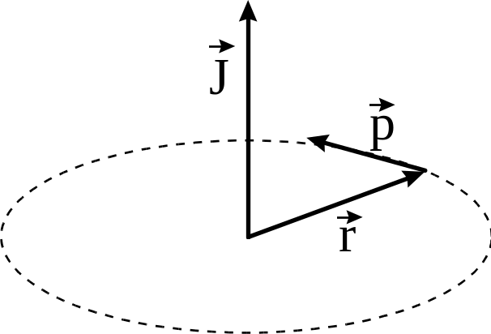

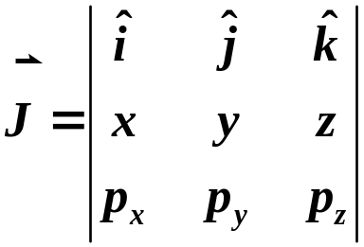
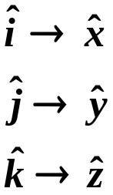




Angular Momentum
Classical
radius vector
from origin
linear
momentum
determinant form of cross product
Copyright – Michael D. Fayer, 2018
Notes:
2
2

Slide 3
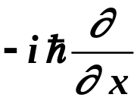
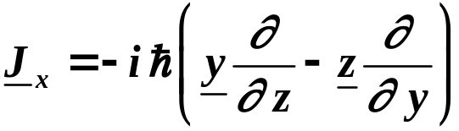
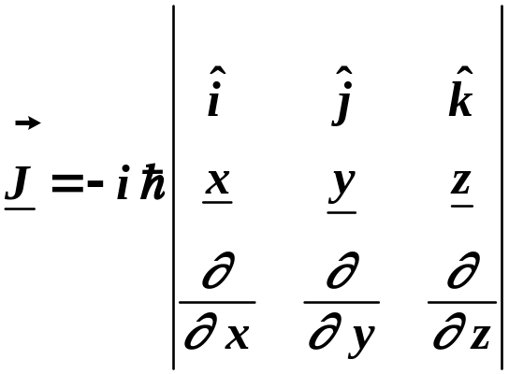
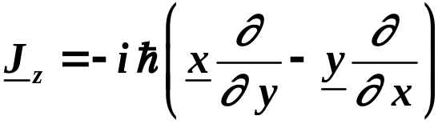
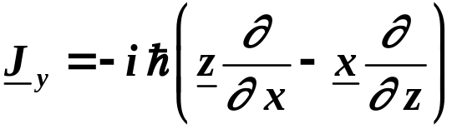

Q.M. Angular Momentum
In the Schrödinger Representation, use Q.M. operators for x and p, etc.
P _{x}=
x = x
Substituting
Copyright – Michael D. Fayer, 2018
Notes:
3
3

Slide 4

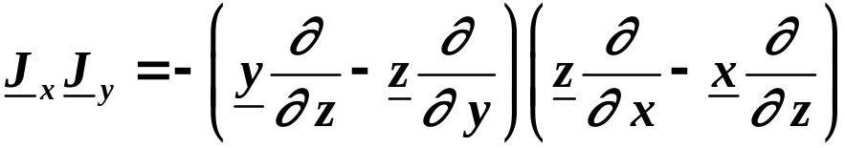
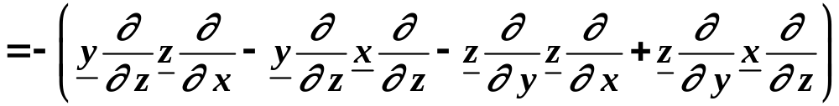
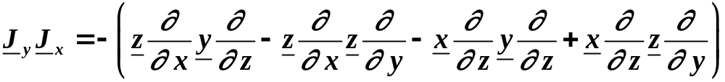
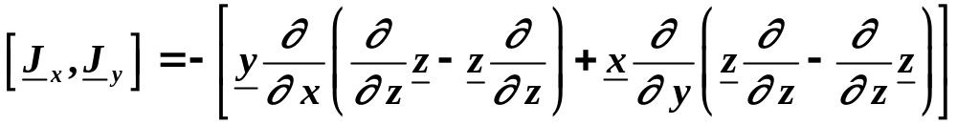
Commutators
Consider
substituting operators in units of 
Keep track of what
commutes.
Similarly
Subtracting
Copyright – Michael D. Fayer, 2018
Notes:
4
4

Slide 5
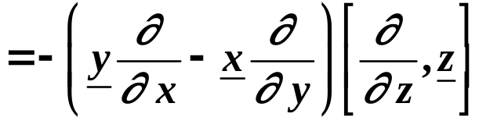
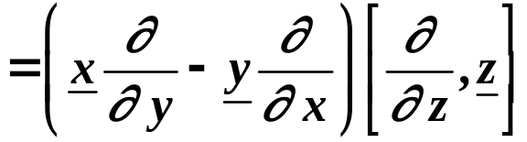
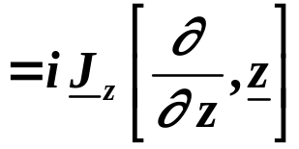
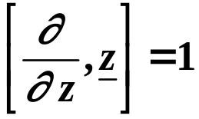
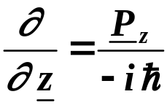
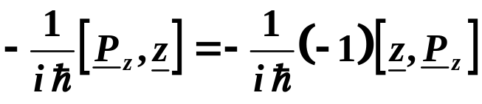

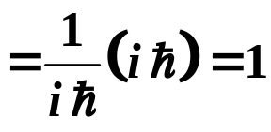


But
because
Using
Therefore,
in conventional units
Copyright – Michael D. Fayer, 2018
Notes:
5
5

Slide 6


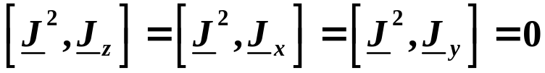
The commutators in units of  are
Using these it is found that
Components of angular momentum do not commute.
J² commutes with all components.
Copyright – Michael D. Fayer, 2018
Notes:
6
6

Slide 7

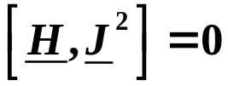
Therefore,
J² and one component of angular momentum
can be measured simultaneously.
Call this component J_{z}.
Therefore,
J² and J_{z} matrices can be simultaneously diagonalized
by the same unitary transformation.
Furthermore,
(J looks like rotation)
Therefore,
H, J², J_{z} are all simultaneous observables.
Copyright – Michael D. Fayer, 2018
Notes:
7
7

Slide 8





Diagonalization of J² and J_{z}
J² and J_{z} commute.
Therefore, set of vectors
Labeling kets with eigenvalues.
are eigenvectors of both operators.
and
are simultaneously diagonal in the basis
(in units of )
Copyright – Michael D. Fayer, 2018
Notes:
8
8

Slide 9









Form operators
From the definitions of and and the angular momentum commutators,
the following commutators and identities can be derived.
Commutators
Identities
Copyright – Michael D. Fayer, 2018
Notes:
9
9

Slide 10




Expectation value
Because
Positive numbers because J’s are Hermitian –
give real numbers. Square of real numbers – positive.
Therefore,
the sum of three positive numbers is greater than or equal to one of them.
Now
Therefore,
Eigenvalues of J² are greater than or equal to
square of eigenvalues of J_{z}.
Copyright – Michael D. Fayer, 2018
Notes:
10
10

Slide 11




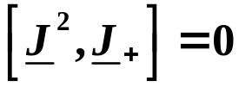


Using
Consider
eigenvalue eigenvector
Furthermore,
J² commutes with J₊ because it commutes with J_{x} and J_{y}.
Then
eigenvalue eigenvector
Copyright – Michael D. Fayer, 2018
Notes:
11
11

Slide 12



eigenvalue eigenvector
eigenvalue eigenvector
Thus,
is eigenvector of J_{z} with eigenvalue m + 1
and of J² with eigenvalue λ.
J₊ is a raising operator.
It increases m by 1
and leaves λ unchanged.
Copyright – Michael D. Fayer, 2018
Notes:
12
12

Slide 13



Repeated applications of
to
gives new eigenvectors of J_{z} (and J²) with larger and larger
values of m.
But,
this must stop at a largest value of m, m_{max}
because
(m increases, λ doesn’t change)
Call largest value of m (m_{max}) j.
m_{max} = j
For this value of m, that is, m = j
with
Can’t raise past max value.
Copyright – Michael D. Fayer, 2018
Notes:
13
13

Slide 14





In similar manner can prove
is an eigenvector of with eigenvalues m – 1
and of J² with eigenvalues λ.
Therefore,
is a lowering operator.
It reduces the value of m by 1 and leaves λ unchanged.
Operating repeatedly on
largest value of m
gives eigenvectors with sequence of m eigenvalues
Copyright – Michael D. Fayer, 2018
Notes:
14
14

Slide 15




But,
Therefore, can’t lower indefinitely.
Must be some
such that
with
Smallest value of m.
Can’t lower below smallest value.
Thus,
j = j' + an integer.
Went from largest value to smallest
value in unit steps.
largest value
of m
smallest value
of m
Copyright – Michael D. Fayer, 2018
Notes:
15
15

Slide 16




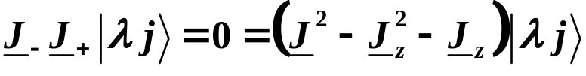
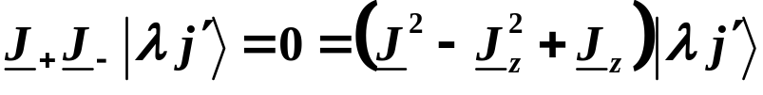


We have
largest value of m
smallest value of m
Left multiplying top equation by and bottom equation by
identities
Then
and operating
Copyright – Michael D. Fayer, 2018
Notes:
16
16

Slide 17






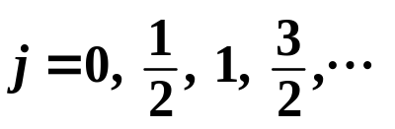

Because and
the coefficients of the kets must equal 0.
Therefore,
and
Because j > j'
and
2j = an integer j = integer/2; j can have integer
or half integer values.
because we go from j to j' = -j in unit steps with lowering operator .
Thus, the eigenvalues of J² are
and
(largest m for a λ)
The eigenvalues of J_{z} are
largest m change by unit steps smallest value of m
Copyright – Michael D. Fayer, 2018
Notes:
17
17

Slide 18




Final results
There are (2j + 1) m-states for a given j, going from j to –j in integer steps.
Can derive
Copyright – Michael D. Fayer, 2018
Notes:
18
18

Slide 19

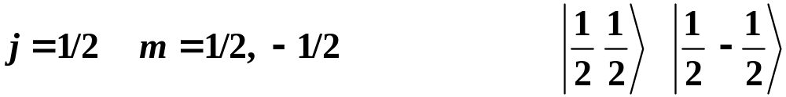
Angular momentum states can be grouped by the value of j.
Eigenvalues of J², λ = j(j + 1).
etc.
Copyright – Michael D. Fayer, 2018
Notes:
19
19

Slide 20




Eigenvalues of are the square of the total angular momentum.
The length of the angular momentum vector is
or in conventional units
Example
j = 1
z
Eigenvalues of J_{z} are the
projections of the angular
momentum on the z axis.
m = 1
m = 0
m = -1
Copyright – Michael D. Fayer, 2018
Notes:
20
20

Slide 21


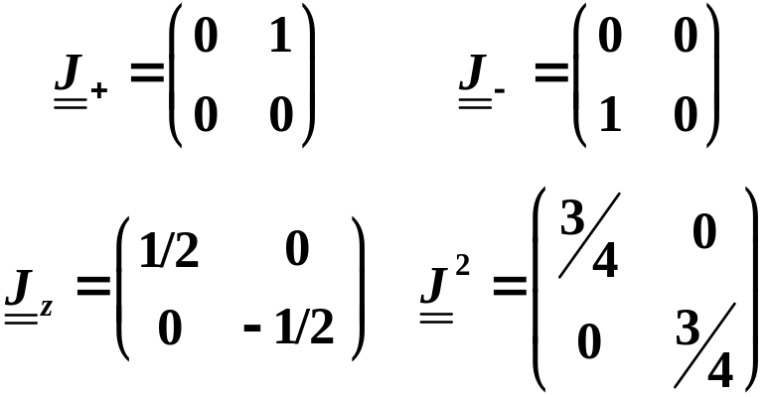
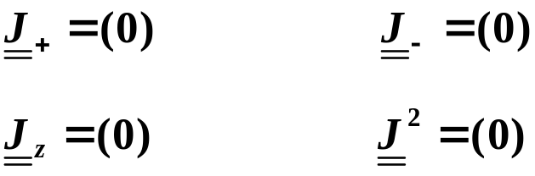
The matrix elements of are
The matrices for the first few values of j are (in units of  )
j = 0
j = 1/2
Copyright – Michael D. Fayer, 2018
Notes:
21
21

Slide 22
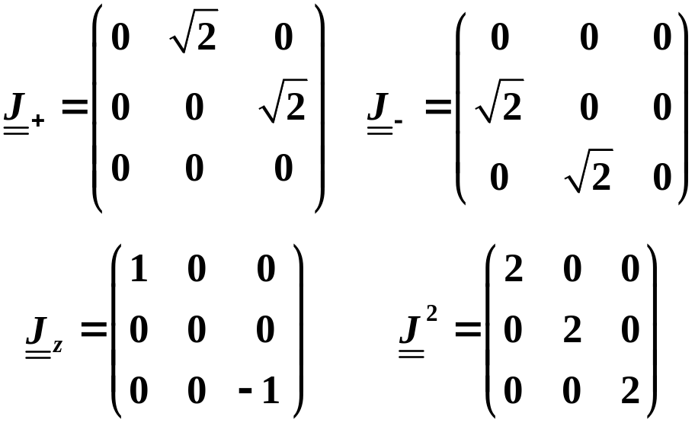

j = 1
The are eigenkets of the and operators – diagonal matrices.
The raising and lowering operators and have matrix elements
one step above and one step below the principal diagonal, respectively.
Copyright – Michael D. Fayer, 2018
Notes:
22
22

Slide 23



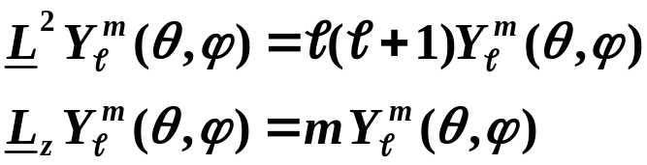
Particles such as atoms
spherical harmonics from solution of H atom
The are the eigenvectors of the operators
L² and L_{z}.
The
Copyright – Michael D. Fayer, 2018
Notes:
23
23

Slide 24
Addition of Angular Momentum
Examples
Orbital and spin angular momentum -  and s.
These are really coupled – spin-orbit coupling.
ESR – electron spins coupled to nuclear spins
Inorganic spectroscopy – unpaired d electrons
Molecular excited triplet states – two unpaired electrons
Could consider separate angular momentum vectors
j₁ and j₂.
These are distinct.
But will see, that when they are coupled, want to combine
the angular momentum vectors into one resultant vector.
Copyright – Michael D. Fayer, 2018
Notes:
24
24

Slide 25
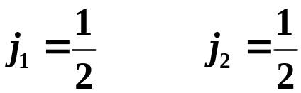
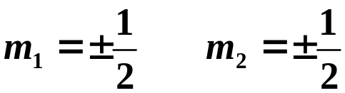

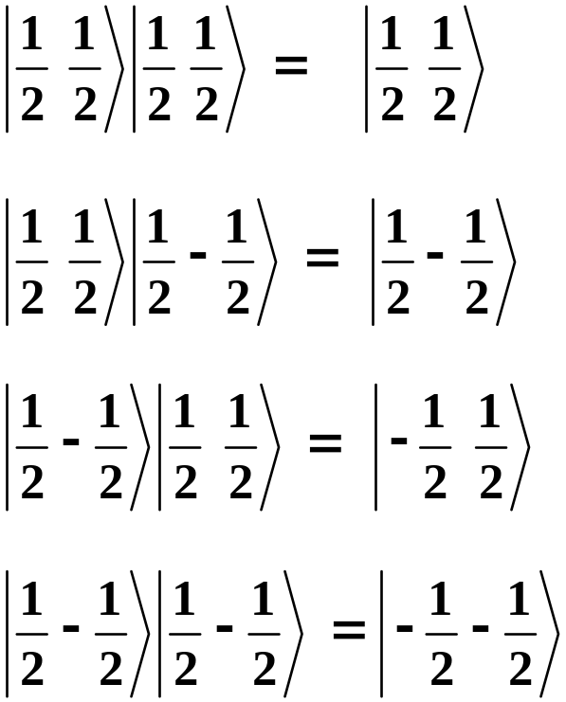
Specific Case
Four product states
j₁ and j₂ omitted because
they are always the same.
Called the m₁m₂ representation
The two angular momenta are
considered separately.
Copyright – Michael D. Fayer, 2018
Notes:
25
25

Slide 26




m₁m₂ representation
Want different representation Unitary Transformation to
coupled rep.
Angular momentum vectors added.
New States labeled
jm representation
Copyright – Michael D. Fayer, 2018
Notes:
26
26

Slide 27




Eigenkets of operators in jm representation.
and
where
vector sum of j₁ and j₂
Want unitary transformation from the m₁m₂ representation
to the jm representation.
Copyright – Michael D. Fayer, 2018
Notes:
27
27

Slide 28
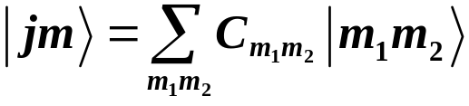



Want
are the Clebsch-Gordan coefficients; Wigner coefficients;
vector coupling coefficients
are the basis vectors
N states in the m₁m₂ representation N states in the jm representation.
J² and J_{z} obey the normal commutator relations.
Prove by using
and cranking through commutator relations
using the fact that J₁ and J₂ and their components commute.
Operators operating on different state spaces commute.
Copyright – Michael D. Fayer, 2018
Notes:
28
28

Slide 29

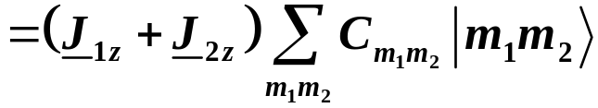
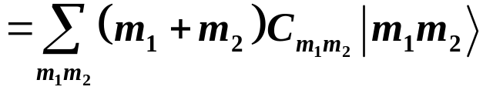
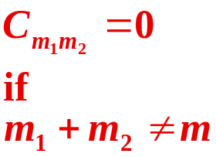
Finding the transformation
or coupling coefficient vanishes.
To see this consider
Operate with J_{z}
equal
These must be equal.
Other terms
Copyright – Michael D. Fayer, 2018
Notes:
29
29

Slide 30




Largest value of m
since largest
and
Then the largest value of j is
because the largest value of j equals the largest value of m.
There is only one state with the largest
j and m.
There are a total of (2j + 1) m states associated with the largest .
Copyright – Michael D. Fayer, 2018
Notes:
30
30

Slide 31





Next largest m (m – 1)
But
Two ways to get m - 1
Can form two orthogonal and normalized combinations.
One of the combinations belongs to
Because this value of j has m values
Other combination with
with
largest
smallest
Copyright – Michael D. Fayer, 2018
Notes:
31
31

Slide 32
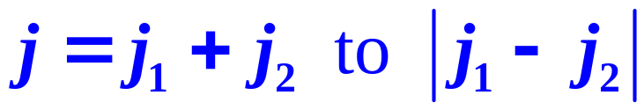
Doing this repeatedly
j values from
in unit steps
Each j has associated with it,
its 2j + 1 m values.
Copyright – Michael D. Fayer, 2018
Notes:
32
32

Slide 33
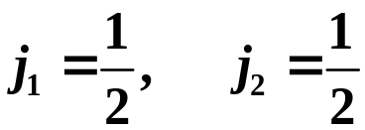
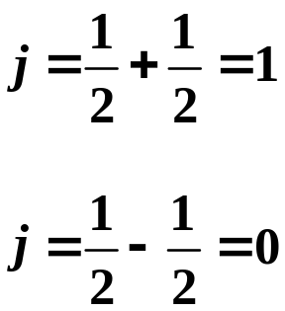
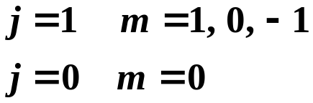

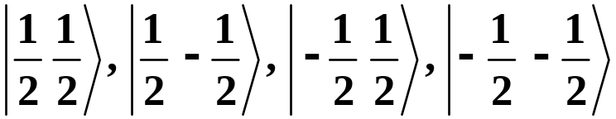
Example
j values
in unit steps.
jm rep. kets
m₁m₂ rep. kets
Know jm kets still need correct combo’s of m₁m₂ rep. kets
Copyright – Michael D. Fayer, 2018
Notes:
33
33

Slide 34



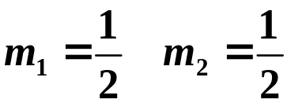

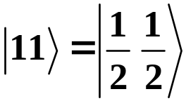
Generating procedure
Start with the jm ket with the largest value of j and the largest value of m.
m = 1
But
Therefore,
because this is the only way to get
Then
jm m₁m₂
Clebsch-Gordan coefficient = 1
Copyright – Michael D. Fayer, 2018
Notes:
34
34

Slide 35


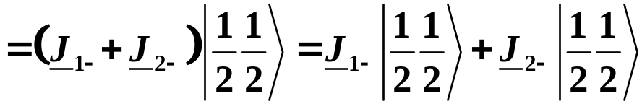
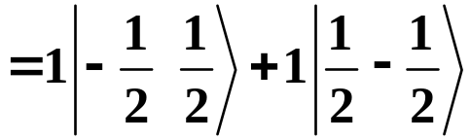
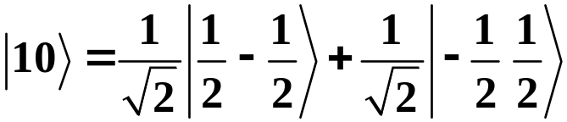
Use lowering operators
jm m₁m₂
jm m₁m₂
from
lowering
op. expression
Then
from
lowering
op. expression
(Use correct j_{i} and m_{i} values.)
Clebsch-Gordan Coefficients
Copyright – Michael D. Fayer, 2018
Notes:
35
35

Slide 36






Plug into raising and lowering op. formulas correctly.
For jm rep.
plug in j and m.
For m₁m₂ rep.
For must put in
when operating with
and
when operating with
Copyright – Michael D. Fayer, 2018
Notes:
36
36

Slide 37

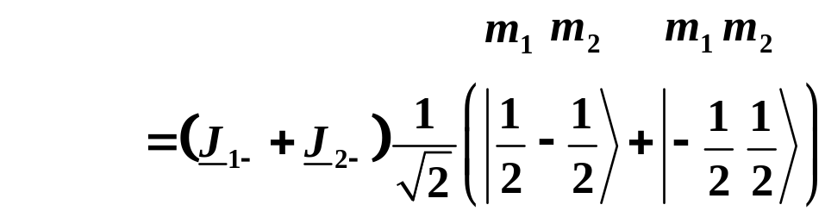
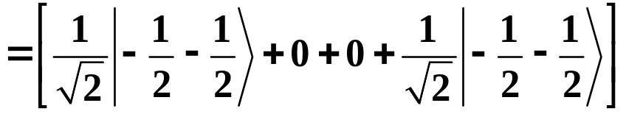
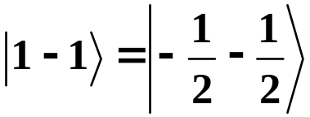

Lowering again
Therefore,
jm m₁m₂
Have found the three m states for j = 1 in terms of the m₁m₂ states.
Still need
Copyright – Michael D. Fayer, 2018
Notes:
37
37

Slide 38







Need jm
Two m₁m₂ kets with
The is a superposition of these.
Have already used one superposition of these to form
orthogonal to and normalized. Find combination of
normalized and orthogonal to .
Clebsch-Gordan Coefficients
Copyright – Michael D. Fayer, 2018
Notes:
38
38

Slide 39


Table of Clebsch-Gordan Coefficients
j
=1/2
1
1
0
1
j
1
j
=1/2
1
0
0
−
1
m
2
1
1
1
2
2
1
−
1
2
2
−
1
1
2
2
−
1
−
1
1
2
2
m
m
1
2
Copyright – Michael D. Fayer, 2018
Notes:
39
39

Slide 40





Next largest system
m₁m₂ kets
jm states
jm kets
Copyright – Michael D. Fayer, 2018
Notes:
40
40

Slide 41





Table of Clebsch-Gordan Coefficients
3
3
1
3
1
3
j
j
= 1
2
2
2
2
2
2
1
j
2
= 1/2
3
1
1
−
1
−
1
−
3
m
2
2
2
2
2
2
1
1
1
2
1
−
1
2
0
1
2
−
1
0
2
−
1
1
2
−
1
−
1
1
2
m
m
1
2
Example
Copyright – Michael D. Fayer, 2018
Notes:
41
41

