Slide 1
Chapter 16

Slide 2
Electron Spin
Electron spin hypothesis
Solution to H atom problem gave three quantum numbers, n, , m.
These apply to all atoms.
Experiments show not complete description. Something missing.
Alkali metals show splitting of spectral lines in absence of magnetic field.
s lines not split
p, d lines split
Na D-line (orange light emitted by excited Na) split by 17 cm⁻¹
Many experiments not explained without electron "spin."
Stern-Gerlach experiment early, dramatic example.
Copyright – Michael D. Fayer, 2018
Notes:
2
2
2

Slide 3
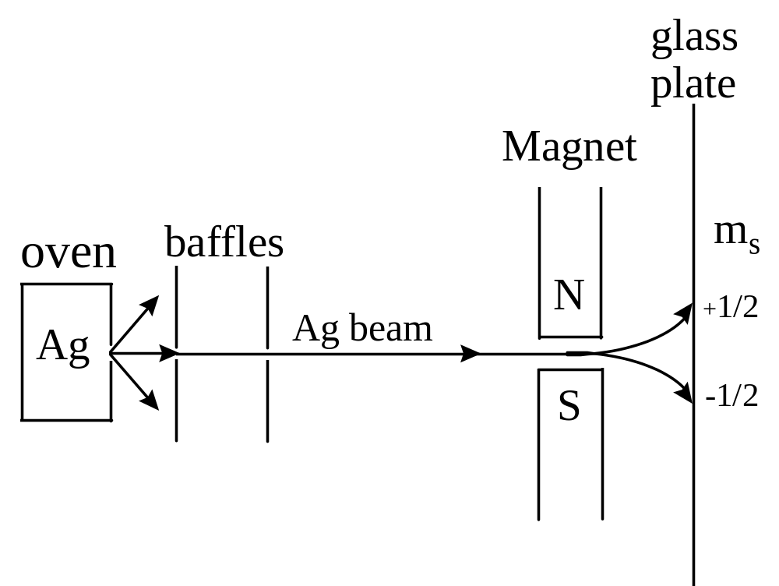
Stern-Gerlach experiment - 1922
Beam of silver atoms deflected by magnetic field gradient.
Single unpaired electron - should not give two lines on glass plate.
s-orbital. No orbital angular momentum. No magnetic moment.
Observed deflection corresponds to one Bohr magneton.
Copyright – Michael D. Fayer, 2018
Notes:
3
3
3

Slide 4
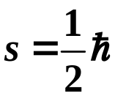
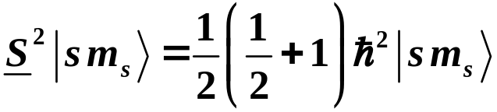
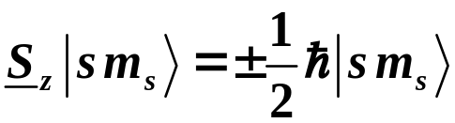

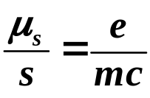
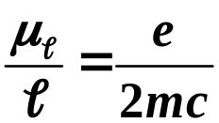
Assume: Electron has intrinsic angular momentum called "spin."
square of
angular
momentum
operator
projection of
angular
momentum on
z-axis
Electron has magnetic moment.
One Bohr magneton.
Charged particle with angular mom.
Ratio twice the ratio for
orbital angular momentum.
Copyright – Michael D. Fayer, 2018
Notes:
4
4
4

Slide 5


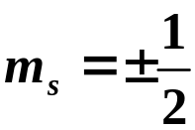

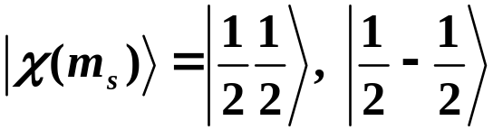
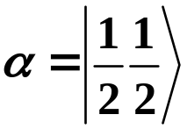
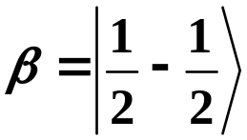
Electronic wavefunction with spin
with spin
spin angular momentum kets
Copyright – Michael D. Fayer, 2018
Notes:
5
5
5

Slide 6




Electronic States in a Central Field
Electron in state of orbital angular momentum 
label as orbital angular momentum
quantum number
m_{s}
spin angular momentum quantum number
product space of angular momentum (orbital and spin) eigenvectors
Copyright – Michael D. Fayer, 2018
Notes:
6
6
6

Slide 7




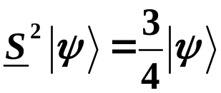


Simultaneous eigenvectors of
constant - eigenvalues of S² are s(s + 1), s = 1/2
linearly independent functions of form .
Copyright – Michael D. Fayer, 2018
Notes:
7
7
7

Slide 8




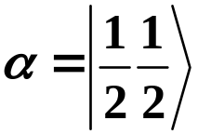
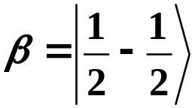


Example - p states of an electron
Orbital functions
● = 1
radial spherical harmonics
orbital angular momentum part
j₁m₁
j₁m₁
j₁m₁
spin functions
j₂m₂
j₂m₂
Copyright – Michael D. Fayer, 2018
Notes:
8
8
8

Slide 9
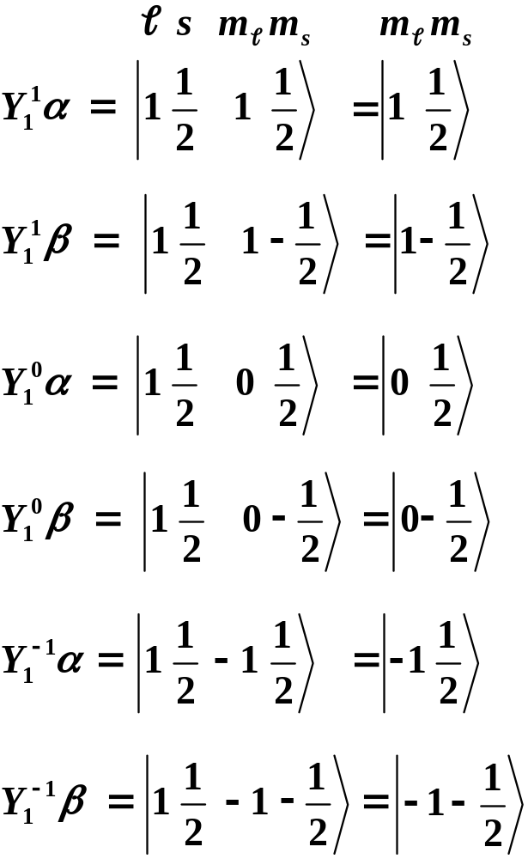

In the m₁m₂ representation
Each of these is multiplied by R(r).
Copyright – Michael D. Fayer, 2018
Notes:
9
9
9

Slide 10
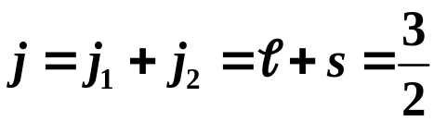
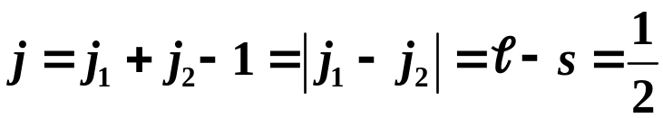
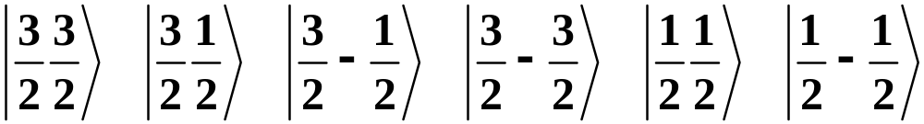
Total angular momentum - jm representation
Two states of total angular momentum
The jm kets are
Copyright – Michael D. Fayer, 2018
Notes:
10
10
10

Slide 11
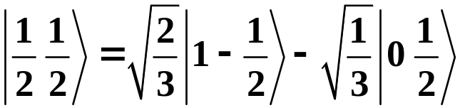
The jm kets can be obtained from the m₁m₂ kets using the
table of Clebsch-Gordon coefficients.
For example
jm
m₁m₂
m₁m₂
Table of Clebsch-Gordon
Coefficients
3
3
1
3
1
3
j
j
= 1
2
2
2
2
2
2
1
j
2
= 1/2
3
1
1
−
1
−
1
−
3
m
2
2
2
2
2
2
1
1
1
2
1
−
1
1
2
2
3
3
0
1
2
−
1
2
3
3
0
−
1
2
1
2
3
3
−
1
1
1
−
2
2
3
3
−
1
−
1
1
2
m
m
1
2
Copyright – Michael D. Fayer, 2018
Notes:
11
11
11

Slide 12




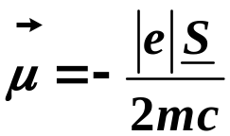
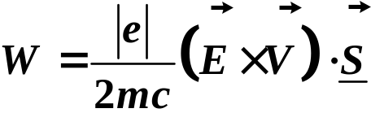
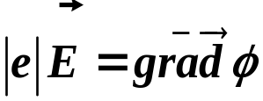

Spin-orbit Coupling
An electron, with magnetic moment moves in the electric field
of rest of atom (or molecule).
classical energy of magnetic dipole
moving in electric field with velocity
energy
spin magnetic moment of electron
Then
Using
Coulomb potential (usually called V, but V is velocity)
and
Copyright – Michael D. Fayer, 2018
Notes:
12
12
12

Slide 13
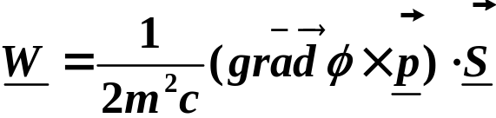
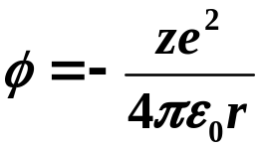
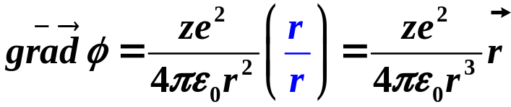
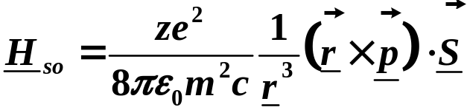


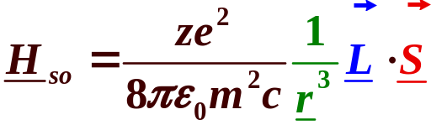
Hydrogen like atoms
Coulomb potential
unit vector
vector derivative of potential
Substituting
orbital angular momentum
operates on
spin ang. mom.
part of wavefunction
operates on
radial part of
wavefunction
operates on
orbital ang. mom.
part of wavefunction
Copyright – Michael D. Fayer, 2018
Notes:
13
13
13

Slide 14

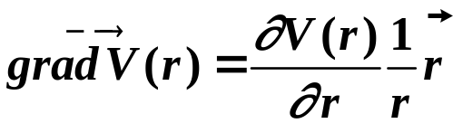
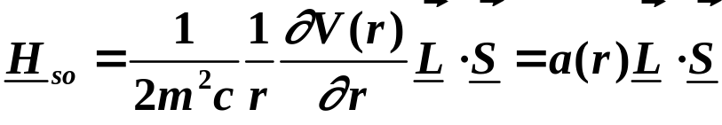
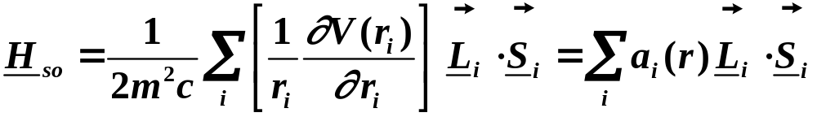

One unpaired electron – central field
(Sodium outer electron)
result of operating on
radial part of wavefunction
Many electron system
Ignore terms involving, , the orbital angular momentum of one electron
with the spin of another electron. Extremely small.
Copyright – Michael D. Fayer, 2018
Notes:
14
14
14

Slide 15

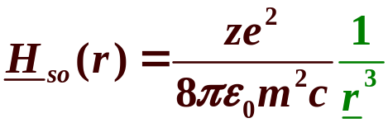
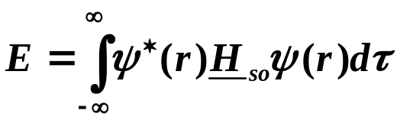



Spin-orbit coupling piece of Hamiltonian
H-like atom – spatial part of operator
Normalization constant (eq.7.63) contains
heavy atom effect
similar for all atoms
and molecules
H – little S.O. coupling
Br – sizable S.O. coupling
Heavy atom effect and external heavy
atom effect important in many processes.
Copyright – Michael D. Fayer, 2018
Notes:
15
15
15

Slide 16


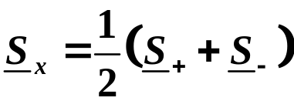
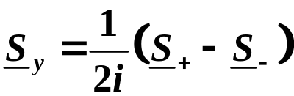
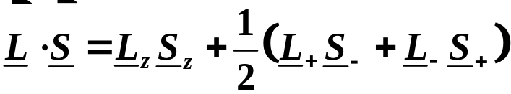
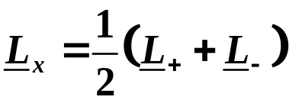
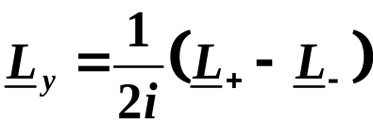
The a(r) part is independent of the angular momentum states.
Consider
Rearranging the expressions for the angular momentum
raising and lowering operators
Substituting
diagonal off-diagonal
Copyright – Michael D. Fayer, 2018
Notes:
16
16
16

Slide 17
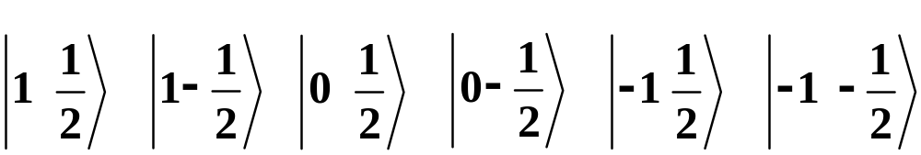

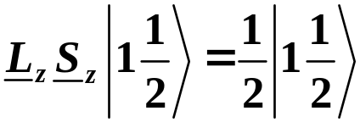
Spin-Orbit Coupling in the m₁m₂ representation
not diagonal in the m₁m₂ representation
States in the m₁m₂ representation
The spin-orbit coupling Hamiltonian matrix in the m₁m₂ representation
is a 6 × 6.
Calculating the matrix elements
Kets are diagonal for the piece of the Hamiltonian. For example
L_{z} brings out m and S_{z} brings out m_{s} .
mm_{s}
mm_{s}
Copyright – Michael D. Fayer, 2018
Notes:
17
17
17

Slide 18
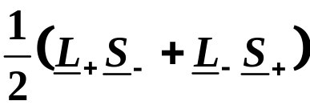
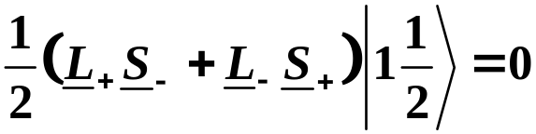
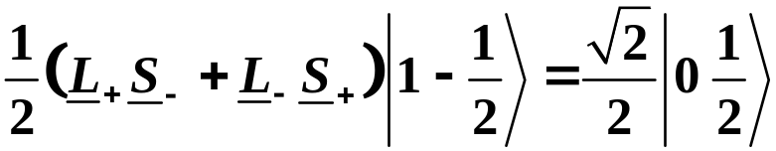
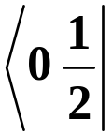
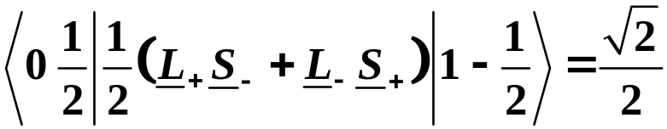
not diagonal
Apply to the six kets.
Examples
can’t raise above largest values
Left multiply by
matrix element
Copyright – Michael D. Fayer, 2018
Notes:
18
18
18

Slide 19
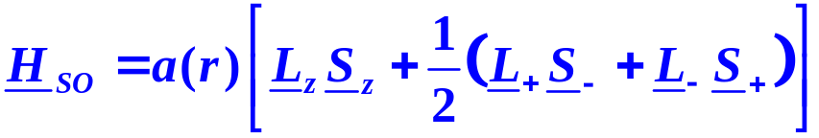
put kets along top
1
1
1
−
1
0
1
−
1
−
1
1
−
1
−
1
2
2
2
0
2
2
2
1
1
1
2
2
1
−
1
1
−
2
2
2
2
0
1
2
2
2
0
H
so
= a(r)
1
0
−
2
0
2
2
1
−
1
−
1
2
2
2
2
−
1
1
−
1
2
2
put bras down left side
example
Matrix is block diagonal.
Copyright – Michael D. Fayer, 2018
Notes:
19
19
19

Slide 20
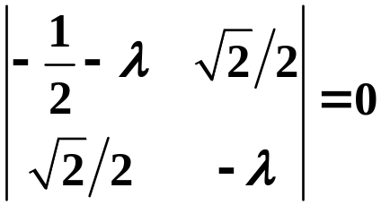
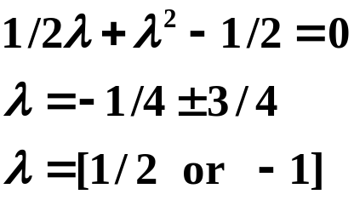
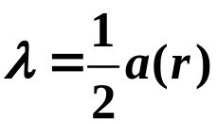

Matrix – Block Diagonal
Each block is independent. Diagonalize separately.
Form determinant from block with λ (eigenvalue) subtracted from
diagonal elements.
The two blocks are the same. Only need
to solve one of them.
The two 1×1 blocks
are diagonal – eigenvalues.
Expand the determinant. Solve for λ. Each block multiplied by a(r).
The two 2×2 blocks each give these results.
The two 1×1 blocks each give 1/2a(r).
Therefore,
4 eigenvalues of 1/2a(r).
2 eigenvalues of -1a(r).
Copyright – Michael D. Fayer, 2018
Notes:
20
20
20

Slide 21
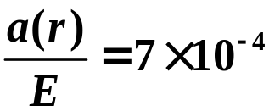
Energy level diagram
0.5a(r)
←
four-fold degenerate
fluorescence
0
no spin-orbit coupling
E = 16,980 cm⁻¹
3p
E
-1a(r)
←
two-fold degenerate
Na D-line (3p to 3s transition) split by 17 cm⁻¹.
17 cm⁻¹ = 3/2 a(r).
a(r) = 11.3 cm⁻¹.
3s
Ratio
Ratio small, but need spin-orbit coupling
to explain line splitting.
Copyright – Michael D. Fayer, 2018
Notes:
21
21
21

Slide 22

Spin-orbit Coupling in the jm representation
The jm kets are
However
is in the m₁m₂ representation.
Can’t operate H_{SO} directly on the jm kets.
Use table of Clebsch-Gordan coefficient to take jm kets into m₁m₂ rep.,
operate, then convert back to jm rep. (Done in this manner in book.)
Alternatively, rewrite operator so it can operate on the jm kets.
Copyright – Michael D. Fayer, 2018
Notes:
22
22
22

Slide 23
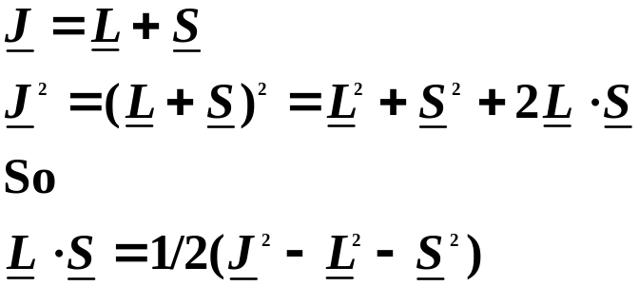




We need the operator, , which is an m₁m₂, in the jm
Recall that a jm ket, , is an abbreviation for .
So for the spin-orbit coupling problem, the jm ket is
l is an eigenket of the L² operator.
s is an eigenket of the S² operator.
and
J is an eigenket of the J² operator.
Therefore, the jm kets are eigenkets of the operator.
Copyright – Michael D. Fayer, 2018

Slide 24
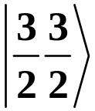



Operate on
Therefore,
is an eigenket of with eigenvalue 1/2a(r)
Copyright – Michael D. Fayer, 2018
Notes:
24
24
24

Slide 25



The jm kets are
Since
does not operate on the m of the jm kets, , all of the kets with
J = 3/2 give the same eigenvalue, 1/2a(r).
Then operating on
Copyright – Michael D. Fayer, 2018

Slide 26




Applying H_{SO} to all jm kets
Eigenkets
The jm representation kets are the eigenkets because H_{SO} couples the
orbital and spin angular momenta.
Coupled representation eigenkets.
The jm kets
eigenvalues - +0.5a(r)
eigenvalues - -1.0a(r)
+0.5a(r)
Na - 3p
unpaired
electron
0
-1.0a(r)
Copyright – Michael D. Fayer, 2018
Notes:
26
26
26

Slide 27

The jm representation kets will be the eigenkets
whenever a term in Hamiltonian couples
two types of angular momenta.
Examples:
Hyperfine Interaction -
Coupling of electron spin and nuclear spin.
Small splitting in Na optical spectrum.
Structure in ESR spectra.
Electronic triplet states - coupling of two unpaired electrons.
Copyright – Michael D. Fayer, 2018
Notes:
27
27
27

Slide 28




Have diagonalized H_{SO} in m₁m₂ representation.
Have shown that jm kets are eigenkets.
A unitary transformation
will take the non-diagonal matrix in the m₁m₂ representation
into the diagonal matrix in the jm representation.
is the matrix of Clebsch-Gordan Coefficients.
Copyright – Michael D. Fayer, 2018
Notes:
28
28
28

Slide 29


H
= a(r)
m₁m₂ matrix
so
Both are block diagonal.
Only need to work with
corresponding blocks.
Table of
Clebsch-Gordan
coefficients
Copyright – Michael D. Fayer, 2018
Notes:
29
29
29

Slide 30



Multiplying the 2×2 blocks
diagonal matrix with
eigenvalues on the diagonal
Copyright – Michael D. Fayer, 2018
Notes:
30
30
30

Slide 31

Electron Spin, Antisymmetrization of Wavefunctions, and the Pauli Principle
In treating the He atom, electron spin was not included.
Electron - particle with intrinsic angular momentum, spin
Copyright – Michael D. Fayer, 2018
Notes:
31
31
31

Slide 32



Excited States of He neglecting Spin
Ground State of He - perturbation theory
perturbation
Zeroth order wavefunctions (any level)
Product of H atom orbitals
(1) electron 1; coordinates
(2) electron 2; coordinates
Copyright – Michael D. Fayer, 2018
Notes:
32
32
32

Slide 33




Zeroth order energy
μ - reduced mass of H atom
First excited state energy
zeroth order
since
same energy
Copyright – Michael D. Fayer, 2018
Notes:
33
33
33

Slide 34

First Excited Configuration
States corresponding to zeroth order energy - 8 fold degenerate
All have same zeroth order energy.
All have
or
Copyright – Michael D. Fayer, 2018
Notes:
34
34
34

Slide 35

Degenerate perturbation theory problem
System of equations (matrix)
Form determinant
E' - eigenvalues
J's - diagonal matrix elements
K's - off diagonal matrix elements
Block diagonal
Four 2x2 blocks
Copyright – Michael D. Fayer, 2018
Notes:
35
35
35

Slide 36


Copyright – Michael D. Fayer, 2018
Notes:
36
36
36

Slide 37



J's - Coulomb Integrals
Classically represent average Coulomb interaction energy of
two electrons with probability distribution functions
and
for J_{s}
K's - Exchange Integrals
No classical counter part.
Product basis set not correct zeroth order set of functions.
Exchange - Integrals differ by an Exchange of electrons.
Copyright – Michael D. Fayer, 2018
Notes:
37
37
37

Slide 38

Other matrix elements are zero.
Example
odd function - changes sign on inversion
through origin
Other functions are even.
Integral of even function times odd function over all space = 0.
Copyright – Michael D. Fayer, 2018
Notes:
38
38
38

Slide 39




Eigenvalues (E')
1) Set determinant = 0
2) Expand
Four 2×2 blocks
3 blocks for p orbitals
identical
triple root, p_{x}, p_{y}, p_{z}
triple root, p_{x}, p_{y}, p_{z}
Energy level diagram
1
P
triply degenerate
1S2P
first excited states
3
P
triply degenerate
n₁,n₂ = 1,2
1S2S
1
S
3
S
no off-diagonal
elements
S configuration more stable.
S orbital puts more electron
density close to nucleus -
greater Coulombic attraction.
1S
2
1
S
n₁,n₂ = 1,1
ground state
Copyright – Michael D. Fayer, 2018
Notes:
39
39
39

Slide 40








Eigenfunctions
Copyright – Michael D. Fayer, 2018
Notes:
40
40
40

Slide 41

Symmetric and Antisymmetric Combinations
+ combination symmetric.
Symmetric with respect to the interchange of
electron coordinates (labels).
P is the permutation operator.
P interchanges the labels of two electrons (labels - coordinates)
Applying P to the wavefunction gives back identical function times 1.
Copyright – Michael D. Fayer, 2018
Notes:
41
41
41

Slide 42

– combination antisymmetric.
Antisymmetric with respect to the interchange of
electron coordinates (labels).
Switching coordinates of two electrons gives function back
multiplied by –1.
Copyright – Michael D. Fayer, 2018
Notes:
42
42
42

Slide 43
Both + and – functions are
eigenfunctions of permutation operator.
Symmetric function eigenvalue +1
Antisymmetric function eigenvalue –1
All wavefunctions for a system containing two or more identical particles
are either symmetric or antisymmetric with respect to exchange of a pair
of electron labels (positions).
Many electron wavefunctions must be eigenfunctions of the
permutation operator.
Copyright – Michael D. Fayer, 2018
Notes:
43
43
43

Slide 44


Inclusion of electron spin in He atom problem
Two spin 1/2 particles 4 possible states.
In m₁m₂ representation
The two functions,
are neither symmetric nor antisymmetric.
m₁m₂ representation not proper representation
for two (or more) electron system.
Copyright – Michael D. Fayer, 2018
Notes:
44
44
44

Slide 45





Transform into jm representation
In jm representation
symmetric
spin = 1
antisymmetric
spin = 0
Copyright – Michael D. Fayer, 2018
Notes:
45
45
45

Slide 46

Eight spatial functions.
H independent of spin.
Each of 8 orbital functions can be multiplied by
the 4 spin functions.
32 total (spin×orbital) functions.
Copyright – Michael D. Fayer, 2018
Notes:
46
46
46

Slide 47
Secular determinant looks like
8
8
=
0
Block diagonal same as before except the correct zeroth order functions
are obtained by multiplying each of the previous spatial functions by
the four spin functions.
Example 1s2s orbitals
Copyright – Michael D. Fayer, 2018
Notes:
47
47
47

Slide 48


Totally Symmetric
(1-3 spat. & spin sym.
4 spat. & spin antisym.)
Totally Antisymmetric
(5-7 spat. antisym; spin sym.
8 spat. sym.; spin antisym.)
Copyright – Michael D. Fayer, 2018
Notes:
48
48
48

Slide 49
Energy Level Diagram
Divided according to totally symmetric or totally antisymmetric.
Totally Symmetric
Totally Antisymmetric
1s2p
1s2p
1
P
1s2p
1s2p
3
P
1s2s
1s2s
1
S
1s2s
1s2s
3
S
1s
2
1s
2
1
S
symmetric
antisymmetric
spin function
spin function
No perturbation can mix symmetric and antisymmetric states. (H does not
Change a symmetric function into an antisymmetric function and vise versa.)
Copyright – Michael D. Fayer, 2018
Notes:
49
49
49

Slide 50

Which functions occur in nature?
Totally symmetric or totally antisymmetric
Answer with experiments.
All experiments States occuring in nature
are always
Totally Antisymmetric
Example - ground state of He atoms not paramagnetic,
spins paired.
Copyright – Michael D. Fayer, 2018
Notes:
50
50
50

Slide 51
Assume:
The wavefunction representing an actual state of a system
containing two or more electrons must be totally
antisymmetric in the coordinates of the electrons; i.e.,
on interchanging the coordinates of any two electrons
the wavefunction must change sign.
Q.M. statement of the Pauli Exclusion Principle
(Applies to any Fermions.)
Copyright – Michael D. Fayer, 2018
Notes:
51
51
51

Slide 52

To see equivalence of Antisymmetrization and Pauli Principle
Antisymmetric functions can be written as determinants.
A(1) represents an orbital×spin function for one electron,
for example, 1s(1)α(1),
and B, C, … N are others, then
Expand the determinant gives the antisymmeterized wavefunction.
Totally antisymmetric because interchange of any two rows
changes the sign of the determinant.
Copyright – Michael D. Fayer, 2018
Notes:
52
52
52

Slide 53



Example - He ground state
(no bar means α spin)
(bar means β spin)
(symmetric spatial,
antisymmetric spin)
Correct antisymmetric ground state function.
Copyright – Michael D. Fayer, 2018
Notes:
53
53
53

Slide 54
Another important property of determinants
Two Columns of Determinant Equal Determinant Vanishes
Pauli Principle
For a given orbital there are only two possible
orbital×spin functions,
i. e., those obtained by multiplying the orbital function by α or β spin functions.
Thus, no more than two electrons can occupy the same orbital in an atom,
and the two must have their spins opposed,
that is,
no two electrons can have the same values of all four quantum numbers
n, , m, m_{s}
otherwise two columns will be equal and the determinant,
the wavefunction, vanishes.
Copyright – Michael D. Fayer, 2018
Notes:
54
54
54

Slide 55


Example - He ground state with both spins α
Requirement of antisymmetric wavefunctions is the equivalent of
the Pauli Principle.
Copyright – Michael D. Fayer, 2018
Notes:
55
55
55

Slide 56
Singlet and Triplet States
term symbols
Totally Antisymmetric
1s2p
1
P
1s2p
3
P
1s2s
1
S
1s2s
3
S
1s
2
1
S
symmetric
antisymmetric
spin function
spin function
singlet states, sym. orbital function × (single) antisym. spin function.
triplet states, antisym. orbital function × (three) sym. spin functions.
Copyright – Michael D. Fayer, 2018
Notes:
56
56
56

Slide 57






For same orbital configuration
Triplet States lower in energy than singlet states
because of electron correlation.
Triplet sym. spin. Therefore, antisym. orbital
For example:
Singlet antisym. spin. Therefore, sym. orbital
Copyright – Michael D. Fayer, 2018
Notes:
57
57
57

Slide 58



Singlet - 2 electrons can be at the same place.
Consider a point with coordinates, q.
Correlation Diagram
Fix electron 1.
Plot prob. of finding 2.
(1)
Prob. of finding electron (2) at
r given electron (1) is at q.
D
q
r
(schematic illustration)
Copyright – Michael D. Fayer, 2018
Notes:
58
58
58

Slide 59



Triplet - 2 electrons cannot be at the same place.
2 electrons have node for being in same place.
Consider a point with coordinates, q (any q).
Correlation Diagram
Fix electron 1.
Plot prob. of finding 2.
Prob. of finding electron (2) at
r given electron (1) is at q.
(1)
(1)
D
D
q
q
r
r
(schematic illustrations)
Copyright – Michael D. Fayer, 2018
Notes:
59
59
59

Slide 60
In triplet state
Electrons are anti-correlated.
Reduces electron-electron repulsion.
Lowers energy below singlet state of same orbital configuration.
Copyright – Michael D. Fayer, 2018
Notes:
60
60
60

