Slide 1
Chapter 17

Slide 2
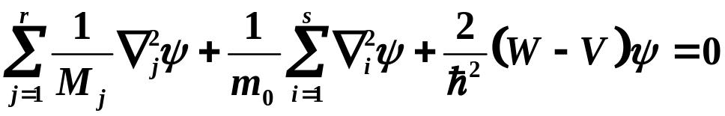
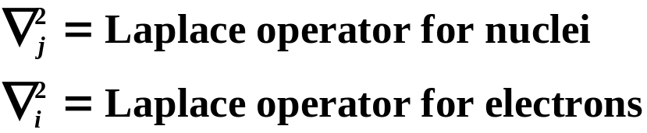
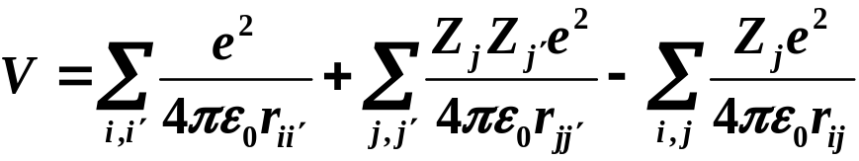
Molecular Bonding
Molecular Schrödinger equation
r - nuclei
s - electrons
M_{j} = mass of j^{th} nucleus
m₀ = mass of electron
Coulomb potential
electron-electron nuclear-nuclear electron-nuclear
repulsion repulsion attraction
Copyright – Michael D. Fayer, 2018
Notes:
2

Slide 3
Born-Oppenheimer Approximation
Electrons very light relative to nuclei they move very fast.
In the time it takes nuclei to change position a significant amount,
electrons have “traveled their full paths.”
Therefore,
Fix nuclei - calculate electronic eigenfunctions and energy for
fixed nuclear positions.
Then move nuclei, and do it again.
The resulting curve is the energy as a function of internuclear separation.
If there is a minimum – bond formation.
Copyright – Michael D. Fayer, 2018
Notes:
3

Slide 4

Born-Oppenheimer Approximation
Separation of total Schrödinger equation into an
electronic equation and a
nuclear equation
is obtained by expanding the total Schrödinger equation in powers of
M – average nuclear mass, m₀ - electron mass.
1) Not exact
2) Good approximation for many problems
3) Many important effects are due to the “break down” of
the Born-Oppenheimer approximation.
Copyright – Michael D. Fayer, 2018
Notes:
4

Slide 5
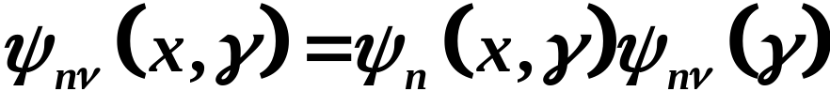
Born-Oppenheimer Approximate wavefunction
electronic nuclear
coordinates coordinates
nuclear wavefunction
depends on electronic
quantum number, n and
nuclear (vibrational)
quantum number, ν
electronic wavefunction
depends on electronic
quantum number, n
Copyright – Michael D. Fayer, 2018
Notes:
5

Slide 6

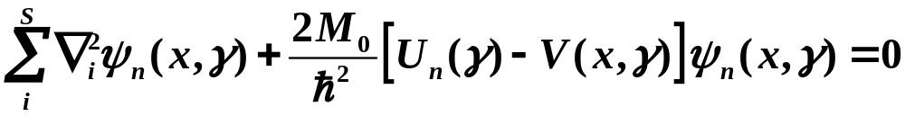


Electronic wavefunction
depends on fixed nuclear coordinates, γ.
Obtained by solving “electronic Schrödinger equation”
for fixed nuclear positions, γ.
No nuclear kinetic energy term.
The energy
depends on the nuclear coordinates and the
electronic quantum number.
The potential function
complete potential function for
fixed nuclear coordinates.
Solve, change nuclear coordinates, solve again.
Copyright – Michael D. Fayer, 2018
Notes:
6

Slide 7
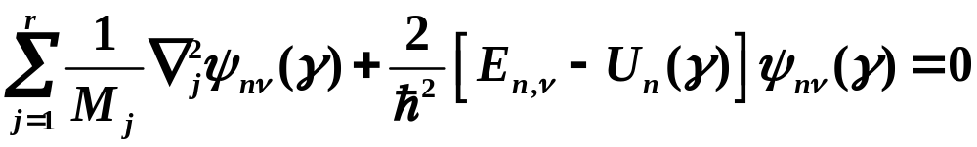
Solve electronic wave equation
Nuclear Schrödinger equation becomes
- the electronic energy as a function of nuclear coordinates, γ,
acts as the potential function.
Copyright – Michael D. Fayer, 2018
Notes:
7

Slide 8






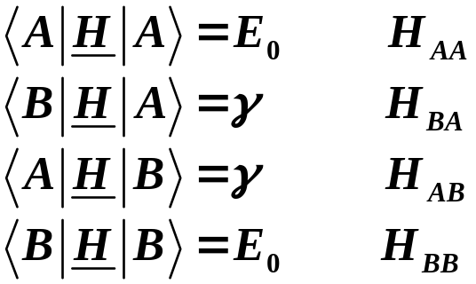
Before examining the hydrogen molecule ion and the hydrogen molecule
need to discuss matrix diagonalization with non-orthogonal basis set.
Two states orthonormal
No interaction
States have same energy:
Degenerate
With interaction of magnitude γ
The matrix elements are
Copyright – Michael D. Fayer, 2018
Notes:
8

Slide 9
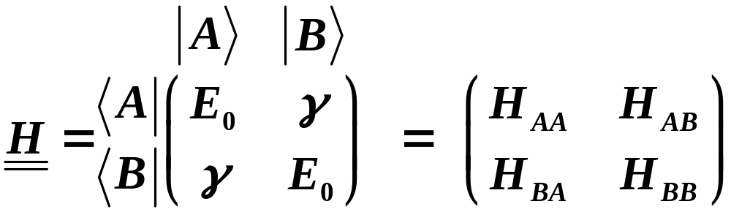
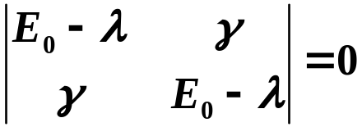


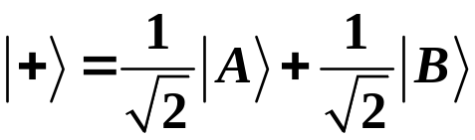
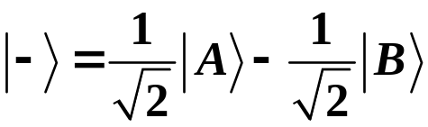
Hamiltonian Matrix
Matrix diagonalization -
form secular determinant
Energy Eigenvalues
Eigenvectors
Copyright – Michael D. Fayer, 2018
Notes:
9

Slide 10
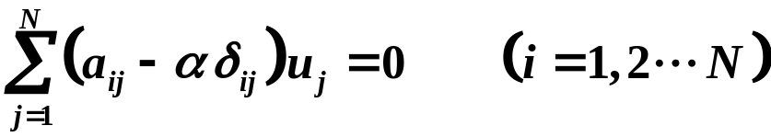
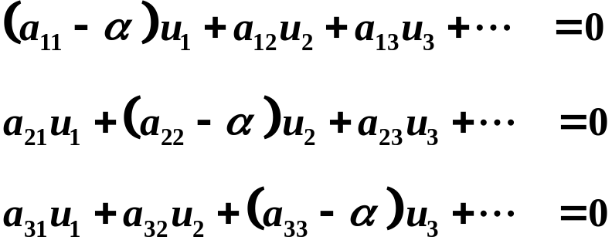
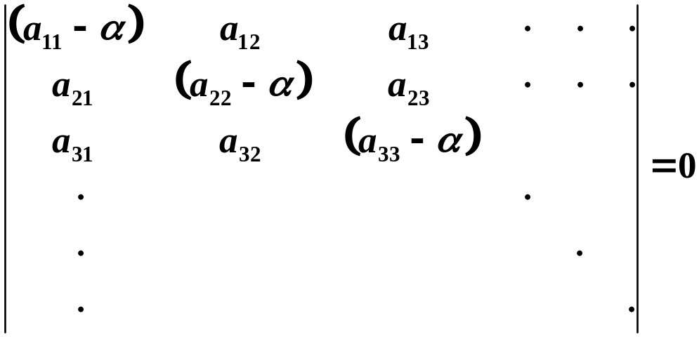
Matrix Formulation - Orthonormal Basis Set
eigenvalues
vector representative of eigenvector
This represents a system of equations
only has solution if
Copyright – Michael D. Fayer, 2018
Notes:
10

Slide 11


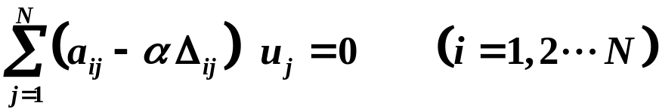
Basis Set Not Orthogonal but Normalized
overlap
Basis vectors not orthogonal
Equals 1 if i = j.
In Schrödinger representation
system of equations
only has solution if
(
a
−
α
)
(
a
−
Δ
α
)
(
a
−
Δ
α
)
⋅
⋅
⋅
11
12
12
13
13
(
a
−
Δ
α
)
(
a
−
α
)
(
a
−
Δ
α
)
⋅
⋅
⋅
21
21
22
23
23
(
a
−
Δ
α
)
(
a
−
Δ
α
)
(
a
−
α
)
31
31
32
32
33
=
0
⋅
⋅
⋅
⋅
⋅
⋅
Copyright – Michael D. Fayer, 2018
Notes:
11

Slide 12
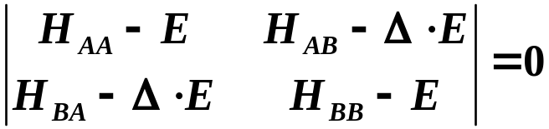
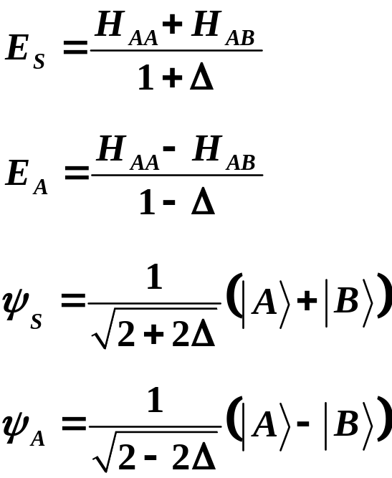
For a 2×2 matrix with non-orthogonal basis set
E eigenvalues
Δ overlap integral
Δ 0, recover standard 2×2 determinant for orthogonal basis.
Copyright – Michael D. Fayer, 2018
Notes:
12

Slide 13
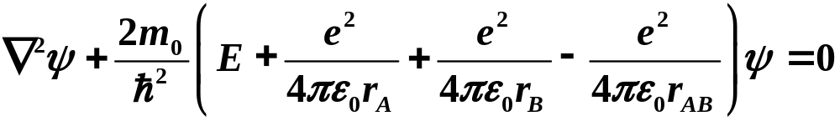

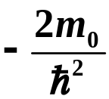
Hydrogen Molecule Ion - Ground State
A simple treatment
e
–
r
r
A
B
H
+
+
A
r
H
B
A
B
Born-Oppenheimer Approximation electronic Schrödinger equation
- refers to
electron coordinates
electron kinetic energy
Have multiplied through by
Copyright – Michael D. Fayer, 2018
Notes:
13

Slide 14



Large nuclear separations
r_{AB} ∞
System looks like H atom and H⁺ ion
Energy
Ground state wavefunctions
Either H atom at A in 1s state with H⁺ at B or
H atom at B in 1s state with H⁺ at A
and degenerate
Copyright – Michael D. Fayer, 2018
Notes:
14

Slide 15





Suggests simple treatment involving
as basis functions not orthogonal
and
Form 2×2 Hamiltonian matrix and corresponding secular determinant.
E eigenvalues
Δ overlap integral
Copyright – Michael D. Fayer, 2018
Notes:
15

Slide 16
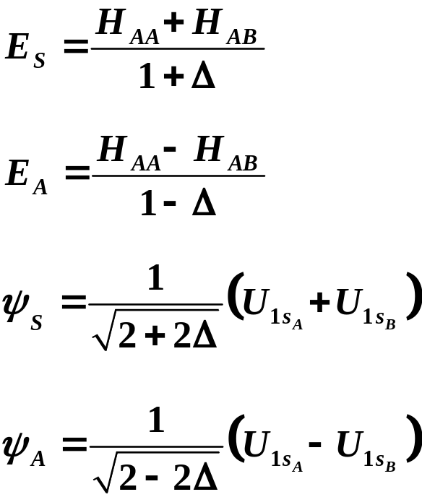
Energies and Eigenfunctions
S - symmetric (+ sign) A - antisymmetric (- sign)
(Not really symmetric and antisymmetric because only one electron.)
Copyright – Michael D. Fayer, 2018
Notes:
16

Slide 17
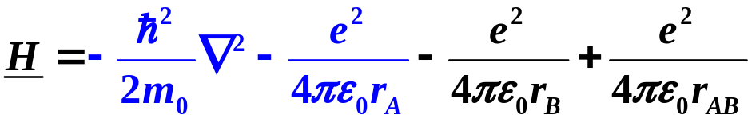
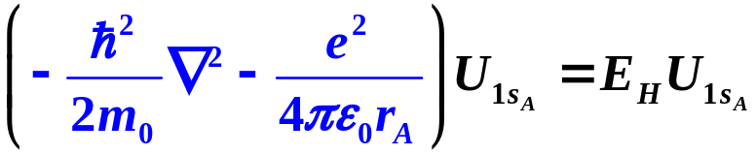


Evaluation of Matrix Elements
Need H_{AA}, H_{AB}, and Δ
Part of H looks like Hydrogen atom Hamiltonian
These terms operating on can be set equal to ,
E_{H} - energy of 1s state of H atom.
Copyright – Michael D. Fayer, 2018
Notes:
17

Slide 18
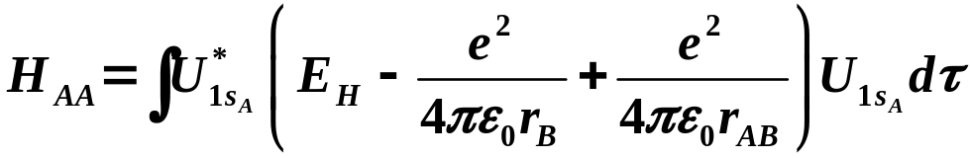
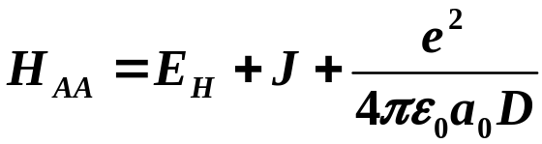
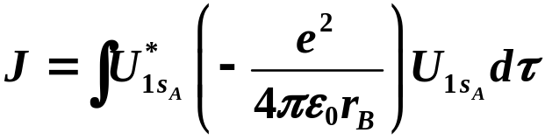
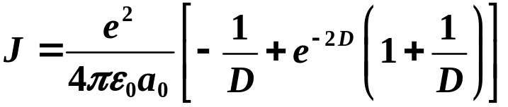
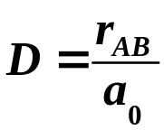
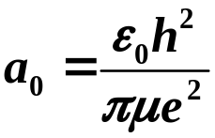
Then
(Coulomb Integral)
distance in units of the Bohr radius
Copyright – Michael D. Fayer, 2018
Notes:
18

Slide 19
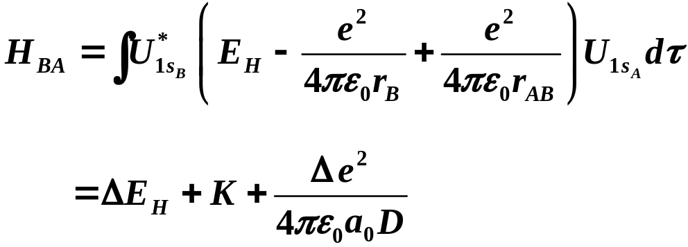
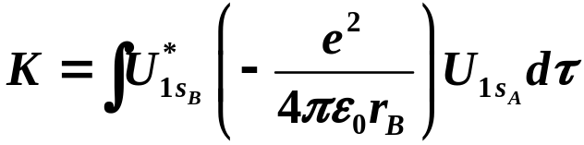
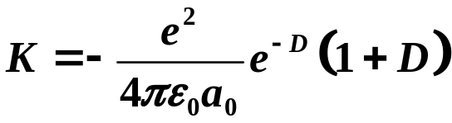
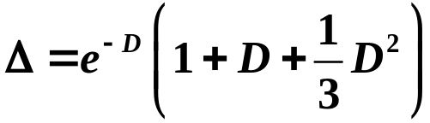
(Again collecting terms equal
to the H atom Hamiltonian.)
(Exchange integral)
(K is a negative number)
J - Coulomb integral - interaction of electron in 1s orbital around A with
a proton at B.
K - Exchange integral – exchange (resonance) of electron between
the two nuclei.
Copyright – Michael D. Fayer, 2018
Notes:
19

Slide 20
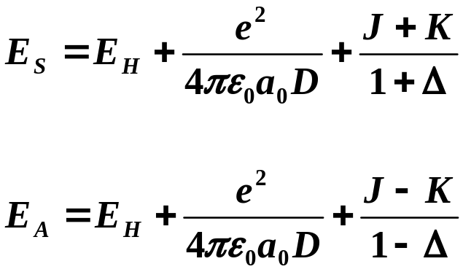
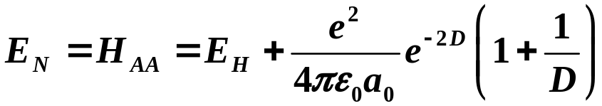
These results yield
(K is a negative number)
The essential difference between
these is the sign of the exchange
integral, K.
Also consider
Classical - no exchange
Interaction of hydrogen 1s electron charge distribution at A
with a proton (point charge) at B.
Electron fixed on A.
Copyright – Michael D. Fayer, 2018
Notes:
20

Slide 21
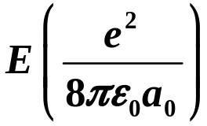
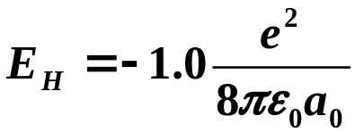


classical – no exchange
-0.8
repulsive at all distances
anti-bonding M.O.
-0.9
E
A
E
N
H 1s energy
-1.0
D_{e}
E
-1.1
S
bonding M.O.
-1.2
0
2
4
6
8
10
- equilibrium bond length
D_{e} - dissociation energy
Copyright – Michael D. Fayer, 2018
Notes:
21

Slide 22

Dissociation Energy Equilibrium Distance
D_{e}
This Calc.
1.77 eV (36%) 1.32 Å (25%)
Exp.
2.78 eV 1.06 Å
Variation
in Z'
2.25 eV (19%) 1.06 Å (0%)
Copyright – Michael D. Fayer, 2018
Notes:
22

Slide 23
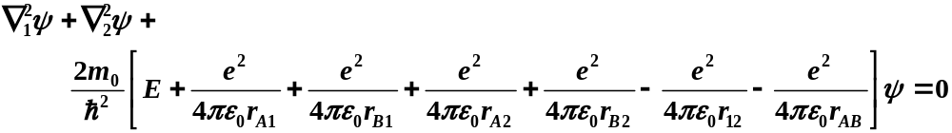
Hydrogen Molecule
e
-
r
1
2
2
e
-
1
r
A
2
r
B
2
r
A
1
r
B
1
H
+
H
+
A
r
A
B
B
In Born-Oppenheimer Approximation the electronic Schrödinger equation is
Copyright – Michael D. Fayer, 2018
Notes:
23

Slide 24

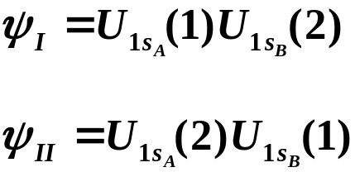
, system goes to 2 hydrogen atoms
Use product wavefunction as basis functions
Electron 1 around A electron 2 around B.
Electron 2 around A electron 1 around B.
These are degenerate.
Copyright – Michael D. Fayer, 2018
Notes:
24

Slide 25
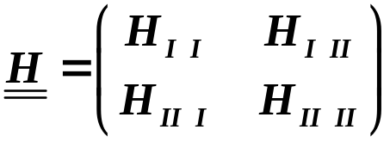
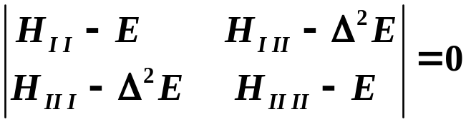





Form Hamiltonian Matrix secular determinant
Copyright – Michael D. Fayer, 2018
Notes:
25

Slide 26
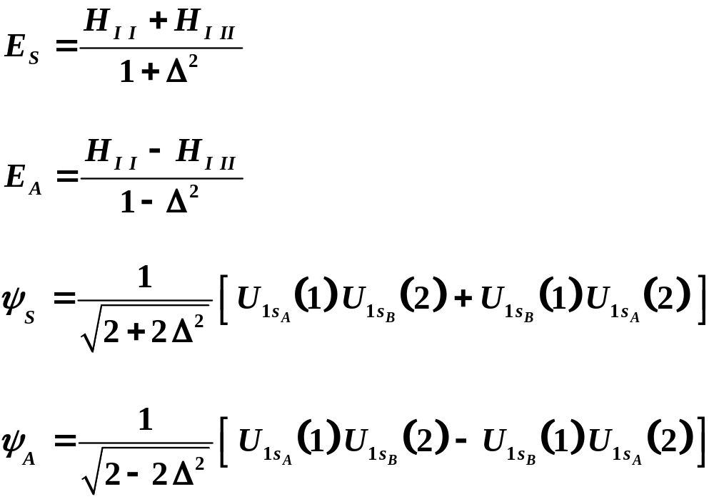
Diagonalization yields
S - symmetric orbital wavefunction
A - antisymmetric orbital wavefunction
Copyright – Michael D. Fayer, 2018
Notes:
26

Slide 27
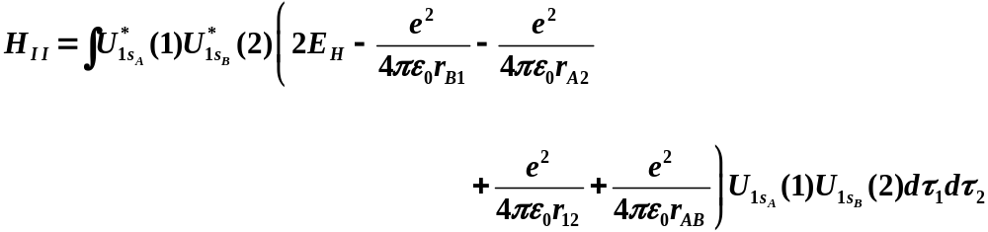
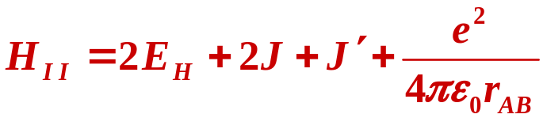
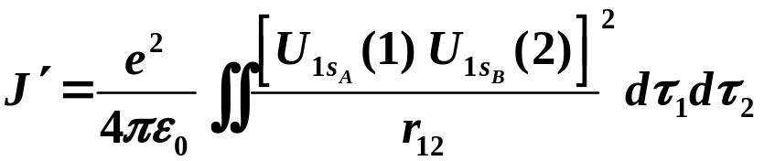
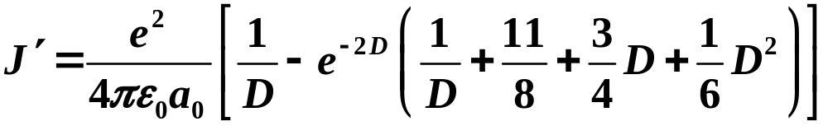

Evaluating
attraction to nuclei
nuclear-nuclear
repulsion
Two kinetic energy terms
and two electron-nuclear
attraction terms comprise
2 H atom Hamiltonians.
electron-electron repulsion
J same as before.
Copyright – Michael D. Fayer, 2018
Notes:
27

Slide 28
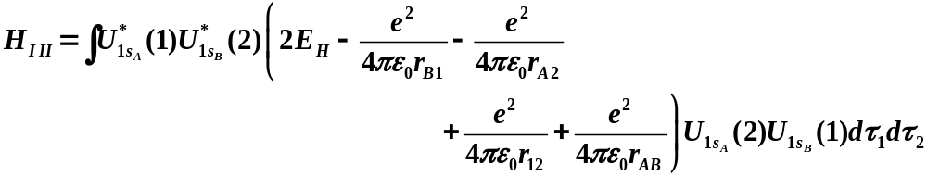
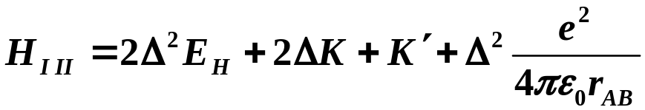
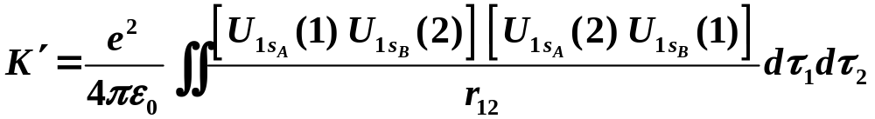
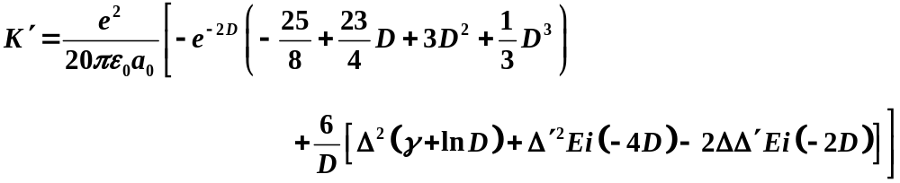

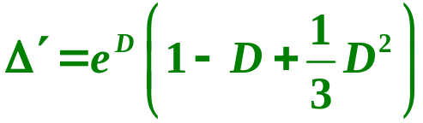
K and Δ same as before.
Ei - integral logarithm
math tables, approx., see book.
(Euler's constant)
Copyright – Michael D. Fayer, 2018
Notes:
28

Slide 29
J and K - same physical meaning as before.
J - Coulomb integral. Attraction of electron around one nucleus for
the other nucleus.
K - Corresponding exchange integral.
J' - Coulomb integral. Interaction of electron in 1s orbital on nucleus A
with electron in 1s orbital on nucleus B.
K' - Corresponding exchange or resonance integral.
Copyright – Michael D. Fayer, 2018
Notes:
29

Slide 30




Putting the pieces together
K' is negative.
The essential difference
between these is the sign
of the K' term.
Energy of
No exchange.
Classical interaction of spherical H atom charge distributions.
Charge distribution about H atoms A and B.
Electron 1 stays on A.
Electron 2 stays on B.
Copyright – Michael D. Fayer, 2018
Notes:
30

Slide 31

classical – no exchange
-1.6
-1.7
repulsive at all distances
anti-bonding M.O.
-1.8
E
A
⎞
⎟
⎠
-1.9
a
o
2
o
2 × H 1s energy
e
πε
-2
⎛
⎜
8
E
E
⎝
N
-2.1
D_{e}
E
S
bonding M.O.
-2.2
-2.3
0.5
1.5
2.5
3.5
4.5
5.5
Dissociation Energy Equilibrium Distance
D_{e}
This Calc.
3.14 eV (33%) 0.80 Å (8%)
Exp.
4.72 eV 0.74 Å
Variation
in Z'
3.76 eV (19%) 0.76 Å (3%)
Vibrational Frequency - fit to parabola, 3400 cm⁻¹; exp, 4318 cm⁻¹
Copyright – Michael D. Fayer, 2018
Notes:
31

