Slide 1
Basic Concepts
Absolute Size
The Superposition Principle
Size
Classical Mechanics Quantum Mechanics
Relative Absolute
What does relative vs. absolute size mean?
Why does it matter?
Copyright – Michael D. Fayer, 2018

Slide 2
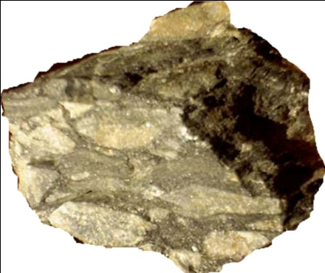



Classical Mechanics
Excellent for: bridges
airplanes
the motion of baseballs
Size is relative.
Tell whether something is big or small
by comparing it to something else.
Rocks come in
all sizes.
Comparison
determines if
a rock is
big or small.
Copyright – Michael D. Fayer, 2018

Slide 3

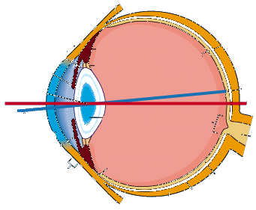

Why does the definition of size matter?
To observe something, must interact with it.
Always true - in classical mechanics
in quantum mechanics
Light hits flower, "bounces off."
Detect (observe) with eye, camera, etc.
Copyright – Michael D. Fayer, 2018

Slide 4
Definition of Big and Small
(Same for classical mechanics and quantum mechanics.)
Disturbance caused by observation (measurement)
negligible object big
non-negligible object small
Classical Mechanics
Assume: when making an observation
can always find a way to make a negligible disturbance.
Can always make object big.
Do wrong experiment object small.
Do right experiment object big.
Observe wall with light big.
Observe wall with billiard balls small.
Implies – Size is relative. Size depends on the object and your experimental
technique.
Nothing inherent.
Copyright – Michael D. Fayer, 2018

Slide 5
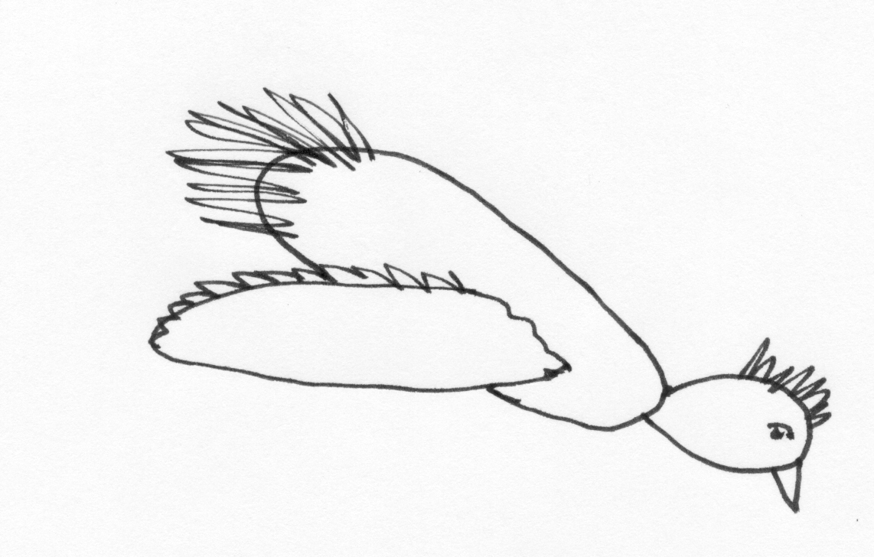
Classical, systems evolve with causality.
Free particle
a rock
t = 0
t = t'
x - position
p - momentum
observe
observe
Make observation of trajectory. Predict future location.
?
?
a rock
t = 0
bird
t = t'
?
x – position
p – momentum
predict
observe
bird – rock
scattering event
?
?
Following non-negligible disturbance – don't know outcome.
Copyright – Michael D. Fayer, 2018

Slide 6
Quantum Mechanics
Size is absolute.
Quantum Mechanics is fundamentally different
from classical mechanics in the way it treats size.
Absolute Meaning of Size
Assume: "There is a limit to the fineness of our
powers of observation and the smallness of
the accompanying disturbance, a limit which
is inherent in the nature of things and can
never be surpassed by improved technique
or increased skill on the part of the observer."
Dirac
Copyright – Michael D. Fayer, 2018

Slide 7
Quantum Mechanics – Absolute Definition of Size
Big object – unavoidable limiting disturbance is negligible.
Small object – unavoidable limiting disturbance is not negligible.
Object is small in an absolute sense.
No improvement in experimental technique
will make the disturbance negligible.
Classical mechanics not set up to describe objects that are
small in an absolute sense.
Copyright – Michael D. Fayer, 2018

Slide 8
Q. M. – Observation of an Absolutely small system.
?
?
photon
t = 0
?
predict
?
an electron
observe
t = t'
?
Photon – Electron scattering. Non-negligible disturbance.
Can’t predict trajectory after observation.
Causality is assumed to apply to undisturbed systems.
Act of observation of a small Q. M. system causes a non-negligible disturbance.
Therefore, the results of one observation will not allow
a causal prediction of the results of a subsequent observation.
Not surprising from the definition of a small Q. M. system.
Indeterminacy comes in calculation of observables.
Act of observation destroys causality.
Theory gives probability of obtaining a particular result.
Copyright – Michael D. Fayer, 2018

Slide 9
The Nature of the Disturbance that Accompanies a Measurement
The Superposition Principle
Fundamental Law of Q. M. Inherently different from classical mechanics.
Pervades quantum theory.
Two examples to illustrate idea before formulating Superposition Principle.
Polarization of photons
Interference of photons
Polarization of light (direction of E-field)
Light polarized along one
axis goes through polarizer.
I||.
Light polarized along other
axis does not go through.
Perpendicular axis, I⊥.
light
I||
polarizer
Classical electromagnetic theory tells what happens.
Light is a wave.
Light polarized parallel goes through.
Light polarized perpendicular is reflected or diverted.
Copyright – Michael D. Fayer, 2018

Slide 10
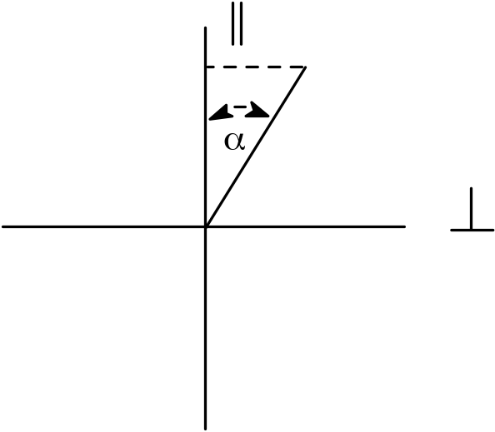
What happens when light is polarized at an angle, α?
The projection of the electric field, E,
on the parallel axis is
E = cos α.
Intensity is proportional to |E|².
I ∝ |E|²
A fraction, cos²α of the light goes through the polarizer.
Copyright – Michael D. Fayer, 2018

Slide 11
Photo-electric Effect –
Classical Theory – Light is a wave.
electrons
e⁻
e⁻
Experimental results
light
e⁻
Shine light of one color on metal –
electrons come out with a certain speed.
Increase light intensity
get more electrons out with identical speed.
Tune frequency far enough to red
no electrons come out.
metal
Light wave “hits” electron gently.
Electrons come out – low speed.
Low Intensity - Small Wave
High Intensity - Big Wave
Light wave “hits” electron hard.
Electrons come out – high speed.
Copyright – Michael D. Fayer, 2018

Slide 12
Einstein explains the photoelectric effect (1905)
Light is composed of small particles – photons.
increase
intensity
electron out
One photon hits one electron.
photon in
Increase intensity – more photons,
more electrons hit – more come out.
metal
Each photon hits an electron with same impact
whether there are many or few.
Therefore, electrons come out with same speed
independent of the intensity.
Tune to red, energy to low to overcome binding energy.
Light not a wave – light is composed of photons
Beam of light composed of polarized photons.
No problem if light || or ⊥.
|| photon goes right through the polarizer
⊥ photon does not go through (reflected)
What happens if a photon is polarized at some angle, α?
Copyright – Michael D. Fayer, 2018

Slide 13
Photons polarized at angle, α - need an experiment.
Q. M. describes observables. Can only ask questions about observables.
Need experiment.
Experiment – single photons incident on polarizer one at a time.
polarization
measured here
photon
Observable – does photon
appear at back side of
polarizer?
light
detector
polarizer
Q. M. predicts results
Some times get “whole” photon at back side of polarizer.
Photon has same energy as incident photon.
Sometimes get nothing.
When “find” photon, it is always polarized parallel.
Do this for many photons – observed cos² α of them at back.
Copyright – Michael D. Fayer, 2018

Slide 14
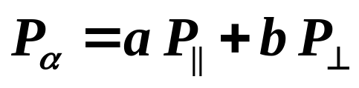
Act of “observation” of polarization by polarizer causes a
non-negligible disturbance of photon.
Photon with polarization α “jumps” to either polarization || or ⊥.
Superposition of photon polarization states
Photon of polarization α P_{α}
P_{α} is some type of “superposition” of polarization states, || and ⊥.
Any state of polarization can be resolved into or expressed as a superposition
of two mutually perpendicular states of polarization.
Copyright – Michael D. Fayer, 2018

Slide 15



Coefficients a and b tell how much of each of the
“special” states, comprise the state .
When the photon meets the polarizer, we are observing whether it is
polarized || or ⊥.
Observation of the system forces the system from the state into one of the
states, .
The special states are called “eigenstates.”
Observation causes non-negligible disturbance that changes the system from
being in the state into one of the states .
System makes sudden jump from being part in each state
to being in only one state.
Probability laws determine which is the final state.
Copyright – Michael D. Fayer, 2018

Slide 16

Interference of light – described classically by Maxwell’s Equations in terms
of light waves.
end mirror
50% beam splitting mirror
one beam
light wave
incoming beam
end mirror
crossed beams
intensity
overlap region
I
oscillates
x
interference pattern
Classical description – Maxwell’s Equations: wave functions
A light wave enters the interferometer.
Light wave is split into two waves by 50% beam splitter.
Each wave reflects from end mirror, returns, and crosses at small angle.
In region of overlap, light waves constructively and destructively interfere
to give interference pattern.
Copyright – Michael D. Fayer, 2018

Slide 17
But light composed of photons.
end mirror
50% beam splitting mirror
photons
incoming beam
end mirror
intensity
overlap region
I
oscillates
x
interference pattern
Einstein taught us that light is not a wave but particles, photons.
Initial idea:
Classical E&M wave function described number of photons in
a region of space. Otherwise, everything the same.
Photons enter interferometer. At beam splitter, half go into one leg, half
go into the other leg.
They come together and interfere.
Many problems with this description.
Example: interference pattern unchanged when light intensity approaches zero.
Copyright – Michael D. Fayer, 2018

Slide 18
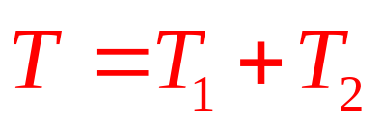
Proper description – Superposition Principle
end mirror
Translation State 1 − T₁
Translation State 2 – T₂
photons
incoming beam
end mirror
intensity
overlap region
I
oscillates
x
interference pattern
The “translation state” T of a photon can be written as a superposition
Photon in superposition state T. It should be thought of as being in both legs of
apparatus. Can’t say which one it is in.
Each photon interferes with itself. No problem at low light intensity.
Wave function probability of finding a single photon (particle)
in each leg of the apparatus (region of space).
Not number in each leg.
Copyright – Michael D. Fayer, 2018

Slide 19
State
Collection of bodies with various properties
mass
moment of inertia
Bodies interact according to specific laws of force.
Certain motions consistent with bodies and laws.
Each such motion is a state of the system.
Definition:
The state of a system is an
undisturbed motion that is restricted by as
many conditions as are theoretically possible
without contradiction.
Example – s, p, d states of H atom
State can be at a single time or time dependent.
Copyright – Michael D. Fayer, 2018

Slide 20
Superposition Principle
Assume:
Whenever a system is in one state
it can always be considered to be partly in
each of two or more states.
Original state – can be regarded as a superposition of two or more states.
Conversely – two or more states can be superimposed to give a new state.
Non-classical superposition.
In mathematics can always form superpositions.
Sometimes physically useful, sometimes not.
In Q. M., superposition of states is central to
the theoretical description of nature.
Copyright – Michael D. Fayer, 2018

Slide 21
Observables in Q. M.
Consider system with two states – A and B.
[Correct notation will be introduced
shortly. This is still a qualitative
introduction.]
Observation of system in state A
result α.
Observation on B
result β.
Observation on a superposition of A and B
Gives either α or β.
Never gives anything else.
Probability of getting result α or β depends on
relative weights of A and B in the superposition.
Copyright – Michael D. Fayer, 2018

Slide 22
"The intermediate character of the state formed
by superposition thus expresses itself through
the probability of a particular result for an
observation being 'intermediate' between the
corresponding probabilities for the original
state,
not through the result itself being
intermediate between the corresponding results
for the original states.
"
Dirac
Copyright – Michael D. Fayer, 2018

Slide 23
Absolute size and Superposition Principle intimately related.
When making a series of observations on
identically prepared atomic systems,
the result from one observation to the next
in general will vary.
If you make enough observations,
you will get a probability distribution for the results.
Quantum mechanics calculates these probabilities.
Copyright – Michael D. Fayer, 2018
Notes:
23

