Slide 1
Chapter 3

Slide 2
Hermitian linear operator Real dynamical variable –
represents observable quantity
Eigenvector A state associated with an
observable
Eigenvalue Value of observable associated
with a particular linear operator
and eigenvector
Copyright – Michael D. Fayer, 2018
Notes:
2
2
2

Slide 3
Momentum of a Free Particle
Free particle – particle with no forces acting on it.
The simplest particle in classical and quantum mechanics.
classical
rock in interstellar space
Know momentum, p, and position, x,
can predict exact location at any subsequent time.
Solve Newton's equations of motion.
p = mV
What is the quantum mechanical description?
Should be able to describe photons, electrons, and rocks.
Copyright – Michael D. Fayer, 2018
Notes:
3
3
3

Slide 4
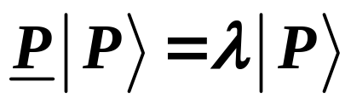
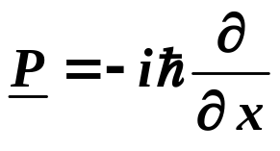
Momentum eigenvalue problem for Free Particle
momentum momentum momentum
operator eigenvalues eigenkets
Know operator want: eigenvectors
eigenvalues
Schrödinger Representation – momentum operator
Later – Dirac’s Quantum Condition shows how to select operators
Different sets of operators form different representations of Q. M.
Copyright – Michael D. Fayer, 2018
Notes:
4
4
4

Slide 5
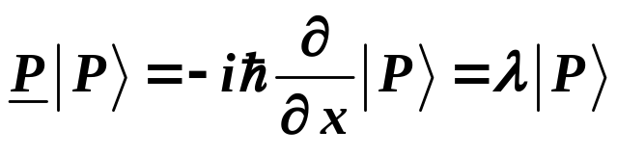
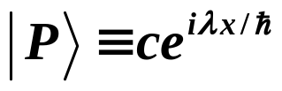
Have
Try solution
eigenvalue
Eigenvalue – observable.
Proved that must be real number.
Function representing state of system in a particular
representation and coordinate system called wave function.
Copyright – Michael D. Fayer, 2018
Notes:
5
5
5

Slide 6
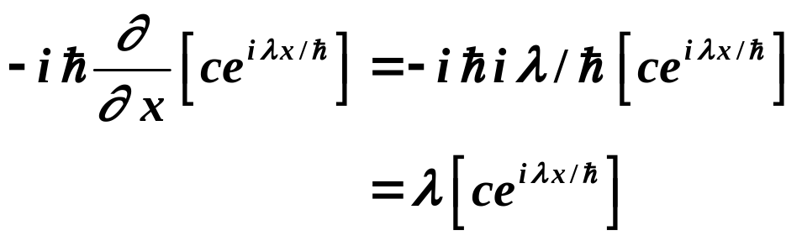

Schrödinger Representation
momentum operator
Proposed solution
Check
Operating on function gives
identical function back
times a constant.
Continuous range of eigenvalues.
Momentum of a free particle can take on
any value (non-relativistic).
Copyright – Michael D. Fayer, 2018
Notes:
6
6
6

Slide 7
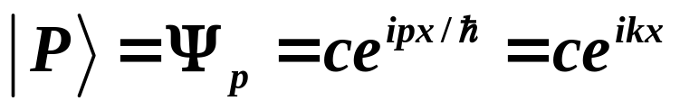
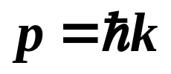
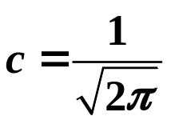
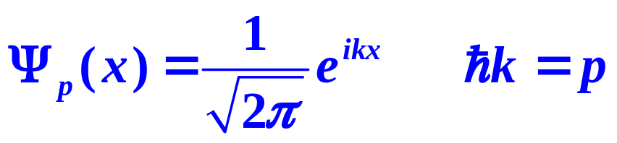
momentum
eigenkets
momentum
wave functions
Have called eigenvalues λ = p
k is the “wave vector.”
c is the normalization constant.
c doesn’t influence eigenvalues
direction not length of vector matters.
Show later that normalization constant
The momentum eigenfunction are
momentum eigenvalue
Copyright – Michael D. Fayer, 2018
Notes:
7
7
7

Slide 8
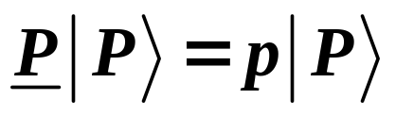
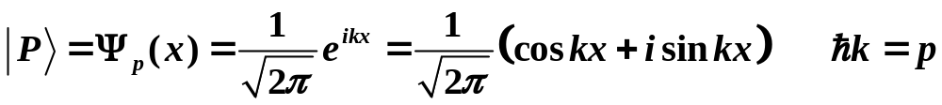
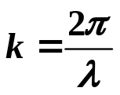
Momentum eigenstates are delocalized.
momentum momentum momentum
operator eigenvalue eigenket
Free particle wavefunction in the Schrödinger Representation
State of definite momentum
wavelength
Copyright – Michael D. Fayer, 2018
Notes:
8
8
8

Slide 9


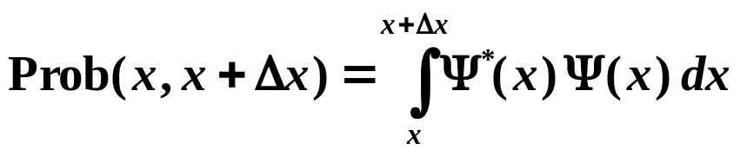
Born Interpretation of Wavefunction
Schrödinger Concept of Wavefunction
Solution to Schrödinger Eq.
Eigenvalue problem (see later).
Thought represented “Matter Waves” – real entities.
Born put forward
Like E field of light – amplitude of classical E & M wavefunction
proportional to E field, .
Absolute value square of E field Intensity.
Born Interpretation – absolute value square of Q. M. wavefunction
proportional to probability.
Probability of finding particle in the region x + Δx given by
Q. M. Wavefunction Probability Amplitude.
Wavefunctions complex.
Probabilities always real.
Copyright – Michael D. Fayer, 2018
Notes:
9
9
9

Slide 10

Free Particle
What is the particle's location in space?
real imaginary
x
Not localized Spread out over all space.
Equal probability of finding particle from .
Know momentum exactly No knowledge of position.
Copyright – Michael D. Fayer, 2018
Notes:
10
10
10

Slide 11
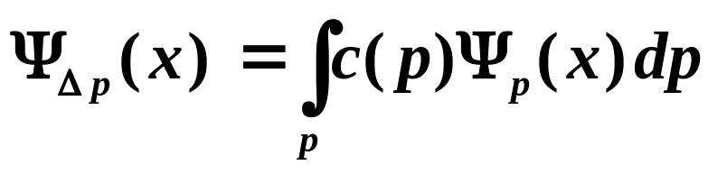
Not Like Classical Particle!
Plane wave spread out over all space.
Perfectly defined momentum – no knowledge of position.
Wave Packets
What does a superposition of states of definite momentum look like?
must integrate because continuous
range of momentum eigenkets
coefficient – how much of each
eigenket is in the superposition
indicates that wavefunction is composed
of a superposition of momentum eigenkets
Copyright – Michael D. Fayer, 2018
Notes:
11
11
11

Slide 12


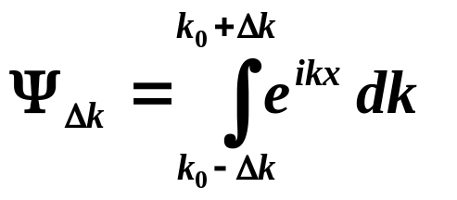
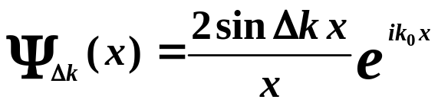
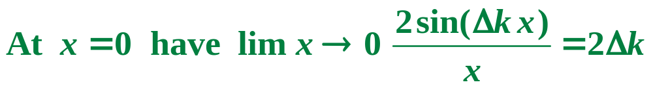
First Example
Work with wave vectors -
Wave vectors in the range
k₀ – Δk to k₀ + Δk.
In this range, equal amplitude of each state.
Out side this range, amplitude = 0.
k₀ – Δk
k₀
k₀ + Δk
k
Then
Superposition of
momentum eigenfunctions.
Integrate over k about k₀.
Rapid oscillations in envelope of
slow, decaying oscillations.
Copyright – Michael D. Fayer, 2018
Notes:
12
12
12

Slide 13
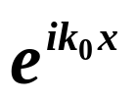
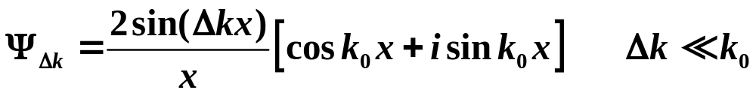
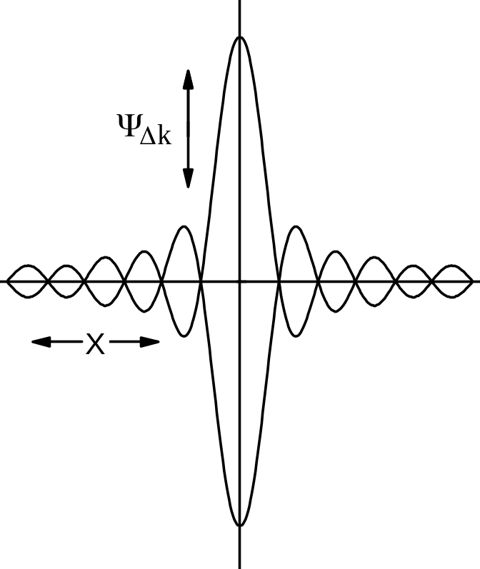

Writing out the
Wave Packet
This is the “envelope.” It is “filled in”
by the rapid real and imaginary
spatial oscillations at frequency k₀.
The wave packet is now “localized” in space.
Greater Δk more localized.
Large uncertainty in p small uncertainty in x.
Copyright – Michael D. Fayer, 2018
Notes:
13
13
13

Slide 14
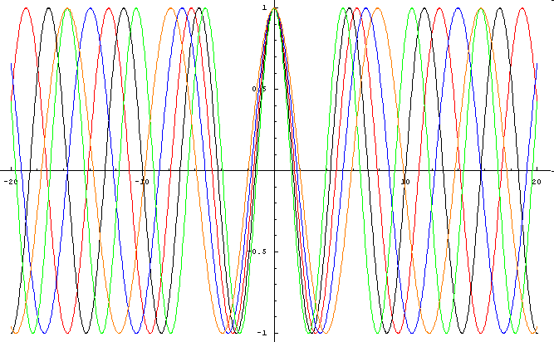
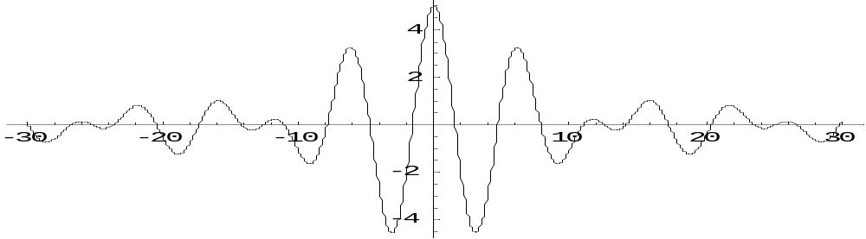
Localization caused by regions of constructive and destructive interference.
5 waves
Sum of the 5 waves
Copyright – Michael D. Fayer, 2018
Notes:
14
14
14

Slide 15

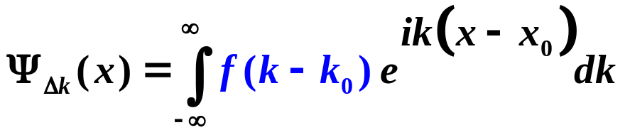

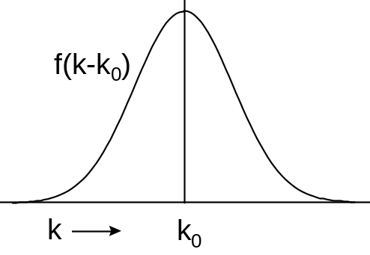
Wave Packet – region of constructive interference
Combining different ,
free particle momentum eigenstates
wave packet.
Concentrate probability of finding particle in some region of space.
Get wave packet from
Wave packet centered around
x = x₀,
made up of k-states centered around
k = k₀.
Tells how much of each k-state is in superposition.
Nicely behaved dies out rapidly away from k₀.
Copyright – Michael D. Fayer, 2018
Notes:
15
15
15

Slide 16
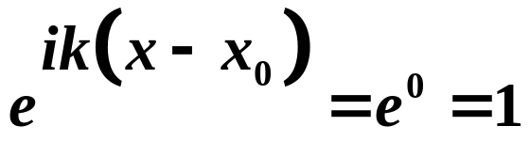
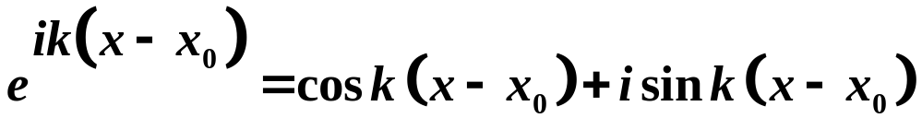
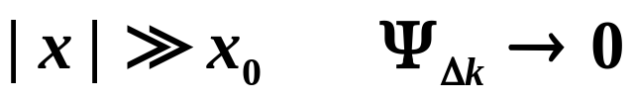

Only have k-states near k = k₀.
At x = x₀
All k-states in superposition in phase.
Interfere constructively add up.
All contributions to integral add.
For large (x – x₀)
Oscillates wildly with changing k.
Contributions from different k-states destructive interference.
Probability of finding particle 0
wavelength
Copyright – Michael D. Fayer, 2018
Notes:
16
16
16

Slide 17
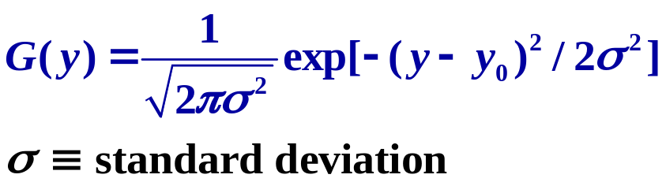
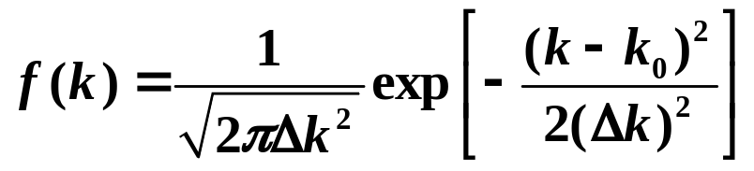

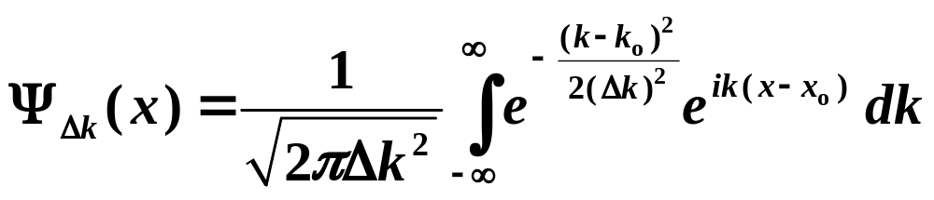
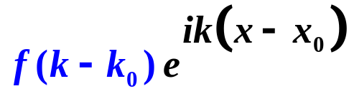
Gaussian Wave Packet
Gaussian Function
Gaussian distribution of k-states
Gaussian in k, with
normalized
Gaussian Wave Packet
Written in terms of x – x₀ Packet centered around x₀.
Copyright – Michael D. Fayer, 2018
Notes:
17
17
17

Slide 18
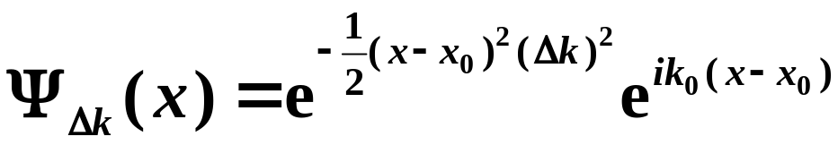
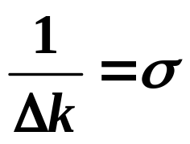
Gaussian Wave Packet
(Have left out normalization)
Looks like momentum eigenket at
k = k₀
times Gaussian in real space.
Width of Gaussian (standard deviation)
The bigger Δk, the narrower the wave packet.
When x = x₀, exp = 1.
For large | x - x₀|, real exp term << 1.
Copyright – Michael D. Fayer, 2018
Notes:
18
18
18

Slide 19
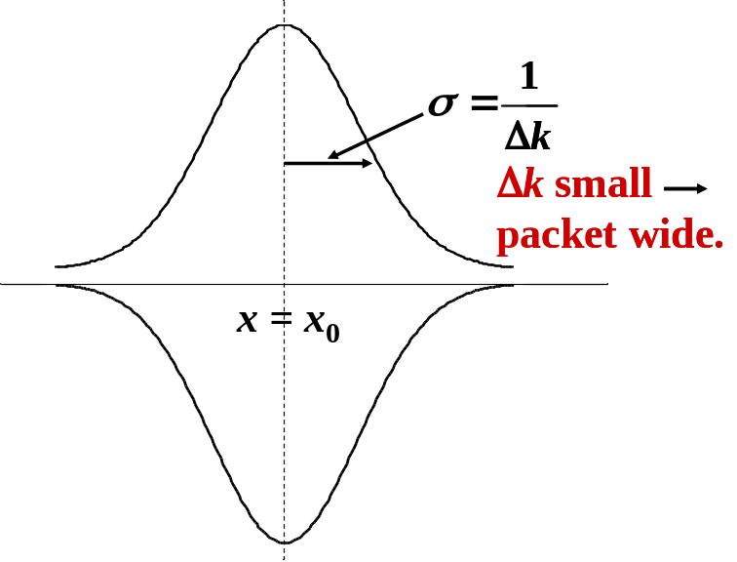
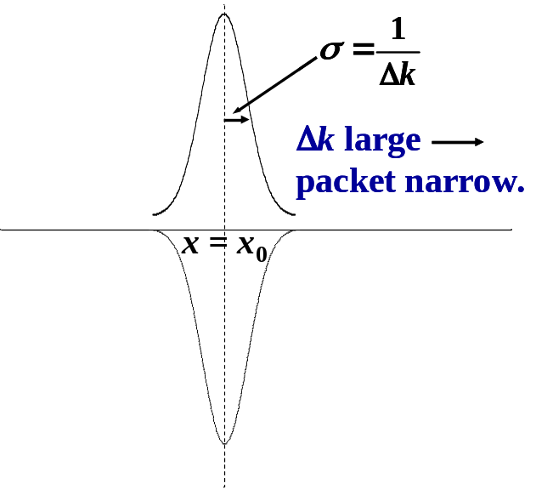
Gaussian Wave Packets
To get narrow packet (more well defined position) must superimpose
broad distribution of k states.
Copyright – Michael D. Fayer, 2018
Notes:
19
19
19

Slide 20
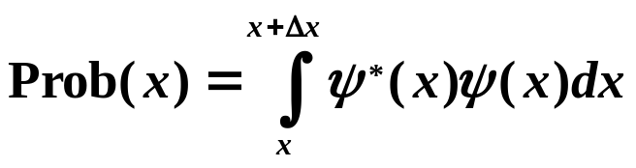

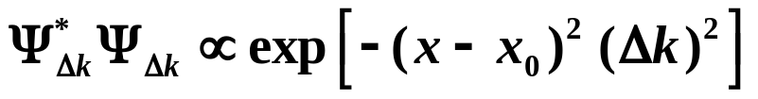

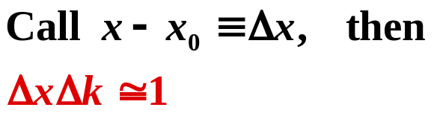
Brief Introduction to Uncertainty Relation
Probability of finding particle
between x & x + Δx
Written approximately as
For Gaussian Wave Packet
(note – Probabilities are real.)
This becomes small when
Copyright – Michael D. Fayer, 2018
Notes:
20
20
20

Slide 21



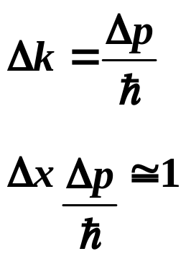
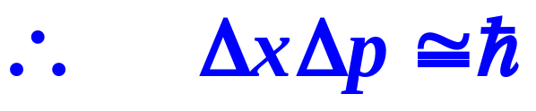

momentum
spread or "uncertainty" in momentum
Superposition of states leads to uncertainty relationship.
Large uncertainty in x, small uncertainty in p, and vis versa.
(See later that
differences from choice of 1/e point instead of σ)
Copyright – Michael D. Fayer, 2018
Notes:
21
21
21

Slide 22
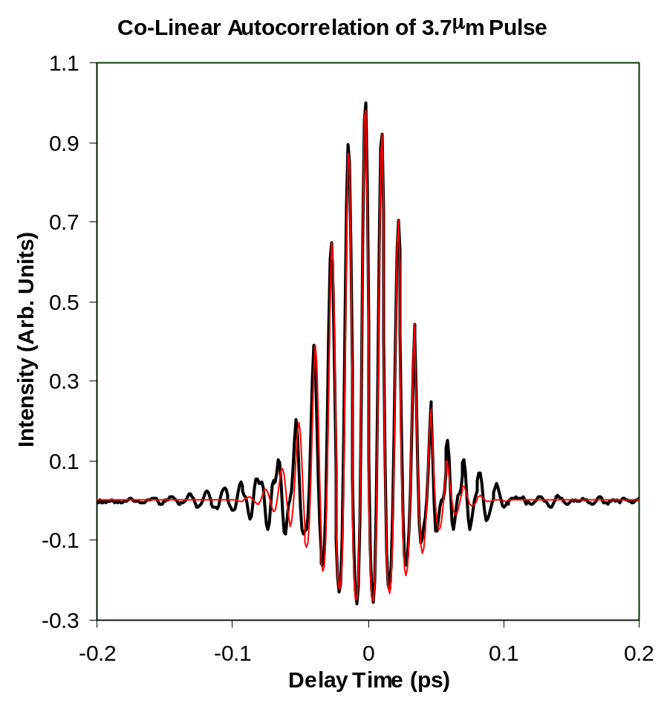

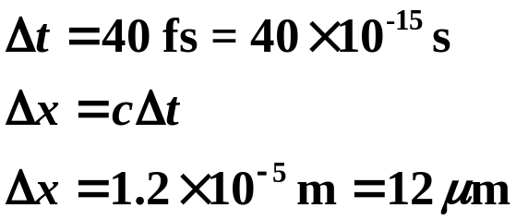
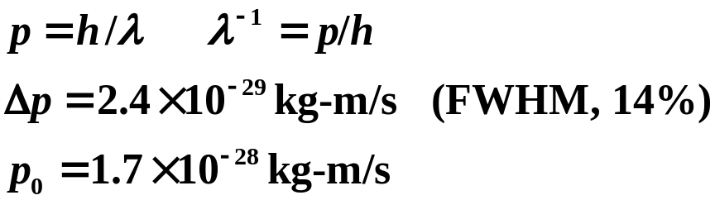
Observing Photon Wave Packets
Ultrashort mid-infrared optical pulses
collinear
autocorrelation
40 fs FWHM
Gaussian fit
1.1
368 cm⁻¹ FWHM
Gaussian Fit
0.9
0.7
Intensity (Arb. Units)
0.5
0.3
0.1
-0.1
1850
2175
2500
2825
3150
frequency (cm
-1
)
(FWHM)
?
FWHM to σ
Copyright – Michael D. Fayer, 2018
Notes:
22
22
22

Slide 23
Electrons can act as “particle” or “waves” – wave packets.
CRT - cathode ray tube
Old style TV or computer monitor
control
grid
electrons aimed
cathode
electrons
hit screen
-
e⁻
+
filament
electrons
boil off
screen
acceleration
grid
Electron beam in CRT.
Electron wave packets like bullets.
Hit specific points on screen to give colors.
Measurement localizes wave packet.
Copyright – Michael D. Fayer, 2018
Notes:
23
23
23

Slide 24
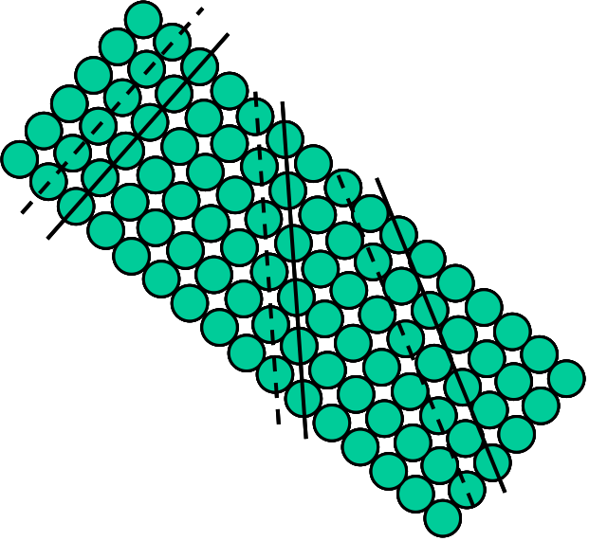
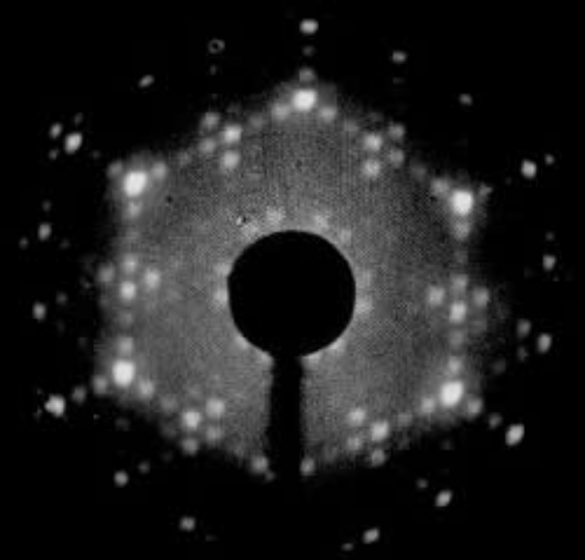
Electron diffraction
Electron beam impinges
on surface of a crystal
low energy electron diffraction
diffracts from surface.
Acts as wave.
Measurement
determines
momentum eigenstates.
in coming
electron “wave"
crystal
surface
out going
waves
many grating
different directions
different spacings
Peaks line up.
Constructive interference.
Low Energy Electron Diffraction (LEED)
from crystal surface
Copyright – Michael D. Fayer, 2018
Notes:
24
24
24

Slide 25
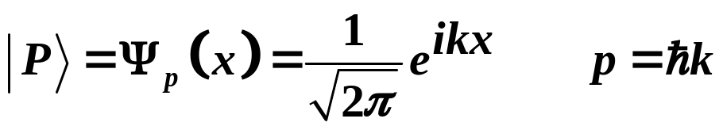

Group Velocities
Time independent momentum eigenket
Direction and normalization ket still not completely defined.
Can multiply by phase factor
Ket still normalized.
Direction unchanged.
Copyright – Michael D. Fayer, 2018
Notes:
25
25
25

Slide 26
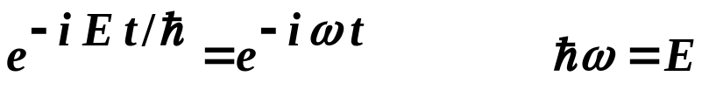
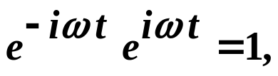
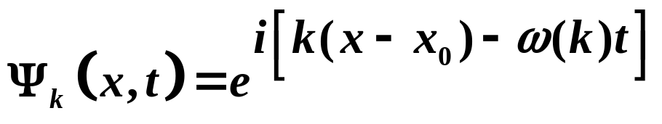
For time independent Energy
In the Schrödinger Representation (will prove later)
Time dependence of the wavefunction is given by
Time dependent phase factor.
Still normalized
The time dependent eigenfunctions of the momentum operator are
Copyright – Michael D. Fayer, 2018
Notes:
26
26
26

Slide 27
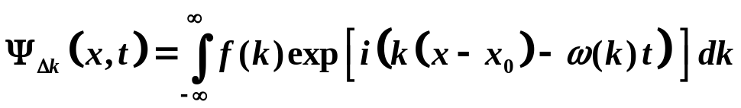


Time dependent Wave Packet
time dependent phase factor
Photon Wave Packet in a vacuum
Superposition of photon plane waves.
Need ω
Copyright – Michael D. Fayer, 2018
Notes:
27
27
27

Slide 28


Using
At t = 0,
Packet centered at x = x₀.
Have factored out k.
Argument of exp. = 0. Max constructive interference.
At later times,
Peak at x = x₀ + ct.
Point where argument of exp = 0 Max constructive interference.
Packet moves with speed of light.
Each plane wave (k-state) moves at same rate, c.
Packet maintains shape.
Motion due to changing regions of constructive and destructive
interference of delocalized planes waves
Localization and motion due to superposition
of momentum eigenstates.
Copyright – Michael D. Fayer, 2018
Notes:
28
28
28

Slide 29


Photons in a Dispersive Medium
Photon enters glass, liquid, crystal, etc.
Velocity of light depends on wavelength.
n(λ) Index of refraction – wavelength dependent.
glass – middle of visible
n ~ 1.5
n(λ)
red
blue
λ
Dispersion, no longer linear in k.
Copyright – Michael D. Fayer, 2018
Notes:
29
29
29

Slide 30



Wave Packet
Still looks like wave packet.
Moves, but not with velocity of light.
Different states move with different velocities;
in glass blue waves move slower than red waves.
Velocity of a single state in superposition
Phase Velocity.
Copyright – Michael D. Fayer, 2018
Notes:
30
30
30

Slide 31



Velocity – velocity of center of packet.
max constructive interference
Argument of exp. zero for all k-states at
The argument of the exp. at later times
ω(k) does not change linearly with k, can’t factor out k.
Argument will never again be zero
for all k in packet simultaneously.
Most constructive interference when argument changes with k
as slowly as possible.
This produces slow oscillations as k changes.
k-states add constructively, but not perfectly.
Copyright – Michael D. Fayer, 2018
Notes:
31
31
31

Slide 32




No longer perfect constructive interference at peak.
In glass
Red waves get ahead.
Blue waves fall behind.
The argument of the exp. is
When φ changes slowly as a function of k within range of k determined by f(k)
Constructive interference.
Find point of max constructive interference.
φ changes as slowly as possible with k.
max of packet
at time, t.
Copyright – Michael D. Fayer, 2018
Notes:
32
32
32

Slide 33


Distance Packet has moved at time t
Point of maximum constructive interference (packet peak) moves at
V_{g} speed of photon in dispersive medium.
V_{p} phase velocity = λν = ω/k
only same when ω(k) = ck vacuum (approx. true in
low pressure gasses)
Copyright – Michael D. Fayer, 2018
Notes:
33
33
33

Slide 34




Electron Wave Packet
de Broglie wavelength
(1922 Ph.D. thesis)
A wavelength associated with a particle
unifies theories of light and matter.
Used
Non-relativistic free particle
energy divided by  (will show later).
Copyright – Michael D. Fayer, 2018
Notes:
34
34
34

Slide 35


V_{g} – Free non-zero rest mass particle
Group velocity of electron wave packet same as classical velocity.
However, description very different. Localization and motion due to
changing regions of constructive and destructive interference.
Can explain electron motion and electron diffraction.
Correspondence Principle – Q. M. gives same results as classical mechanics
when in “classical regime.”
Copyright – Michael D. Fayer, 2018
Notes:
35
35
35

Slide 36



momentum
eigenkets
momentum
wave functions
Have called eigenvalues λ = p
k is the “wave vector.”
c is the normalization constant.
c doesn’t influence eigenvalues
direction not length of vector matters.
Normalization
scalar product
scalar product of a vector with itself
normalized
Copyright – Michael D. Fayer, 2018
Notes:
36
36
36

Slide 37







Normalization of the Momentum Eigenfunctions – the Dirac Delta Function
scalar product of vector functions (linear algebra)
scalar product of vector function with itself
Using
Want to adjust c so the integral
times c² = 1.
Can’t do this integral with normal methods – oscillates.
Copyright – Michael D. Fayer, 2018
Notes:
37
37
37

Slide 38




Dirac δ function
Definition
For function f(x) continuous at x = 0,
or
Copyright – Michael D. Fayer, 2018
Notes:
38
38
38

Slide 39
Physical illustration
unit area
x
x=0
double height
half width
still unit area
Limit width 0, height ∞
area remains 1
Copyright – Michael D. Fayer, 2018
Notes:
39
39
39

Slide 40



Mathematical representation of δ function
g = π
g any real number
zeroth order spherical
Bessel function
Has value g/π at x = 0.
Decreasing oscillations for increasing |x|.
Has unit area independent of the choice of g.
As g
∞ δ
1. Has unit integral
2. Only non-zero at point x = 0,
because oscillations infinitely fast, over
finite interval yield zero area.
Copyright – Michael D. Fayer, 2018
Notes:
40
40
40

Slide 41





Use δ(x) in normalization and orthogonality of momentum eigenfunctions.
Want
Adjust c to make equal to 1.
Evaluate
Rewrite
Copyright – Michael D. Fayer, 2018
Notes:
41
41
41

Slide 42






δ function multiplied by 2π.
The momentum eigenfunctions are
orthogonal. We knew this already.
Proved eigenkets belonging to different
eigenvalues are orthogonal.
δ function
To find out what happens for k = k' must evaluate .
But, whenever you have a continuous range in the variable of a vector function
(Hilbert Space), can't define function at a point. Must do integral about point.
Copyright – Michael D. Fayer, 2018
Notes:
42
42
42

Slide 43



Therefore
are orthogonal and the normalization constant is
The momentum eigenfunction are
momentum eigenvalue
Copyright – Michael D. Fayer, 2018
Notes:
43
43
43

