Slide 1
Stanford GPS/GNSS Matlab Platform
Integrated Research Platform
with Unbounded Positioning Database
February 2009
Juyong Do
Stanford University
Notes:
Good afternoon.
This is Juyong Do from GPS Lab.
Today, I’m going to talk about Noise Floor Measurement on GPS frequency band.

Slide 2
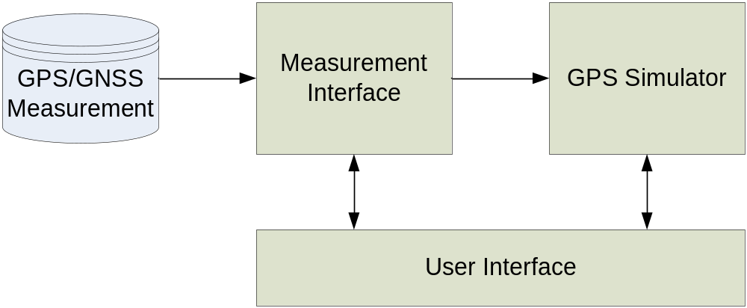
Stanford GPS/GNSS Matlab Platform
Stanford GPS Matlab Platform (SGMP) is a platform that enables you to use GPS/GNSS measurements in various formats for your GPS research activity.

Slide 3
Key Aspects of SGMP
Everything Matlab
Matlab has been most popular for GPS/GNSS research. So let’s move everything to the world of Matlab for seamless and uninterrupted research.
Access to Unbounded Database
Convert positioning database in various formats (NSTB, NMEA, RINEX…) to a single format in Matlab.
Integrated Platform
SGMP is a platform intended for GPS simulation as well as measurement interface. Any simulation based on SGMP format can operate under SGMP platform.

Slide 4
Components in SGMP
Measurement Interface
Convert various formats to SGMP format.
GPS Simulator
Position estimation, RAIM research…
User Interface
Provides user control.

Slide 5
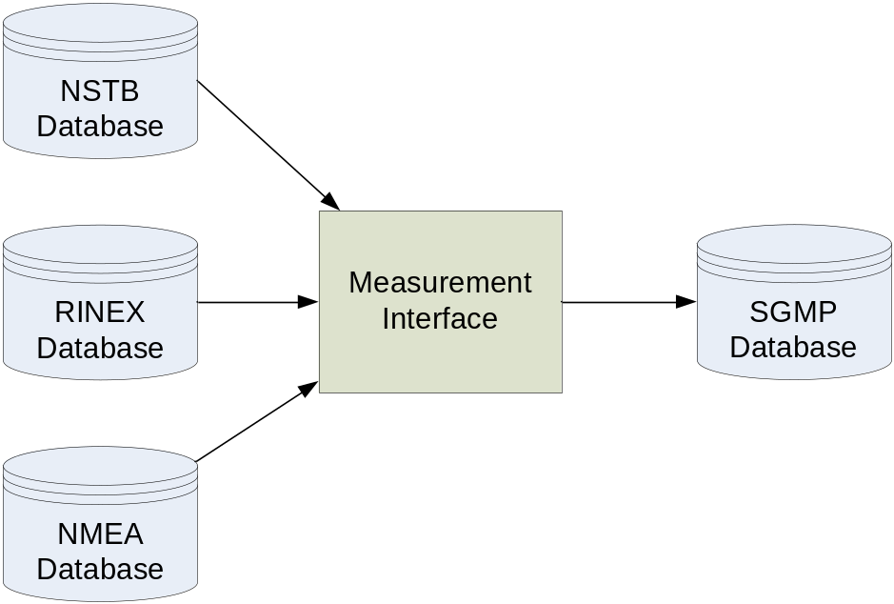
Measurement Interface
An interface to various formats of GPS intermediate measurements (psuedorange). All supported formats of measurements are converted to a Matlab format.
Extension to other sensors (TV, WiFi, INS…)?

Slide 6
Input Formats: NSTB, …
National Satellite Test Bed (NSTB)
A data format for Test Bed Reference Station (TRS) and WAAS Reference Stations (WRS) data. The recorded data includes GPS measurements; ephemeris and almanac data; GEO measurement and WAAS broadcast data; as provided by the GPS receivers at the Reference sites.
Receiver Independent Exchange Format (RINEX)
A data interchange format for raw satellite navigation system data. This allows the user to post-process the received data (usually with other data unknown to the original receiver, such as better models of the atmospheric conditions at time of measurement) to produce a more accurate solution.
National Marine Electronics Association (NMEA)
NMEA 0183 (or NMEA for short) is a combined electrical and data specification for communication between marine electronic devices such as echo sounder, sonars, anemometer (wind speed and direction), gyrocompass, autopilot, GPS receivers and many other types of instruments. It has been defined by, and is controlled by, the U.S.-based National Marine Electronics Association.

Slide 7
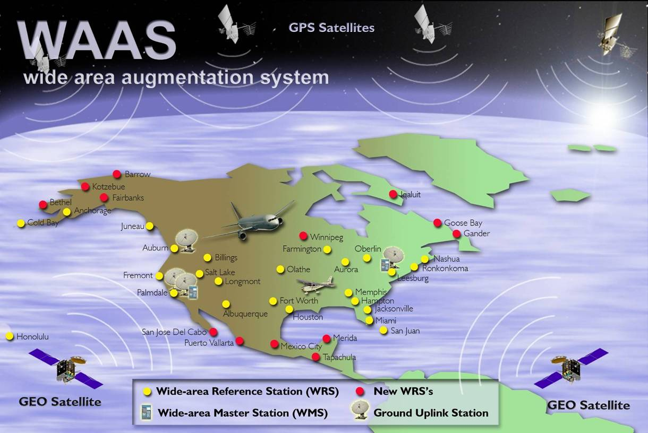
NSTB Stations

Slide 8
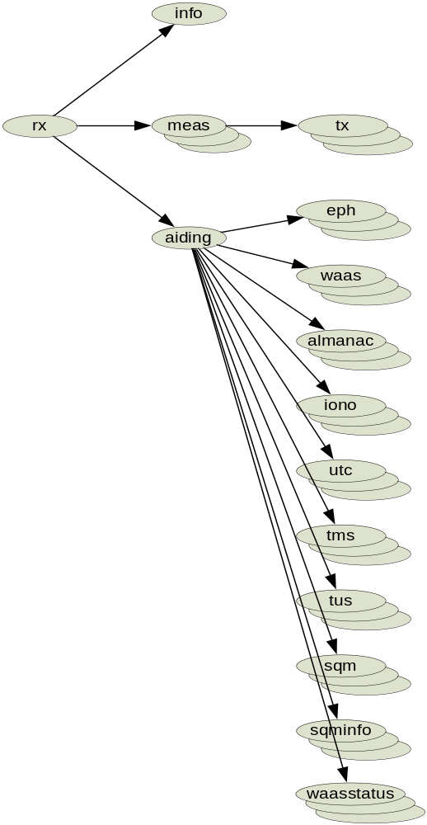
Output Format: SGMP
Structured data tree
rx contains information and measurements by a receiver during a specific time frame.
rx.info, rx.meas, and rx.aiding.
Field | Description
info | receiver and data file information
meas | measurements by receiver
aiding | aiding information from external sources

Slide 9
rx.info
rx.info contains receiver specific static information such as receiver type and the start and end time of overall data file.
Field | Description
id | User defined receiver identification number
sitename | receiver site name
type | receiver type
initpos | initial position of receiver in XYZ (meter) and equivalent to true position for stationary receiver
gpswk | reference time in gps week number
starttow | start time of reception in time of week (second)
endtow | end time of reception in time of week (second)

Slide 10
rx.meas.tx
rx.meas.tx contains transmitter specific measurements for given reference measurement time.
Field | Description
prn | transmitter identification number. prn for GPS satellites
numch | number of channels for this transmitter
pr | pseudo-range (meter)
cr | carrier-range (meter)
dp | Doppler (meter/second)
snr | signal-to-noise ratio (dBHz)
slip | cyclic slip counter (0-7)

Slide 11
rx.aiding
rx.aiding contains aiding information provided by external sources such as GPS satellites and WAAS satellites. Includes eph, waas, almanac, iono, utc, tms, tus, sqm, sqminfo, and waasstatus.
Field | Description
eph | ephemeris and clock parameters from GPS navigation message
waas | WAAS broadcast message
almanac | almanac message
iono | ionosphere (Klobuchar) message
utc | UTC message
tms | TMS to TUS message
tus | TUS to TMS message
sqm | SQM message
sqminfo | SQM information message
waasstatus | WAAS subsystem status message

Slide 12
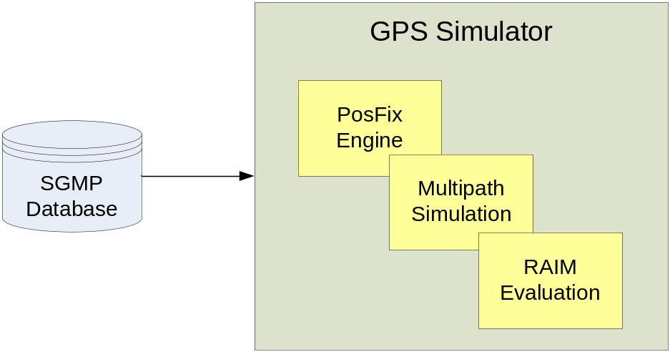
GPS Simulator
Now We’re Ready to Rock!
GPS Simulator is a block allocated for signal processing functionalities based on data from Measurement Interface. A sample program is provided which can be modified according to user’s needs.

Slide 13
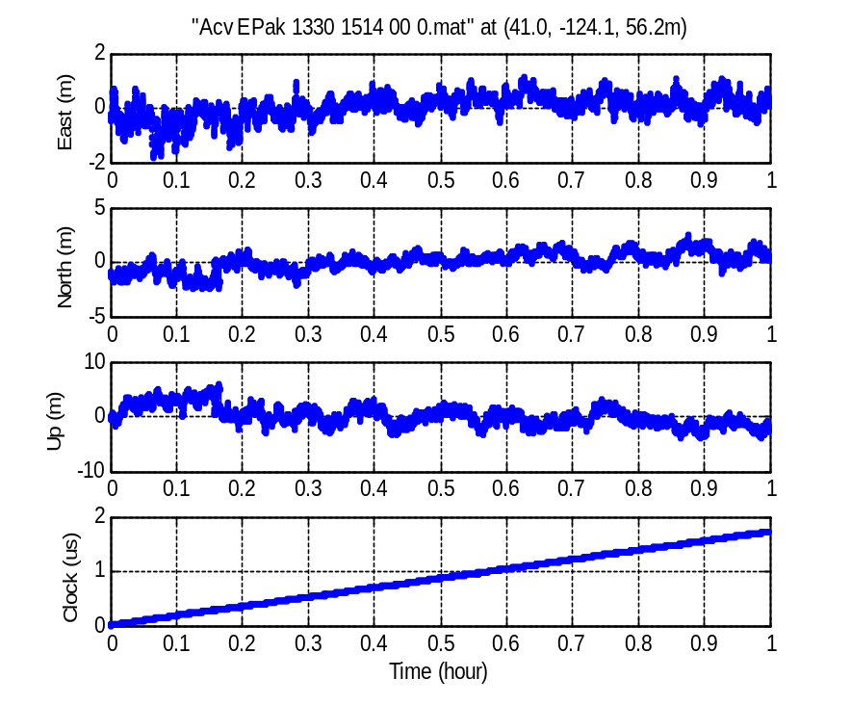
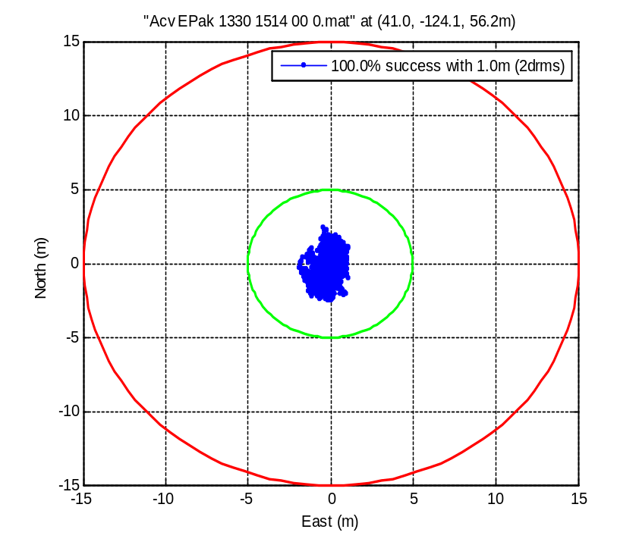
Example: Position Fixes
Position Estimation

Slide 14
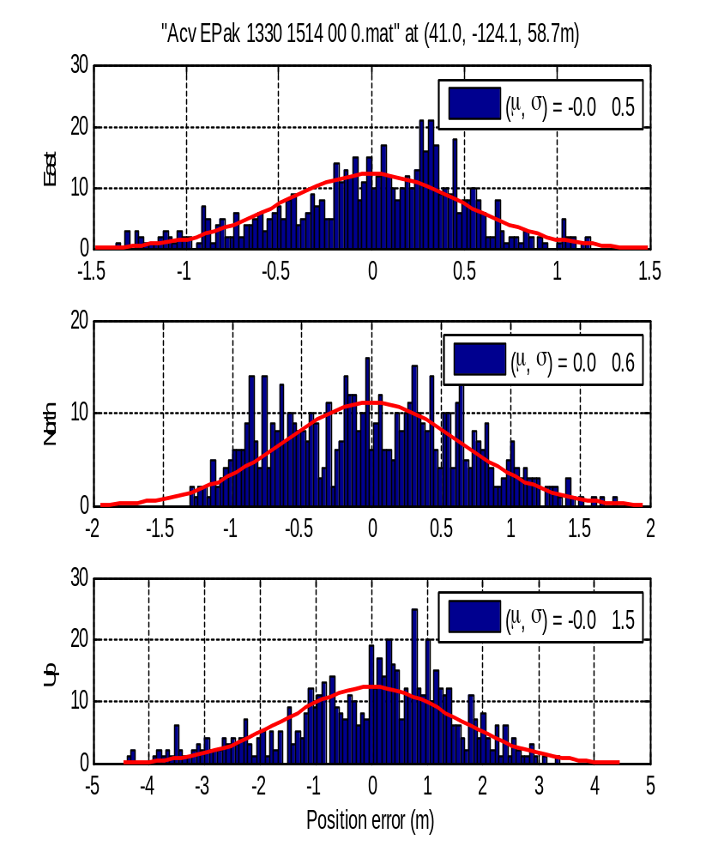
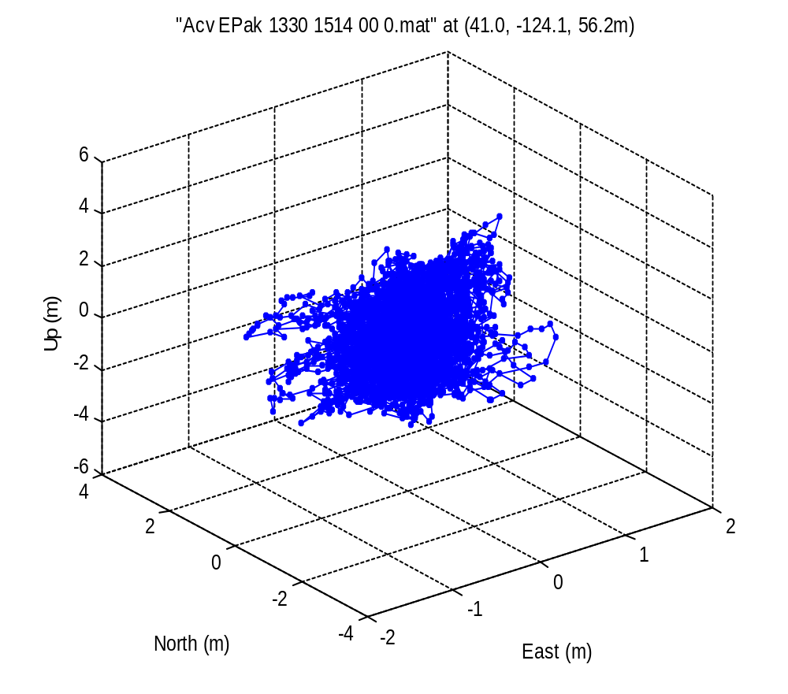
Example: Position Fixes (cont’d)

Slide 15
How it works: Setting Up
Go to waas.stanford.edu
Download and unzip SGMP.zip
You’ll see following directories created under /SGMPrelease:
  /SGMPrelease/document
  /SGMPrelease/measurement interface
  /SGMPrelease/simulator
  /SGMPrelease/user interface

Slide 16
How it works: Parsing
Getting NSTB Data
  Go to http://www.nstb.tc.faa.gov/DisplayNSTBDataDownload.htm
  Download and unzip NSTB files
  Move the unzipped NSTB files to /SGMPrelease/measurement interface/data/nstb
Parsing
  To parse all NSTB files, use /SGMPrelease/measurement interface/batchparseNSTB.m
  To parse a NSTB file, use /SGMPrelease/measurement interface/parseNSTB(filename, starthour, endhour, crccheck)
  ex) rx = parseNSTB( 'Acv_EPak_1330_1514_00', 1, 5, 0);
  %parse NSTB file from 1 hour to 5 hour without CRC checking

Slide 17
How it works: Positioning
Positioning
  After parsing NSTB files to SGMP files (located under /SGMPrelease/measurement interface/data/parsed), we are ready to rock!
  Start Matlab and go to /SGMPrelease/simulator/
  Execute batchPosfixSGMP.m
  Alternatively, use posfixNSTB(filename)
Results
  Go to /SGMPrelease/simulator/result/posfix/
  Check out *.mat, *.fig, or *.eps files for results

Slide 18
Summary
SGMP (Stanfor GPS/GNSS Matlab Platform) is a Matlab based platform providing access to multi-format positioning database.
SGMP enables you to tap into existing and ever-growing database regardless of formats.
Standardized format (SGMP) opens door to research collaboration and connection b.t. generations of students.

Slide 19
What’s next…
Measurement Interface
  Support for NMEA, RINEX, …
  Extension to other sensors such as TV, WiFi,…
GPS simulator
  Add more blocks (RAIM simulation, differential positioning,…)
  For example, NSTB provides dual frequency code and carrier measurements. Lots of possibilities.
User Interface
  Implement a “Per”-friendly GUI?

Slide 20
Reference
NstbDataFormat1103.doc Description of NSTB format
www.nstb.tc.faa.gov/DisplayNSTBDataDownload.htm
NSTB data files are provided.
www.mathworks.com/access/helpdesk/help/techdoc/ref/struct.html Matlab structure type is described.
SGMP.zip

Slide 21
Thanks!
Thanks to Euiho and Grace for their earlier works for NSTB data.
Thanks to Todd, Juan and Per for their inputs to SGMP.
Thank you, everyone!

