Slide 1
MS&E 214
Minimum Cost Flow LP
Ashish Goel

Slide 2
Roadmap for Rest of the Class
Next and Final Applied Module: Business Logistics and Revenue Management
Need our last technique: Network Flows (today)
    Revisit Basic Feasible Solutions
Example Problems
  Routing
  Scheduling
  Assignment
  Warehouse planning
  Supply Chains
  Pricing and Revenue Management
  Special problem
Revisit Duality using Production Problems

Slide 3
p
4
6
t
s
2
3
1
4
2
r
q

Slide 4
Shortest Path Problem
Find the shortest path from s to t
  Using linear programs
Many direct applications
  Web applications to compute routes
Indirect applications
  Currency arbitrage
  Most reliable path
Beautiful structure: BFSs, duality
Generalizes to Min-cost Flows

Slide 5
Notation
Given a directed graph G
  V = Set of nodes in the graph, eg. {s, p, q, r, t}
  N = Number of nodes, eg. N = 5
p
4
6
t
s
2
3
1
4
2
r
q

Slide 6
Notation
Given a directed graph G
  E = Set of edges, eg. {(s,p), (p,s), (s,q), (q,s),(p,t), (q,r), (r,t)}
  M = Number of edges, eg. M = 7
p
4
6
t
s
2
3
1
4
2
r
q

Slide 7
Notation
Given a directed graph G
  c(u,v) = Cost of edge from u to v, eg. c(s,p) = 4, whereas c(s,t) is undefined
p
4
6
t
s
2
3
1
4
2
r
q

Slide 8
Notation
Given a directed graph G
  Assume that s is the “start” and t the “terminating point” of the path we want to find
p
4
6
t
s
2
3
1
4
2
r
q

Slide 9
Notation
Given a directed graph G
  Assume that “s” is the start and t the “terminating point” of the path we want to find
p
4
6
G, V, E, N, M, c, s, t
are all just a convention;
we will use other symbols
where necessary
t
s
2
3
1
4
2
r
q

Slide 10
Linear Program?
Decision Variables?
  A variable for every path?
Number of s-t paths in this graph = 70
Number of s-t paths in 10 X 10 grid = 184,756
In 20 X 20 grid = 137,846,528,820
t
s

Slide 11
Linear Program?
Decision Variables?
  A variable for every edge
x(u,v): The amount of edge (u,v) used in the path, perhaps fractionally
  x(u,v) = 1 : The edge is used on the path
  x(u,v) = 0 : The edge is not used
  x(u,v) = ½ : The edge is used half the time
x(u,v): Leave u, enter v

Slide 12
Constraints
x(u,v) ≥ 0
x(u,v) ≤ 1
If you enter a vertex other than s or t, you must leave it
You must leave s once
You must enter t once

Slide 13
Constraints
x(u,v) ≥ 0
x(u,v) ≤ 1
If you enter a vertex other than s or t, you must leave it exactly as much as you enter it
You must leave s once more than you enter it
You must enter t once more than you leave it

Slide 14
Solution for Example
x(s,q) = x(q,r) = x(r,t) = 1; all other x’s are 0
p
4
6
t
s
2
3
1
4
2
r
q

Slide 15
Minimum Cost Flow (MCF)
Need to ship some good from “supply” nodes to “demand” nodes over a network
  Example: the good could be crude oil; the network could be a network of pipelines; the supply nodes could be oil fields; the demand nodes could be refineries
Assumption: The good is divisible, so we can ship fractional amounts of a good over an edge
Fundamental problem: generalizes shortest paths; maximum compatibility matching; max-flow

Slide 16
Modeling the Network
The network is modeled as a directed graph G
  V = Set of nodes; E = Set of edges
  N = number of nodes; M = number of edges
  c(v,w) = cost of edge (v,w)
  u(v,w) = capacity of edge (v,w)
Capacity of the edge: the maximum amount of flow on the edge

Slide 17
Modeling the Network
The network is modeled as a directed graph G
  V = Set of nodes; E = Set of edges
  N = number of nodes; M = number of edges
  c(v,w) = cost of edge (v,w)
  u(v,w) = capacity of edge (v,w)
Capacity of the edge: the maximum amount of flow on the edge

Slide 18
Modeling the Network
The network is modeled as a directed graph G
  V = Set of nodes; E = Set of edges
  N = number of nodes; M = number of edges
  c(v,w) = cost of edge (v,w)
  u(v,w) = capacity of edge (v,w)
Capacity of the edge: the maximum amount of flow on the edge

Slide 19
Modeling Demands
Demand of a node: The amount of the good that a node wants to consume
Supply of a node: The amount of the good that a node wants to produce
Modeled as a single number, d(v), for node v
  d(v) is positive for “demand nodes”
  d(v) is negative for “supply nodes”
  d(v) = 0 otherwise

Slide 20
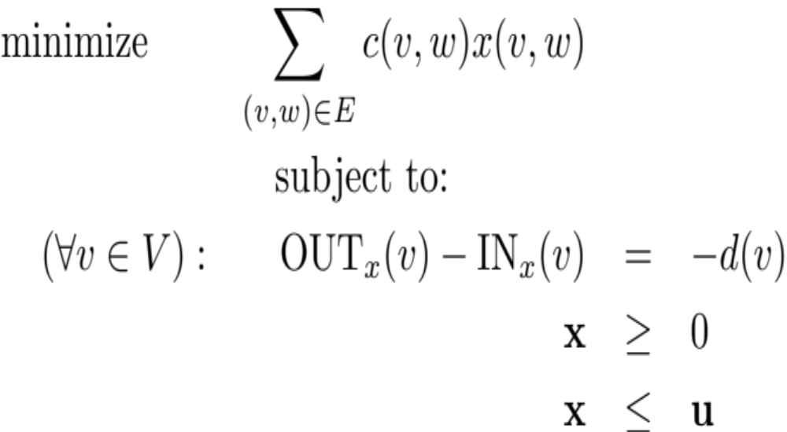
The Linear Program
CONSERVATION
CONSTRAINTS

Slide 21
The Linear Program
CAPACITY
CONSTRAINTS

Slide 22
Can Demands be Arbitrary?
For the problem to be feasible, should the sum of the demands be
      Strictly Negative?
      Zero
      Strictly Positive?
      Doesn’t matter.

Slide 23
The Linear Program
SUMS TO ZERO, WHEN SUMMED
OVER ALL NODES

Slide 24
Can Demands be Arbitrary?
For the problem to be feasible, should the sum of the demands be
      Strictly Negative?
      Zero
      Strictly Positive?
      Doesn’t matter.

Slide 25
Reduction to MCF
Reduction to MCF: Model a problem using the general framework of MCF
Very powerful tool
Suppose we are reducing a problem P to MCF
Must specify how to obtain
  The graph G (nodes, edges)
  Edge capacities u and costs c
  Node demands d
from the parameters of the given problem P
Must specify how the solution x to MCF gives a solution to P

Slide 26
A Simple Reduction
Reducing s-t Shortest Paths to MCF
  Use the same graph G and the given costs c
  Set d(s) = -1, d(t) = 1, d(v) = 0 for all other nodes
  Set u(v,w) = 1 for all edges (v,w)
  (Or, set u(v,w) = ∞ for all edges (v,w))
  The solution x(v,w) to the MCF is also a solution to the shortest path problem
Hence, MCF is more general than shortest paths

Slide 27
A Simple Example
Every edge has a cost and a capacity, written as (c, u)
p
(4,1)
(6,1)
t
s
(2,1)
(3,1)
(1,1)
(4,1)
(2,1)
r
q

Slide 28
A Simple Example
Every node has a demand
d = 0
p
(4,1)
(6,1)
t
d = 1
s
(2,1)
d = -1
(3,1)
(1,1)
(4,1)
(2,1)
r
q
d = 0
d = 0

Slide 29
A Simple Example
Every node has a demand ⇒ capacities can be ∞
d = 0
p
(4,∞)
(6, ∞)
t
d = 1
s
(2, ∞)
d = -1
(3, ∞)
(1, ∞)
(4, ∞)
(2, ∞)
r
q
d = 0
d = 0

Slide 30
Infinite Capacities?
Can handle infinite capacity edges by just removing the capacity constraint for those edges
For shortest paths
  Setting capacity = ∞ guarantees that there will never be an optimum solution if there is a negative cost cycle (better fits the spirit of the problem)
  Setting capacity = 1 guarantees that there will be an optimum solution if there is a feasible solution

Slide 31
Next Steps
Theory: Examine Basic Feasible Solutions
Reductions: See two more examples
Hands On: Solve an example problem
  Illustrate capacity constraints
  A nice trick for generating the constraint matrix A

Slide 32
Main Theorem
For an instance of a Minimum Cost Flow Problem, if
(a) Every demand is integral
and
(b) Every capacity is integral
then
Every Basic Feasible Solution is Integral
Very useful, since in many applications (eg. Shortest paths), fractional solutions do not make sense

Slide 33
Proof Sketch
Start with any feasible fractional solution
Find a cycle of edges (ignoring directions) such that every edge on the cycle has fractional flow
Show that along this cycle, flow can be increased a little clockwise, as well as counterclockwise
➔ The original fractional solution was an average of two other feasible solutions, and hence not a BFS

Slide 34
A Simple Example
Labels on edges are (costs, capacities)
d = 0
p
(4,1)
(6,1)
t
d = 1
s
(2,1)
d = -1
(3,1)
(1,1)
(4,1)
(2,1)
r
q
d = 0
d = 0

Slide 35
Step 1: Start With a Fractional Solution
Labels on edges are flows
d = 0
p
0.6
0.6
t
d = 1
s
0
d = -1
0.4
0.4
0
0.4
r
q
d = 0
d = 0

Slide 36
Step 2: Find a Cycle of Fractionally Used Edges
Labels on edges are flows
d = 0
p
0.6
0.6
t
d = 1
s
0
d = -1
0.4
0.4
0
0.4
r
q
d = 0
d = 0

Slide 37
Step 2: Find a Cycle of Fractionally Used Edges
Labels on edges are flows
Start with an arbitrary fractional edge
d = 0
p
0.6
0.6
t
d = 1
s
0
d = -1
0.4
0.4
0
0.4
r
q
d = 0
d = 0

Slide 38
Step 2: Find a Cycle of Fractionally Used Edges
Labels on edges are flows
Start with an arbitrary fractional edge
d = 0
p
0.6
0.6
t
d = 1
s
0
d = -1
0.4
0.4
0
0.4
r
q
d = 0
d = 0

Slide 39
Step 2: Find a Cycle of Fractionally Used Edges
Since t has integer demand, there must be another edge incident on t with fractional flow
Labels on edges are flows
d = 0
p
0.6
0.6
t
d = 1
s
0
d = -1
0.4
0.4
0
0.4
r
q
d = 0
d = 0

Slide 40
Step 2: Find a Cycle of Fractionally Used Edges
Since t has integer demand, there must be another edge incident on t with fractional flow
Labels on edges are flows
d = 0
p
0.6
0.6
t
d = 1
s
0
d = -1
0.4
0.4
0
0.4
r
q
d = 0
d = 0

Slide 41
Step 2: Find a Cycle of Fractionally Used Edges
Use the same argument at r
Labels on edges are flows
d = 0
p
0.6
0.6
t
d = 1
s
0
d = -1
0.4
0.4
0
0.4
r
q
d = 0
d = 0

Slide 42
Step 2: Find a Cycle of Fractionally Used Edges
Use the same argument at r
Labels on edges are flows
d = 0
p
0.6
0.6
t
d = 1
s
0
d = -1
0.4
0.4
0
0.4
r
q
d = 0
d = 0

Slide 43
Step 2: Find a Cycle of Fractionally Used Edges
Use the same argument at q
Labels on edges are flows
d = 0
p
0.6
0.6
t
d = 1
s
0
d = -1
0.4
0.4
0
0.4
r
q
d = 0
d = 0

Slide 44
Step 2: Find a Cycle of Fractionally Used Edges
Use the same argument at q
Labels on edges are flows
d = 0
p
0.6
0.6
t
d = 1
s
0
d = -1
0.4
0.4
0
0.4
r
q
d = 0
d = 0

Slide 45
Step 2: Find a Cycle of Fractionally Used Edges
Use the same argument at s
Labels on edges are flows
d = 0
p
0.6
0.6
t
d = 1
s
0
d = -1
0.4
0.4
0
0.4
r
q
d = 0
d = 0

Slide 46
Step 2: Find a Cycle of Fractionally Used Edges
Use the same argument at s
Labels on edges are flows
d = 0
p
0.6
0.6
t
d = 1
s
0
d = -1
0.4
0.4
0
0.4
r
q
d = 0
d = 0

Slide 47
Step 2: Find a Cycle of Fractionally Used Edges
We have our cycle
Labels on edges are flows
d = 0
p
0.6
0.6
t
d = 1
s
0
d = -1
0.4
0.4
0
0.4
r
q
d = 0
d = 0

Slide 48
Step 2: Find a Cycle of Fractionally Used Edges
We have our cycle
Labels on edges are flows
d = 0
p
0.6
0.6
t
d = 1
s
0
d = -1
0.4
Strongly used the fact that demands are integer
0.4
0
0.4
r
q
d = 0
d = 0

Slide 49
Step 3: Find Two New Feasible Solutions
None of the edges on the cycle is at capacity
Labels on edges are flows
d = 0
p
0.6
0.6
t
d = 1
s
0
d = -1
0.4
0.4
0
0.4
r
q
d = 0
d = 0

Slide 50
Step 3: Find Two New Feasible Solutions
None of the edges on the cycle is at capacity
Labels on edges are flows
d = 0
p
0.6
0.6
t
d = 1
s
0
d = -1
0.4
Strongly used the fact that capacities are integer
0.4
0
0.4
r
q
d = 0
d = 0

Slide 51
Step 3: Find Two New Feasible Solutions
Each edge on the cycle has non-zero flow
Labels on edges are flows
d = 0
p
0.6
0.6
t
d = 1
s
0
d = -1
0.4
0.4
0
0.4
r
q
d = 0
d = 0

Slide 52
Step 3: Find Two New Feasible Solutions
Each edge on the cycle has non-zero flow
Labels on edges are flows
d = 0
p
0.6
0.6
t
d = 1
s
0
d = -1
0.4
Hence, can increase or decrease the flow on each edge
0.4
0
0.4
r
q
d = 0
d = 0

Slide 53
Step 3: Find Two New Feasible Solutions
Send some flow (say 0.1) “clockwise”
Labels on edges are flows
d = 0
p
0.6
0.6
t
d = 1
s
0
d = -1
0.4
0.4
0
0.4
r
q
d = 0
d = 0

Slide 54
Step 3: Find Two New Feasible Solutions
Send some flow (say 0.1) “clockwise”
Labels on edges are flows
d = 0
p
0.7
0.7
t
d = 1
s
0
d = -1
0.3
0.3
Solution A
0
0.3
r
q
d = 0
d = 0

Slide 55
Step 3: Find Two New Feasible Solutions
Send some flow (say 0.1) “counter-clockwise”
Labels on edges are flows
d = 0
p
0.6
0.6
t
d = 1
s
0
d = -1
0.4
0.4
0
0.4
r
q
d = 0
d = 0

Slide 56
Step 3: Find Two New Feasible Solutions
Send some flow (say 0.1) “counter-clockwise”
Labels on edges are flows
d = 0
p
0.5
0.5
t
d = 1
s
0
d = -1
0.5
0.5
Solution B
0
0.5
r
q
d = 0
d = 0

Slide 57
Step 3: Find Two New Feasible Solutions
The average of Solutions A and B gives us the fractional solution we started with
Labels on edges are flows
d = 0
p
0.6
0.6
t
d = 1
s
0
d = -1
0.4
0.4
0
0.4
r
q
d = 0
d = 0

Slide 58
Step 3: Find Two New Feasible Solutions
The average of Solutions A and B gives us the fractional solution we started with
Labels on edges are flows
d = 0
p
0.6
0.6
t
d = 1
s
0
d = -1
0.4
Hence, we did not start with a BFS
0.4
0
0.4
r
q
d = 0
d = 0

Slide 59
While we used a specific example, the proof is completely generalizable for any MCF with integer capacities and demands

Slide 60
Main Theorem
For an instance of a Minimum Cost Flow Problem, if
(a) Every demand is integral
and
(b) Every capacity is integral
then
Every Basic Feasible Solution is Integral
Very useful, since in many applications (eg. Shortest paths), fractional solutions do not make sense

Slide 61
Minimum Cost Flow – Two Special Cases
Ashish Goel

Slide 62
Example: Matching
Match every child to exactly one flavor, and vice-versa, while maximizing total compatibility (i.e., how much the child likes the flavor)
C_{i,j} : Compatibility of flavor i with child j
COMPATIBILTY | Gloria | Harish | Ivy
Dipping-Dots | 1 | 0 | 0.5
Espresso | 0.75 | 2 | 1
Fudge | 0.5 | 2.5 | 1.5

Slide 63
Reduction to MCF
D
G
E
H
F
I

Slide 64
Reduction to MCF
D
G
E
H
F
I
Cost = -compatibility
Capacity = 1

Slide 65
Reduction to MCF
D
G
WHAT SHOULD
THE DEMAND OF
DIPPING-DOTS BE
IN THIS PROBLEM?
E
H
F
I
Cost = -compatibility
Capacity = 1

Slide 66
Reduction to MCF
d = -1
D
G
d = -1
E
H
d = -1
F
I
Cost = -compatibility
Capacity = 1

Slide 67
Reduction to MCF
d = -1
D
G
WHAT SHOULD
THE DEMAND OF
IVY BE IN THIS
PROBLEM?
d = -1
E
H
d = -1
F
I
Cost = -compatibility
Capacity = 1

Slide 68
Reduction to MCF
d = -1
D
G
d = +1
d = -1
E
H
d = +1
d = -1
F
I
d = +1
Cost = -compatibility
Capacity = 1

Slide 69
Reduction to MCF
d = -1
D
G
d = +1
d = -1
E
H
d = +1
d = -1
F
I
d = +1
x(v,w) → The amount of
ice-cream v
allocated to child w
Cost = -compatibility
Capacity = 1

Slide 70
Reduction to MCF
d = -1
D
G
d = +1
d = -1
E
H
d = +1
d = -1
F
I
d = +1
x(v,w) → The amount of
ice-cream v
allocated to child w
Cost = -compatibility
Capacity = ∞

Slide 71
Negative costs and negative cycles
Cost = -compatibility
Capacity = ∞
Negative costs do not pose any difficulty, as long as there are no cycles with negative cost
Negative costs cycles can pose difficulty and opportunity
-- If capacities are infinite, a negative cost cycle implies that the LP will not have an optimum solution
-- But sometimes, the presence of a negative costs cycle can also be used to identify revenue opportunities.
-- No one correct way to handle negative cost cycles, so need to really understand the underlying problem

Slide 72
Basic Feasible Solutions for Matchings
Any BFS for the Maximum Compatibility Matching problem written as a MCF must be an integer
  Integer capacities and demands
Interesting observation: The LP for the Maximum Compatibility Matching that we saw earlier is exactly the same as the LP for the corresponding MCF

Slide 73
(s,t) Max-Flow Problem
Given a directed graph G with capacities (but no costs) on edges
Given two special nodes in V: a source s and a terminus t
Find the maximum amount of flow that can be sent from s to t

Slide 74
Example
Labels on edges represent capacities, not costs
Eyeballing: Optimum solution is to send 4 units of flow on top path, and 1 unit on bottom path
p
4
6
t
s
2
3
1
4
2
r
q

Slide 75
Max flow example
Consider this network and let us compute the s-t max flow on it. Will solve on excel in class. Labels on edges represent capacities
9
D
C
15
10
10
15
4
5
8
10
s
t
B
E
6
10
4
15
10
30
F
A

Slide 76
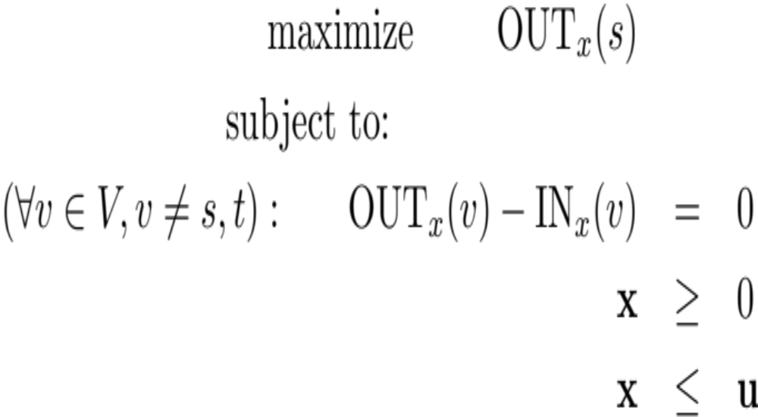
LP For (s,t) Max Flow
(Assumes that edges into s have been removed)

Slide 77
Reduction to MCF (Technical)
Start with an instance of the max-flow problem
  Graph G with edge capacities
  Missing: edge costs; node demands
  Set each edge cost to 0, each node demand to 0
Add a new edge from t to s of infinite capacity and cost -1, to obtain an instance of MCF
Intuition: MCF solution will try to minimize cost by pushing as much flow as possible from t to s
  Since demands are all zero, this flow must travel back from s to t using edges in the original graph G
Consequence: The resulting MCF LP ends up being the same as the Max-flow LP.
Hence, the Max-Flow LP on the previous slide will give an integral solution if
(a) The capacities are integers
(b) The LP is solved using (almost) any commercial or open-source LP solver

Slide 78
HW Hints: The logarithmic trick
Log (ab) = Log a + Log b
Hence, if our goal is to minimize the product of some quantity (say q(v,w)) along a s-t path, we can just define a cost
c(v,w) = log (q(v,w))
and solve the usual shortest path/mcf problem with this new cost.
You will use this idea twice in the HW. Here are quick hints.
  To find the most reliable path. Given a failure probability f(v,w) along each edge, the success probability of a path is the product of the success probabilities along each edge, hence set c(v,w) = -log(1- f(v,w))
  Negative Costs cycles? Not possible. All edges have non-negative cost.
  To do currency arbitrage. You need to find a cycle of currencies where the product of the exchange rates is more than 1. Same as saying that the sum of the logs of the exchange rates is more than 0, or the sum of the negative of the log of the exchange rates is less than 0.
  Negative Costs cycles? Indicate Arbitrage. Make sure capacities are set to 1.

Slide 79
Conclusion
MCF is a very powerful class of LPs
Reducing another problem to MCF allows us to use the structure of MCF
Next: Duality Revisited!

