Slide 1
Support Vector Machines: A case study in quadratic programming
MS&E 214: Optimization via Case Studies
Instructor: Ashish Goel
Slides originally by Oliver Hinder

Slide 2
The problem
For current patients which we know if they have heart disease.
Want an automated way to predict if a new patient has heart disease.
Real data sample:
Goal of this module: to teach you how to fit a “linear classification” model to this type of data using quadratic programming – related to the linear separator

Slide 3
Model
PATIENT
ATTRIBUTES
MODEL
PREDICTION
A model is systematic way of making predictions from data.
The model we are going to focus on is support vector machines which is a more advanced version of the separating hyperplane technique from an earlier in the course.
Models have coefficients that are fitted to the dataset, e.g., the coefficient vector of the separating hyperplane.
COEFFICENTS

Slide 4
Test and training sets
Dataset
You should always split your dataset into training and test data.

Slide 5
Test and training sets
Training set
Test set
You should always split your dataset into training and test data.

Slide 6
Test and training sets
Training set
Test set
You should always split your dataset into training and test data.
On the training data you optimize the model parameters.
On the test set you check model performance.
For the heart disease dataset we use 100 of the data points as a test set and the remainder for the training set.
Why not use the training set to check model performance?
  Model is often overfitted to the training set.
  Test set estimates performance on unseen examples.
  Can use the test set to estimate how much model is overfitted to training set.

Slide 7


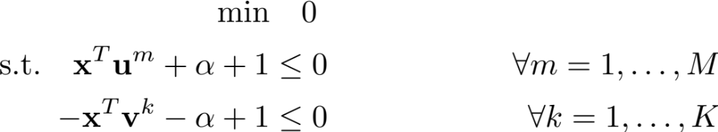
Separating hyperplanes (recap)
Data
  Positive samples:
  Negative samples:
Linear program:
For now we will assume training set is perfectly separable … later we will consider inseparable case.
Notes:
Data:
Positive samples $\mathbf{u}^1, \dots, \mathbf{u}^{M} \in \mathfrak{R}^{N}$
Negative samples $\mathbf{v}^1, \dots, \mathbf{v}^{K} \in \mathfrak{R}^{N}$
Linear program
\min & \quad 0 \\
\text{s.t.} \quad \mathbf{x}^T \mathbf{u}^m + \alpha + 1 &\le 0 &\forall m = 1, \dots , M \\
\quad -\mathbf{x}^T \mathbf{v}^k - \alpha + 1 &\le 0 & \forall k = 1, \dots, K

Slide 8
Overfitting with separating hyperplanes
B
B
A
A
New set of unseen points
Training points
A yields 4 points misclassified
B yields 1 points misclassified
Which hyperplane is better A or B?
Notes:
Separating hyperplane could either be A or B! Clearly one is better!

Slide 9

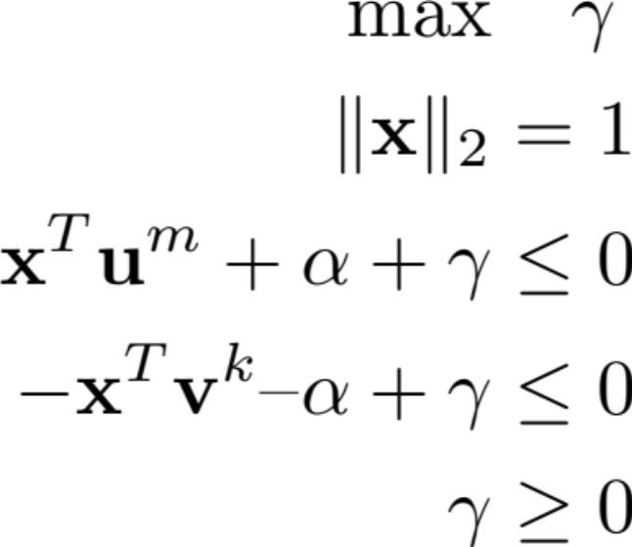
Maximum margin separating hyperplane
The margin is the total distance that we can shift the normalized separating hyperplane without misclassifying any point.
Mathematical formulation:
=margin
B
A
Why is B better than A?
A margin is small
B margin is large
Larger margin = more room for error
Notes:
\max & \quad \gamma \\
\| \mathbf{x} \|_2 &= 1 \\
\mathbf{x}^T \mathbf{u}^{m} + \alpha + \gamma &\le 0 \\
-\mathbf{x}^T \mathbf{v}^{k} – \alpha + \gamma &\le 0 \\
\gamma &\ge 0

Slide 10
Maximum margin separating hyperplane
The margin is the total distance that we can shift the normalized separating hyperplane without misclassifying any point.
Mathematical formulation:
=margin
B
A
Why is B better than A?
A margin is small
B margin is large
Larger margin = more room for error
Notes:
\max & \quad \gamma \\
\| \mathbf{x} \|_2 &= 1 \\
\mathbf{x}^T \mathbf{u}^{m} + \alpha + \gamma &\le 0 \\
-\mathbf{x}^T \mathbf{v}^{k} – \alpha + \gamma &\le 0 \\
\gamma &\ge 0

Slide 11
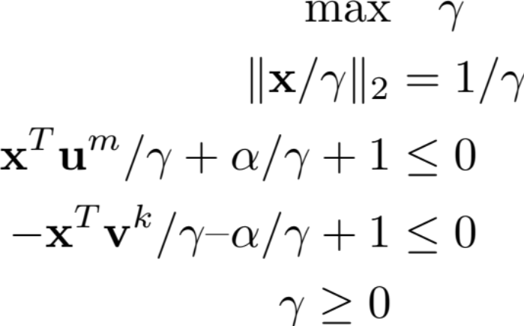
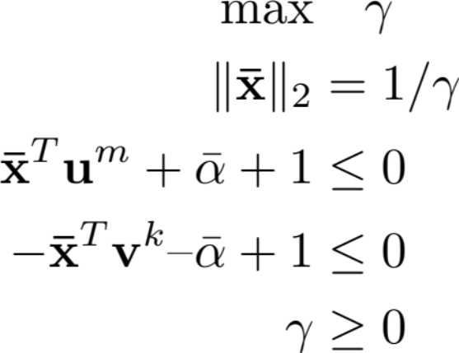
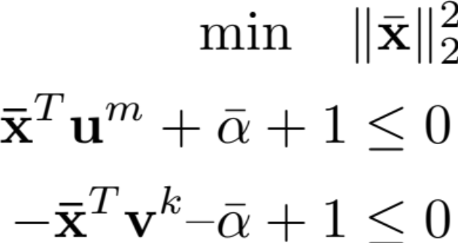
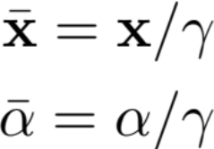

Derivation of quadratic program
Lets convert the previous problem into a quadratic program:
Divide by
Substituting
Maximize
is the same as minimizing
quadratic program
Notes:
\max & \quad \gamma \\
\| \mathbf{x} / \gamma \|_2 &= 1/\gamma \\
\mathbf{x}^T \mathbf{u}^{m} / \gamma + \alpha / \gamma + 1 &\le 0 \\
-\mathbf{x}^T \mathbf{v}^{k} / \gamma – \alpha / \gamma + 1 &\le 0 \\
\gamma \ge 0
Substitute
\bar{\mathbf{x}} = \mathbf{x} / \gamma \\
\bar{\alpha} = \alpha / \gamma
\max & \quad \gamma \\
\| \mathbf{\bar{x}} \|_2 &= 1/\gamma \\
\mathbf{\bar{x}}^T \mathbf{u}^{m} + \bar{\alpha} + 1 &\le 0 \\
-\mathbf{\bar{x}}^T \mathbf{v}^{k} – \bar{\alpha} + 1 &\le 0 \\
\gamma &\ge 0
\min \quad &\| \bar{\mathbf{x}} \|_2^2 \\
\mathbf{\bar{x}}^T \mathbf{u}^{m} + \bar{\alpha} + 1 &\le 0 \\
-\mathbf{\bar{x}}^T \mathbf{v}^{k} – \bar{\alpha} + 1 &\le 0
\| \mathbf{\bar{x}} \|^2

Slide 12
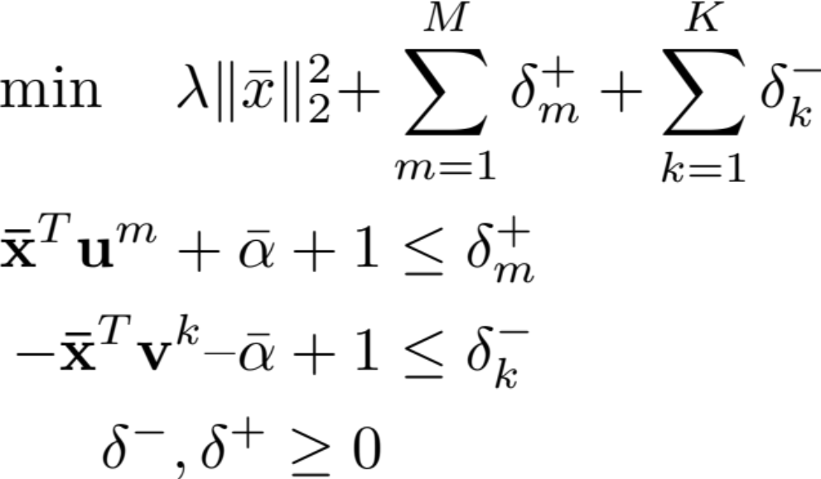
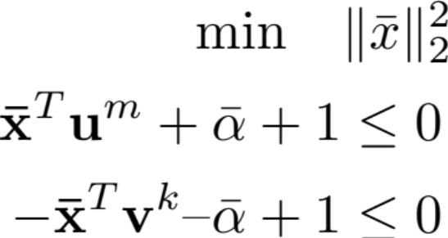
What if there is no separating hyperplane?
Hard margin SVM
Soft margin SVM
Find an exact separating hyperplane that maximizes the margin
Find hyperplane that balances maximizing the margin with the sum of violations
Soft margin SVM is used in practice since data is rarely exactly separable.

Slide 13
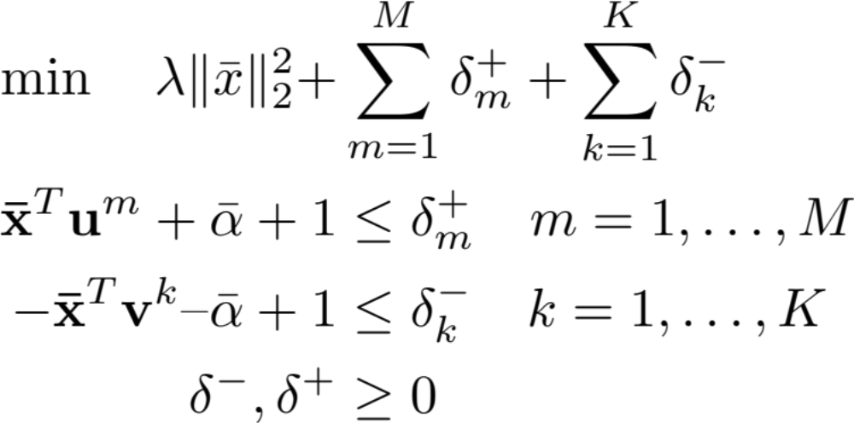

Soft margin support vector machines
Always has a feasible solution and is a quadratic program.
More robust to overfitting than separating hyperplanes.
The parameter needs to be tuned carefully:
  Very large values focus on maximizing the margin and underfits data.
  Very small values focus on minimizing the violation and overfits data.
Notes:
\min \quad \lambda \| \bar{x} \|_2^2 +& \sum_{m=1}^{M} \delta_m^{+} + \sum_{k=1}^{K} \delta_k^{-} \\
\mathbf{\bar{x}}^T \mathbf{u}^{m} + \bar{\alpha} + 1 &\le \delta_{m}^{+} \quad m = 1, \dots, M \\
-\mathbf{\bar{x}}^T \mathbf{v}^{k} – \bar{\alpha} + 1 &\le \delta_k^{-} \quad k = 1, \dots, K \\
\delta^{-}, \delta^{+} &\ge 0

Slide 14
Methods for solving SVM

Slide 15
Excel
Main benefit is easy to use with no programming experience.
Can formulate very tiny problems in excel (less than 50 data points).
Can solve slightly bigger problems if one purchases commercial software but might still be slow to solve problems with a few hundred data points and model coefficients.
For solving large linear programs in excel it is recommended to use open solver https://opensolver.org/.

Slide 16
Mathematical optimization modelling languages
JuMP (Julia) http://www.juliaopt.org/JuMP.jl/stable/
Pyomo (Python) http://www.pyomo.org/documentation
CVXPY (Python) https://www.cvxpy.org/
AMPL https://ampl.com/
Main benefit of these packages is ease of use and flexibility.
You can build your own custom machine learning models with these packages but also solve other optimization problems, e.g., min cost flow.
Disadvantage of these packages is that it may be slow for solving problem more than ten thousand data points and a few thousand coefficients (for many applications this is sufficient).

Slide 17
Machine learning modelling languages
Tensor flow (Python) https://www.tensorflow.org/
PyTorch (Python) https://pytorch.org/
Main benefit is the ability to train sophisticated models, e.g., neural networks.
Can be difficult to learn and cannot be used to solve non-machine learning optimization problems, e.g., minimum cost flow.

Slide 18
Machine learning packages with SVM
Statistics and Machine Learning Toolbox (Matlab)
Scikit (Python) https://scikit-learn.org/stable/tutorial/basic/tutorial.html
Main benefit is easy to learn and scalable.
Low flexibility – have to use model provided.

Slide 19
Getting ready to implement SVM
Remember to split the data into test and training set!
Divide each column by their standard deviation. This stops issues with poor scaling of data.
Try multiple different values of . Pick the value that makes the most correct classifications.
Since this for this data set we our algorithm to be conservative (i.e., always correctly classify individuals with heart disease) we may want to modify our objective accordingly.

