Slide 1
Regression and Quadratic Programming
Ashish Goel

Slide 2
Linear Regression
Given a set of K data points, where each data point has d features x_{i} and an outcome y_{i}
  Note that x_{i} is a d-dimensional vector whereas y_{i} is a scalar
Goal: make a model based on data that can be used to estimate/predict the values of the outcome variable for other data points where you know the features but not the outcome
Example: Predict risk of breast cancer or prostate cancer in the next five years given height, weight, age, race, family history, and blood test results
  Lots of data points from patients who underwent the same tests 5 or more years ago
  Another simple example: predicting stride length (last class)

Slide 3
Linear Regression
Let f be an unknown real-valued function defined on points in d dimensions. We are given the value of f on K points, x₁, x₂, …, x_{K}, where each x_{i} is d × 1
f(x_{i}) = y_{i}
Goal: Find the best linear estimator of f
Linear estimator: Approximate f(x) as x^{T}p + q
  p and q are decision variables, (p is d × 1, q is scalar)
  p is often known as the coefficients, and q as the intercept/shift
Error of the linear estimator for x_{i} is denoted Δ_{i}
Δ_{i} = (x_{i})^{T}p + q - y_{i}

Slide 4
Linear Regression
Best linear estimator: one which minimizes the error
  Individual error for x_{i}: Δ_{i}
  Overall error: Multiple formulas; one commonly used formula is the sum of the squares of the individual errors

Slide 5
Linear Least Squares Regression
  Minimize Σ_{i} (Δ_{i})²
  s.t.
For all i in {1..K}: Δ_{i} = (x_{i})^{T}p + q - y_{i}

Slide 6
Absolute Error Regression
  Minimize Σ_{i} |Δ_{i}|
  s.t.
For all i in {1..K}: Δ_{i} = (x_{i})^{T}p + q - y_{i}

Slide 7
Absolute Error Regression
  Equivalent to minimizing L1 norm
  Minimize ||Δ||₁
  s.t.
For all i in {1..K}: Δ_{i} = (x_{i})^{T}p + q - y_{i}

Slide 8
Linear Regression [contd]
In class, we saw how to solve both versions of these using excel for a simple example.
  For the L1 norm, we reduced it to a LP by using auxiliary variables.
  For the square error, we solved it using a non-linear solver, but we have no idea why it works for this quadratic objective
This class and next:
  We will first see how to solve these using python, so we can get a head start on the HW
  We will see (with a certain amount of formalism) a general case of quadratic objectives
  We will see (with a wave of the hand) why we can just use the L1 norm formulation in the objective function without auxiliary variables

Slide 9
Folding in the intercept
  Minimize Σ_{i} (Δ_{i})²
  s.t.
For all i in {1..K}: Δ_{i} = (x_{i})^{T}p + q - y_{i}
Can simplify this further. Let X denote the d × K matrix obtained from all the x_{i} ’s: X = (x₁ x₂ … x_{K})

Slide 10
Folding in the intercept
  QP: Minimize Σ_{i} (Δ_{i})²
  s.t.
For all i in {1..K}: Δ_{i} = (x_{i})^{T}p + q - y_{i}
Can simplify this further. Let X denote the d × K matrix obtained from all the x_{i} ’s: X = (x₁ x₂ … x_{K})
Let e denote a K × 1 vector of all 1’s

Slide 11
Folding in the intercept
  QP: Minimize Δ^{T}Δ (or ||Δ ||₁)
  s.t.
Δ = X^{T}p + qe – y
But now we can just add the column e to X and pretend that we have just one (d+1)-dimensional variable p

Slide 12
A simple quadratic program
Minimize (x₁)²
Subject to:
-x₁ + x₂ ≥ 3
-x₁ – x₂ ≥ -2

Slide 13
A simple quadratic program
Minimize (x₁)²
Subject to:
-x₁ + x₂ ≥ 3
-x₁ – x₂ ≥ -2
MOST OPTIMIZATION SOFTWARE HAS A QUADRATIC OR CONVEX OR NON-LINEAR SOLVER THAT CAN BE USED TO SOLVE MATHEMATICAL PROGRAMS WITH LINEAR CONSTRAINTS AND A MIN-QUADRATIC OBJECTIVE FUNCTION
EASY IN PRACTICE

Slide 14
A simple quadratic program
Minimize (x₁)²
Subject to:
-x₁ + x₂ ≥ 3
-x₁ – x₂ ≥ -2
MOST OPTIMIZATION SOFTWARE HAS A QUADRATIC OR CONVEX OR NON-LINEAR SOLVER THAT CAN BE USED TO SOLVE MATHEMATICAL PROGRAMS WITH LINEAR CONSTRAINTS AND A MIN-QUADRATIC OBJECTIVE FUNCTION
EASY IN PRACTICE
QUADRATIC
PROGRAM

Slide 15
Next Steps
Why are Quadratic programs (QPs) easy?
Formal Definition of QPs
Examples of QPs

Slide 16
Next Steps
Why are Quadratic programs (QPs) easy?
  Intuition; not formal proof
Formal Definition of QPs
Examples of QPs
  Regression and Portfolio Optimization

Slide 17
Approximating the Quadratic
Approximate x² by a set of tangent lines (here x is a scalar, corresponding to x₁ in the previous slides)
d(x²)/dx = 2x, so the tangent line at (a, a²) is given by y – a² = 2a (x-a) or
y = 2ax – a²
The upper envelope of the tangent lines gets closer and closer to the real curve

Slide 18
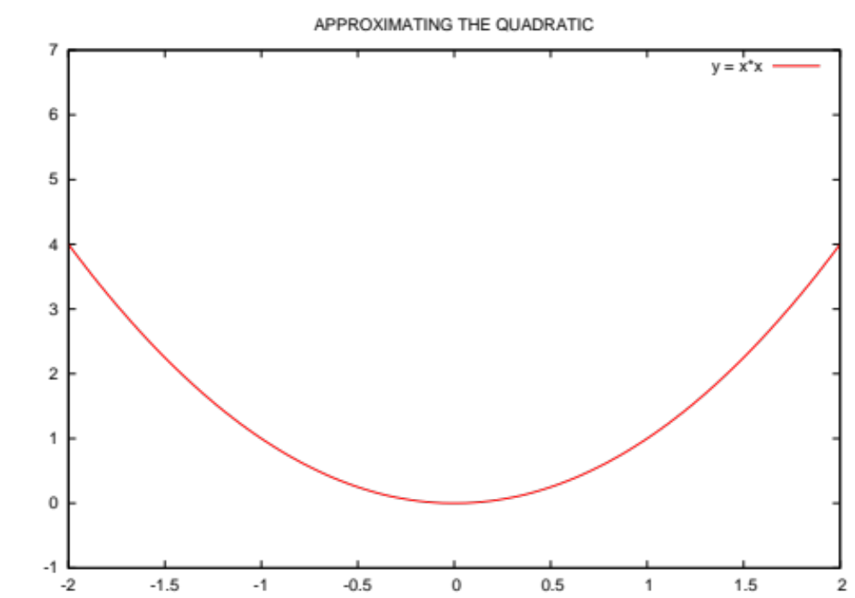

Slide 19
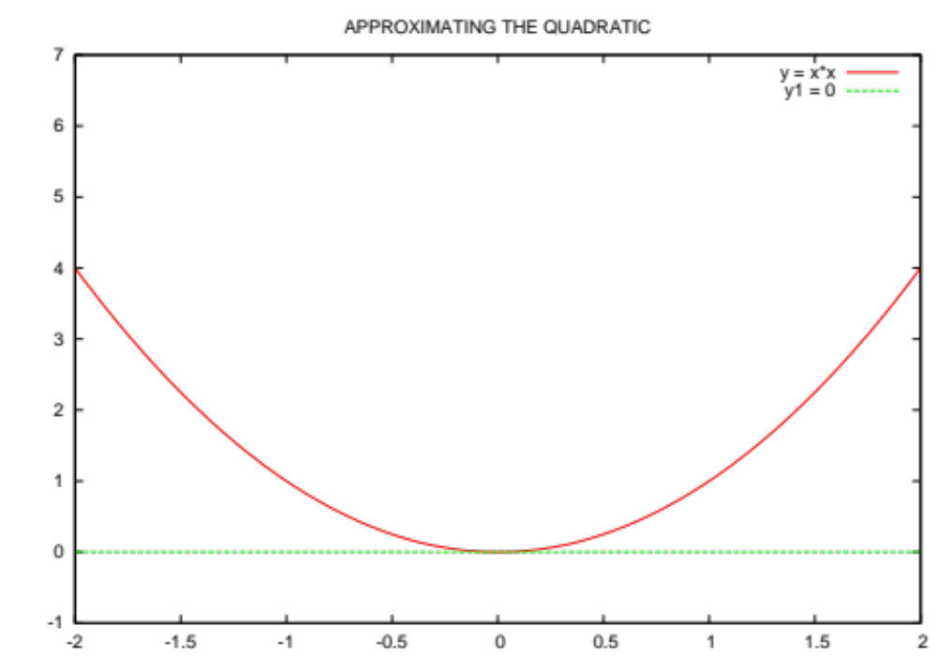

Slide 20
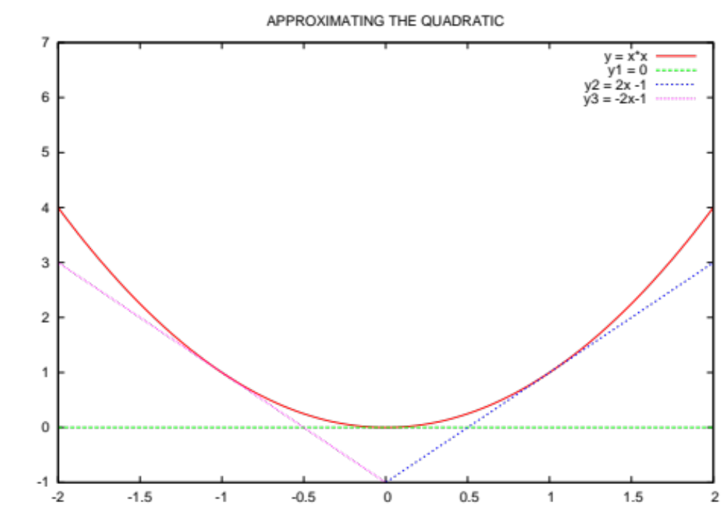

Slide 21
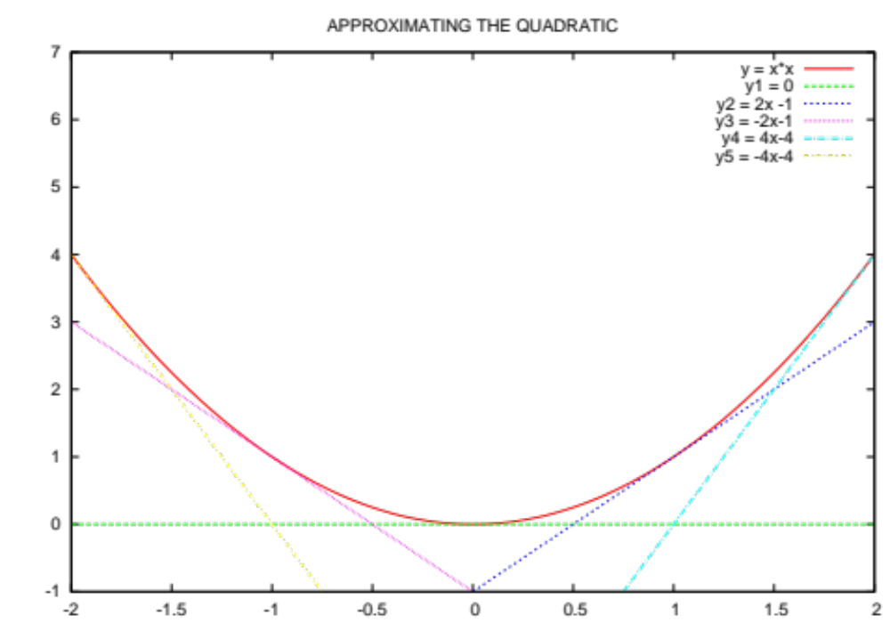

Slide 22
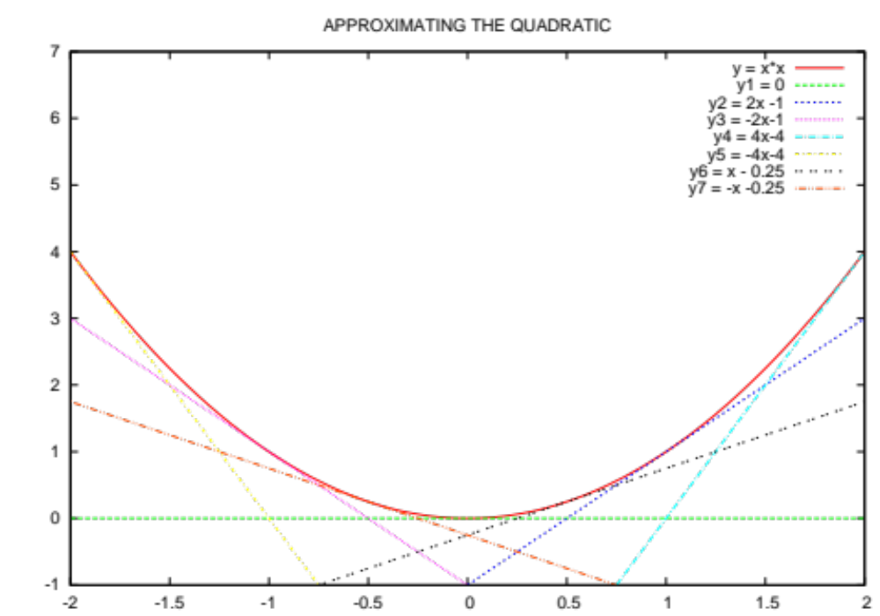

Slide 24
Approximating the Quadratic
Minimize Max {y₁, y₂, y₃, y₄, y₅, y₆, y₇}
Subject to:
-x₁ + x₂ ≥ 3
-x₁ – x₂ ≥ -2
y₁ = 0
y₂ = 2x₁ – 1
y₃ = -2x₁ – 1
y₄ = 4x₁ – 4
y₅ = -4x₁ – 4
y₆ = x₁ – 0.25
y₇ = -x₁ – 0.25
Minimize (x₁)²
Subject to:
-x₁ + x₂ ≥ 3
-x₁ – x₂ ≥ -2

Slide 25
Approximating the Quadratic
Minimize z
Subject to:
-x₁ + x₂ ≥ 3
-x₁ – x₂ ≥ -2
z ≥ 0
z ≥ 2x₁ – 1
z ≥ -2x₁ – 1
z ≥ 4x₁ – 4
z ≥ -4x₁ – 4
z ≥ x₁ – 0.25
z ≥ -x₁ – 0.25
Minimize (x₁)²
Subject to:
-x₁ + x₂ ≥ 3
-x₁ – x₂ ≥ -2

Slide 26
Approximating the Quadratic
Minimize z
Subject to:
-x₁ + x₂ ≥ 3
-x₁ – x₂ ≥ -2
z ≥ 0
z ≥ 2x₁ – 1
z ≥ -2x₁ – 1
z ≥ 4x₁ – 4
z ≥ -4x₁ – 4
z ≥ x₁ – 0.25
z ≥ -x₁ – 0.25
Minimize (x₁)²
Subject to:
-x₁ + x₂ ≥ 3
-x₁ – x₂ ≥ -2
LPs can give successively better approximations

Slide 27
Approximating the Quadratic
Minimize z
Subject to:
-x₁ + x₂ ≥ 3
-x₁ – x₂ ≥ -2
z ≥ 0
z ≥ 2x₁ – 1
z ≥ -2x₁ – 1
z ≥ 4x₁ – 4
z ≥ -4x₁ – 4
z ≥ x₁ – 0.25
z ≥ -x₁ – 0.25
Minimize (x₁)²
Subject to:
-x₁ + x₂ ≥ 3
-x₁ – x₂ ≥ -2
Quadratic Programs = Linear Programs in the “limit”

Slide 28
QPs and LPs
Is it necessarily true for a QP that if an optimal solution exists and a BFS exists, then an optimal BFS exists?

Slide 29
QPs and LPs
Is it necessarily true for a QP that if an optimal solution exists and a BFS exists, then an optimal BFS exists?
NO!!
  Intuition: When we think of a QP as being approximated by a succession of LPs, we have to add many new variables and constraints; the BFS of the new LP may not be the same as the BFS of the feasible region for the original constraints.

Slide 30
QPs and LPs
In any QP, it is still true that any local minimum is also a global minimum
Is it still true that the average of two feasible solutions is also feasible?

Slide 31
QPs and LPs
In any QP, it is still true that any local minimum is also a global minimum
Is it still true that the average of two feasible solutions is also feasible?
  Yes!!

Slide 32
QPs and LPs
In any QP, it is still true that any local minimum is also a global minimum
Is it still true that the average of two feasible solutions is also feasible?
  Yes!!
QPs still have enough nice structure that they are easy to solve

Slide 33
Formal Definition of a QP
Minimize c^{T}x + y^{T}y
s.t.
Ax = b
Ex ≥ f
Gx ≤ h
y = Dx
Where x, y are decision variables. All vectors are column vectors.

Slide 34
Formal Definition of a QP
Minimize c^{T}x + y^{T}y
s.t.
Ax = b
Ex ≥ f
Gx ≤ h
y = Dx
Where x, y are decision variables. All vectors are column vectors.
The quadratic part is always non-negative

Slide 35
Formal Definition of a QP
Minimize c^{T}x + y^{T}y
s.t.
Ax = b
Ex ≥ f
Gx ≤ h
y = Dx
Where x, y are decision variables. All vectors are column vectors.
i.e. ANY LINEAR CONSTRAINTS

Slide 36
Equivalently
Minimize c^{T}x + (Dx)^{T}(Dx)
s.t.
Ax = b
Ex ≥ f
Gx ≤ h
Where x are decision variables. All vectors are column vectors.

Slide 37
Equivalently
Minimize c^{T}x + x^{T}D^{T}Dx
s.t.
Ax = b
Ex ≥ f
Gx ≤ h
Where x are decision variables. All vectors are column vectors.

Slide 38
Equivalently
Minimize c^{T}x + x^{T}Px
s.t.
Ax = b
Ex ≥ f
Gx ≤ h
Where x are decision variables. All vectors are column vectors.
P is positive semi-definite (a matrix that can be written as D^{T}D for some D)

Slide 39
Equivalently
Minimize c^{T}x + y^{T}y
s.t.
Ax = b
Ex ≥ f
Gx ≤ h
Where x are decision variables, and y represents a subset of the coordinates of x. All vectors are column vectors.

Slide 40
Equivalently
Instead of minimizing, the objective function is
Maximize c^{T}x – x^{T}Px
For some positive semi-definite matrix P

Slide 41
Is this a QP?
Minimize xy
s.t.
x + y = 5

Slide 42
Is this a QP?
Minimize xy
s.t.
x + y = 5
No, since x = 1, y=-1 gives xy = -1. Hence xy is not an acceptable quadratic part for the objective function.

Slide 43
Is this a QP?
Minimize xy
s.t.
x + y = 5
x, y ≥ 0

Slide 44
Is this a QP?
Minimize xy
s.t.
x + y = 5
x, y ≥ 0
No, for the same reason as before!

Slide 45
Is this a QP?
Minimize x² -2xy + y² - 2x
s.t.
x + y = 5

Slide 46
Is this a QP?
Minimize x² -2xy + y² - 2x
s.t.
x + y = 5
Yes, since we can write the quadratic part as (x-y)(x-y).

Slide 47
Linear Least Squares Regression
  QP: Minimize Σ_{i} (Δ_{i})²
  s.t.
For all i in {1..K}: Δ_{i} = (x_{i})^{T}p + q - y_{i}

Slide 48
Linear Least Squares Regression
  QP: Minimize Δ^{T}Δ
  s.t.
Δ = X^{T}p + qe – y

