Slide 1
Fairness and Majorization
Lecture 16, Computational Social Choice
Ashish Goel
Stanford University
http://www.stanford.edu/~ashishg/msande336.html

Slide 2
Plan for today
Surprising existence results in fair allocations for social choice and welfare
Part I: Envy free division of rent
An examination of http://spliddit.org
Discussion of the envy free algorithm described therein
Part II: Approximate Majorization

Slide 3
Part I: Envy free division of rent
[Handbook of Computational Social Choice, Chapter 13
http://www.spliddit.org/apps/rent
Which Is the Fairest (Rent Division) of Them All, Gal et al.]
K rooms, K roommates, each needs a room
W_{i,j} is the value of room i for user j, assuming that the total value of all rooms for each roommate is the total rent R
Goal: to come up with an assignment (1-1) of rooms to roommates and a price p_{j} for each room such that the allocation is envy free with respect to (room_value – room_price), and total price is R
Observe that fractional envy-free assignments must exist and computing such an assignment is going to be easy, since envy-freeness can be modeled as linear constraints (e.g. in HW2).
Hence, the hard part is to prove existence of integer solutions! We will informally outline the existence proof, including some interesting properties on the way

Slide 4
Part I: Envy free division of rent
Property 1: A market-clearing solution exists, i.e. prices such that roommate chooses a room that maximizes (value-price) and all the rooms get chosen exactly once [duality based proof]
Property 2: This solution must be envy-free
Property 3: Any envy-free allocation must maximize the total value, for all roommates, of the assigned rooms
  Special case of 2nd welfare theorem
  In this case, suppose not. Start with an envy-free solution that does not maximize total value of assigned rooms to the person they are assigned to. Keep the same price but switch to the solution that maximizes total value. The total (value – price) must be higher in the utility-maximizing solution, which means that at least one roommate must have been envious in the original solution.

Slide 5
Part I: Discussion Points
Computation: First fix the assignment, then compute prices, which makes it a linear program again if the overall objective is linear, e.g. maximizing the minimum value of (value-price) for assigned rooms. Extends to concave objective functions in (value-price) of assigned rooms.
Explore via examples on the spliddit site:
-- The solution – max-min on surplus (i.e. value-price)
-- Can someone get negative prices?
-- Is it strategy-proof?

Slide 6
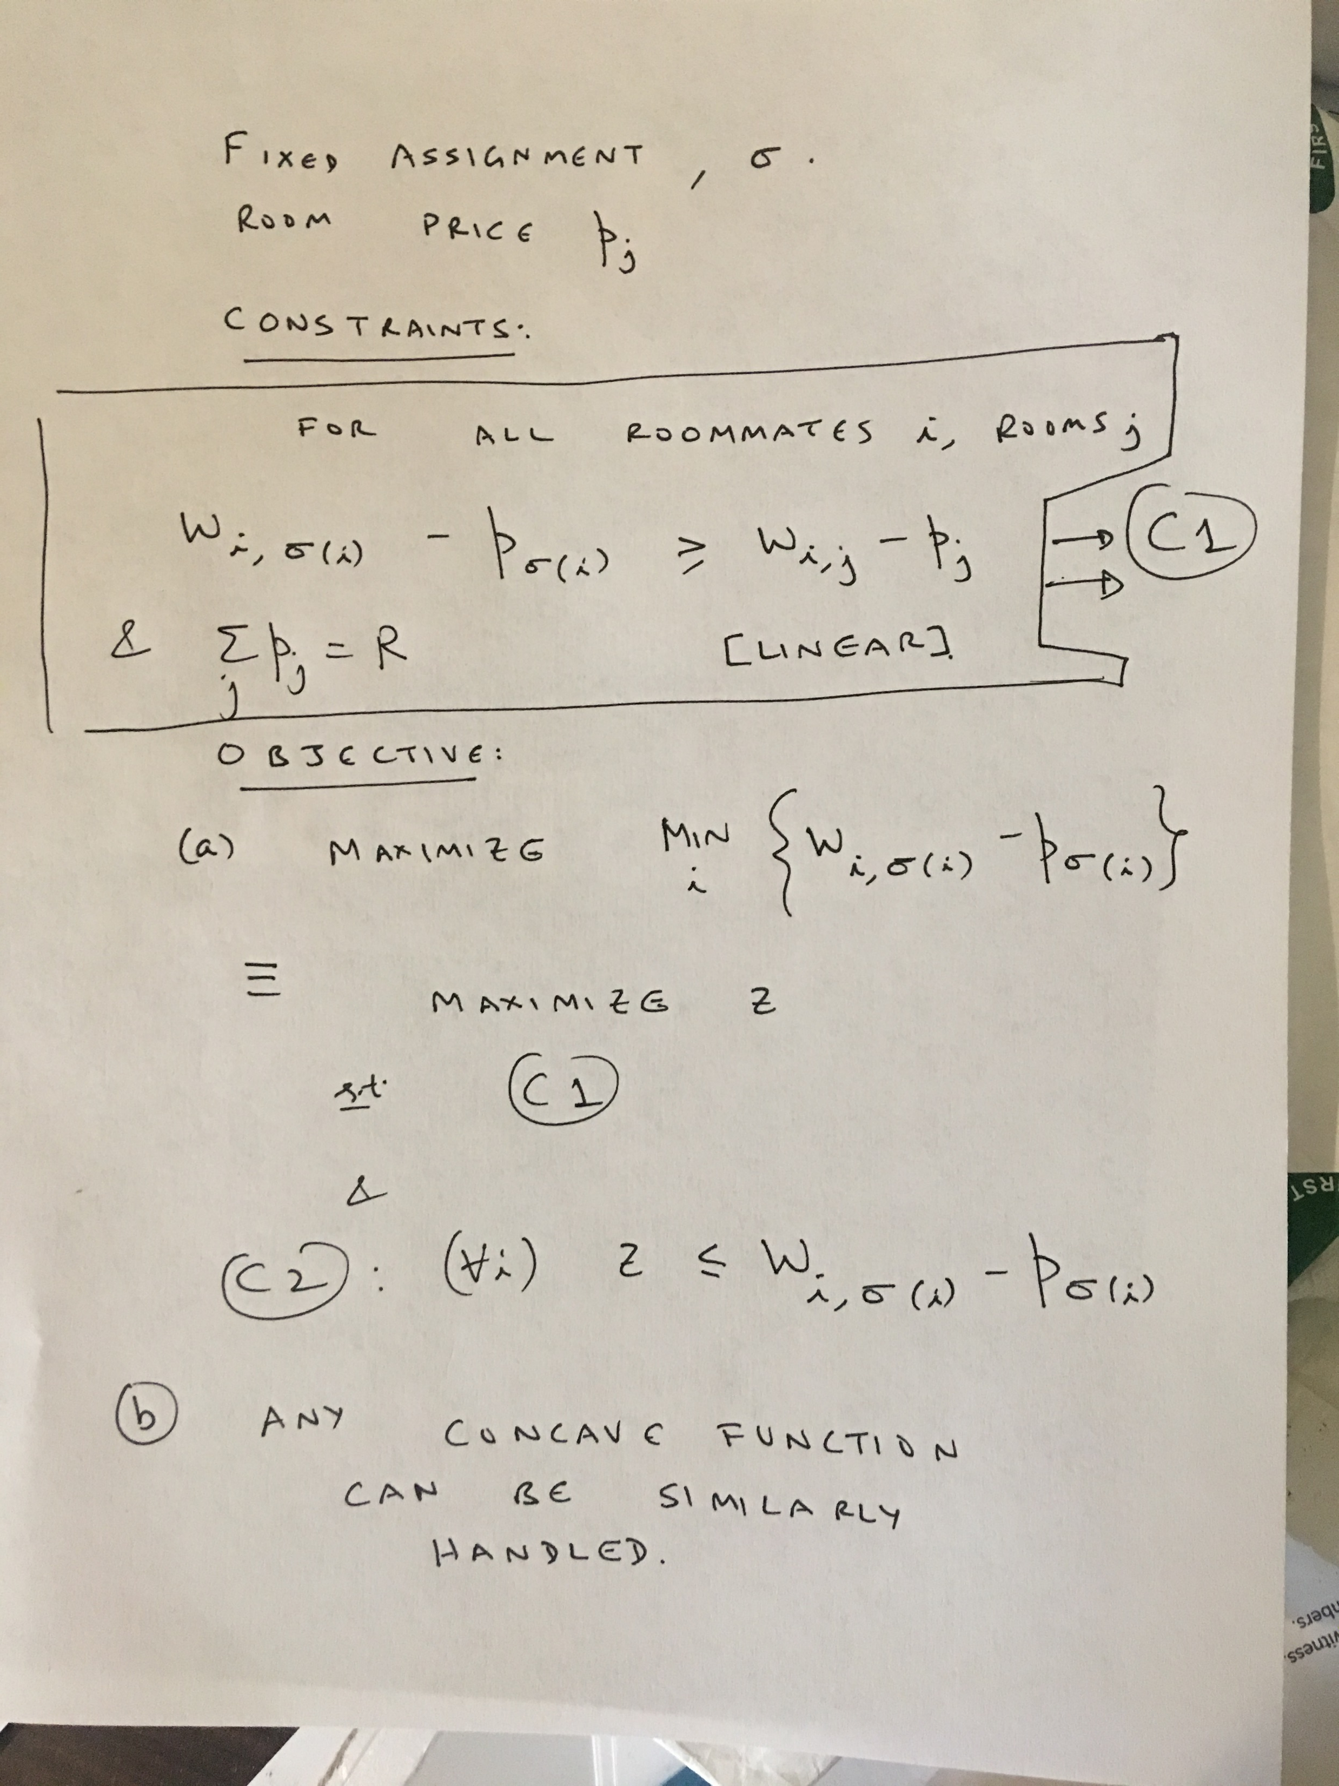

Slide 7


Part II : Bandwidth allocation Example
Simple example of resource allocation
Consider N best-effort, long-lived flows sharing the Internet
Each flow only cares about its bandwidth allocation
x_{i} = bandwidth allocated to the i-th flow
TCP: Additive Increase Multiplicative Decrease
Window size
t

Slide 8
Primal-Dual approach to resource allocation
Constraints: Can not exceed capacity on any link
Convert 0/1 capacity constraints into “smooth” costs
  p_{j} = price for link j
  Artificial. Known variously as dual costs, shadow prices etc.
Compute the total price w_{i} of all the links in path of i-th flow
Primal update (real):
w_{i} high => decrease x_{i}
w_{i} low => increase x_{i}
Recompute p_{j}, w_{i}; iterate
Primal-Dual algorithm: compute prices, decide increase/decrease rule

Slide 9
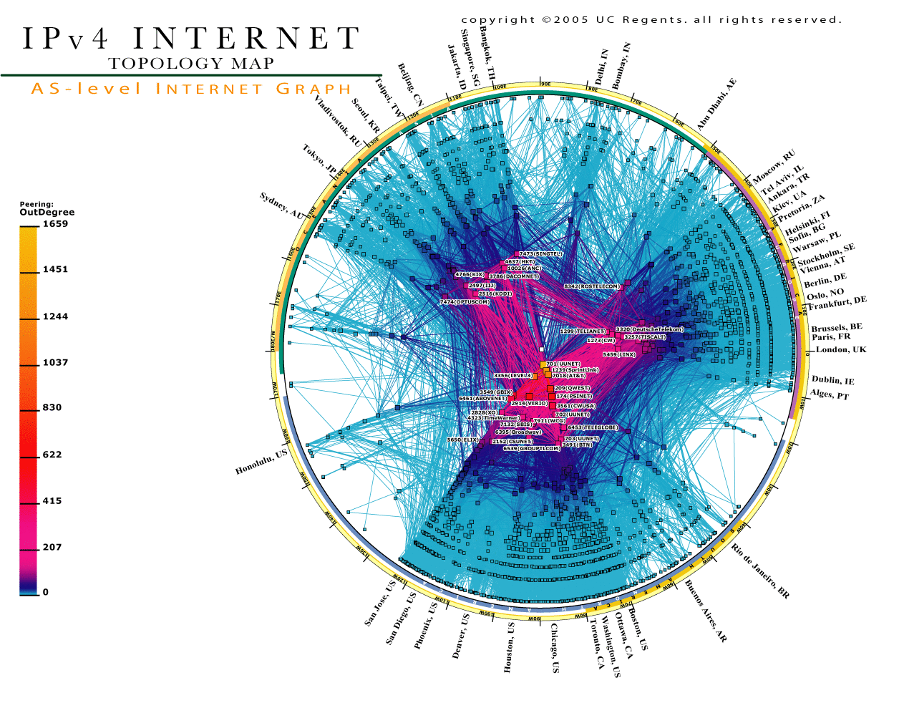
Some perspective

Slide 10
Example: utility maximization
[Kelly, Maullo, Tan]
Goal: maximize ∑_{i} U_{i}(x_{i})
U_{i} = utility function for flow i
  U_{i} is assumed to be concave, non-decreasing, non-negative
Primal-dual algorithm results in utility maximization
  Simple rule for updating x_{i}
  Prices p_{j} depend only on λ_{j}
  Convergence understood [Johari,Tan; Vinnicombe]

Slide 11
Example: TCP as implicit primal-dual
[Kelly, Maullo, Tan; Low, Peterson, Wang]
TCP reacts to drops
  p_{j} = drop probability, which depends only on λ_{j}
  TCP AIMD: reacts to w_{i} = aggregate drop probability along the route
  Example: basic TCP approximately follows the dynamics
  dx_{i}/dt = a - bx_{i}² w_{i}
  Can be interpreted as a primal-dual algorithm
TCP Vegas: implicitly maximizes ∑_{i} log x_{i}
  Nash bargaining solution
Basic variant: ¼ maximizes ∑_{i} tan⁻¹x_{i}

Slide 12
Which utility function to maximize?
It is not apriori clear which utility function to maximize
  ∑_{i} log x_{i}
  ∑_{i} tan⁻¹x_{i}
  ∑_{i} x_{i}
  min_{i} x_{i} (or max-min fairness; achieved by fair queueing at each router or by the poor stealing from the rich)
  P_{k}(x) = sum of the k smallest x_{i}’s (Prefix functions)
All the above choices are reasonable
  And there are many, many more
  Need a “fair” allocation
  Need to maximize efficiency
Different choices lead to dramatically different allocations

Slide 13
Example
v₁
v₂
v₃
v_{n+1}
n-1 long connections
n short (1-hop) connections
Max-min fair solution: Everyone gets bandwidth 1/n, total ¼ 2 Max-sum solution: Long connections get 0, total = n
The average of the two solutions is good for both criteria

Slide 14
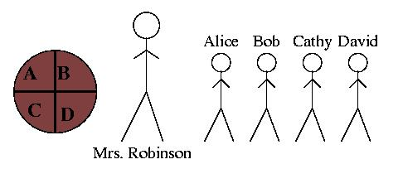
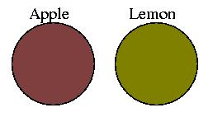
Another example
How to split a pie?
But what if there are more constraints?
Alice and Eddy want only apple pie
Frank: allergic to apples
Cathy: equal portions of both pies
David: twice as much apple pie as lemon
How do we measure the “goodness” of an allocation?

Slide 15
Goal: simultaneous optimization
Suppose the utility function is U(x₁,x₂,…,x_{N})
Canonical Utility Functions: Assume that U is
  Concave, i.e. follows the Pigou-Dalton principle: U((a+b)/2, ((a+b)/2) ¸ U(a,b)
  Non-decreasing (more bandwidth can not harm)
  Symmetric in x₁,x₂,…,x_{N}
  U(0) = 0 (this assumption can be removed for slightly weaker guarantees)
  Subsumes all the utility functions we have seen in this talk, and all the fairness functions we found in the literature
Simultaneous optimization: (Approximately) maximize U(x) simultaneously for all canonical U

Slide 16
Why simultaneous optimization?
Often, the utility function is poorly understood, but is likely to be canonical, e.g. customer satisfaction
Consider the following three allocations of bandwidths to two users
  ha,bi
  hb,ai
  h(a+b)/2,(a+b)/2i
If f measures fairness, then intuitively,
  f(a,b) = f(b,a) · f((a+b)/2,(a+b)/2)
  Hence, f is a symmetric concave function
  Simultaneous optimization promotes all reasonable measures of fairness

Slide 17
Background: Majorization
Suppose x and y are two n-tuples of +ve Reals
  P_{k}(x): sum of k smallest numbers in x (Prefixes)
  S_{k}(x): sum of k largest numbers in x (Suffixes)
x is said to be majorized by y, denoted x Á y, if
    (8 k · n), P_{k}(x) ¸ P_{k}(y), and
    P_{n}(x) = P_{n}(y)
Premise: x Á y implies x fairer than y
    [Hardy, Littlewood, and Polya (1929)]
    [Lorenz (1905)]

Slide 18
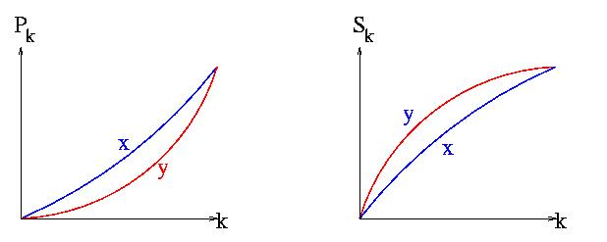
Majorization
x Á y
Theorem: [HLP29] x Á y iff g(x) ¸ g(y) for all symmetric concave functions g
    Intuition: x Á y iff x = Dy for some doubly stochastic matrix D. But d.s. matrices take generalized averages, which can only increase symmetric concave functions.
Implication: A “most-majorized” vector simultaneously maximizes all symmetric concave functions

Slide 19
Approximate majorization
Let P_{i}* denote the largest feasible value of P_{i}
Definition: x is said to be α-majorized if P_{i}(x) ¸ P_{i}*/α for all 1· i· N
  Variant of the notion of majorization
  Interpretation: the K poorest individuals in the allocation x are collectively at least 1/α times as rich as the K poorest individuals in any other feasible allocation
Analogous definition for α-balance in terms of suffixes S_{i}*

Slide 20
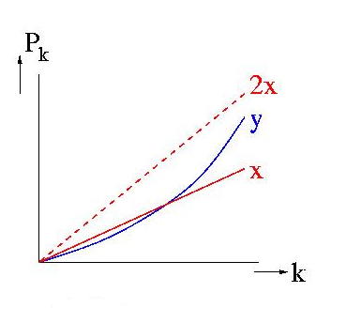
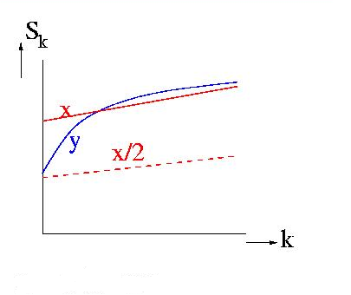
Approximate majorization: Examples
x is 2-majorized
x is 2-balanced
α-majorization: allocating resources to individuals
α-balance: assigning jobs to machines

Slide 21
Why approximate majorization?
Theorem 1: An allocation x is α-majorized if and only if U(x) is an α-approximation for all canonical utility functions U
  ie. α-majorization results in approximate simultaneous optimization
  The N prefix functions are “complete” for the class of canonical utility functions

Slide 22
Proof of Theorem 1
Suppose P_{i}(x) ¸ P_{i}(y)/α (8 i)
  Define z = αx
    P_{i}(z) ¸ P_{i}(y) (8 i)
    x = z¢(1/α) + 0¢(1-1/α)
  Iteratively reduce the largest component(s) of z to obtain w
    w Á y
    w · z
For any canonical utility function f
f(x) ¸ f(z)/α + f(0) (1-1/α) [Concavity of f]
  = f(z)/α [f(0) = 0]
  ¸ f(w)/α [since w · z]
  ¸ f(y)/α [HLP]

Slide 23
Existence
Theorem 2: For the bandwidth allocation problem in networks, there exists an O(log I)-majorized solution
  ie. Can simultaneously approximate all canonical utility functions up to a factor O(log I)
  I is defined later
Results extend to arbitrary linear (even convex) programs
And hence, to social choice problems, where the x_{i}’s represent the “happiness” of different individuals for a common decision

Slide 24
Definitions
P_{k}*: Largest possible value of P_{k} for a given problem
α*: Smallest value of α
x*: A feasible α*-fair solution
Inherent Imbalance: I = (P_{n}*/N)/P₁*
  Largest possible average benefit/Largest possible minimum benefit
  Often, grows polynomially (or slower) in problem size
  For Participatory budgeting under overlap utility, I is at most N.
    Maximum overlap for anyone is at most B, the total budget. Therefore, Pn*/N <= B
    But you can average everyone’s ideal budget, to get overlap >= B/n for everyone.
    => log(N)-approximate majorization

Slide 25
Existence of small α*
Suppose the set of feasible allocations is convex
Theorem: α* · 2 + 2 log ((P₁*/n)/P₁*)
Proof Sketch: Define T_{k} = P_{k}*/k
  Consider the sequence T₁, T₂, …, T_{n} (increasing)
  Find largest subsequence γ₁,γ₂, …, γ_{p} satisfying
  (1) γ₁ = T₁ , and (2) γ_{i+1} ¸ 2 γ_{i}
  Let a₁, a₂, …, a_{p} be the corresponding allocations
  x = average of a₁, a₂, …, a_{p} is the approximately fair solution
α* = O(log (Inherent Imbalance))
  Non-constructive (computing T_{i}, a_{i} may be hard)

Slide 26
Example
Suppose n = 8, and the optimal prefixes are
h2, 6, 15, 28, 50, 78, 112, 160i
Then, the T_{k} are h2, 3, 5, 7, 10, 13, 16, 20i
  Inherent Imbalance = 10
The solution a’ = (a₁+a₃+a₅+a₈)/4 is 8-fair
Eg. P₅(a’) ¸ P₅*/4
Also,
P₇(a’)/7 ¸ P₅(a’)/5 ¸ (P₅*/5)/4 ¸ (P₇*/7)/8

Slide 27
Finding α* given linear constraints
Example: Computing P_{k}*
  Max P_{k}, Subject to:
  Ax · C
  P_{k} · x_{σ(1)}+x_{σ(2)}+…+x_{σ(k)}, for all permutations σ 2 S_{N}
  Exponentially many constraints (N!), but detecting a violated constraint is easy
  Use separation oracle to solve LP in polynomial time
  Extensions: Can impose fairness as constraint (eg. require α < 20); can obtain smaller LP
  Extends to general convex programs; α-balance
  Natural centralized primal-dual algorithm

Slide 28
Tractability
Theorem 3: Given arbitrary linear constraints, we can find (in polynomial time) the smallest α such that an α-majorized solution exists
  Can also find the corresponding α-majorized solution
[Goel, Meyerson; Algorithmica 2005]
[Bhargava, Goel, Meyerson; short abstract in Sigmetrics ’01]

Slide 29
History
Prefix-competitive algorithms for scheduling
  [Kleinberg, Rabani, Tardos; FOCS ’99]
Online (streaming) algorithms for fair bandwidth allocation
  [Goel, Meyerson, Plotkin; STOC ’00]
Extension to several combinatorial problems
  [Kleinberg, Kumar; FOCS ’00]
Online allocation of loads to machines
  The first paper to introduce approximate majorization
  [Goel, Meyerson, Plotkin; SODA ’01]
Stochastic Load Balancing; Integer Programming
  [Goel, Meyerson; Algorithmica 2005]
Computation using simple dual prices
  [Cho, Goel 2006]
mproved online bounds
  [Buchbinder, Naor 2006]

