Slide 1
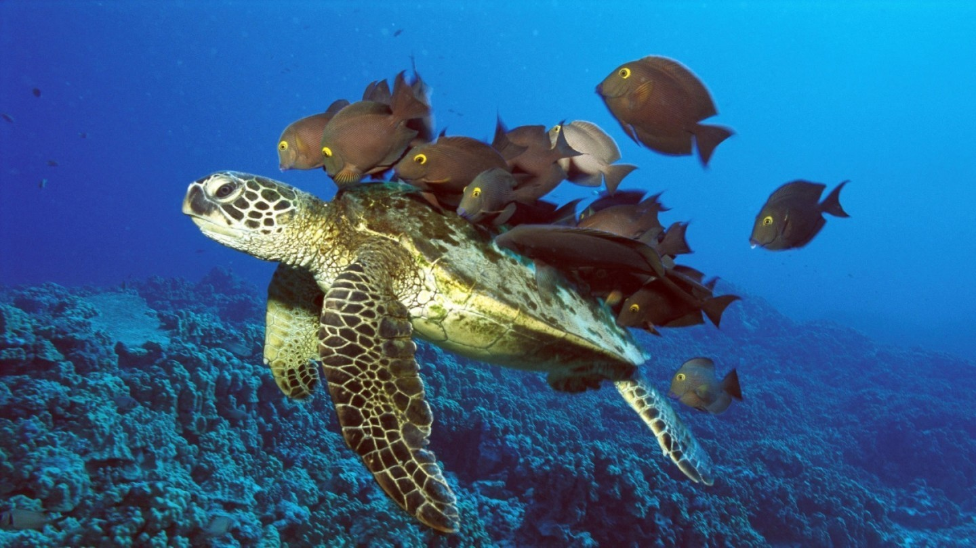
Deep Learning

Slide 2
Announcements
Project proposals tonight

Slide 3

Motivating Example

Slide 4
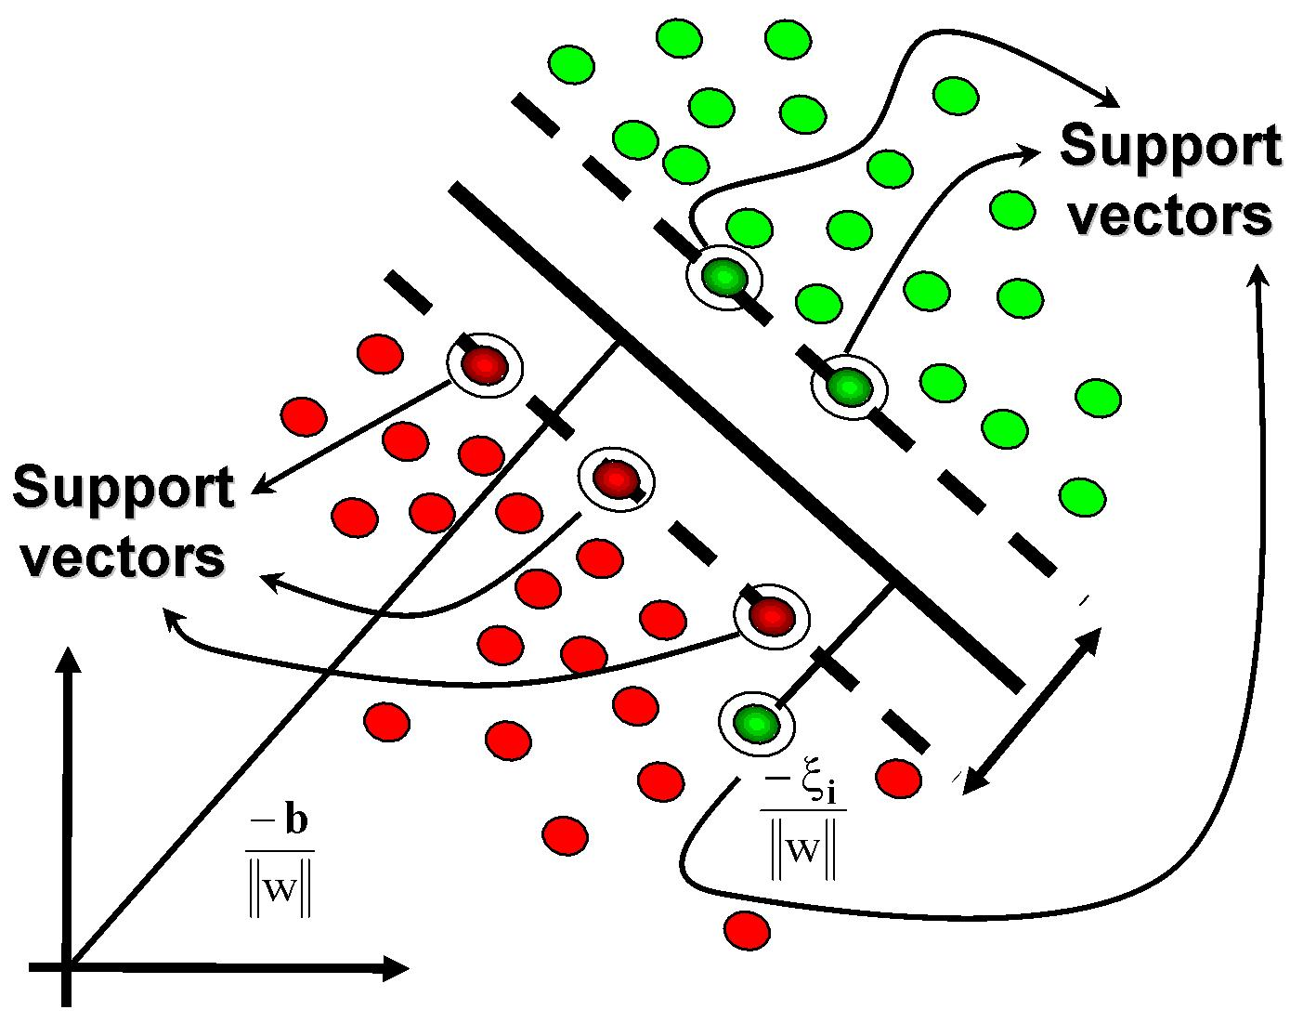
Linear Classification

Slide 5
Overfitting?
Training Set
AUC (how good)
Testing Set
Model Complexity

Slide 6
Overfitting?
Training Set
Are you
here?
AUC (how good)
Testing Set
Model Complexity

Slide 7
Oh no!!!!

Slide 8


Slide 9
Over fitting Puppy.

Slide 10
What can we do?

Slide 11
More data.

Slide 12
Reduce Features

Slide 13
Overfitting?
Training Set
Are you
here?
AUC (how good)
Testing Set
Model Complexity

Slide 14
Overfitting?
Want to
be here
Training Set
AUC (how good)
Testing Set
Model Complexity

Slide 15


Code Web:
Improving Life for Future Tas
John, Andy, Chris, Leo
Feature Reduction

Slide 16
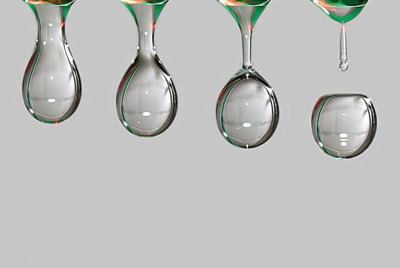
Feature Reduction #1

Slide 17
Drop Least Good Features
Correlation
Mutual Information
http://en.wikipedia.org/wiki/Feature_selection

Slide 18
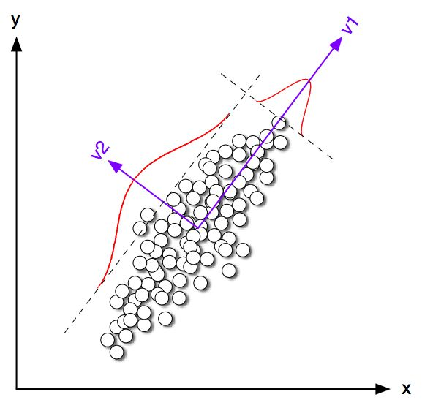
Feature Reduction #2

Slide 19
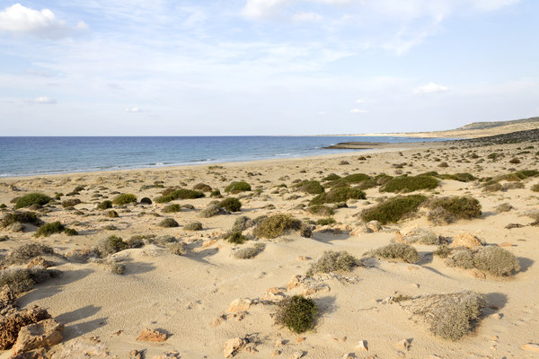
Feature Reduction #3

Slide 20
Unsupervised Learning?
class
f_{n}
f₀
…
f₁
f₂

Slide 21
Unsupervised Learning?
X
Features (n)
Samples (m)

Slide 22
Unsupervised Learning?
X
Features (n)
Samples (m)

Slide 23
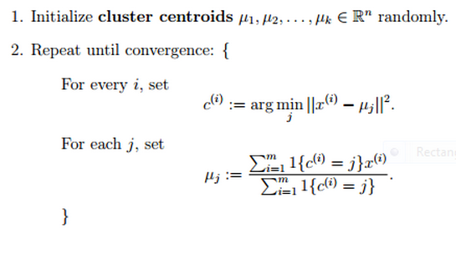
Unsupervised Learning?
X
Features (n)
Samples (m)

Slide 24
Code Web:
Improving Life for Future Tas
John, Andy, Chris, Leo
Deep Learning

Slide 25
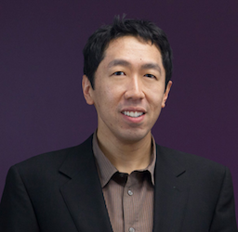
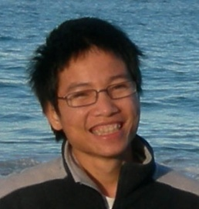
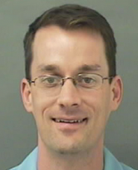
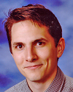

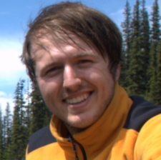
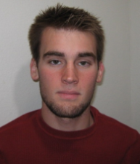


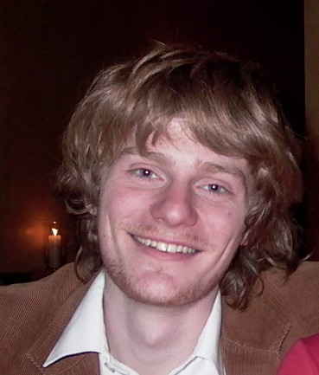
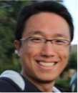
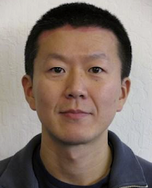
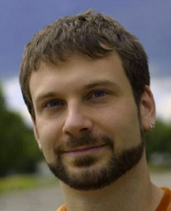
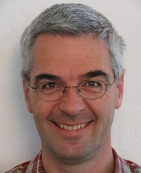

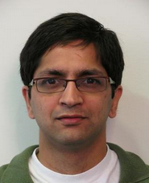
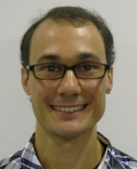
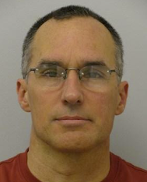
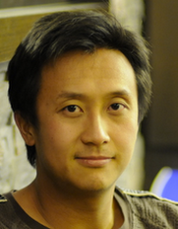
[
Andrew Ng
Quoc Le
Jeff Dean
Also Thanks to:
Stanford:
Adam Coates Quoc Le Honglak Lee Andrew Saxe Andrew Maas Chris Manning Jiquan Ngiam Richard Socher Will Zou
Google:
Kai Chen Greg Corrado Jeff Dean Matthieu Devin Andrea Frome Rajat Monga Marc’Aurelio Paul Tucker Kay Le
Ranzato

Slide 26

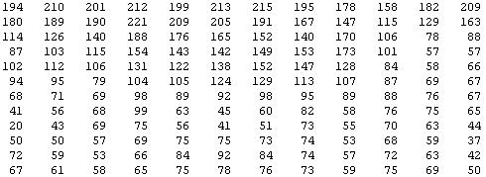
Why is this hard?
[
Vision is Hard
You see this:
But the camera sees this:
[Andrew Ng]

Slide 27

















Human Features
Human Created Features
0.1
0.7
0.4
0.6
0.1
0.7
0.4
0.6
0.1
0.4
0.5
0.5
…
0.1
0.4
0.5
0.5
0.1
0.6
0.5
0.7
0.2
0.3
0.4
0.4
Final
feature
vector
Find edges
at four
orientations
Sum up edge
strength in
each quadrant
[Andrew Ng]

Slide 28
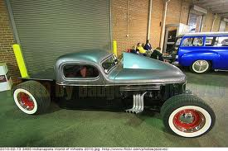
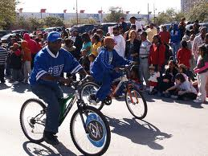
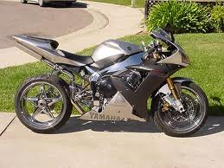
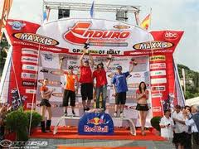
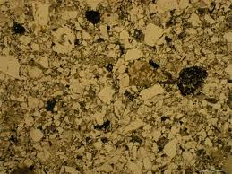
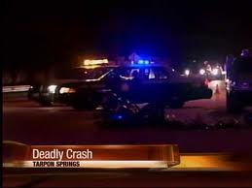
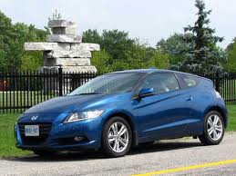
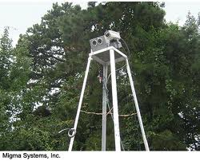
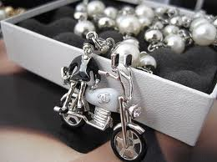
Computer vision is hard!
Motorcycle
Motorcycle
Motorcycle
Motorcycle
Motorcycle
Motorcycle
Motorcycle
Motorcycle
Motorcycle
Notes:
Good faith effort to implement state-of-the-art.
Cluttered scenes.

Slide 29
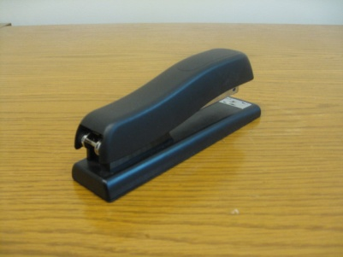
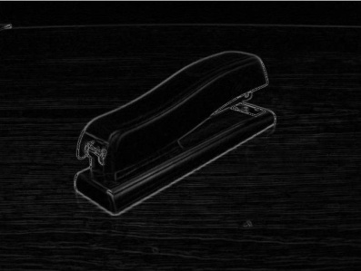




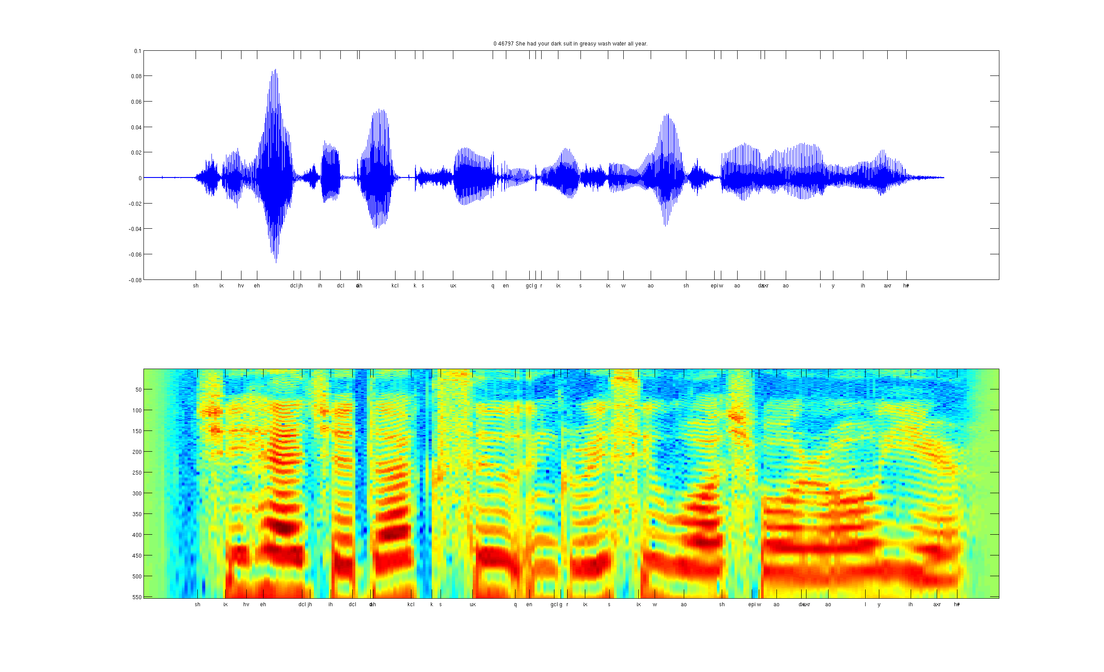

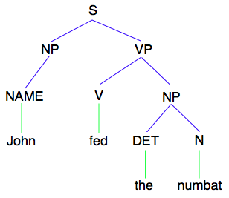
Computer Perception?
Features for all hard problems
Images/video
Image
Vision features
Detection
Audio
Image
Low-level features
Grasp point
Audio
Audio features
Speaker ID
Text classification, Machine translation, Information retrieval, ....
Text
Text
Text features
[Andrew Ng]

Slide 30
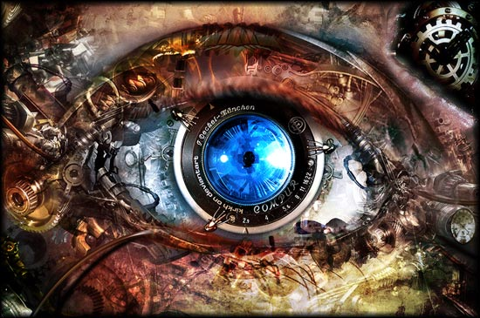
Vision Features
Vision Features
Notes:
Where do we get these low-level representations from?

Slide 31
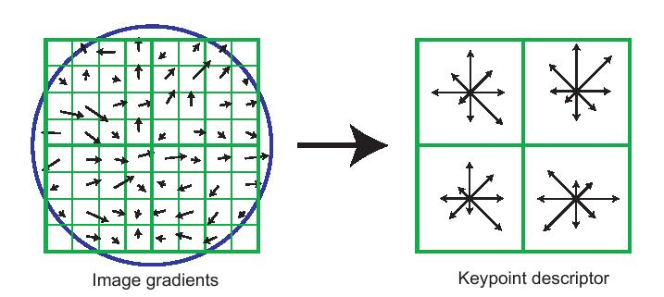
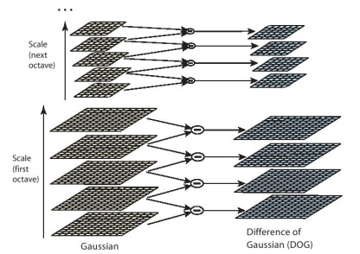
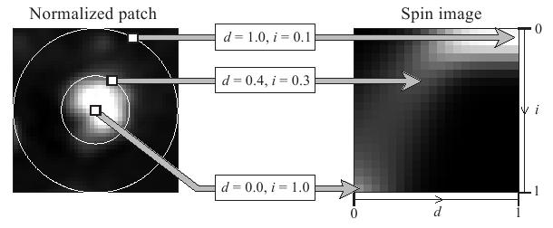
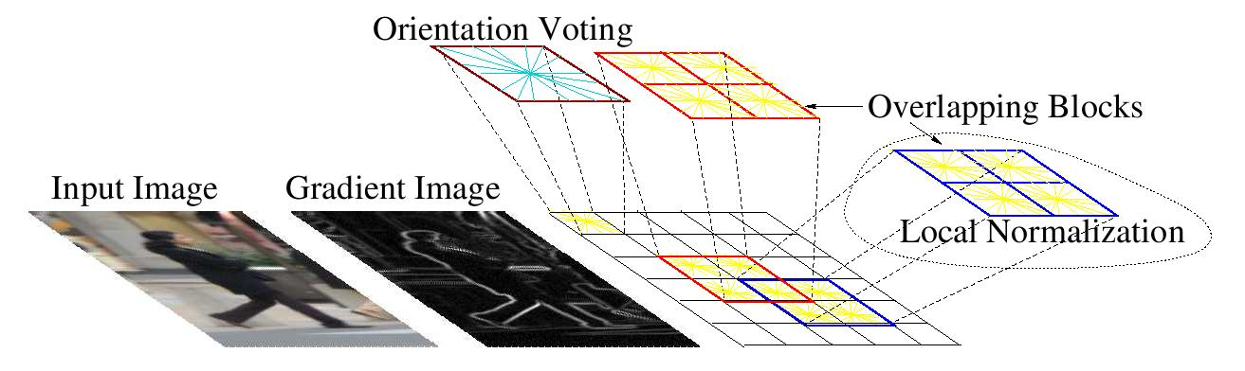
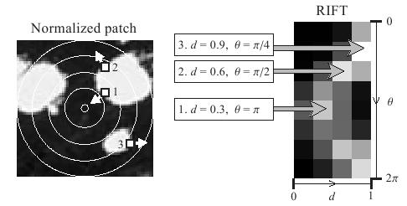
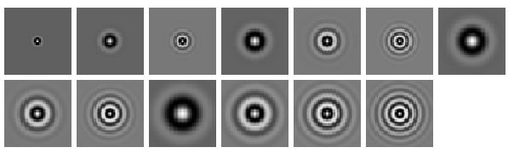
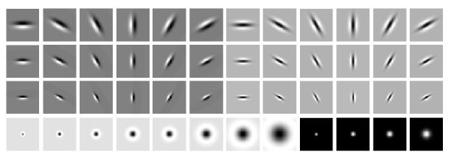
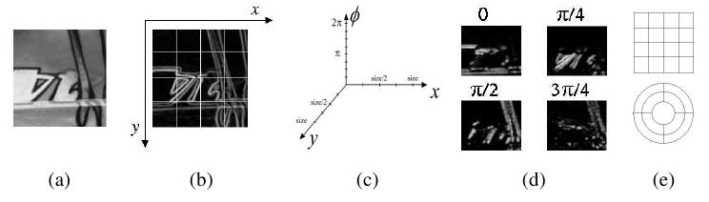
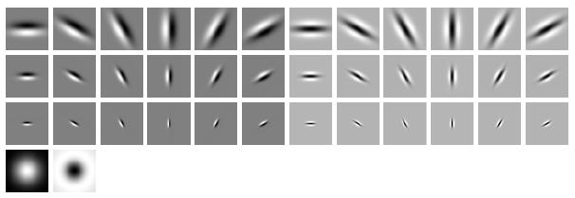
SIFT
Spin image
HoG
RIFT
Textons
GLOH
[Andrew Ng]

Slide 32
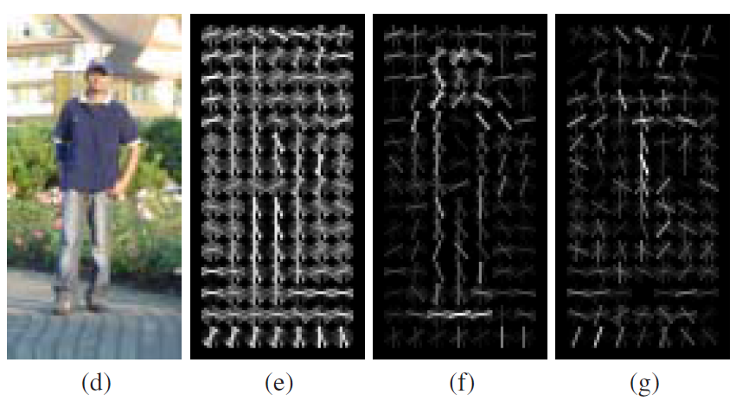
Histogram of Gradients

Slide 33

Audio Features
Audio Features
Notes:
Where do we get these low-level representations from?

Slide 34
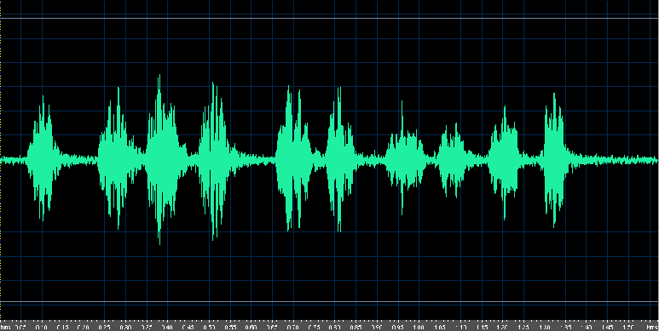
Audio
[Andrew Ng]

Slide 35
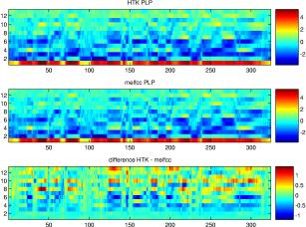
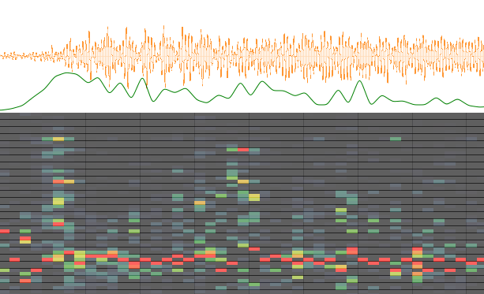
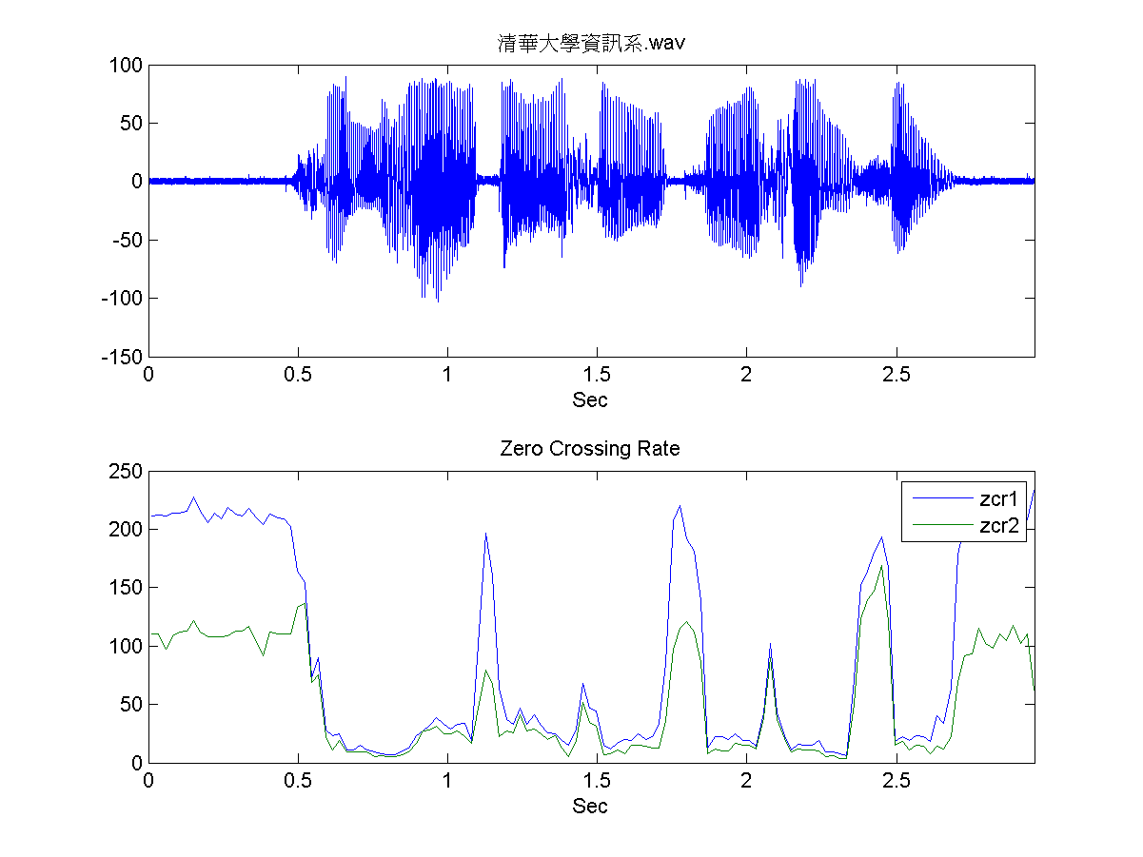

Spectrogram
MFCC
Flux
ZCR
Rolloff
[Andrew Ng]

Slide 36

NLP Features
NLP Features
Notes:
Where do we get these low-level representations from?

Slide 37







Named entity recognition
Stemming
Parser features
Anaphora
Part of speech
Ontologies (WordNet)

Slide 38

The hypothesis
One Algorithm Hypothesis
Much of perception in the brain can be explained with a single learning algorithm.
[Andrew Ng]

Slide 39



One Learning Algorithm
One Algorithm Hypothesis
Auditory Cortex
Auditory cortex learns to see
[Roe et al., 1992]
[Andrew Ng]

Slide 40


One Algorithm Hypothesis
Somatosensory Cortex
Somatosensory cortex learns to see
[Metin & Frost, 1989]
[Andrew Ng]

Slide 41






Sensor Representations
Seeing with your tongue
Human echolocation (sonar)
Haptic belt: Direction sense
Implanting a 3rd eye
[BrainPort; Welsh & Blasch, 1997; Nagel et al., 2005; Constantine-Paton & Law, 2009]

Slide 42

Feature Learning Challenge

Slide 43






Input Representations
Find a better way to represent images than pixels.
[Andrew Ng]

Slide 44

Input Representations
Find a better way to represent audio.
[Andrew Ng]

Slide 45
Sparse Autoencoder

Slide 46



Neuron Notation
x₃
x_{n}
asd
x₂
x₁

Slide 47

Auto Encoder

Slide 48

Learned Basis

Slide 49

Feature hierarchies
Deep Autoencoder
Higher layer
(Combinations of edges;
cf. V2)
a₁
a₂
a₃
“Sparse coding”
(edges; cf. V1)
x₁
x₂
x₃
x₄
Input image (pixels)
[Technical details: Sparse autoencoder or sparse version of Hinton’s DBN.]
[Lee, Ranganath & Ng, 2007]

Slide 50
Feature hierarchies
Deep Autoencoder
Higher layer
(Model V3?)
Higher layer
(Model V2?)
a₁
a₂
a₃
Model V1
x₁
x₂
x₃
x₄
Input image
[Technical details: Sparse autoencoder or sparse version of Hinton’s DBN.]
[Lee, Ranganath & Ng, 2007]

Slide 51





Feature Hierarchies
Deep Autoencoder
object models
object parts
(combination
of edges)
Training set: Aligned
images of faces.
edges
pixels
[Honglak Lee]

Slide 52

Deep Learning?

Slide 53
Yes.

Slide 54

Magic?

Slide 55
No.

Slide 56
Images
CIFAR Object classification | Accuracy
Prior art (Ciresan et al., 2011) | 80.5%
Stanford Feature learning | 82.0%
NORB Object classification | Accuracy
Prior art (Scherer et al., 2010) | 94.4%
Stanford Feature learning | 95.0%
Galaxy
Video
Hollywood2 Classification | Accuracy
Prior art (Laptev et al., 2004) | 48%
Stanford Feature learning | 53%
YouTube | Accuracy
Prior art (Liu et al., 2009) | 71.2%
Stanford Feature learning | 75.8%
KTH | Accuracy
Prior art (Wang et al., 2010) | 92.1%
Stanford Feature learning | 93.9%
UCF | Accuracy
Prior art (Wang et al., 2010) | 85.6%
Stanford Feature learning | 86.5%
Text/NLP
Paraphrase detection | Accuracy
Prior art (Das & Smith, 2009) | 76.1%
Stanford Feature learning | 76.4%
Sentiment (MR/MPQA data) | Accuracy
Prior art (Nakagawa et al., 2010) | 77.3%
Stanford Feature learning | 77.7%
Multimodal (audio/video)
Other unsupervised feature learning records:
Pedestrian detection (Yann LeCun)
Speech recognition (Geoff Hinton)
PASCAL VOC object classification (Kai Yu)
AVLetters Lip reading | Accuracy
Prior art (Zhao et al., 2009) | 58.9%
Stanford Feature learning | 65.8%
Notes:
Other SOTA performance records held by Kai Yu, Geoff Hinton.

Slide 57
Creativity Vs Learning
Contribution to performance
Time
Now
[Andrew Ng]
Notes:
NVIDIA or ATI will be future of AI. Probably NVIDIA.

Slide 58

The End?

Slide 59
No.

Slide 60
When is redundancy good?

Slide 61

Best Supervised Learner?
Choices of learning algorithm:
  Naïve Bayes
  SVM
  K Nearest Neighbors
  Logistic Regression
  ….
What matters the most?
Accuracy
Training set size (millions)
[Banko & Brill, 2001]
“It’s not who has the best algorithm that wins. It’s who has the most data.”

Slide 62
Best Feature Learner?

Slide 63
Other Feature Learners?

Slide 64
Yes.

Slide 65

Best Feature Learner?

Slide 66

Best Feature Learner?
K-Means
Auto Encoder
Number of features matters most
[Adam Coates]

Slide 67
Code Web:
Improving Life for Future Tas
John, Andy, Chris, Leo
Scaling Up

Slide 68
Motivating Example

Slide 69
How many training images?

Slide 70


Slide 71
Before: 50 thousand 32x32 images

Slide 72
Google Brain: 10 million 200x200 images

Slide 73

1 billion parameters

Slide 75
Scaling Up
Machine #1
Machine #2
Machine #3
Machine #4
Sparse features
Image
Le, et al., Tiled Convolutional Neural Networks. NIPS 2010

Slide 76

Parallel Back Propagation
Le, et al., Building high-level features using large-scale unsupervised learning. ICML 2012

Slide 77

Parallel Back Propagation
Parameter server
Le, et al., Building high-level features using large-scale unsupervised learning. ICML 2012

Slide 78
Parallel Back Propagation
Parameter server
Le, et al., Building high-level features using large-scale unsupervised learning. ICML 2012

Slide 79


Training Procedure
What features can we learn if we train a massive model on a massive amount of data. Can we learn a “grandmother cell”?
Train on 10 million images (YouTube)
1000 machines (16,000 cores) for 1 week.
1.15 billion parameters
Test on novel images
Training set (YouTube) Test set (FITW + ImageNet)

Slide 80
Data Set
RICA
Dataset: 10 million 200x200 unlabeled images from YouTube/Web
Train on 2000 machines (16000 cores) for 1 week
1.15 billion parameters
100x larger than previously reported
Small compared to visual cortex
Human brain is estimated to have 100 trillion synapses.
- Off by an order of 100,000
RICA
RICA
Image
Le, et al., Building high-level features using large-scale unsupervised learning. ICML 2012
Input to another layer above
(image with 8 channels)
Number of output
channels = 8
LCN Size = 5
H
Pooling Size = 5
Number
of maps = 8
One layer
W
RF size = 18
Number of input
channels = 3
Image Size = 200

Slide 81

RICA?

Slide 82

Predicting Cancer

Slide 83


The Face Neuron
Top stimuli from the test set
Optimal stimulus
by numerical optimization
Le, et al., Building high-level features using large-scale unsupervised learning. ICML 2012

Slide 84

The Face Neuron
Random distractors
Faces
Frequency
Feature value
Le, et al., Building high-level features using large-scale unsupervised learning. ICML 2012

Slide 85




Invariance Properties
Feature response
Feature response
0 pixels
20 pixels
0 pixels
20 pixels
Horizontal shifts
Vertical shifts
Feature response
Feature response
o
o
0
90
0.4x
1x
1.6x
3D rotation angle
Scale factor
Le, et al., Building high-level features using large-scale unsupervised learning. ICML 2012

Slide 86

Human Body Neuron
Optimal stimulus
by numerical optimization
Le, et al., Building high-level features using large-scale unsupervised learning. ICML 2012

Slide 87

Random distractors
Pedestrians
Frequency
Feature value
Le, et al., Building high-level features using large-scale unsupervised learning. ICML 2012

Slide 88


The Cat Neuron
Top stimuli from the test set
Optimal stimulus
by numerical optimization
Le, et al., Building high-level features using large-scale unsupervised learning. ICML 2012

Slide 89

The Cat Neuron
Random distractors
Cat faces
Frequency
Feature value
Le, et al., Building high-level features using large-scale unsupervised learning. ICML 2012

Slide 90


Slide 91


Slide 92


Slide 93





Best Stimuli for Features (final neurons)
Feature 1
Feature 2
Feature 3
Feature 4
Feature 5
Le, et al., Building high-level features using large-scale unsupervised learning. ICML 2012
Input to another layer above
(image with 8 channels)
Number of output
channels = 8
LCN Size = 5
H
Pooling Size = 5
Number
of maps = 8
One layer
W
RF size = 18
Number of input
channels = 3
Image Size = 200

Slide 94




Best Stimuli for Features
Feature 6
Feature 7
Feature 8
Feature 9
Le, et al., Building high-level features using large-scale unsupervised learning. ICML 2012
Input to another layer above
(image with 8 channels)
Number of output
channels = 8
LCN Size = 5
H
Pooling Size = 5
Number
of maps = 8
One layer
W
RF size = 18
Number of input
channels = 3
Image Size = 200

Slide 95





Best Stimuli for Features
Feature 10
Feature 11
Feature 12
Feature 13
Le, et al., Building high-level features using large-scale unsupervised learning. ICML 2012
Input to another layer above
(image with 8 channels)
Number of output
channels = 8
LCN Size = 5
H
Pooling Size = 5
Number
of maps = 8
One layer
W
RF size = 18
Number of input
channels = 3
Image Size = 200

Slide 96
ImageNet Classification
22,000 categories
14,000,000 images
Hand-engineered features (SIFT, HOG, LBP),
Spatial pyramid, SparseCoding/Compression
Le, et al., Building high-level features using large-scale unsupervised learning. ICML 2012

Slide 97





22,000 is a lot!
…
smoothhound, smoothhound shark, Mustelus mustelus
American smooth dogfish, Mustelus canis
Florida smoothhound, Mustelus norrisi
whitetip shark, reef whitetip shark, Triaenodon obseus
Atlantic spiny dogfish, Squalus acanthias
Pacific spiny dogfish, Squalus suckleyi
hammerhead, hammerhead shark
smooth hammerhead, Sphyrna zygaena
smalleye hammerhead, Sphyrna tudes
shovelhead, bonnethead, bonnet shark, Sphyrna tiburo
angel shark, angelfish, Squatina squatina, monkfish
electric ray, crampfish, numbfish, torpedo
smalltooth sawfish, Pristis pectinatus
guitarfish
roughtail stingray, Dasyatis centroura
butterfly ray
eagle ray
spotted eagle ray, spotted ray, Aetobatus narinari
cownose ray, cow-nosed ray, Rhinoptera bonasus
manta, manta ray, devilfish
Atlantic manta, Manta birostris
devil ray, Mobula hypostoma
grey skate, gray skate, Raja batis
little skate, Raja erinacea
…
Stingray
Mantaray

Slide 98
0.005%
9.5%
?
Random guess
State-of-the-art
(Weston, Bengio ‘11)
Feature learning
From raw pixels
Le, et al., Building high-level features using large-scale unsupervised learning. ICML 2012

Slide 99
0.005%
9.5%
21.3%
Random guess
State-of-the-art
(Weston, Bengio ‘11)
Feature learning
From raw pixels
Le, et al., Building high-level features using large-scale unsupervised learning. ICML 2012

Slide 100

[
Hawk!

Slide 101
[

Slide 102
[

Slide 103
[

Slide 104
[
Ideally

Slide 105
[

Slide 106
[

Slide 107
Our Visual Cortex?

Slide 108
Plane

Slide 109
[

Slide 110
Google Brain?

Slide 111
[

Slide 112
[YouTube videos demo]
Credit: Quoc Le & John Shlens
Notes:
NVIDIA or ATI will be future of AI. Probably NVIDIA.

Slide 113
Code Web:
Improving Life for Future Tas
John, Andy, Chris, Leo
Weaknesses

Slide 114
\
Weakness
You’re learning everything. It’s better to encode prior knowledge about structure of images (or audio, or text).
Wasn’t there a similar machine learning vs. linguists debate in NLP ~20 years ago….
Notes:
Q1: Encode translation, rotational invariance.
Q2: Kai Yu’s result.

Slide 115
Weakness
Unsupervised feature learning cannot currently do X, where X is:
  Go beyond Gabor (1 layer) features.
  Work on temporal data (video).
  Learn hierarchical representations (compositional semantics).
  Get state-of-the-art in activity recognition.
  Get state-of-the-art on image classification.
  Get state-of-the-art on object detection.
  Learn variable-size representations.
Not fundamental weaknesses… still work to be done.
Notes:
Q1: Encode translation, rotational invariance.
Q2: Kai Yu’s result.

Slide 116
Code Web:
Improving Life for Future Tas
John, Andy, Chris, Leo
Can I Do Deep Learning?

Slide 117
Yes

Slide 118


MNIST

Slide 119
Show off Dataset

Slide 120

Not Sparse

Slide 121

One Layer

Slide 122

Two Layer

Slide 123


Performance

Slide 124
Performance
Learn Features before
supervised learning

Slide 125
Performance
One layer at a time

Slide 126
Performance
Come up with one hypothesis function

Slide 127
Performance
Test of validation (holdout) set
Come up with one hypothesis function
98.4% accuracy
Under 1 hour

Slide 128


Bigger model on my big computer

Slide 129
Kaggle Contest
http://www.kaggle.com/c/digit-recognizer

Slide 130
Code Web:
Improving Life for Future Tas
John, Andy, Chris, Leo
ML Conclusion

Slide 131
Not just deep learning
Bayes nets play a large role
http://www.youtube.com/watch?v=tmrAh1CqCRo

Slide 132

Slam++

Slide 133












Unsupervised Feature Learning Summary
Deep Learning and Self-Taught learning: Lets learn rather than manually design our features.
Discover the fundamental computational principles that underlie perception?
Sparse coding and deep versions very successful on vision and audio tasks. Other variants for learning recursive representations.
To get this to work for yourself, see online tutorial:
http://deeplearning.stanford.edu/wiki
Car
Motorcycle
Unlabeled images
Stanford
Adam Coates Quoc Le Honglak Lee Andrew Saxe Andrew Maas Chris Manning Jiquan Ngiam Richard Socher Will Zou
Google
Kai Chen Greg Corrado Jeff Dean Matthieu Devin Andrea Frome Rajat Monga Marc’Aurelio Paul Tucker Kay Le
Ranzato

