Slide 1
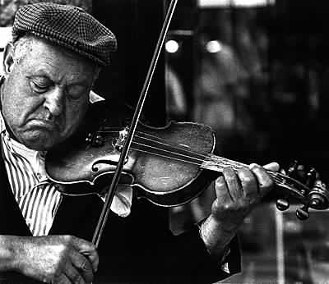
Review Session

Slide 2
This guy practiced
a lot!
Review Session

Slide 3
Announcements
Midterm 24th 7-9pm, NVIDIA
Midterm review in class next Tuesday
Two practice midterms
Jeff moved office hours
Exam will be fun…
… a lot more fun if you study
Slide PDFs

Slide 4
Today
Review

Slide 5
Today
Review
The exam you could have had

Slide 6
Midterm Structure

Slide 7
Midterm Structure
Deterministic Search

Slide 8
Midterm Structure
Deterministic Search
Adversary Search and MDP

Slide 9
Midterm Structure
Deterministic Search
Adversary Search and MDP
Bayesian Networks

Slide 10
Midterm Structure
Deterministic Search
Adversary Search and MDP
Temporal Models
Bayesian Networks

Slide 11

Midterm Structure

Slide 12

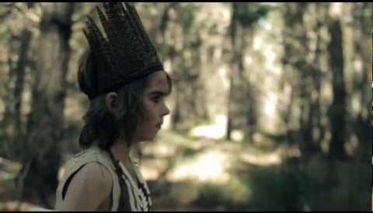

Search Overview
Deterministic Search
Vs Self
Markov Decisions
Vs Nature
Adversarial Search
Vs Opponent

Slide 13



Variable Overview
CSP
Variables not States
Bayesian Network
Factored Joint
Temporal Models
Bayes Net of Time

Slide 14
AI Pipeline
Real World Problem
Model the problem
Formal Problem
Learning Algorithm
Parameterized Model
Inference Algorithm
Evaluate
Solution

Slide 15
Model It
Real World Problem
Model the problem
Formal Problem
Learning Algorithm
Parameterized Model
Inference Algorithm
Evaluate
Solution

Slide 16
Learn It
Real World Problem
Model the problem
Formal Problem
Learning Algorithm
Parameterized Model
Inference Algorithm
Evaluate
Solution

Slide 17
Learn It (sometimes)
Real World Problem
Model the problem
Formal Problem
Learning Algorithm
Parameterized Model
Inference Algorithm
Evaluate
Solution

Slide 18
Solve It
Real World Problem
Model the problem
Formal Problem
Learning Algorithm
Parameterized Model
Inference Algorithm
Evaluate
Solution

Slide 19
1. Deterministic Search
Deterministic Search
Adversary Search and MDP
Temporal Models
Bayesian Networks

Slide 20
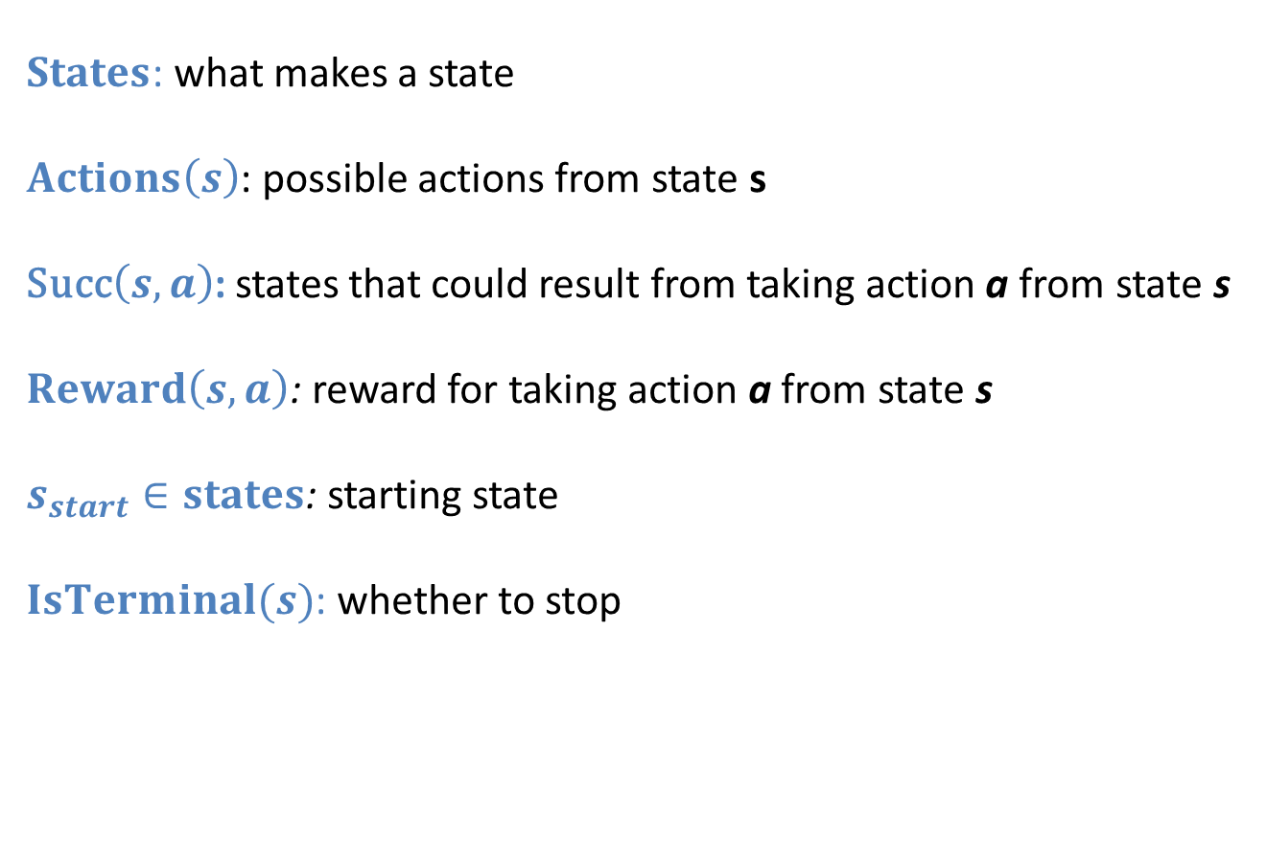
Modeling DSPs
$States$: what makes a state
$Actions\left(s\right)$: possible actions from state s
Succ$\left(s, a\right)$: states that could result from taking action a from state s
$Reward\left(s, a\right)$: reward for taking action a from state s
$s_{start}∈states$: starting state
$IsTerminal(s)$: whether to stop

Slide 21
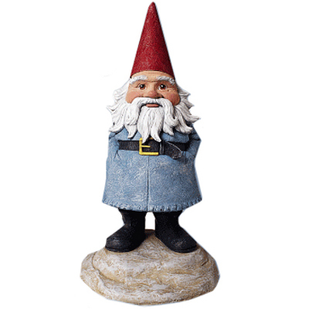
1a. Travelocity

Slide 22
1a. Travelocity
For each airport, we have a set of flights from that airport.
Each flight is annotated with, startTime, duration, cost.
Have start city, goal city and start time
Want to find the flight that minimizes a * cost + b * time.

Slide 23
State
Start State
Legal Actions
Cost of Action
Successor
Goal Test

Slide 24
DSP Hints
Think of a strategy
Natural to think of states first.
The right answer will allow the computer to try everything

Slide 25
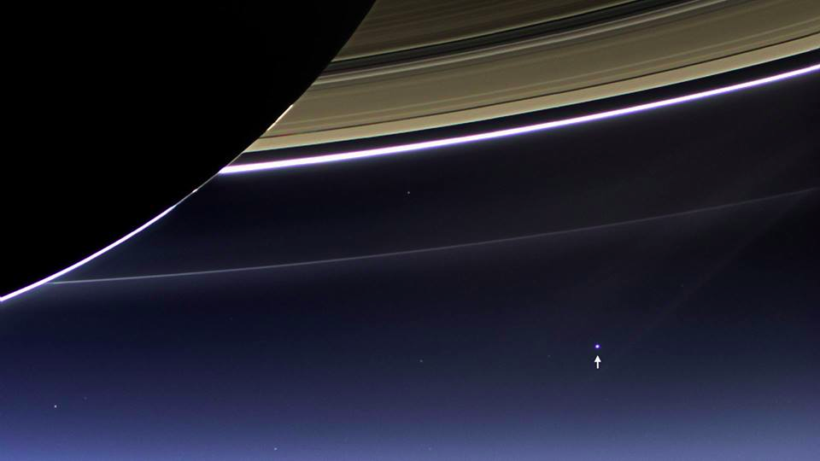
State (3 points)
Notes:
Everything is on that spot. Every important and unimportant person. Everyone you and your ancestors love or have ever loved.

Slide 26
State (3 points)
Current city.
Arrival time.

Slide 27
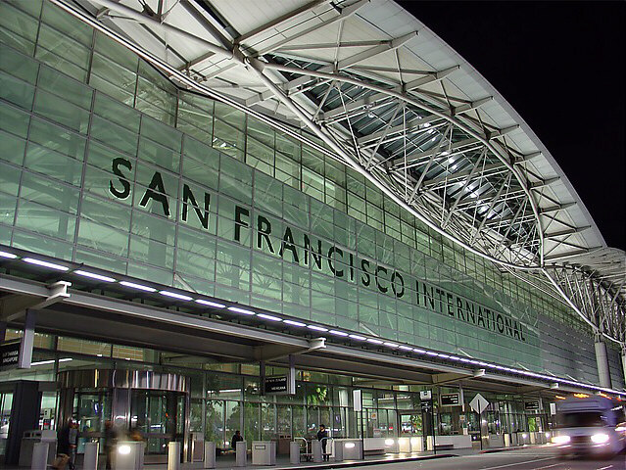
Start State (1 point)

Slide 28
Start State (1 point)
Current city = start city.
Arrival time = start time.

Slide 29
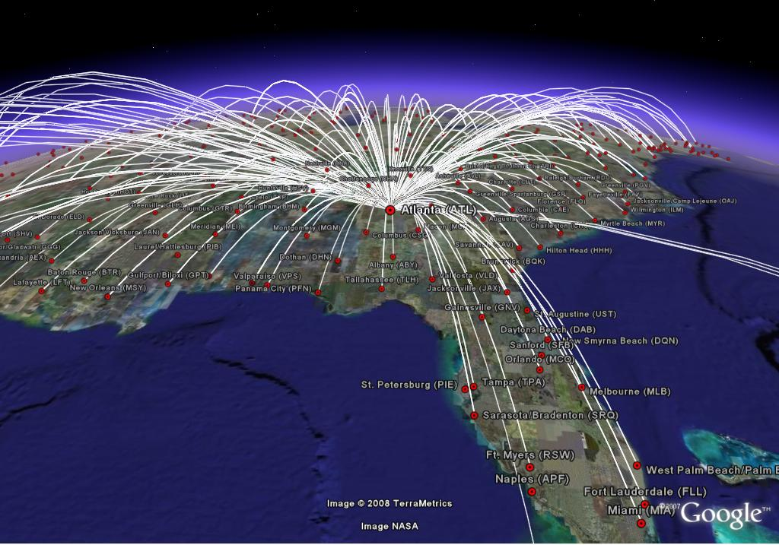
Legal Actions (2 points)

Slide 30
Legal Actions (2 points)
You can take any flight from your current city that takes off after your arrival time (+30 mins for transfer).

Slide 31
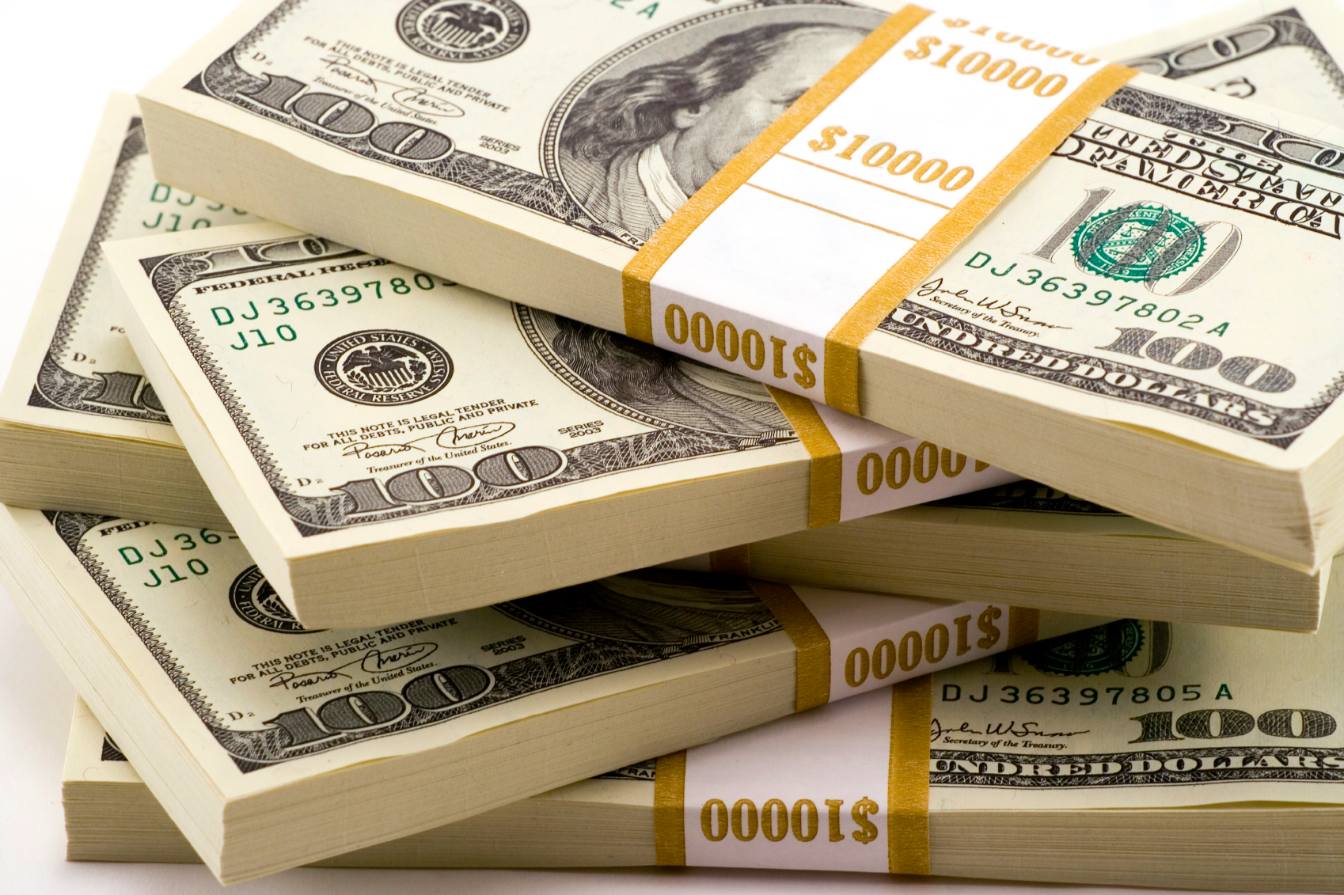
Action Cost (3 points)

Slide 32
Action Cost (3 points)
Cost of a single flight = a * flight.cost
+ b * flight.duration
+ b * [flight.takeOff – arrivalTime]
Special case for first flight: [flight.takeOff – arrivalTime] = 0

Slide 33

Successor (2 points)

Slide 34
Successor (2 points)
If you take flight A, your next state will be the city where A lands, and your arrival time will be the arrival time of flight A.

Slide 35

Goal Test (1 point)

Slide 36
Goal Test (1 point)
Are you in your final destination?

Slide 37
Which Work? (2 points)
DFS
BFS
UCS (dijkstra)
Bellman-Ford

Slide 38
Complexity (2 points)
DFS
BFS
UCS (dijkstra)
Bellman-Ford
Assume cheapest path is M hops away, and each city has under N flights. Give a lower bound for number of nodes you will expand if you use BFS.

Slide 39
Heuristic # 1 (3 points)
Fastest plane speed is S. Planes must travel at least haversine distance.
Make heuristic that is admissible.

Slide 40
Heuristic # 2 (2 points)
Average cost of flights per mile is C.
Is:
h(s) = C * haversine(s)
an admissible heuristic?

Slide 41

Sanity Checks.

Slide 42
Sanity Checks.
Can you construct a search tree?
Will you try everything
Will a “cursor” help?

Slide 43
1. Deterministic Search
Deterministic Search
Adversary Search and MDP
Temporal Models
Bayesian Networks

Slide 44

1. Deterministic Search
Deterministic Search
Adversary Search and MDP
Temporal Models
Bayesian Networks

Slide 45
2. Adversary and MDP
Deterministic Search
Adversary Search and MDP
Temporal Models
Bayesian Networks

Slide 46
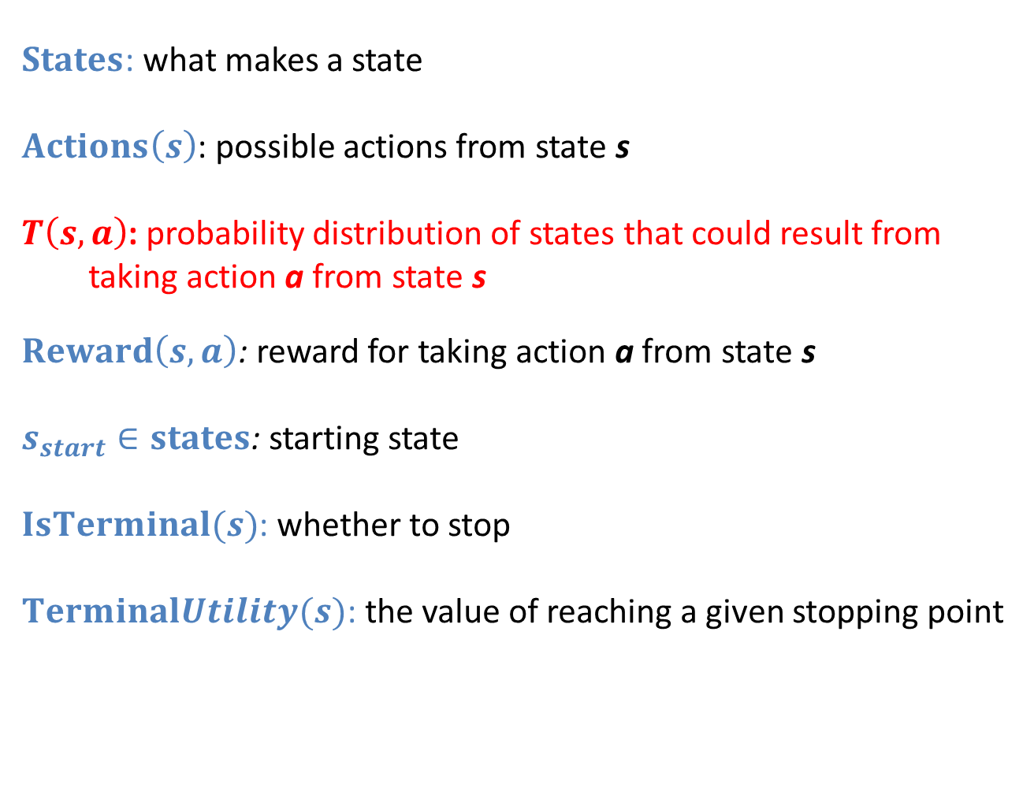
Modeling MDPs
$States$: what makes a state
$Actions\left(s\right)$: possible actions from state s
$T\left(s, a\right)$: probability distribution of states that could result from taking action a from state s
$Reward\left(s, a\right)$: reward for taking action a from state s
$s_{start}∈states$: starting state
$IsTerminal(s)$: whether to stop
$TerminalUtility(s)$: the value of reaching a given stopping point

Slide 47
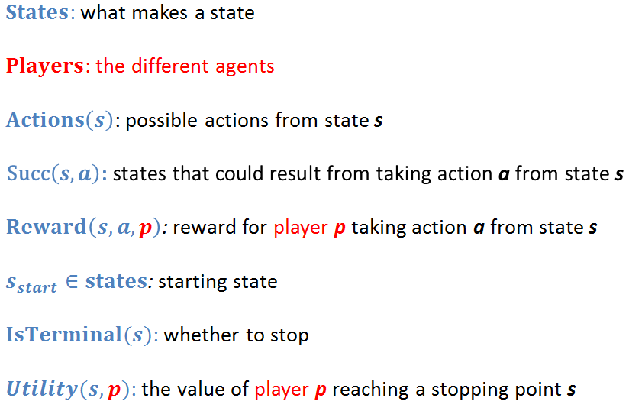
Modeling Zero Sum

Slide 48
Ply
3
6
3
6
8
5
4
9
2
1
8
8
5
4
9
2
1
8

Slide 49
Minimax vs Expectimax
Alternating rows of
expectation (nature) and
maximizing (player)
Alternating rows of
minimizing (adversary)
and maximizing (player)
Expectimax
Minimax

Slide 50
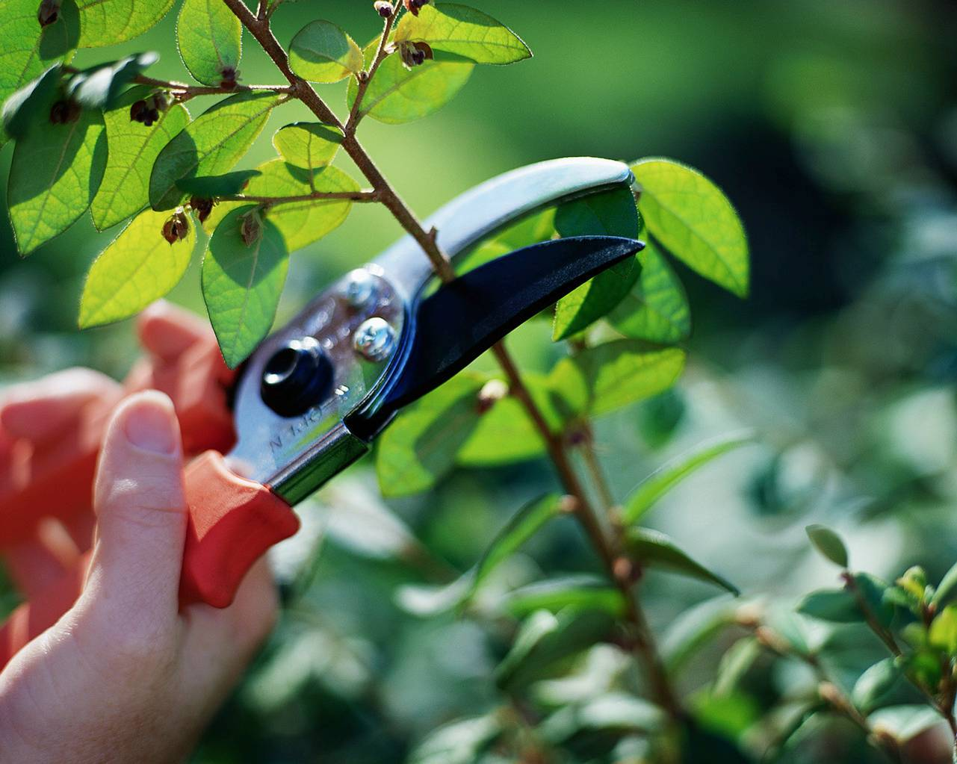
Alpha Beta Pruning

Slide 51
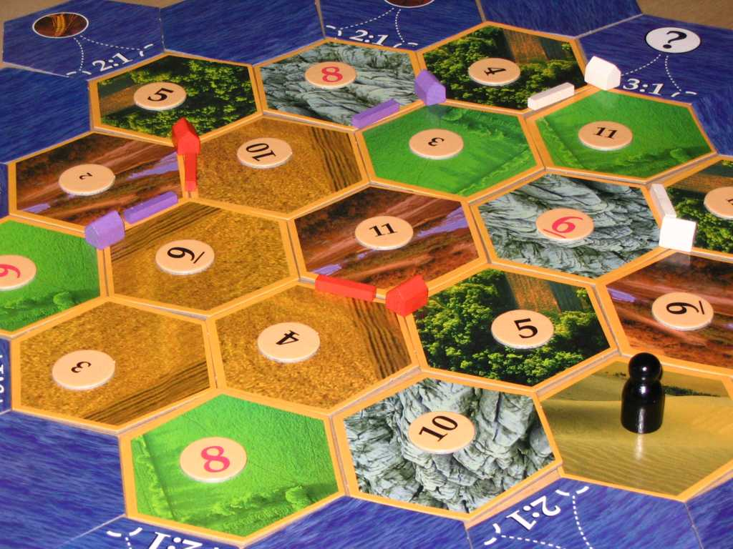
2a. Expecti-mini-max

Slide 52
Description

Slide 53
Description
Players have resources, settlements, roads, cards
Dice roll before each turn (does stuff)
Alternate turns

Slide 54
Assumptions
Assume: 2 players
Assume: LegalActions(s) is known
Assume: Succ(s, a) distribution is known

Slide 55
Draw one ply (2 points)
Circle for agent, square for opponent, traingle for chance
Chance turn before each player.

Slide 56
Draw one ply (2 points)
Circle for agent, square for opponent, traingle for chance
…
…
…
…
…
…
…

Slide 57
What is the utility of a player turn (2 points)
Hint: expressed in terms of the utilities of its children.

Slide 58
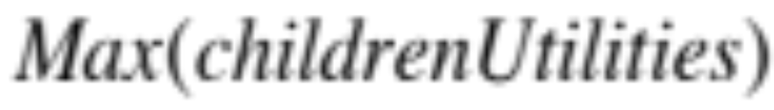
What is the utility of a player turn (2 points)
Hint: expressed in terms of the utilities of its children.

Slide 59
What is the utility of an opponent turn (2 points)
Hint: expressed in terms of the utilities of its children.

Slide 60
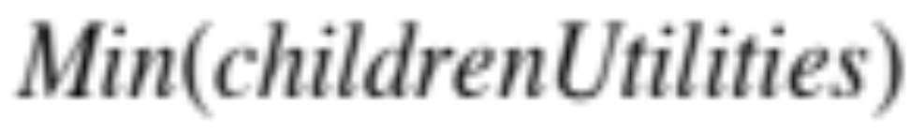
What is the utility of an opponent turn (2 points)
Hint: expressed in terms of the utilities of its children.

Slide 61
What is the utility of a chance turn (2 points)
Hint: expressed in terms of the utilities of its children.

Slide 62
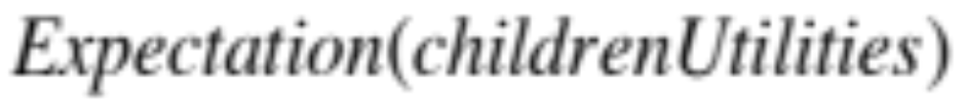
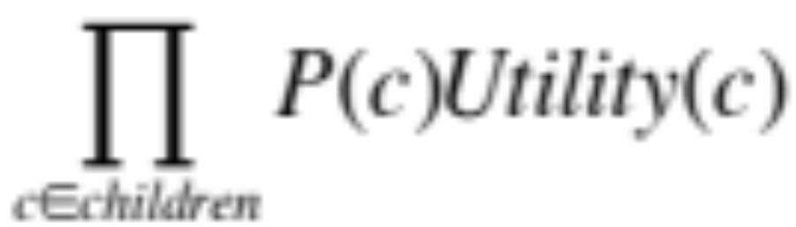
What is the utility of a chance turn (2 points)
Hint: expressed in terms of the utilities of its children.

Slide 63
Find Utility of Action 1 (2 points)
Action 1
C1
C2
0.5
0.5
0.3
0.7
10
10
15
0

Slide 64

Write Code That Finds Best Action (10 points)

Slide 65
Write chooseAction(state)
actions = legalActions(state)
next = getNext(state, action)
utility = getExpMinMax(state,
depth)
def choseAction(state, depth):
# your code here

Slide 66
Write getExpMinMax(state)
state.isAgentTurn()
state.isOpponentTurn()
state.isChanceTurn()
h = heuristic(state)
state.getP() #if parent is chance
def getExpMinMax(state, depth):
# your code here

Slide 67
2. Adversary and MDP
Deterministic Search
Adversary Search and MDP
Temporal Models
Bayesian Networks

Slide 68
2. Adversary and MDP
Deterministic Search
Adversary Search and MDP
Temporal Models
Bayesian Networks

Slide 69

http://www.youtube.com/watch?v=l-gQLqv9f4o

Slide 70
2. Adversary and MDP
Deterministic Search
Adversary Search and MDP
Temporal Models
Bayesian Networks

Slide 71
3. Bayesian Networks
Deterministic Search
Adversary Search and MDP
Temporal Models
Bayesian Networks

Slide 72
Things you should be able to do.
Chose a good model. Why not build one? Makes the rest of the problem really hard to grade ☺.
Exact inference a query variable given evidence.
Decide if two sets of variables are conditionally independent given a third.
Learn parameters if all variables are observed.

Slide 73
3a. Grit
grit
 | Description | Domain
g_{i} | Grade on assn i | Low, med, high
t_{i} | Time taken | Fast, average, slow
grit | Overcoming obstacles | Low, med, high
g_{i}
t_{i}
Assume all CPTs are known

Slide 74
Time = low. Find P(grade = high)
grit
 | Description | Domain
g_{i} | Grade on assn i | Low, med, high
t_{i} | Time taken | Fast, average, slow
grit | Overcoming obstacles | Low, med, high
g_{i}
t_{i}
Assume all CPTs are known

Slide 75
Time = low. Find P(grade = high)
Express in terms of CPTs (3 points)
grit
 | Description | Domain
g_{i} | Grade on assn i | Low, med, high
t_{i} | Time taken | Fast, average, slow
grit | Overcoming obstacles | Low, med, high
g_{i}
t_{i}
Assume all CPTs are known

Slide 76
G indy of T given Grit? (2 points)
grit
 | Description | Domain
g_{i} | Grade on assn i | Low, med, high
t_{i} | Time taken | Fast, average, slow
grit | Overcoming obstacles | Low, med, high
g_{i}
t_{i}
Assume all CPTs are known

Slide 77
The Ball Metaphore

Slide 78
The Ball Metaphore

Slide 79
The Ball Metaphore

Slide 80
The Ball Metaphore

Slide 81
The Ball Metaphore

Slide 82
The Ball Metaphore

Slide 83
The Ball Metaphore

Slide 86
G indy of T given Grit? (2 points)
grit
 | Description | Domain
g_{i} | Grade on assn i | Low, med, high
t_{i} | Time taken | Fast, average, slow
grit | Overcoming obstacles | Low, med, high
g_{i}
t_{i}
Assume all CPTs are known

Slide 87
G indy of T given Grit? (2 points)
grit
 | Description | Domain
g_{i} | Grade on assn i | Low, med, high
t_{i} | Time taken | Fast, average, slow
grit | Overcoming obstacles | Low, med, high
g_{i}
t_{i}
Assume all CPTs are known

Slide 88
The Ball Metaphore

Slide 89
G indy of T given Grit? (2 points)
grit
 | Description | Domain
g_{i} | Grade on assn i | Low, med, high
t_{i} | Time taken | Fast, average, slow
grit | Overcoming obstacles | Low, med, high
g_{i}
t_{i}
Assume all CPTs are known

Slide 90
Midterm grade is caused by grit
grit
 | Description | Domain
g_{i} | Grade on assn i | Low, med, high
t_{i} | Time taken | Fast, average, slow
grit | Overcoming obstacles | Low, med, high
g_{i}
t_{i}
Assume all CPTs are known

Slide 91
…Conditionally independent of rest
grit
 | Description | Domain
g_{i} | Grade on assn i | Low, med, high
t_{i} | Time taken | Fast, average, slow
grit | Overcoming obstacles | Low, med, high
g_{i}
t_{i}
Assume all CPTs are known

Slide 92
Model Midterm Grade (2 points)
grit
 | Description | Domain
g_{i} | Grade on assn i | Low, med, high
t_{i} | Time taken | Fast, average, slow
grit | Overcoming obstacles | Low, med, high
g_{i}
t_{i}
Assume all CPTs are known

Slide 93
Model Midterm Grade (2 points)
grit
 | Description | Domain
g_{i} | Grade on assn i | Low, med, high
t_{i} | Time taken | Fast, average, slow
grit | Overcoming obstacles | Low, med, high
m | Midterm grade | Low, med, high
g_{i}
t_{i}
m

Slide 94
M indy of G | grit? (2 points)
grit
 | Description | Domain
g_{i} | Grade on assn i | Low, med, high
t_{i} | Time taken | Fast, average, slow
grit | Overcoming obstacles | Low, med, high
m | Midterm grade | Low, med, high
g_{i}
t_{i}
m

Slide 95
M indy of G | grit? (2 points)
grit
 | Description | Domain
g_{i} | Grade on assn i | Low, med, high
t_{i} | Time taken | Fast, average, slow
grit | Overcoming obstacles | Low, med, high
m | Midterm grade | Low, med, high
g_{i}
t_{i}
m

Slide 96
Parameter Learning (4 points)
grit | g | m | t
low | low | low | fast
low | med | med | slow
med | med | low | slow
high | high | high | fast
med | med | high | slow
low | med | low | med
high | high | med | med
low | low | low | slow
high | high | high | med
Calculate P(midterm = high | grit = high)

Slide 97
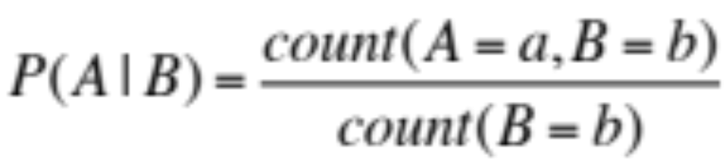
Parameter Learning (review)

Slide 98
Parameter Learning (4 points)
grit | g | m | t
low | low | low | fast
low | med | med | slow
med | med | low | slow
high | high | high | fast
med | med | high | slow
low | med | low | med
high | high | med | med
low | low | low | slow
high | high | high | med
Calculate P(midterm = high | grit = high)

Slide 99
Parameter Learning (4 points)
grit | g | m | t
low | low | low | fast
low | med | med | slow
med | med | low | slow
high | high | high | fast
med | med | high | slow
low | med | low | med
high | high | med | med
low | low | low | slow
high | high | high | med
Calculate P(midterm = high | grit = high)

Slide 100
P(midterm = high | grit = high)
grit | g | m | t
low | low | low | fast
low | med | med | slow
med | med | low | slow
high | high | high | fast
med | med | high | slow
low | med | low | med
high | high | med | med
low | low | low | slow
high | high | high | med
2/3

Slide 101
P(midterm = med| grit = high)
grit | g | m | t
low | low | low | fast
low | med | med | slow
med | med | low | slow
high | high | high | fast
med | med | high | slow
low | med | low | med
high | high | med | med
low | low | low | slow
high | high | high | med

Slide 102
P(midterm = med| grit = high)
grit | g | m | t
low | low | low | fast
low | med | med | slow
med | med | low | slow
high | high | high | fast
med | med | high | slow
low | med | low | med
high | high | med | med
low | low | low | slow
high | high | high | med
1/3

Slide 103
P(midterm = low| grit = high)
grit | g | m | t
low | low | low | fast
low | med | med | slow
med | med | low | slow
high | high | high | fast
med | med | high | slow
low | med | low | med
high | high | med | med
low | low | low | slow
high | high | high | med

Slide 104
P(midterm = low| grit = high)
grit | g | m | t
low | low | low | fast
low | med | med | slow
med | med | low | slow
high | high | high | fast
med | med | high | slow
low | med | low | med
high | high | med | med
low | low | low | slow
high | high | high | med
0/3

Slide 105
How big is the CPT for midterm?
grit
 | Description | Domain
g_{i} | Grade on assn i | Low, med, high
t_{i} | Time taken | Fast, average, slow
grit | Overcoming obstacles | Low, med, high
m | Midterm grade | Low, med, high
g_{i}
t_{i}
m

Slide 106
Things you should be able to do.
Chose a good model. Why not build one? Makes the rest of the problem really hard to grade ☺.
Exact inference a query variable given evidence.
Decide if two sets of variables are conditionally independent given a third.
Learn parameters if all variables are observed.

Slide 107
3. Bayesian Networks
Deterministic Search
Adversary Search and MDP
Temporal Models
Bayesian Networks

Slide 108
3. Bayesian Networks
Deterministic Search
Adversary Search and MDP
Temporal Models
Bayesian Networks

Slide 109
4. Temporal Models
Deterministic Search
Adversary Search and MDP
Temporal Models
Bayesian Networks

Slide 110
Things you should be able to do.
Model a temporal problem as a Markov Model, or a Hidden Markov Model (for both either order 1 or order N)
Filtering exact inference (both observe and elapseTime).
Particle filter inference.
Grok the Markov assumption.

Slide 111

4a. Brain Music

Slide 112
Part I
4a. Brain Music

Slide 113
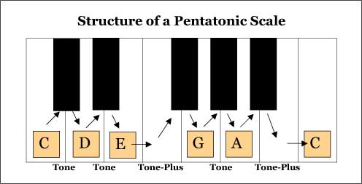
Domain of Notes

Slide 114

Observation of brain signal every 1s

Slide 115
Emission Probability
brain(C)
0
1
C
A
D
E
G

Slide 116
Emission Probability
0
brain(C)
1
μ = Brain(note)
Note_{i}
C
σ = Constant
Probability Density
Signal_{i}
Value of brainSignal

Slide 117
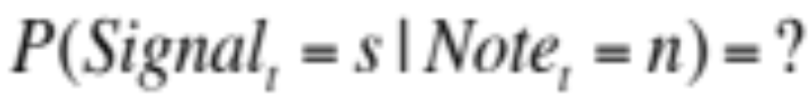
Emission Probability
0
brain(C)
1
μ = Brain(note)
Note_{i}
C
σ = Constant
Probability Density
Signal_{i}
Value of brainSignal

Slide 118
Question (1 point)
0
brain(C)
1
μ = Brain(note)
Note_{i}
C
σ = Constant
Probability Density
Signal_{i}
Value of brainSignal

Slide 119
Design the HMM (1 point)

Slide 120
Design the HMM
Note₁
Note₂
Note₃
Brain₁
Brain₂
Brain₃

Slide 121

Transition Probability is Known…
Note_{t}
Note_{t+1}

Slide 122
Transition CPT size (1 point)
Note_{t}
Note_{t+1}

Slide 123
Update beliefs | observe signal s (3 points)
Note | Prior Belief
C | 0.10
D | 0.20
E | 0.60
G | 0.05
A | 0.05
Note = n | P(s|n)
C | 0.01
D | 0.12
E | 0.50
G | 0.50
A | 0.12

Slide 124
Update beliefs | observe signal s (3 points)
Note | Prior Belief
C | 0.10
D | 0.20
E | 0.60
G | 0.05
A | 0.05
Note = n | P(s|n)
C | 0.01
D | 0.12
E | 0.50
G | 0.50
A | 0.12

Slide 125
Part II
4a. Brain Music

Slide 126
Given a sequence of observations and want to chose the best hidden variables post-hoc
Warning: Not filtering!
Most Likely Explanation

Slide 127
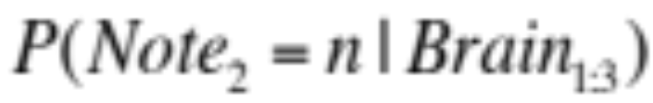
Intuition
Note₁
Note₂
Note₃
Brain₁
Brain₂
Brain₃
Write exact inference equation for
Using only values from the implied CPTs

Slide 128
Intuition
Note₁
Note₂
Note₃
Hint: Not filtering. We are using evidence from the future
Brain₁
Brain₂
Brain₃
Write exact inference equation for
Using only values from the implied CPTs

Slide 129
Exact Inference (3 points)
Note₁
Note₂
Note₃
Brain₁
Brain₂
Brain₃
Write exact inference equation for
Using only values from the implied CPTs

Slide 130
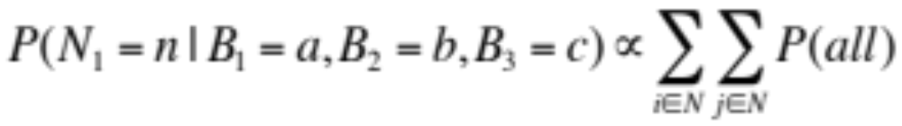
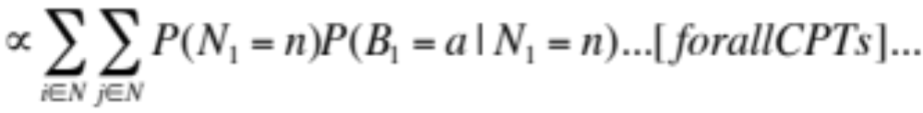
Exact Inference (3 points)
Write exact inference equation for
Using only values from the implied CPTs

Slide 131
Complexity of Exact Inference (1 point)
Linear Time
Polynomial Time
Exponential Time

Slide 132
Complexity of Exact Inference (1 point)
Linear Time
Polynomial Time
Exponential Time

Slide 133
Need better algorithm

Slide 134
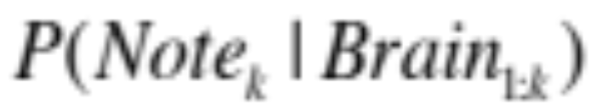
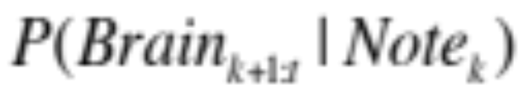
Claim
Polynomial Time

Slide 135
Independence (1 point)
Note₁
Note₂
Note₃
Brain₁
Brain₂
Brain₃
Explain why:

Slide 136
Algorithm (3 points)
Given
Find
Notes:
Make sure to practice this one!

Slide 137
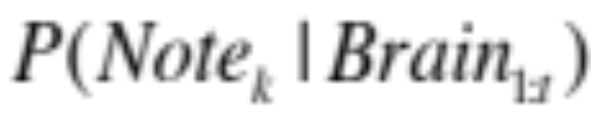
Understanding
Polynomial Time

Slide 138
4. Temporal Models
Deterministic Search
Adversary Search and MDP
Temporal Models
Bayesian Networks

Slide 139
4. Temporal Models
Deterministic Search
Adversary Search and MDP
Temporal Models
Bayesian Networks

Slide 140
Midterm Structure
Deterministic Search
Adversary Search and MDP
Temporal Models
Bayesian Networks

Slide 141
Good luck, have fun!
http://www.youtube.com/watch?v=l-gQLqv9f4o

Slide 142
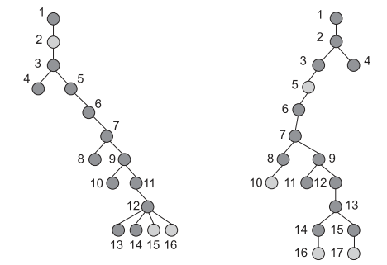
1b. Tree Edit Distance

Slide 143
Tree Mapping!

Slide 144
Tree Mapping!

Slide 145
Tree Mapping!

Slide 146
Tree Mapping!

Slide 147
Tree Mapping!

Slide 148
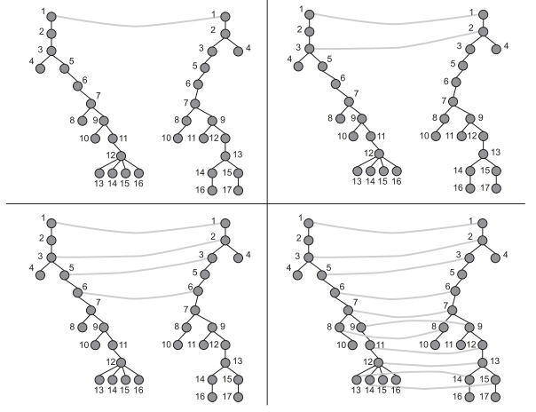
Tree Mapping!

Slide 149
Tree Edit Distance
Each node can only be assigned once.
A node can be mapped to epsilon
The two roots must be assigned to each other
When two nodes are paired, at least one of the assigned nodes must be a direct child of a previously assigned node.

Slide 150
1. State
2. Start State
3. Legal Actions
4. Successor
5. Cost of Action

Slide 151
1. State

Slide 152
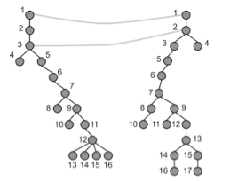
1. State
A set of matchings so far

Slide 153
2. Start State

Slide 154
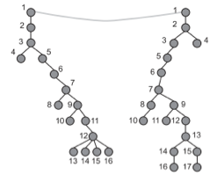
2. Start State
{(root to root)}

Slide 155
3. Legal Actions

Slide 156
3. Legal Actions
Let the cursor be on the next unmatched node in A
Match cursor to epsilon or any of the legal nodes in tree B

Slide 157
4. Successor

Slide 158
4. Successor
If your action was to match x to y. Put (x, y) into the set of matches

Slide 159
5. Cost of Action

Slide 160
5. Cost of Action
1 for a match to epsilon or N where N is the distance from the parent of the matched node in B to a node in the matched list.

Slide 161
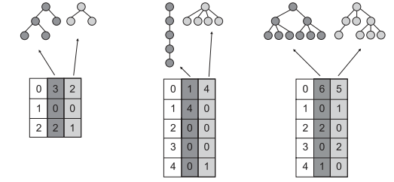
Heuristic 1
H1 = difference between number of nodes in remaining trees

Slide 162
Heuristic 2
H2 = difference between the number of nodes with exactly i children.

Slide 163
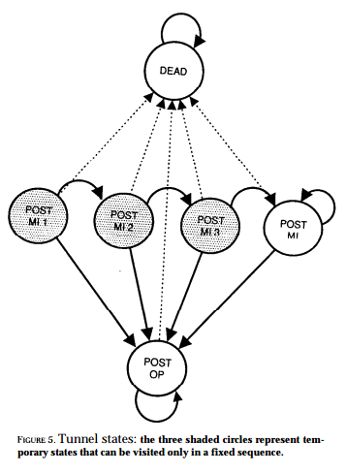
2b. Not Killing People

Slide 164
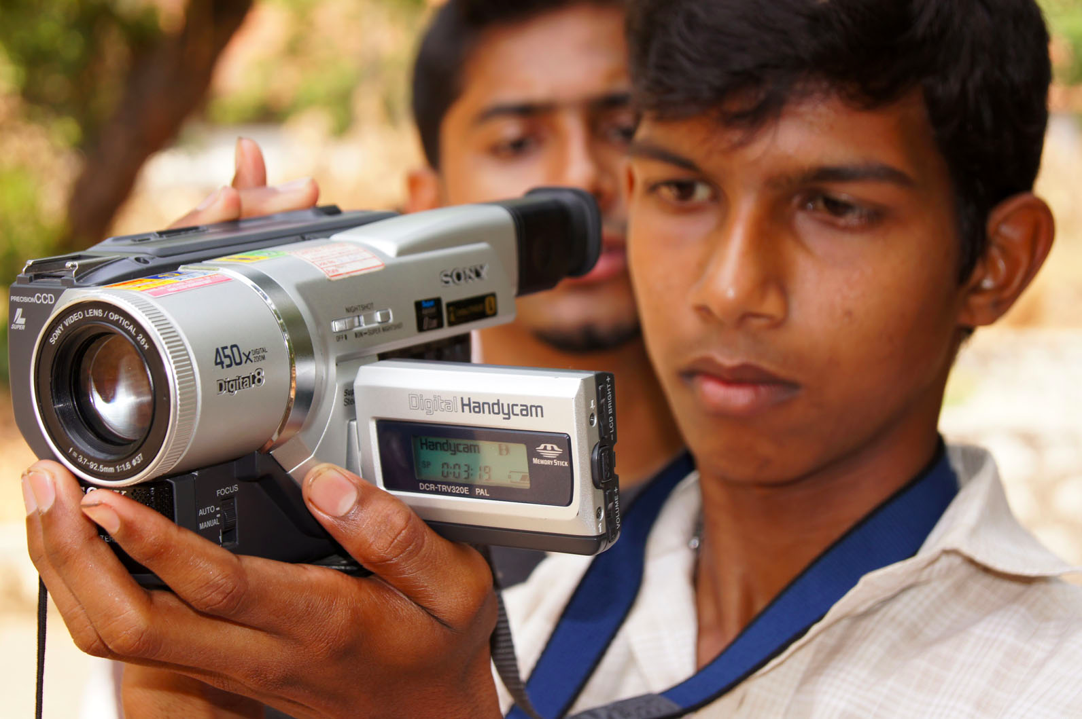
4b. Tracking a Hand Held Camera

