Slide 1
Information Theory:
From Wireless Communication to DNA Sequencing
David Tse
Dept. of EECS
U.C. Berkeley
Gilbreth Lecture
TexPoint fonts used in EMF: AAAAAAAAAAAAAAAA

Slide 2
Information in an Information Age
Some fundamental questions:
How to quantify information?
How fast can information be communicated?
How much information is needed for an inference task?

Slide 3
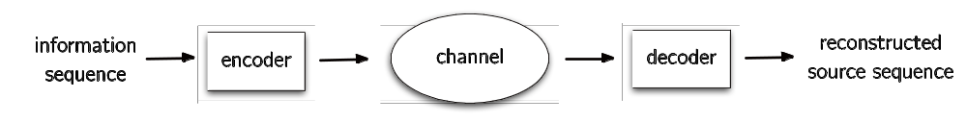


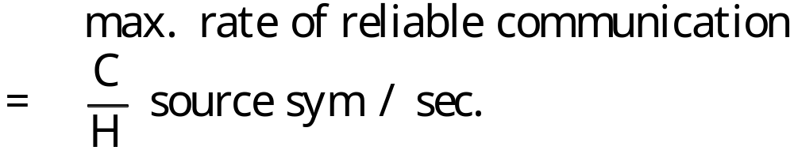
Information Theory
source
sequence
Given statistical models for source and channel:
Shannon 48
Theorem:
A unified way of looking at all communication problems.

Slide 4
Two stories
Wireless communication
High-throughput DNA sequencing
(a gigantic jigsaw puzzle)

Slide 5
Wireless Communication
Explosive increase in penetration and data rate:
~ 0 mobile phones in mid 90’s → ~ 6 billions now
low-rate voice → high-rate data
Powering this increase is one of the biggest engineering feats in human history.
Advances in physical layer communication techniques play a key role.
Led to 10 to 15-fold increase in spectral efficiency from 2 G to 4 G.

Slide 6

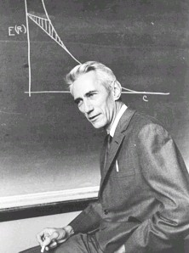
How do these advances come about?
Gugliemo Marconi
Claude Shannon
1901
1948
Wireless communication has been around since 1900’s.
Ingenious system design techniques…….
but somewhat adhoc
Information theory says every channel has a capacity.
Provides a systematic view of the communication problem.
Engineering meets science.
New points of views arise.

Slide 7
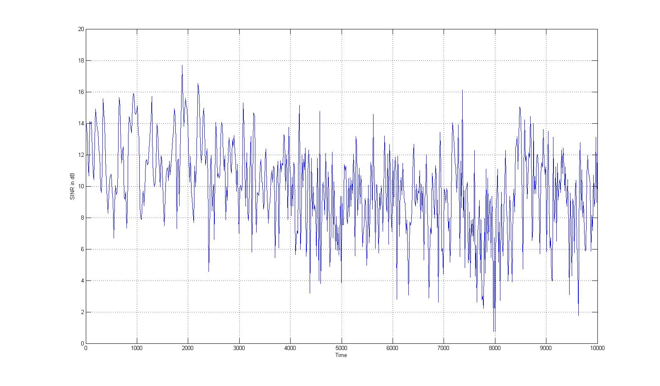
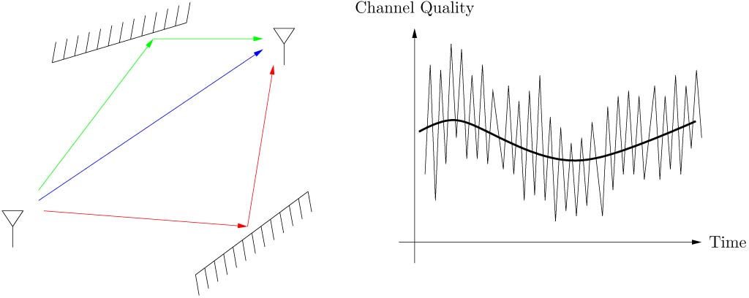
Multipath Fading
16dB
Classical view: fading channels are unreliable
line-of-sight is best.

Slide 8
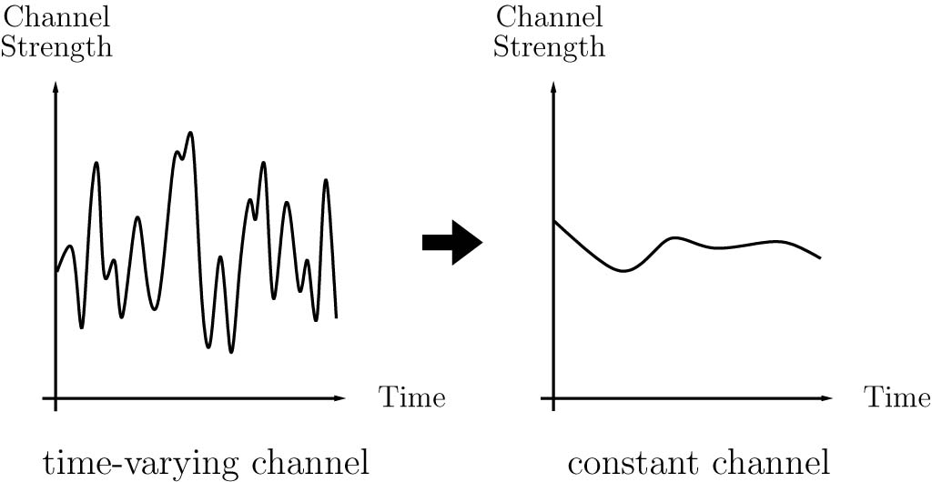
Traditional Approach to
Wireless System Design
Compensates for deep fades via diversity techniques over time, frequency and space.
fading channel
line-of-sight like channel

Slide 9
Opportunistic Communication
Information theory says:
to achieve capacity, transmit opportunistically.
(Goldsmith & Varaiya 96)
Multipath fading provides high peaks to exploit.

Slide 10
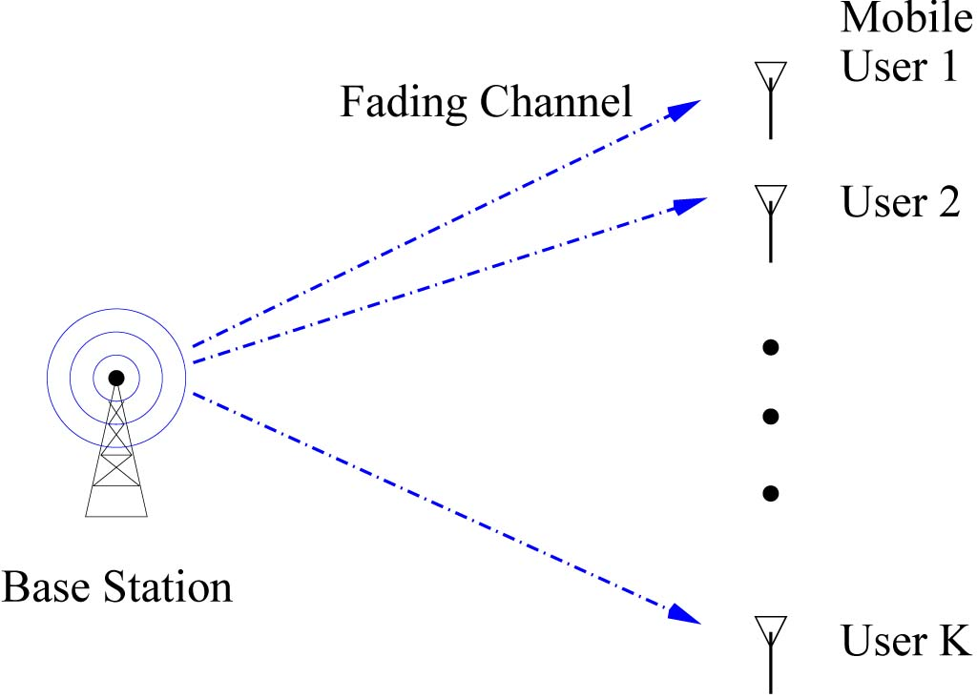

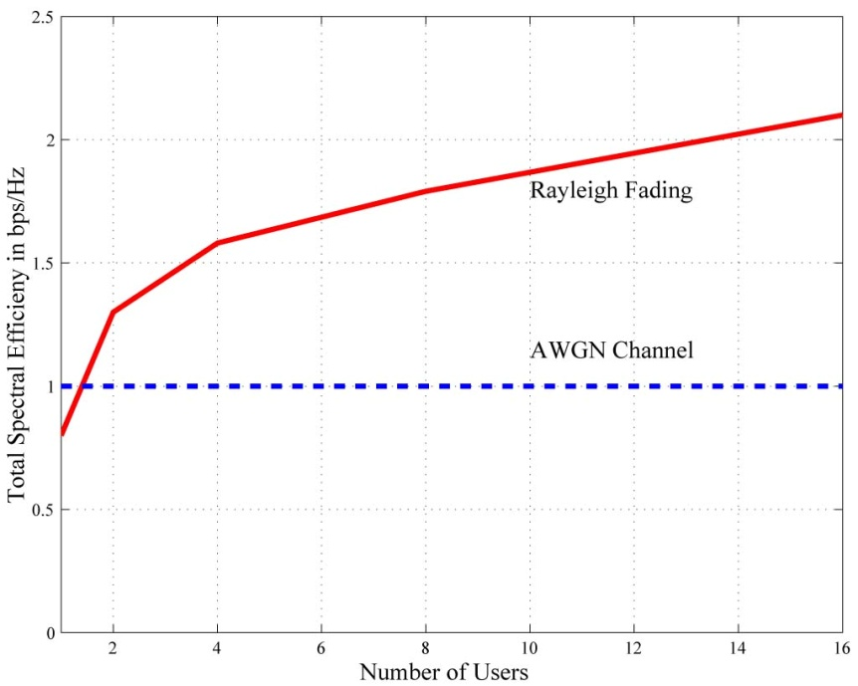
Multiuser Opportunistic Communication
Knopp & Humblet 95
Tse 97
capacity
(bits/s/Hz)
fading
line-of-sight
number of users
Optimal strategy transmits to the best user at each time.
With large number of users, there is always a user at the peak.

Slide 11
From Theory to Practice
An opportunistic scheduler was implemented for Qualcomm’s EVDO system. (Tse 99)
Opportunistic while being fair and sensitive to delay.
Now used in all 3G and 4G systems. (1.6 B devices)

Slide 12
Lesson Learnt
Fading should be exploited rather than avoided.
Another example: MIMO (multiple antenna communication).

Slide 13
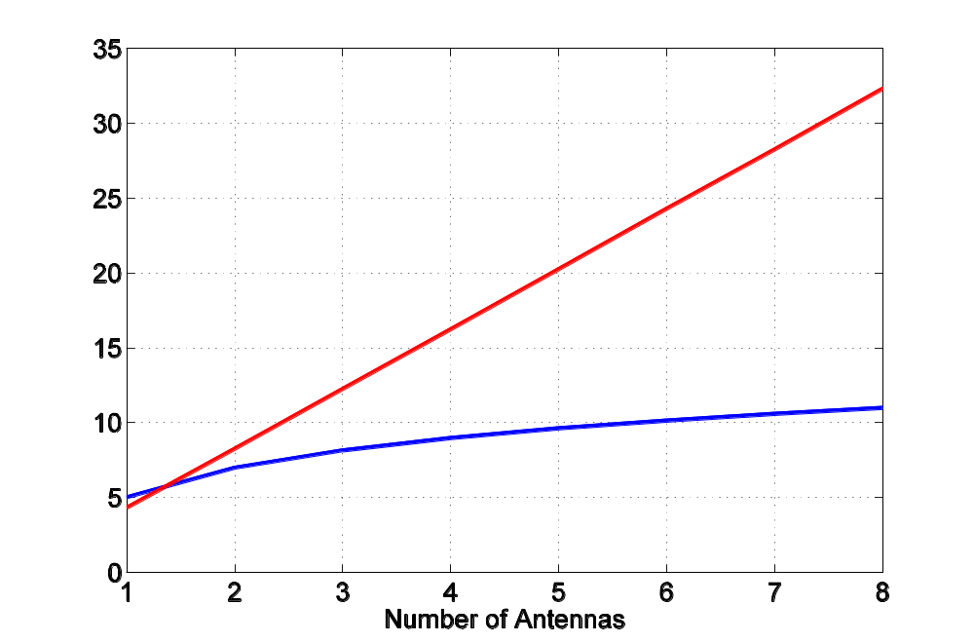
MIMO
Foschini 98
Telatar 99
capacity
(bits/s/Hz)
fading
line-of-sight
number of antennas per device
Why?

Slide 14
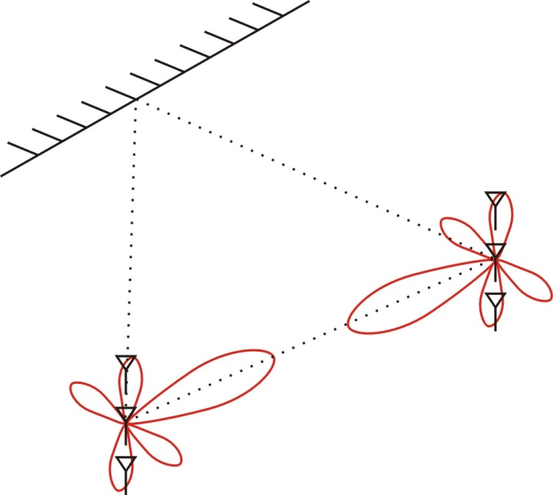
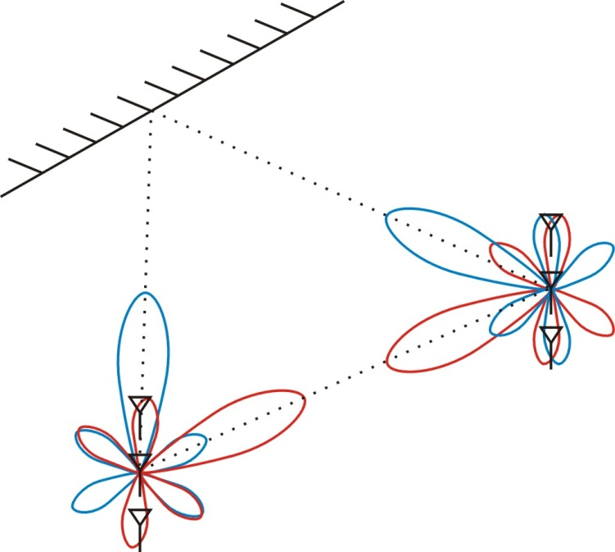
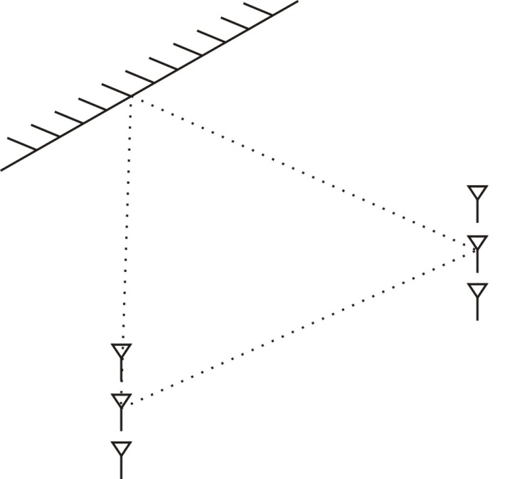
Power versus Dimensions
Line-of-sight allows more power transfer via beamforming.
Multipaths provides more signal dimensions for spatial multiplexing.
Information theory: more dimensions is better than more power.

Slide 15
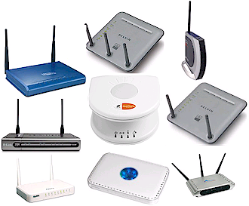
From Theory to Practice
MIMO theory established in late 90’s and early 00’s.
MIMO implemented in past few years in 802.11n and 4G cellular.

Slide 16
Part 2: DNA Sequencing

Slide 17
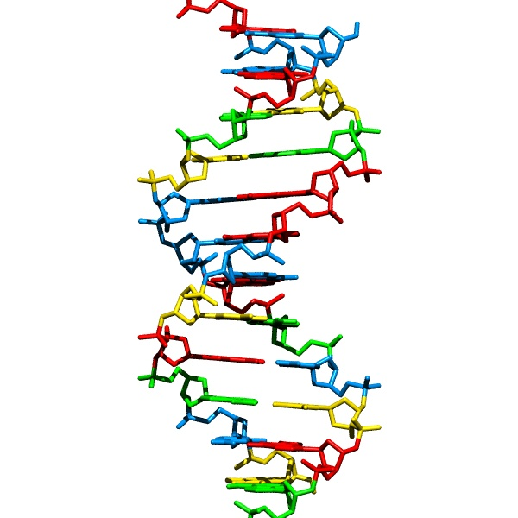
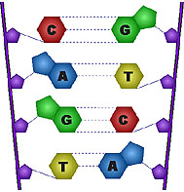
DNA sequencing
Process of obtaining the sequence of nucleotides.
A basic workhorse of modern biology and medicine.
…ACGTGACTGAGGACCGTG
CGACTGAGACTGACTGGGT
CTAGCTAGACTACGTTTTA
TATATATATACGTCGTCGT
ACTGATGACTAGATTACAG
ACTGATTTAGATACCTGAC
TGATTTTAAAAAAATATT…

Slide 18
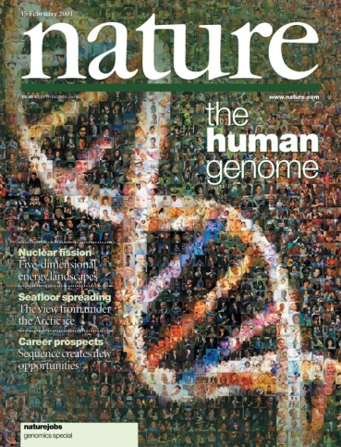
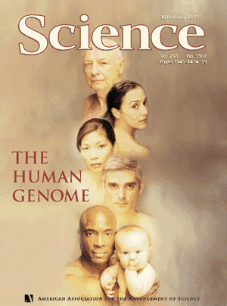
Impetus: Human Genome Project
1990: Start
2001: Draft
3 billion basepairs
2003: Finished

Slide 19
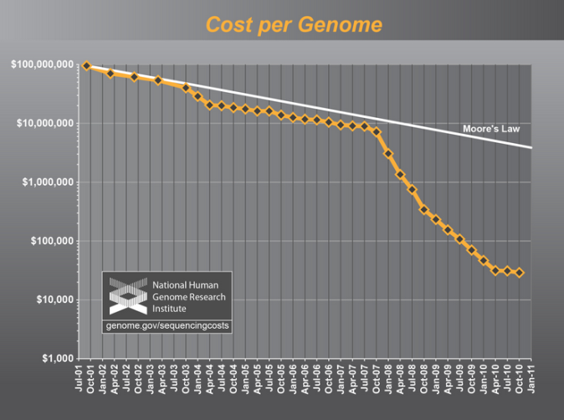
Sequencing Gets Cheaper and Faster
Cost of one human genome
HGP: $ 3 billion
2004: $30,000,000
2008: $100,000
2010: $10,000
2011: $4,000
2012-13: $1,000
???: $300
Time to sequence one genome: years/months → hours
Massive parallelization.

Slide 20
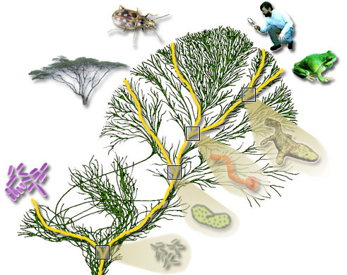
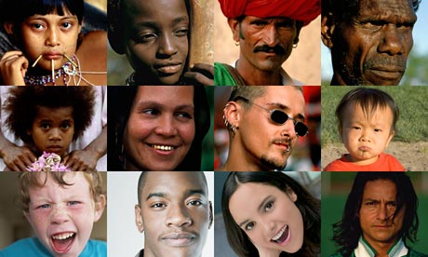
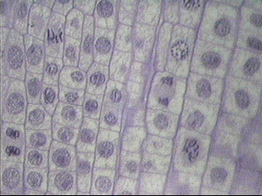
But many genomes to sequence
100 million species
(e.g. phylogeny)
7 billion individuals
(SNP, personal genomics)
10¹³ cells in a human
(e.g. somatic mutations
such as HIV, cancer)

Slide 21
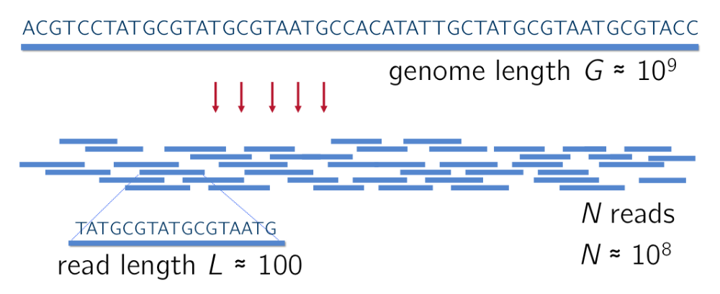
Whole Genome Shotgun Sequencing
Reads are assembled to reconstruct the original DNA sequence.

Slide 22
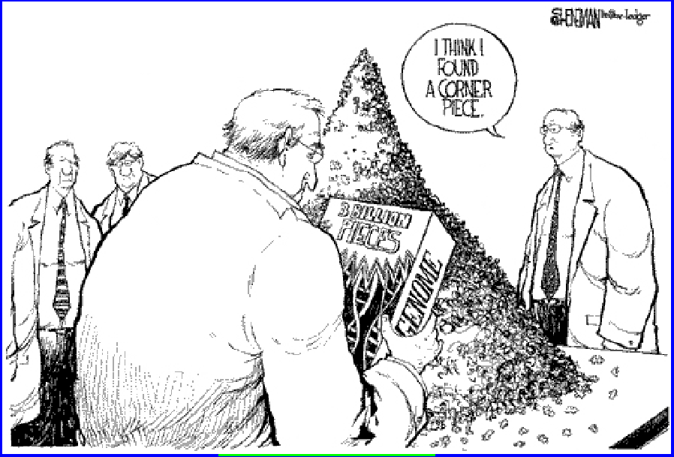
A Gigantic Jigsaw Puzzle

Slide 23
Computation versus Information View
Many proposed assembly algorithms.
But what is the minimum number of reads required for reliable reconstruction?
How much intrinsic information does each read provide about the DNA sequence?

Slide 24
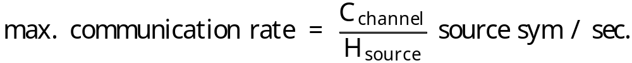


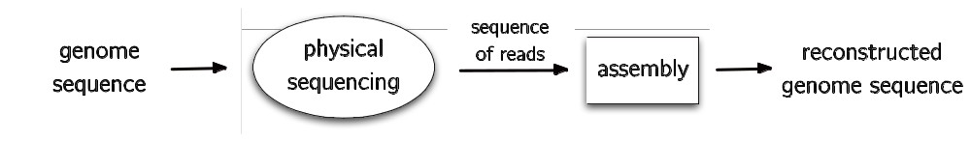

Communication and Sequencing:
An Analogy
Motahari, Bresler & Tse 12
Communication:
source
sequence
Sequencing:
Question: what is the max. sequencing rate such that reliable reconstruction is possible?

Slide 25


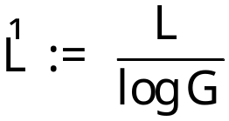

The read channel
Capacity depends on
  read length: L
  DNA length: G
Normalized read length:
Eg. L = 100, G = 3 £ 10⁹ :
read
channel
AGCTTATAGGTCCGCATTACC
AGGTCC

Slide 26
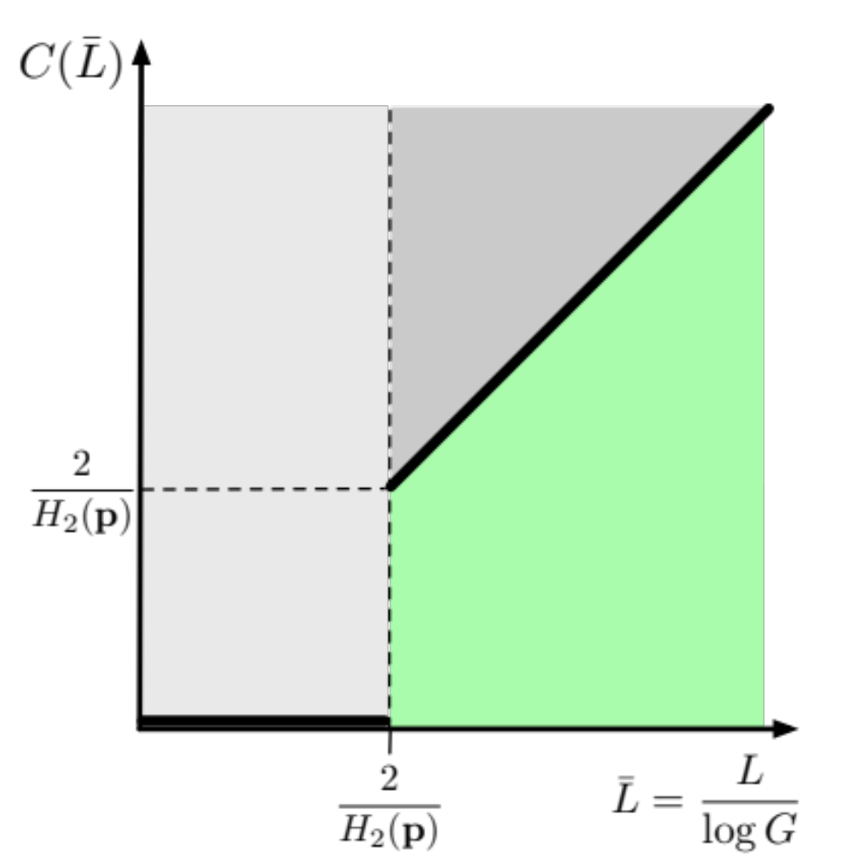


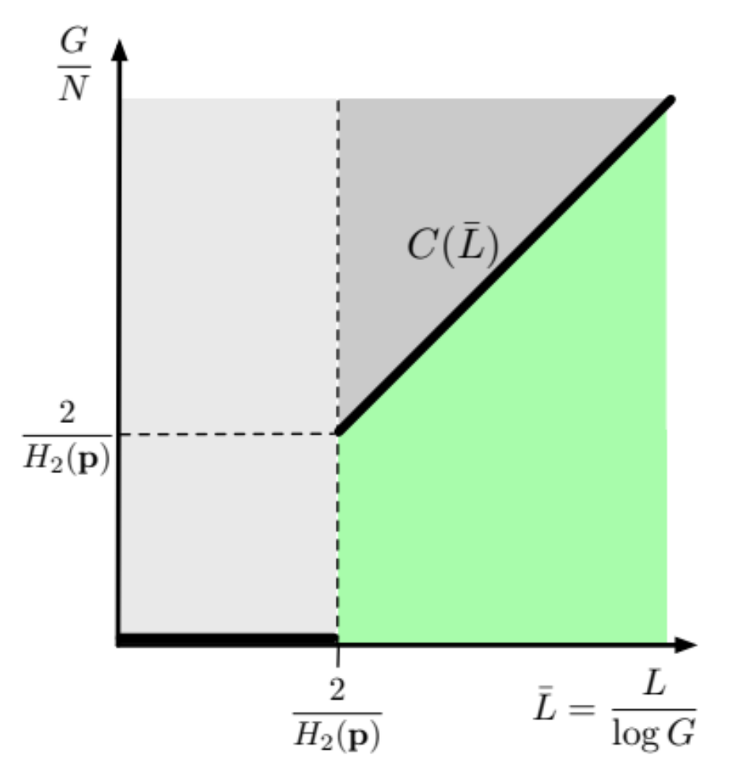
Result: Sequencing Capacity
H₂( p) is (Renyi) entropy rate
of the DNA sequence .
The higher the entropy,
the easier the problem!

Slide 27

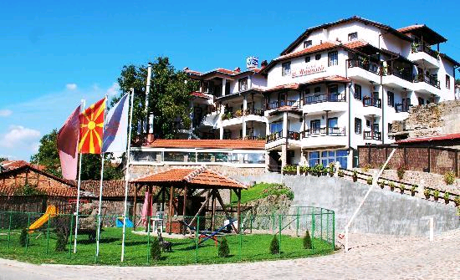
Complexity is in the eyes of the beholder
Low entropy
High entropy

Slide 28
Conclusion
Information theory has made a huge impact on wireless communication.
It provides new points of view.
Its success stems from focusing on something fundamental: information.
This philosophy is useful for other important engineering problems.

