Slide 1
Information Theory for
High Throughput Sequencing
David Tse
U.C. Berkeley
ITA
Feb , 2013
Research supported by NSF Center for Science of Information.
TexPoint fonts used in EMF: AAAAAAAAAAAAAAAA

Slide 2
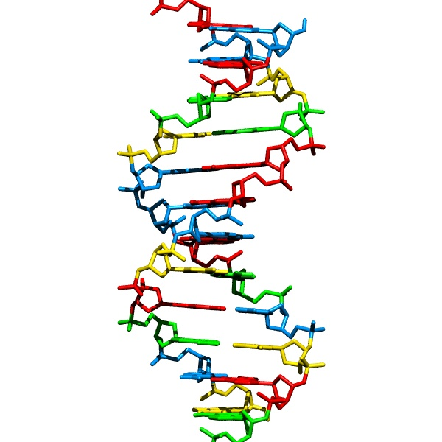
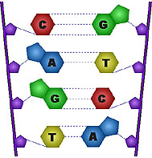
DNA sequencing
…ACGTGACTGAGGACCGTG
CGACTGAGACTGACTGGGT
CTAGCTAGACTACGTTTTA
TATATATATACGTCGTCGT
ACTGATGACTAGATTACAG
ACTGATTTAGATACCTGAC
TGATTTTAAAAAAATATT…

Slide 3
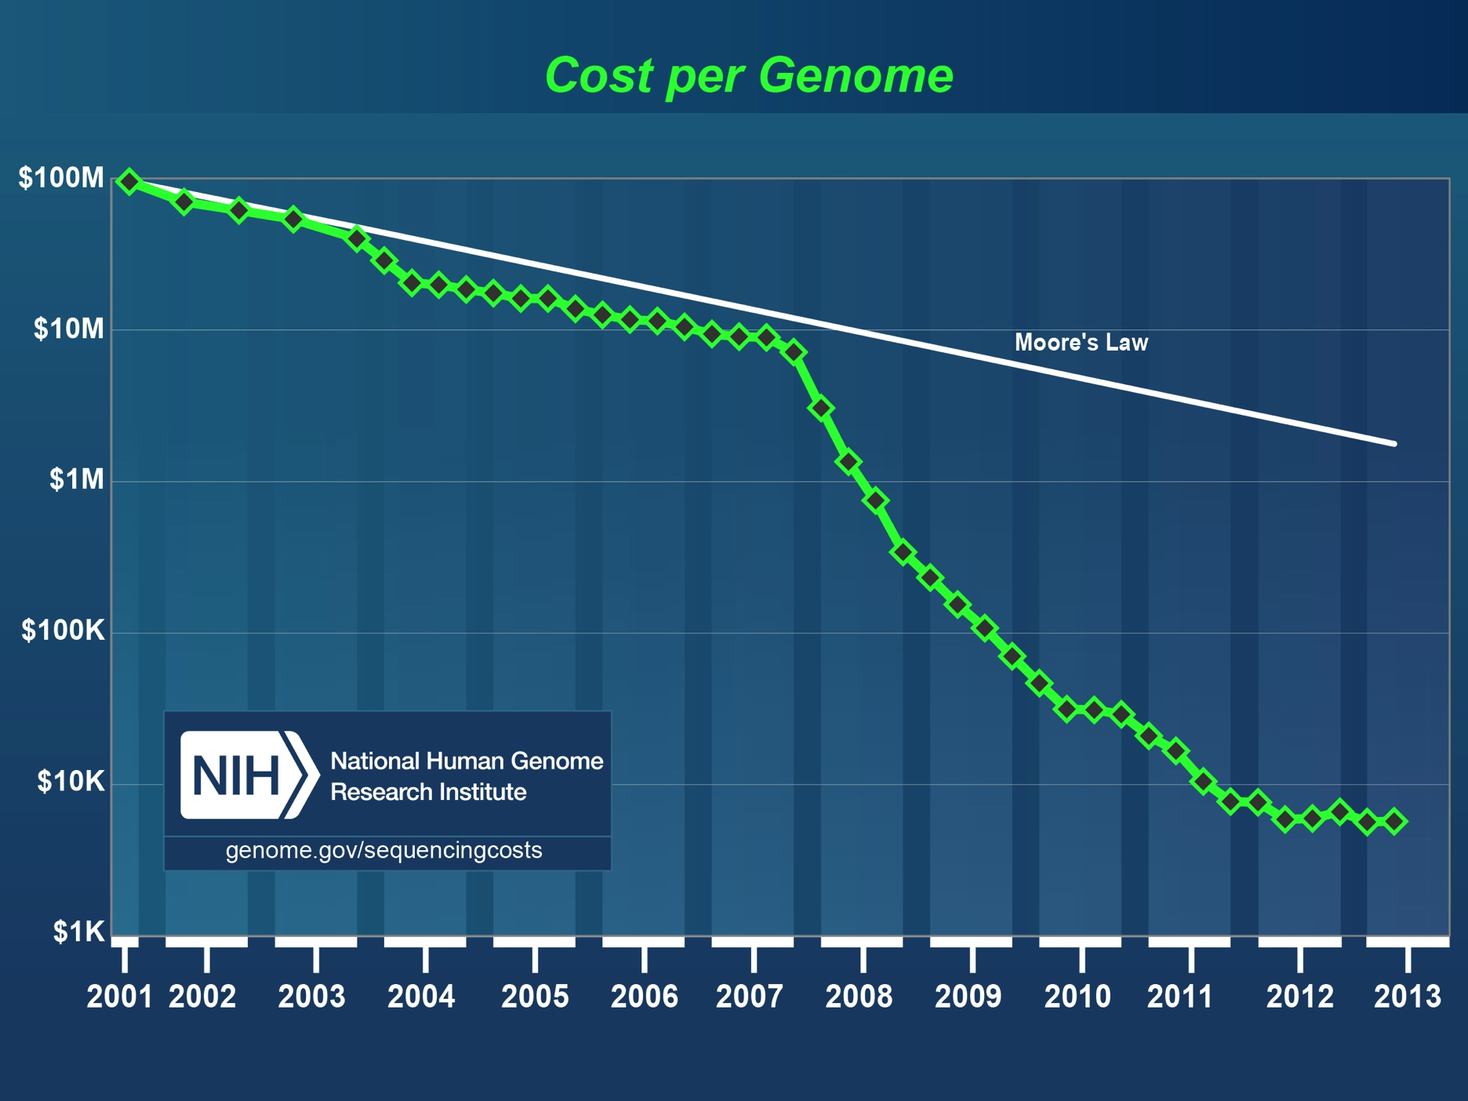
High throughput sequencing revolution
tech. driver for info. theory
Notes:
Faster than Moore;s Law
Implication to the IT community

Slide 4
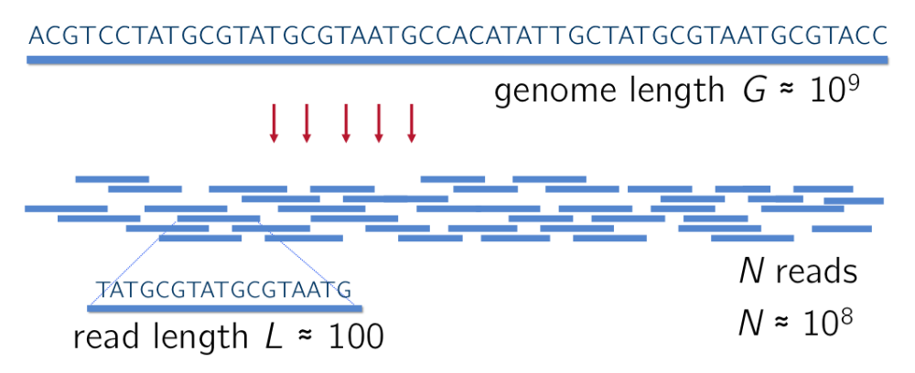
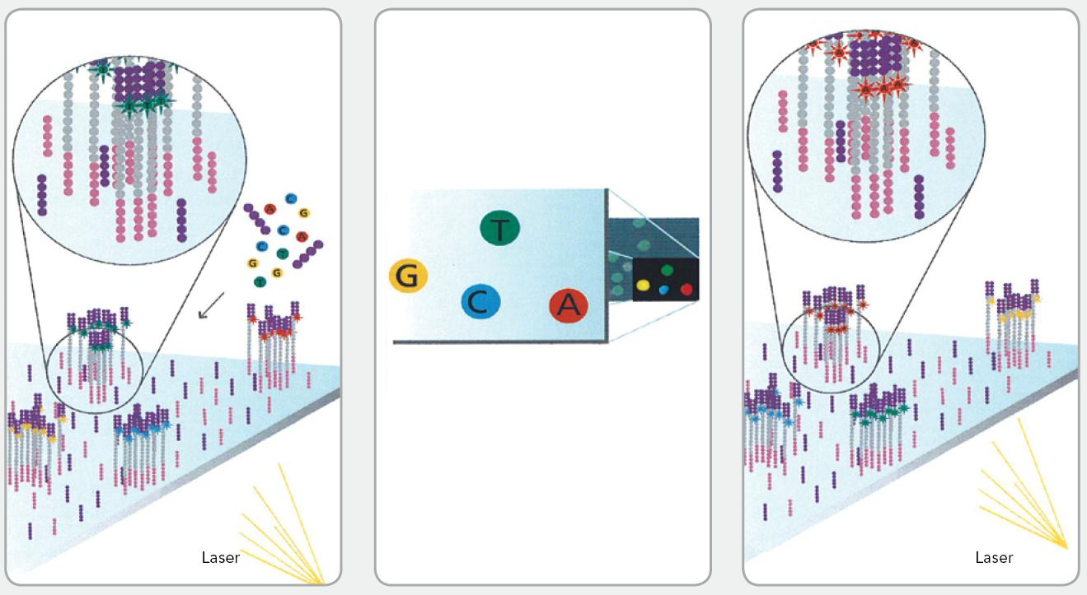
Shotgun sequencing
read

Slide 5
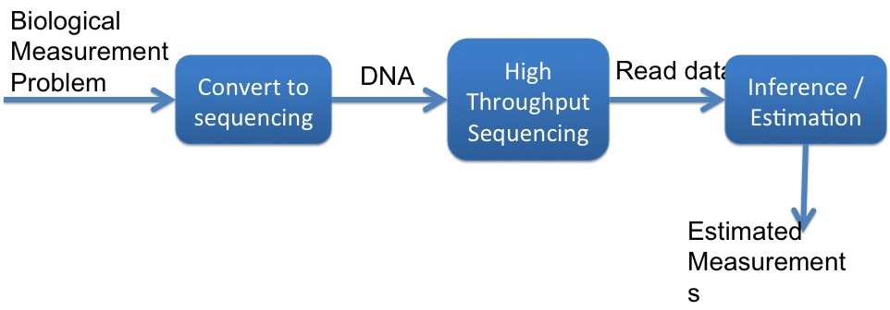
High throughput sequencing:
Microscope in the big data era
(Pachter diagram)
Genomic variations, 3-D structures, transcription, translation,
protein interaction, etc.
Notes:
HTS as the 21st century microscope
Pachter diagram

Slide 6
High-throughput sequencing assays
Courtesy: Lior Pachter
dsRNA-Seq: Qi Zheng et al., “Genome-Wide Double-Stranded RNA Sequencing Reveals the Functional Significance of Base-Paired RNAs in Arabidopsis,” PLoS Genet 6, no. 9 (September 30, 2010): e1001141, doi:10.1371/journal.pgen.1001141.
FRAG-Seq: Jason G. Underwood et al., “FragSeq: Transcriptome-wide RNA Structure Probing Using High-throughput Sequencing,” Nature Methods 7, no. 12 (December 2010): 995–1001, doi:10.1038/nmeth.1529.
SHAPE-Seq: (a) Julius B. Lucks et al., “Multiplexed RNA Structure Characterization with Selective 2′-hydroxyl Acylation Analyzed by Primer Extension Sequencing (SHAPE-Seq),” Proceedings of the National Academy of Sciences 108, no. 27 (July 5, 2011): 11063–11068, doi:10.1073/pnas.1106501108.
(b) Sharon Aviran et al., “Modeling and Automation of Sequencing-based Characterization of RNA Structure,” Proceedings of the National Academy of Sciences (June 3, 2011), doi:10.1073/pnas.1106541108.
PARTE-Seq: Yue Wan et al., “Genome-wide Measurement of RNA Folding Energies,” Molecular Cell 48, no. 2 (October 26, 2012): 169–181, doi:10.1016/j.molcel.2012.08.008.
PARS-Seq: Michael Kertesz et al., “Genome-wide Measurement of RNA Secondary Structure in Yeast,” Nature 467, no. 7311 (September 2, 2010): 103–107, doi:10.1038/nature09322.
Structure-Seq: Yiliang Ding et al., “In Vivo Genome-wide Profiling of RNA Secondary Structure Reveals Novel Regulatory Features,” Nature advance online publication (November 24, 2013), doi:10.1038/nature12756.
DMS-Seq: Silvi Rouskin et al., “Genome-wide Probing of RNA Structure Reveals Active Unfolding of mRNA Structures in Vivo,” Nature advance online publication (December 15, 2013), doi:10.1038/nature12894.
Viral RNA
Cir-Seq: Ashley Acevedo, Leonid Brodsky, and Raul Andino, “Mutational and Fitness Landscapes of an RNA Virus Revealed through Population Sequencing,” Nature 505, no. 7485 (January 30, 2014): 686–690, doi:10.1038/nature12861.
DNA
Dup-Seq: Schmitt, Michael W., Scott R. Kennedy, Jesse J. Salk, Edward J. Fox, Joseph B. Hiatt, and Lawrence A. Loeb. “Detection of Ultra-rare Mutations by Next-generation Sequencing.” Proceedings of the National Academy of Sciences 109, no. 36 (September 4, 2012): 14508–14513. doi:10.1073/pnas.1208715109.
IMS-MDA-Seq: Helena M. B. Seth-Smith et al., “Generating Whole Bacterial Genome Sequences of Low-abundance Species from Complex Samples with IMS-MDA,” Nature Protocols 8, no. 12 (December 2013): 2404–2412, doi:10.1038/nprot.2013.147.
Chromatin structure, accessibility and nucleosome positioning
Nucleo-Seq: Anton Valouev et al., “Determinants of Nucleosome Organization in Primary Human Cells,” Nature 474, no. 7352 (June 23, 2011): 516–520, doi:10.1038/nature10002.
DNAse-Seq: Gregory E. Crawford et al., “Genome-wide Mapping of DNase Hypersensitive Sites Using Massively Parallel Signature Sequencing (MPSS),” Genome Research 16, no. 1 (January 1, 2006): 123–131, doi:10.1101/gr.4074106.
DNAseI-Seq: Jay R. Hesselberth et al., “Global Mapping of protein-DNA Interactions in Vivo by Digital Genomic Footprinting,” Nature Methods 6, no. 4 (April 2009): 283–289, doi:10.1038/nmeth.1313.
Sono-Seq: Raymond K. Auerbach et al., “Mapping Accessible Chromatin Regions Using Sono-Seq,” Proceedings of the National Academy of Sciences 106, no. 35 (September 1, 2009): 14926–14931, doi:10.1073/pnas.0905443106.
Hi-C-Seq: Erez Lieberman-Aiden et al., “Comprehensive Mapping of Long-Range Interactions Reveals Folding Principles of the Human Genome,” Science 326, no. 5950 (October 9, 2009): 289–293, doi:10.1126/science.1181369.

Slide 7
ChIA-PET-Seq: Melissa J. Fullwood et al., “An Oestrogen-receptor-α-bound Human Chromatin Interactome,” Nature 462, no. 7269 (November 5, 2009): 58–64, doi:10.1038/nature08497.
FAIRE-Seq: Hironori Waki et al., “Global Mapping of Cell Type–Specific Open Chromatin by FAIRE-seq Reveals the Regulatory Role of the NFI Family in Adipocyte Differentiation,” PLoS Genet 7, no. 10 (October 20, 2011): e1002311,
NOMe-Seq: Theresa K. Kelly et al., “Genome-wide Mapping of Nucleosome Positioning and DNA Methylation Within Individual DNA Molecules,” Genome Research 22, no. 12 (December 1, 2012): 2497–2506, doi:10.1101/gr.143008.112.
ATAC-Seq: Jason D. Buenrostro et al., “Transposition of Native Chromatin for Fast and Sensitive Epigenomic Profiling of Open Chromatin, DNA-binding Proteins and Nucleosome Position,” Nature Methods advance online publication (October 6, 2013), doi:10.1038/nmeth.2688.
Genome variation
RAD-Seq: Nathan A. Baird et al., “Rapid SNP Discovery and Genetic Mapping Using Sequenced RAD Markers,” PLoS ONE 3, no. 10 (October 13, 2008): e3376, doi:10.1371/journal.pone.0003376.
Freq-Seq: Lon M. Chubiz et al., “FREQ-Seq: A Rapid, Cost-Effective, Sequencing-Based Method to Determine Allele Frequencies Directly from Mixed Populations,” PLoS ONE 7, no. 10 (October 31, 2012): e47959, doi:10.1371/journal.pone.0047959.
CNV-Seq: Chao Xie and Martti T. Tammi, “CNV-seq, a New Method to Detect Copy Number Variation Using High-throughput Sequencing,” BMC Bioinformatics 10, no. 1 (March 6, 2009): 80, doi:10.1186/1471-2105-10-80.
Novel-Seq: Iman Hajirasouliha et al., “Detection and Characterization of Novel Sequence Insertions Using Paired-end Next-generation Sequencing,” Bioinformatics 26, no. 10 (May 15, 2010): 1277–1283, doi:10.1093/bioinformatics/btq152.
TAm-Seq: Tim Forshew et al., “Noninvasive Identification and Monitoring of Cancer Mutations by Targeted Deep Sequencing of Plasma DNA,” Science Translational Medicine 4, no. 136 (May 30, 2012): 136ra68, doi:10.1126/scitranslmed.3003726.
DNA replication
Repli-Seq: R. Scott Hansen et al., “Sequencing Newly Replicated DNA Reveals Widespread Plasticity in Human Replication Timing,” Proceedings of the National Academy of Sciences 107, no. 1 (January 5, 2010): 139–144, doi:10.1073/pnas.0912402107
ARS-Seq: Ivan Liachko et al., “High-resolution Mapping, Characterization, and Optimization of Autonomously Replicating Sequences in Yeast,” Genome Research 23, no. 4 (April 1, 2013): 698–704, doi:10.1101/gr.144659.112.
Sort-Seq: Carolin A. Müller et al., “The Dynamics of Genome Replication Using Deep Sequencing,” Nucleic Acids Research (October 1, 2013): gkt878, doi:10.1093/nar/gkt878.
Pool-Seq: Robert Kofler, Andrea J. Betancourt, and Christian Schlötterer, “Sequencing of Pooled DNA Samples (Pool-Seq) Uncovers Complex Dynamics of Transposable Element Insertions in Drosophila Melanogaster,” PLoS Genet 8, no. 1 (January 26, 2012): e1002487, doi:10.1371/journal.pgen.1002487.
Replication
Bubble-Seq: Larry D. Mesner et al., “Bubble-seq Analysis of the Human Genome Reveals Distinct Chromatin-mediated Mechanisms for Regulating Early- and Late-firing Origins,” Genome Research (July 16, 2013), doi:10.1101/gr.155218.113.

Slide 8
RNA-Seq: Ali Mortazavi et al., “Mapping and Quantifying Mammalian Transcriptomes by RNA-Seq,” Nature Methods 5, no. 7 (July 2008): 621–628, doi:10.1038/nmeth.1226.
GRO-Seq: Leighton J. Core, Joshua J. Waterfall, and John T. Lis, “Nascent RNA Sequencing Reveals Widespread Pausing and Divergent Initiation at Human Promoters,” Science 322, no. 5909 (December 19, 2008): 1845–1848, doi:10.1126/science.1162228.
Quartz-Seq: Yohei Sasagawa et al., “Quartz-Seq: a Highly Reproducible and Sensitive Single-cell RNA-Seq Reveals Non-genetic Gene Expression Heterogeneity,” Genome Biology 14, no. 4 (April 17, 2013): R31, doi:10.1186/gb-2013-14-4-r31.
CAGE-Seq: Hazuki Takahashi et al., “5′ End-centered Expression Profiling Using Cap-analysis Gene Expression and Next-generation Sequencing,” Nature Protocols 7, no. 3 (March 2012): 542–561, doi:10.1038/nprot.2012.005.
Nascent-Seq: Joseph Rodriguez, Jerome S. Menet, and Michael Rosbash, “Nascent-Seq Indicates Widespread Cotranscriptional RNA Editing in Drosophila,” Molecular Cell 47, no. 1 (July 13, 2012): 27–37, doi:10.1016/j.molcel.2012.05.002.
Precapture RNA-Seq: Tim R. Mercer et al., “Targeted RNA Sequencing Reveals the Deep Complexity of the Human Transcriptome,” Nature Biotechnology 30, no. 1 (January 2012): 99–104, doi:10.1038/nbt.2024.
Cel-Seq: Tamar Hashimshony et al., “CEL-Seq: Single-Cell RNA-Seq by Multiplexed Linear Amplification,” Cell Reports 2, no. 3 (September 27, 2012): 666–673, doi:10.1016/j.celrep.2012.08.003.
3P-Seq: Calvin H. Jan et al., “Formation, Regulation and Evolution of Caenorhabditis Elegans 3′UTRs,” Nature 469, no. 7328 (January 6, 2011): 97–101, doi:10.1038/nature09616.
NET-Seq: L. Stirling Churchman and Jonathan S. Weissman, “Nascent Transcript Sequencing Visualizes Transcription at Nucleotide Resolution,” Nature 469, no. 7330 (January 20, 2011): 368–373, doi:10.1038/nature09652.
SS3-Seq: Oh Kyu Yoon and Rachel B. Brem, “Noncanonical Transcript Forms in Yeast and Their Regulation During Environmental Stress,” RNA 16, no. 6 (June 1, 2010): 1256–1267, doi:10.1261/rna.2038810.
FRT-Seq: Lira Mamanova et al., “FRT-seq: Amplification-free, Strand-specific Transcriptome Sequencing,” Nature Methods 7, no. 2 (February 2010): 130–132, doi:10.1038/nmeth.1417.
3-Seq: Andrew H. Beck et al., “3′-End Sequencing for Expression Quantification (3SEQ) from Archival Tumor Samples,” PLoS ONE 5, no. 1 (January 19, 2010): e8768, doi:10.1371/journal.pone.0008768.
PRO-Seq: Hojoong Kwak et al., “Precise Maps of RNA Polymerase Reveal How Promoters Direct Initiation and Pausing,” Science 339, no. 6122 (February 22, 2013): 950–953, doi:10.1126/science.1229386.
Bru-Seq: Artur Veloso et al., “Genome-Wide Transcriptional Effects of the Anti-Cancer Agent Camptothecin,” PLoS ONE 8, no. 10 (October 23, 2013): e78190, doi:10.1371/journal.pone.0078190.
TIF-Seq: Vicent Pelechano, Wu Wei, and Lars M. Steinmetz, “Extensive Transcriptional Heterogeneity Revealed by Isoform Profiling,” Nature 497, no. 7447 (May 2, 2013): 127–131, doi:10.1038/nature12121.
3′-Seq: Steve Lianoglou et al., “Ubiquitously Transcribed Genes Use Alternative Polyadenylation to Achieve Tissue-specific Expression,” Genes & Development 27, no. 21 (November 1, 2013): 2380–2396, doi:10.1101/gad.229328.113.
TIVA-Seq: Ditte Lovatt et al., “Transcriptome in Vivo Analysis (TIVA) of Spatially Defined Single Cells in Live Tissue,” Nature Methods 11, no. 2 (February 2014): 190–196, doi:10.1038/nmeth.2804.
Smart-Seq: Simone Picelli et al., “Full-length RNA-seq from Single Cells Using Smart-seq2,” Nature Protocols 9, no. 1 (January 2014): 171–181, doi:10.1038/nprot.2014.006.

Slide 9
PAS-Seq: Peter J. Shepard et al., “Complex and Dynamic Landscape of RNA Polyadenylation Revealed by PAS-Seq,” RNA 17, no. 4 (April 1, 2011): 761–772, doi:10.1261/rna.2581711.
PAL-Seq: Alexander O. Subtelny et al., “Poly(A)-tail Profiling Reveals an Embryonic Switch in Translational Control,” Nature advance online publication (January 29, 2014), doi:10.1038/nature13007.
Translation
Ribo-Seq: Nicholas T. Ingolia et al., “Genome-Wide Analysis in Vivo of Translation with Nucleotide Resolution Using Ribosome Profiling,” Science 324, no. 5924 (April 10, 2009): 218–223, doi:10.1126/science.1168978.
Frac-Seq: Timothy Sterne-Weiler et al., “Frac-seq Reveals Isoform-specific Recruitment to Polyribosomes,” Genome Research (June 19, 2013), doi:10.1101/gr.148585.112.
GTI-Seq: Ji Wan and Shu-Bing Qian, “TISdb: a Database for Alternative Translation Initiation in Mammalian Cells,” Nucleic Acids Research (November 6, 2013), doi:10.1093/nar/gkt1085.
TFBS and Enhancer activity
SELEX-Seq: Matthew Slattery et al., “Cofactor Binding Evokes Latent Differences in DNA Binding Specificity Between Hox Proteins,” Cell 147, no. 6 (December 9, 2011): 1270–1282, doi:10.1016/j.cell.2011.10.053.
CRE-Seq: Jamie C. Kwasnieski et al., “Complex Effects of Nucleotide Variants in a Mammalian Cis-regulatory Element,” Proceedings of the National Academy of Sciences 109, no. 47 (November 20, 2012): 19498–19503, doi:10.1073/pnas.1210678109.
STARR-Seq: Cosmas D. Arnold et al., “Genome-Wide Quantitative Enhancer Activity Maps Identified by STARR-seq,” Science 339, no. 6123 (March 1, 2013): 1074–1077, doi:10.1126/science.1232542.
SRE-Seq: Robin P. Smith et al., “Massively Parallel Decoding of Mammalian Regulatory Sequences Supports a Flexible Organizational Model,” Nature Genetics 45, no. 9 (September 2013): 1021–1028, doi:10.1038/ng.2713.
HITS-KIN-Seq: Ulf-Peter Guenther et al., “Hidden Specificity in an Apparently Nonspecific RNA-binding Protein,” Nature 502, no. 7471 (October 17, 2013): 385–388, doi:10.1038/nature12543.
Capture-C-Seq: Jim R. Hughes et al., “Analysis of Hundreds of Cis-regulatory Landscapes at High Resolution in a Single, High-throughput Experiment,” Nature Genetics 46, no. 2 (February 2014): 205–212, doi:10.1038/ng.2871.
RNA-RNA interaction
CLASH-Seq: Aleksandra Helwak et al., “Mapping the Human miRNA Interactome by CLASH Reveals Frequent Noncanonical Binding,” Cell 153, no. 3 (April 2013): 654–665, doi:10.1016/j.cell.2013.03.043.
RNA-DNA binding
ChIRP-Seq: Ci Chu et al., “Genomic Maps of Long Noncoding RNA Occupancy Reveal Principles of RNA-Chromatin Interactions,” Molecular Cell 44, no. 4 (November 18, 2011): 667–678, doi:10.1016/j.molcel.2011.08.027.
CHART-Seq: Matthew D. Simon et al., “The Genomic Binding Sites of a Noncoding RNA,” Proceedings of the National Academy of Sciences 108, no. 51 (December 20, 2011): 20497–20502, doi:10.1073/pnas.1113536108.
RAP-Seq: Jesse M. Engreitz et al., “The Xist lncRNA Exploits Three-Dimensional Genome Architecture to Spread Across the X Chromosome,” Science 341, no. 6147 (August 16, 2013): 1237973, doi:10.1126/science.1237973.

Slide 10
RIP-Seq: Ci Chu et al., “Genomic Maps of Long Noncoding RNA Occupancy Reveal Principles of RNA-Chromatin Interactions,” Molecular Cell 44, no. 4 (November 18, 2011): 667–678, doi:10.1016/j.molcel.2011.08.027.
PAR-Clip-Seq: Markus Hafner et al., “Transcriptome-wide Identification of RNA-Binding Protein and MicroRNA Target Sites by PAR-CLIP,” Cell 141, no. 1 (April 2, 2010): 129–141, doi:10.1016/j.cell.2010.03.009.
iCLIP-Seq: Julian König et al., “iCLIP Reveals the Function of hnRNP Particles in Splicing at Individual Nucleotide Resolution,” Nature Structural & Molecular Biology 17, no. 7 (July 2010): 909–915, doi:10.1038/nsmb.1838.
PTB-Seq: Yuanchao Xue et al., “Genome-wide Analysis of PTB-RNA Interactions Reveals a Strategy Used by the General Splicing Repressor to Modulate Exon Inclusion or Skipping,” Molecular Cell 36, no. 6 (December 24, 2009): 996–1006, doi:10.1016/j.molcel.2009.12.003.
Protein-DNA binding
ChIP-Seq: David S. Johnson et al., “Genome-Wide Mapping of in Vivo Protein-DNA Interactions,” Science 316, no. 5830 (June 8, 2007): 1497–1502, doi:10.1126/science.1141319.
ChIP-Seq: Tarjei S. Mikkelsen et al., “Genome-wide Maps of Chromatin State in Pluripotent and Lineage-committed Cells,” Nature 448, no. 7153 (August 2, 2007): 553–560, doi:10.1038/nature06008.
HiTS-Flip-Seq: Razvan Nutiu et al., “Direct Measurement of DNA Affinity Landscapes on a High-throughput Sequencing Instrument,” Nature Biotechnology 29, no. 7 (July 2011): 659–664, doi:10.1038/nbt.1882.
Chip-exo-Seq: Ho Sung Rhee and B. Franklin Pugh, “Comprehensive Genome-wide Protein-DNA Interactions Detected at Single-Nucleotide Resolution,” Cell 147, no. 6 (December 9, 2011): 1408–1419, doi:10.1016/j.cell.2011.11.013.
PB-Seq: Michael J. Guertin et al., “Accurate Prediction of Inducible Transcription Factor Binding Intensities In Vivo,” PLoS Genet 8, no. 3 (March 29, 2012): e1002610, doi:10.1371/journal.pgen.1002610.
AHT-ChIP-Seq: Sarah Aldridge et al., “AHT-ChIP-seq: a Completely Automated Robotic Protocol for High-throughput Chromatin Immunoprecipitation,” Genome Biology 14, no. 11 (November 7, 2013): R124, doi:10.1186/gb-2013-14-11-r124.
Protein-protein interaction
PDZ-Seq: Andreas Ernst et al., “Coevolution of PDZ Domain–ligand Interactions Analyzed by High-throughput Phage Display and Deep Sequencing,” Molecular BioSystems 6, no. 10 (2010): 1782, doi:10.1039/c0mb00061b.
Small molecule-protein interaction
PD-Seq: Daniel Arango et al., “Molecular Basis for the Action of a Dietary Flavonoid Revealed by the Comprehensive Identification of Apigenin Human Targets,” Proceedings of the National Academy of Sciences 110, no. 24 (June 11, 2013): E2153–E2162, doi:10.1073/pnas.1303726110.
Small molecule-DNA interaction
Chem-Seq: Lars Anders et al., “Genome-wide Localization of Small Molecules,” Nature Biotechnology 32, no. 1 (January 2014): 92–96, doi:10.1038/nbt.2776.
Methylation
CAB-Seq: Xingyu Lu et al., “Chemical Modification-Assisted Bisulfite Sequencing (CAB-Seq) for 5-Carboxylcytosine Detection in DNA,” Journal of the American Chemical Society 135, no. 25 (June 26, 2013): 9315–9317, doi:10.1021/ja4044856.
HELP-Seq: Mayumi Oda et al., “High-resolution Genome-wide Cytosine Methylation Profiling with Simultaneous Copy Number Analysis and Optimization for Limited Cell Numbers,” Nucleic Acids Research 37, no. 12 (July 1, 2009): 3829–3839, doi:10.1093/nar/gkp260.
TAB-Seq: Miao Yu et al., “Base-Resolution Analysis of 5-Hydroxymethylcytosine in the Mammalian Genome,” Cell 149, no. 6 (June 8, 2012): 1368–1380, doi:10.1016/j.cell.2012.04.027.

Slide 11
TAmC-Seq: Liang Zhang et al., “Tet-mediated Covalent Labelling of 5-methylcytosine for Its Genome-wide Detection and Sequencing,” Nature Communications 4 (February 26, 2013): 1517, doi:10.1038/ncomms2527.
fCAB-Seq: Chun-Xiao Song et al., “Genome-wide Profiling of 5-Formylcytosine Reveals Its Roles in Epigenetic Priming,” Cell 153, no. 3 (April 25, 2013): 678–691, doi:10.1016/j.cell.2013.04.001.
MeDIP-Seq: Thomas A. Down et al., “A Bayesian Deconvolution Strategy for Immunoprecipitation-based DNA Methylome Analysis,” Nature Biotechnology 26, no. 7 (July 2008): 779–785, doi:10.1038/nbt1414.
Methyl-Seq: Alayne L. Brunner et al., “Distinct DNA Methylation Patterns Characterize Differentiated Human Embryonic Stem Cells and Developing Human Fetal Liver,” Genome Research 19, no. 6 (June 1, 2009): 1044–1056, doi:10.1101/gr.088773.108.
oxBS-Seq: Michael J. Booth et al., “Quantitative Sequencing of 5-Methylcytosine and 5-Hydroxymethylcytosine at Single-Base Resolution,” Science 336, no. 6083 (May 18, 2012): 934–937, doi:10.1126/science.1220671.
RBBS-Seq: Zachary D. Smith et al., “High-throughput Bisulfite Sequencing in Mammalian Genomes,” Methods 48, no. 3 (July 2009): 226–232, doi:10.1016/j.ymeth.2009.05.003.
BS-Seq: Ryan Lister et al., “Human DNA Methylomes at Base Resolution Show Widespread Epigenomic Differences,” Nature 462, no. 7271 (November 19, 2009): 315–322, doi:10.1038/nature08514.
BisChIP-Seq: Aaron L. Statham et al., “Bisulfite Sequencing of Chromatin Immunoprecipitated DNA (BisChIP-seq) Directly Informs Methylation Status of Histone-modified DNA,” Genome Research 22, no. 6 (June 1, 2012): 1120–1127, doi:10.1101/gr.132076.111.
Phenotyping
Bar-Seq: Andrew M. Smith et al., “Quantitative Phenotyping via Deep Barcode Sequencing,” Genome Research (July 21, 2009), doi:10.1101/gr.093955.109.
TraDI-Seq: Gemma C. Langridge et al., “Simultaneous Assay of Every Salmonella Typhi Gene Using One Million Transposon Mutants,” Genome Research (October 13, 2009), doi:10.1101/gr.097097.109.
Tn-Seq: Tim van Opijnen, Kip L. Bodi, and Andrew Camilli, “Tn-seq; High-throughput Parallel Sequencing for Fitness and Genetic Interaction Studies in Microorganisms,” Nature Methods 6, no. 10 (October 2009): 767–772, doi:10.1038/nmeth.1377.
IN-Seq: Andrew L. Goodman et al., “Identifying Genetic Determinants Needed to Establish a Human Gut Symbiont in Its Habitat,” Cell Host & Microbe 6, no. 3 (September 17, 2009): 279–289, doi:10.1016/j.chom.2009.08.003.
Immuno-Seq: Harlan S. Robins et al., “Comprehensive Assessment of T-cell Receptor Β-chain Diversity in Αβ T Cells,” Blood 114, no. 19 (November 5, 2009): 4099–4107, doi:10.1182/blood-2009-04-217604.
mutARS-Seq: Ivan Liachko et al., “High-resolution Mapping, Characterization, and Optimization of Autonomously Replicating Sequences in Yeast,” Genome Research 23, no. 4 (April 1, 2013): 698–704, doi:10.1101/gr.144659.112.
Ig-Seq: Vollmers, Christopher, Rene V. Sit, Joshua A. Weinstein, Cornelia L. Dekker, and Stephen R. Quake. “Genetic Measurement of Memory B-cell Recall Using Antibody Repertoire Sequencing” Proceedings of the National Academy of Sciences 110, no. 33 (August 13, 2013): 13463–13468. doi:10.1073/pnas.1312146110.
Ig-seq: Busse, Christian E., Irina Czogiel, Peter Braun, Peter F. Arndt, and Hedda Wardemann. “Single-cell Based High-throughput Sequencing of Full-length Immunoglobulin Heavy and Light Chain Genes.” European Journal of Immunology (2013): n/a–n/a. doi:10.1002/eji.201343917.
Ren-Seq: Florian Jupe et al., “Resistance Gene Enrichment Sequencing (RenSeq) Enables Reannotation of the NB-LRR Gene Family from Sequenced Plant Genomes and Rapid Mapping of Resistance Loci in Segregating Populations,” The Plant Journal 76, no. 3 (2013): 530–544, doi:10.1111/tpj.12307.
Mu-Seq: Donald R. McCarty et al., “Mu-seq: Sequence-Based Mapping and Identification of Transposon Induced Mutations,” PLoS ONE 8, no. 10 (October 23, 2013): e77172, doi:10.1371/journal.pone.0077172.
Stable-Seq: Ikjin Kim et al., “High-throughput Analysis of in Vivo Protein Stability,” Molecular & Cellular Proteomics: MCP 12, no. 11 (November 2013): 3370–3378, doi:10.1074/mcp.O113.031708.

Slide 12
Some computational problems
De novo assembly
Read mapping , SNP calling, quantification.
Downstream association studies
Notes:
Assembly
Mapping and SNP detection
Down stream Association studiies

Slide 13
Assembly as a software engineering problem
A single sequencing experiment can generate 100’s of millions of reads, 10’s to 100’s gigabytes of data.
Primary concerns are to minimize time and memory requirements.
No guarantee on optimality of assembly quality and in fact no optimality criterion at all.
Notes:
Include a paper with many authors

Slide 14
Computational complexity view
Formulate the assembly problem as a combinatorial optimization problem:
  Shortest common superstring (Kececioglu-Myers 95)
  Maximum likelihood (Medvedev-Brudno 09)
  Hamiltonian path on overlap graph (Nagarajan-Pop 09)
Typically NP-hard and even hard to approximate.
Does not address the question of when the solution reconstructs the ground truth.

Slide 15
Information theoretic view
Basic question:
What is the quality and quantity of read data needed to reliably reconstruct?

Slide 16
Information theoretic approach to assembly design
I. DNA assembly
ShannonDNA:
a de novo DNA assembler from long, noisy reads
II. RNA assembly
ShannonRNA:
a de novo RNA-Seq assembler from short reads

Slide 17
Part I:
DNA Assembly
Bresler, Bresler, T.
BMC Bioinformatics 13
Lam, Khalak, T.
Recomb-Seq 14
TexPoint fonts used in EMF: AAAAAAAAAAAAAAAA

Slide 18
DNA Assembly
genome length G ¼ 10⁹
number of reads
N ¼ 10⁸
randomly sampled noisy reads
length L ¼ 100 - 1000
Reads are assembled to reconstruct the original DNA sequence.

Slide 19

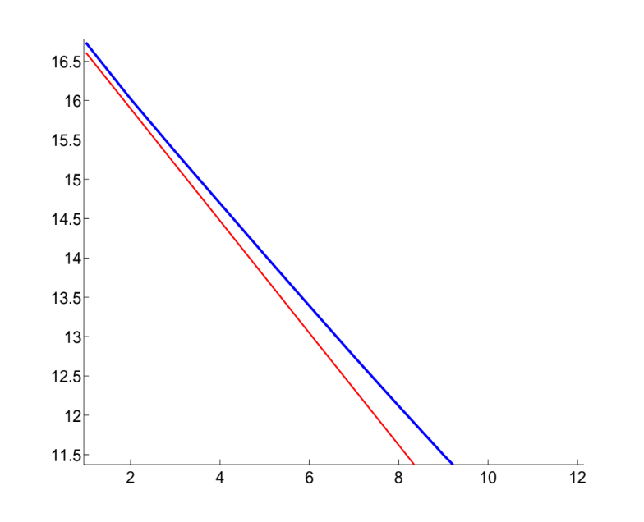
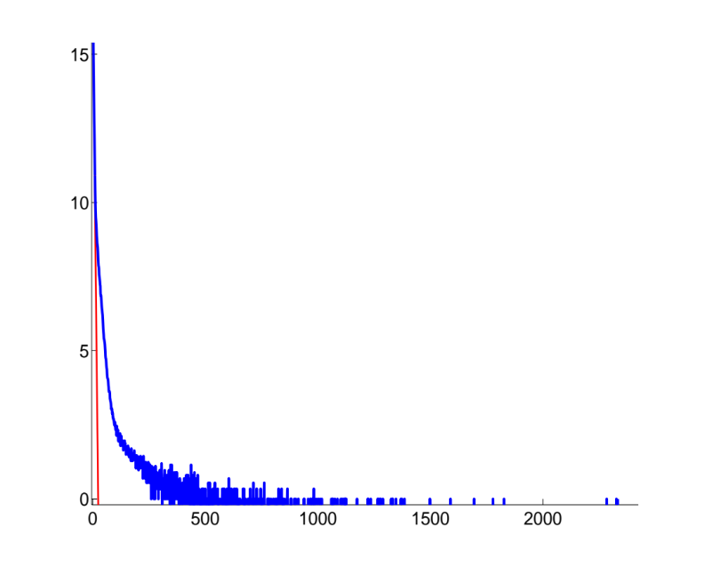
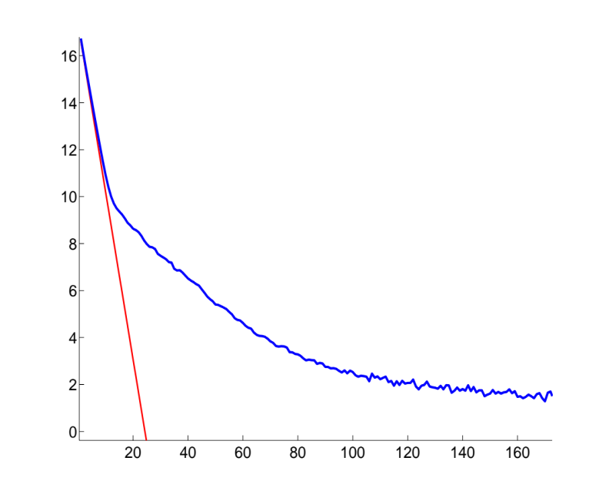
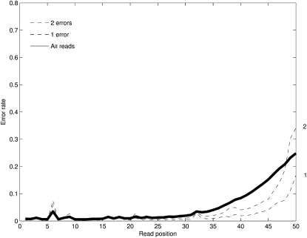

Challenges
Long repeats
Noisy reads
Human Chr 22
repeat length histogram
Illumina read error profile
Notes:
Plots of repeat statistcs
Plot of errors

Slide 20
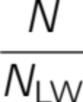
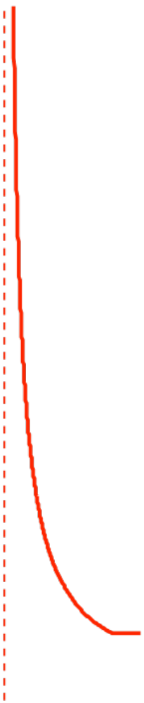
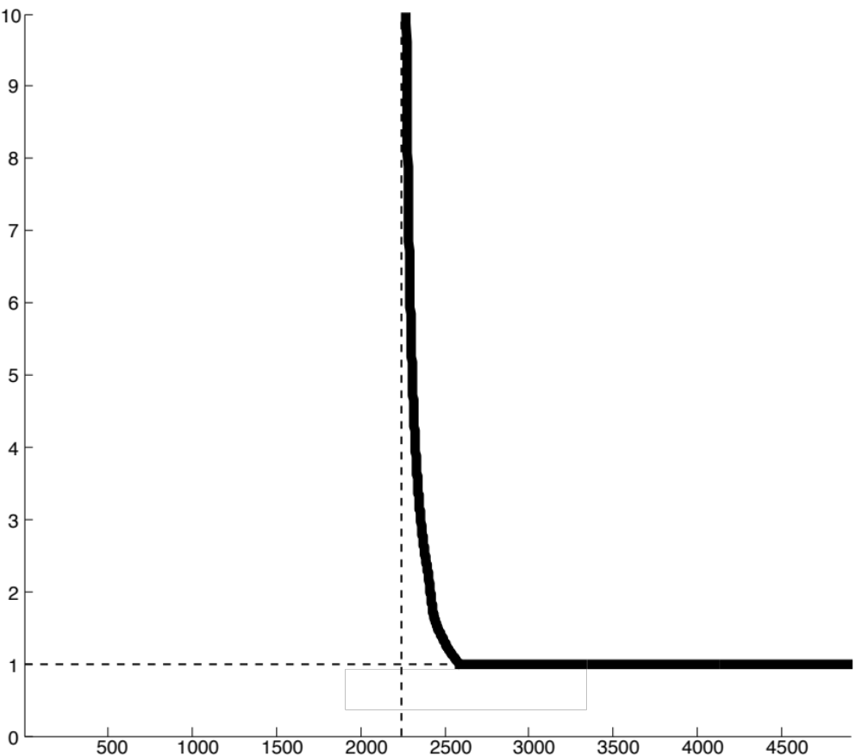

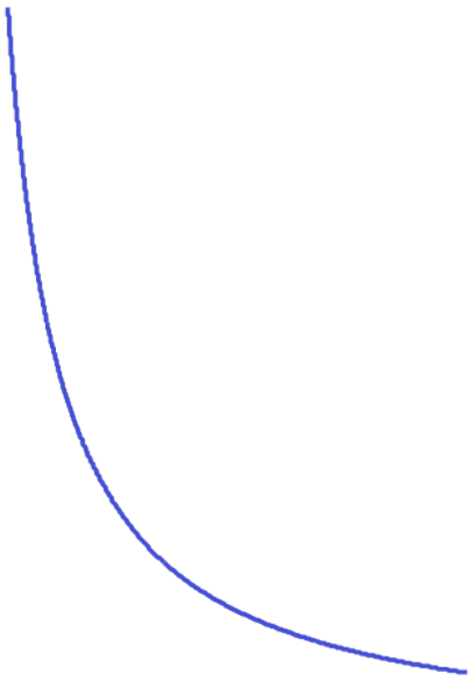

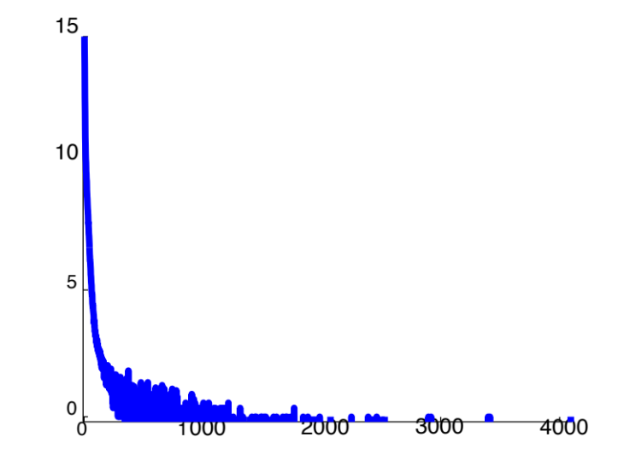


Noiseless Reads
(Bresler, Bresler, T.
BMC Bioinformatics 13)
greedy
deBruijn
lower bound
simpleBridging
length
multiBridging
Human Chr 19
Build 37
Lander-Waterman coverage
Notes:
4. Multibridging is the algorithm we propose, which is nearly optimal, at least for chromosome 19. Did we get lucky?

Slide 21
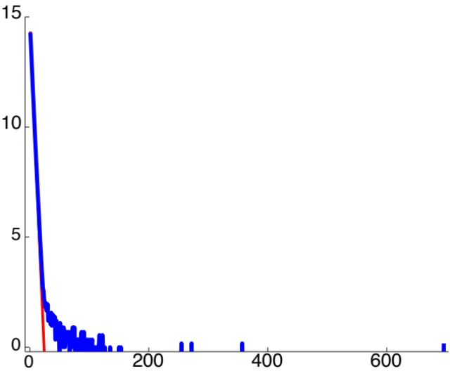
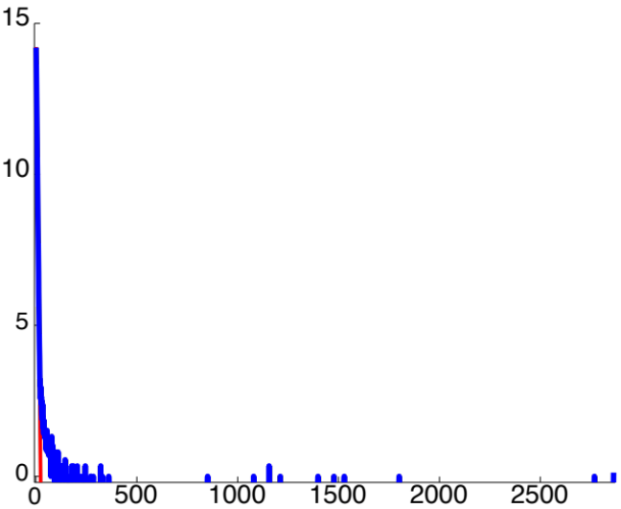
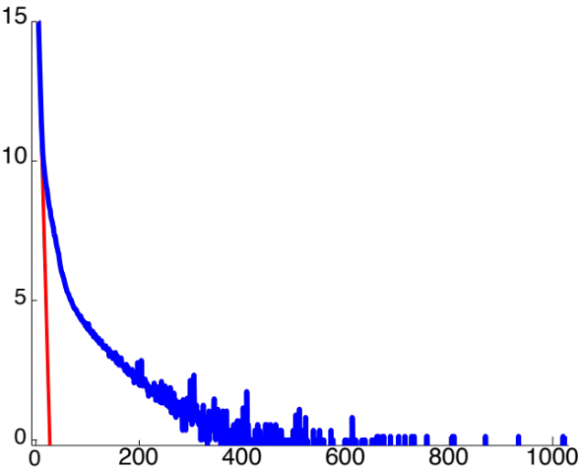

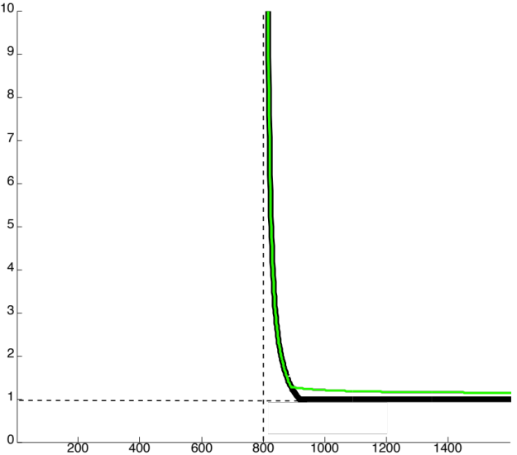
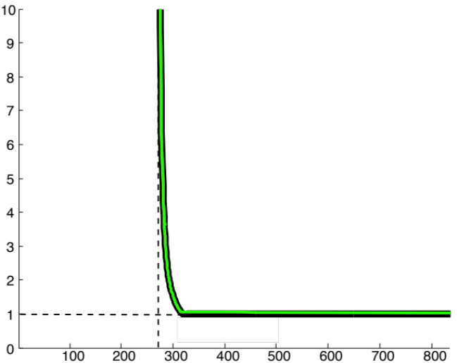
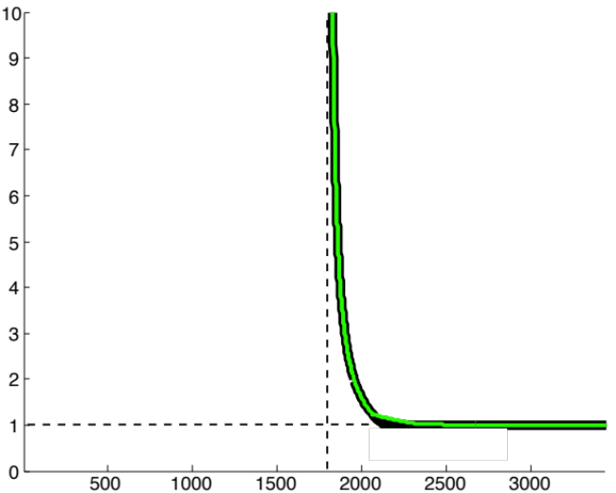
GAGE Benchmark Datasets
http://gage.cbcb.umd.edu/
Rhodobacter sphaeroides
Staphylococcus aureus
Human Chromosome14
G = 4,603,060
G = 2,903,081
G = 88,289,540
L_{critical}
L_{critical}
L_{critical}
lower bound
multiBridging
lower bound
multiBridging
lower bound
multiBridging
Notes:
What about the lower bound?

Slide 22
Unresolvable repeat patterns: interleaved repeats
L-1
L-1
L-1
L-1
L
If no such repeat pattern in the genome, then
unique reconstruction with sufficient coverage depth.
L_{critical} is the longest of such interleaved repeats.

Slide 23
Read Noise
A
A
T
C
T
T
A
T
ACGTCCTATGCGTATGCGTAATGCCACATATTGCTATGCGTAATGCGT
Each symbol corrupted by a noisy channel.

Slide 24
Assembly with noisy reads
(Lam,Khalak, T.
Recomb-Seq 14)
A C G T
Sensitive to noise ?

Slide 25
Information from random flanking region
A C G T
Copy 1
TAGCAGCAAATAGTT…CTGTTTGTT…TTGCC… GCCAGGATGT
TACGACGGAATAGTT…CTGTTTGTT…TTGCC… GTGACCACAG
001101110000000…000000000…00000…0110110111
Copy 2
Distance

Slide 26
Effect on assembly performance
lower bound
multiBridging
L-W coverage

Slide 27
Approximate repeat
?
?
A C G T
Copy 1
TACCACCAAATAGTT…CTGTTTGTT…TTGCC… GCCAGGATGT
TACCACCGAATAGTT…CTGTTTGTT…TTGCC… GTCAGGATGT
000000010000000…000000000…00000…0100000000
Copy 2
Distance

Slide 28
Information from coverage
noise averaging
covering every position => most positions covered by many reads.
Key is to be able to align reads that belong together.
(Earlier work: Abolfazl et al, ISIT 13)

Slide 29
Multiple sequence alignment
Use flanking region as anchor to align reads close to
boundary of approximate repeats
Average across reads to correct errors
Bootstrap to extend further into the interior of repeat.
A C G T
Notes:
Slide 6 would show some animations showing how multiple alignment is done using the flanking region as anchors, and then more reads are aligning to further extend outward away from the flanking region, which in turn correct more errors, etc.

Slide 30
Impact on performance
lower bound
X-PHASED
MULTI-BRIDGING
longest approx.
repeat length
multiBridging
L-W coverage

Slide 31
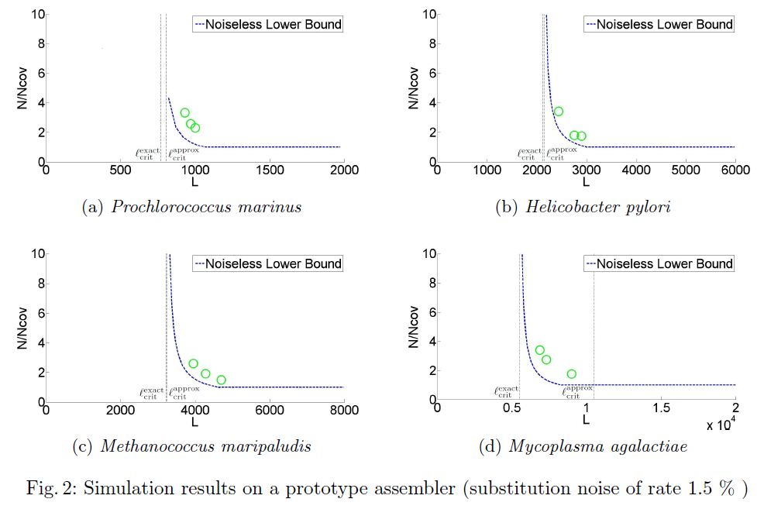
ShannonDNA: initial results

Slide 32
Part II:
RNA Assembly
(Kannan, Pachter, T.,
Genomics Informatics 13)
TexPoint fonts used in EMF: AAAAAAAAAAAAAAAA

Slide 33
Central dogma of molecular biology
RNA transcripts and their abundances capture the state of a cell at a given time.
DNA
transcription
translation
RNA
Protein

Slide 34
Alternative splicing
DNA
ATC
AC
GAT
TGAA
CAT
AGC
TCG
Exon
Intron
1000’s to 10,000’s symbols long
ATC
CAT
TCG
GAT
TCG
RNA Transcript 1
RNA Transcript 2
Alternative splicing yields different isoforms.

Slide 35
Transcriptome
ATC
CAT
TCG
20 copies in cell
GAT
TCG
30 copies in cell
Different transcripts are present at different abundances.
Transcriptome is the mixture of transcripts from all the genes.
Human transcriptome has 10,000’s of transcripts from
20,000 genes.

Slide 36
RNA-Seq
(Mortazavi et al,
Nature Methods 08)
Reads
ATC
CAT
TCG
TTC
ATC
CAT
TCG
GAT
TCG
GAT
GAT
TCG
GAT
TCG
TCG

Slide 37
What is L_{critical} for a transcriptome?
L_{critical} is lower bounded by the length of the longest interleaved repeat in any trancript
It can potentially be much larger due to inter-transcript repeats of exons across isoforms.
ATC
CAT
TCG
ATC
CAT
TCG
GAT
TCG
GAT
TCG
GAT
TCG

Slide 38
s₁
s₃
s₄
s₁
s₃
s₅
Ambiguity due to inter-transcript repeats
s₁
s₃
s₄
transcript 1
L-1
s₁
s₃
s₅
transcript 2
L-1

Slide 39
s₁
s₃
s₄
s₁
s₃
s₅
Ambiguity due to inter-transcript repeats
s₁
s₃
s₅
transcript 1
L-1
s₁
s₃
s₄
transcript 2
L-1

Slide 40
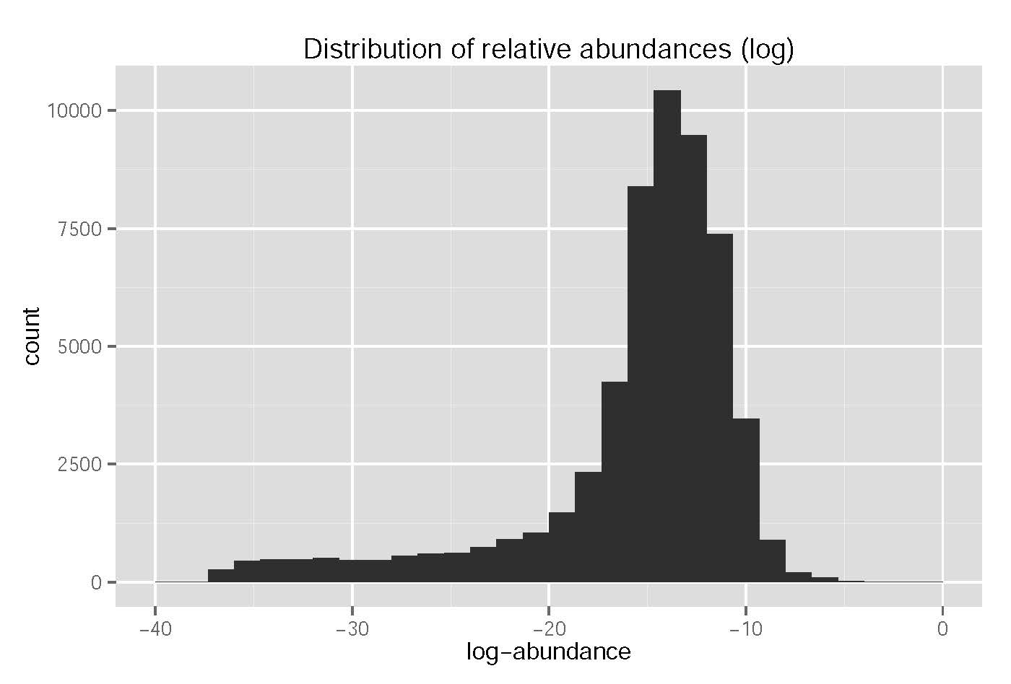
Abundance diversity
lymphoblastoid cell line
Geuvadis dataset

Slide 41
Equal abundance
Unequal abundance
s₁
s₃
s₄
s₁
s₃
s₄
L-1
?
s₂
s₃
s₅
s₂
s₃
s₅
a
L-1
unique solution, also sparse
c
b
s₁
s₃
s₅
s₁
s₃
s₅
L-1
s₂
s₃
s₄
s₂
s₃
s₄
b
L-1

Slide 42
a+c
b-c
Unresolvable inter-transcript repeats
s₁
s₂
a
s₃
L-1
s₁
s₂
s₄
b
s₄
L-1
s₅
s₂
s₃
c
L-1

Slide 43
Assembly algorithm architecture
Multi-bridging
to resolve intra-transcript repeats
transcript graph
Min-cost network flow
to estimate aggregate abundance at exons
abundance estimates
Sparsest decomposition
to extract transcripts
transcriptome

Slide 44
Example: L_{critical} for mouse transcriptome
no algorithm can
reconstruct
proposed algorithm can
reconstruct here
L_{critical}
0
Read Length, L
These two bounds match, establishing L_{critical} !
Value of L_{critical} = 4077
What can we do at practical values of L?

Slide 45
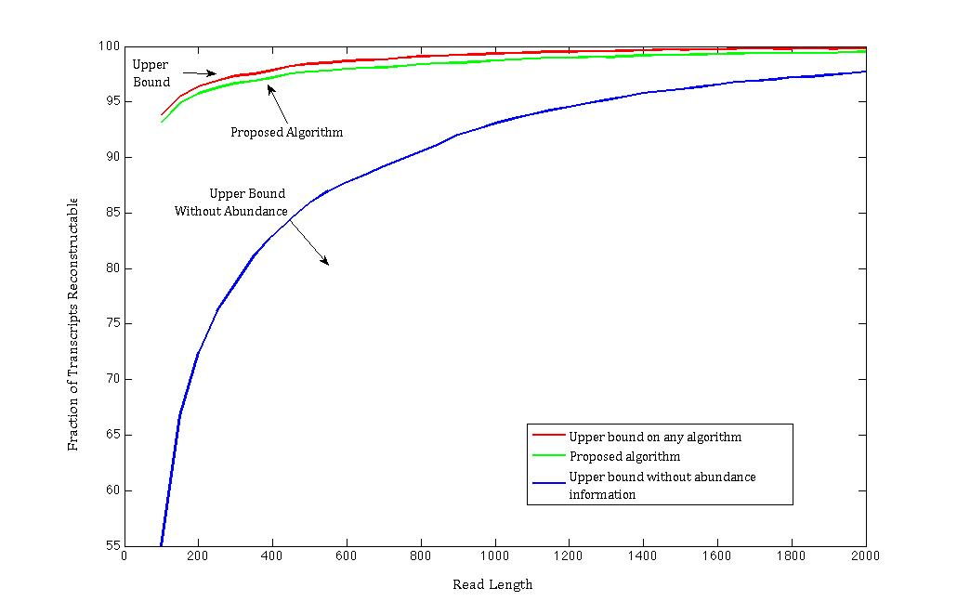
What can one do for given L?

Slide 46
ShannonRNA: initial results
Human chr 15, 1600 transcripts, 1M simulated reads, 1% error rate.
Sensitivity (mis-detection rate)
Specificity (false positive rate)
Coverage depth of transcripts

Slide 47
Summary
An approach to assembly design based on principles of information theory.
Driven by and tested on genomics and transcriptomics data.
Ultimate goal is to build robust, scalable software with performance guarantees.

Slide 48
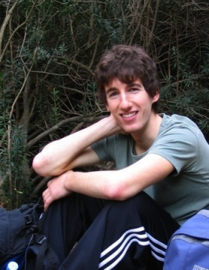

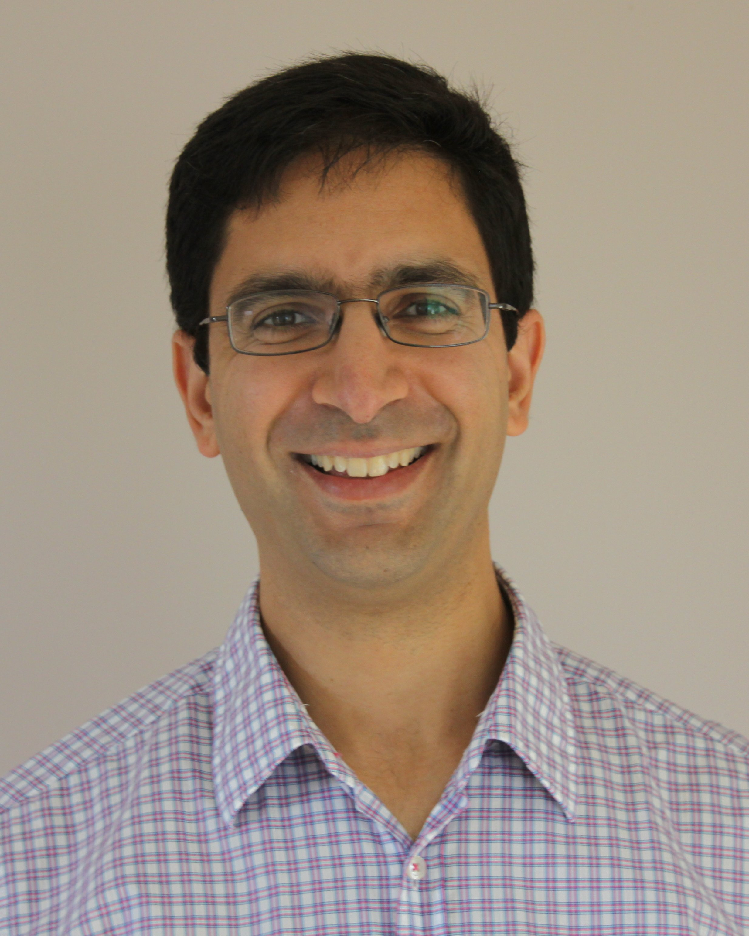

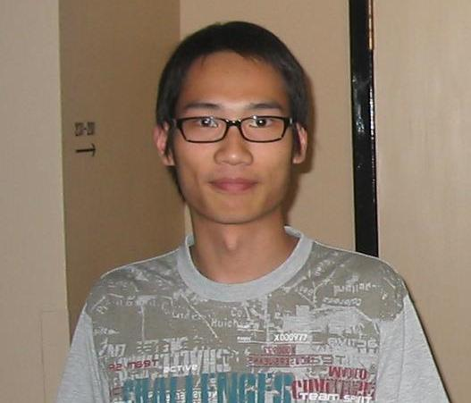



Acknowledgements
DNA Assembly
RNA Assembly
Guy Bresler
MIT
Ma’ayan Bresler
Berkeley
Sreeram Kannan
Berkeley
Lior Pachter
Berkeley
Ka Kit Lam
Berkeley
Asif Khalak
Pacific Biosciences
Joseph Hui
Berkeley
Kayvon Mazooji
Berkeley

