Slide 1
Geometry of Power Flows on Trees with Applications to the Voltage Regulation Problem
David Tse
Dept. of EECS
U.C. Berkeley
Santa Fe
May 23, 2012
Joint work with Baosen Zhang (UCB) , Albert Lam (UCB), Javad Lavaei (Stanford), Alejandro Dominguez-Garcia (UIUC).
TexPoint fonts used in EMF: AAAAAAAAAAAAAAAA

Slide 2
Optimization problems in power networks
Increasing complexity:
  Optimal Power Flow (OPF)
  Unit Commitment
  Security Constraint Unit Commitment
All are done at the level of transmission networks
Smart grid: Optimization in distribution networks
Notes:
Each optimization problem is based on the previous one

Slide 3
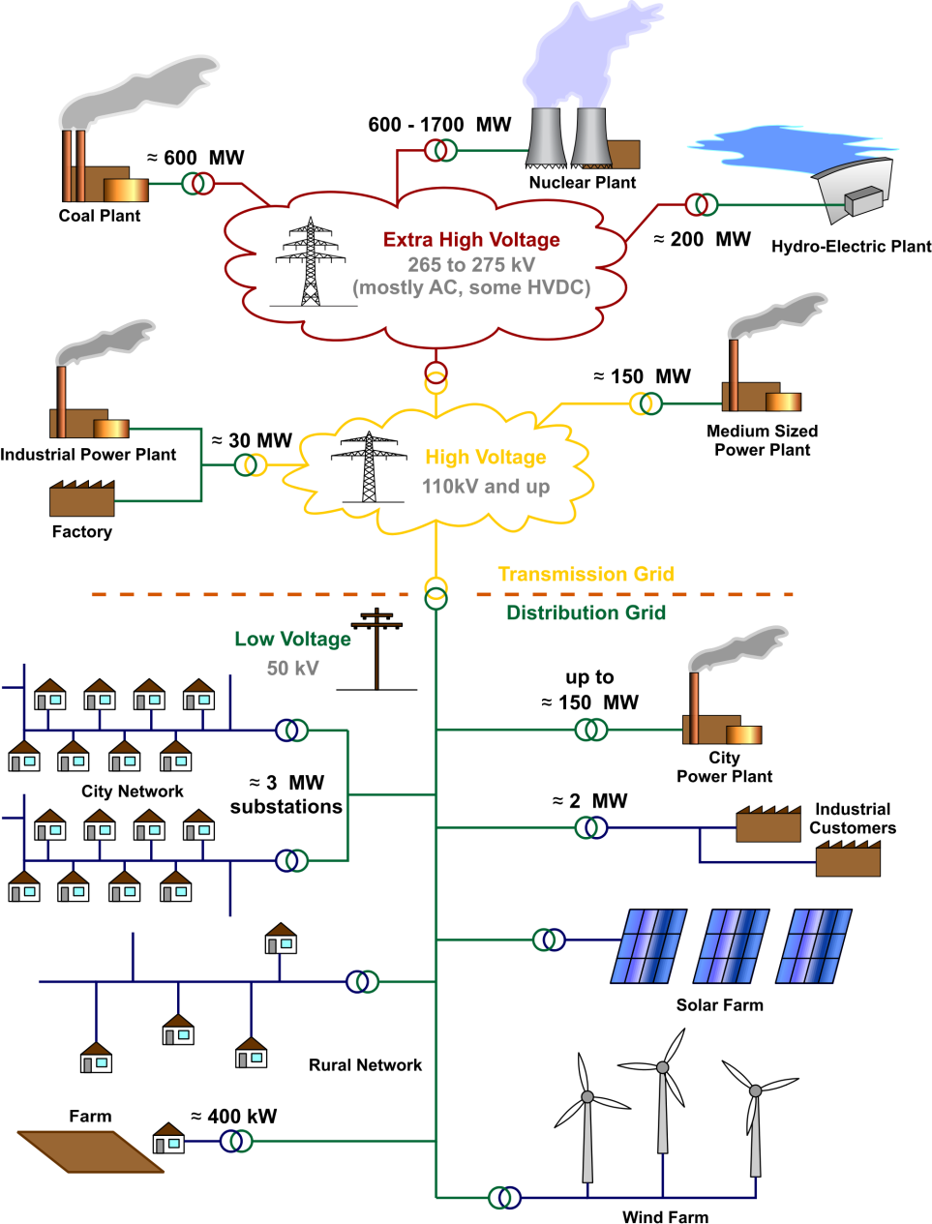
Power flow in traditional networks
Optimization is currently over transmission networks rather than distribution networks.
http://srren.ipcc-wg3.de/report/IPCC_SRREN_Ch08
Notes:
Current operational view of control in the grid: solve the optimization problem in the transmission grid, and the distribution networks are treated as passive demands

Slide 4
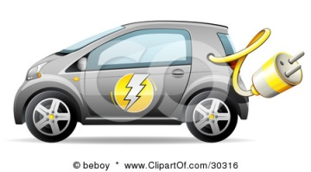
Power flow in the smart grid
Distributed
Generation
Demand
Response
Demand
Response
EVs
Renewables
Notes:
Going forward, control and optimization in the distribution network would become increasingly important, due to the addition of : distributed generation, demand response, Renewables, storage…

Slide 5
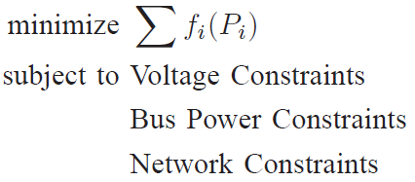
Optimal power flow
Focus on OPF, the basic problem
Non-convex
DC power flow often used for transmission network
Not satisfactory for distribution network due to high R/X ratios
  Higher losses
  Reactive power coupled with active power flow

Slide 6
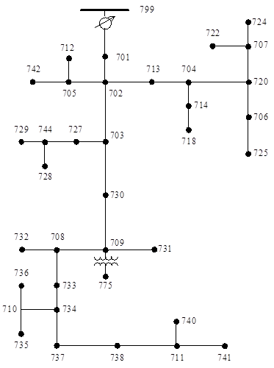
Transmission vs. distribution
Transmission Network
OPF is non-convex, hard
Distribution Network
OPF still non-convex
We show:
  convex relaxation tight
  can be solved distributedly
cycles
tree topology
Notes:
Comparison of the transmission and the distribution network. Optimization in the transmission network is hard (e.g. OPF), but in the distribution it is easy due to the tree structure. To arrive at this conclusion, need to think about the fundamentals of power flow under various conditions.

Slide 7
Outline of talk
Results on optimal power flow on trees.
A geometric understanding.
Application to the voltage regulation problem in distribution networks with renewables.
An optimal distributed algorithm for solving this problem.

Slide 8
Previous results for general networks
Jabr 2006: SOCP relaxation for OPF
Bai et.al 2008: rank relaxation SDP formulation of OPF:
Formulate in terms of VV^{H} and replace by positive definite A.
Lavaei & Low 2010:
  key observation: rank relaxation for OPF is tight in many IEEE networks
  key theoretical result: rank relaxation is tight for purely resistive networks
What about for networks with general transmission lines?

Slide 9
OPF on trees: take 1
Theorem 1 (Zhang & T., 2011):
Convex rank relaxation for OPF is tight if:
1) the network is a tree
2) no two connected buses have tight bus power lower bounds.
No assumption on transmission line characteristics.
(See also: Sojoudi & Lavaei 11, Bose & Low 11)

Slide 10
Proof approach
Focus on the underlying injection region and investigate its convexity.
Used a matrix-fitting lemma from algebraic graph theory.
Drawbacks:
Role of tree topology unclear.
Restriction on bus power lower bounds unsatisfactory.

Slide 11
OPF on trees: take 2
Theorem 2 (Lavaei, T. & Zhang 12):
Convex relaxation for OPF is tight if
1) the network is a tree
2) angle differences along lines are “reasonable”
More importantly:
Proof is entirely geometric and from first principles.
Notes:
By tight we mean that OPF can be solved via its convex relaxation

Slide 12













Example: Two Bus Network
$$P_{1}$$
$$P_{2}$$
injection
region
$$P_{2}$$
$$V_{1}$$
$$V_{2}$$
convex rank relaxation
$$g+jb$$
$$P_{1}$$
$$P_{2}$$
$\left|V_{1}\right|=\left|V_{2}\right|=1 pu, θ=θ_{1}−θ_{2}$
$$P_{1}=g−g\cos{θ}−b\sin{θ}$$
$$P_{2}=g−g\cos{θ}+b\sin{θ}$$
$$\min{f(P_{1},P_{2})}$$
Pareto-Front
$$P_{1}$$
Pareto-Front = Pareto-Front of its Convex Hull
=> convex rank relaxation is tight.

Slide 13









Add constraints
$$P_{2}$$
Two bus network
Loss
Power upper bounds
Power lower bounds
$$P_{1}$$
$$P_{2}$$
$$V_{1}$$
$$V_{2}$$
$$P_{1}$$
$$P_{2}$$
$$P_{1}$$

Slide 14

Add constraints
$$P_{2}$$
Two bus network
Loss
Power upper bounds
Power lower bounds
$$P_{1}$$
$$P_{2}$$
$$V_{1}$$
$$V_{2}$$
$$P_{1}$$
$$P_{2}$$
$$P_{1}$$

Slide 15

Add constraints
$$P_{2}$$
Two bus network
Loss
Power upper bounds
Power lower bounds
$$P_{1}$$
$$P_{2}$$
$$V_{1}$$
$$V_{2}$$
$$P_{1}$$
$$P_{2}$$
$$P_{1}$$
This situation is avoided by adding angle constraints

Slide 16
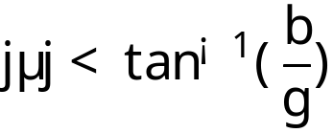
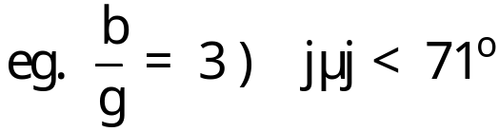


Angle Constraints
Angle difference is often constrained in practice
  Thermal limits, stability, …
Only a partial ellipse where
all points are Pareto
optimal.
Power lower bounds
$$P_{2}$$
$$P_{1}$$

Slide 17
Angle constraints
Angle difference is often constrained in practice
  Thermal limits, stability, …
Only a partial ellipse where
all points are Pareto
optimal
Power lower bounds
$$P_{2}$$
Problem is
Infeasible
No Solution
Or
$$P_{1}$$

Slide 18
















Injection Region of Tree Networks
Injections are sums of line flows
Injection region =
monotine linear transformation of the flow region
Pareto front of injection region is preserved under convexification if same property holds for flow region.
Does it?
$$1$$
$$P_{12}$$
$$P_{13}$$
$$P_{1}=P_{12}+P_{13}$$
$$P_{1}$$
$$P_{2}$$
$$P_{2}=P_{21}$$
$$P_{3}$$
$$P_{21}$$
$$P_{3}=P_{31}$$
$$P_{31}$$
$$2$$
$$3$$

Slide 19

Flow Region
One partial ellipse per line
Trees: line flows are decoupled
$$1$$
$$P_{12}$$
$$P_{13}$$
$$P_{21}$$
$$P_{31}$$
$$2$$
$$3$$
Flow region=Product of n-1 ellipses
Pareto-Front of
Flow Region
Pareto-Front of
its Convex Hull
$$=$$

Slide 20
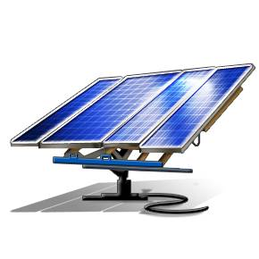
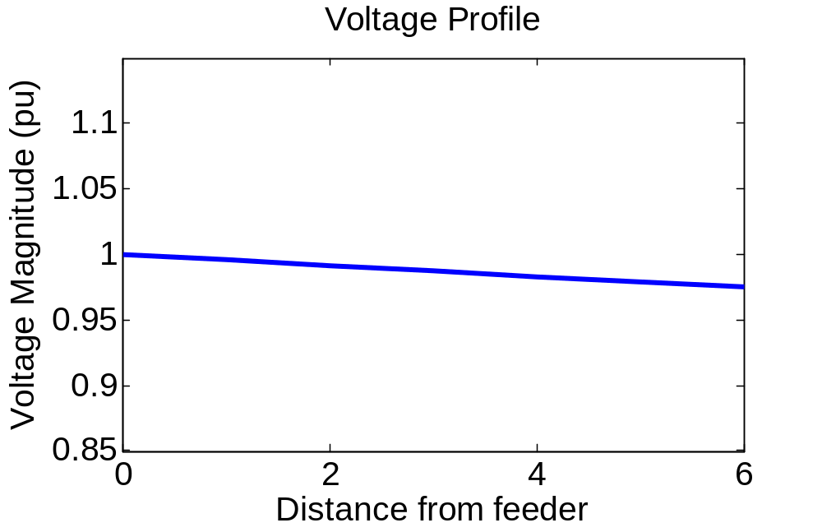
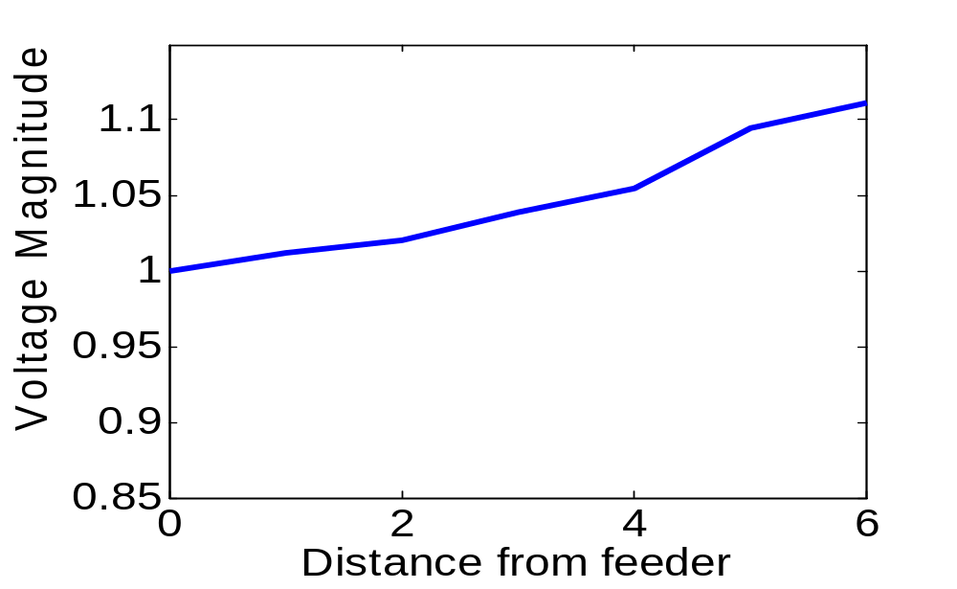
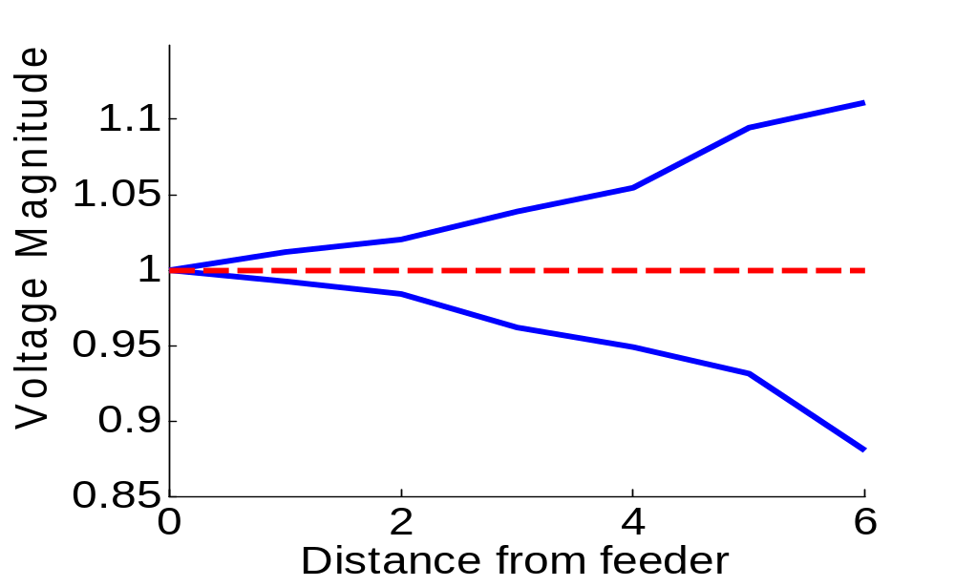
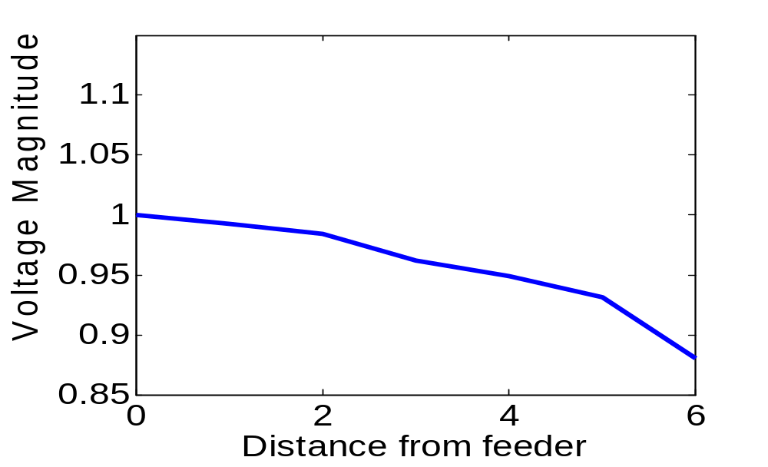


Application: Voltage regulation
(Lam,Zhang, Dominguez-Garcia & T., 12)
Feeder
Solar
Desired
Current capacitor banks
Too slow
Small operating range
EV
Use power electronics to regulate voltage via controlling reactive
power.
Notes:
Current operation, voltage drops slightly as bus gets further from the feeder
EVs would cause large voltage drop

Slide 21
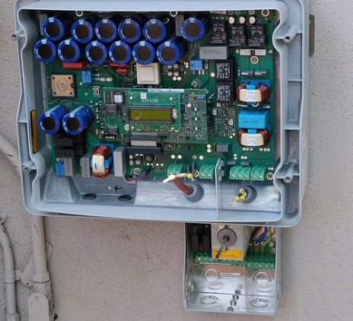


Power Electronics
The reactive powers can be used to regulate voltages
Solar Inverter
P-Q Region
$$Q$$
$$P$$
http://en.wikipedia.org/wiki/File:Solar_inverter_1.jpg
Notes:
Showing a solar inverter and its operating ranges

Slide 22
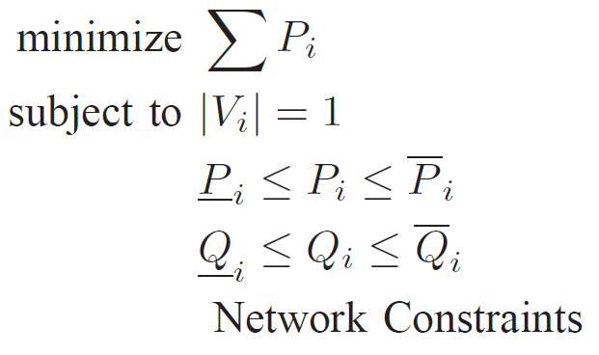
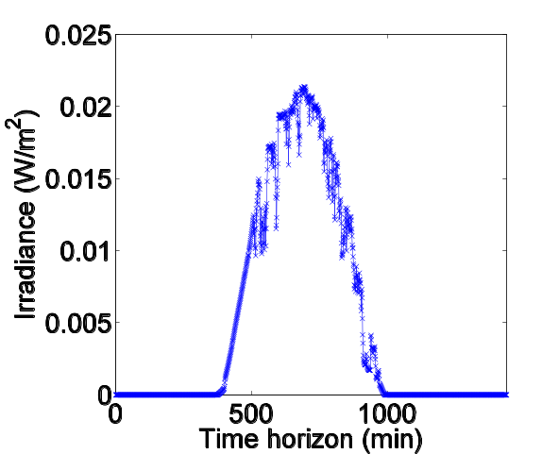
Voltage Regulation Problem
Can formulate as an loss minimization problem
System Loss
Voltage Regulation
Active Power
Reactive Power
Control
Previous results can be extended to reactive power constraints
Notes:
Active power bounds are random, since they are determined by the constraints

Slide 23


Random Solar Injections
Solar Injections are random
Random
Net Load=Load - Solar
$$∈[Load−Solar, Load]$$
Random Bus Active
Power Constraints
8 am
6 pm
Notes:
Load is within a range since

Slide 24




Reactive Power Constraints
Reactive
Active
Upper bound
Lower bound
$$P_{2}$$
$$Q_{2}$$
Rotation
$$Q_{1}$$
$$P_{1}$$
We provide conditions on system parameters
s.t. lower bounds are not tight

Slide 25
Distributed Algorithm
Convex relaxation gives an SDP, does not scale
No infrastructure to transfer all data to a central node
We exploit the tree structure to derive a distributed algorithm
Local communication along physical topology.
Notes:
Highlighted communication since that is more limiting constraint. Even if we have a fast central solver, can’t get the data there
SOCP: second order cone programming, scales much better than SDP. Steven Low’s formulation

Slide 26




















Example
Each node solves its sub-problem with
  Its bus power constraints
  Lagrangian multipliers for its neighbors
$$1$$
$$2$$
$$3$$
$$4$$
$$1$$
$$1$$
$$λ$$
$$2$$
$$2$$
$$λ$$
$$λ$$
$$λ$$
$$2$$
$$2$$
$$λ$$
$$3$$
$$4$$
$$λ$$
$$3$$
$$4$$
Update Lagrangian multipliers
Only new Lagrangian multipliers are communicated

Slide 27
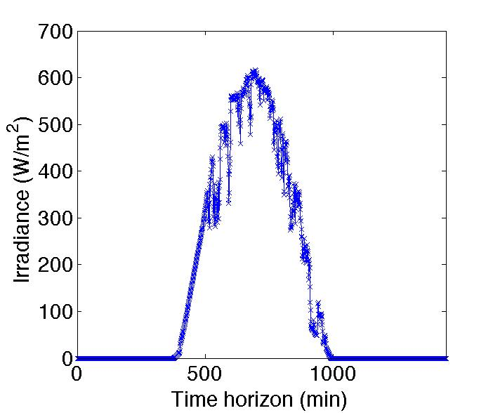

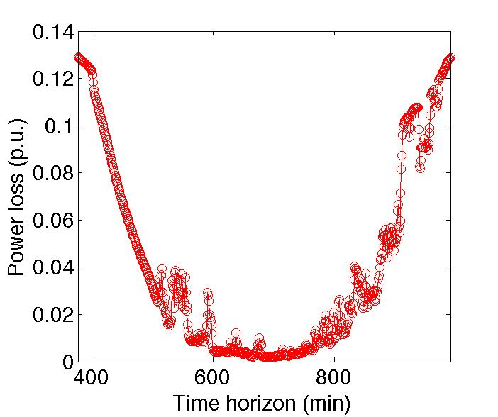
Simulations
37 Bus Network
8am
6pm
2.4 KV
Bus~ 10 households
Nominal Loads
Fixed capacitor banks
20% Penetration
8am
6pm
Notes:
All buses are equipped with micro inverters
The losses are inversely proportional to the radiation, since more solar means less power transferred from the feeder to the end buses
Running time is for Matlab, maybe mention it will speed up significantly with c (connect to Boyd)

Slide 28
Summary
Geometrical view of power flow
Optimization problems on tree networks can be convexified
Applied to design an optimal distributed algorithm for voltage regulation.

Slide 29
References
http://arxiv.org/abs/1107.1467 (Theorem 1)
http://arxiv.org/abs/1204.4419 (Theorem 2)
http://arxiv.org/abs/1204.5226 (the voltage regulation problem)

