Slide 1
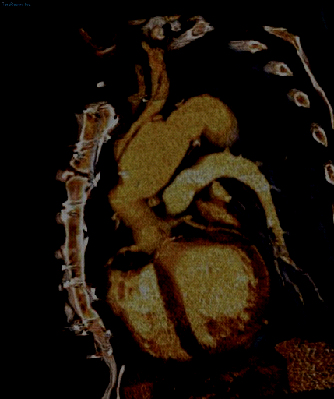

3D and 4D Imaging of the Aortic Root
20th Annual Summer Practicum, Masters in Body Imaging
Jackson Lake Lodge, Moran, Wyoming
August 8-11, 2010
Dominik Fleischmann
Department of Radiology
Stanford University

Slide 2
20th Annual Summer Practicum, Masters in Body Imaging
Jackson Lake Lodge, Moran, Wyoming
August 8-11, 2010
Conflicts of Interest Disclosure
Research support: General Electric
Speaker's board: Bracco
Siemens
Dominik Fleischmann
Department of Radiology
Stanford University

Slide 3
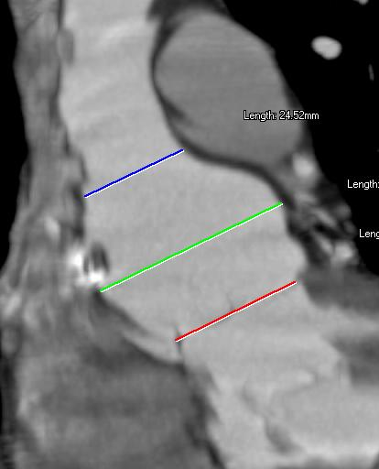
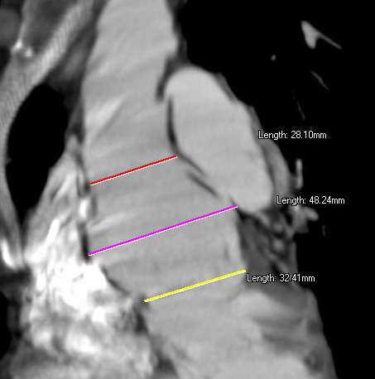
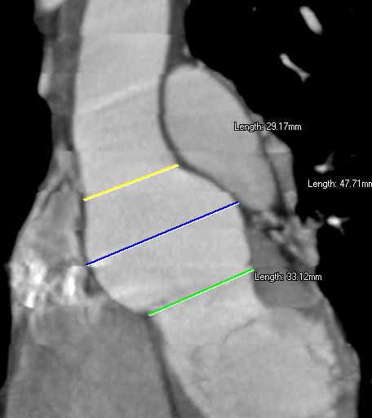
Progressive root enlargement (Marfan's)
with ECG gating
24 mm
29 mm
28 mm
45 mm
49 mm
47 mm
30 mm
32 mm
33 mm
Jan '04
Nov '04
Sep '05
Notes:
The possibility of synchronizing the CT acquisition with the patient's EKG signal has lead to EKG-gated CT, originally derived for coronary CT imaging, but this technique also finally allows us image the aortic root in great detail.

Slide 4
3D and 4D Imaging of the Aortic Root
Learning Objectives / Outline
Technique: 'gated chest' CT
Surgical anatomy of thoracic aorta
Clinical pre- and postop. imaging in
  - Marfan's disease
  - Bicuspid aortic valve disease / aneurysm
Notes:
In this presentation, I want to first explain how such 3- and 4-dimensional images of the aortic root can be acquired – that is the technical topic of a so called 'gated chest' (comment: gated stands for EKG gated)
Next, I will briefly review the surgical anatomy of the thoracic aorta and aortic root
And the clinical focus of this talk will be on pre- and postoperative imaging of the aortic root in patients with Marfans disase and patients with bicuspid aortic valve disease.

Slide 5
Aortic Root Aneurysms
Etiology and associated conditions
genetic (congenital wall defect)
  Marfan's
  Bicuspid aortic valve
atherosclerotic
chronic dissection
infectious ('mycotic', syphilis)
vasculitis
post-traumatic
very
common
rare
Notes:
the most common etiology of aortic root aneurysms are genetic, congenital wall defects of the proximal thoracic aorta. The two entities most commonly causing aortic root aneurysms are
Marfans disease, and
Bicuspid aortic valve – related aneurysms.
The aortic root can also be involved in degenerative atherosclerotic aneurysms of the thoracic aorta, or in chronic dissections, but the diseases that primarily affect the aortic root are really the genetic diseases I just mentioned

Slide 6
Aortic Root Aneurysms (TAA)
Etiology and associated conditions
congenital (intrinsic, defect of aortic wall):
Marfan's FBN-1 gene
fibrillin= extracell.matrix fiber
regulates TGF-β
Bicuspid AV ↓ fibrillin, ↑ MMP 2
Ehlers-Danlos-IV COL 3A1 gene (procollagen III)
Loeys-Dietz TGFBR1 or TGFBR2 gene
(0.01-0.02 %)
(1-2 % prevalence)
TGF: transforming growth factor, MMP: matrix metalloproteinase;
Notes:
The genetic defect that causes aortic dilatation in patients with MArfan disease is related to the fibrillin-1 gene, and there are several different mutations possible.
The genetics of bicuspid aortic valve related aneurysms is not well understood. What we do know, however, is that patients with bicuspid valves also have a decreased number of fibrillin microfibers in their aortic walls, and an increased concentration of matrix metallo-poroteinases
Not all patients with bicuspid aortic valve develop aortic root aneurysms, but since bicuspid aortic valves are very prevalent in the general population, we see these bicuspid aortic valve aneurysms as commonly as aortic root aneurysms related to Marfan's disease.

Slide 7
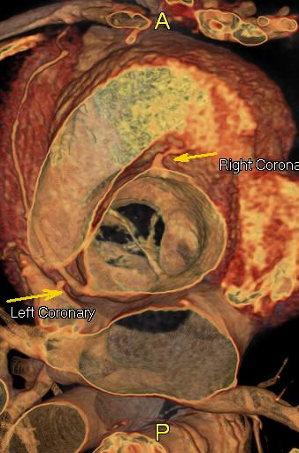
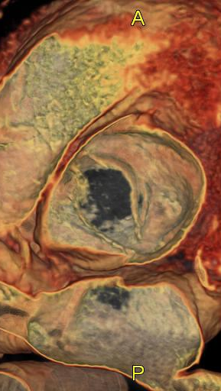
BAV disease
(bicuspid aortic valve disease)
Prevalence 1-2%
Complications (>33%)
valve degeneration and stenosis
endocarditis
aortic root dilatation (50% of young pts.)
→ ao. root aneurysm
Notes:
aron nancy BAV minorty

Slide 8
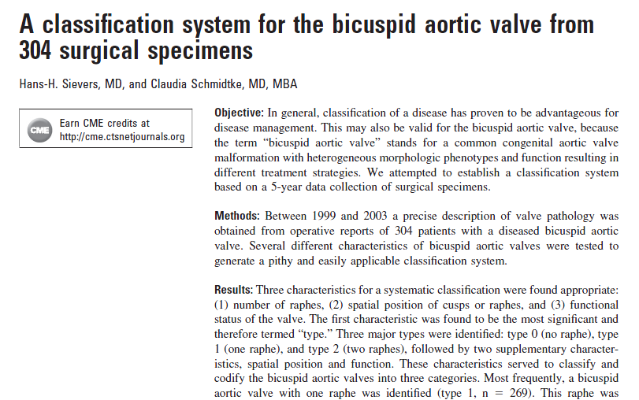
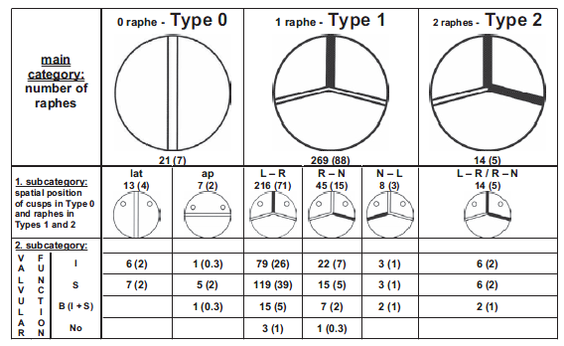
Bicuspid aortic valve (BAV)
Classification (Sievers)
Sievers et al.; J Thorac Cardiovasc Surg 2007;133:1226-33

Slide 9
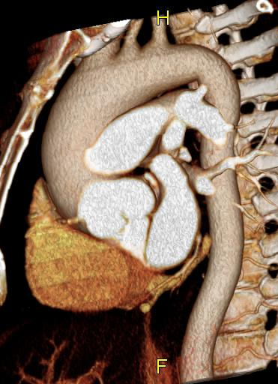
BAV disease
(bicuspid aortic valve disease)
Notes:
aron nancy BAV minorty

Slide 10
3D and 4D Imaging of the Aortic Root
Learning Objectives / Outline
Technique: 'gated chest' CT
Surgical anatomy of thoracic aorta
Clinical focus
  pre and postoperative imaging
  - Marfan's disease
  - Bicuspid aortic valve disease / aneurysm
Notes:
Now let's talk in more detail about the technique of acquiring 3D and 4D datasets of the aortic root - which is by means of a EKG- gated CT of the thorax - a so-called 'gated chest'

Slide 11
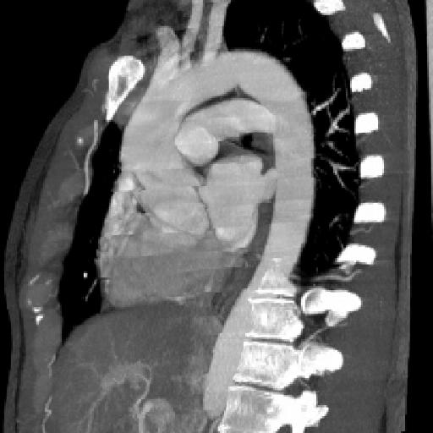
EKG gated CTA of the Thorax
(16- channel MDCT)
'Gated Chest'
entire thoracic aorta
not thinnest collimation (1.25mm)
no beta-blockers, no subling. nitro
recon. 10 phases (0–90% of RR interval)
no ECG-pulsing (constant mA)
Coronary CTA
heart
thinnest collimation (0.625mm)
beta-blockers, and subling. nitro
recon. 1 diastolic phase (65% of RR)
ECG pulsing on (dose reduction)
Notes:
the easiest way to think of a EKG gated CT of the thorax is to compare it with a coronary CTA.
For a gated chest, the anatomic coverage includes not only the heart but the entire thoracic aorta, and - particularly with older 16-slice CT) it is not necessary to use the thinnest collimation.
With coronary CTA, it is sufficient to obtain one single dataset obtained during the diastolic phase of the cardiac cycle. For a gated chest, however, we always reconstruct at least 10 phases of the cardiac cycle – in 10% intervals from 0% through 90% of the RR-interval of the EKG. These 10 phases can then be viewed in a cine display, which provides the 4th-dimension – or the time dimension of the acquisition.

Slide 12
EKG gated CTA of the Thorax
(16- channel MDCT)
'Gated Chest'
entire thoracic aorta
not thinnest collimation (1.25mm)
no beta-blockers, no subling. nitro
recon. 10 phases (0–90% of RR interval)
no ECG-pulsing (constant mA)
Coronary CTA
heart
thinnest collimation (0.75 mm)
beta-blockers, and subling. nitro
recon. 1 diastolic phase (65% of RR)
ECG pulsing on (dose reduction)
Notes:
another difference between coronary CTA and a ;gated chest' is, that for a gated chest, we use constant mA settings, and do not use ECG-pulsing (or ECG tube-current-modulation), as we would usually do for a coronary CTA for reductin radiation dose.
The reason is that ECG pulsing results in variable image noise over the cardiac cycle.
As you can see in this movie clip obtained with ECG tube current modulation, there is very low noise with good valve delineation during diastole, but one can hardly see the valve during systole, due to the excessive image noise.
In the setting of ECG gated chest, however, we are interested not only in the diastolic phase, but also in the systolic phase of the aortic root structures, and the 4D motion in general, and - at least with 16-slice CT, we cannot use ECG pulsing, but we have to use constant mA.

Slide 13
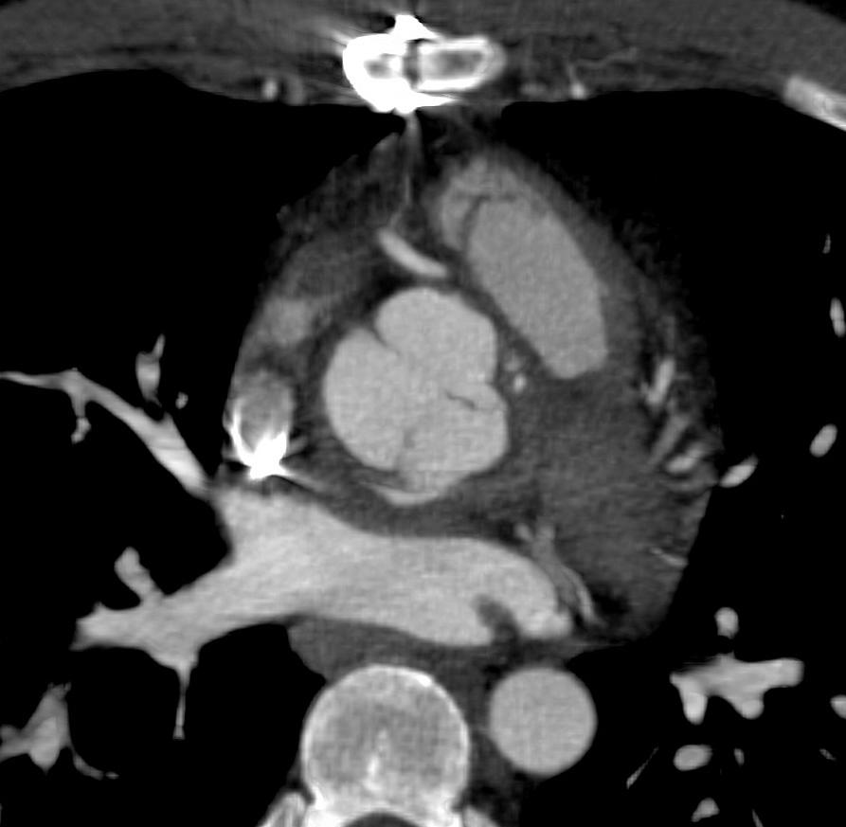
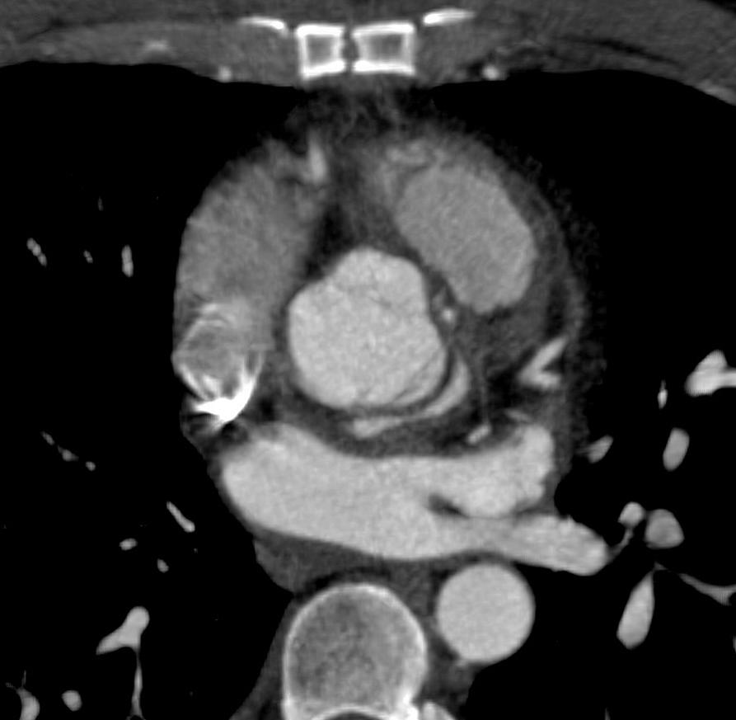
s/p Ross procedure (pulmonary- to aorta autograft)
susp. leak/pseudoaneurysm
diastole
systole
Notes:
this example demonstrates the importance of havig both, systolic and diastolic images of high quality.
this is a postperative patient after a Ross procedure (a pulmonary to aorta autograft), with a suspected leak or pseudoaneurysm at the proximal anastomosis.
we can see a small amount of extraluminal contrast posterior to the aortic root, with is much smaller in diastole, but larger in systole

Slide 14
"Gated Chest"
(16-slice CT, 64-slice CT)
Dual-Source CT
Advantages:
motion-'free' (3D) and dynamic (4D) visualization of thor. aorta + aortic root
high 3D spatial resolution (0.5mm³)
Limitations:
temporal resolution (~165ms)
lack of flow information
radiation dose (25-50mSv*)
(~85ms)
allows ECG-dose modulation
(8-15mSv)
*(~3-6 times of std.chest CT)
Notes:
With the advent of dual-source technology, however, this has changed.
- the temporal resolution of dual source CT is substantially better, it is only 85 milliseconds, and this does not only improve image quality, but this also allows to use ECG-dose modulation much more effectively, and in out experience, the radiation dose has become significantly lower with dual-source CT when compared with 16- and even 64-slice CT scanners

Slide 15
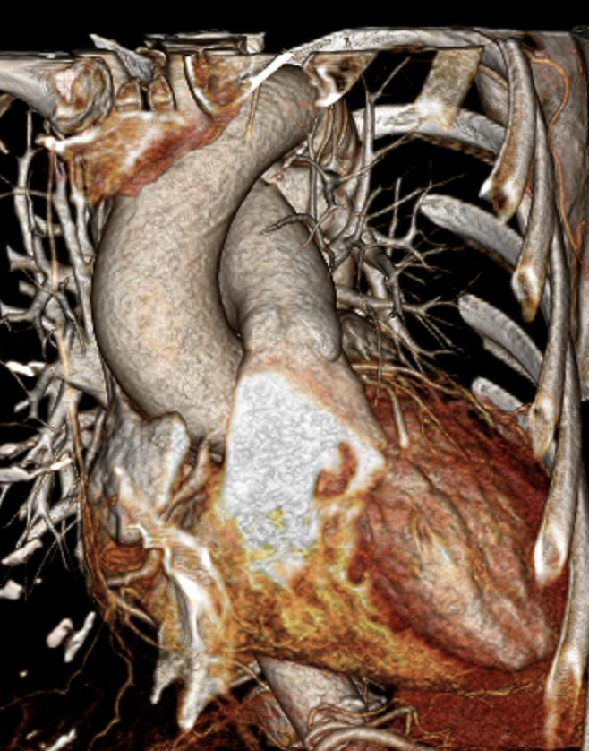
Gated Chest, Dual-Source CT
27.01 mGy, (667mGy*cm), [~11mSv]
58 yo woman
abnormal valve (BAV?),
aneurysmal aortic root
LV dilatation, low-normal EF
53kg (117 lbs)
65 bpm heart rate
24.7 cm
→ 100 kVp
→ ECG pulsing (30-70% of RR Interval)
Notes:
Here is a clinical example of a gated chest obtained in a 58 year old woman using a dual-source scanner.
the patient was referred to evaluate her aortic roon, since she had an abnormal, what looked like a bicuspid valve on echocardiography, aortic insufficiency, and left ventricular dilatation and a low-normal ejection-fraction.
because she was relatively slim, with a body weight of 53 kilogramms, and her heart rate was low and stable, we were able to obtain the scn qith 100kVp, instead of the standard 120kVp, and because of the impoved temporal resolution of the scanner, we were able to use ECG tube current modulation, where we used full tube power only from 30-70% of the RR interval to capture good end-systolic and diastolic views, and allowed to down-modulate the tube-current to 20% during the remainder of the cardiac cycle

Slide 16
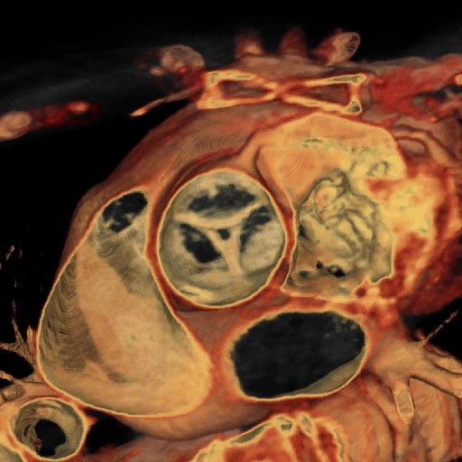
Gated Chest, Dual-Source CT
27.01 mGy, (667mGy*cm), [~11mSv]
58 yo woman
→ 100 kVp
→ ECG pulsing (30-70% of RR Interval)
Notes:
here is a view of the aortic valve, which his thickened, and also clearly shows the central coaptation defect

Slide 17
3D and 4D Imaging of the Aortic Root
Learning Objectives / Outline
Technique: 'gated chest' CT
Surgical anatomy of thoracic aorta
Clinical focus
  pre and postoperative imaging
  - Marfan's disease
  - Bicuspid aortic valve disease / aneurysm
Notes:
Lets briefly review the surgical terminology of thoracic aortic anatomy

Slide 18
Thoracic Aorta
Surgical Anatomy
Transverse Arch
Descending Aorta
Transverse Aorta
Ascending Aorta
Aortic Root
Sinotubular junction
Sinuses of Valsalva
aortic valve
coronary ostia
Aortic anulus
Ascending Ao.
Descending Ao.
STJ*
Ao. Root
SOV#
Aortic Anulus
* Sino-tubular Junction
# Sinuses of Valsalva
Notes:
the aortic root consists of the following structures
- the aortic anulus, which is the junction between the left ventricle and the aorta
- then there are three sinuses of Valsalve. The sinuses contain the aortic valve apparatus, and the right and left coronary artery also arise from the respective sinuses.
- and finally there is the sinotubular junction, which is usually a small waist or ridge between the aortic root and the tubular portion of the ascending aorta.

Slide 19
Normal diameter of thoracic aorta
Anulus
normal 23-27mm
>27mm anuloaortic ectasia
Thoracic aorta (incl. sinuses and STJ)
normal age-, sex-, body size dependent
'ectatic' appears enlarged, but ≤4cm
>4.0 cm aneurysm (root, asc., tra., desc.)
Treatment indication (elective)
>4.5-5.0cm (syndromic patients) >6.0 +cm (degenerative)
rapid diameter increase (>5mm/year)
Ao. root valve insufficiency
Notes:
Now what are the normal dimensions of the aortic root ?
The aortic anulus noramlly measures 23-27mm, and whenever it is larger, we use the term 'anuloaortic ectasia'. This can be an isolated abnormality, or it is mre often associated with a dilatation of other portions of the aortic root
The normal diameter of the remainder of the thoracic aorta, including the sinuses of valsalve and the sinotubular junction is quite variable and depends on age, sex, and body size and there is no generally accepted definition. For practical purposes and for simplicity and we usually use the term 'ectatic', when the aorta looks enlareged but measures less than 4cm in diameter.
When the aortic diameter is greater than 4cm, then we use the term 'aneurysm'.
More important than the definition of aneurysm is the threshild for elective treatment indication, though.
In patients with degenerative thoracic aortic aneurysms, elective surgical repari is usually indicated when the aortic diameter is more than 5 or 6 cm. In patients with genetic aortic diseases, such as Marfan's and bicuspid aortic valve aneurysms, a diameter greater than 4.5 to 5cm is considerd a indication for surgical repair, mainly to prevent dissection.
Another indication for surgical repair is a rapid increase in diameter – notably more than 5mm per year, or
aortic root dilatation that causes valvular insufficiency

Slide 20
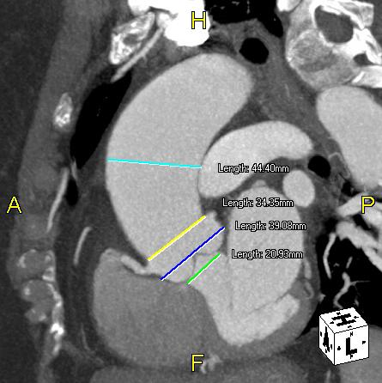
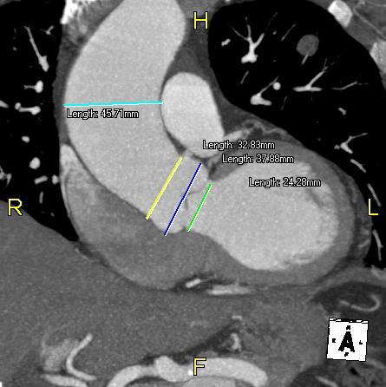
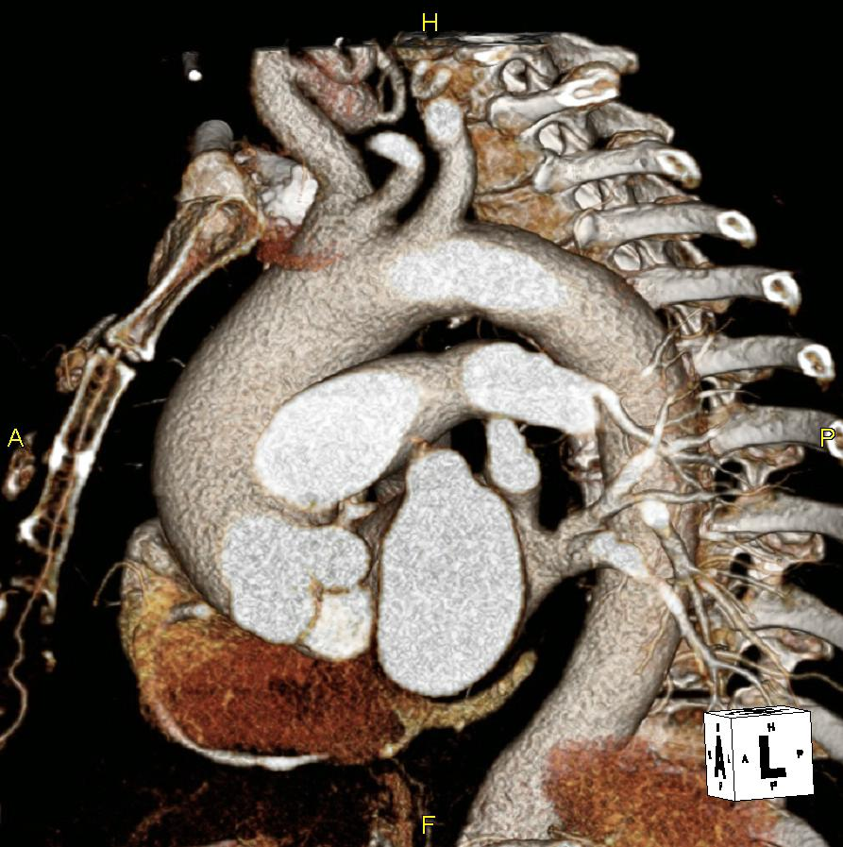
73 y/o retired RN
ascending aortic aneurysm
asc.ao.
sin.tub.-junct.
anulus
sinus.of Vals.
MIP (thin-slab) centered at valve
Notes:
and these thin-slab MIP images show the respective diameters of the aorta, and where we usually measure them.
The green line indicates the aortic anulus,
the blue line indicates the diameter of the root at the level of the sinuses of valsalve,
and the yellow line measures the sino-tubular-junction.
here is the mid portion of the ascending aorta

Slide 21
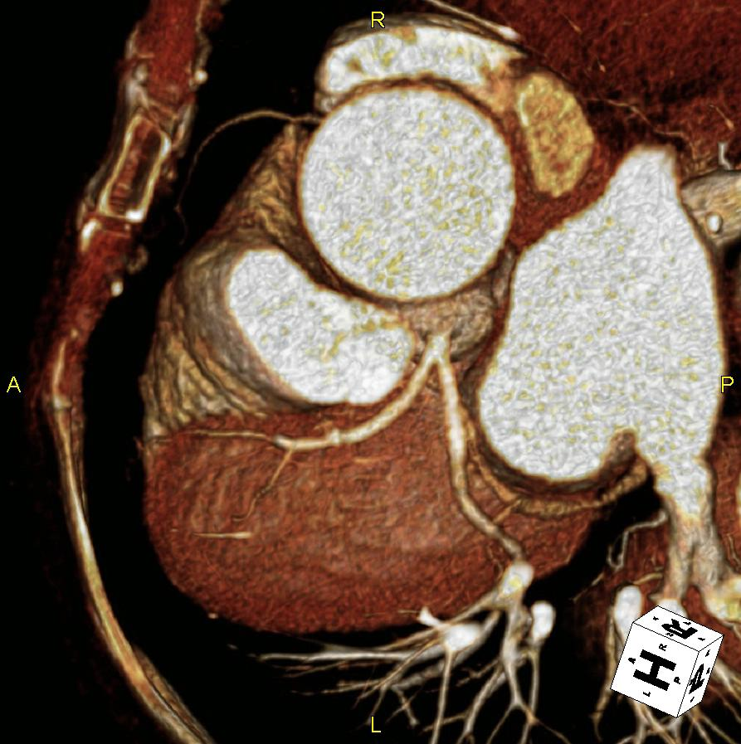
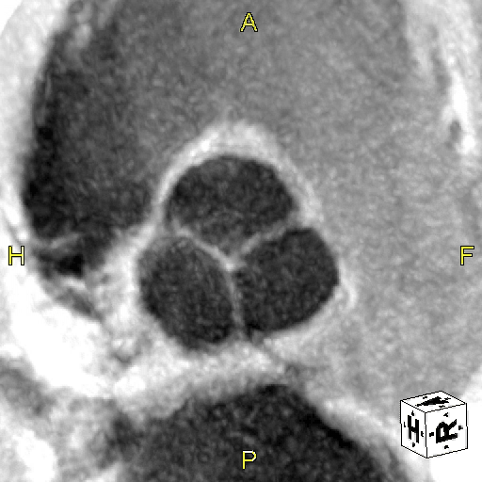
Interactive Visualization – Interpretation
3D thoracic Aorta
  VR (candy-cane view)
Measurements
  MIP (5mm) ~ a-p
  MIP (5mm) ~ lat.
  (MPR othogonal)
Coronary Anatomy
  VR
Sinuses + valve
  VR 'transparent'
  MinIP (inverted)
  3 Chamber view
  anulus
  sinuses of Valsalva
  sinotubular junction
  syst., diast., or CINE

Slide 22
3D and 4D Imaging of the Aortic Root
Learning Objectives / Outline
Technique: 'gated chest' CT
Surgical anatomy of thoracic aorta
Clinical focus
  pre and postoperative imaging
  - Marfan's disease
  - Bicuspid aortic valve disease / aneurysm
Notes:
and this brings us to the clinical topic of preoperative imaging

Slide 23
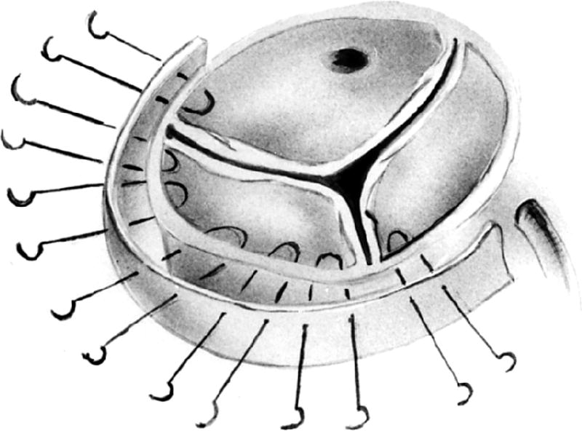
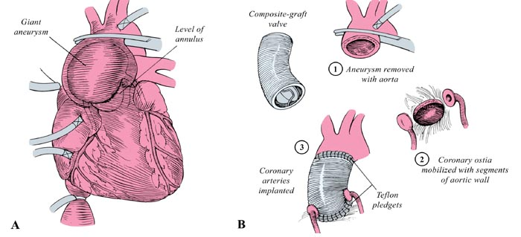
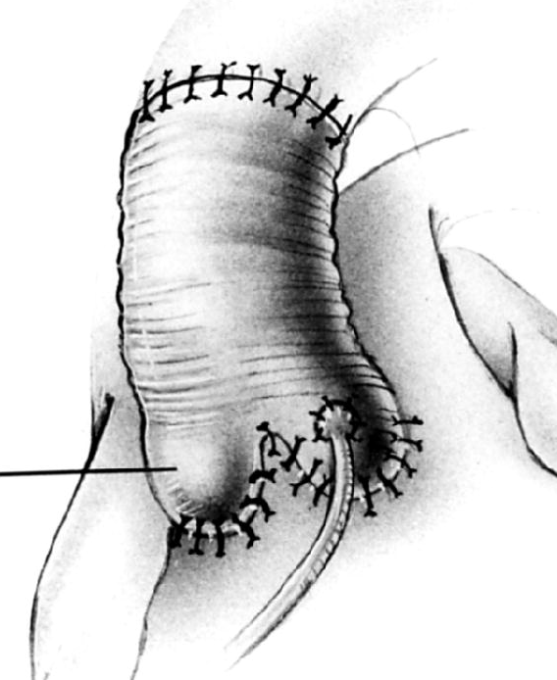
Thoracic Aorta
Surgical Options
Transverse Arch
Aortic Root
Anuloplasty
Composite graft
  Contains valve
  Coronary reimplantation
Valve Sparing Surgery
  Resect sinuses down to valve insertions
  Preserve native valves
  Coronary reimpl.
Ascending Ao.
Descending Ao.
STJ*
Ao. Root
SOV#
Aortic Annulus
* Sino-tubular Junction
# Sinuses of Valsalva
Notes:
first, let's have a look at the surgical options of repairing the aortic root.
- a dilated aortic anulus can be repaired by a so called anuloplasty.
- the traditional technique for replacing the entire aortic root is a Composit graft repair.
A composit graft is a synthetic tube graft that contains a mechanical valve. It is sutured proximally to the aortic anulus and distally to the ascending aorta, and of course the coronary arteries need to be reimplanted to provide coronary blood flow.
A fairly new surgical technique that is becoming increasingly popular in large centers, is a so called valve sparing surgery. The principle of this procedure is resect the aortic root down to the valve insertions, but leave the patinets own native valves in place. The key benefit of couse is that with the patients own valve spared, there is no need for life-long anticiagulation, which is required when a mechanical valve is used.
Again, as with any root graft, the coronary arteries need to be reimplaneted.

Slide 24
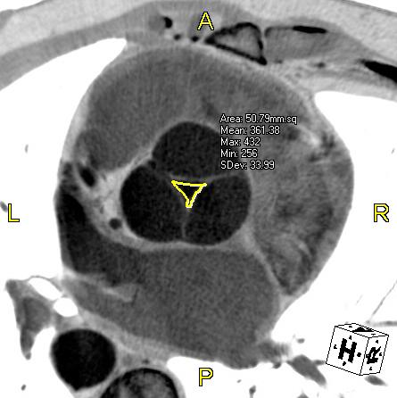
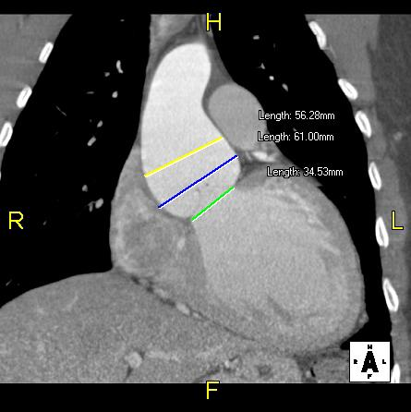
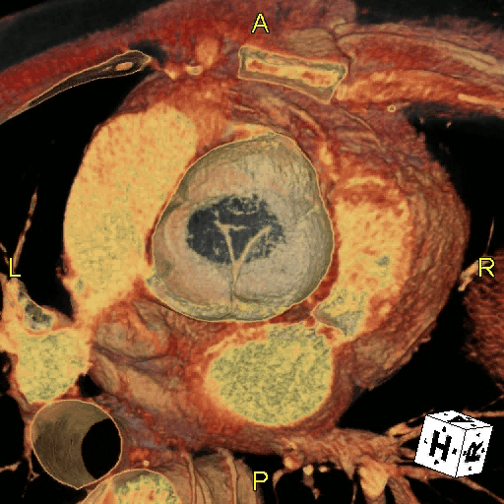
41 yo man
Marfan's
sin.tub.-junct.
sinus.of Vals.
anulus
Notes:
williams

Slide 25
Valve Sparing Aortic Root Procedures
Tirone David- I “Reimplantation” Technique

Slide 26
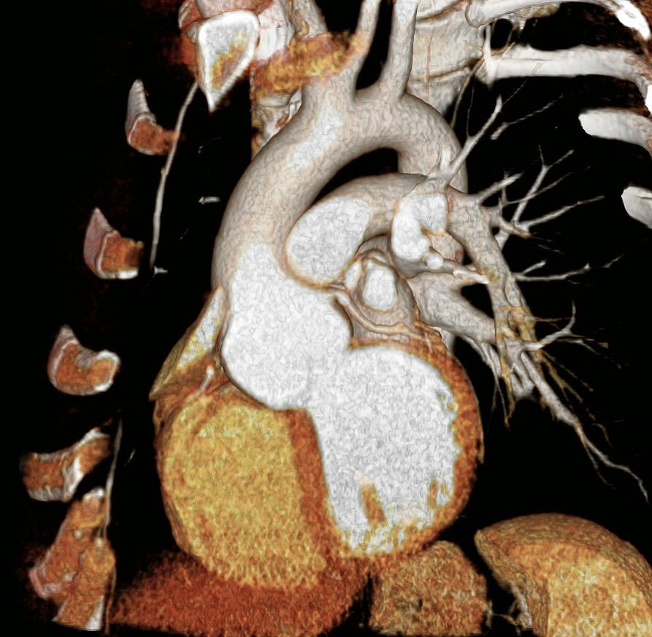
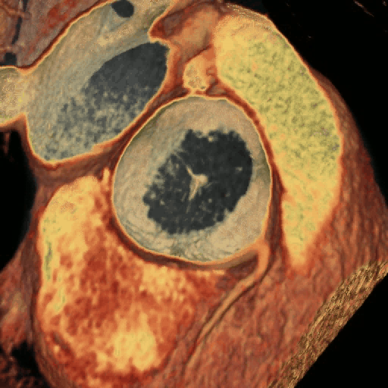
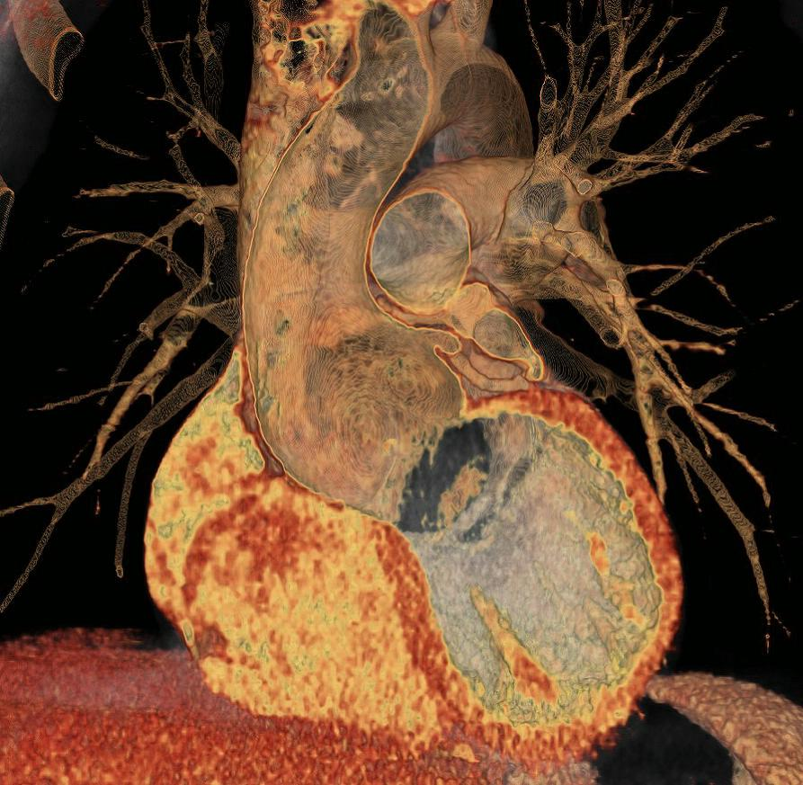
PRE-OP
27 y/o man, Marfan's
VR (slab)
VR (transparent blood)
Notes:
This is a preoperative CT of a 27 year old patient with Marfan's disease.
You can clearly see the dilated aortic root.
The movie clip nicely illustrates how ballooned the aortic root is

Slide 27
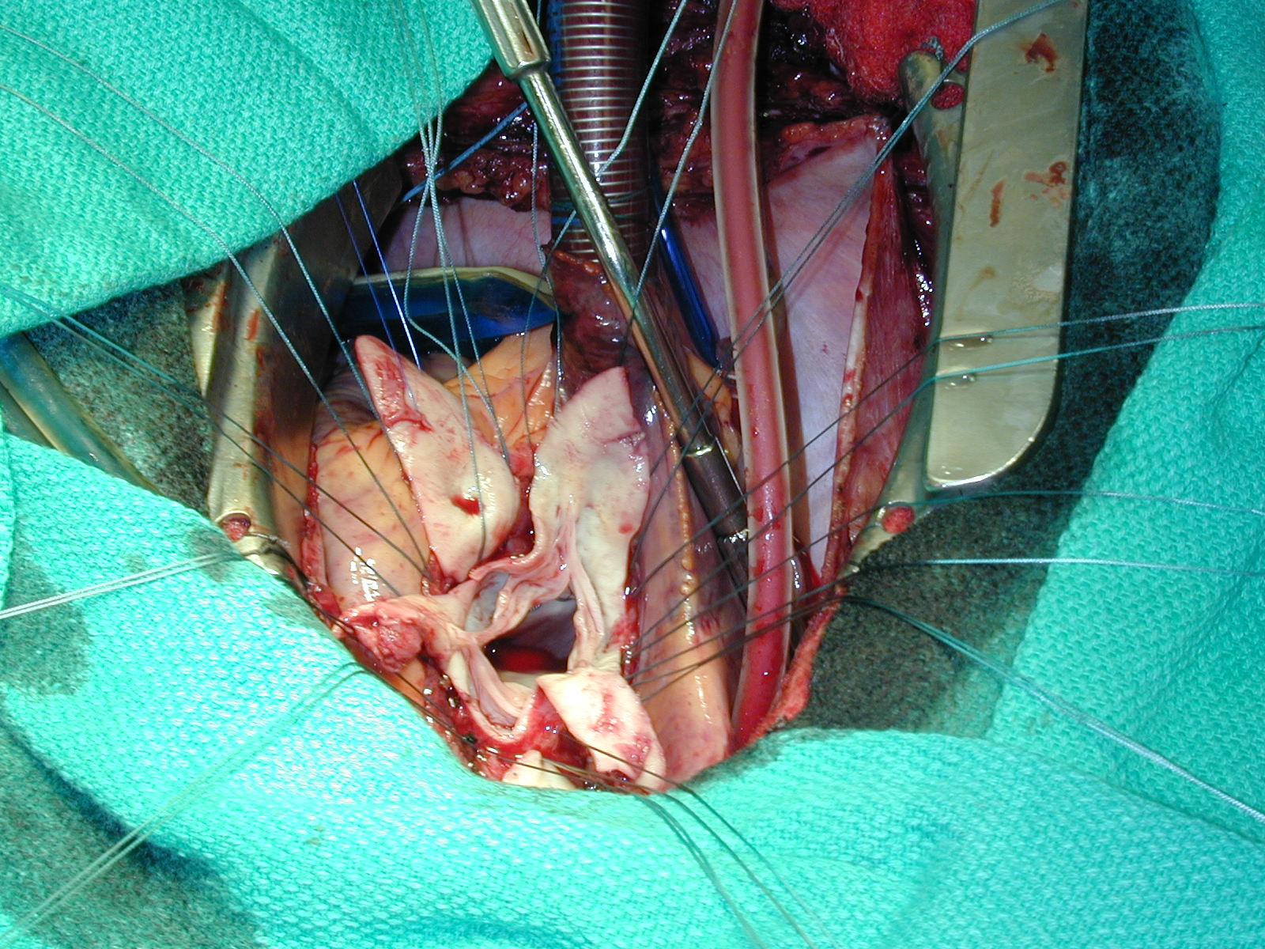
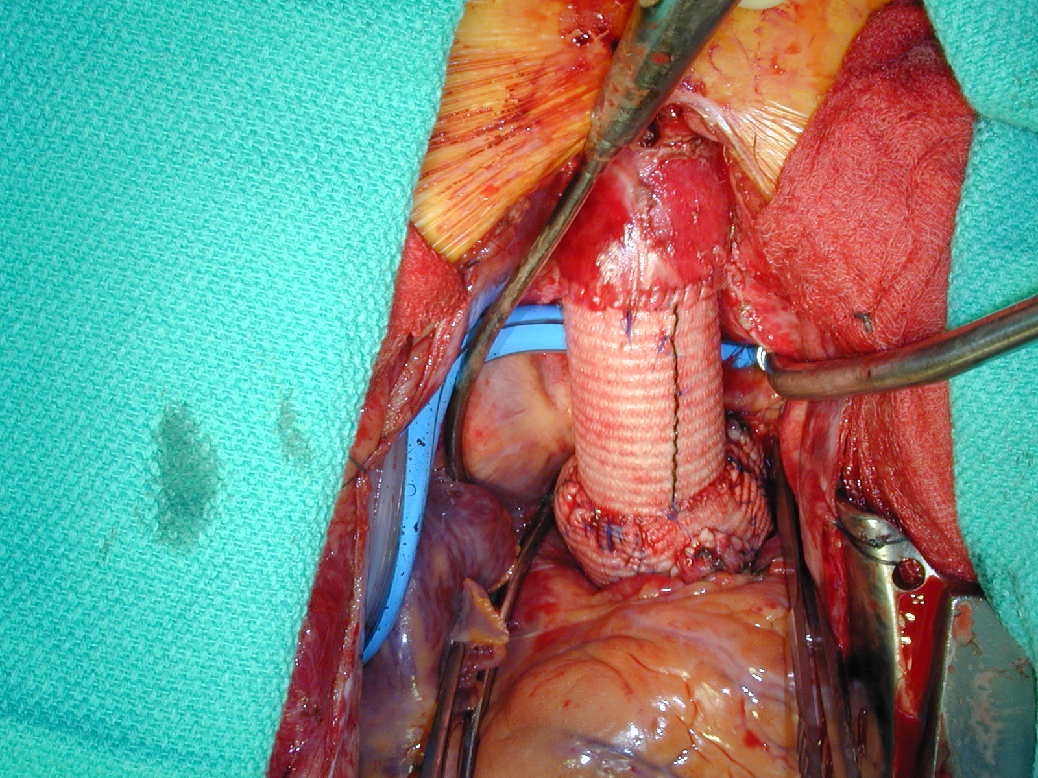
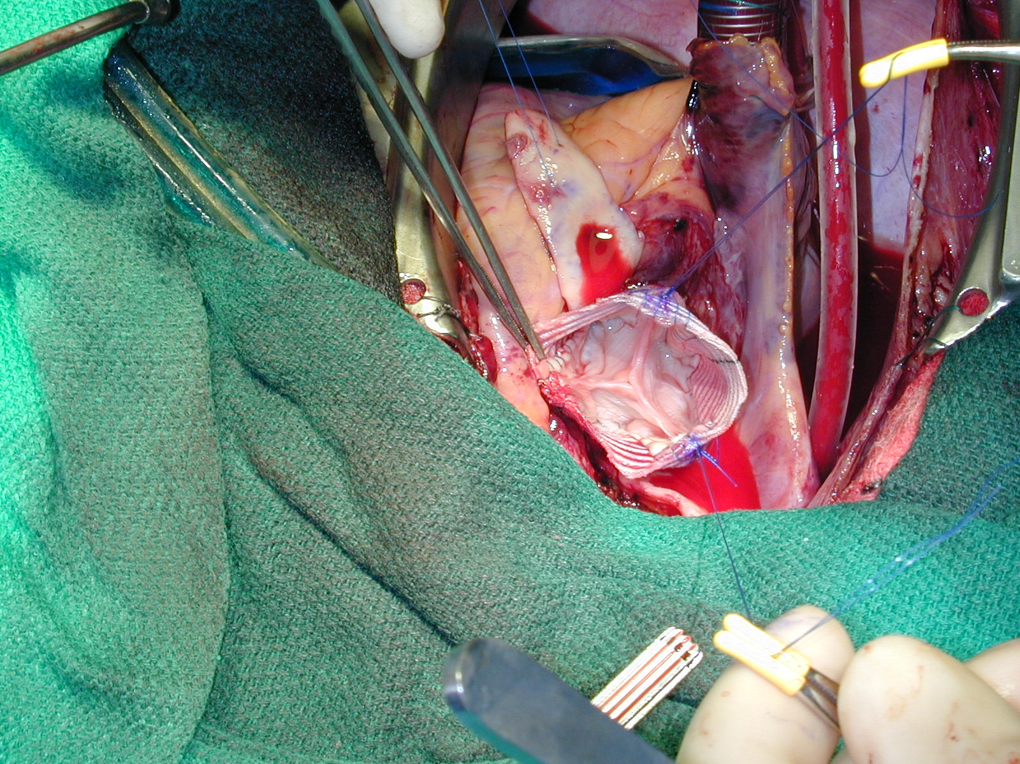
Surgical procedure
coronary
ostium
valve
leaflets
coronary
reiplanted
Notes:
this is the surgical correlation for the same patient undergoing a valve sparing aortic root repair.
- on the first picture you can see the flaccid aortic valve, and the valve commissures. Note that the coronary ostum can be seen here, this will later be reimplanted
- this image shows the aortic graft already sutured to the anulus, and we can now see how the aortic valve is resuspended on the inside of the graft. Again, we can see the coronary osium
- and this is the final result: down here is the aortic root, and we can see the coronary bottons that are reimplanted into the graft, and here is the distal anastomosis to the ascending aorta.

Slide 28
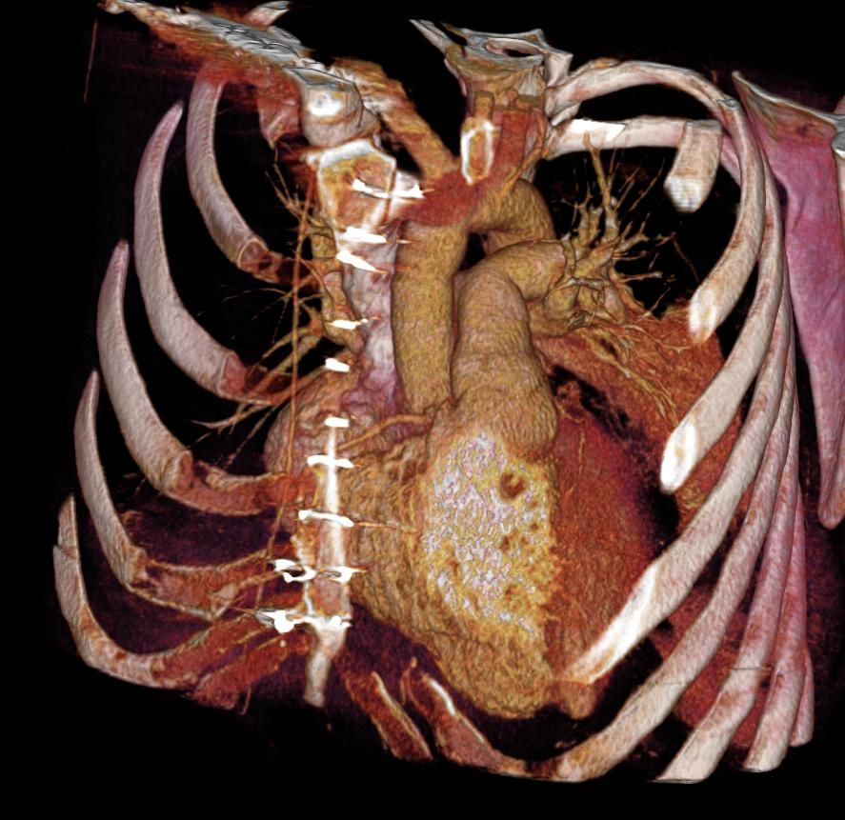
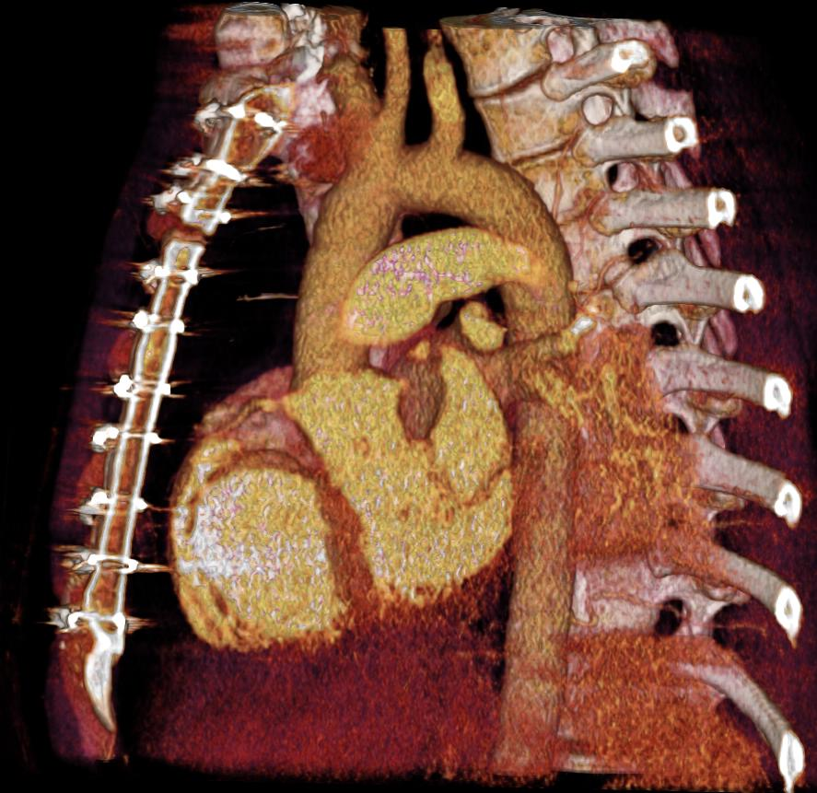
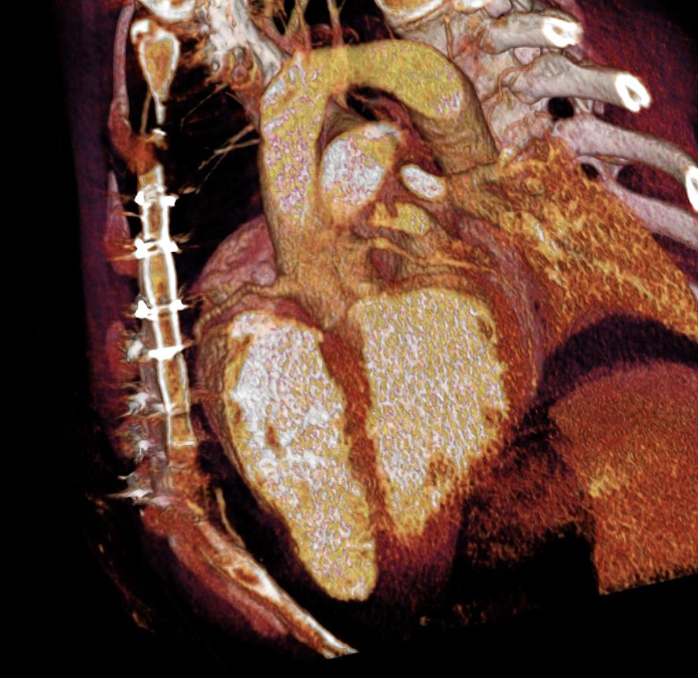
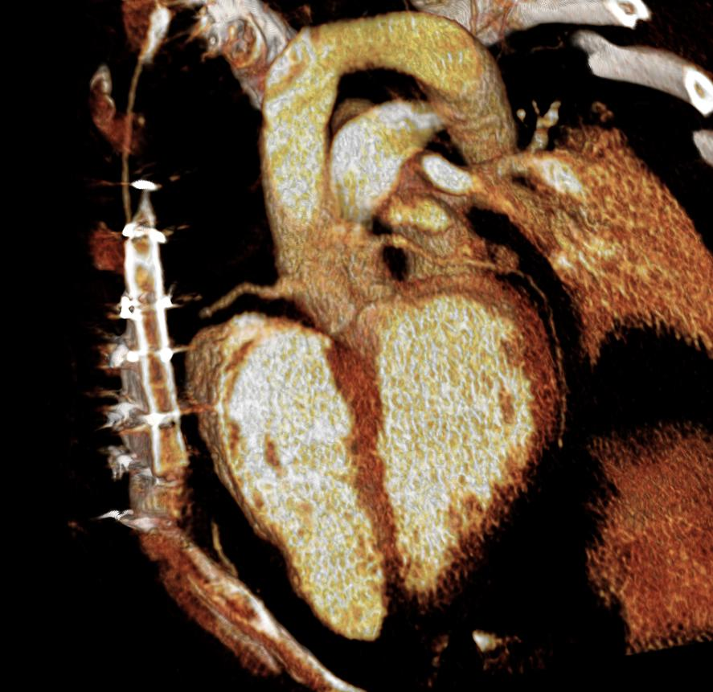
POST-OP
Notes:
these are volume rendered views of the post-operative situation, you can see that the aortic root looks normal in size, and here we can see the patent reimplanted coronary arteries.

Slide 29
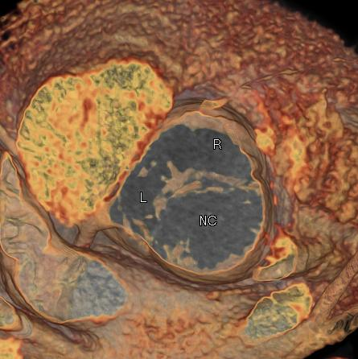
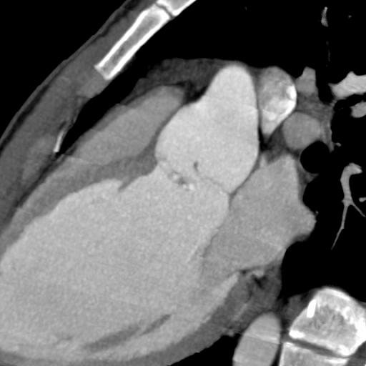
Bicuspid Aortic Valve
27 year old man
bicuspid aortic valve root aneurysm
valve prolaps with severe aortic regurgitation and left ventricular dilatation
Raphe 'L+R' leaflet
Severe prolaps of R+L - leaflet
Notes:
Here is another interesting sugical case, this time from a 27 year old man with a bicuspid aortiv valve and a root aneurysm.
From echcardiography it was know that the patient also has a valve prolaps, and significant aortic regurgitation, leading to left ventricular dilatation.
The left image shows the bicuspid valve, with one large non-coronary leaflet, and a combined left-and-right leaflet, fused by a so-called raphe.
the 3chamber view nicely shows that the more anterior left-right leaflet is actually prolapsing below the valve plane

Slide 30
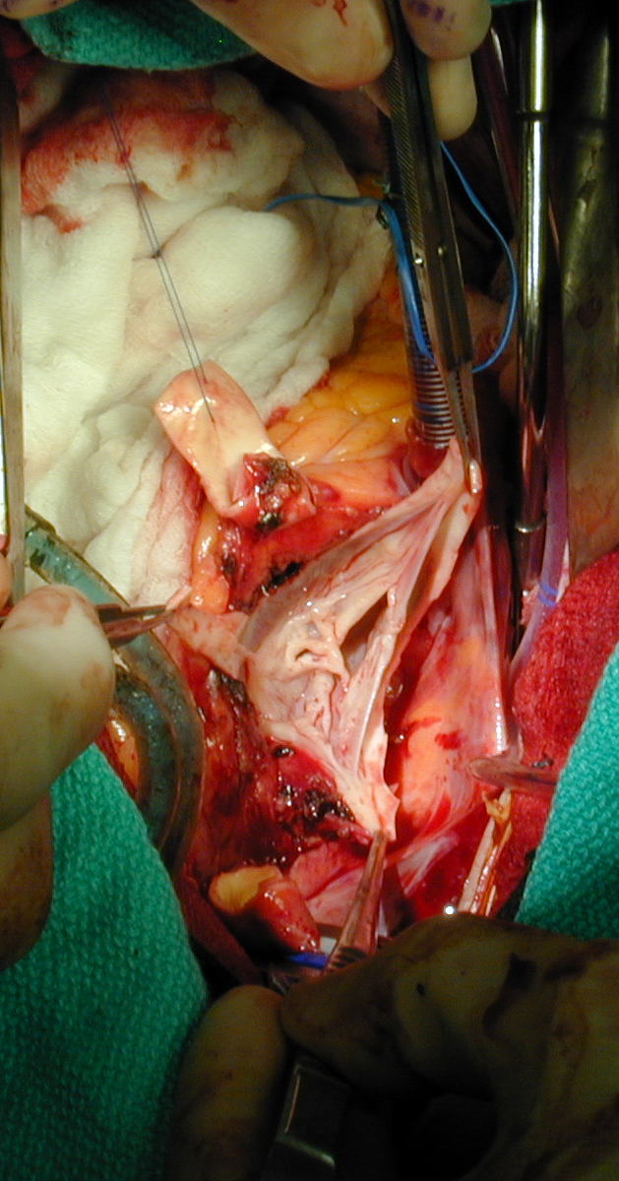
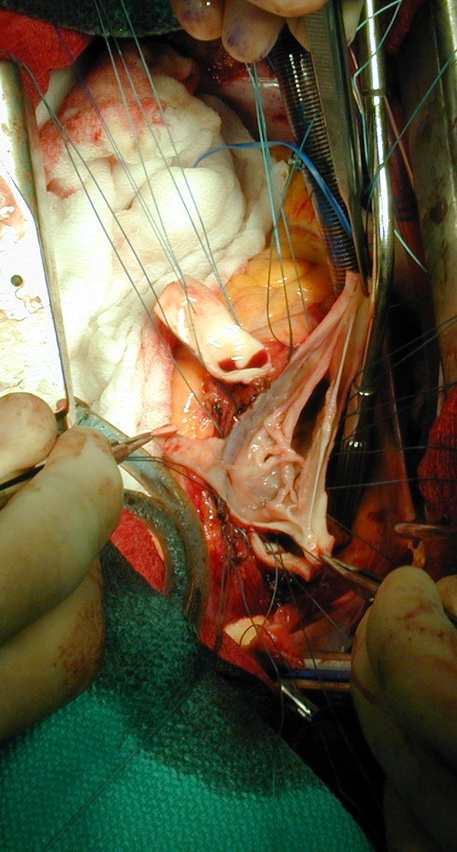
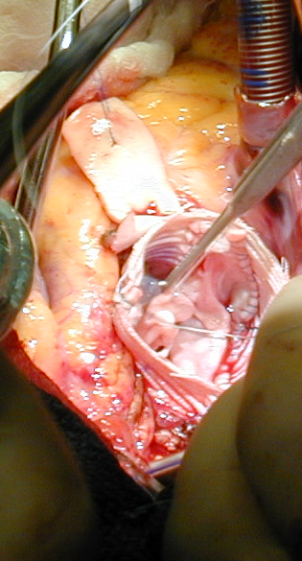
Bicuspid Aortic Valve
'L+R' sinus
raphe/chord
Severe prolaps of R/L-cusp
due to rupture of commissural suspensory 'chord'
Notes:
here is the surgical correlation of this patient,
We can see on these two images, that the abnormal soft tissue that we have seen on the CT, corrseponds to this small piece of tissue sitting right on the fused left/right leaflet,
It turned out, that this tissue is in fact a ruptured commissural suspensory chord. This tissue was originally fixed to the aortic wall, holding the valve in place. The rupture of this chord explains why the patients Right/Left leaflet had prolapsed, causing his aortic insufficiency and ventricular dilatation.
Despite one might think at it is not possible to preserve such an abnormal valve in a valve sparing procedure, the cardiothoracic surgeon was able to repair this valve, and resuspend the leaflet within an aortic root graft, allowing this young patient to avoid anticoagulation for hopefully at least 5 – 10 years.

Slide 31
3D and 4D Imaging of the Aortic Root
SUMMARY
Technique: 'gated chest' CT
Surgical anatomy of thoracic aorta
Clinical focus
  pre and postoperative imaging
  - Marfan's disease
  - Bicuspid aortic valve
Notes:
Now let me summarize:
I hope I was able to explain how we use gated CT of the chest to obtain 3D and 4D images of the aortic root, which allows us to see
the very specific surgical anatomy and pathology of the thoracic aorta and particularly the aortic root.
I tried to illustrate, how gated CTA plays an increasingly important role in the pre and postoperative imaging of patients with aortic root aneurysms, notable patinets with Marfans disease and bicuspid aoritc valve related aneurysms.

Slide 32
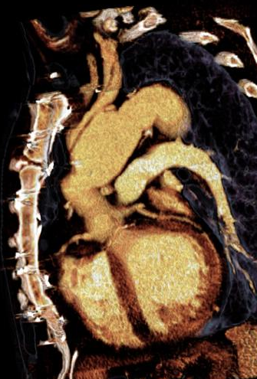
Thank you..
20th Annual Summer Practicum, Masters in Body Imaging
Jackson Lake Lodge, Moran, Wyoming
August 8-11, 2010
DC Miller
RS Mitchell
M Fischbein

