Slide 1
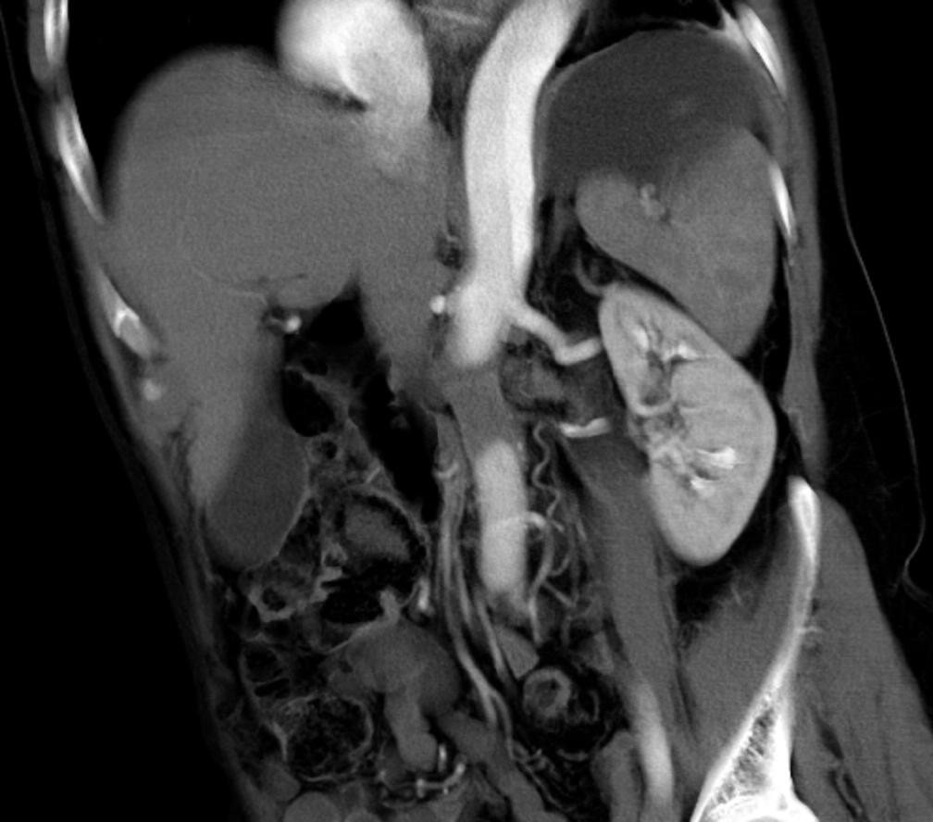

Aortic Dissection, and its Complications
20th Annual Summer Practicum, Masters in Body Imaging
Jackson Lake Lodge, Moran, Wyoming
August 8-11, 2010
Dominik Fleischmann
Department of Radiology
Stanford University
Notes:
movie clip
RAPOZ_AXIAL-CT.avi

Slide 2
Research support: General Electric
Speaker's board: Bracco
Siemens
20th Annual Summer Practicum, Masters in Body Imaging
Jackson Lake Lodge, Moran, Wyoming
August 8-11, 2010
Conflicts of Interest Disclosure
Dominik Fleischmann
Department of Radiology
Stanford University
Notes:
movie clip
RAPOZ_AXIAL-CT.avi

Slide 3
Background & Clinical Context
Acute aortic syndrome:
acute life-threatening abnormalities of aorta assoc. with intense chest or back pain, traditionally include:
Aortic dissection (AD), Intramural hematoma (IMH), Penetrating atherosclerotic ulcer (PAU)
RARE: 2.6-3.5 /100k/yr in US
(440 /100k/yr for myocardial infarction)
LIFE THREATENING
DIAGNOSIS/MANAGEMENT: IMAGING BASED

Slide 4
Acute aortic syndromes
Natural History of Type A Dissection
(approx 60% of dissections are Type A)
40% die immediately (~50% within 48 hrs) mainly from rupture
2% per hour mortality
(1-3% die in hour before surgery)
end-organ malperfusion occurs in 16-30%, dramatically reduces survival
short term (in-hospital and 30 day) mortality: 3.4% - 25%

Slide 5
Acute Aortic Syndromes
Imaging Strategy
Thick./Rec.-Int.
Precontrast series
  mandatory in acute setting
CTA series
  CTA chest-abdomen-pelvis
  scanning range:
  thoracic inlet → femoral a. bifurcation !!
  Gated chest + (abd.-pelv. non-gated CTA)
3mm/3mm
1mm/0.7mm

Slide 6
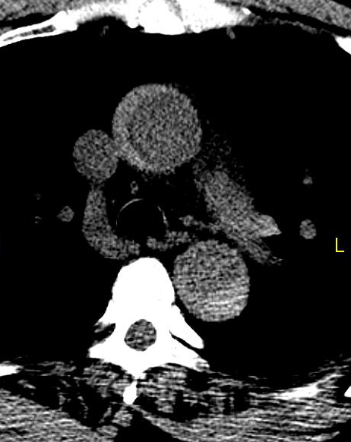
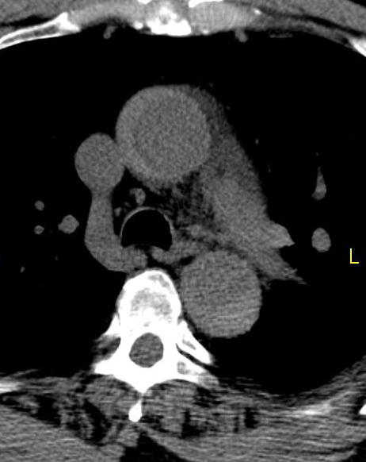
Intramural Hematoma
Acute aortic syndrome: MUST HAVE non-contrast acquisition
62 year old man with hypercholesterolemia and hypertension;
in morning squeezing chest pain, back pain
non contrast CT

Slide 7
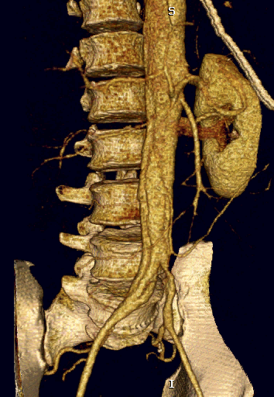
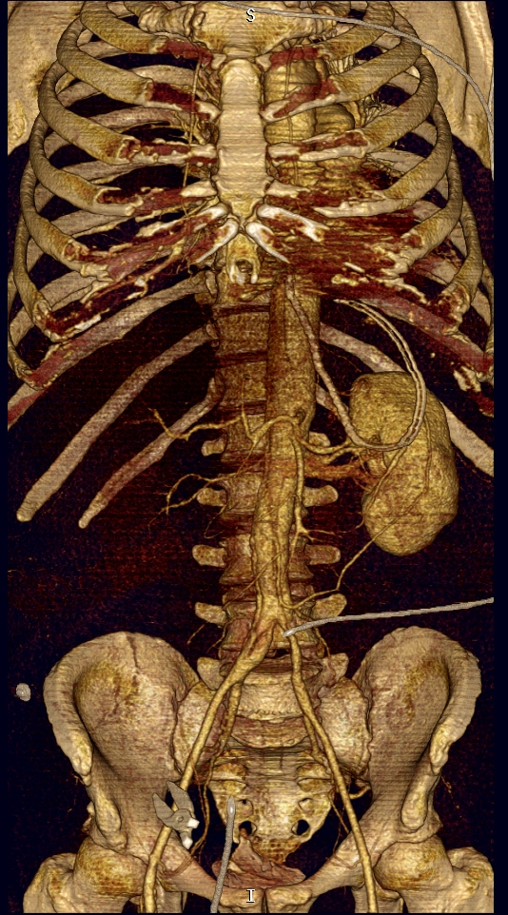
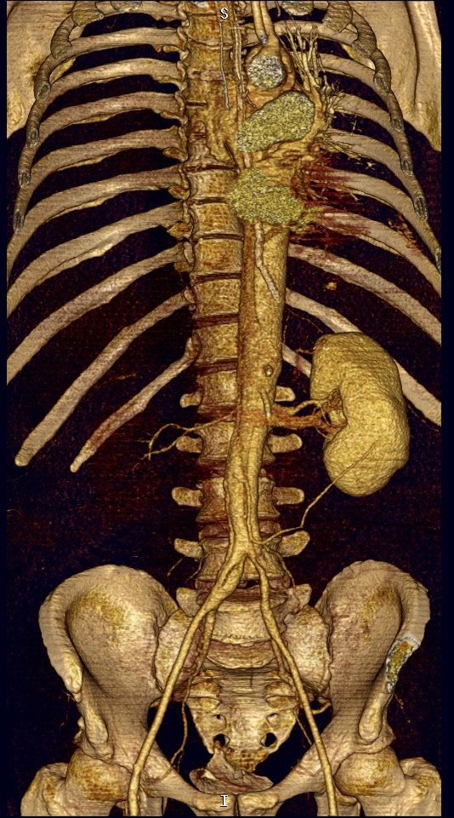
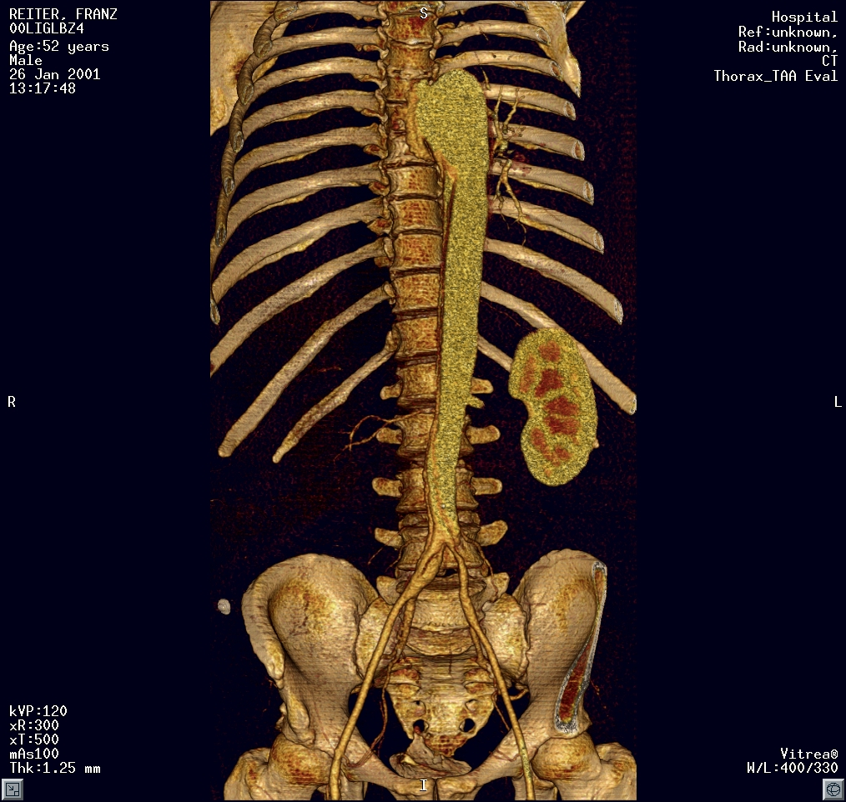
Acute Type B Dissection
Evaluation of femoral artery access for intervention
right femoral a.:
→ false lumen
left femoral a.:
→ true lumen
Notes:
This is very important, because in many cases these patients may require endovascular treatment using stentgrafts, and it is extremely helpful for the interventional radiologist when we can provide a roadmap to the patient's true and false lume.
In this patient with an acute aortic dissection, with bowel ischemia and ischemia of the right kidney, we can see that the left femoral artery leads directly into the true lumen, whereas the right femoral artery leads most likely to the false lumen.
And this is why you need to always include the groin in you CT scanning range

Slide 8
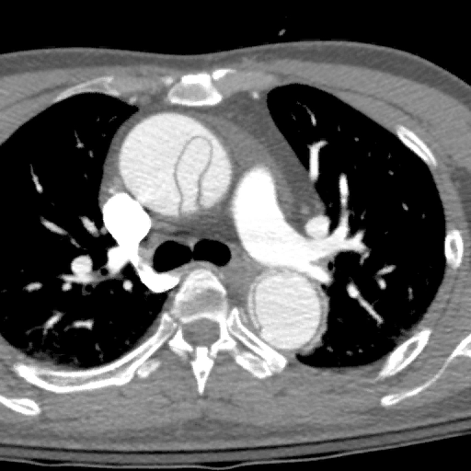
Clinical 3D and 4D Imaging of the Thoracic Aorta
49 year old man
acute chest pain;
RR 170 / 20
Gated CTA of chest (+ abd pelv)
r/o aortic disease

Slide 9
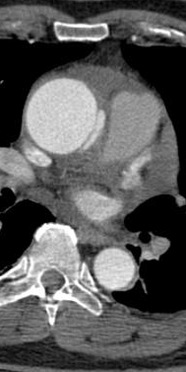
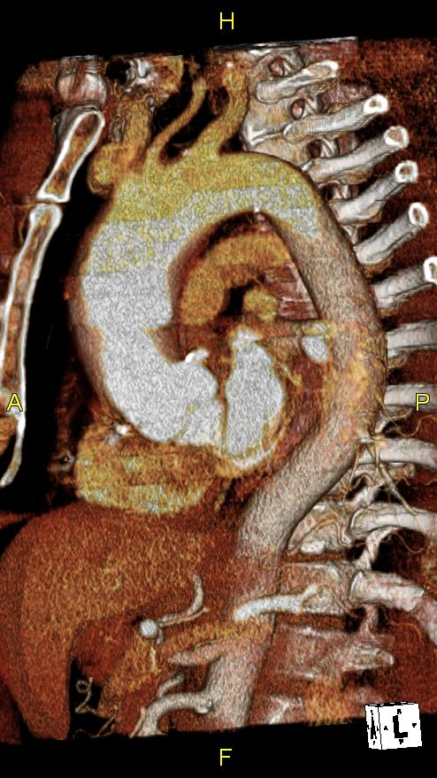
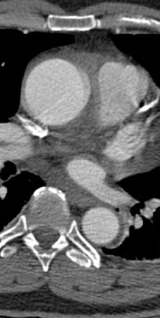
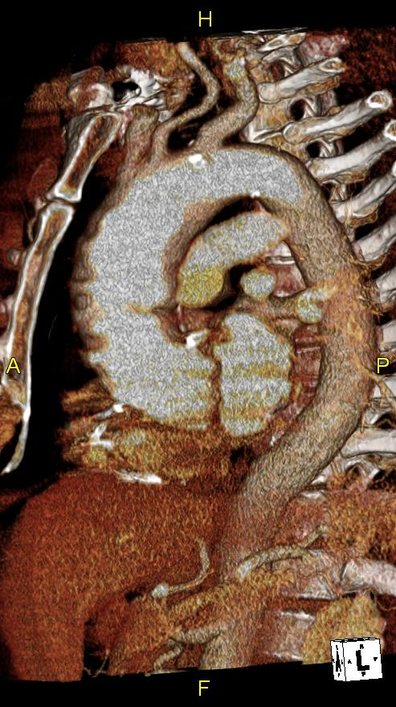
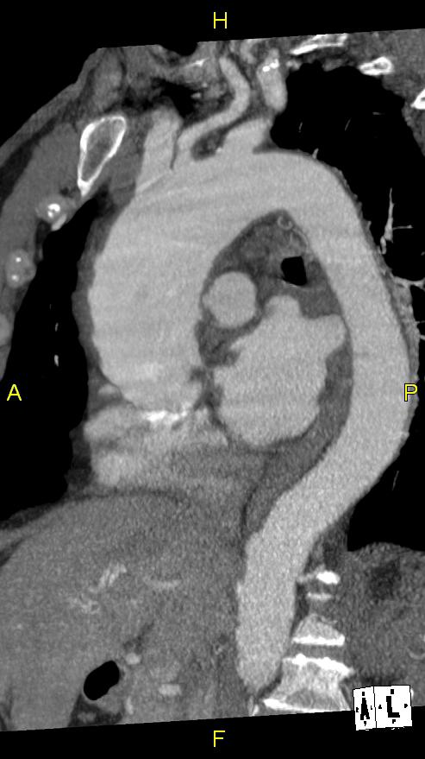
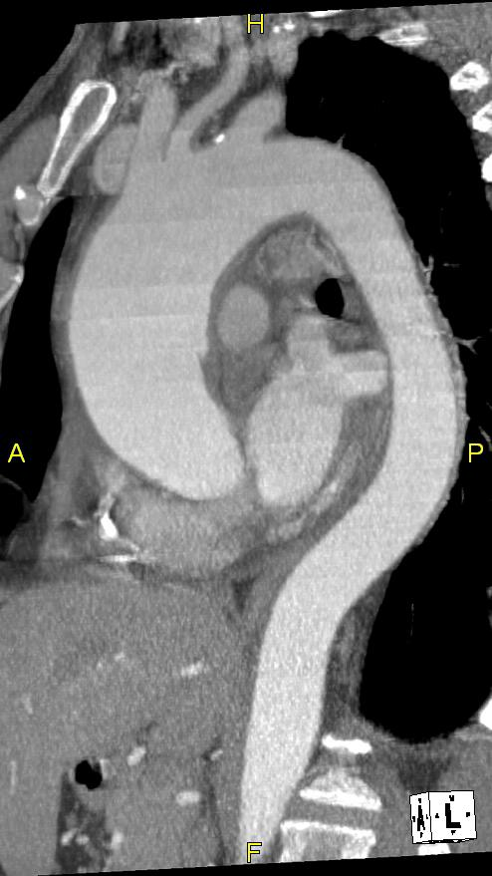
CT of the Thoracic Aorta
with ECG gating

Slide 10
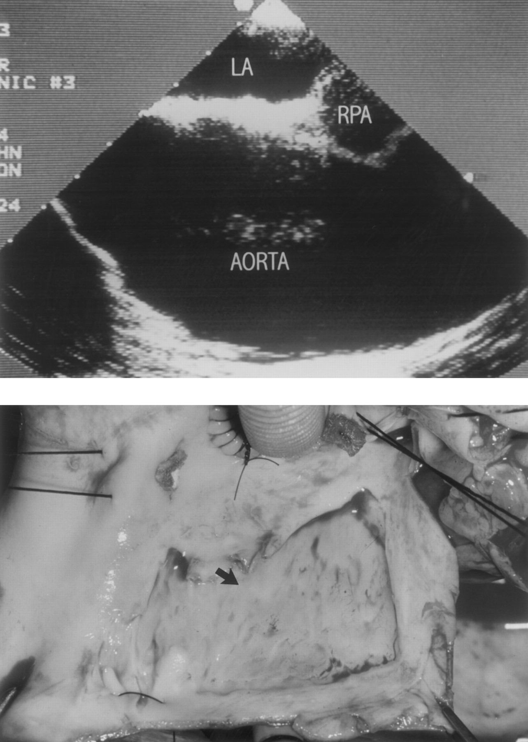


Copyright ©1999 American Heart Association
  Dissection variant:
  Limited Intimal Tear
Svensson, L. G. et al. Circulation 1999;99:1331-1336
Top, TEE of patient 2 whose initial clinical presentation was suspicious for aortic dissection but in whom no dissecting flap or hematoma was found, although aortic aneurysm was noted
Notes:
10
Figure 5. Top, TEE of patient 2 whose initial clinical presentation was suspicious for aortic dissection but in whom no dissecting flap or hematoma was found, although aortic aneurysm was noted. Patient developed recurrent symptoms 2 weeks after discharge and was taken to surgery. Bottom, Intraoperative photograph of limited intimal aortic dissection in same patient. Arrow indicates intimal tear edge. LA indicates left atrium; RPA, right pulmonary artery.
Figure 5. Top, TEE of patient 2 whose initial clinical presentation was suspicious for aortic dissection but in whom no dissecting flap or hematoma was found, although aortic aneurysm was noted. Patient developed recurrent symptoms 2 weeks after discharge and was taken to surgery. Bottom, Intraoperative photograph of limited intimal aortic dissection in same patient. Arrow indicates intimal tear edge. LA indicates left atrium; RPA, right pulmonary artery.

Slide 11
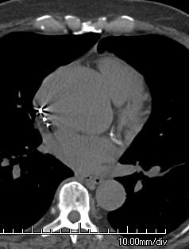
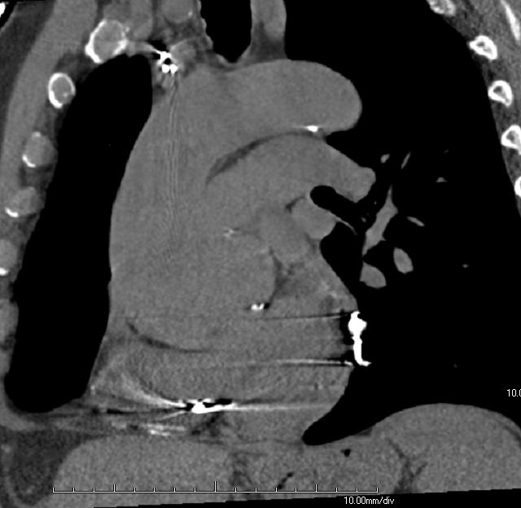
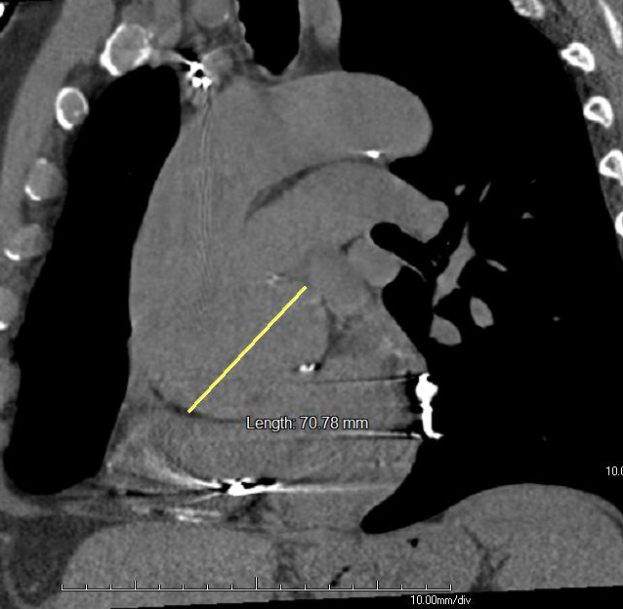
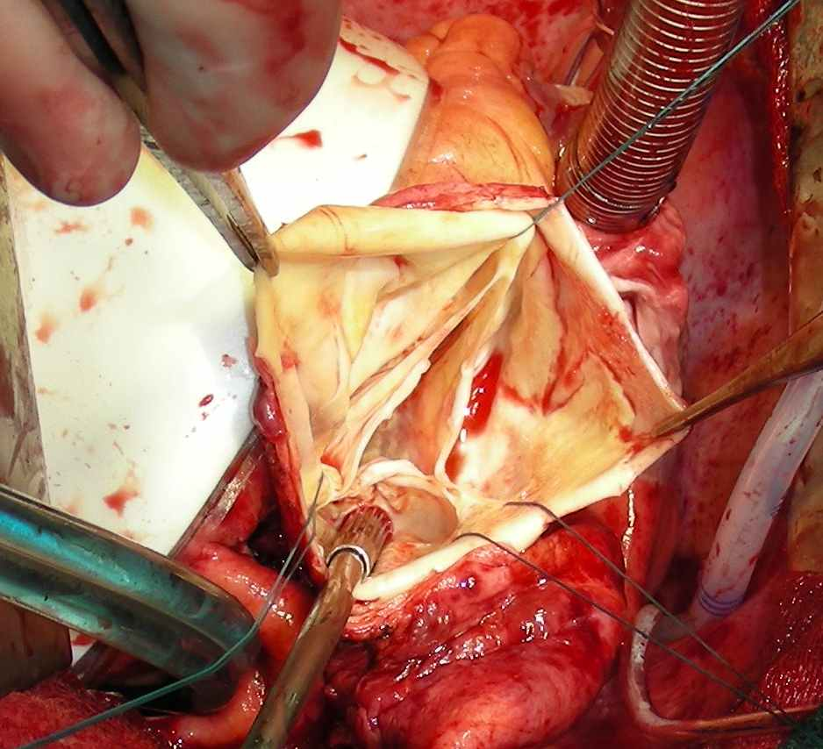
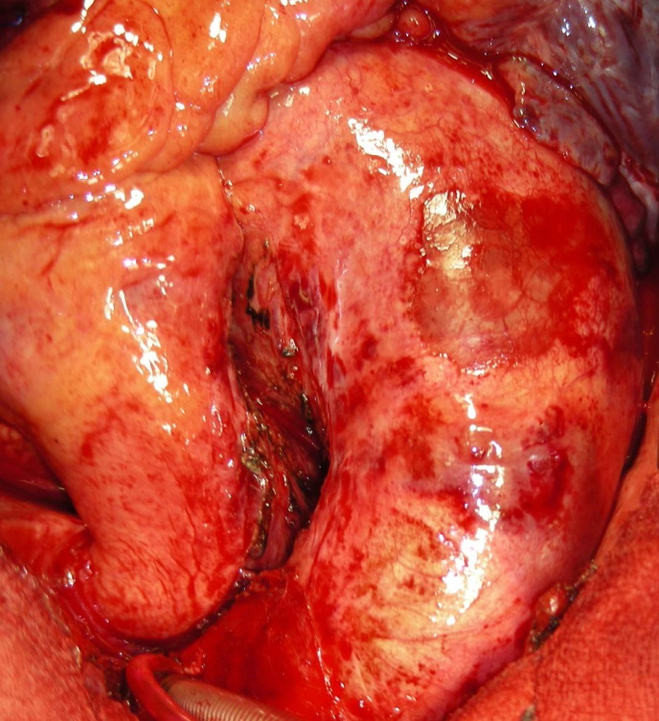
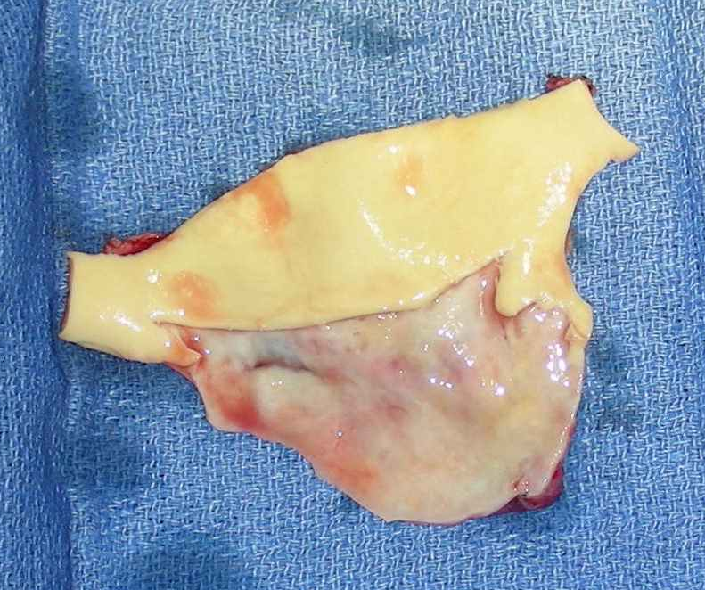
72 y.o. man, aneurysmal ascending aorta, chest pain

Slide 12
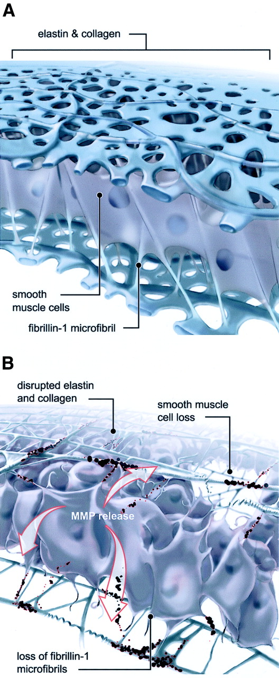
Aortic Dissection: Manifestation
of a Diseased Media
Elastic Lamina of
Aortic Wall
Marfans (fibrillin)
Ehlers Danlos IV (collagen)
familial TAA
severe hypertension !!!!
normal aging
Adventita
Media
Intima
lumen
‘cystic medial necrosis’
elastolysis (elastic & collagen fiber loss)
mucoid degeneration
smooth-muscle cell loss and dedifferentiation
Fedak, P. W.M. et al. Circulation 2002
Notes:
'cystic media necrosis'
‘cystic medial necrosis’
elastolysis (degeneration and fragmentation of elastic fibers and collagen),
mucoid degeneration (accumulation of basophilic ground substance in cell-depleted layer of the vessel wall; no cysts)
smooth-musclecell loss and dedifferentiation (no necrosis).

Slide 13
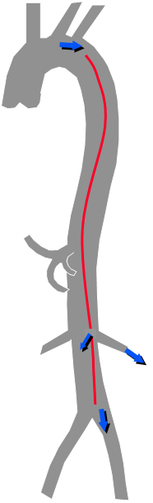

Classic Aortic Dissection
false lumen within the media
'intimal flap'=inner 2/3 of med + intima → intimo-media flap
Adventita
Media
Intima
false
true
lumen
entry tear (primary intimal tear [PAI]
exit tear(s) ['reentry tear', fenestrations]

Slide 14
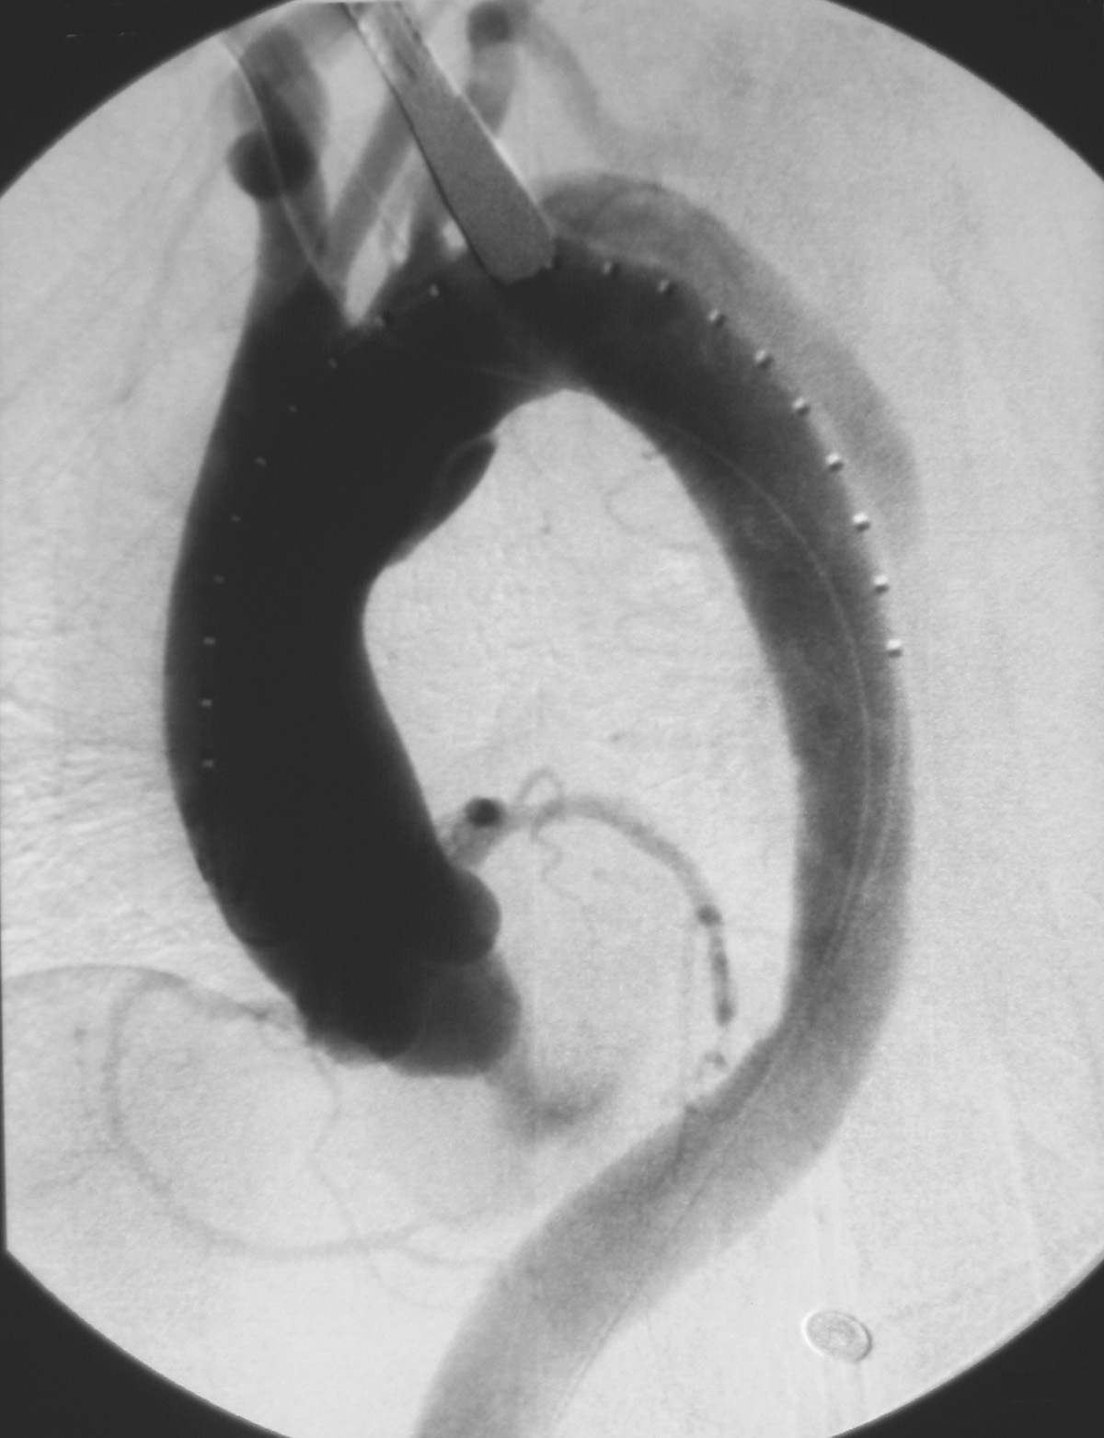
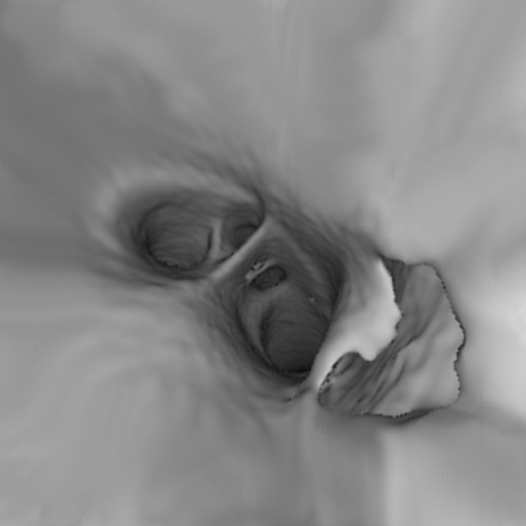
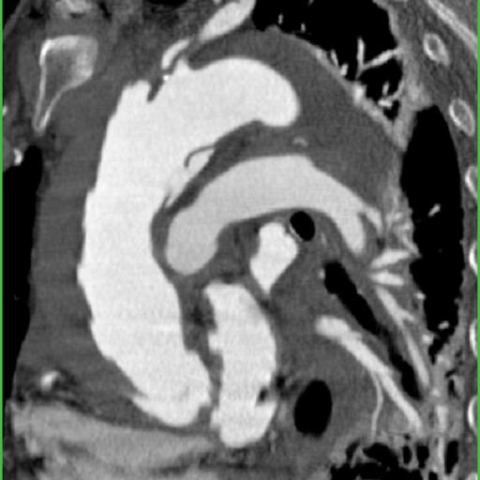
Acute Type–A Dissection
IMH BI^V
DSA
CTA
primary intimal tear
true / false lumen (DSA)

Slide 15
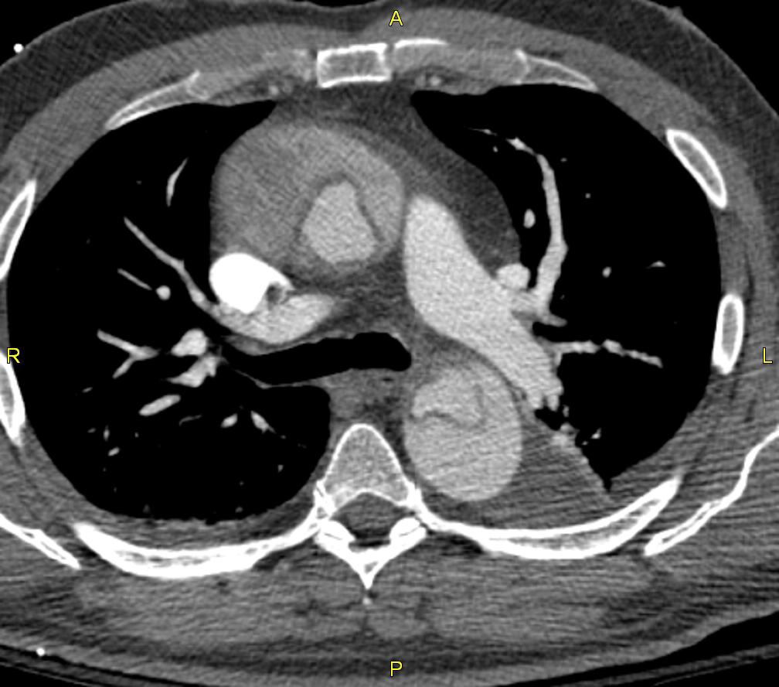
True versus False Lumen
normal
f
t
f
t
f
t
f
t
f
t
'typical'
TL collaps
VA^C
Notes:
15

Slide 16
True versus False Lumen
normal
f
t
f
t
f
t
f
t
f
t
'typical'
TL collaps
'complex'
‘pseudonormal’
intima-intussusception
VA^C
Notes:
16

Slide 17
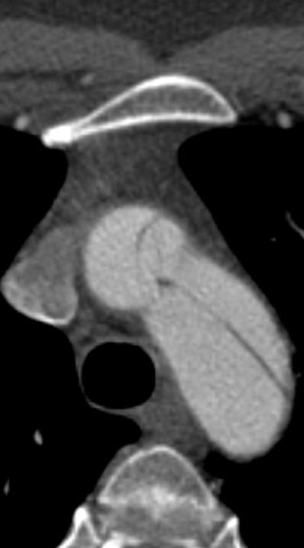
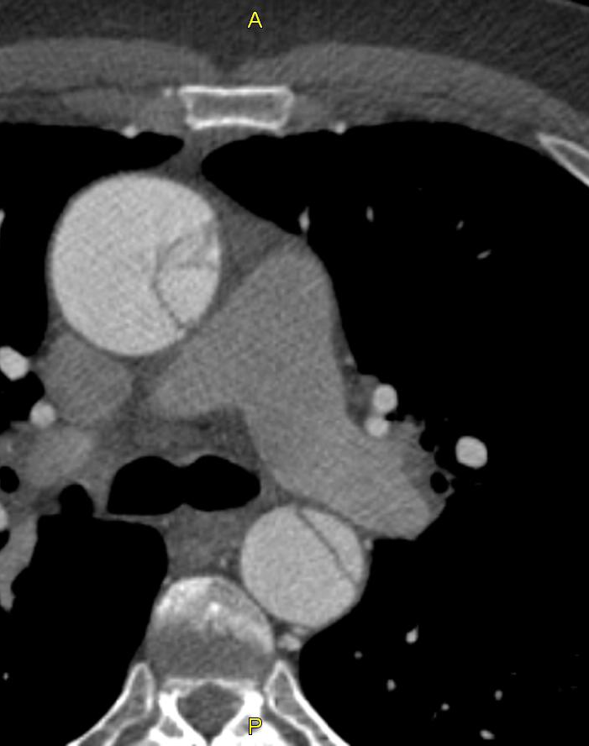
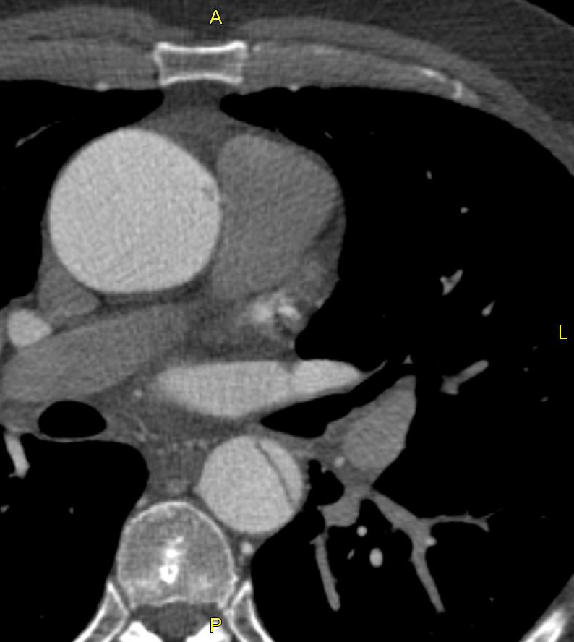
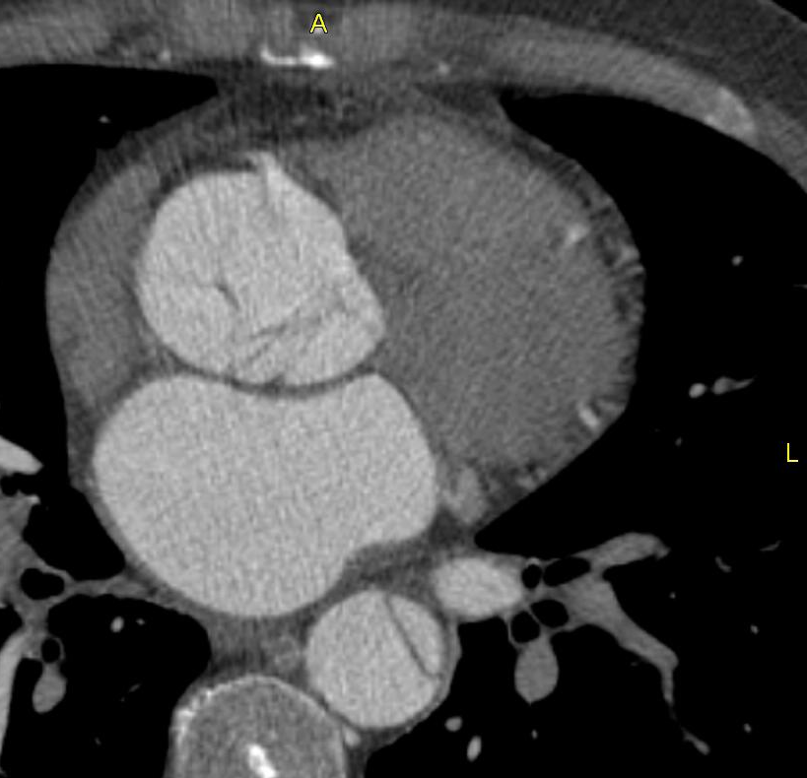
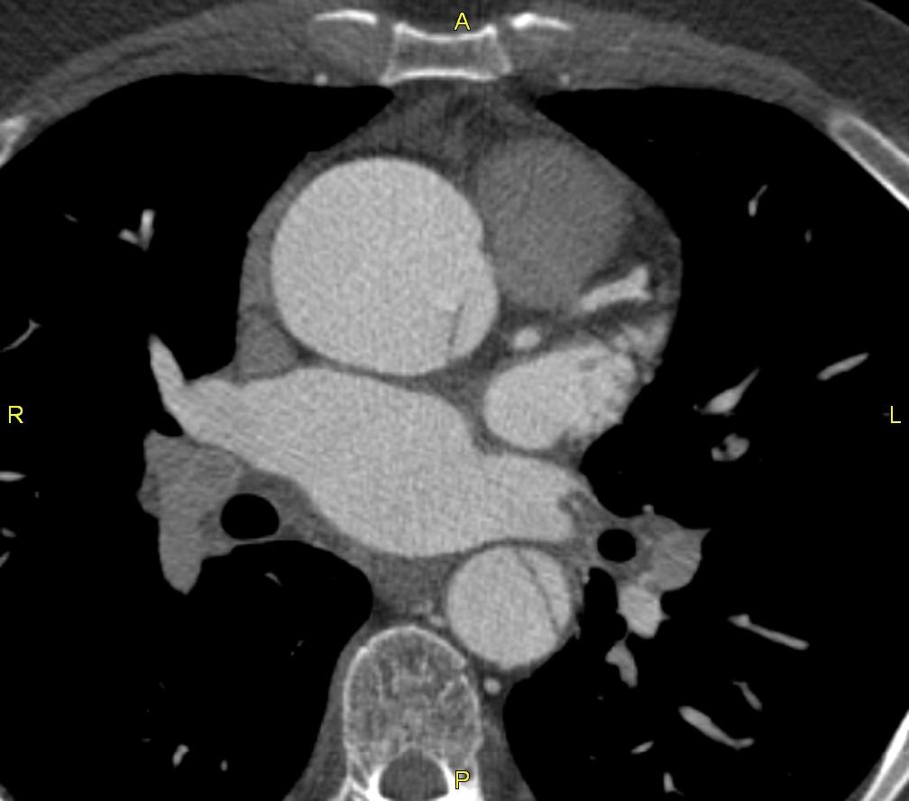
45 y/o man
3 wks dyspnea, no 'pain'
on TTE: type A dissection

Slide 18
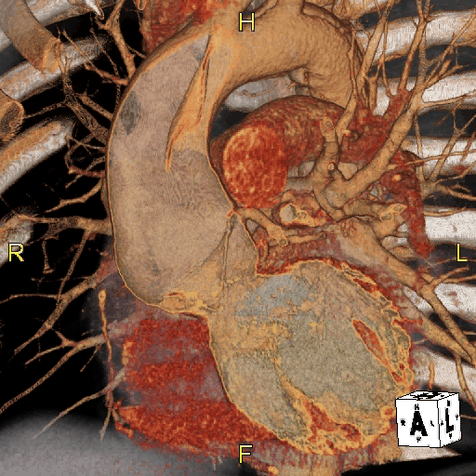
45 y/o man
3 wks dyspnea, no 'pain'
on TTE: type A dissection

Slide 19
Primary Intimal Tear (PIT)
Small PIT
Large / Circumferential PIT
Prolapse
Intimal
intussusception
Notes:
19

Slide 20
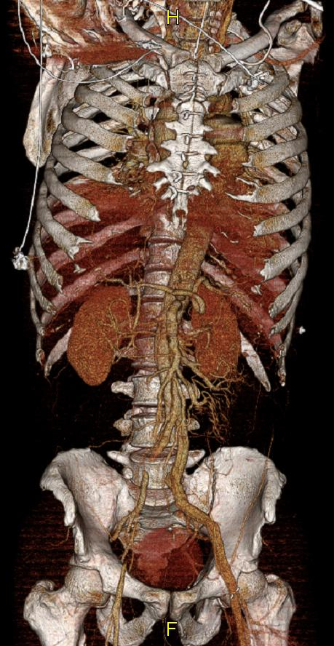
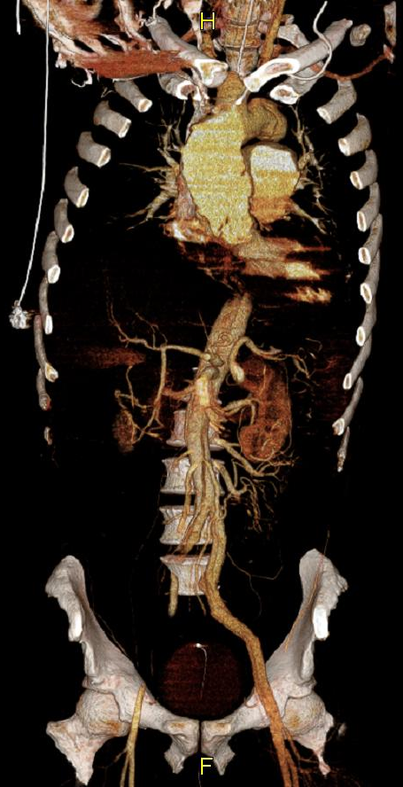
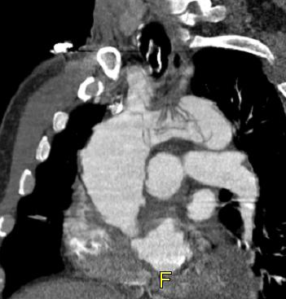
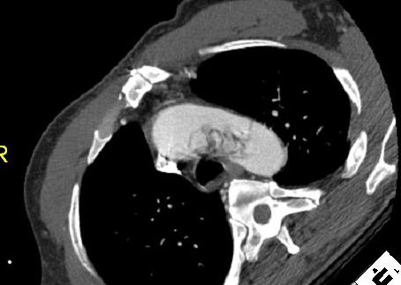
48 yo man
hx of crack cocain use;
outside hx of type-A IMH which was evacuated, but not repaired

Slide 21

Aortic Dissection
Stanford Classification
ascend. involved
ascend. not involved
Type A
Type B

Slide 22
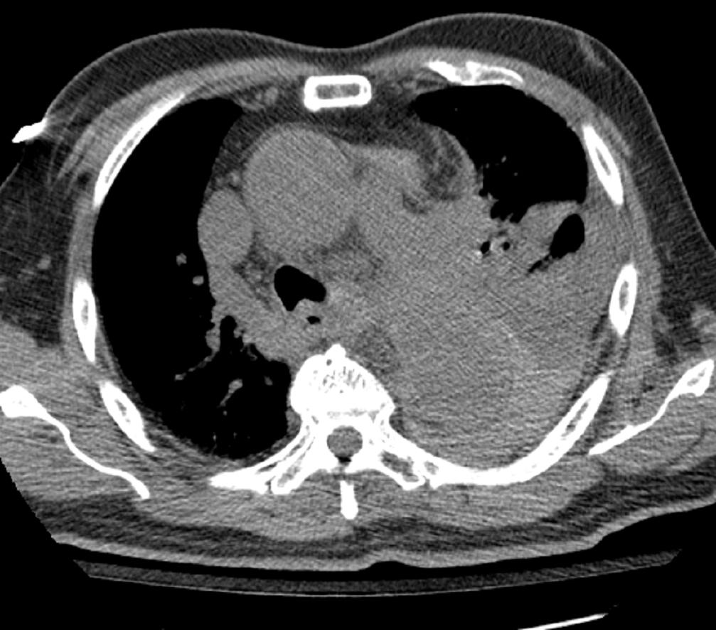
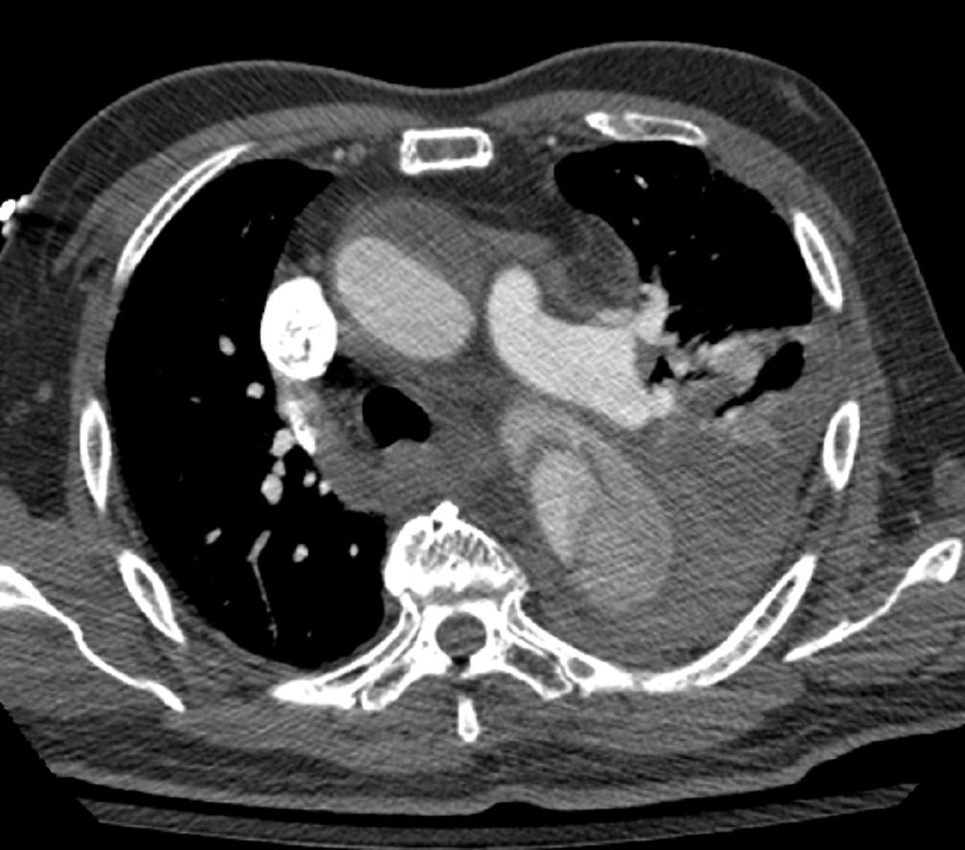
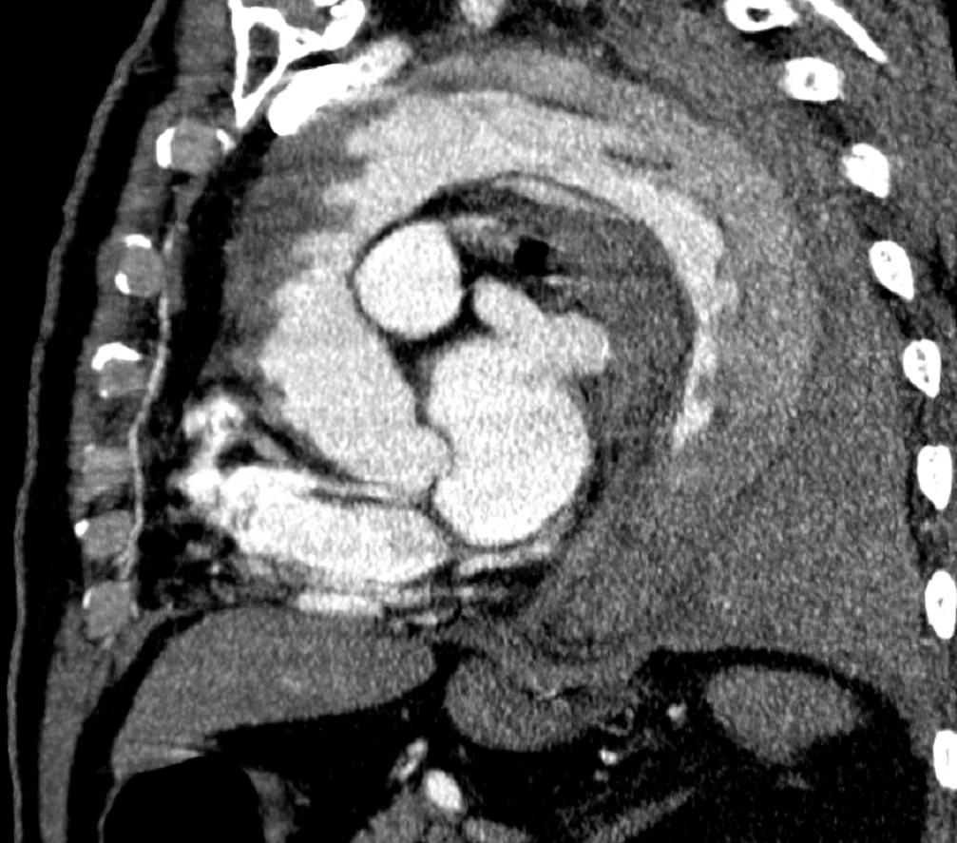
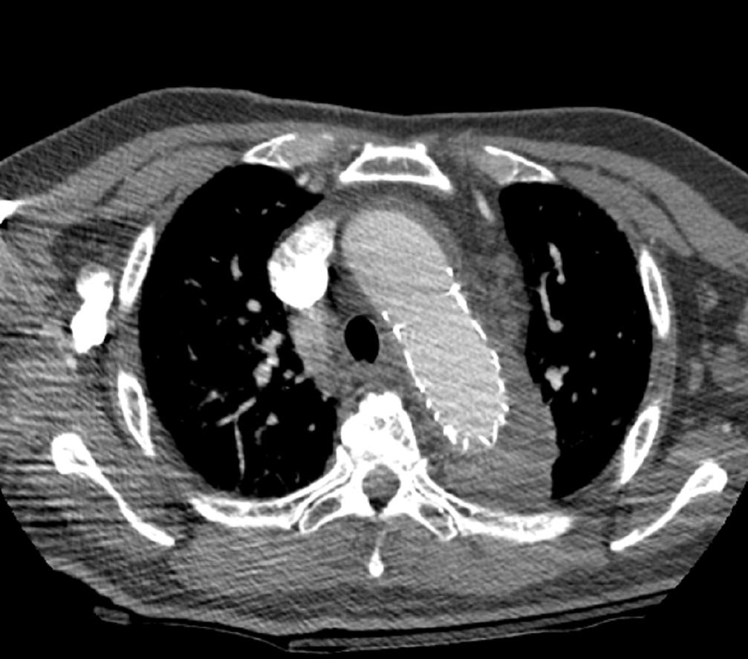
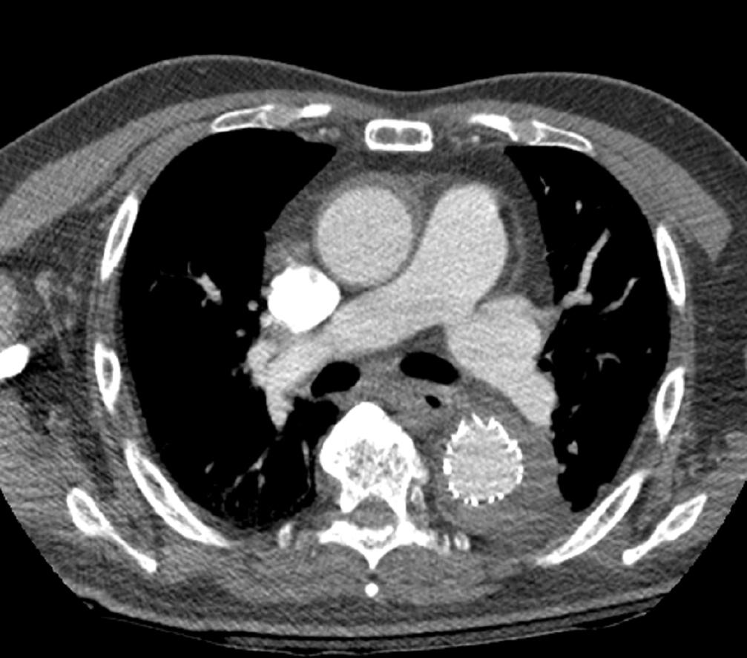
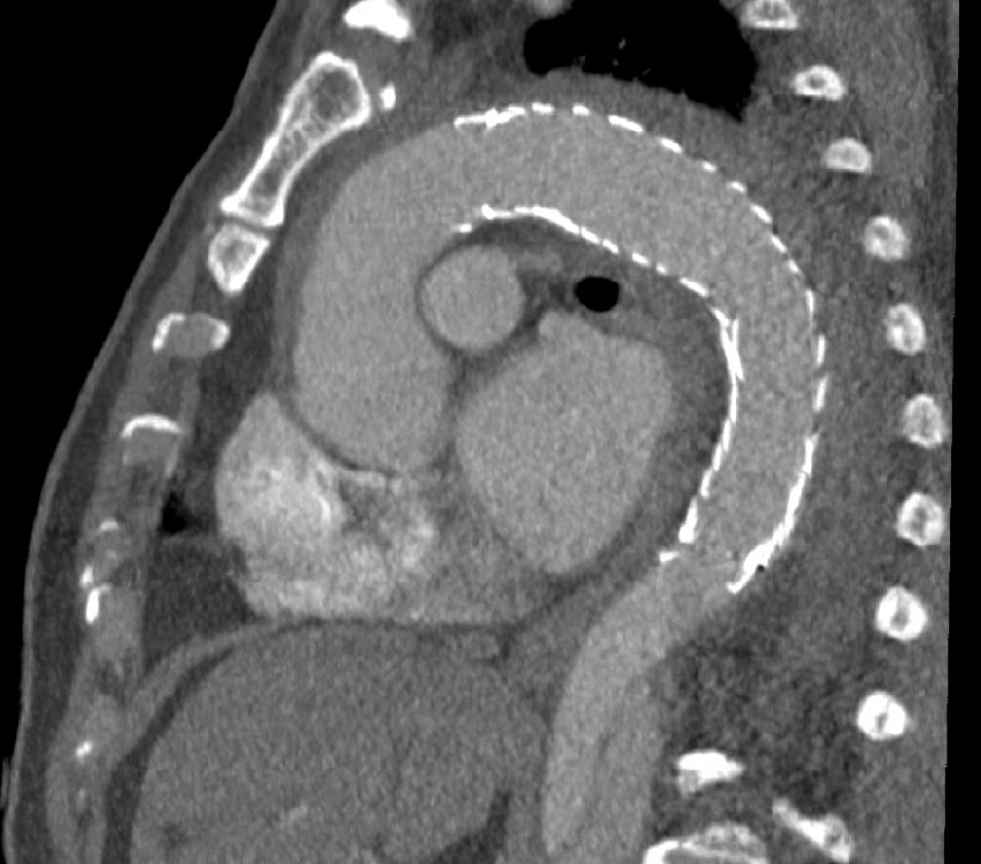
Type A dissection/IMH
75 y/o hypertensive man, acute chest pain,
and left hemothorax
05-Dec
desc.ao. intimal tear
Treatment with descending ao. Stentgraft
17-Dec

Slide 23
Aortic Dissection
Stanford Classification Subclass. → site of tear)
Type A: intimal flap involving ascending ao.
→ immediate surgery
subtype: asc / arch / desc / other [no])
Type B: no involvement of asc.ao.
→ conservative, unless complicated
subtype: arch / desc / other [no])
Primary intimal tear important !
→ endovasc. treatment target
Daily PO et al, Ann Thorac Surg. 1970;10:237-247

Slide 24
Aortic Dissection – Stanford Subclassification
168 patients operated for acute dissections
Subclass. → site of tear)
 | Asc. | Arch | Desc. | Mult.* | None
TYPE A (n=139) | 83 (60%) | 31 (22%) | 8 (6%) | 11 * (8%) | 4 (3%)
TYPE B (n=29) | n/a | 1 | 21 | 0 | 2
1/3rd 'retro-A'
Stanford TYPE
(* arch in 10 of 11)
(Lansman, Griepp; Ann Thorac Surg 1999;67:1975–1978)
Notes:
168 patients operated for acute dissections
Subtypes of Acute Aortic Dissection
Steven L. Lansman, MD, PhD, Jock N. McCullough, MD, Khanh H. Nguyen, MD,
David Spielvogel, MD, James J. Klein, MD, Jan D. Galla, MD, PhD,
M. Arisan Ergin, MD, PhD, and Randall B. Griepp, MD
(Ann Thorac Surg 1999;67:1975– 8)

Slide 25
Acute Aortic Dissection
Complications
(contained) rupture, leakage → tamponade; aortic regurgitation (Type A)
side branch malperfusion syndromes:
(in approx. 1/3rd of acute type A diss), substantially reduces survival
Type A: coronary, cerebral + ...
Type A&B: renal, mesenteric, peripheral, paraplegia
Notes:
25

Slide 26
Aortic Dissection
Side-branch Malperfusion
Mortality
  coronary arteries ~ 25%
  cerebral arteries/parapl. ~ 45%
  renal (ATN, hypertens.) ~ 50-70 %
  mesenteric ~ 50-95 %
  peripheral (extremity) ~ 45 %
Diagnosis
clinical
labs
→ CT cannot diangose mal-perfusion !!
Notes:
26

Slide 27
Aortic Dissection
Side-branch Malperfusion
Role of CT in side branch malperfusion
once diagnosis is established/suspected
identify detailed anatomy to infer and
explain mechanism ('flow')
→ treatment consequence !
Possible mechanisms
local obstruction at branch ostium
limited in- (out-)flow into true (or false) lumen
Notes:
27

Slide 28
False Lumen: In- Outflow
PIT*
How does blood get ?
→ into the false lumen, and
- Primary Intimal Tear (*PIT)
← out of the false lumen
- side branches off FL
- Re-Entry Tear (**RET)
(inter-
costal)
branch a.
(renal)
RET**
Notes:
28

Slide 29
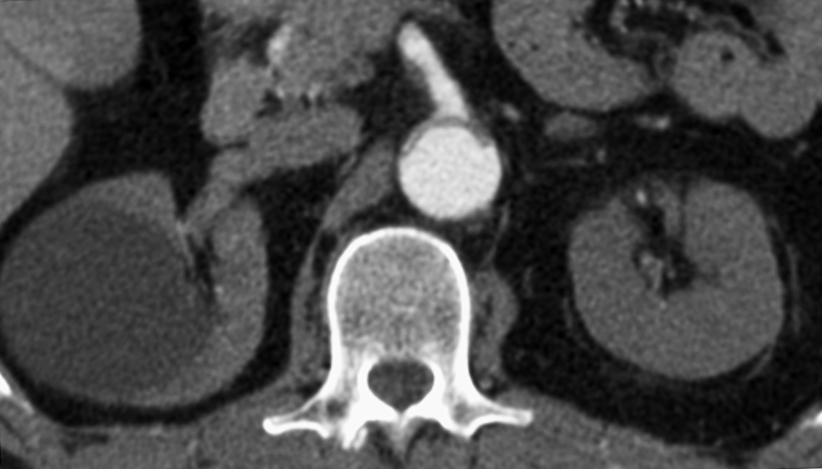
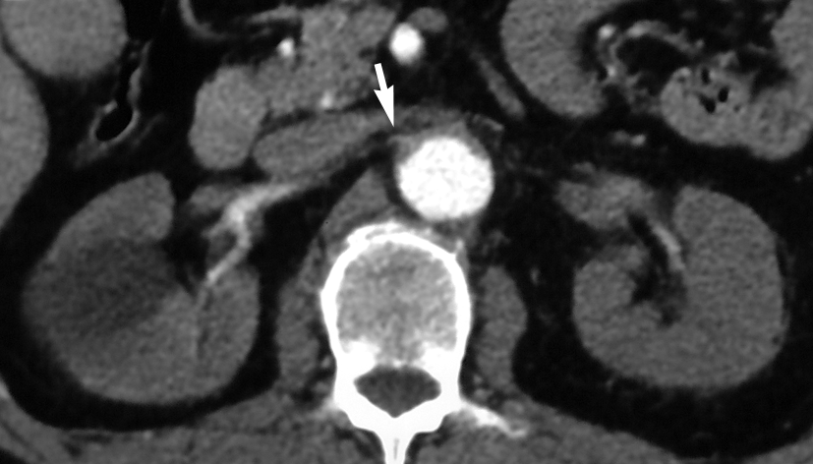
Aortic dissection with true lumen collapse
mesenteric and renal ischemia
Intima
Aorta
Notes:
29

Slide 30
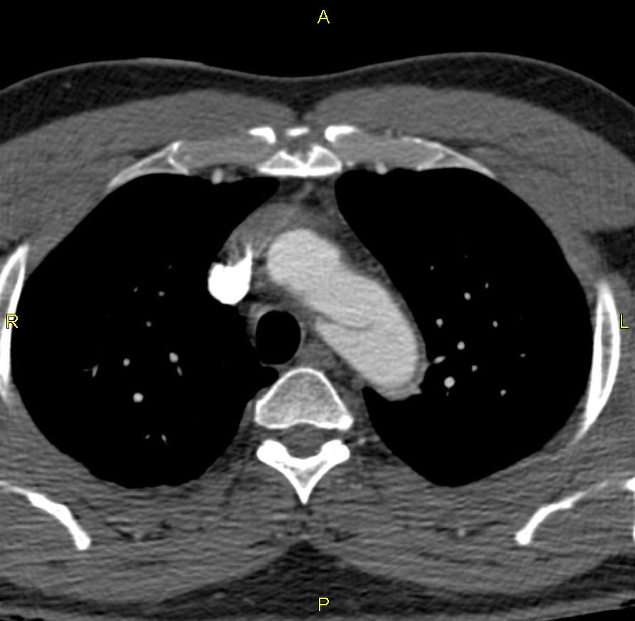
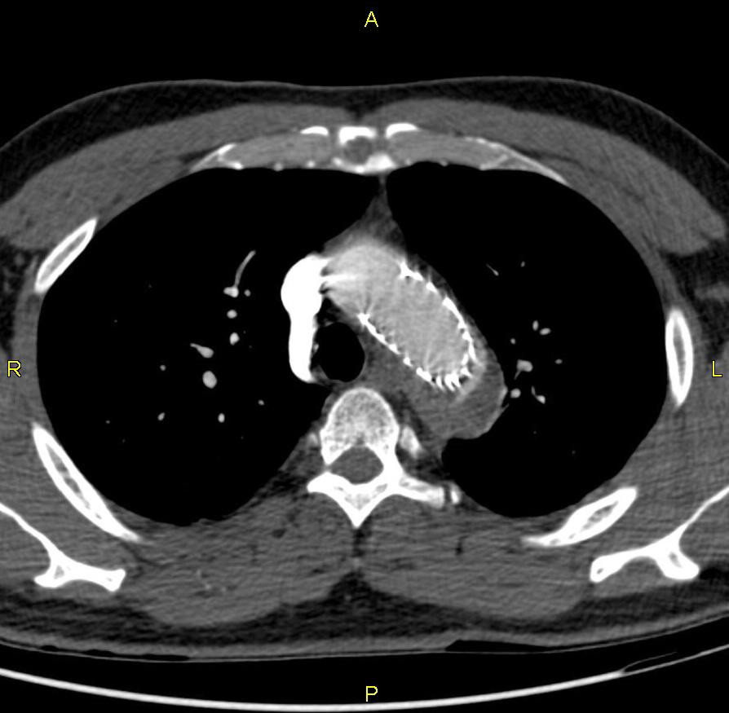
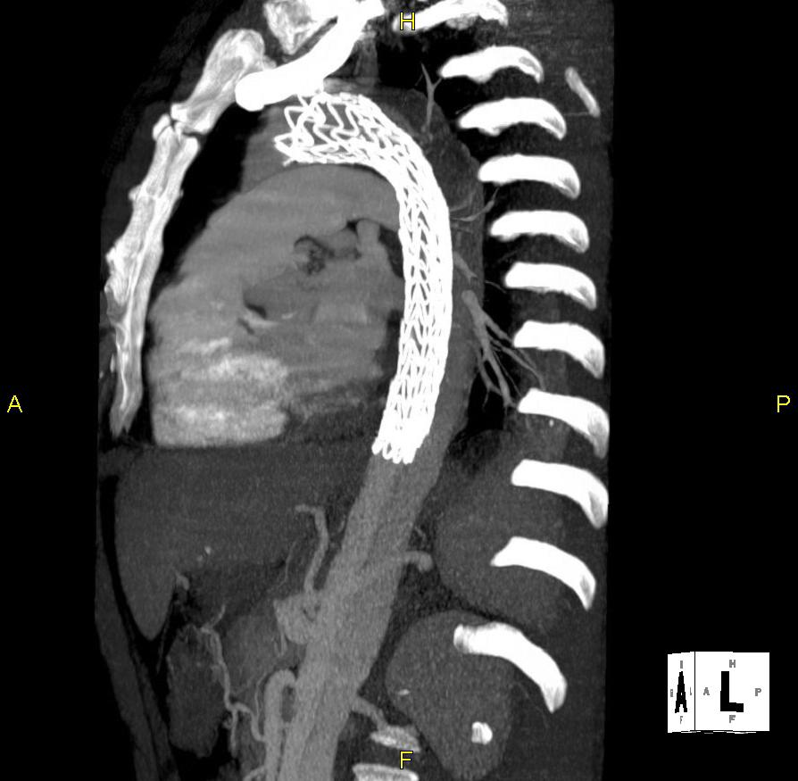
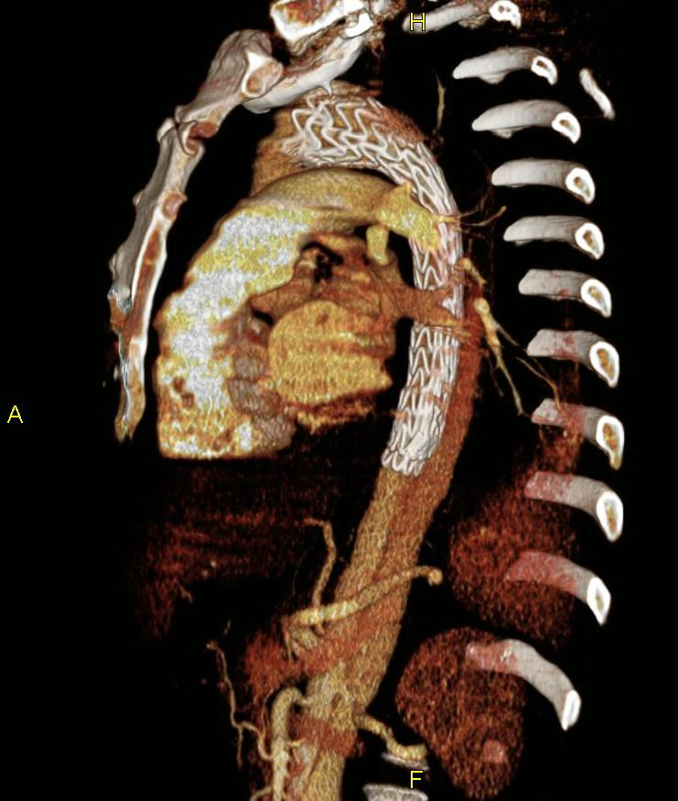
Type B dissection with TAAA
Notes:
30

Slide 31
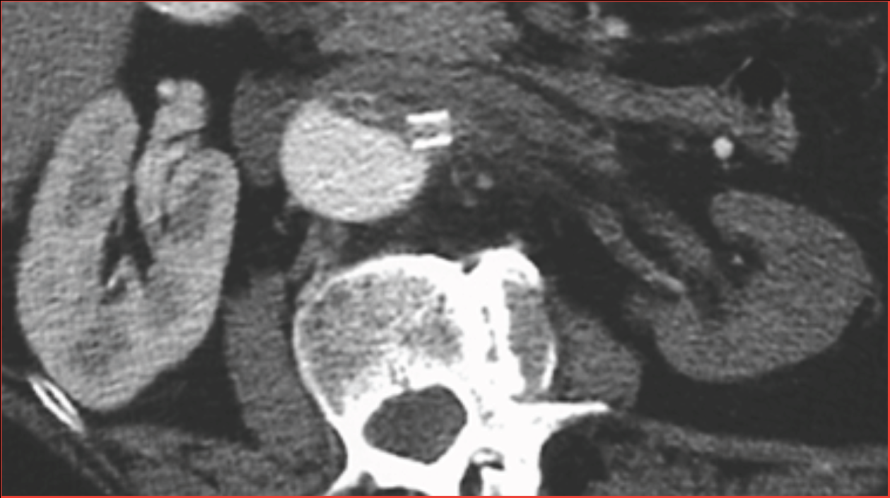

Type B dissection
true lumen collapse,left renal artery occlusion with stent-placement

Slide 32
Local Side Branch Involvement in Dissection
uncompli-
cated
natural fenestration
('reentry tear', if large)
torn flap within branch /w stenosis
local flow-limiting
lesions
diss. ext. into branch(es) /w stenosis
windsock in branch /w stenosis/occlusion

Slide 33



acute bowel ischemia
52 y/o hypertensive man
acute type B dissection
average IP

Slide 34





Acute Type B Dissection
51 y/o man, Marfan's
pulsless legs
hx of aortobifemoral graft
TL collapse
FL
('windsock')
IMA
(reimplanted into
aortobifemoral graft)
False lumen
injection
Notes:
this reformation demonstrates the situation more intuitively,
you can see the true lumen collapse
the blind ending enlarged false lumen, giving this wind-sock appearance, resulting in an occlusion of the infrarenal aorta and graft,
also, you can again see the reconstitution of some flow into the graft through the reimplanted inferior mesenteric artery.
Note that the low attenuation within the graft is actually non-opacified blood.
- the intuitive way to treat this, as you may have guessed, is to perforate the windsock, which would allow outflow of blood from the false lumen to the legs and reestablish flow there, and also it would preven the true lumen collapse at the same time.

Slide 35
Diagnostic information sought in patients
Acute Aortic Syndromes
SUMMARY
lesion detection, characteriz. (AD, IMH, PAU)
  incl. signs of leakage / rupture
involvement of ascending aorta (type A vs B)
  pericardial effusion
  involvement of coronary arteries / aortic valve apparatus
location of entry tear (or ulcer, if PAU)
distal extent (anatomic) for roadmap
side branch involvement / mechanism
Notes:
35

Slide 36

Acute aortic syndromes
Aortic dissection
  Classic aortic dissection
  Intramural hematoma
  Dissection variant
  'limited tear with aortic bulge' =
  'dissection without intimal flap' =
  'subtle/discrete dissection
Intramural hematoma (NO DISEASE)
Penetrating atherosclerotic ulcer
  with intramural hematoma
(Traumatic transection)
(Rupturing/leaking aneurysm)
Diseased media
Diseased
intima
Semin Thorac Cardiovasc Surg 2008 (Dec) 20:340-347
Notes:
36
Subtle-discrete aortic dissection (class 3)
The structural weakness can lead either to clinically
inapparent disease or minor forms of aortic dissection.
Subtle dissection has been described[89] as a partial
stellate or linear tear of the vessel wall, covered by
thrombus. When the partial tear forms a scar, this
constellation is called an abortive, discrete dissection.
Partial ruptures of the inner layer of the aorta allow
blood to enter the already damaged media and thus
cause dissection of the aortic wall, eventually leading to
a second lumen within the wall, to a rupture or healing
during follow-up[89].

