Slide 1
nEXO

Slide 2







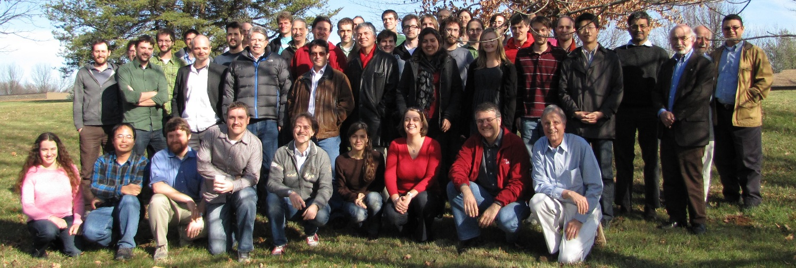

EXO is a well oiled (but extremely clean!)
collaboration that has been together for ~10
years and has managed to build one of the most
competitive double-beta decay detectors in the
world, producing results in a timely and
effective way.
Most recently several new groups, including IHEP-Beijing and TRIUMF, have joined the team

Slide 3
The EXO
Collaboration
University of Alabama, Tuscaloosa AL, USA - D. Auty, T. Didberidze, M. Hughes, A. Piepke
University of Bern, Switzerland - M. Auger, S. Delaquis, D. Franco, G. Giroux, R. Gornea, T. Tolba, J-L. Vuilleumier, M. Weber
California Institute of Technology, Pasadena CA, USA - P. Vogel
Carleton University, Ottawa ON, Canada - V. Basque, M. Dunford, K. Graham, C. Hargrove, R. Killick, T. Koffas F. Leonard, C. Licciardi, M. Rozo, D. Sinclair
Colorado State University, Fort Collins CO, USA - C. Benitez-Medina, C. Chambers, A. Craycraft, W. Fairbank, Jr., N. Kaufhold, T. Walton
Drexel University, Philadelphia PA, USA - M.J. Dolinski, M.J. Jewell, Y.H. Lin, E. Smith
Duke University, Durham NC, USA - P.S. Barbeau
University of Illinois, Urbana-Champaign IL, USA - D. Beck, J. Walton, M. Tarka, L. Yang
IHEP Beijing, People’s Republic of China - G. Cao, X. Jiang, Y. Zhao
Indiana University, Bloomington IN, USA - J. Albert, S. Daugherty, T. Johnson, L.J. Kaufman
University of California, Irvine, Irvine CA, USA - M. Moe
ITEP Moscow, Russia - D. Akimov, I. Alexandrov, V. Belov, A. Burenkov, M. Danilov, A. Dolgolenko, A. Karelin, A. Kovalenko, A. Kuchenkov, V. Stekhanov, O. Zeldovich
Laurentian University, Sudbury ON, Canada - B. Cleveland, J. Farine, B. Mong, U. Wichoski
University of Maryland, College Park MD, USA - C. Davis, A. Dobi, C. Hall, S. Slutsky, Y-R. Yen
University of Massachusetts, Amherst MA, USA - T. Daniels, S. Johnston, K. Kumar, M. Lodato, C. Mackeen, K. Malone, A. Pocar, J.D. Wright
University of Seoul, South Korea - D. Leonard
SLAC National Accelerator Laboratory, Menlo Park CA, USA - M. Breidenbach, R. Conley, A. Dragone, K. Fouts, R. Herbst, S. Herrin, A. Johnson, R. MacLellan, K. Nishimura, A. Odian, C.Y. Prescott, P.C. Rowson, J.J. Russell, K. Skarpaas, M. Swift, A. Waite, M. Wittgen
Stanford University, Stanford CA, USA - J. Bonatt, T. Brunner, J. Chaves, J. Davis, R. DeVoe, D. Fudenberg, G. Gratta, S. Kravitz, D. Moore, I. Ostrovskiy, A. Rivas, A. Schubert, D. Tosi, K. Twelker, L. Wen
Technical University of Munich, Garching, Germany - W. Feldmeier, P. Fierlinger, M. Marino
TRIUMF, Vancouver BC, Canada – P.A. Amandruz, D. Bishop, J. Dilling, P. Gumplinger, R. Kruecken, C. Lim, F. Retiere, V. Strickland

Slide 4
The EXO
Collaboration
115 collaborators (90% scientists and students, 10% engineers)
20 institutions
7 countries
3 continents
We are generally keen in growing the collaboration further (to some extent)
with groups with the right expertize and interests. Indeed in the last years
we accreted in part from new “EXO-generated” groups (Drexel and Duke)
and in part from entirely new groups (IHEP-Beijing and TRIUMF)

Slide 5
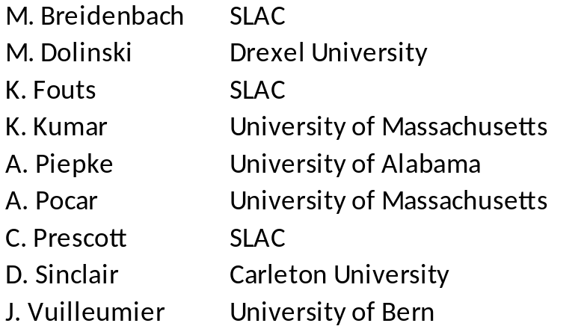
Collaboration Board
Chairperson: J. Farine, Laurentian University
Makes policy decisions and rules on issues that affect the collaboration as a whole, including new collaboration members, author list decisions, etc,
P. Barbeau
Duke University
Collaboration Council
Membership is by invitation from the spokesperson
Serves as an advisory council to the spokesperson.
M. Breidenbach
SLAC
M. Dolinski
Drexel University
B. Fairbank
Colorado State University
J. Farine
Laurentian University
P. Fierlinger
Munich Technical University
K. Fouts
SLAC (non voting)
G. Gratta
Stanford University
C. Hall
University of Maryland
L. Kaufman
Indiana University
D. Leonard
University of Seoul
M. Moe
University of California, Irvine
A. Piepke
University of Alabama
A. Pocar
University of Massachusetts
D. Sinclair
Carleton University
P. Vogel
Caltech
J. Vuilleumier
University of Bern
L. Wen
IHEP Beijing
L. Yang
University of Illinois
O. Zeldovich
ITEP Moscow
TRIUMF membership not yet finalized

Slide 6
The EXO is funded by the following agencies:
-DoE-HEP
-DoE-NP
-NSF
-Swiss National Science Foundation
-NSERC
-Russian Foundation for Basic Research
-Chinese Academy of Sciences
In the US nEXO R&D is mainly supported by DoE-HEP but with substantial contributions from the NSF and DoE-NP.
It is our understanding that when DoE will decide to fund nEXO as
a project this will occur under DOE-NP, while DOE-HEP will continue supporting the science teams under their programme.
It is also expected that agencies from the other collaborating Countries will contribute to the nEXO, although negotiations on this
have not started yet.

Slide 7
EXO: summary and plans
Since the beginning, in 1999, the EXO collaboration has been
planning a staged approach to 0νββ decay
“Stage 1”, i.e. EXO-200 is taking data, producing results and
leading the charge in the field
EXO-200 is also a (very successful) prototype for a larger,
“Stage 2” detector
“Stage 2”, nEXO, is being designed as a
5 tonne LXe detector
following closely the EXO-200 layout
Some R&D is required to address some scaling issues and non
optimal EXO-200 solutions

Slide 8
EXO: summary and plans, cont’d
R&D in progress to improve items that either do not scale well or
were imperfectly designed in EXO-200. Expect to have a
“CD1-quality” detector design by end of calendar 2015
EXO submitted a letter of interest to locate the nEXO detector
in the Cryopit at SNOlab
From the start of construction this is likely to be a
10-15 yrs program with unique physics potential:
  A conservative detector with wide reach using the
  well tested EXO-200 technology
  The unique possibility of swapping the enriched
  Xe to Nat’l Xe in the case a discovery is made
  A unique upgrade path to Ba tagging (of course,
  in this case, on a riskier path)

Slide 9
EXO: summary and plans, cont’d
R&D in progress to improve items that either do not scale well or
were imperfectly designed in EXO-200. Expect to have a
“CD1-quality” detector design by end of calendar 2015
EXO submitted a letter of interest to locate the nEXO detector
in the Cryopit at SNOlab
From the start of construction this is likely to be a
10-15 yrs program with unique physics potential
“How exciting it would be to discover violations of either of our two
surviving exact global conservation laws:
lepton number L and baryon number B!”
S.L.Glashow, arXiv:1305.5482 (2013)
…In addition 0νßß decay would discover the neutrino mass scale
and a new type of Fermion: the 2-component Majorana Fermion

Slide 10
The central role of 0νββ decay in particle and
nuclear physics was stated by many panels
and committees in the last decade:
“Major Nuclear Physics Facilities for the Next Decade”, Report of the NSAC
subcommittee, Mar 2013, arXiv:1212.5190;
"Report to NSAC on Implementing the 2007 Long Range Plan", Subcommittee, Jan 2013;
"Discovering the New Standard Model: Fundamental Symmetries and Neutrinos“,
White paper in preparation for Tribble Subcommittee by the NP community, Aug 2012;
“Fundamental Physics at the Intensity Frontier”, Report of the Workshop held
Dec 2011 in Rockville MD, arXiv:1205.2671;
“An Assessment of the Deep Underground Science and Engineering Laboratory”,
Ad Hoc Committee to Assess the Science Proposed for a Deep Underground
Science and Engineering Laboratory (DUSEL), US NRC (2011);
“The Frontiers of Nuclear Science, A Long Range Plan”, NSAC (2007);
“Revealing the Hidden Nature of Space and Time: Charting the Course for Elementary
Particle Physics”, Comm. on Elem. Part. Phys. in the 21st Century,US NRC (2006);
“NuSAG report” Sept 2005, http://www.er.doe.gov/hep/NuSAGReport1final.pdf
“The Neutrino Matrix”, Report from the APS multi-divisional neutrino study, Nov 2004;
“SAGENAP report” Dec 13, 2004, http://www.er.doe.gov/hep/SAGENAPFINAL.pdf;
“Connecting Quarks with the Cosmos: Eleven Science Questions for the New Century”
Report of the National Academy of Sciences, 2003.

Slide 11
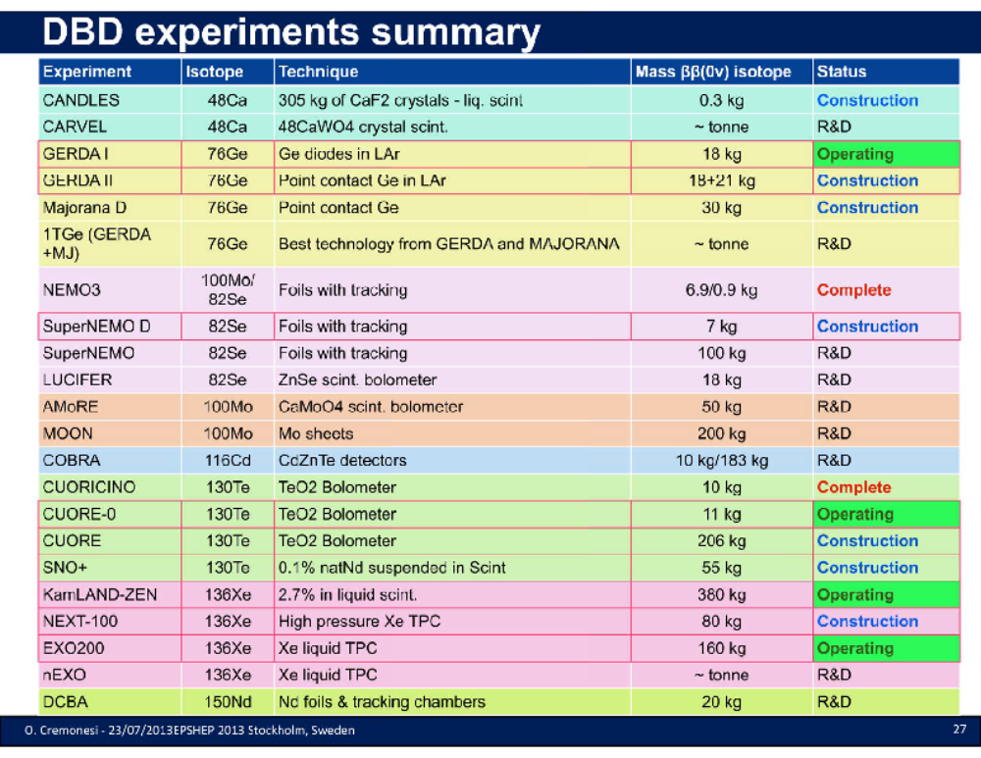
0.3% Nat Te
100kg

Slide 12
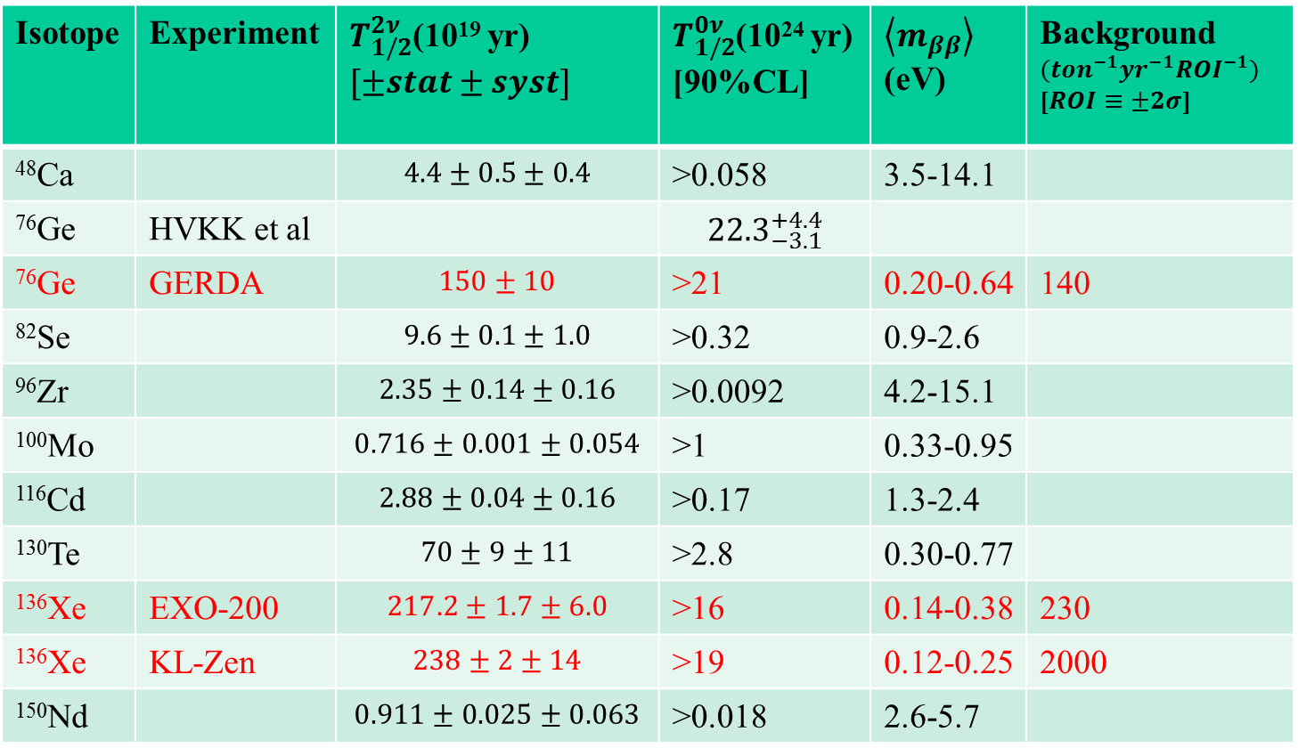
Status of ββ-decay measurements
Isotope | Experiment | $T_{1/2}^{2ν}$(10¹⁹ yr) $[±stat±syst]$ | $T_{1/2}^{0ν}$(10²⁴ yr) [90%CL] | $\left\langle m_{ββ}\right\rangle$ (eV) | Background $({ton}^{−1}{yr}^{−1}{ROI}^{−1})$ [$ROI≡±2σ$]
⁴⁸Ca |  | $$4.4±0.5±0.4$$ | >0.058 | 3.5-14.1
⁷⁶Ge | HVKK et al |  | $${22.3}_{−3.1}^{+4.4}$$
⁷⁶Ge | GERDA | $$150±10$$ | >21 | 0.20-0.64 | 140
⁸²Se |  | $$9.6±0.1±1.0$$ | >0.32 | 0.9-2.6
⁹⁶Zr |  | $$2.35±0.14±0.16$$ | >0.0092 | 4.2-15.1
¹⁰⁰Mo |  | $$0.716±0.001±0.054$$ | >1 | 0.33-0.95
¹¹⁶Cd |  | $$2.88±0.04±0.16$$ | >0.17 | 1.3-2.4
¹³⁰Te |  | $$70±9±11$$ | >2.8 | 0.30-0.77
¹³⁶Xe | EXO-200 | $$217.2±1.7±6.0$$ | >16 | 0.14-0.38 | 230
¹³⁶Xe | KL-Zen | $$238±2±14$$ | >19 | 0.12-0.25 | 2000
¹⁵⁰Nd |  | $$0.911±0.025±0.063$$ | >0.018 | 2.6-5.7
Red: action in the last ~year

Slide 13
The virtues of ¹³⁶Xe for ββ decay
No need to grow crystals
Can be re-purified during the experiment
No long lived Xe isotopes to activate
Can be easily transferred from one detector to another
if new technologies become available ➔ GXe R&D
Noble gas: easy(er) to purify
¹³⁶Xe enrichment easier and safer:
- noble gas (no chemistry involved)
- centrifuge feed rate in gram/s, all mass useful
- centrifuge efficiency ~ Δm. For Xe 4.7 amu
Only known case where final state identification
appears to be not impossible
→ eliminate all non-ββ backgrounds, possibly only
chance of getting to Normal Hierarchy
EXO-200 has demonstrated the power of a LARGE
and HOMOGENEOUS detector
¹³⁶Xe can be replaced with ^{Nat’l}Xe if a signal is observed!

Slide 14
The virtues of ¹³⁶Xe for ββ decay
No need to grow crystals
Can be re-purified during the experiment
No long lived Xe isotopes to activate
Can be easily transferred from one detector to another
if new technologies become available ➔ GXe R&D
Noble gas: easy(er) to purify
¹³⁶Xe enrichment easier and safer:
- noble gas (no chemistry involved)
- centrifuge feed rate in gram/s, all mass useful
- centrifuge efficiency ~ Δm. For Xe 4.7 amu
Only known case where final state identification
appears to be not impossible
→ eliminate all non-ββ backgrounds, possibly only
chance of getting to Normal Hierarchy
EXO-200 has demonstrated the power of a LARGE
and HOMOGENEOUS detector
¹³⁶Xe can be replaced with ^{Nat’l}Xe if a signal is observed!

Slide 15
5 tonnes of LXe,
enriched to 90%* in isotope 136
¹³⁶Xe enrichment easier and safer:
➔ 90% enriched ¹³⁶Xe: ~10$/g
90% enriched ⁷⁶Ge: ~90$/g (+xtal growth)
➔ Very top-down nEXO cost estimate: ~150M$
* EXO-200 uses 80% enriched Xe. It now seems customary
to do 90% and it appears that there is no major cost difference

Slide 16
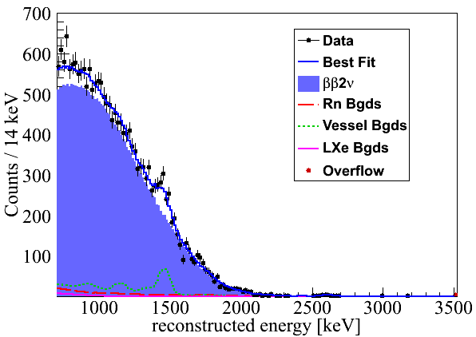
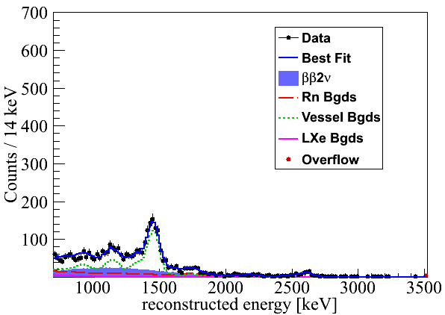
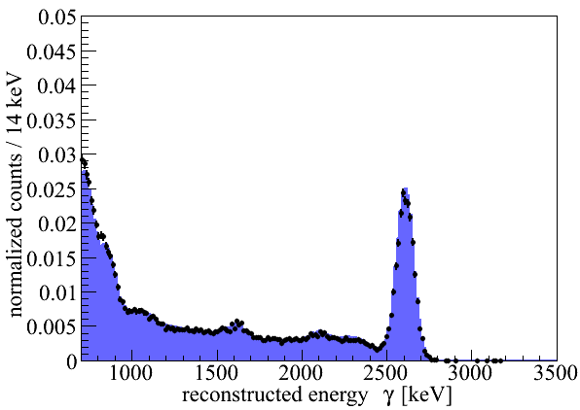
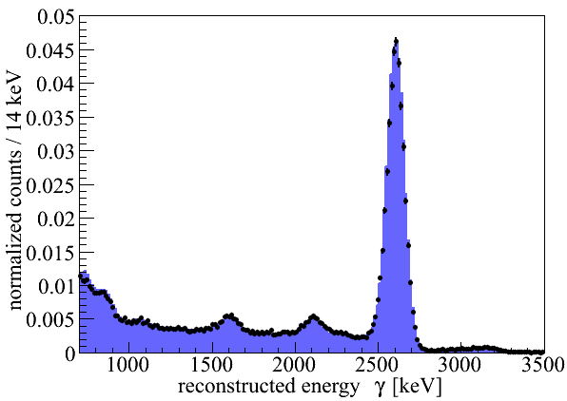
Xe is ideal for a large experiment
EXO-200 has proven that an homogeneous TPC is ideal to suppress
main backgrounds that for ßß decay is due to ~MeV γ-rays
single cluster
multiple cluster
Low background
data
2νββ
γ
γ
²²⁸Th calibration
source

Slide 17
Xe is ideal for a large experiment
EXO-200 has proven that an homogeneous TPC is ideal to suppress
main backgrounds that for ßß decay is due to ~MeV γ-rays
single cluster
multiple cluster
Low background
data
2νββ
This advantage gets better the larger the detector!
γ
γ
²²⁸Th calibration
source

Slide 18
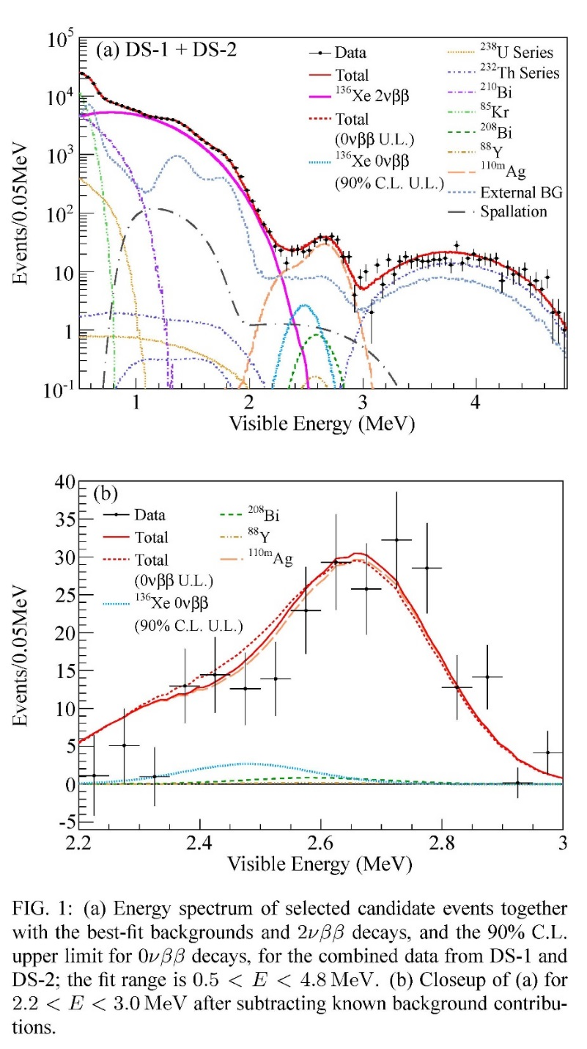
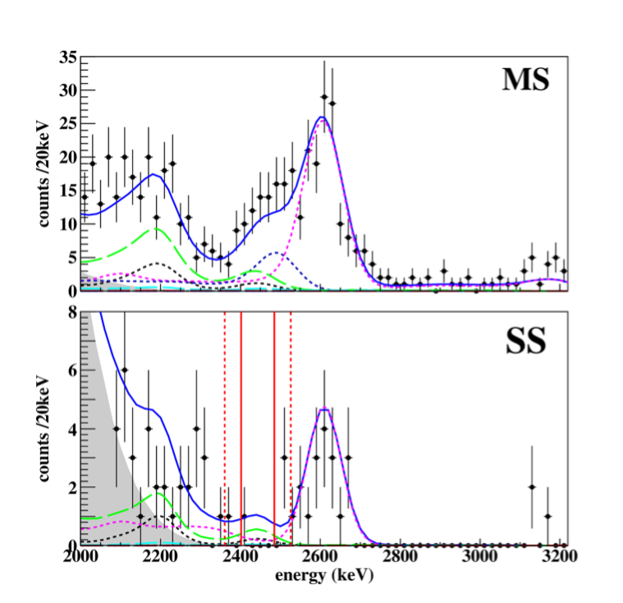
Comparison between
EXO-200 (PRL 109 (2012) 032505)
KamLAND-ZEN (PRL 110 (2013) 062502)
ROI
KamLAND-ZEN
2000 cts tonne⁻¹yr⁻¹ROI⁻¹
EXO-200
230 cts tonne⁻¹yr⁻¹ROI⁻¹

Slide 19
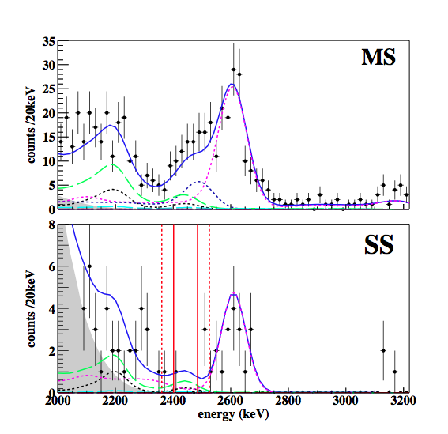
Comparison between
EXO-200 (PRL 109, 032505 (2012)
KamLAND-ZEN (PRL 110 (2013) 062502)
Background
is constrained
from data!
ROI
KamLAND-ZEN
2000 cts tonne⁻¹yr⁻¹ROI⁻¹
EXO-200
230 cts tonne⁻¹yr⁻¹ROI⁻¹

Slide 20
Comparison between
EXO-200 (PRL 109, 032505 (2012)
KamLAND-ZEN (PRL 110 (2013) 062502)
Background
estimate relies on
perfect spectral
knowledge over
many orders of
magnitude
Background
is constrained
from data!
ROI
KamLAND-ZEN
2000 cts tonne⁻¹yr⁻¹ROI⁻¹
EXO-200
230 cts tonne⁻¹yr⁻¹ROI⁻¹

Slide 21
ROI
EXO-200
230 cts tonne⁻¹yr⁻¹ROI⁻¹
My conclusion:
LiqScint detectors are appealing as they can “easily” handle large masses
But unless the backgrounds can be drastically reduced they are not discovery tools
Also: the cts tonne⁻¹yr⁻¹ ROI⁻¹ is not
entirely fair for EXO because there is
discriminating power in the SS/MS and the event location.
KamLAND-ZEN
2000 cts tonne⁻¹yr⁻¹ROI⁻¹

Slide 22
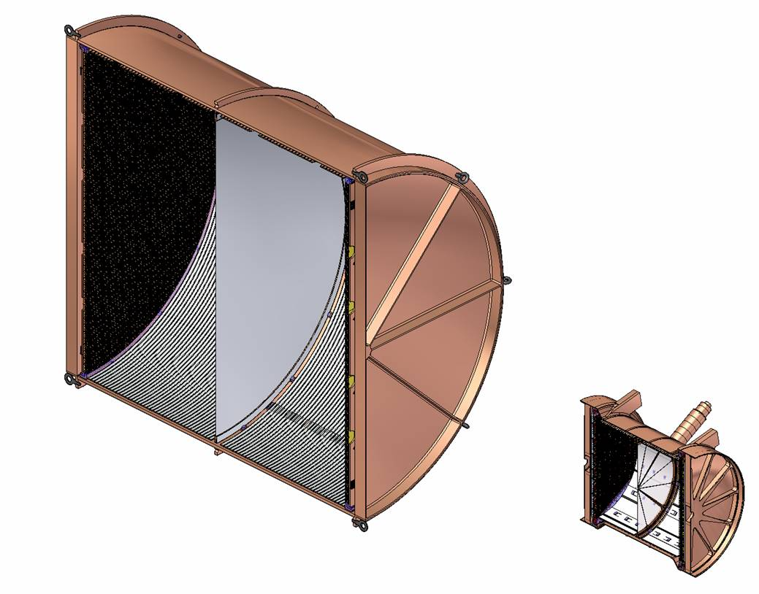
nEXO
5 tonne: entirely cover inverted hierarchy
LXe TPC “as similar to EXO-200 as possible”
Provide access ports for a possible later
upgrade to Ba tagging
➔ A unique combination of
conservative and aggressive
design with important
upgrade paths as desirable
for a large experiment
~150cm
~40cm

Slide 23
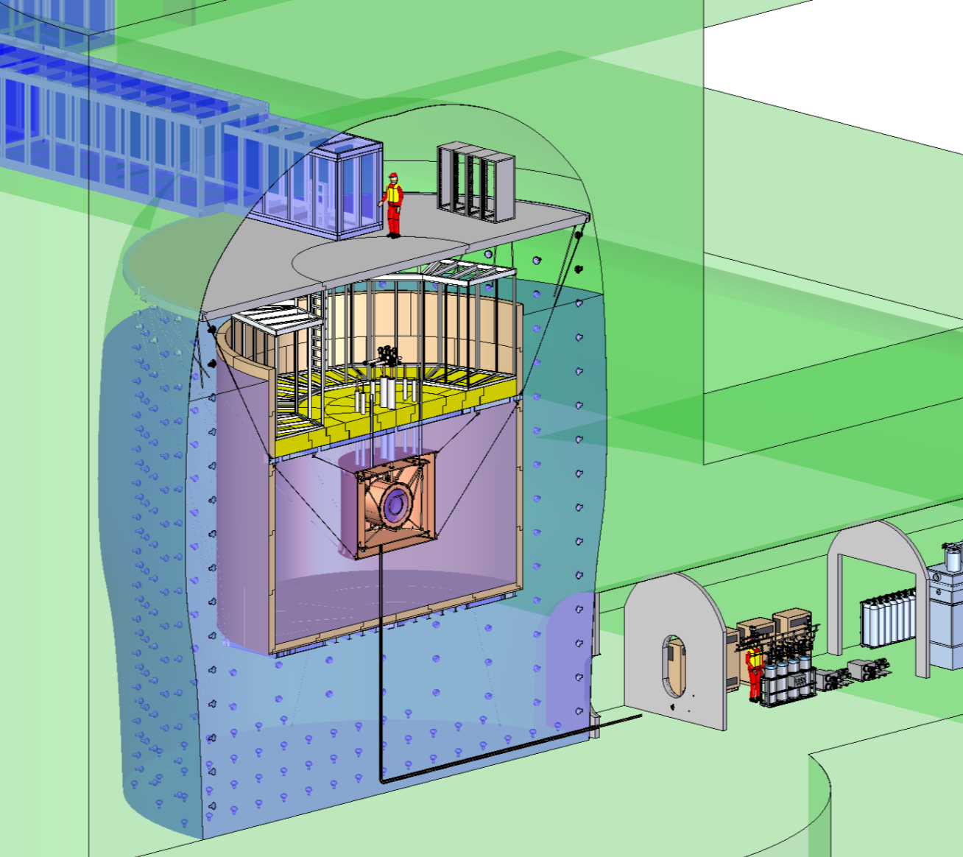
Sketch of nEXO in the SNOlab Cryopit

Slide 24
On-going nEXO R&D program involves many institutions (red items discussed in more detail)
Site-specific engineering (SNOlab)
Detector Conceptual engineering (SLAC)
Electrostatics and fluid mech sim. (Bern)
High Voltage Stability (SLAC)
Charge readout simulation (Umass)
Control system and thermodynamic simulation (Drexel)
Counter-flow heat exchanger (U Illinois UC)
Cosmogenic/neutron background studies (Indiana)
Simulation coordination (Carleton)
Electronics test in LXe (U Illinois UC)

Slide 25
100kg LXe test setup (Bern)
Photodetector (TRIUMF, Stanford, Umass)
Xe recirculation pump (IHEP Beijing/Stanford)
Cryogenic engineering
Cold electronics and charge readout (SLAC/Stanford)
Study of calibration techniques (Laurentian)
LXe (chemical) purity diagnostics (Drexel)
Radon trap (Laurentian)
Veto counter electronics (IHEP Beijing)
Ba tagging (Carleton, CSU, Stanford, TRIUMF)
Project Management (SLAC)

Slide 26
In addition we have re-started the very
successful material characterization program
Radioactivity screening coord. (Alabama): Was one of the
reasons of EXO-200 success and needs to be maintained
Neutron activation analysis (Alabama): Most sensitive technique;
only requires small samples; some materials can’t be processed
Direct counting (Bern, Alabama): Not particularly sensitive; only
non-destructive technique, needs large samples, never impossible
ICPMS (Seoul): May replace or complement NAA in some cases;
was key for screening (NRC Ottawa) for EXO-200
Rn emanation counting (Laurentian): Several high sensitivity
dedicated counters. Connection with SNOlab.
➔ From EXO-200 experience expect to have to test
hundreds of samples.

Slide 27
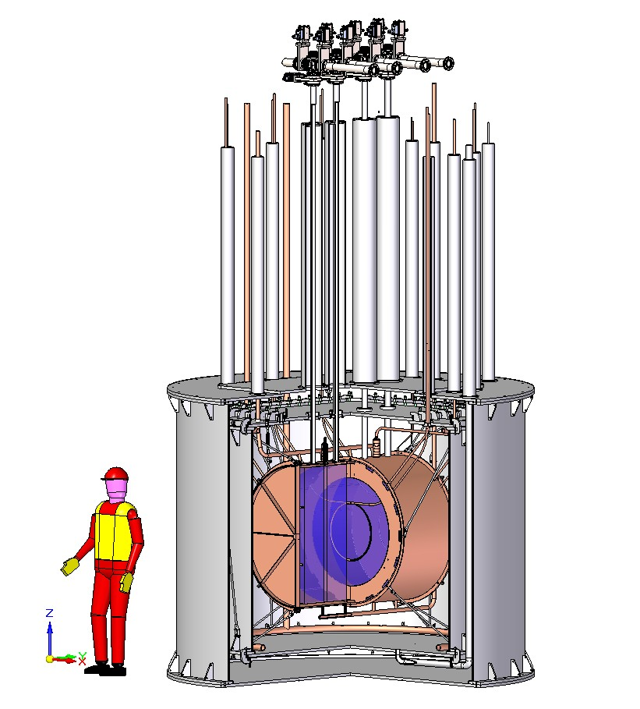
Cryostat with Ba tagging ports
Tagging Load-Locks
There is lots of experience
(not all positive!) on LXe
cryogenics that is already
being used to conceptually
design nEXO’s subsystems
This has to happen
together with the
simulation effort
(and, indeed, the cryostat
here is probably too small
-see later-)
Ba Tagging Access tubes

Slide 28
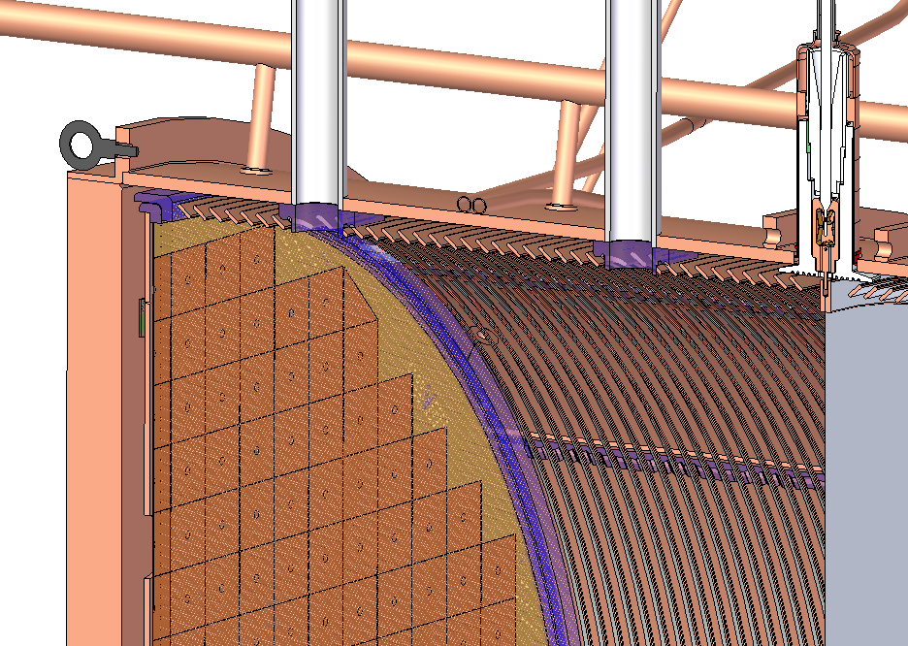
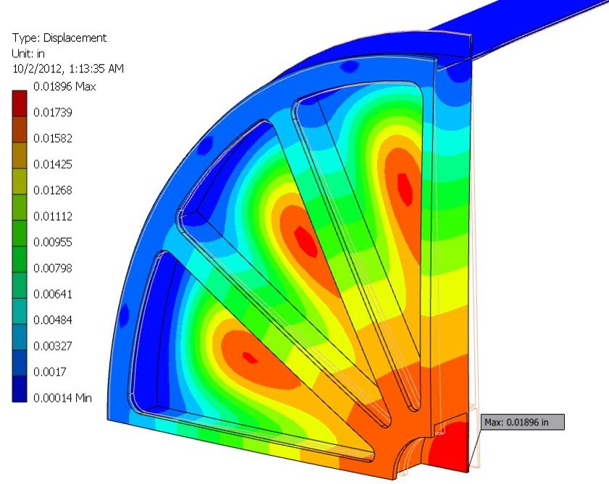
TPC
HV
feedthrough
Cathode
Field shaping rings
Wire planes SiPM’s
Initial TPC endplate FEA
28

Slide 29
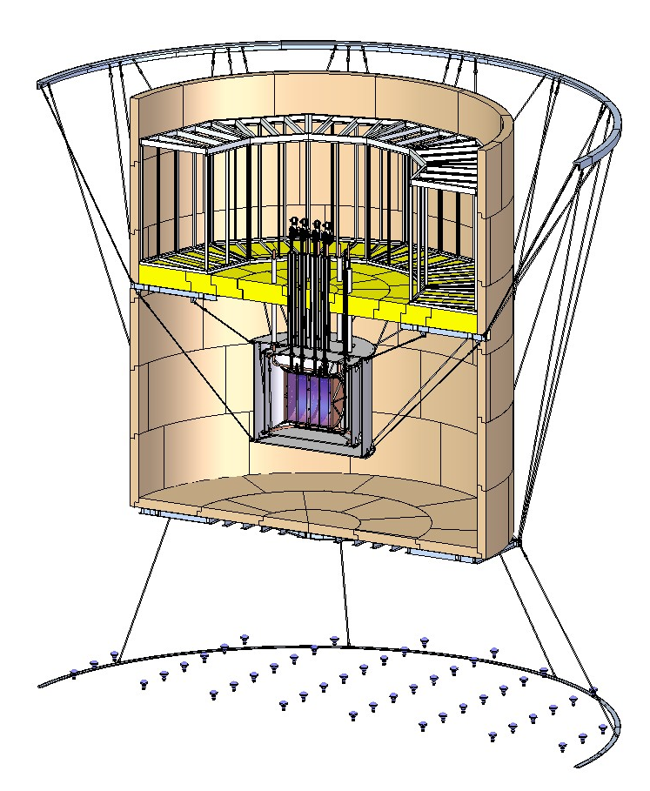
Cable Support Scheme; Ba tagging area
Present ideas include a secondary water tank that can be pumped dry for ease of access and a thin Pb shielding on top to reduce the length of penetrations for the Ba tagging system.
This assembly hangs from cables.
Other schemes are under consideration

Slide 30
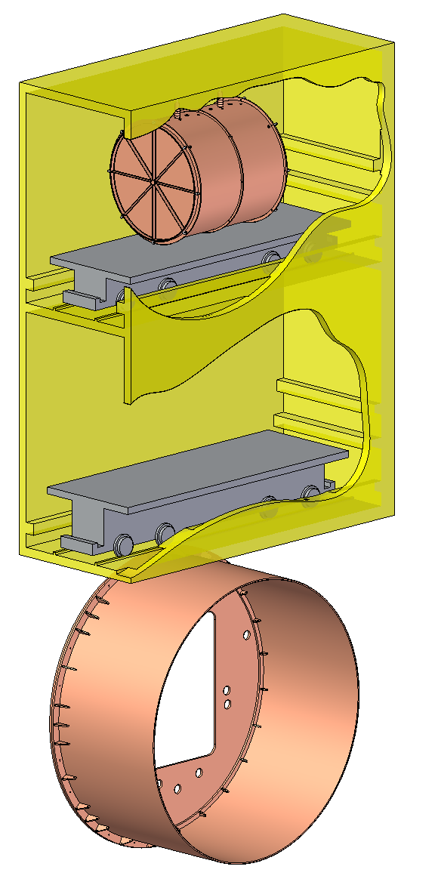
More site-specific work just started and will need SNOlab engineering help
The TPC fits in the cage
½ Cryostat fits under the cage (but this cryostat is too small)
The TPC may need to be
fabricated UG: probably need clean shop with
ebeam welder near Cryopit
➔ Looking into alternatives to a large cryostat

Slide 31
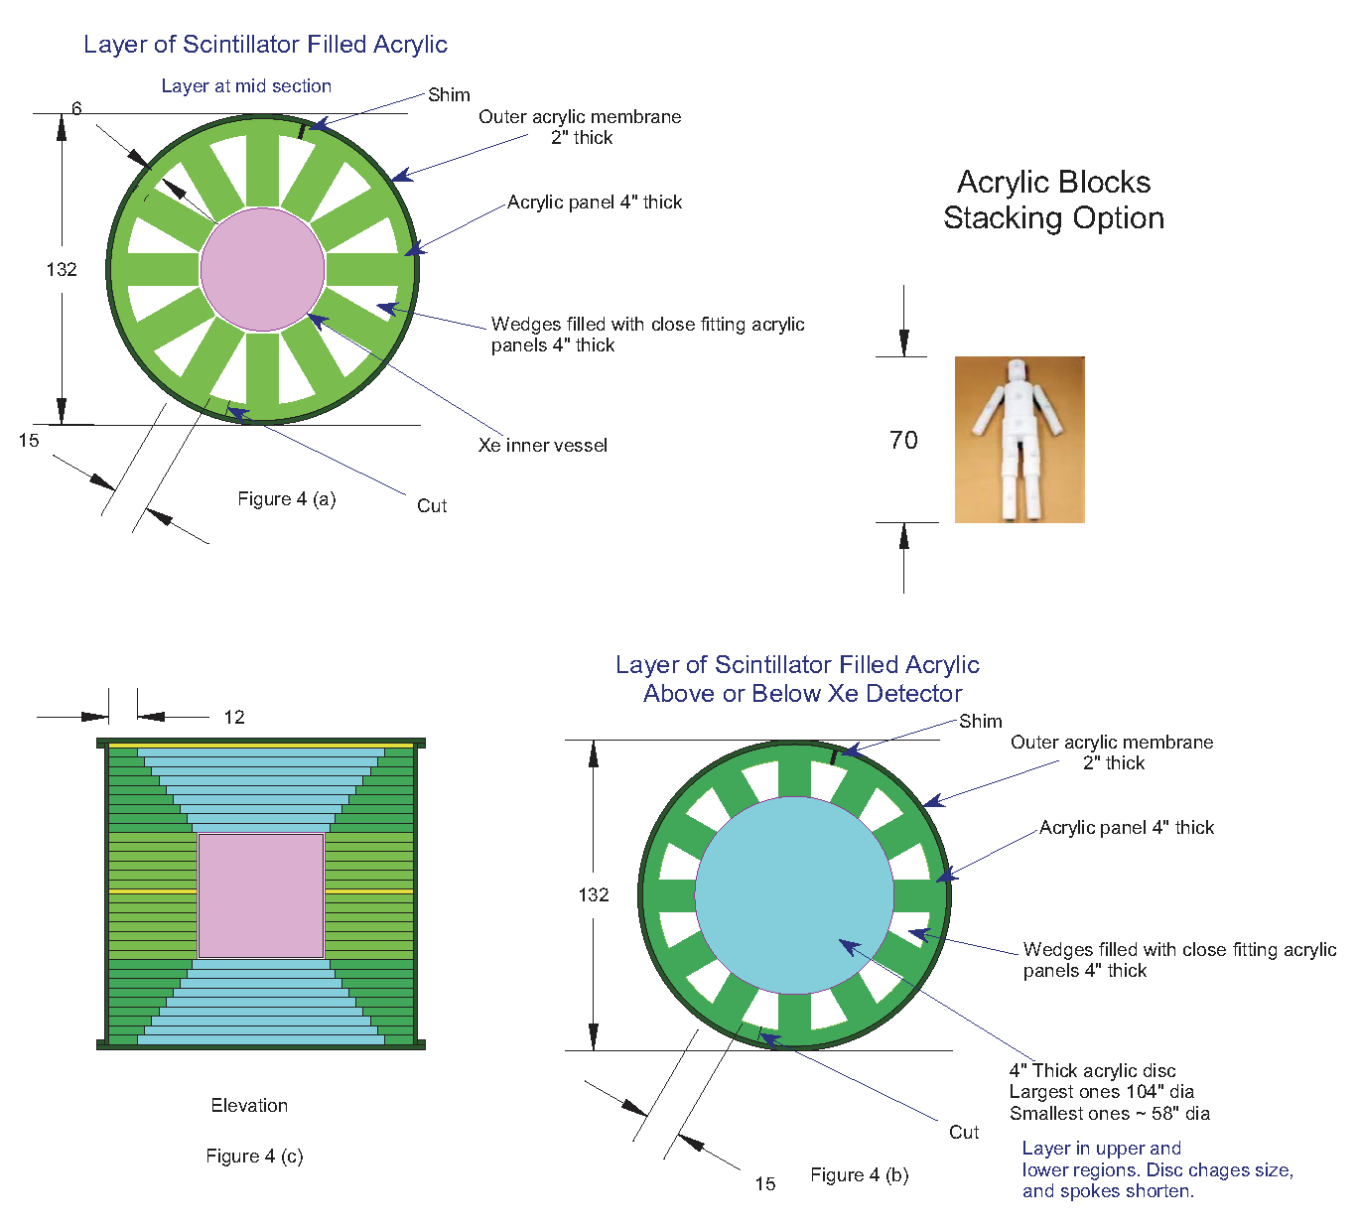
Interesting alternative:
“conductive” insulation and shielding using acrylic blocks
Heat load is 400W, nothing
crazy. But many of us like
the Xe to be in good thermal
contact with the HFE7000
fluid (safety and removal of
electronics heat)
Maybe the winner is a hybrid
with inner HFE and acrylic
insulation, both in an acrylic
vessel at room temperature

Slide 32
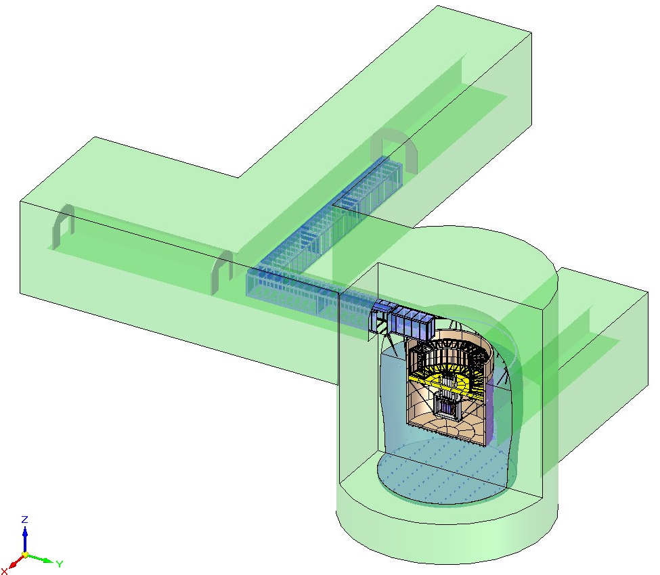
Infrastructure footprint
nEXO will require
infrastructure space also outside
of the Cryopit

Slide 33
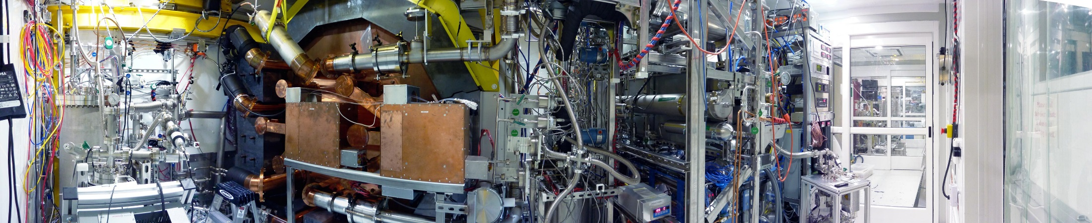
Infrastructure footprint
nEXO will require
infrastructure space also outside
of the Cryopit
…this was fun, once…

Slide 34
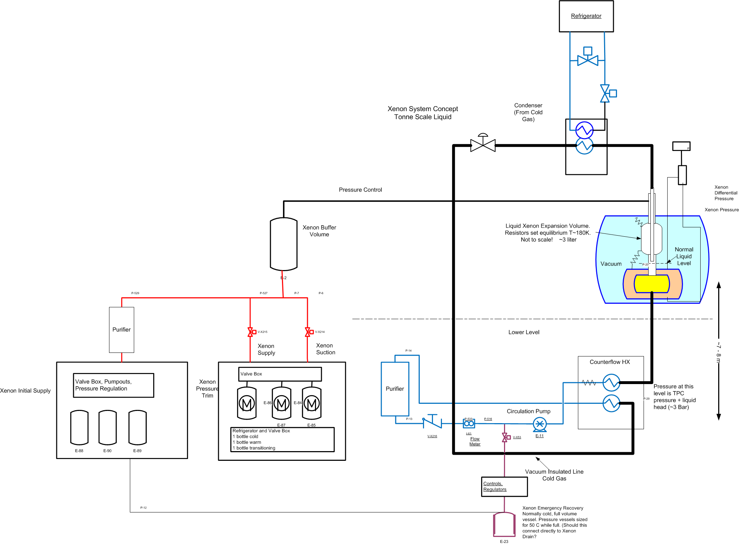
Xenon circulation and purification concept

Slide 35
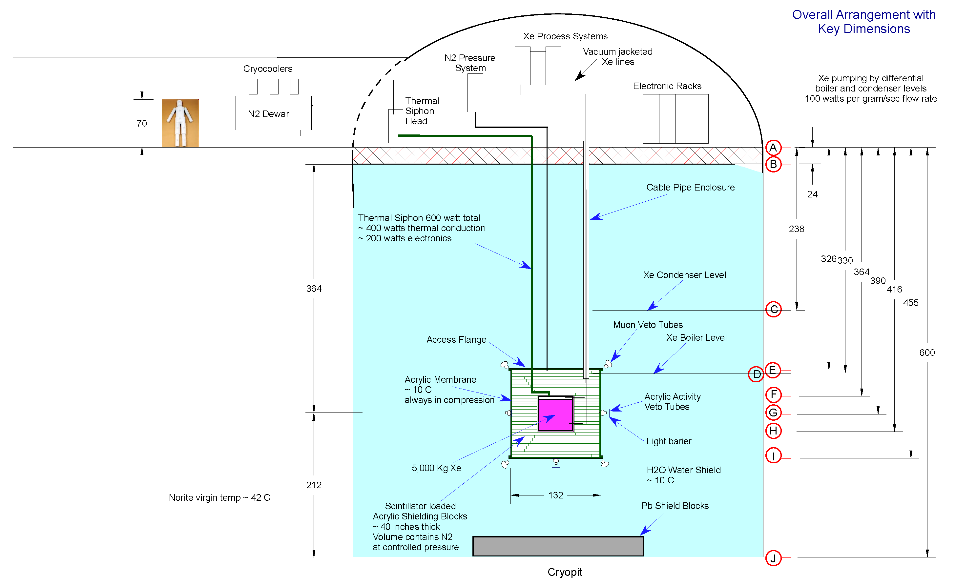
Different concept with acrylic insulation and Xe on top
Dimensions in Canadian Inches

Slide 36
Different concept with acrylic insulation and Xe on top
Maybe want to
locate the Xe process all at the same level.
This may work well if we find that we do not need the entire shield thickness
Dimensions in Canadian Inches

Slide 37
Facility requirements
(quantitative figures available)
Power and cooling
Networking
Some uninterruptable power to support cryogenics
operations, controls and communications
LN2 (need both but design can trade
capacity of one for the other.
We need help to understand and freeze this)
UG machine shop,
some e-beam welding desirable to essential
Shielding water
Chemical etch of surfaces

Slide 38
HV R&D
EXO-200 has had HV problem since the first
engineering run in 2010.
- First fill could hold 15kV and run at 10kV
- Second (science) fill could hold 12kV and have been
running at 8kV since.
This does not appreciably affect the physics performance
but is a concern for nEXO where substantially higher
voltage is required for the same field.
The problem appears as noise on the HV feed,
accompanied by light and charge collected
in the detector.

Slide 39
Goal: reproduce/understand/resolve
the EXO200 HV issues
Phase I : Test fundamental LXe HV issues, small parts
Small (~400cc) LXe HV testing apparatus
Tests have been underway since early April 2013
Phase II : Test full scale parts, long-term effects
Medium sized setup (~5 liter) setup
Stanford cold electronics test stand could be used.
Phase III : Test prototype solutions
Large scale tests maybe required to validate
final design

Slide 40
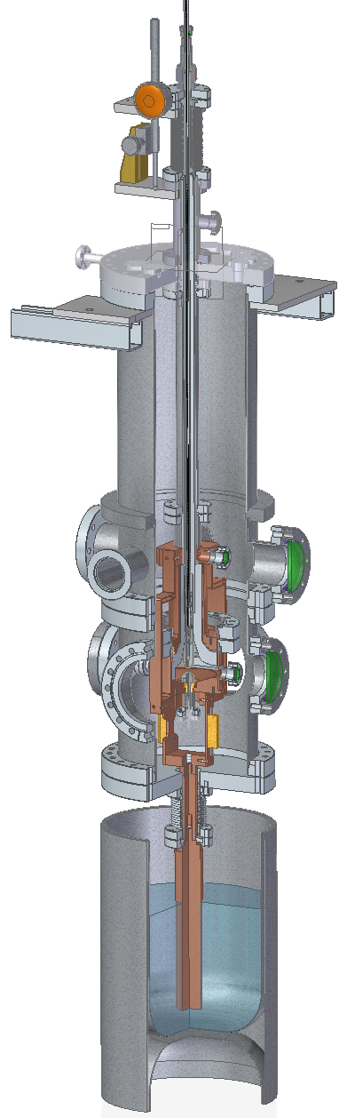
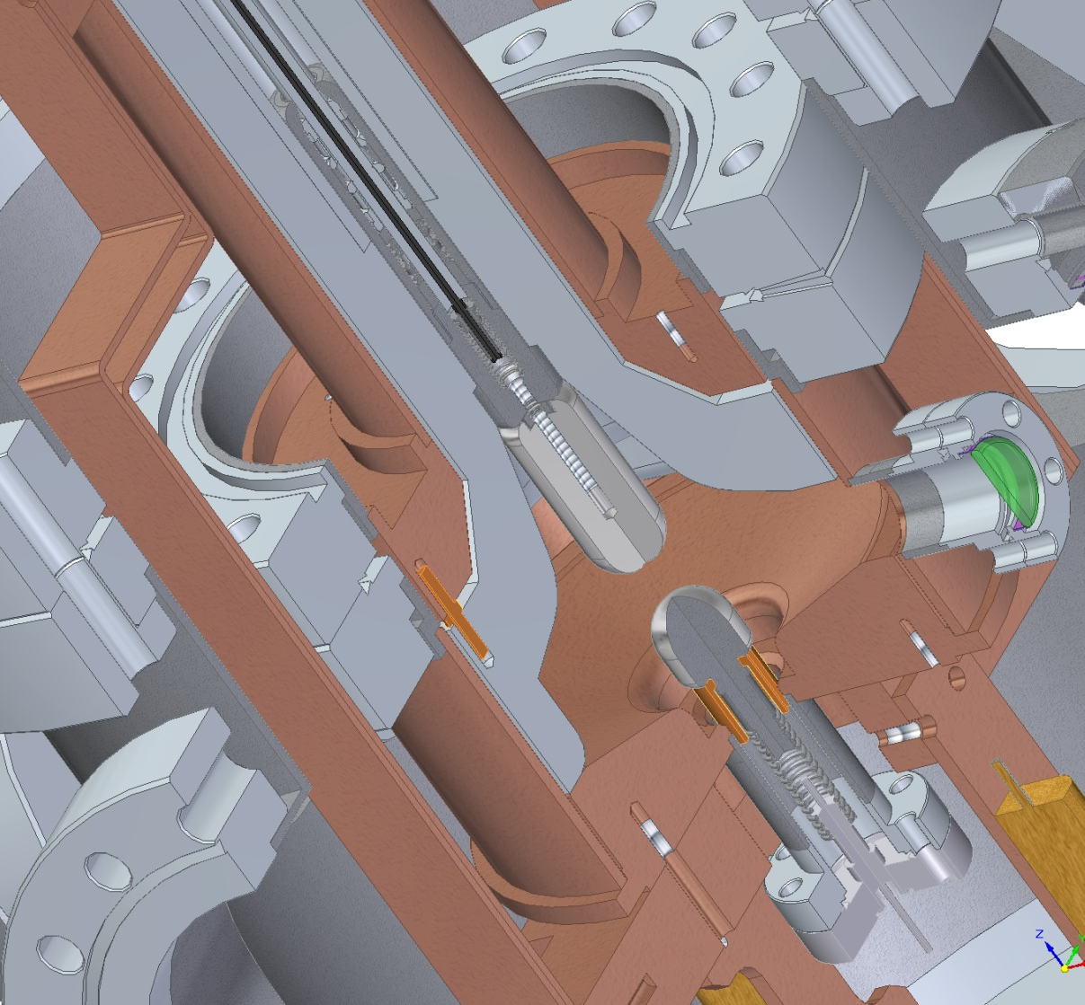
Phase 1 HV test cell

Slide 41
Undesirable features of LAAPDs
Single vendor for bare LAAPDs (Advanced Photonix)
Low gain (G~200, the electronics noise in the LAAPD
channel presently dominated E res in EXO-200)
Complex 2-wafer sandwich devices (expensive
and relatively heavy –more activity)
Poor packing fraction (circular and have substantial
non-active ring)
1500V bias
Large (dG/G)/dT ~ 5%/K
Large (dG/G)/(dV/V) ~ 15
In addition the collection area is
EXO-200: 0.1m² nEXO: 2-5m²

Slide 42
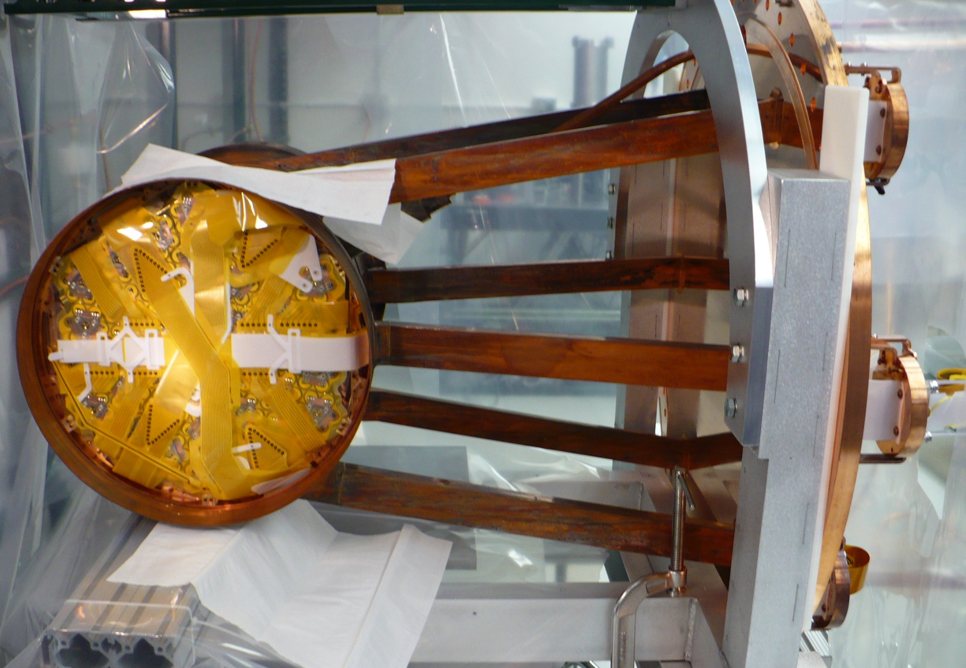
EXO-200 TPC Assembled
1500V bias distributed from here
In LXe electronics would
sit here and take less
space than the cables
Notes:
07/01/09
42
42

Slide 43
SiPMs are better in a number of ways
Widely used (but see later)
Large gain (10⁵-10⁶)
Plain single wafer devices (cheaper and for the same
quality materials get lower activity)
Square (or any shape), better packing fraction
30V bias
Lower (dG/G)/dT ~ 0.6%/K
Lower (dG/G)/(dV/V) ~ 0.3
But SiPMs are not perfect either
In most cases not sensitive to VUV
Small (large devices have problems of yield)

Slide 44
Large number of suppliers. Working with three of them:
FBK (Italy)
  Semiprivate research institute related to INFN
  Large productions of Si devices for LHC and AMS
  Very flexible
  Claim to have process to obtain high QE@175nm
  We have ordered a test run of 175nm devices that should
  also address the issue of device size and yield
Hamamatsu (Japan)
  Have VUV sensitive device
  Initially unwilling to sell bare devices
  However in new discussions this may be negotiable
  Will soon get samples (both electrical and for NAA)
Fraunhofer Institute (Germany)
  Just received devices to test for radioactivity

Slide 45
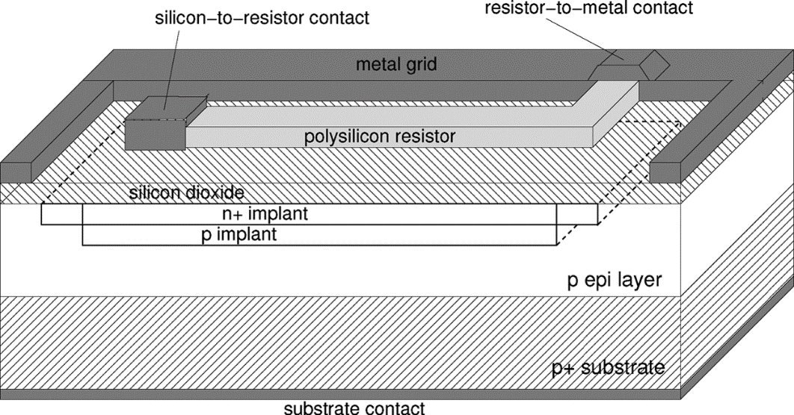
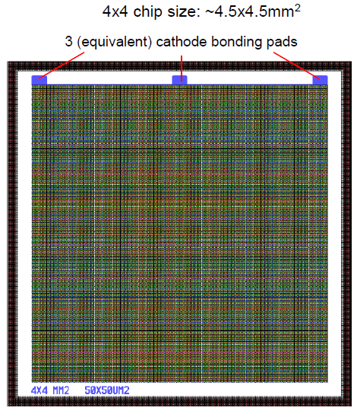
FBK devices
Several “standard” devices in hand:
Substrate: ~4 µm epi layer
Junction is created by Arsenic implantation (100 nm from top silicon surface)
Breakdown voltage fixed by further Boron implantation
50 or 100 µm cells, up to 4x4mm² pixel size
Gain is given by ~capacitance of a cell and the bias voltage: ~7x10⁵

Slide 46
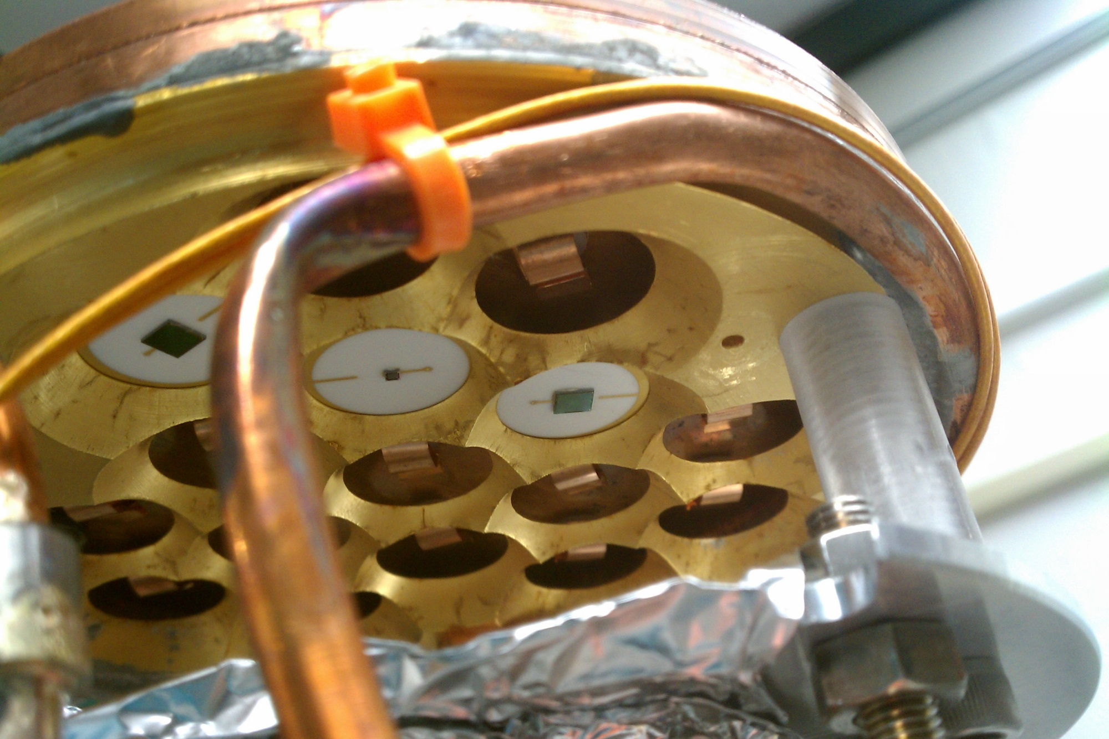
SiPMs mounted on a ceramic “LAAPD interface”
into the cryogenic LAAPD tester at Stanford

Slide 47
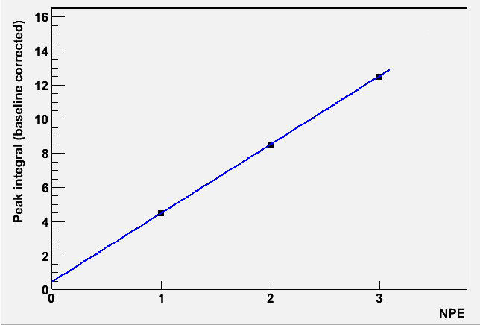
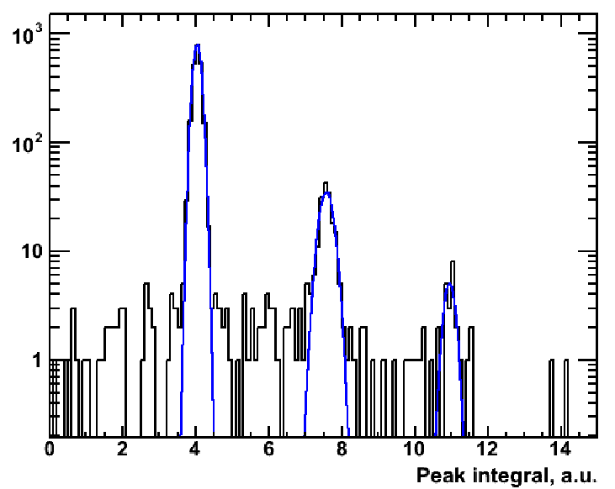
Can easily resolve individual photoelectrons
(LAAPDs can’t do this)
Off the shelf devices: few % QE@ 175nm

Slide 48
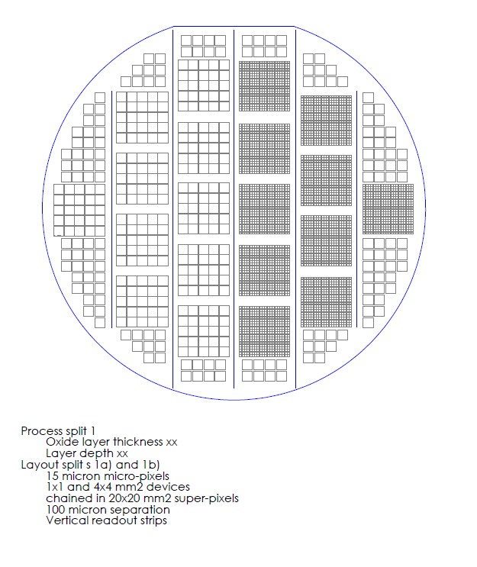
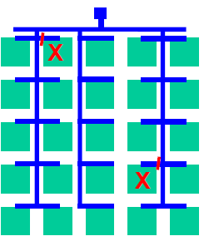
1st FBK test run in progress
4x4mm² devices
chained in 20x20mm²
Super-pixels
1x1mm² devices
chained in 20x20mm²
Super-pixels
2cm
Single 4x4mm²
devices
100µm separation
for a thin cut
6’’ diameter wafer
Trick to produce large area
devices getting around the
issues of yield

Slide 49
Charge readout in nEXO will have 3mm readout pitch
(is 9mm in EXO-200) to optimally take advantage
of Compton multiplicity tagging
Prefer to have the two grids at the same potential.
Developing two techniques:
- Weaved grid
- Supported strips
(probably on quartz)
15kg LXe test cell under
construction for this purpose

Slide 50
Cold electronics
(some old problems, some new problems…)
- Charge readout channels >10³
- Light readout channels ~10⁴ (~10³ digitizer channels)
Eliminate (most of) the cables
  Reliability, ease of clean assembly
Lower intrinsic noise
➔ Eliminate cable capacitance
Lower microphonic noise
➔ In EXO-200 some microphonic noise is produced by
vibrating cables with HV (not a major problem)
Lower radioactivity
➔ Suspect that EXO-200 flat cables are a substantial
contributor to the (low) background

Slide 51
Noise budget for electronics at different locations
(here assuming EXO-200-style wires)
Location | Cable length (m) | Total cap (pF) | Intrinsic Noise (e) | Charge collect. Threshold (keV) | Induction Threshold (keV)
In lab (warm) | 8 | 600 | 1500 | 225 | 750
At cryostat (warm/cold) | 2 | 150 | 500 | 75 | 250
Inside TPC (cold) | ~0 | 40 | 200 | 38 | 125
EXO-200

Slide 52
Electronics system block diagram
At cryostat, warm/cold
On deck, accessible
warm
In LXe, Cold
128
Wires
32-channel Front-End ASIC
32-channel Front-End ASIC
electrical to optical conversion
ATCA SLAC RCE DAQ
Buffer
ASIC
32-channel Front-End ASIC
32-channel Front-End ASIC
Digital serial transmission (500 Mbps),
trigger primitives, trigger request, timing, data
ATCA: Advanced Telecommunication
Computing Architecture
SLAC RCE: Reconfigurable
Cluster Element
128-channel Si/SiO₂ MCM
Components in LXe
  Front-End (FE) ASIC (for 32 channels, mixed-signal)
  Buffer ASIC (for 128 channels, digital)
  Si/SiO₂ MCM (128-channel Multi-Chip Module, holds 4 FE ASICs and 1 Buffer ASIC)
  Ultra-low background
Electrical-to-optical conversion at cryostat
  Ground isolation (no ground-loops, digital DAQ isolation), longer distance comm.
SLAC ATCA RCE DAQ system
  Used or to be used for LCLS, HPS, LSST, LHC ATLAS CSC, LBNE, Darkside, etc
  See backup slides for more details

Slide 53
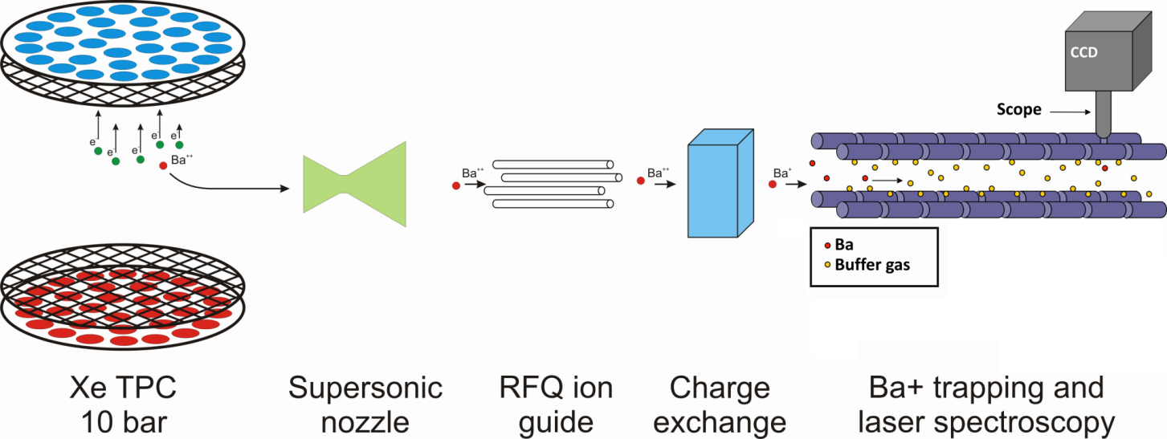
Tagging from Gas Xenon (actually not nEXO)
Extract Ba⁺⁺ from TPC by shaping E-field
Guide into vacuum
Convert Ba⁺⁺ to Ba⁺ [J.Phys. Conf. Ser. 309(2011)12005]
      Identify via laser spectroscopy [Phys.Rev.A 76, 023404 (2007)]

Slide 54
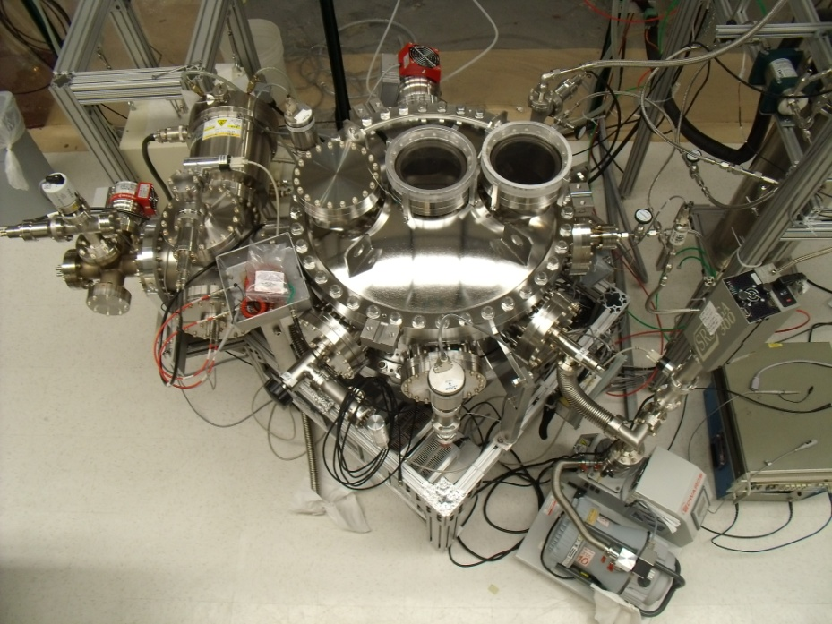
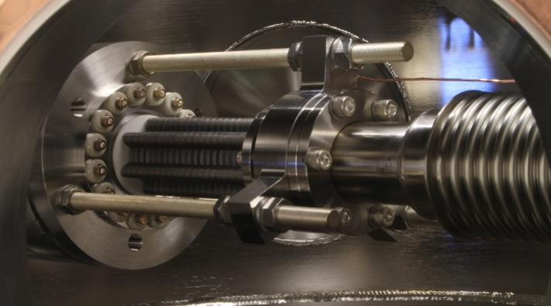
Ion detector
10bar GXe chamber + Ba source
Current work has
demonstrated
extraction/transport
of Ba ions from
10 bar Xe
to 10⁻⁸ torr vacuum
Ion guide
Large capacity cryopump
Very excited to start
working with the new
TRIUMF colleagues on this challenging project!
RF Funnel

Slide 55
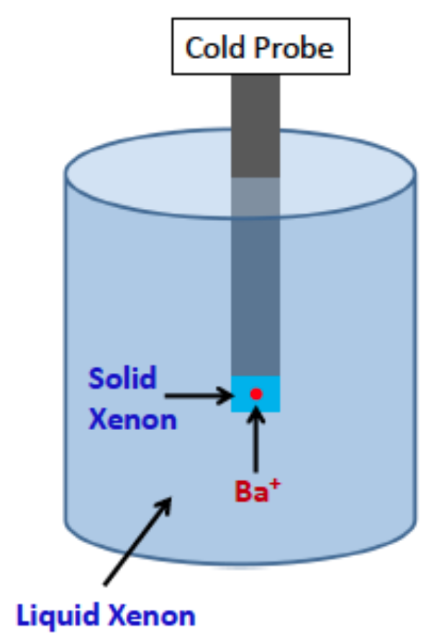
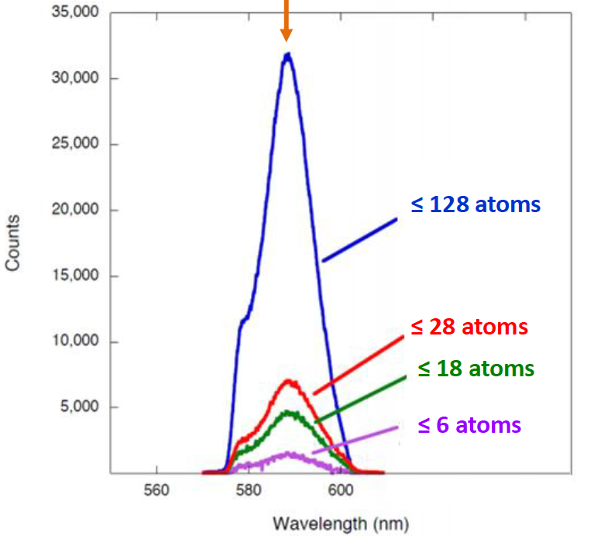
Direct Ba Tagging in LXe
Trap barium daughter ion in SXe on a cooled probe
Detect single ion or atom on the probe with laser-induced fluorescence
laser
CCD
Fluorescence peak of Ba in SXe
after excitation w/ 558 nm laser

Slide 56
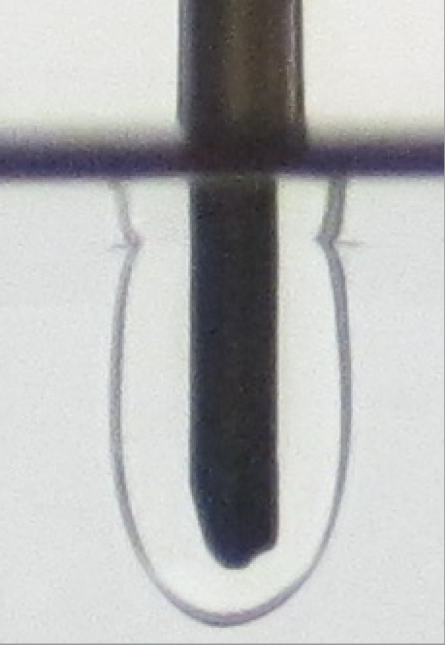
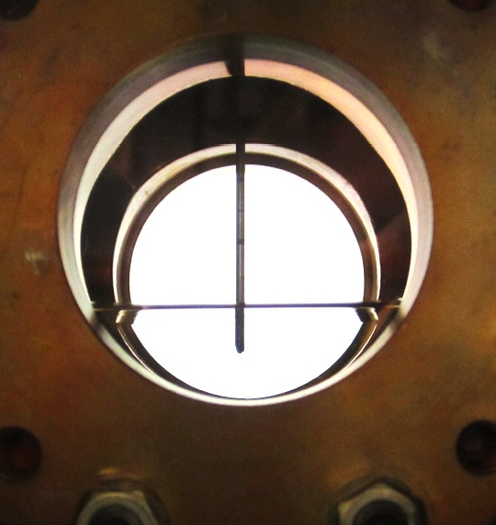
First generation cryoprobe in LXe
Copper cell
LXe
LXe
Solid Xe
(transparent!)

Slide 57
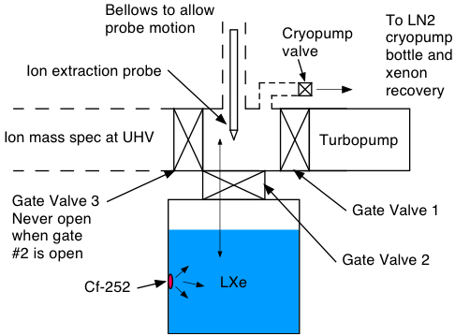
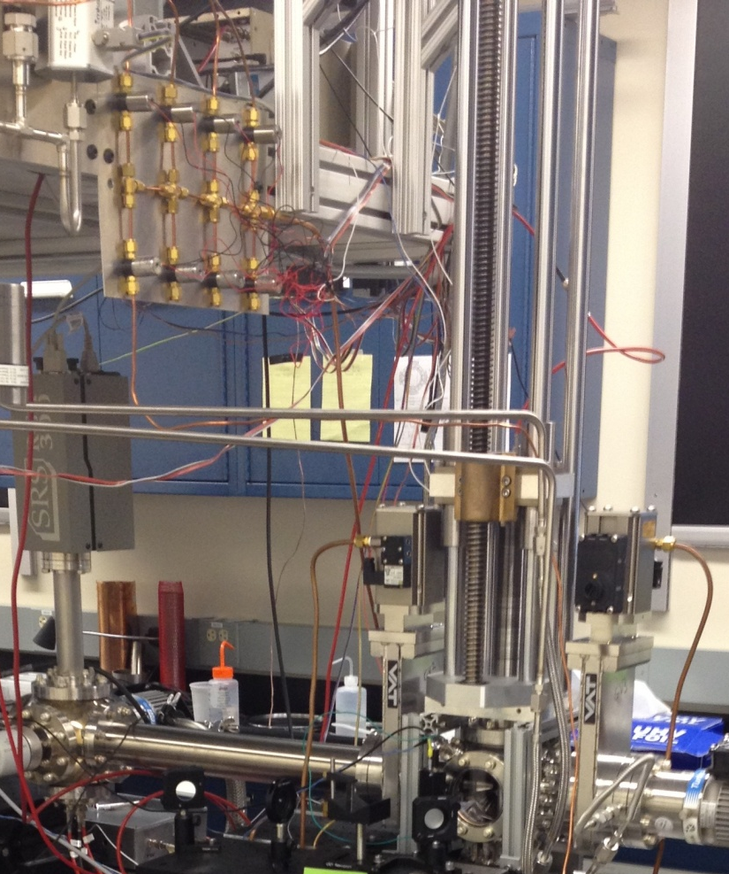



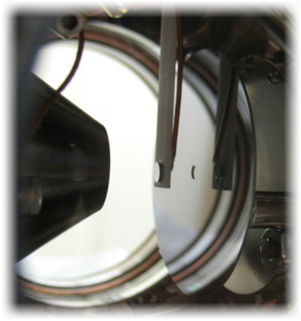
Ba removal from LXe
and tagging in vacuum
        1064 nm
        553.5 nm
        389.7 nm
        Ba⁺
        To Time of Flight
        Spectrometer

Slide 58
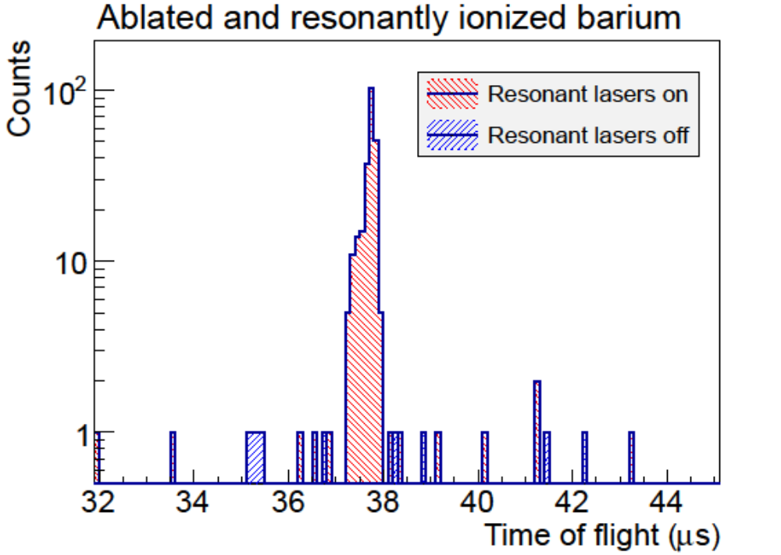
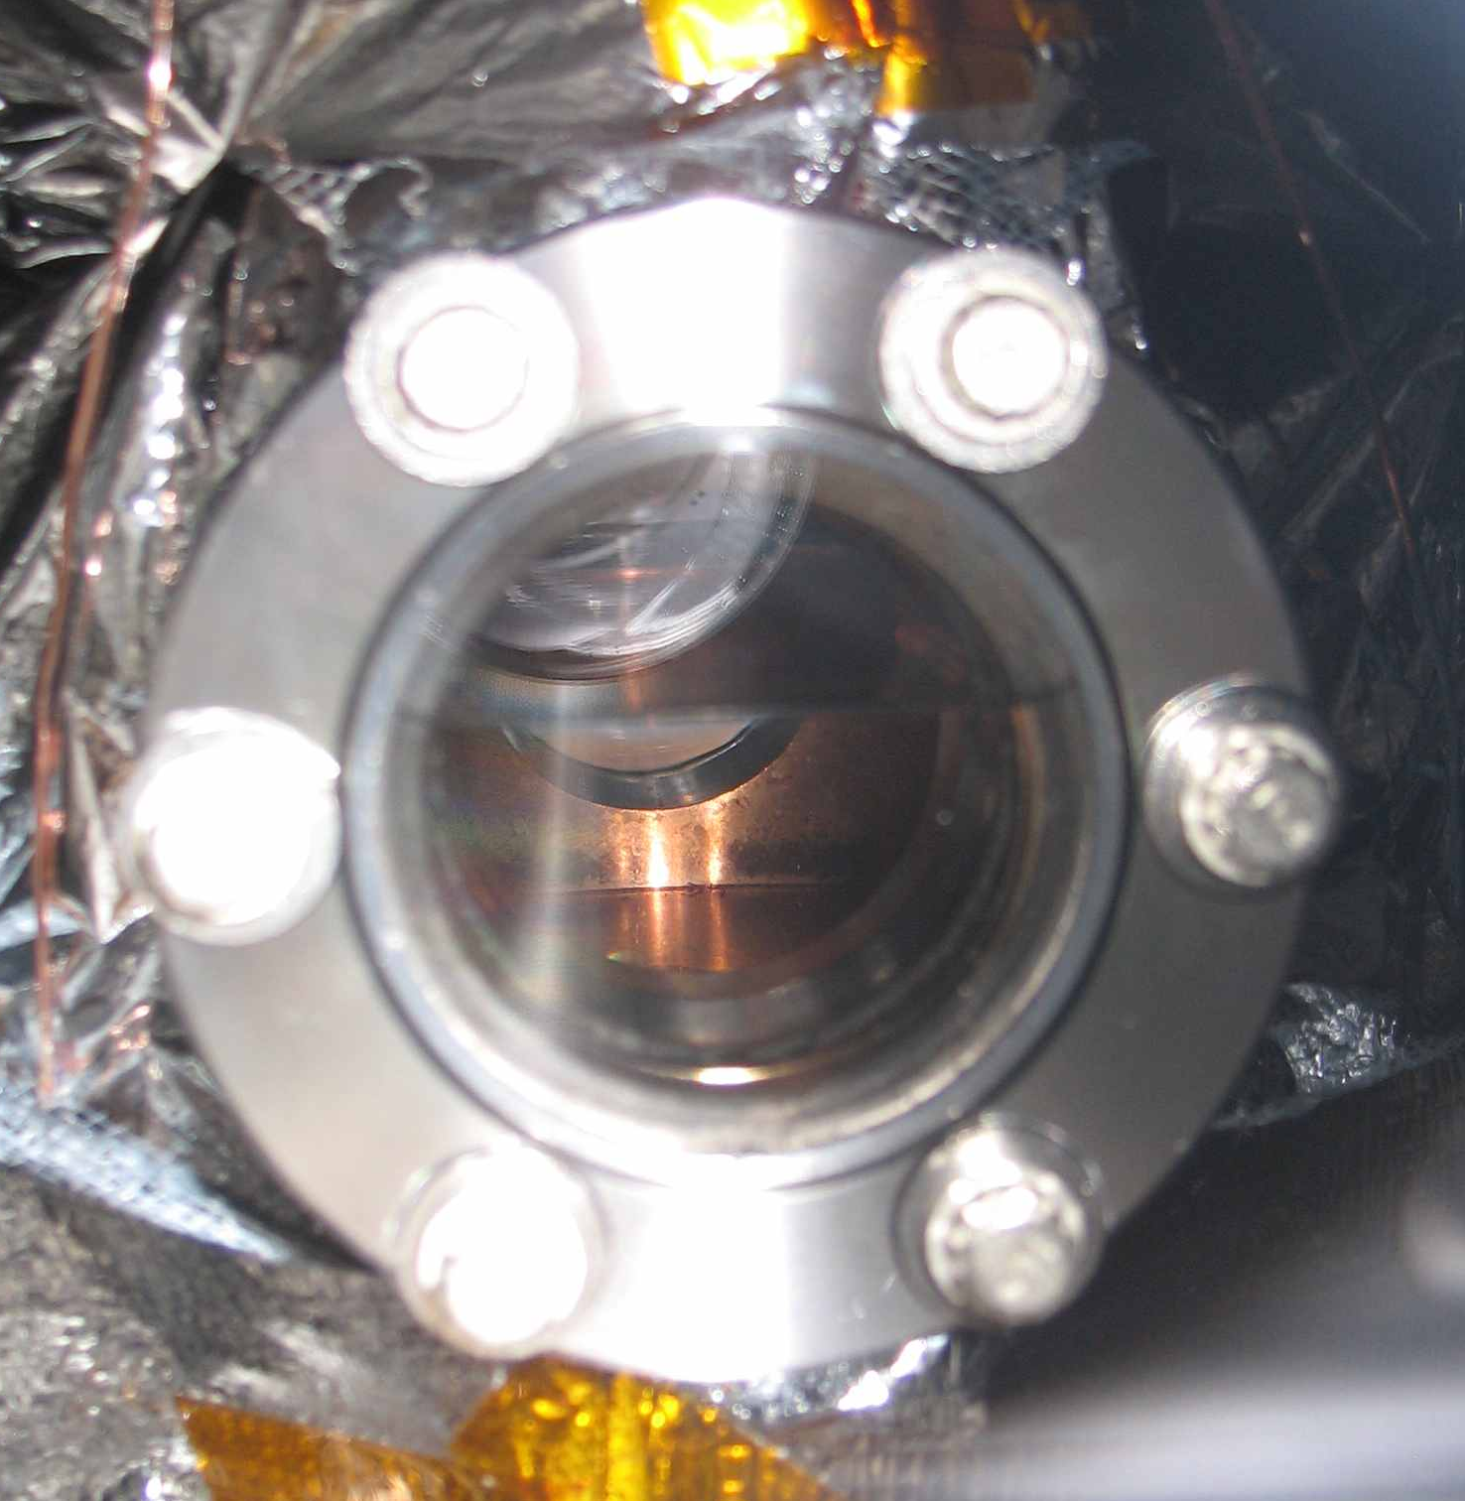
- Proper choice of
material and surface
prep ➔ signal with
almost no background
- Ideal conditions + luck:
>5% efficiency from
deposition to detection
Next:
  Continued work on improving repeatability, efficiency
  Start operating in LXe
LXe

Slide 59
From the closeout of DoE panel review of nEXO R&D
(Germantown 12 Jul 2013)
from the Charge (Standard HEP Merit Review Criteria)
“We welcome all of your comments, but we are also willing to stipulate that the
well-established EXO scientific team would rate highly on these points.”
Is the scope of the R&D appropriate for success?
“Comments:
1. The successful completion of the nEXO R&D program, and additional R&D at other
institutions, will put the EXO collaboration in a position to be able to build a ton-scale
double beta decay experiment.
2. Given the interest worldwide in the neutrino mass hierarchy which may be unfolding
over the next 5 years, it really is important that the momentum be kept at a high level
to pursue this program in a timely way.”
Rest of comments on specific topics very positive
Report is available to the EAC and SNOlab Director
upon request

Slide 60
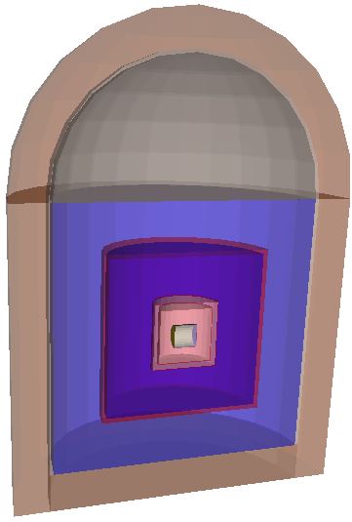
nEXO Simulation and Sensitivity
Geant4 simulation for γ bkgnd
Includes all major components of nEXO,
as known now
Cryopit full of water, detector centered
σ_{E} = 1.5% (this is conservative)
e-γ discrim. 2x that of EXO-200
(3x finer pitch & lower threshold)
Scale material amounts and use EXO-200
material contaminations except where
new numbers are available (e.g. copper)
Short term work to be done:
  Iterate for shielding thickness
  Add LXe/readout physics (confirm or
  modify discrimination power)
  Insert new figures for material
  radioactivity as they become available

Slide 61
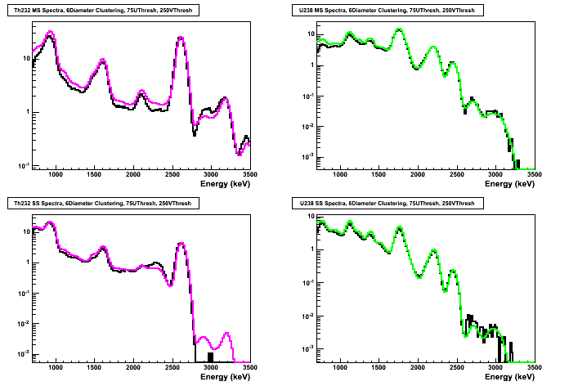
The relatively crude model can reproduce reasonably well the better EXO-200 reconstruction if asked…
²³²Th
²³⁸U
MS
SS
EXO-200
nEXO
EXO-200
nEXO

Slide 62
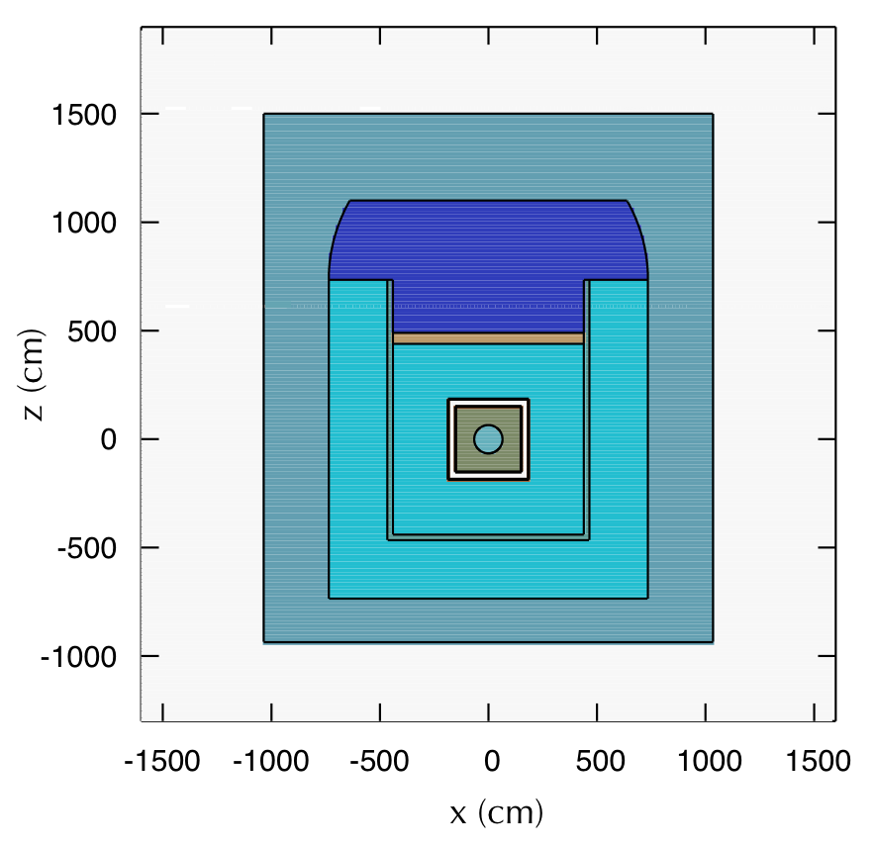

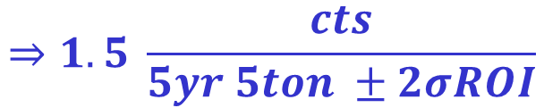

Neutrons are simulated using FLUKA,
with a slightly simplified geometry
Main background from
n capture on ¹³⁶Xe
T_{1/2}=3.8min, Q=4.2MeV
µ
$${}_{}^{136}{Xe+n→{}_{}^{137}{Xe}}$$
Rock
$${}_{}^{137}{Cs+\overline{ν_{e}}+e^{−}}$$
Air
Pb
HFE
$$⇒1.5 \frac{cts}{5yr 5ton ±2σROI}$$
LXe
Water
Backgrounds from prompt n
and n from rock activity are
greatly attenuated by the large
water shield and negligible

Slide 63
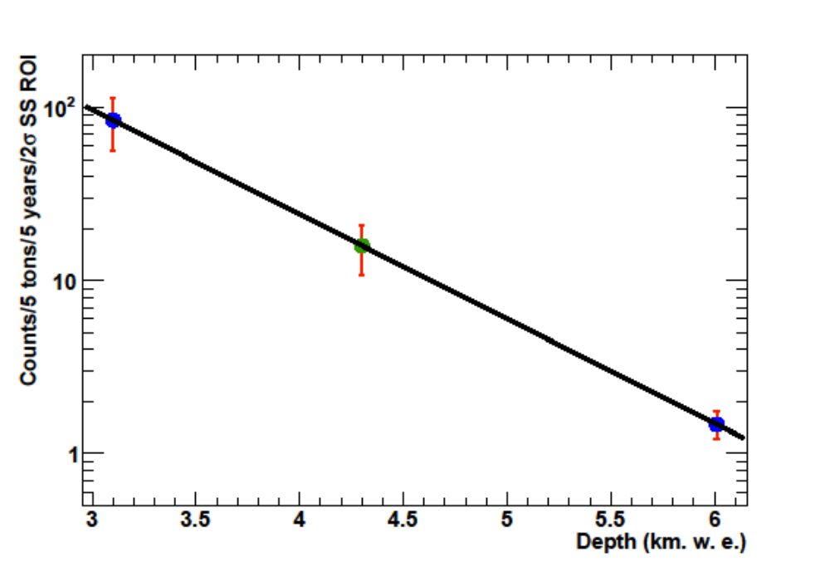
How important is the depth
for this cosmogenic background?
Gran Sasso
Simulation done
with muon
spectrum and
rate of LNGS
Homestake 4850
(interpolated)
SNOlab
Background substantially higher, but we are studying various tags,
including coinc. between µ veto and ¹³⁶Xe(n,γ) signal (~15min veto).
➔ Looks promising but not ready yet (and useful for SNOlab too).

Slide 64
Other n backgrounds
Prompt events following a muon
Neutrons from rock radioactivity
very strongly suppressed by the large water shield and give a
negligible contribution (→ we may reduce the shield!)

Slide 65

Neutrino backgrounds
Not included yet in the sensitivity calculations
Source | Process | $$\frac{cts}{5ton 5yr 2σROI}$$ | Comments
Solar ⁸B | $${}_{}^{136}{Xe}+ν_{e}→{}_{}^{136}{Cs}+e^{−}$$ | 1.2
 | $$e^{−}+ν_{e}→e^{−}+ν_{e}$$ | 1.2
Solar ⁷Be, pep | $${}_{}^{136}{Xe}+ν_{e}→{}_{}^{136}{Cs}+e^{−}$$ $↳{}_{}^{ 136}{Ba}+\overline{ν_{e}}+e^{−}+γs$ | 0.15 | γs essential for rejection
ν_{Atm} | Many | <0.1
ν_{React}, ν_{Geo} | Elastic scattering + $${}_{}^{136}{Xe}+\overline{ν_{e}}→{}_{}^{136}I+e^{+}$$ | <0.2
 | Total | <4.6

Slide 66


Like for EXO-200 data the fit to
0ν, 2ν and background uses energy and standoff separately for SS/MS.

Slide 67

Sensitivity

Slide 68

Sensitivity

Slide 69

Sensitivity

Slide 70

Sensitivity

Slide 71

Sensitivity

Slide 72


Slide 73

Constraints on neutrino masses
PRL 109 (2012) 032505 (EXO-200)
Final EXO-200
Cosmology bounds
95%CL

Slide 74
Constraints on neutrino masses
PRL 109 (2012) 032505 (EXO-200)
Final EXO-200
nEXO 5yr
Cosmology bounds
95%CL

Slide 75
Constraints on neutrino masses
PRL 109 (2012) 032505 (EXO-200)
Final EXO-200
nEXO 5yr
Cosmology bounds
95%CL
nEXO 10yr w/ Ba tag

Slide 76


Slide 77


Slide 78

Notional time schedule

