Slide 1
Using Student Test Scores to Distinguish Good Teachers from Bad
Edward Haertel
School of Education
Stanford University
AERA Presidential Session
Measuring and Developing Teacher Effectiveness:
An Assessment of Research, Policy, and Practice
New Orleans, Louisiana
April 10, 2011
Notes:
Much attention, much controversy around so-called “Value-Added Models.”

Slide 2
FRAMING THE PROBLEM
Policy makers wish to measure teachers' effectiveness
This goal is pursued using complex statistics to model student test scores
Notes:
Value-added models are designed to quantify the amount of achievement “value” teachers add to their students over the course of a school year. There are some old, familiar ideas here, but with some new vocabulary and some new statistical twists.

Slide 3
Complicating Factors
Start-of-year student achievement varies due to
  Home background and community context
  Individual interests and aptitudes
  Peer culture
  Prior schooling
Notes:
Of course, students don’t all begin the school year with the same levels of prior achievement. Initial achievement varies as a function of these factors and you may be able to think of others, as well.

Slide 4
Complicating Factors
End-of-year student achievement varies due to
  Start-of-year differences
  Continuing effects of out-of-school factors, peers, and individual aptitudes and interests
  Instructional effectiveness
Notes:
Over the course of the school year, many of these factors responsible for initial differences continue to operate, influencing rate of learning. In addition, of course, students’ achievement gains are influenced by the instruction they receive.

Slide 5
Complicating Factors
Instructional effectiveness reflects
  District and state policies
  School policies and climate
  Available instructional materials and resources
  Student attendance
  The teacher
Notes:
Research suggests that the classroom teacher is the most important within-school factor affecting student achievement, but this is not the same as saying that teacher effects are more powerful than out-of-school factors.
Also, while teachers are one very important within-school factor, the teacher is not the only factor determining effectiveness of instruction.

Slide 6
Two Simplified Assumptions
Teaching matters, and some teachers teach better than others
There is a stable construct we may refer to as a teacher’s “effectiveness”
Simplified to
Notes:
I suppose I could have said “Simplifying,” but “simplified” seemed like a better word to convey my meaning here.
[After second bullet] A construct is an underlying variable—An attribute that cannot be observed directly, but can be inferred from observables. In building psychological theories, we regard constructs as working hypotheses that must be supported by theory and research. This “effectiveness” construct may not stand up to rigorous scrutiny.

Slide 7
Two Simplified Assumptions
Student achievement is a central goal of schooling
Valid tests can measure achievement
Achievement is a one-dimensional continuum
Brief, inexpensive achievement tests locate students on that continuum
Simplified to
Notes:
Since I’m a psychometrician, I could easily spend my entire 20 minutes on this one slide.
I’ll just say that it’s very difficult to take two test scores from a year apart, on two different tests aligned to different grade level content standards, and use those two scores to figure out how much a student has learned over the course of the year. Defining an achievement continuum that spans multiple grade levels is technically challenging.

Slide 8
More later on these simplified assumptions.
Let us press ahead.
Notes:
We’ll come back to these assumptions.

Slide 9
Logic of the Statistical Model
What is a “Teacher Effect”?
  Student growth (change in test score) attributable to the teacher
  I.e., caused by the teacher
Notes:
Let’s look more closely at the quantity these “value-added” models are trying to measure.

Slide 10
Logic of the Statistical Model
Teacher Effect on One Student
Student’sObserved Score
Student’s Predicted Score
=
—
“Predicted Score” is Counterfactual – an estimate of what would have been observed with a hypothetical average teacher,
all else being equal
These (student-level) “Teacher Effects” are averaged up to the classroom level to obtain an overall score for the teacher.
Notes:
Imagine what end-of-year score a student would have earned with an average teacher. The difference between that student's actual score and the hypothesized counterfactual score with an average teacher represents the effectiveness of the student's actual teacher relative to an average teacher. A positive difference means above-average; a negative difference means below-average. So, one way to look at this equation is as the difference between student outcomes under two conditions. This is the framework for causal inference. However, as my colleague Mark Wilson has pointed out, this is also the equation for the residual term from a regression equation. In effect, we’re taking everything left over, that we cannot explain, and attributing it to the teacher. Interpreting residuals in this way is a risky business.

Slide 11
In or out?
District leadership
School norms, academic press
Quality of school instructional staff
Early childhood history; medical history
Quality of schooling in prior years
Parent involvement
Assignment of pupils (to schools, to classes)
Peer culture
Students’ school attendance histories
…
Notes:
[While clicking through list] VAM results depend heavily on what variables are included in the equation for students’ predicted scores. Some of these influences might be captured by prior-year test scores or by school fixed effects. Others may not be. Many of these factors are partially under the teacher’s control, but not completely.

Slide 12
Controlling for prior-year score is not sufficient
First problem—Measurement Error:
prior-year achievement is imperfectly measured
Second problem—Omitted variables:
models with additional variables predict different prior-year true scores as a function of
  additional test scores
  demographic / out-of-school factors
Notes:
The main point here is that statistical adjustment for one or more prior years’ test scores is not enough. Test scores don’t even measure achievement perfectly, and there are a lot of other influences on rate of learning that they leave out altogether.

Slide 13
Controlling for prior-year score is not sufficient
Third problem—Different trajectories:
students with identical prior-year true scores have different expected growth depending on
  individual aptitudes
  out-of-school supports for learning
  prior instructional histories
Notes:
The net result of these omitted variables is that students with the same prior-year test score may know different things about this year’s instructional content, and may differ in their readiness to profit from further instruction.

Slide 14
A small digression:
Student Growth Percentiles
Construction
  Each student’s SGP score is the percentile rank of that student’s current-year score within the distribution for students with the same prior-year score
Notes:
I want to spend just a moment here on a kind of value-added model that looks a little different and is talked about using different terminology. This is the quantile regression model used in Colorado and some other states, referred to as student growth percentiles. Damian Betebenner has done some very good work on these models, and they have some nice features. This little figure shows a scatterplot of current-year scores on the vertical axis and prior-year scores on the horizontal axis. The box shows how we can look at a group of students who all got the same score last year. The student growth percentile is a student’s percentile rank on this year’s test, within that group of students who earned the identical score last year. Fancier versions may condition on scores going back more than one year.

Slide 15
Student Growth Percentiles
Interpretation
  How much this student has grown relative to others who began at the “same” (prior-year) starting point
Advantages
  Invariant under monotone transformations of score scale
  Directs attention to distribution of outcomes, versus point estimate
Notes:
SGPs are appealing in part because they seem easy to understand.

Slide 16
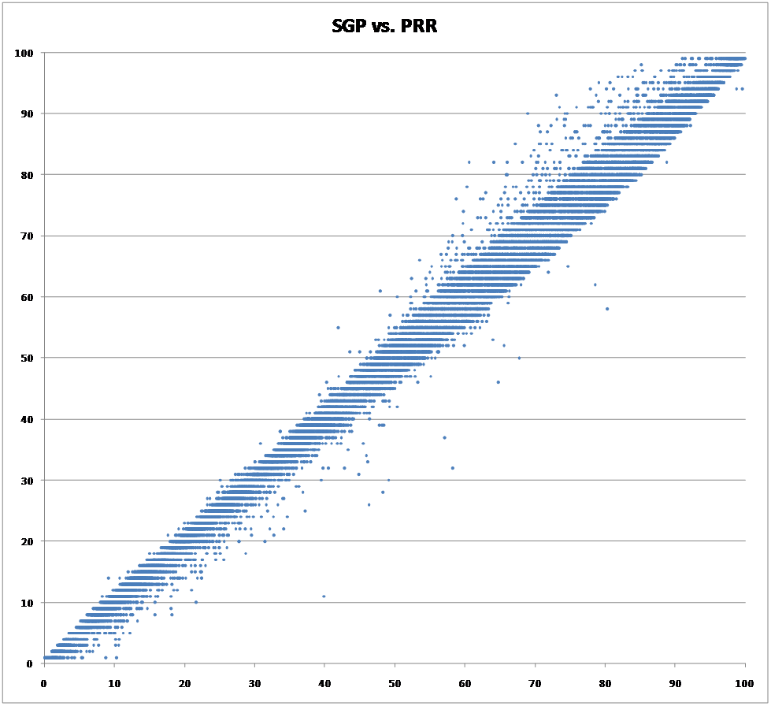
Is anything really new here?
Thanks to Andrew Ho and Katherine Furgol for this graphic
Notes:
However, even though the statistics are a little different, for purposes of teacher value-added modeling, the SGPs have almost exactly the same limitations as more familiar regression models.
This scatterplot used a 4-year longitudinal dataset, applying Betebenner’s method to construct SGPs, which are plotted against percentile ranks of residuals from an OLS regression. Correlation is .996; even higher (.997) when the corresponding analysis is performed using only a single prior year of data.
What this graphic shows is that SGPs are just scaling those residuals, the differences between students observed and predicted test scores, a little differently.

Slide 17
EXAMINING THE EVIDENCE
Stability of “effectiveness” estimates
  That first “simplified assumption”
Problems with the tests
  That second “simplified assumption”
Random assignment?
Professional consensus
Notes:
Up until now, I’ve described the problem and raised some questions. Next, I’d like to turn to some studies that can show us whether the problems I’ve mentioned are serious or not.
My first “simplified assumption” pertained to the notion that “teacher effectiveness” is a stable construct. That is addressed by evidence concerning the stability of effectiveness estimates.
My second “simplified assumption” had to do with the power of brief, inexpensive tests to locate students along a unidimensional achievement continuum. Since test scores are the fundamental drivers of the whole system, it’s important to look at them closely.
The third bullet here, “Random Assignment,” refers to a strong and important assumption required by these statistical models. Stated simply, the fact that there are omitted variables in the model shouldn’t matter if students are randomly assigned to teachers and teachers to schools conditional on variables included in the model.
Finally, I’ve included a few quotes from experts. These are taken from an Economic Policy Institute briefing released last August, on which Linda Darling-Hammond, Eva Baker, and I were among the ten co-authors.

Slide 18
EXAMINING THE EVIDENCE
Stability of “effectiveness” estimates
  That first “simplified assumption”
Problems with the tests
  That second “simplified assumption”
Random assignment?
Professional consensus
Notes:
Let’s turn to the first of these topics, concerning the stability of effectiveness estimates.

Slide 19
Stability of “Effectiveness” Estimates
Newton, Darling-Hammond, Haertel, & Thomas (2010) compared high school math and ELA teachers’ VAM scores across
  Statistical models
  Courses taught
  Years
Full report at http://epaa.asu.edu/ojs/article/view/810
Notes:
In a paper published last year, Xiaoxia Newton, Linda, and I, together with Professor Ewart Thomas from Stanford’s Psych Department, took advantage of a large dataset constructed for another project to compare teachers’ value-added scores from different courses, from the same course taught two successive years, and across different VAM specifications.

Slide 20
Findings from Newton, et al.
Sample* for Math and ELA VAM Analyses
Academic Year | 2005-06 | 2006-07
Math teachers | 57 | 46
ELA teachers | 51 | 63
Students Grade 9 Grade 10 Grade 11 | 646 714 511 | 881 693 789
*Sample included all teachers who taught multiple courses. Ns in table are for teachers x courses. There were 13 math teachers for 2005-06 and 10 for 2006-07. There were 16 ELA teachers for 2005-06 and 15 for 2006-07.
Notes:
This slide gives you some sense of the size of the study. The numbers in the top half of the table, 57, 46, 51, and 63, are counts of the numbers of separate VAM estimates we were able to calculate. These included multiple estimates for the numbers of math and English Language Arts teachers shown in the note at the bottom.

Slide 21
% of Teachers Whose Effectiveness Ratings Change …
 | By at least 1 decile | By at least 2 deciles | By at least 3 deciles
Across models* | 56-80% | 12-33% | 0-14%
Across courses* | 85-100% | 54-92% | 39-54%
Across years* | 74-93% | 45-63% | 19-41%
*Depending on the model
Notes:
This slide shows how much teacher effectiveness estimates bounced around. From these numbers, we concluded that any simple notion of “effectiveness” as an enduring quality of individual teachers is deeply problematical.
You’ll note that we divided teachers into ten decile bands for purposes of comparison. You may recall that Richard Buddin analyzed data on teachers in the LA Unified School District, and effectiveness ratings for thousands of teachers were published by the LA Times. The LA Times used five effectiveness categories, which is a courser breakdown than our 10 decile categories. Derek Briggs and Ben Domingue reanalyzed the same data as Buddin, using an alternative model that added controls for (1) a longer history of a student’s test performance, (2) peer influence, and (3) school-level factors. They found that under their alternative specification, effectiveness classifications for reading would change for more than half the teachers, and classifications for mathematics would change for almost 40 percent of the teachers. So, the Briggs and Domingue findings are quite consistent with the results in the first row of our table here. They have not published any analyses concerning stability across courses or across years.

Slide 22
One Extreme Case:
An English language arts teacher
Comprehensive high school
Not a beginning teacher
White
Teaching English I
Estimates control for:
  Prior achievement
  Demographics
  School fixed effect
Notes:
This is a particularly dramatic case from the Newton, et al. study, showing how an experienced high school teacher received wildly different effectiveness ratings teaching the same course to two groups of students, even with statistical controls for school, prior student achievement, and student demographics. The Year 1 class included higher proportions of low-income, Hispanic, and English Learner students. With that class, the teacher’s effectiveness was at the bottom of the distribution. The next year, with a different class, it was at the top.

Slide 23
EXAMINING THE EVIDENCE
Stability of “effectiveness” estimates
  That first “simplified assumption”
Problems with the tests
  That second “simplified assumption”
Random assignment?
Professional consensus
Notes:
The second topic I’d like to turn to is the tests themselves. I’d like to show you just four released items from the California Standards Tests, one each in history, English, Algebra, and Biology. Before each item, I’ll show you the standard it’s supposed to measure.

Slide 24
11th Grade History/
Social Studies
US11.11.2.
Discuss the significant domestic policy speeches of Truman, Eisenhower, Kennedy, Johnson, Nixon, Carter, Reagan, Bush, and Clinton (e.g., education, civil rights, economic policy, environmental policy).
Notes:
Here’s a U.S. History standard. There’s a lot to be said about just this one slide, the way it packs so many details into one complicated sentence, but for now just notice the verb “discuss.”

Slide 25

Item Testing US11.11.2
Notes:
Here’s the item. No discussion, just paired-associate learning. A chart with rows for each president, columns for each policy area, and program names in the cells of the chart would likely be all I’d need to nail any item testing this objective.

Slide 26
9th Grade English-
Language Arts
9RC2.8
Expository Critique: Evaluate the credibility of an author’s argument or defense of a claim by critiquing the relationship between generalizations and evidence, the comprehensiveness of evidence, and the way in which the author’s intent affects the structure and tone of the text (e.g., in professional journals, editorials, political speeches, primary source material).
Notes:
Here’s an English Language Arts objective. Let’s see how the state test measures “Expository Critique.”

Slide 27
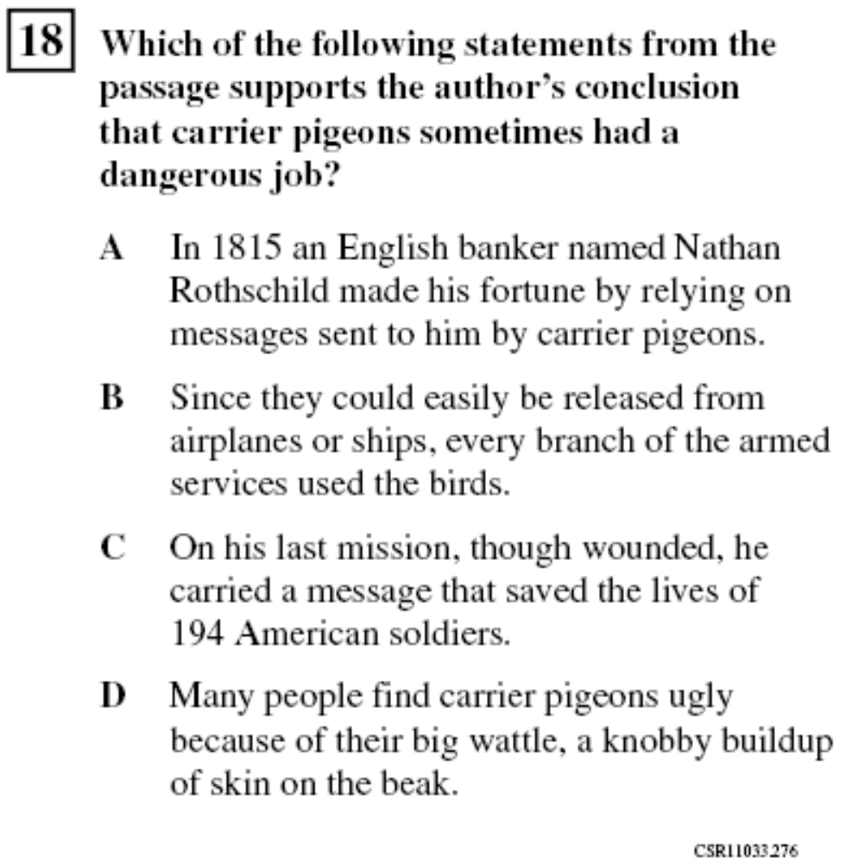
Item Testing 9RC2.8
Notes:
I’m not showing you the reading passage, but you don’t really need it. The evidence from the text appears in response option C, and the generalization appears in the question stem. [click]

Slide 28
Algebra I
25.1
Students use properties of numbers to construct simple, valid arguments (direct and indirect) for, or formulate counterexamples to, claimed assertions.
Notes:
Since these are multiple-choice items, you know students won’t be constructing or formulating anything…

Slide 29
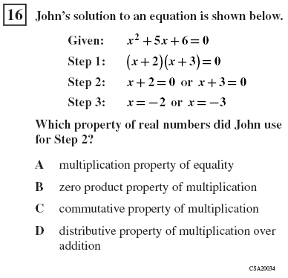
Item Testing 25.1
Notes:
But in fact, all that’s required is to pick the right label.

Slide 30
High School Biology
BI6.f
Students know at each link in a food web some energy is stored in newly made structures but much energy is dissipated into the environment as heat. This dissipation may be represented in an energy pyramid.
Notes:
Here, the key ideas seem to be storage and dissipation of energy. Let’s see how that’s tested.

Slide 31
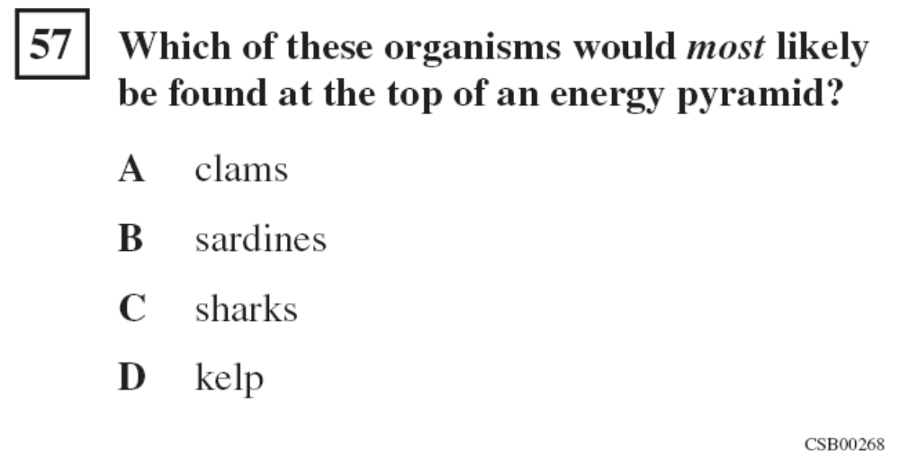
Item Testing BI6.f
Notes:
Well, it looks like an energy pyramid is a lot like a food chain.
The point of these examples is not to argue that we need tougher tests. A lot of smart people worked very hard to build the tests we have, and many committees reviewed and approved them. You can see how each of these items kind of connects to some small piece of its associated objective. My message here is that attaching even higher stakes to tests like these is going to drive curriculum and instruction further in the wrong direction. If “teacher effectiveness” means improving performance on items like these, then the accountability system may reward the wrong people for doing the wrong things.

Slide 32
EXAMINING THE EVIDENCE
Stability of “effectiveness” estimates
  That first “simplified assumption”
Problems with the tests
  That second “simplified assumption”
Random assignment?
Professional consensus
Notes:
Conditionally random assignment of students to teachers is a crucial assumption in value-added models. Depending on the precise model and the intended interpretations of VAM estimates, conditionally random assignment of teachers to schools may also be required. These assumptions matter because there will always be omitted variables. Random assignment conditional on variables included in the model would assure that effectiveness estimates were unbiased even if the model failed to control for all achievement influences outside the teachers’ control.

Slide 33
Student Assignments Affected By
Teachers’ particular specialties
Children’s particular requirements
Parents’ requests
Principals' judgments
Need to separate children who do not get along
Notes:
The processes by which students are assigned to teachers are not well documented, but in a 2010 paper, Jesse Rothstein suggests that anecdotally, some of these factors may influence such assignments.

Slide 34
Teacher Assignments Affected By
Differential salaries / working conditions
Seniority / experience
Match to school’s culture and practices
Residential preferences
Teachers’ particular specialties
Children’s particular requirements
Notes:
There is much better documentation of the nonrandom assignment of teachers to schools.

Slide 35
Does Non-Random Assignment Matter? A falsification test
Logically, future teachers cannot influence past achievement
Thus, if a model predicts significant effects of current-year teachers on prior-year test scores, then it is flawed or based on flawed assumptions
Notes:
In his 2010 paper, Rothstein develops a falsification test to see how important violations of the random assignment assumption turn out to be. The idea is simple and elegant. He looks to see if the model predicts teacher effects running backwards in time. If it does, then there’s a problem.

Slide 36
Falsification Test Findings
Rothstein (2010) examined three VAM specifications using a large data set and found “large ‘effects’ of fifth grade teachers on fourth grade test score gains.”
Notes:
Rothstein used data from fifth-grade classrooms in North Carolina from the 2000-2001 school year. His sample included over 60,000 students in over 3,000 classrooms in 868 schools. He used a variety of value-added models, and consistently found that fifth-grade teacher assignments showed powerful effects on fourth-grade test score gains. His paper explains in detail how this shows that omitted variables and nonrandom assignment together introduce serious bias in teacher’s effectiveness estimates.

Slide 37
Falsification Test Findings
Briggs & Domingue (2011) applied Rothstein’s test to LAUSD teacher data analyzed by Richard Buddin for the LA Times
  For Reading, ‘effects’ from next year’s teachers were about the same as from this year’s teachers
  For Math, ‘effects’ from next year’s teachers were about 2/3 to 3/4 as large as from this year’s teachers
Notes:
In their reanalysis of the LAUSD data, Briggs and Domingue used Rothstein’s test. This falsification test was not included in Richard Buddin’s original paper. In one comparison, they found that the estimated effects of fourth-grade teachers on students’ third-grade reading gains were slightly larger than the estimated effects of fourth-grade teachers on students’ fourth-grade reading gains.

Slide 38
EXAMINING THE EVIDENCE
Stability of “effectiveness” estimates
  That first “simplified assumption”
Problems with the tests
  That second “simplified assumption”
Random assignment?
Professional consensus
Notes:
On my next slides I have just three quotations that appeared in an Economic Policy Institute briefing paper released last August. As I mentioned, Linda Darling-Hammond, Eva Baker, and I were among the ten co-authors on this brief. I agree with these quotes, but I want to acknowledge here that the field is not unanimous on these questions, and some respected methodologists support their use, with appropriate caveats.

Slide 39
Professional Consensus
We do not think that their analyses are estimating causal quantities, except under extreme and unrealistic assumptions.
– Donald Rubin
Notes:
In a 2004 paper in a special issue of the Journal of Educational and Behavioral Statistics, Rubin, Stuart, and Zanutto reached this conclusion. A common dodge is to say that these models are merely descriptive. But if stakes for teachers are attached to the results, then it‘s cold comfort to say the model is descriptive and causal attributions aren‘t intended.

Slide 40
Professional Consensus
The research base is currently insufficient to support the use of VAM for high-stakes decisions about individual teachers or schools.
– Researchers from RAND Corp.
Notes:
In a 2003 RAND research report, McCaffrey, Koretz, Lockwood, and Hamilton had this to say.

Slide 41
Professional Consensus
VAM estimates of teacher effectiveness that are based on data for a single class of students should not used to make operational decisions because such estimates are far too unstable to be considered fair or reliable.
– 2009 Letter Report from the
Board on Testing and Assessment,
National Research Council
Notes:
In 2009, the NRC’s Board on Testing and Assessment issued a letter report directed to Education Secretary Arne Duncan, commenting on the Department’s proposal on the Race to the Top Fund. That letter included strong cautions concerning value-added models, and strongly urged further research and pilot studies before mandating any operational use of these models.

Slide 42
UNINTENDED EFFECTS
Narrowing of curriculum and instruction
  What doesn’t get tested doesn’t get taught
Instructional focus on students expected to make the largest or most rapid gains
  Student winners and losers will depend on details of the model used
Erosion of teacher collegial support and cooperation
Notes:
In closing, I’ll just quickly point to some likely unintended consequences if high-stakes teacher evaluations based on student test scores are implemented thoughtlessly. These include a narrowing of what is taught to just that which is tested, targeting of instructional resources toward those students most likely to make rapid gains, and competition among teachers instead of mutual support and collaboration.

Slide 43
VALID AND INVALID USES
VALID
  Low-stakes
  Aggregate-level interpretations
  Background factors as similar as possible across groups compared
INVALID
  High-stakes, individual-level decisions, comparisons across highly dissimilar schools or student populations
Notes:
Teacher effectiveness estimates with statistical controls for prior achievement are better than estimates based on unadjusted end-of-year student test scores, and these models may be of real value if used appropriately, but they are not magic, and I believe they are being seriously oversold.

Slide 44
UNINTENDED EFFECTS
“The most pernicious effect of these [test-based accountability] systems is to cause teachers to resent the children who don’t score well.”
—Anonymous teacher,
in a workshop many years ago
Notes:
I can still hear a teacher I met over 20 years ago saying these words. I have a great fear that thoughtless implementation of score-based teacher evaluation models may undermine the education of our most vulnerable children.

Slide 45
Thank you

