Slide 1
The FCC and Auctions for Radio Spectrum Licenses

Slide 2
Today’s Lecture
Problem of allocating radio spectrum
Theory and practice of spectrum auctions
  The simultaneous ascending auction
  Theoretical rationale and efficiency
  Evidence on how they work in practice
  What can go wrong, and why.
Bid strategy in the FCC advanced wireless auction.
Spectrum crunch and the FCC incentive auctions.

Slide 3
FCC Spectrum Auctions
Federal government allocates rights to use the radio spectrum for television, radio, cell phones, etc. – historically done by administrative process or lottery.
Auctions to allocate radio spectrum
  Suggested by Coase (1959) – paper is most famous for a footnote in which he suggested the Coase Theorem!
  FCC switched to auctions in early 1990s, with academics involved in the design, followed by other countries.
Spectrum auctions have fostered a great deal of interest in auctions and auction design – a difficult problem, with high stakes for consumers, firm and governments.

Slide 4
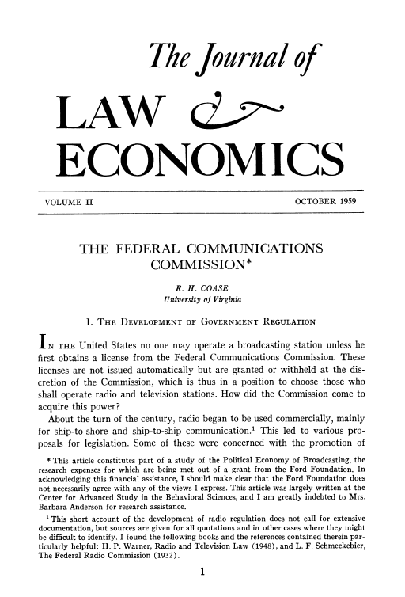
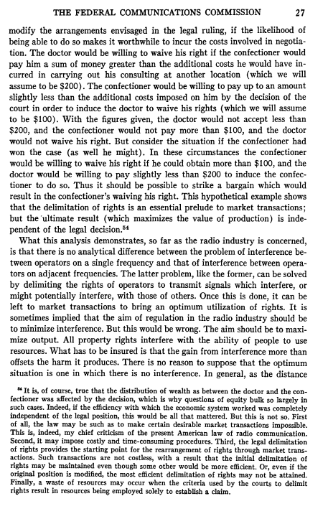
Allocating radio spectrum

Slide 5
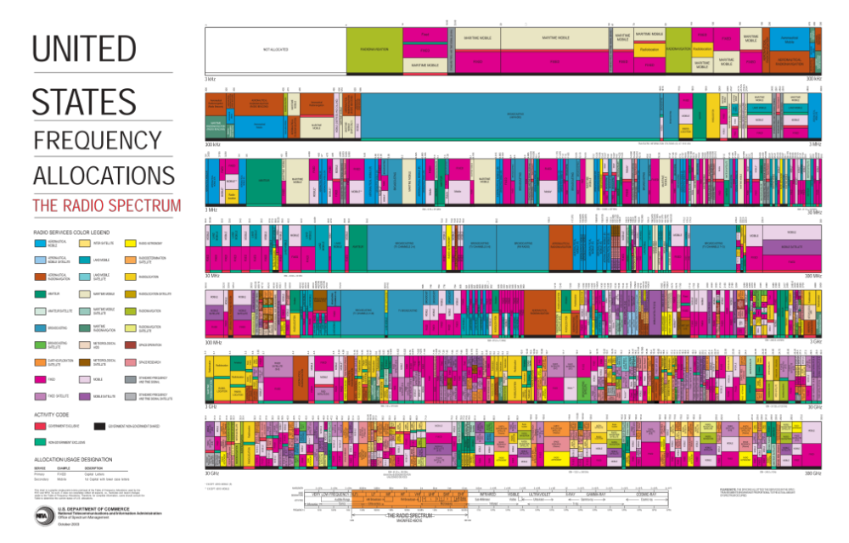
Radio Spectrum in the US

Slide 6
Structure of the Problem
Potentially many different goods for sale
  E.g. license for San Francisco very different than license for Death Valley. Low frequency spectrum different than high.
Potentially bidders with different objectives
  E.g. Verizon may want spectrum to add 4G for data transmission; rural telco might have more modest plans.
Substantial uncertainty about price/value
  Illiquid secondary market, not many licenses or auctions, uncertainty about technology evolution.

Slide 7
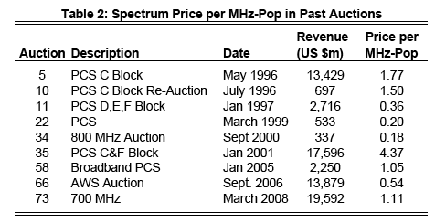
Prices are hard to forecast
Notes:
7
Unfortunately, it is rarely obvious what those later prices will be!
Still, one might ask whether early bidding will reveal information about prices.

Slide 8
Simultaneous Ascending Auction
Design due to Paul Milgrom, Bob Wilson, Preston McAfee.
Auction consists of multiple rounds.
  Round begins with standing high bid on each license (initially the seller), and a minimum bid increment.
  Each bidder can submit bids on any number of items, subject to an eligibility and activity rule.
  If no bids on a license, standing high bidder remains. If multiple bids, one bid selected to be the new high bid.
  Information about bids is revealed; move to next round.
Auction ends when no new bids are submitted.

Slide 9
Arguments for SAA format
Why simultaneous? .. relative to sequential auctions
  Bidders have flexibility to substitute across licenses or to assemble a package of licenses, and more information.
  In principle, expect more equalization of prices for similar items, because of ability to arbitrage in the SAA.
Why ascending? … relative to sealed bidding.
  Bidders obtain information during the auction, which allows them to adapt their bidding, update valuations, and identify target licenses on the fly, as well as “preserve privacy”.
  Maybe more opportunity for demand reduction, collusion.

Slide 10
Activity Rules
Activity rule used to keep the auction moving
  Each license assigned some number of points
  Bidders start with eligibility points, must use them each round or else have their eligibility reduced.
  Necessary so bidders don’t just sit back and wait.
But activity rules also can complicate bidding
  Suppose licenses are different sizes: e.g. NY is worth 200 points, while LA and SF are each worth 100.
  If you’re high on NY and get bid off, can switch to SF/LA, but what if you’re high on SF/LA and are bid off LA only?
  An implication: large licenses tend to sell first!!

Slide 11
Example
Two licenses: a 20 MHz license and a 10 MHz license
Three bidders: A, B, C.
 | 10 MHz | 20 MHz | 30 MHz
A | 100 | 200 | 300
B | 120 | 210 | 290
C | 70 | 120 | 150
Note: obtain 30 MHz by buying both licenses.
Efficient allocation: A wins 20, B wins 10.
(Lowest) market clearing prices: 100, 190

Slide 12
Simultaneous Ascending Auction
Round-by-Round Bidding
Price (10) | Price (20) | A | B | C
0 | 0 | 10, 20 | 10, 20 | 10, 20
License Values
30 | 30 | 10, 20 | 10, 20 | 20
 | 10 | 20 | 30
A | 100 | 200 | 300
B | 120 | 210 | 290
C | 70 | 120 | 150
80 | 80 | 10, 20 | 20 | 20
80 | 120 | 10, 20 | 20
80 | 170 | 10, 20 | 10
81 | 170 | 10, 20 | 20
81 | 171 | 10, 20 | 10
82 | 171 | 10, 20 | 20
… | … | 10, 20 | 10 - 20
100 | 190 | 20 | 10

Slide 13
Theory of SAA
Bidding is “straightforward” if each round bidders bid for the set of licenses that offer the most profit at current prices.
Theorem. If bidders have “substitutes” values (e.g. want only one license) and bid straightforwardly, the SAA leads to an efficient allocation and lowest competitive prices.
“Magic of the market”
  Auction outcome is “as if” the seller knew all the values and used a computer to find the efficient allocation & mkt-clearing prices – auction discovers the right prices and quantities.
  Biders have “no regret” – at the final prices, each winner gets exactly the licenses that gives it the most profit, and no loser would like to be a winner (assignment is “stable” given prices).

Slide 14
From theory to practice
UK auction of 3G spectrum in 1998: British gov’t sells licenses for third generation (3G) wireless services.
Banks estimated an auction might raise £500 million
  Paul Klemperer (former Stanford GSB student); Jeremy Bulow (GSB prof) and Ken Binmore designed the auction.
There were four incumbents with “2G” services, and several potential entrants interested in 3G.
Crucially, the government decided to sell five licenses, with the restriction that license A was only for entrants and incumbents could only bid for one license at a time.

Slide 15
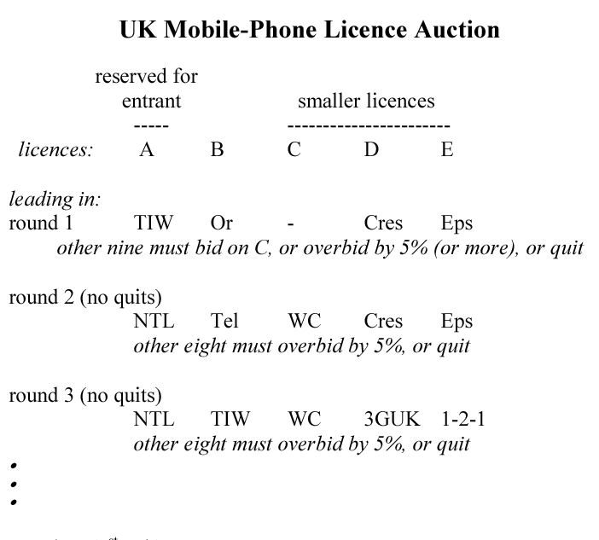
UK Auction of 3G Spectrum

Slide 16
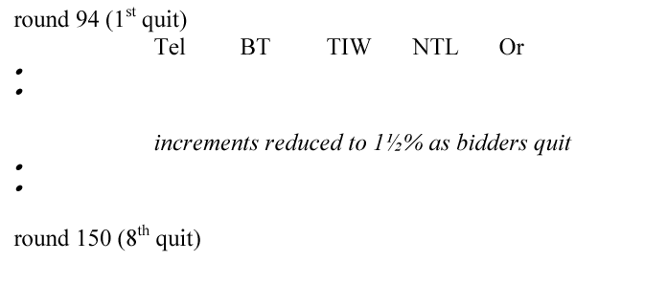
UK Auction of 3G Spectrum
Auction ends after 150 rounds….
Four incumbents and one entrant won licenses.
Auction netted £22 billion, about $39 billion dollars – “the biggest auction ever” – far exceeding revenue estimates.
Key point: there was a lot of competition!

Slide 17
Entry “Deterrence”
Netherlands auction of 3G spectrum in 1999.
Following UK lead, Netherlands decided to sell five licenses using an identical SAA format.
However, there were some differences
  The Netherlands has five incumbent (2G) operators.
  There was no prohibition on bidding partnerships.
What happened?
Notes:
17

Slide 18
Netherlands auction
Prior to auction, major outside telecom firms (Deutsche Telekom, DoKoMo, Hutchinson Whampoa) all reach partnership agreements with an incumbent.
This left just one entrant, a startup called Versatel.
What happened in the auction
  On day 1, Telfort (owned by BT) sends Versatel a letter saying that it “can’t win” and should drop out immediately!
  Versatel shortly drops out: total revenue of 3bn euros – at UK prices, auction would have raised 10bn euros.

Slide 19
Demand Reduction
German GSM auction in 2000.
  Ten nationwide licenses.
  Bidders allowed to win multiple licenses.
  First bid at 10m DM, then 10% price increments.
  Two strong bidders, Mannesman and T-Mobile, potentially interested in buying a lot of spectrum.
  Other bidders are much smaller.
What might you be worried about here?

Slide 20
German GSM Auction
What happened in the auction
  Round 1: Mannesman bids 36.6m for each of 5 bands, and reduces eligibility.
  Round 2: T-Mobile (Deutsche Telekom) bids 40m for the other five bands, reduces eligibilty.
  No bids in round 3!

Slide 21
Demand Reduction
Round-by-Round Bidding
Price (10) | Price (20) | A | B | C
0 | 0 | 10, 20 | 10, 20 | 10, 20
License Values
30 | 30 | 10, 20 | 10, 20 | 20
 | 10 | 20 | 30
A | 100 | 200 | 300
B | 120 | 210 | 290
C | 70 | 120 | 150
80 | 80 | 10, 20 | 20 | 20
80 | 120 | 10, 20 | 20
80 | 170 | 20 | 10
Bidder A stop the auction early and pays 170
Coordinated demand reduction can be a bigger deal.
If there was no bidder C, competitive prices are still 100, 190.
But if B from the start bids only for 10, A will take 20.

Slide 22
Exposure problems
In many countries, incumbents have substantial spectrum and network build-out. A successful new entrant may need to buy many licenses to compete.
  SAA format creates a danger: an entrant might end up winning some very expensive spectrum but not enough for viable entry.
  This “exposure risk” can deter an entrant from competing aggressively, potentially biasing auction in favor of incumbents.
  One reason this is a concern is that even an “efficient” auction allocation is efficient from standpoint of the firms, while consumers might prefer having more providers.
The exposure problem has motivated a lot of work on “combinatorial” auction design.
Notes:
22
The exposure problem has been the driving problem behind many of the innovations in package auction design.
Non-synchronous market clearing would be okay if you had a good guess as to later prices.

Slide 23
Bidder budgets
A surprising observation in spectrum sales has been the importance of bidder budgets.
  In our theoretical models, bidding behavior is determined by bidder values. Bidders don’t have limited cash.
  In practice, firms often give their bidding team a budget and a set of objectives (why would this make sense?).
This shows up in the data: as prices rise in the auction, bidders reduce their demands, but may put a similar amount of money “on the table” in each round.
Notes:
23
Are there other ways to gauge future prices: auction theory models would suggest combining information from early drop outs with a statistical model of valuations… but there is a simpler and more powerful approach.

Slide 24
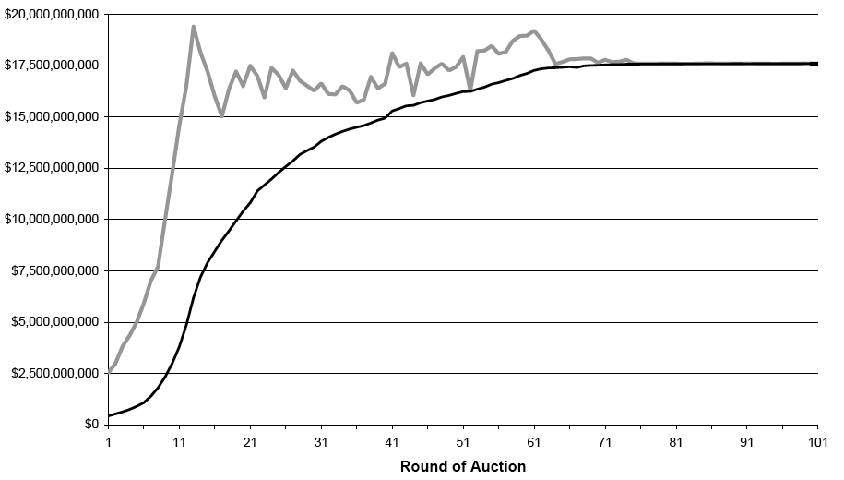
Budget based bidding?
Sum of all bids (exposure)
FCC Auction 35
Sum of high bids (revenue)
Notes:
24
Define “aggregate exposure” to be the sum of all bids in a round, winning and losing. If bidders are budget-constrained, aggregate exposure may reveal the aggregate budgets.
In the last round, all bids are winning, so exposure=revenue.

Slide 25
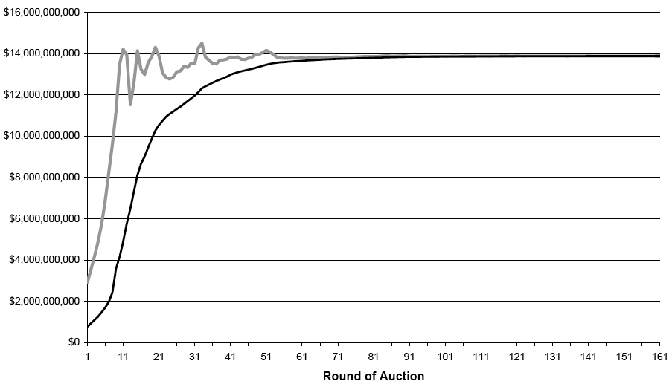
Budget based bidding?
Sum of all bids (exposure)
FCC AWS Auction
Sum of high bids (revenue)
Notes:
25

Slide 26
The AWS Auction
FCC sale of advanced wireless spectrum in 2006.
  Large, complicated auction with a surprising outcome that has subsequently influenced auction design. Also useful to illustrate the value of economics to guide strategy.
FCC offered several “sizes” of licenses:
  Large regional licenses (three bands, 40 MHz)
  Small EA/CMA licenses (three bands, 50 MHz)
  Small licenses could be joined to equal large ones.
Competitors included major incumbents (Verizon, ATT, T-Mobile), many smaller bidders, and two potential national entrants (SpectrumCo and Wireless DBS).

Slide 27
SpectrumCo’s problem
Goals for the auction
  Acquire 20 MHz of spectrum covering 85% of US population, without spending more than budget. If that isn’t possible, don’t buy anything.
Strategic thinking
  Beware the exposure problem! Try to figure out how much it will cost to buy target amount of spectrum… but how?
  Anticipate that bidding is likely to start on the large licenses and subsequently move to the smaller ones – strategic issue will be when to switch if re-switching is hard.

Slide 28
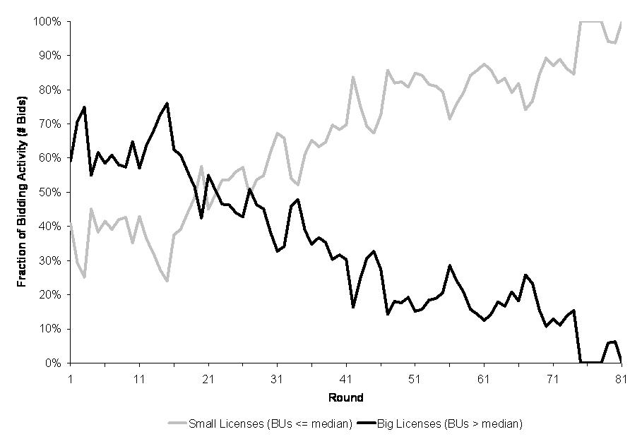
Bidding activity (FCC auction 35)
Fraction of bids on large licenses
Fraction of bids on small licenses
Notes:
28

Slide 29
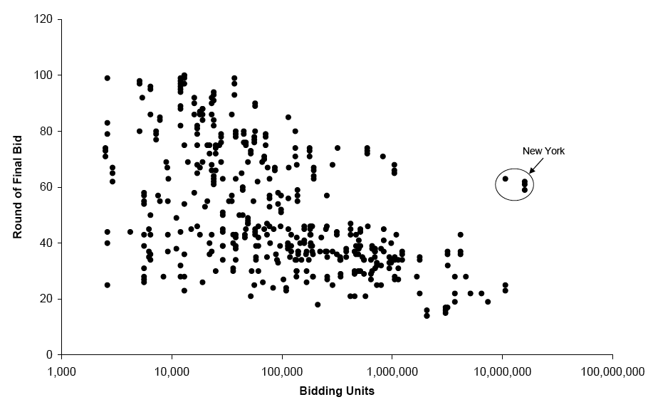
Timing of final bids (auction 35)
Variation in
clearing round
Round of final bid plotted against
license size in bid units
Large licenses
clear first
Notes:
29

Slide 30
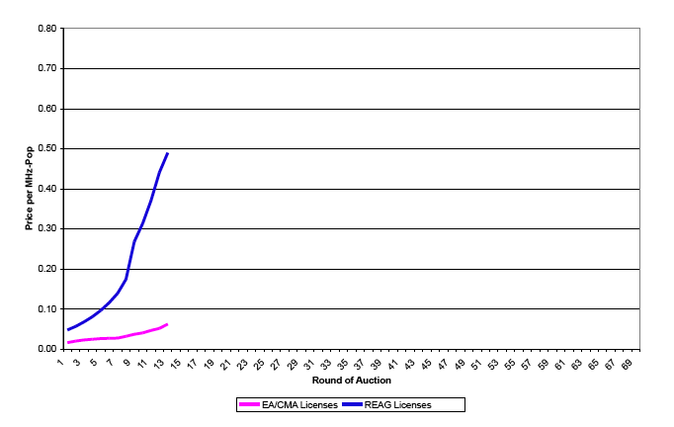
Bidding starts on big licenses

Slide 31
Deciding when to switch
Tempting to switch to small licenses because of lower prices, but activity rule makes it hard to switch back.
At round 13, the situation is
  Large licenses covering country (40 MHz): $5.0 bn
  Small licenses covering country (50 MHz): $0.7 bn
  “Money on the table” had peaked at $14.2 bn.
SpectrumCo gives up on large licenses, figuring they are going to be too expensive, but small ones might be ok.
The other major bidders continue on the large ones.
Notes:
31
Budget algebra: should be possible to buy 20 MHz footprint for no more than $2.6 billion.

Slide 32
Rising prices in AWS auction
Spectrumco
band switch

Slide 33
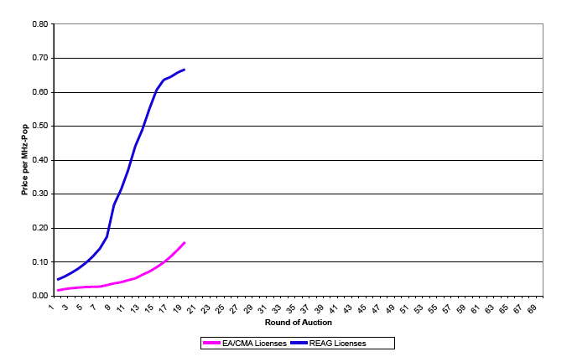
Rising prices in AWS auction

Slide 34
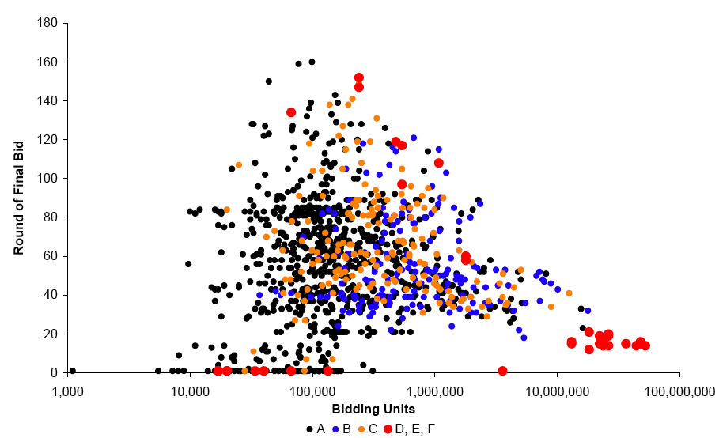
Timing of final bids in AWS
Large REAG licenses

Slide 35
Budget forecasting
At round 19, bidding ends on large licenses
  Total high bids on large licenses: $7.6 bn
  Total high bids on small licenses: $2.3 bn
  Auction is “about to begin” for small licenses!
Spectrumco’s concern: does it have enough budget to buy 40% of the small licenses (20 out of 50 MHz).
  Total money in the auction appears to be $14.2 bn.
  With $7.6 spent on large licenses, leaves $6.6 bn for small.
  Suggests that 20 MHz will cost $2.6 bn – if that’s right, we’ll have just enough money and will get a great deal. If not…

Slide 36
Prices at round 19

Slide 37
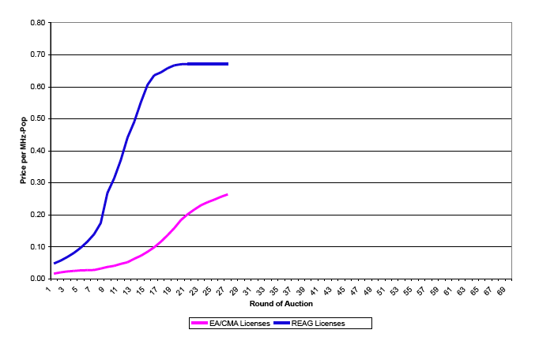
Prices bid up on small licenses
Price per MHz-pop of REAG licenses
Price per MHz-pop
of EA/CMA licenses

Slide 38
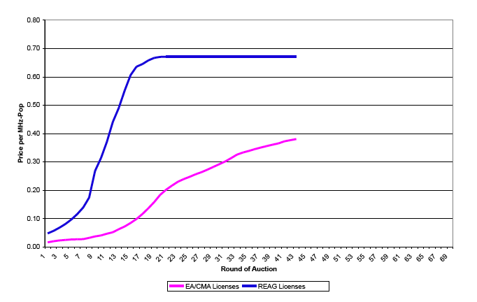
Prices bid up on small licenses
Price per MHz-pop of REAG licenses
Price per MHz-pop
of EA/CMA licenses

Slide 39
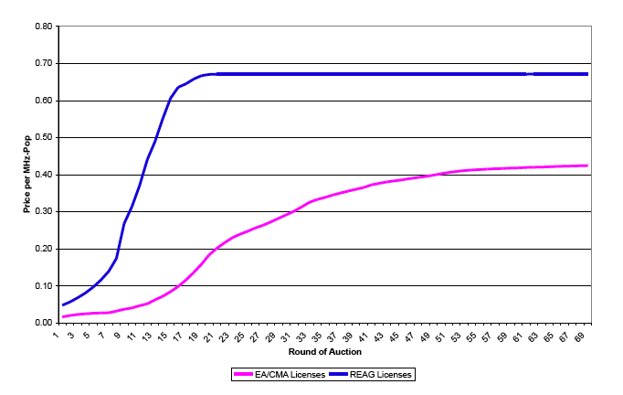
And then bidding tails off…
Price per MHz-pop of REAG licenses
Price per MHz-pop
of EA/CMA licenses

Slide 40
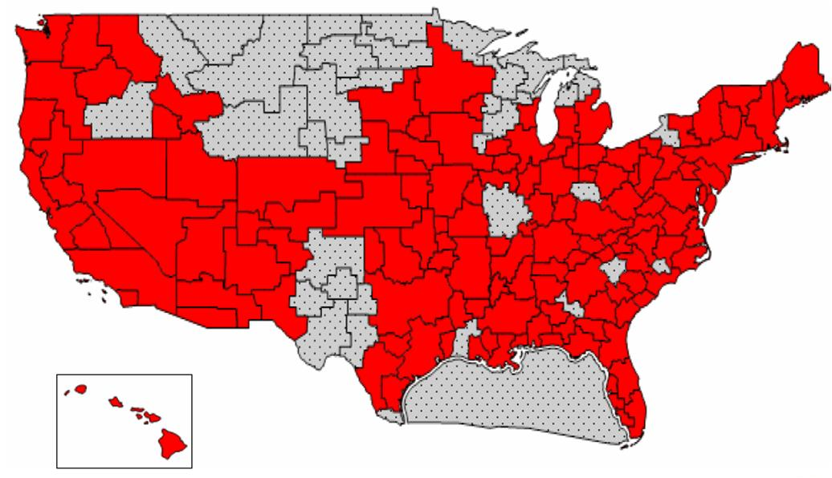
SpectrumCo’s Licenses (20 MHz)
Notes:
40
SpectrumCo’s licenses cover 91.7% of the U.S. population.

Slide 41
Failure of arbitrage
US auction of AWS spectrum (2006)
Band | MHz | Total Price | Price ($/MHz-pop) | Price (for US 20Mhz)
Small Licenses | 40 | $6.1 bn | $0.44 | $2.4 bn
Large Licenses | 50 | $7.6 bn | $0.67 | $3.8 bn
A surprising failure for essentially equivalent spectrum to sell for equivalent prices. Or … how we helped make Comcast a billion dollars on our summer vacation…

Slide 42
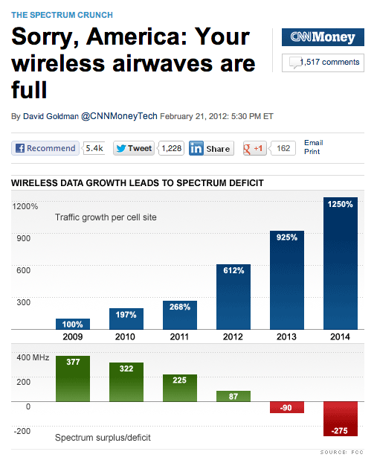
FCC Incentive Auctions
New problem for the FCC: spectrum has been fully allocated.

Slide 43
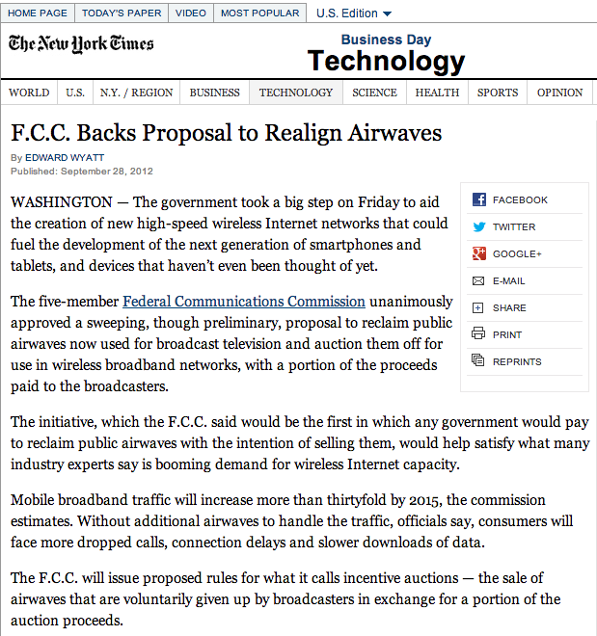
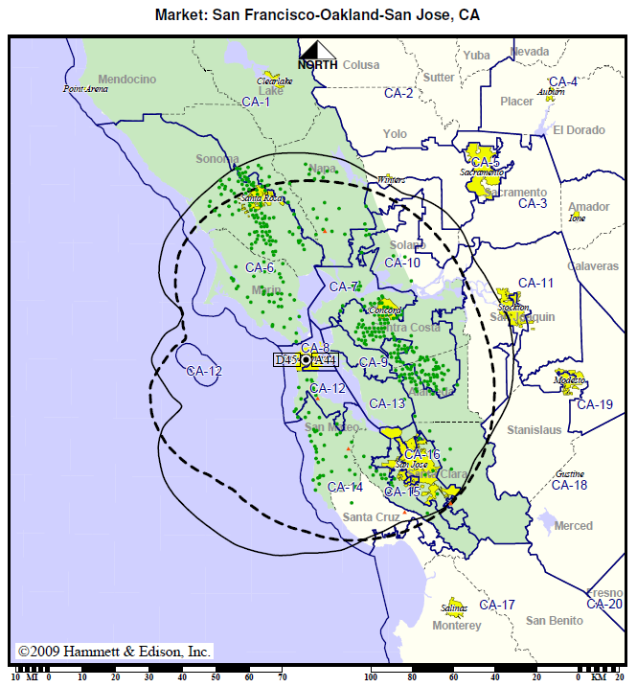
FCC Incentive Auctions
Some TV stations will go off-air and the rest will be “re-packed”, i.e. assigned new channels to they fit in a smaller amount of spectrum.

Slide 44
A Double Auction for Spectrum
$
Spectrum Cleared
Bids from television
broadcasters generate
a supply curve for
spectrum that can be
cleared.
Price paid by buyers
Revenue for US Treasury
The spring 2015 class will find out whether it works!
Price paid to sellers
Bids from wireless
companies generate
a demand curve for
newly free spectrum.
MHz

Slide 45
Conclusions
Allocation of radio spectrum has been a major impetus for modern auction design – complex, high-stakes problem where economic theory proves powerful.
Simultaneous ascending auction is commonly used
  Design has benefit that is gives bidders flexibility, reveals information, and in simple cases seems to promote efficiency.
  Practical concerns include lack of entry, demand reduction.
Complexities arise when bidders want packages, or if activity rules need to accommodate sale of many very different licenses. Designing better auctions for these circumstances is the current frontier.
Notes:
45

