Slide 1
Computing with Affective Lexicons
Affective, Sentimental, and Connotative Meaning in the Lexicon

Slide 2
Affective meaning
Drawing on literatures in
  affective computing (Picard 95)
  linguistic subjectivity (Wiebe and colleagues)
  social psychology (Pennebaker and colleagues)
Can we model the lexical semantics relevant to:
  sentiment
  emotion
  personality
  mood
  attitudes

Slide 3
Why compute affective meaning?
Detecting:
  sentiment towards politicians, products, countries, ideas
  frustration of callers to a help line
  stress in drivers or pilots
  depression and other medical conditions
  confusion in students talking to e-tutors
  emotions in novels (e.g., for studying groups that are feared over time)
Could we generate:
  emotions or moods for literacy tutors in the children’s storybook domain
  emotions or moods for computer games
  personalities for dialogue systems to match the user

Slide 4
Connotation in the lexicon
Words have connotation as well as sense
Can we build lexical resources that represent these connotations?
And use them in these computational tasks?

Slide 5
Scherer’s typology of affective states
Emotion: relatively brief episode of synchronized response of all or most organismic subsystems in response to the evaluation of an event as being of major significance
  angry, sad, joyful, fearful, ashamed, proud, desperate
Mood: diffuse affect state …change in subjective feeling, of low intensity but relatively long duration, often without apparent cause
  cheerful, gloomy, irritable, listless, depressed, buoyant
Interpersonal stance: affective stance taken toward another person in a specific interaction, coloring the interpersonal exchange
  distant, cold, warm, supportive, contemptuous
Attitudes: relatively enduring, affectively colored beliefs, preferences predispositions towards objects or persons
  liking, loving, hating, valuing, desiring
Personality traits: emotionally laden, stable personality dispositions and behavior tendencies, typical for a person
  nervous, anxious, reckless, morose, hostile, envious, jealous

Slide 6
Computing with Affective Lexicons
Sentiment Lexicons

Slide 7
Scherer’s typology of affective states
Emotion: relatively brief episode of synchronized response of all or most organismic subsystems in response to the evaluation of an event as being of major significance
  angry, sad, joyful, fearful, ashamed, proud, desperate
Mood: diffuse affect state …change in subjective feeling, of low intensity but relatively long duration, often without apparent cause
  cheerful, gloomy, irritable, listless, depressed, buoyant
Interpersonal stance: affective stance taken toward another person in a specific interaction, coloring the interpersonal exchange
  distant, cold, warm, supportive, contemptuous
Attitudes: relatively enduring, affectively colored beliefs, preferences predispositions towards objects or persons
  liking, loving, hating, valuing, desiring
Personality traits: emotionally laden, stable personality dispositions and behavior tendencies, typical for a person
  nervous, anxious, reckless, morose, hostile, envious, jealous

Slide 8
The General Inquirer
Philip J. Stone, Dexter C Dunphy, Marshall S. Smith, Daniel M. Ogilvie. 1966. The General Inquirer: A Computer Approach to Content Analysis. MIT Press
  Home page: http://www.wjh.harvard.edu/~inquirer
  List of Categories: http://www.wjh.harvard.edu/~inquirer/homecat.htm
  Spreadsheet: http://www.wjh.harvard.edu/~inquirer/inquirerbasic.xls
Categories:
  Positiv (1915 words) and Negativ (2291 words)
  Strong vs Weak, Active vs Passive, Overstated versus Understated
  Pleasure, Pain, Virtue, Vice, Motivation, Cognitive Orientation, etc
Free for Research Use

Slide 9
LIWC (Linguistic Inquiry and Word Count)
  Pennebaker, J.W., Booth, R.J., & Francis, M.E. (2007). Linguistic Inquiry and Word Count: LIWC 2007. Austin, TX
Home page: http://www.liwc.net/
2300 words, >70 classes
Affective Processes
  negative emotion (bad, weird, hate, problem, tough)
  positive emotion (love, nice, sweet)
Cognitive Processes
  Tentative (maybe, perhaps, guess), Inhibition (block, constraint)
Pronouns, Negation (no, never), Quantifiers (few, many)
$30 or $90 fee

Slide 10
MPQA Subjectivity Cues Lexicon
Theresa Wilson, Janyce Wiebe, and Paul Hoffmann (2005). Recognizing Contextual Polarity in
Phrase-Level Sentiment Analysis. Proc. of HLT-EMNLP-2005.
Riloff and Wiebe (2003). Learning extraction patterns for subjective expressions. EMNLP-2003.
Home page: http://www.cs.pitt.edu/mpqa/subj_lexicon.html
6885 words from 8221 lemmas
  2718 positive
  4912 negative
Each word annotated for intensity (strong, weak)
GNU GPL

Slide 11
Bing Liu Opinion Lexicon
Minqing Hu and Bing Liu. Mining and Summarizing Customer Reviews. ACM SIGKDD-2004.
Bing Liu's Page on Opinion Mining
http://www.cs.uic.edu/~liub/FBS/opinion-lexicon-English.rar
6786 words
  2006 positive
  4783 negative

Slide 12
SentiWordNet
  Stefano Baccianella, Andrea Esuli, and Fabrizio Sebastiani. 2010 SENTIWORDNET 3.0: An Enhanced Lexical Resource for Sentiment Analysis and Opinion Mining. LREC-2010
  Home page: http://sentiwordnet.isti.cnr.it/
  All WordNet synsets automatically annotated for degrees of positivity, negativity, and neutrality/objectiveness
  [estimable(J,3)] “may be computed or estimated”
  Pos 0 Neg 0 Obj 1
  [estimable(J,1)] “deserving of respect or high regard”
  Pos .75 Neg 0 Obj .25

Slide 13
Computing with Affective Lexicons
Sentiment Lexicons

Slide 14
Computing with Affective Lexicons
Other Affective Lexicons

Slide 15
Scherer’s typology of affective states
Emotion: relatively brief episode of synchronized response of all or most organismic subsystems in response to the evaluation of an event as being of major significance
  angry, sad, joyful, fearful, ashamed, proud, desperate
Mood: diffuse affect state …change in subjective feeling, of low intensity but relatively long duration, often without apparent cause
  cheerful, gloomy, irritable, listless, depressed, buoyant
Interpersonal stance: affective stance taken toward another person in a specific interaction, coloring the interpersonal exchange
  distant, cold, warm, supportive, contemptuous
Attitudes: relatively enduring, affectively colored beliefs, preferences predispositions towards objects or persons
  liking, loving, hating, valuing, desiring
Personality traits: emotionally laden, stable personality dispositions and behavior tendencies, typical for a person
  nervous, anxious, reckless, morose, hostile, envious, jealous

Slide 16
Two families of theories of emotion
Atomic basic emotions
  A finite list of 6 or 8, from which others are generated
Dimensions of emotion
  Valence (positive negative)
  Arousal (strong, weak)
  Control

Slide 17
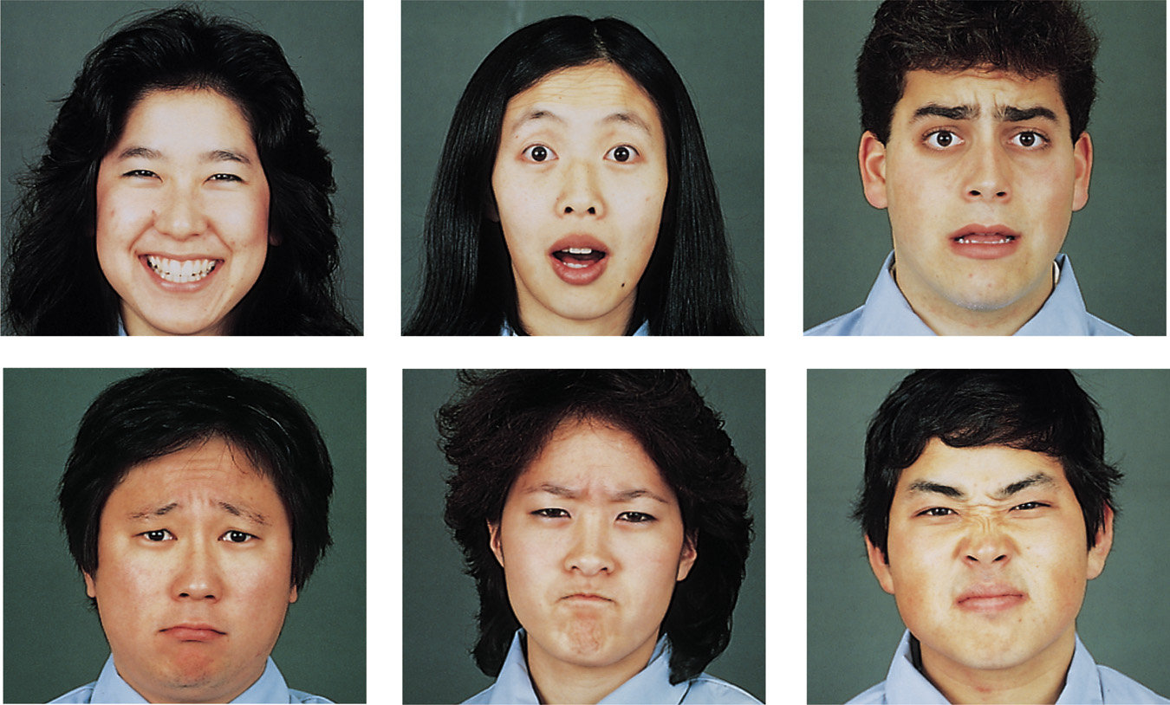
Ekman’s 6 basic emotions:
    Surprise, happiness, anger, fear, disgust, sadness

Slide 18
Valence/Arousal Dimensions
High arousal, low pleasure High arousal, high pleasure
anger excitement
Low arousal, low pleasure Low arousal, high pleasure
sadness relaxation
arousal
valence

Slide 19
Atomic units vs. Dimensions
Distinctive
Emotions are units.
Limited number of basic emotions.
Basic emotions are innate and universal
Dimensional
Emotions are dimensions.
Limited # of labels but unlimited number of emotions.
Emotions are culturally learned.
Adapted from Julia Braverman

Slide 20
One emotion lexicon from each paradigm!
8 basic emotions:
  NRC Word-Emotion Association Lexicon (Mohammad and Turney 2011)
Dimensions of valence/arousal/dominance
  Warriner, A. B., Kuperman, V., and Brysbaert, M. (2013)
Both built using Amazon Mechanical Turk

Slide 21
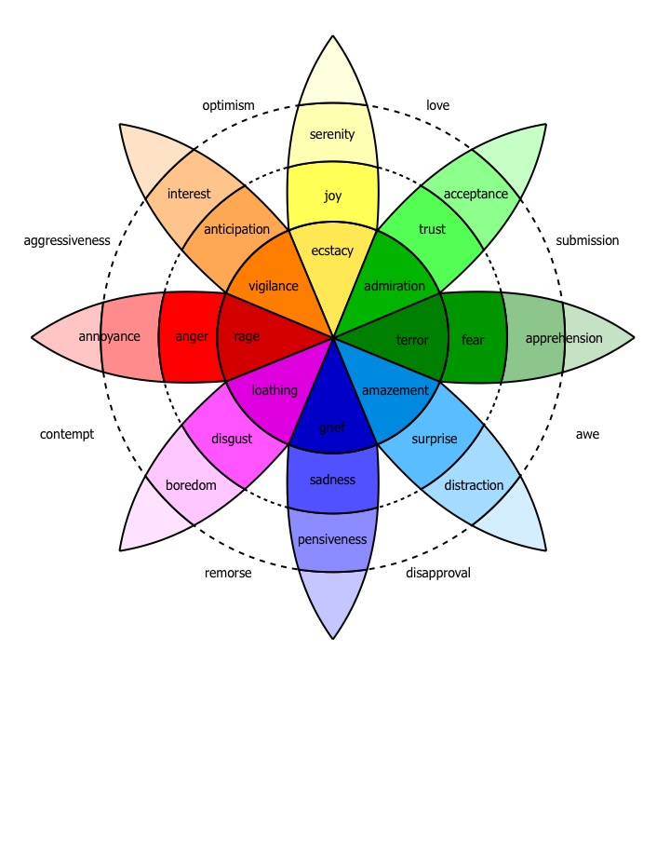
Plutchick’s wheel of emotion
8 basic emotions
in four opposing pairs:
  joy–sadness
  anger–fear
  trust–disgust
  anticipation–surprise

Slide 22
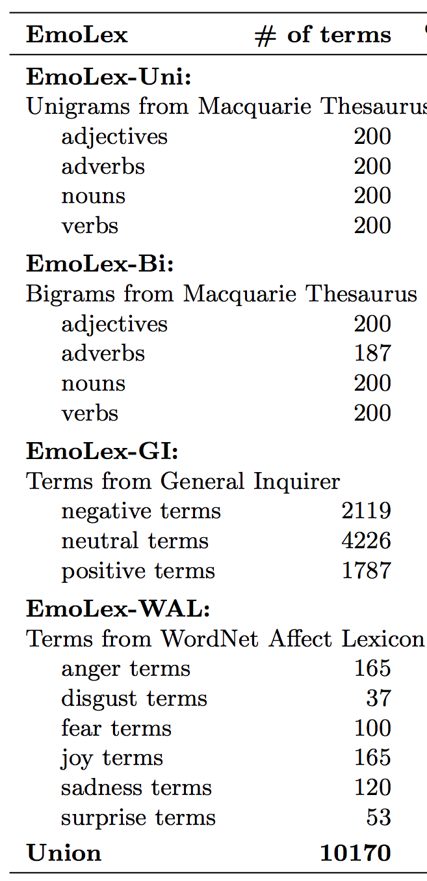
NRC Word-Emotion Association Lexicon
Mohammad and Turney 2011
10,000 words chosen mainly from earlier lexicons
Labeled by Amazon Mechanical Turk
5 Turkers per hit
Give Turkers an idea of the relevant sense of the word
Result:
  amazingly anger 0
  amazingly anticipation 0
  amazingly disgust 0
  amazingly fear 0
  amazingly joy 1
  amazingly sadness 0
  amazingly surprise 1
  amazingly trust 0
  amazingly negative 0
  amazingly positive 1

Slide 23
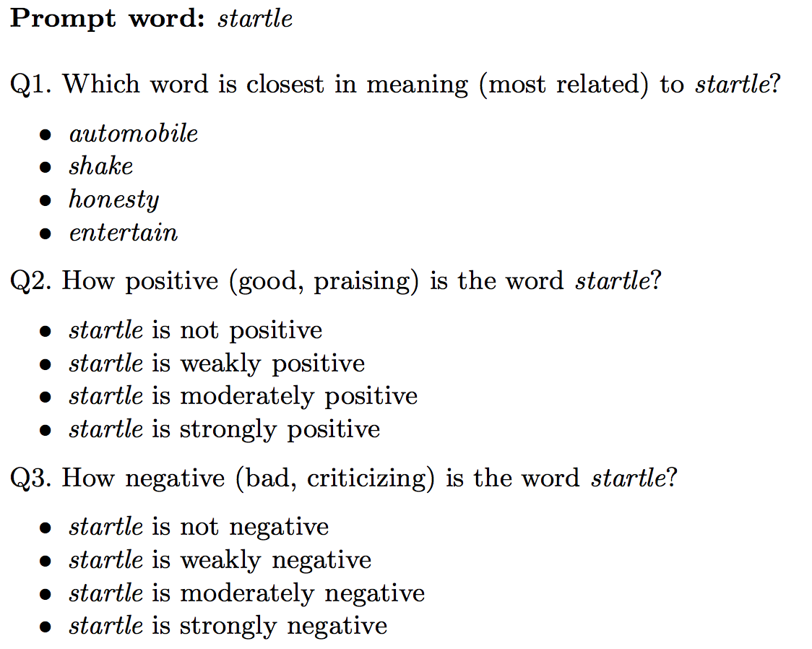
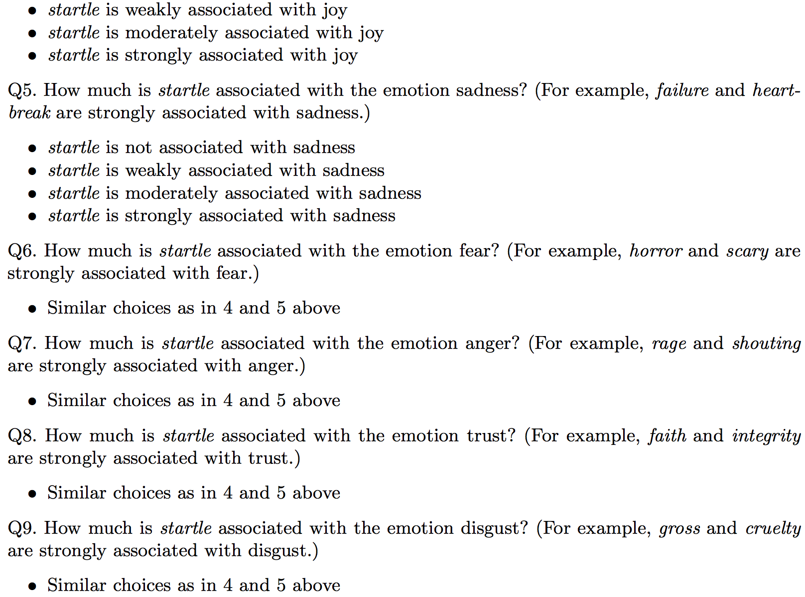
The AMT Hit
…

Slide 24
Lexicon of valence, arousal, and dominance
Warriner, A. B., Kuperman, V., and Brysbaert, M. (2013). Norms of valence, arousal, and dominance for 13,915 English lemmas. Behavior Research Methods 45, 1191-1207.
Supplementary data: This work is licensed under a Creative Commons Attribution-NonCommercial-NoDerivs 3.0 Unported License.
Ratings for 14,000 words for emotional dimensions:
  valence (the pleasantness of the stimulus)
  arousal (the intensity of emotion provoked by the stimulus)
  dominance (the degree of control exerted by the stimulus)

Slide 25
Lexicon of valence, arousal, and dominance
valence (the pleasantness of the stimulus)
  9: happy, pleased, satisfied, contented, hopeful
  1: unhappy, annoyed, unsatisfied, melancholic, despaired, or bored
arousal (the intensity of emotion provoked by the stimulus)
  9: stimulated, excited, frenzied, jittery, wide-awake, or aroused
  1: relaxed, calm, sluggish, dull, sleepy, or unaroused;
dominance (the degree of control exerted by the stimulus)
  9: in control, influential, important, dominant, autonomous, or controlling
  1: controlled, influenced, cared-for, awed, submissive, or guided
Again produced by AMT

Slide 26
Lexicon of valence, arousal, and dominance:
Examples
Valence |  | Arousal |  | Dominance
vacation | 8.53 | rampage | 7.56 | self | 7.74
happy | 8.47 | tornado | 7.45 | incredible | 7.74
whistle | 5.7 | zucchini | 4.18 | skillet | 5.33
conscious | 5.53 | dressy | 4.15 | concur | 5.29
torture | 1.4 | dull | 1.67 | earthquake | 2.14

Slide 27
Concreteness versus abstractness
The degree to which the concept denoted by a word refers to a perceptible entity.
  Do concrete and abstract words differ in connotation?
  Storage and retrieval?
  Bilingual processing?
  Relevant for embodied view of cognition (Barsalou 1999 inter alia)
    Do concrete words activate brain regions involved in relevant perception
Brysbaert, M., Warriner, A. B., and Kuperman, V. (2014) Concreteness ratings for 40 thousand generally known English word lemmas Behavior Research Methods 46, 904-911.
Supplementary data: This work is licensed under a Creative Commons Attribution-NonCommercial-NoDerivs 3.0 Unported License.
37,058 English words and 2,896 two-word expressions ( “zebra crossing” and “zoom in”),
Rating from 1 (abstract) to 5 (concrete)
  Calibrator words:
  shirt, infinity, gas, grasshopper, marriage, kick, polite, whistle, theory, and sugar

Slide 28
Concreteness versus abstractness
Brysbaert, M., Warriner, A. B., and Kuperman, V. (2014) Concreteness ratings for 40 thousand generally known English word lemmas Behavior Research Methods 46, 904-911.
Supplementary data: This work is licensed under a Creative Commons Attribution-NonCommercial-NoDerivs 3.0 Unported License.
Some example ratings from the final dataset of 40,000 words and phrases
  banana 5
  bathrobe 5
  bagel 5
  brisk 2.5
  badass 2.5
  basically 1.32
  belief 1.19
  although 1.07

Slide 29
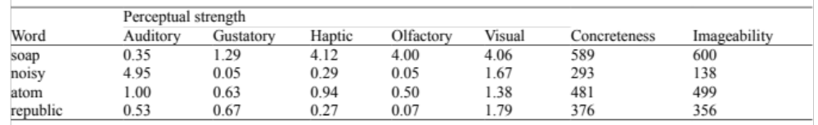

Perceptual Strength Norms
Connell and Lynott norms

Slide 30
Computing with Affective Lexicons
Semi-supervised algorithms for learning sentiment Lexicons

Slide 31
Semi-supervised learning of lexicons
Use a small amount of information
  A few labeled examples
  A few hand-built patterns
To bootstrap a lexicon

Slide 32
Hatzivassiloglou and McKeown intuition for identifying word polarity
Vasileios Hatzivassiloglou and Kathleen R. McKeown. 1997. Predicting the Semantic Orientation of Adjectives. ACL, 174–181
Adjectives conjoined by “and” have same polarity
  Fair and legitimate, corrupt and brutal
  *fair and brutal, *corrupt and legitimate
Adjectives conjoined by “but” do not
  fair but brutal

Slide 33
Hatzivassiloglou & McKeown 1997
Step 1
Label seed set of 1336 adjectives (all >20 in 21 million word WSJ corpus)
  657 positive
    adequate central clever famous intelligent remarkable reputed sensitive slender thriving…
  679 negative
    contagious drunken ignorant lanky listless primitive strident troublesome unresolved unsuspecting…

Slide 34
Hatzivassiloglou & McKeown 1997
Step 2
Expand seed set to conjoined adjectives
nice, helpful
nice, classy

Slide 35
Hatzivassiloglou & McKeown 1997
Step 3
Supervised classifier assigns “polarity similarity” to each word pair, resulting in graph:
brutal
helpful
corrupt
irrational
nice
fair
classy

Slide 36
Hatzivassiloglou & McKeown 1997
Step 4
Clustering for partitioning the graph into two
+
-
brutal
helpful
corrupt
irrational
nice
fair
classy

Slide 37
Output polarity lexicon
Positive
  bold decisive disturbing generous good honest important large mature patient peaceful positive proud sound stimulating straightforward strange talented vigorous witty…
Negative
  ambiguous cautious cynical evasive harmful hypocritical inefficient insecure irrational irresponsible minor outspoken pleasant reckless risky selfish tedious unsupported vulnerable wasteful…

Slide 38
Output polarity lexicon
Positive
  bold decisive disturbing generous good honest important large mature patient peaceful positive proud sound stimulating straightforward strange talented vigorous witty…
Negative
  ambiguous cautious cynical evasive harmful hypocritical inefficient insecure irrational irresponsible minor outspoken pleasant reckless risky selfish tedious unsupported vulnerable wasteful…

Slide 39
Turney Algorithm
Turney (2002): Thumbs Up or Thumbs Down? Semantic Orientation Applied to Unsupervised Classification of Reviews
Extract a phrasal lexicon from reviews
Learn polarity of each phrase
Rate a review by the average polarity of its phrases

Slide 40
Extract two-word phrases with adjectives
First Word | Second Word | Third Word (not extracted)
JJ | NN or NNS | anything
RB, RBR, RBS | JJ | Not NN nor NNS
JJ | JJ | Not NN or NNS
NN or NNS | JJ | Nor NN nor NNS
RB, RBR, or RBS | VB, VBD, VBN, VBG | anything

Slide 41
How to measure polarity of a phrase?
Positive phrases co-occur more with “excellent”
Negative phrases co-occur more with “poor”
But how to measure co-occurrence?

Slide 42
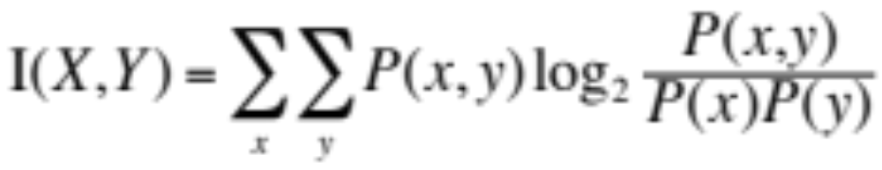
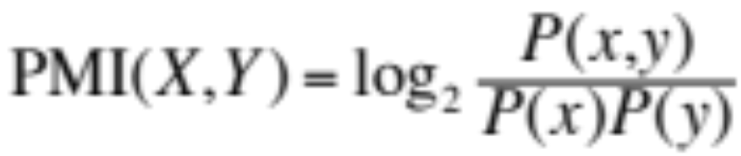
Pointwise Mutual Information
Mutual information between 2 random variables X and Y
Pointwise mutual information:
  How much more do events x and y co-occur than if they were independent?

Slide 43
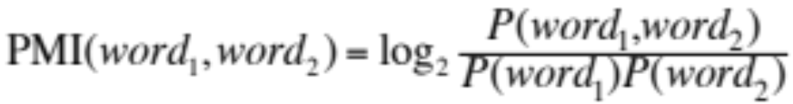
Pointwise Mutual Information
Pointwise mutual information:
  How much more do events x and y co-occur than if they were independent?
PMI between two words:
  How much more do two words co-occur than if they were independent?

Slide 44
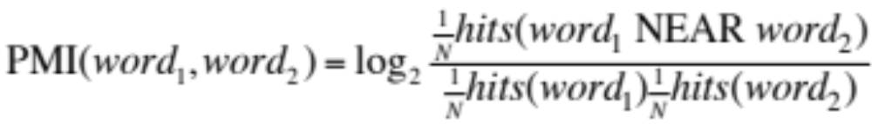
How to Estimate Pointwise Mutual Information
  Query search engine (Altavista)
    P(word) estimated by hits(word)/N
    P(word₁,word₂) by hits(word1 NEAR word2)/N
      (More correctly the bigram denominator should be kN, because there are a total of N consecutive bigrams (word1,word2), but kN bigrams that are k words apart, but we just use N on the rest of this slide and the next.)

Slide 45
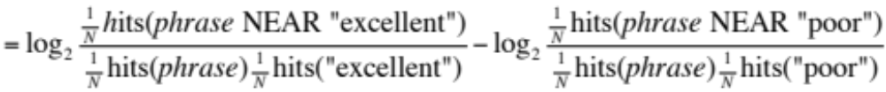
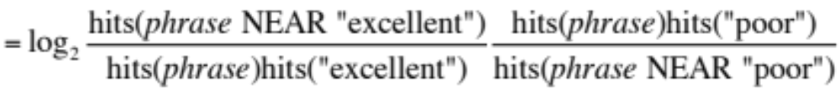
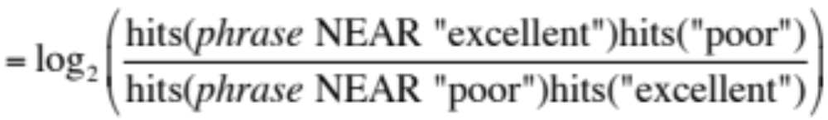
Does phrase appear more with “poor” or “excellent”?

Slide 46
Phrases from a thumbs-up review
Phrase | POS tags | Polarity
online service | JJ NN | 2.8
online experience | JJ NN | 2.3
direct deposit | JJ NN | 1.3
local branch | JJ NN | 0.42
…
low fees | JJ NNS | 0.33
true service | JJ NN | -0.73
other bank | JJ NN | -0.85
inconveniently located | JJ NN | -1.5
Average |  | 0.32

Slide 47
Phrases from a thumbs-down review
Phrase | POS tags | Polarity
direct deposits | JJ NNS | 5.8
online web | JJ NN | 1.9
very handy | RB JJ | 1.4
…
virtual monopoly | JJ NN | -2.0
lesser evil | RBR JJ | -2.3
other problems | JJ NNS | -2.8
low funds | JJ NNS | -6.8
unethical practices | JJ NNS | -8.5
Average |  | -1.2

Slide 48
Results of Turney algorithm
410 reviews from Epinions
  170 (41%) negative
  240 (59%) positive
Majority class baseline: 59%
Turney algorithm: 74%
Phrases rather than words
Learns domain-specific information

Slide 49
Using WordNet to learn polarity
S.M. Kim and E. Hovy. 2004. Determining the sentiment of opinions. COLING 2004
M. Hu and B. Liu. Mining and summarizing customer reviews. In Proceedings of KDD, 2004
WordNet: online thesuarus
Create positive (“good”) and negative seed-words (“terrible”)
Find Synonyms and Antonyms
  Positive Set: Add synonyms of positive words (“well”) and antonyms of negative words
  Negative Set: Add synonyms of negative words (“awful”) and antonyms of positive words (”evil”)
Repeat, following chains of synonyms
Filter

Slide 50
Summary on semi-supervised lexicon learning
Advantages:
  Can be domain-specific
  Can be more robust (more words)
Intuition
  Start with a seed set of words (‘good’, ‘poor’)
  Find other words that have similar polarity:
    Using “and” and “but”
    Using words that occur nearby in the same document
    Using WordNet synonyms and antonyms
    Use seeds and semi-supervised learning to induce lexicons

Slide 51
Computing with Affective Lexicons
Supervised Learning of Sentiment Lexicons

Slide 52
Learn word sentiment supervised by online review scores
Potts, Christopher. 2011. On the negativity of negation. SALT 20, 636-659.
Potts 2011 NSF Workshop talk.
Review datasets
  IMDB, Goodreads, Open Table, Amazon, Trip Advisor
Each review has a score (1-5, 1-10, etc)
Just count how many times each word occurs with each score
  (and normalize)

Slide 53
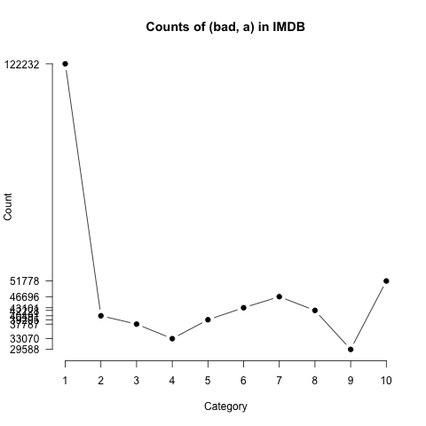
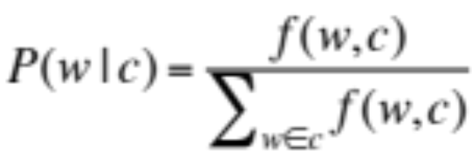
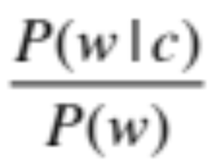
Analyzing the polarity of each word in IMDB
Potts, Christopher. 2011. On the negativity of negation. SALT 20, 636-659.
How likely is each word to appear in each sentiment class?
Count(“bad”) in 1-star, 2-star, 3-star, etc.
But can’t use raw counts:
Instead, likelihood:
Make them comparable between words
  Scaled likelihood:
Notes:
Thanks to Chris Potts for permission to use figure

Slide 54
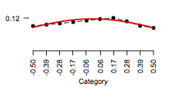
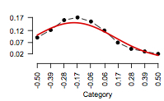
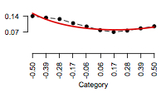
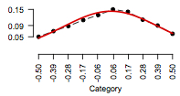
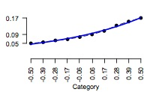
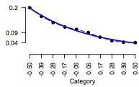
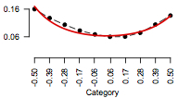
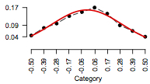
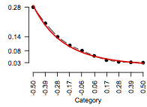
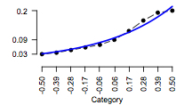
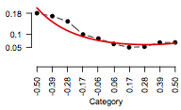
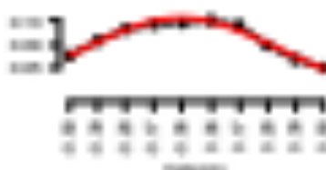
“Potts diagrams”
Potts, Christopher. 2011. NSF workshop on restructuring adjectives.
Positive scalars
Negative scalars
Emphatics
Attenuators
good
disappointing
somewhat
totally
absolutely
fairly
great
bad
excellent
pretty
terrible
utterly

Slide 55
Or use regression coefficients to weight words
Train a classifier based on supervised data
  Predict: human-labeled connotation of a document
  From: all the words and bigrams in it
Use the regression coefficients as the weights
We’ll return to an example of this in the next section.

Slide 56
Computing with Affective Lexicons
Using the lexicons to detect affect

Slide 57
Lexicons for detecting document affect:
Simplest unsupervised method
Sentiment:
  Sum the weights of each positive word in the document
  Sum the weights of each negative word in the document
  Choose whichever value (positive or negative) has higher sum
Emotion:
  Do the same for each emotion lexicon

Slide 58
Lexicons for detecting document affect:
Simplest supervised method
Build a classifier
  Predict sentiment (or emotion, or personality) given features
  Use “counts of lexicon categories” as a features
  Sample features:
    LIWC category “cognition” had count of 7
    NRC Emotion category “anticipation” had count of 2
Baseline
  Instead use counts of all the words and bigrams in the training set
  This is hard to beat
  But only works if the training and test sets are very similar

Slide 59
Computing with Affective Lexicons
Sample affective task: personality detection

Slide 60
Sample affective task: personality detection

Slide 61
Scherer’s typology of affective states
Emotion: relatively brief episode of synchronized response of all or most organismic subsystems in response to the evaluation of an event as being of major significance
  angry, sad, joyful, fearful, ashamed, proud, desperate
Mood: diffuse affect state …change in subjective feeling, of low intensity but relatively long duration, often without apparent cause
  cheerful, gloomy, irritable, listless, depressed, buoyant
Interpersonal stance: affective stance taken toward another person in a specific interaction, coloring the interpersonal exchange
  distant, cold, warm, supportive, contemptuous
Attitudes: relatively enduring, affectively colored beliefs, preferences predispositions towards objects or persons
  liking, loving, hating, valuing, desiring
Personality traits: emotionally laden, stable personality dispositions and behavior tendencies, typical for a person
  nervous, anxious, reckless, morose, hostile, envious, jealous

Slide 62
The Big Five Dimensions of Personality
Extraversion vs. Introversion
  sociable, assertive, playful vs. aloof, reserved, shy
Emotional stability vs. Neuroticism
  calm, unemotional vs. insecure, anxious
Agreeableness vs. Disagreeable
  friendly, cooperative vs. antagonistic, faultfinding
Conscientiousness vs. Unconscientious
  self-disciplined, organised vs. inefficient, careless
Openness to experience
  intellectual, insightful vs. shallow, unimaginative
62

Slide 63
Various text corpora labeled for personality of author
Pennebaker, James W., and Laura A. King. 1999. "Linguistic styles: language use as an individual difference." Journal of personality and social psychology 77, no. 6.
  2,479 essays from psychology students (1.9 million words), “write whatever comes into your mind” for 20 minutes
Mehl, Matthias R, SD Gosling, JW Pennebaker. 2006. Personality in its natural habitat: manifestations and implicit folk theories of personality in daily life. Journal of personality and social psychology 90 (5), 862
  Speech from Electronically Activated Recorder (EAR)
  Random snippets of conversation recorded, transcribed
  96 participants, total of 97,468 words and 15,269 utterances
Schwartz, H. Andrew, Johannes C. Eichstaedt, Margaret L. Kern, Lukasz Dziurzynski, Stephanie M. Ramones, Megha Agrawal, Achal Shah et al. 2013. "Personality, gender, and age in the language of social media: The open-vocabulary approach." PloS one 8, no. 9
  Facebook
  75,000 volunteers
  309 million words
  All took a personality test

Slide 64
Ears (speech) corpus (Mehl et al.)

Slide 65
Essays corpus (Pennebaker and King)

Slide 66
Classifiers
Mairesse, François, Marilyn A. Walker, Matthias R. Mehl, and Roger K. Moore. "Using linguistic cues for the automatic recognition of personality in conversation and text." Journal of artificial intelligence research (2007): 457-500.
  Various classifiers, lexicon-based and prosodic features
Schwartz, H. Andrew, Johannes C. Eichstaedt, Margaret L. Kern, Lukasz Dziurzynski, Stephanie M. Ramones, Megha Agrawal, Achal Shah et al. 2013. "Personality, gender, and age in the language of social media: The open-vocabulary approach." PloS one 8, no.
  regression and SVM, lexicon-based and all-words

Slide 67
Sample LIWC Features
LIWC (Linguistic Inquiry and Word Count)
  Pennebaker, J.W., Booth, R.J., & Francis, M.E. (2007). Linguistic Inquiry and Word Count: LIWC 2007. Austin, TX

Slide 68
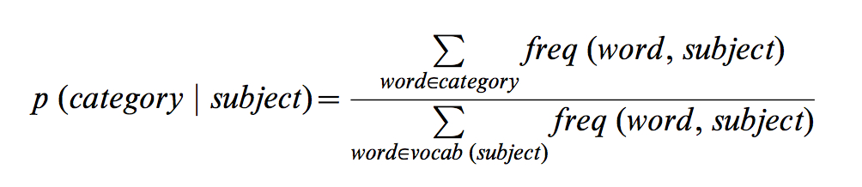
Normalizing LIWC category features
(Schwartz et al 2013, Facebook study)
Mairesse:
Raw LIWC counts
Schwartz et al:
Normalized per writer:

Slide 69
Sample results
Agreeable:
  +Family, +Home, -Anger, -Swear
Extravert
  +Friend, +Religion, +Self
Conscientiousness:
  -Swear, -Anger, -NegEmotion,
Emotional Stability:
  -NegEmotion, +Sports,
Openness
  -Cause, -Space

Slide 70
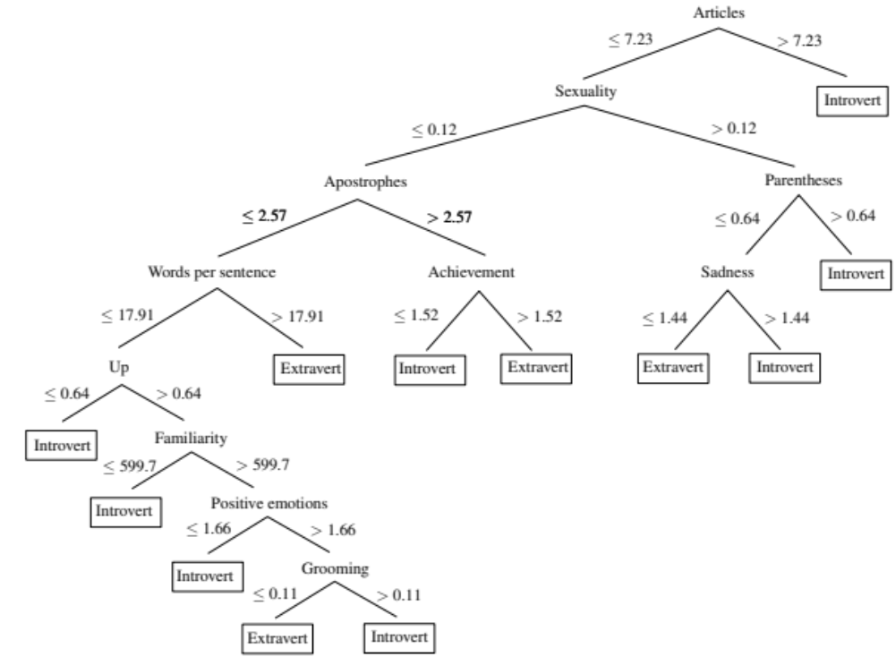
Decision tree for predicting extraversion in essay corpus (Mairesse et al)

Slide 71
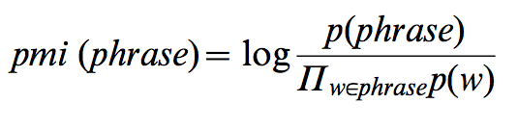
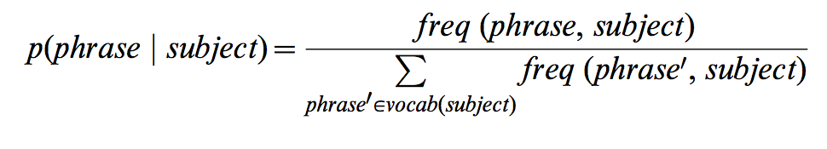
Using all words instead of lexicons
Facebook study
Schwartz et al. (2013)
Choosing phrases with pmi > 2*length [in words]
Only use words/phrases used by at least 1% of writers
Normalize counts of words and phrases by writer

Slide 72
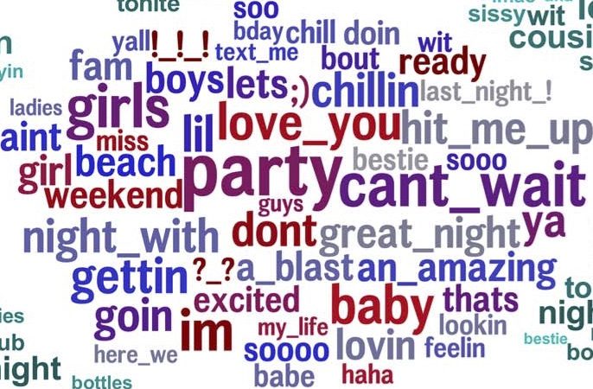
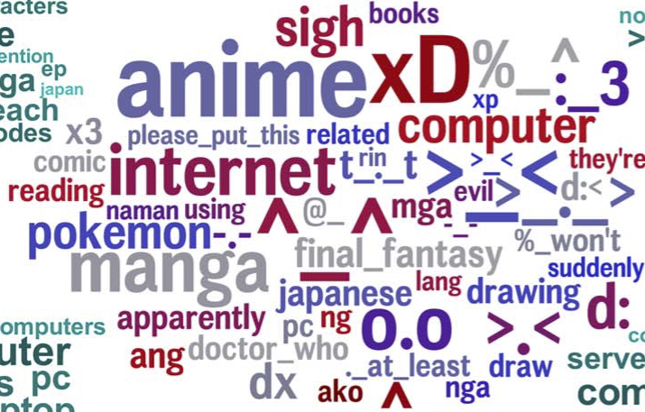
Facebook study, Learned words,
Extraversion versus Introversion

Slide 73
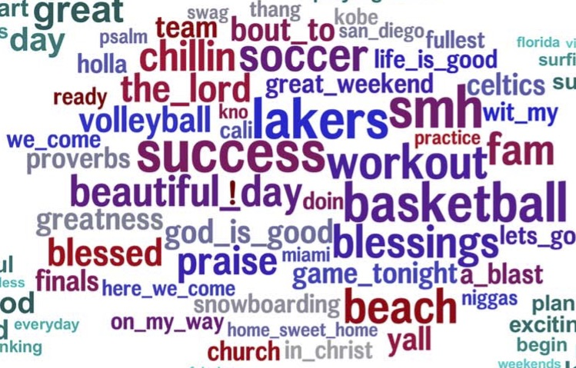
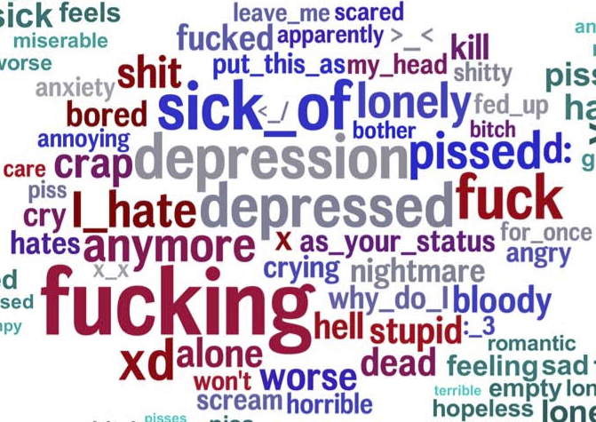
Facebook study, Learned words
Neuroticism versus Emotional Stability

Slide 74
Evaluating Schwartz et al (2013) Facebook Classifier
Train on labeled training data
  LIWC category counts
  words and phrases (n-grams of size 1 to 3, passing a collocation filter
Tested on a held-out set
Correlations with human labels
  LIWC .21-.29
  All Words .29-.41

Slide 75
Affect extraction: of course it’s not just the lexicon
Ranganath et al (2013), McFarland et al (2014)
Detecting interpersonal stance in conversation
Speed dating study, 1000 4-minute speed dates
Subjects labeled selves and each other for
    friendly (each on a scale of 1-10)
    awkward
    flirtatious
    assertive

Slide 76
Scherer’s typology of affective states
Emotion: relatively brief episode of synchronized response of all or most organismic subsystems in response to the evaluation of an event as being of major significance
  angry, sad, joyful, fearful, ashamed, proud, desperate
Mood: diffuse affect state …change in subjective feeling, of low intensity but relatively long duration, often without apparent cause
  cheerful, gloomy, irritable, listless, depressed, buoyant
Interpersonal stance: affective stance taken toward another person in a specific interaction, coloring the interpersonal exchange
  distant, cold, warm, supportive, contemptuous
Attitudes: relatively enduring, affectively colored beliefs, preferences predispositions towards objects or persons
  liking, loving, hating, valuing, desiring
Personality traits: emotionally laden, stable personality dispositions and behavior tendencies, typical for a person
  nervous, anxious, reckless, morose, hostile, envious, jealous

Slide 77
Affect extraction: of course it’s not just the lexicon
Logistic regression classifier with
LIWC lexicons
Other lexical features
  Lists of hedges
Prosody (pitch and energy means and variance)
Discourse features
  Interruptions
  Dialog acts/Adjacency pairs
    sympathy (“Oh, that’s terrible”)
    clarification question (“What?”)
    appreciations (“That’s awesom!”)

Slide 78
Results on affect extraction
Friendliness
  -negEmotion
  -hedge
  higher pitch
Awkwardness
  +negation
  +hedges
  +questions

Slide 79
Scherer’s typology of affective states
Emotion: relatively brief episode of synchronized response of all or most organismic subsystems in response to the evaluation of an event as being of major significance
  angry, sad, joyful, fearful, ashamed, proud, desperate
Mood: diffuse affect state …change in subjective feeling, of low intensity but relatively long duration, often without apparent cause
  cheerful, gloomy, irritable, listless, depressed, buoyant
Interpersonal stance: affective stance taken toward another person in a specific interaction, coloring the interpersonal exchange
  distant, cold, warm, supportive, contemptuous
Attitudes: relatively enduring, affectively colored beliefs, preferences predispositions towards objects or persons
  liking, loving, hating, valuing, desiring
Personality traits: emotionally laden, stable personality dispositions and behavior tendencies, typical for a person
  nervous, anxious, reckless, morose, hostile, envious, jealous

Slide 80
Summary: Connotation in the lexicon
Words have various connotational aspects
Methods for building connotation lexicons
  Based on theoretical models of emotion, sentiment
  By hand (mainly using crowdsourcing)
  Semi-supervised learning from seed words
  Fully supervised (when you can find a convenient signal in the world)
Applying lexicons to detect affect and sentiment
  Unsupervised: pick simple majority sentiment (positive/negative words)
  Supervised: learn weights for each lexical category

