Slide 1
Learning Thesauruses and Knowledge Bases
Thesaurus induction and relation extraction

Slide 2

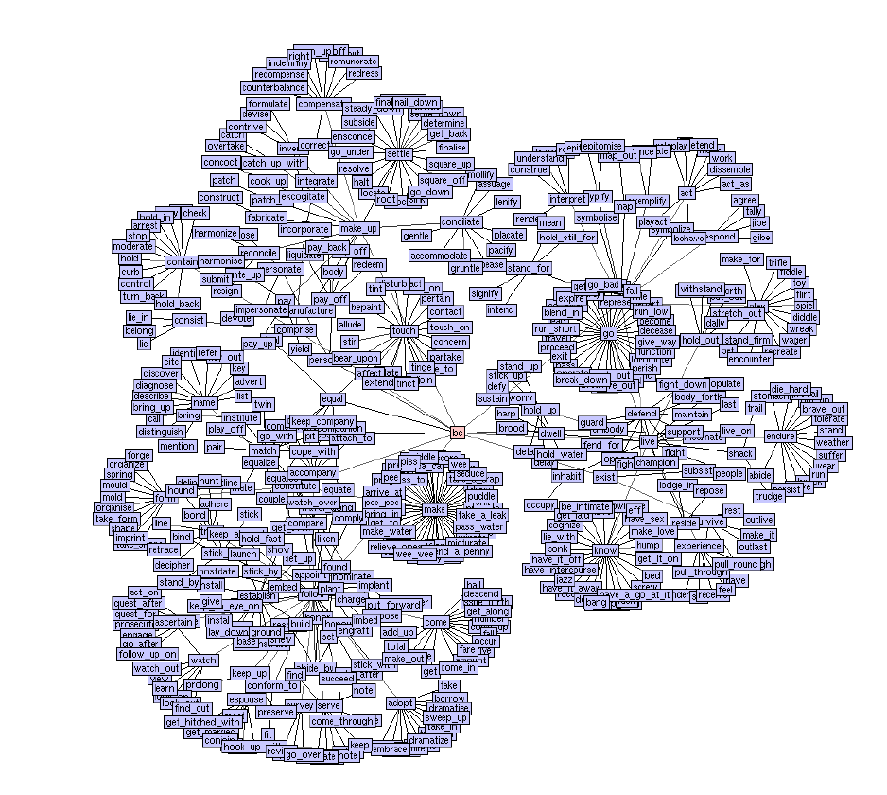
What is thesaurus induction?
Relation extraction
A structured, consistent thesaurus of sense-disambiguated synsets
  Lexico-syntactic patterns (Hearst, 1992),
  LRA (Turney, 2005),
  Espresso (Pantel & Pennacchiotti, 2006),
  Distributional similarity…
bambara
ndang
IS-A
bow lute
Taxonomy
Induction
IS-A
ostrich
bird
wallaby
is-like
kangaroo
And hundreds of thousands more…

Slide 3
Thesaurus induction is a special case of relation extraction
IS-A (hypernym): subsumption between classes
  Giraffe IS-A ruminant IS-A ungulate IS-A mammal IS-A vertebrate IS-A animal…
Instance-of: relation between individual and class
  San Francisco instance-of city
Co-ordinate term (co-hyponym)
  Chicago, Boston, Austin, Los Angeles
Meronym
  Bumper is-part-of car

Slide 4
Extracting relations from text
Company report: “International Business Machines Corporation (IBM or the company) was incorporated in the State of New York on June 16, 1911, as the Computing-Tabulating-Recording Co. (C-T-R)…”
Extracted Complex Relation:
        Company-Founding
          Company IBM
          Location New York
          Date June 16, 1911
          Original-Name Computing-Tabulating-Recording Co.
But we will focus on the simpler task of extracting relation triples
        Founding-year(IBM,1911)
        Founding-location(IBM,New York)

Slide 5
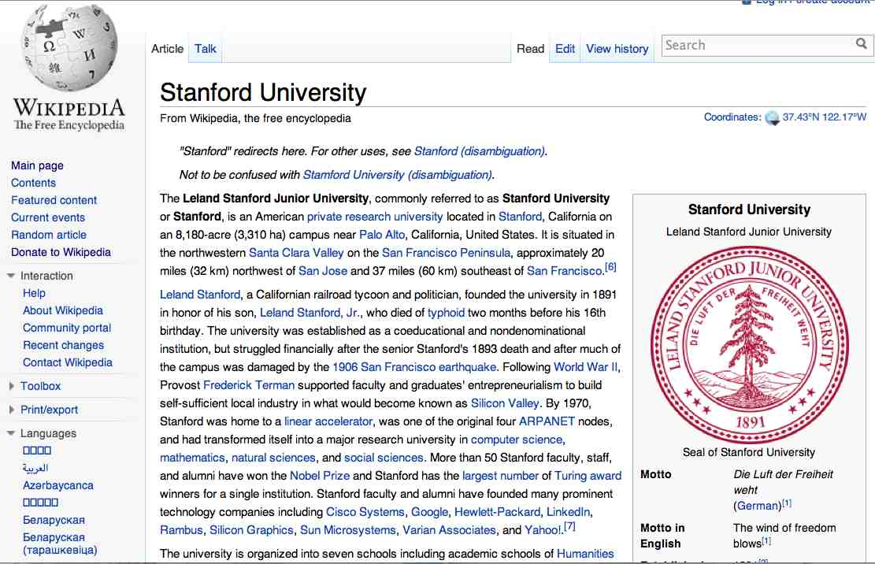
Extracting Relation Triples from Text
The Leland Stanford Junior University, commonly referred to as Stanford University or Stanford, is an American private research university located in Stanford, California … near Palo Alto, California… Leland Stanford…founded the university in 1891
Stanford EQ Leland Stanford Junior University
Stanford LOC-IN California
Stanford IS-A research university
Stanford LOC-NEAR Palo Alto
Stanford FOUNDED-IN 1891
Stanford FOUNDER Leland Stanford

Slide 6
Why Relation Extraction?
Create new structured knowledge bases
Augment current knowledge bases
  Lexical resources: Add words to WordNet thesaurus
  Fact bases: Add facts to FreeBase or DBPedia
Sample application: question answering
  The granddaughter of which actor starred in the movie “E.T.”?
  (acted-in ?x “E.T.”)(is-a ?y actor)(granddaughter-of ?x ?y)
But which relations should we extract?

Slide 7
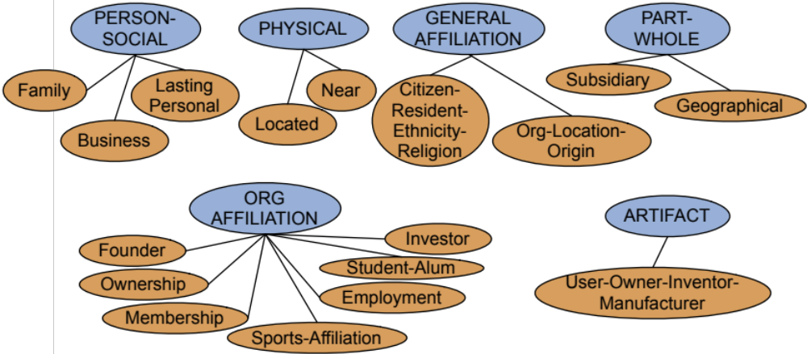
Automated Content Extraction (ACE)
17 relations from 2008 “Relation Extraction Task”

Slide 8
Automated Content Extraction (ACE)
Physical-Located PER-GPE
  He was in Tennessee
Part-Whole-Subsidiary ORG-ORG
  XYZ, the parent company of ABC
Person-Social-Family PER-PER
  John’s wife Yoko
Org-AFF-Founder PER-ORG
  Steve Jobs, co-founder of Apple…

Slide 9
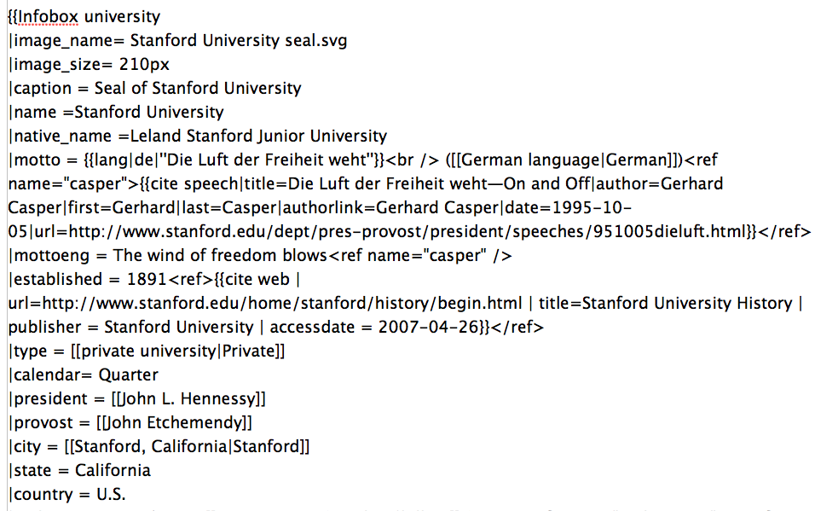
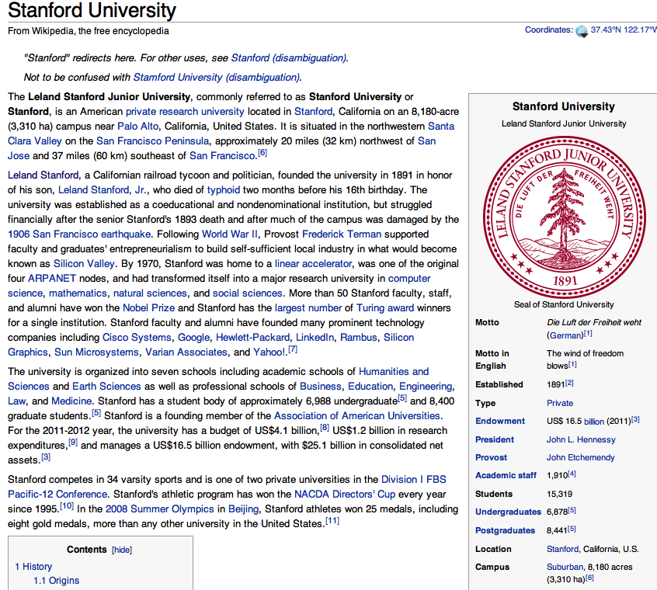
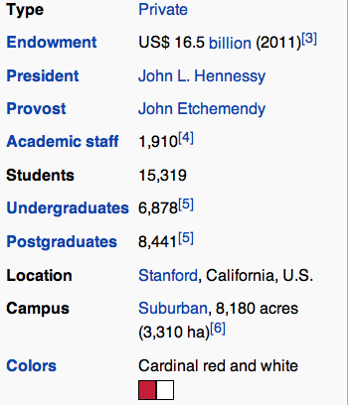
Databases of Wikipedia Relations
Wikipedia Infobox
Relations extracted from Infobox
Stanford state California
Stanford motto “Die Luft der Freiheit weht”
…

Slide 10
Thesaurus relations
IS-A (hypernym): subsumption between classes
  Giraffe IS-A ruminant IS-A ungulate IS-A mammal IS-A vertebrate IS-A animal…
Instance-of: relation between individual and class
  San Francisco instance-of city
Co-ordinate term (co-hyponym)
  Chicago, Boston, Austin, Los Angeles
Meronym
  bumperis-part-of car

Slide 11
Relation databases that draw from Wikipedia
Resource Description Framework (RDF) triples
  subject predicate object
  Golden Gate Park location San Francisco
  dbpedia:Golden_Gate_Park dbpedia-owl:location dbpedia:San_Francisco
DBPedia: 1 billion RDF triples, 385 from English Wikipedia
Frequent Freebase relations:
    people/person/nationality, location/location/contains
    people/person/profession, people/person/place-of-birth
    biology/organism_higher_classification film/film/genre

Slide 12
How to build relation extractors
Hand-written patterns
Supervised machine learning
Semi-supervised and unsupervised
  Bootstrapping (using seeds)
  Distant supervision
  Unsupervised learning from the web

Slide 13
Learning Thesauruses and Knowledge Bases
Using patterns to extract relations

Slide 14
Rules for extracting IS-A relation
Early intuition from Hearst (1992)
  “Agar is a substance prepared from a mixture of red algae, such as Gelidium, for laboratory or industrial use”
What does Gelidium mean?
How do you know?`

Slide 15
Rules for extracting IS-A relation
Early intuition from Hearst (1992)
  “Agar is a substance prepared from a mixture of red algae, such as Gelidium, for laboratory or industrial use”
What does Gelidium mean?
How do you know?`

Slide 16
Hearst’s Patterns for extracting IS-A relations
(Hearst, 1992): Automatic Acquisition of Hyponyms
“Y such as X ((, X)* (, and|or) X)”
“such Y as X”
“X or other Y”
“X and other Y”
“Y including X”
“Y, especially X”

Slide 17
Hearst’s Patterns for extracting IS-A relations
Hearst pattern | Example occurrences
X and other Y | ...temples, treasuries, and other important civic buildings.
X or other Y | Bruises, wounds, broken bones or other injuries...
Y such as X | The bow lute, such as the Bambara ndang...
Such Y as X | ...such authors as Herrick, Goldsmith, and Shakespeare.
Y including X | ...common-law countries, including Canada and England...
Y , especially X | European countries, especially France, England, and Spain...

Slide 18
Extracting Richer Relations Using Rules
Intuition: relations often hold between specific entities
  located-in (ORGANIZATION, LOCATION)
  founded (PERSON, ORGANIZATION)
  cures (DRUG, DISEASE)
Start with Named Entity tags to help extract relation!

Slide 19


Named Entities aren’t quite enough.
Which relations hold between 2 entities?
Cure?
Prevent?
Drug
Cause?
Disease
Notes:
Drug and disease pictures from Wikimedia Commons
http://commons.wikimedia.org/wiki/File:Gnome-face-sick.svg

Slide 20
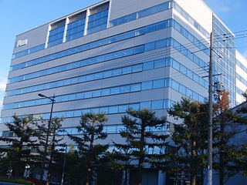

What relations hold between 2 entities?
Founder?
Investor?
Member?
PERSON
ORGANIZATION
Employee?
President?
Notes:
pictures from Wikimedia Commons
http://upload.wikimedia.org/wikipedia/commons/thumb/9/9a/Sanyo_Electric_Corporation.JPG/320px-Sanyo_Electric_Corporation.JPG

Slide 21
Extracting Richer Relations Using Rules and
Named Entities
Who holds what office in what organization?
  PERSON, POSITION of ORG
    George Marshall, Secretary of State of the United States
  PERSON(named|appointed|chose|etc.) PERSON Prep? POSITION
    Truman appointed Marshall Secretary of State
  PERSON [be]? (named|appointed|etc.) Prep? ORG POSITION
    George Marshall was named US Secretary of State

Slide 22
Hand-built patterns for relations
Plus:
  Human patterns tend to be high-precision
  Can be tailored to specific domains
Minus
  Human patterns are often low-recall
  A lot of work to think of all possible patterns!
  Don’t want to have to do this for every relation!
  We’d like better accuracy

Slide 23
Learning Thesauruses and Knowledge Bases
Using patterns to extract relations

Slide 24
Learning Thesauruses and Knowledge Bases
Supervised relation extraction

Slide 25
Supervised machine learning for relations
Choose a set of relations we’d like to extract
Choose a set of relevant named entities
Find and label data
  Choose a representative corpus
  Label the named entities in the corpus
  Hand-label the relations between these entities
  Break into training, development, and test
Train a classifier on the training set

Slide 26
How to do classification in supervised relation extraction
Find all pairs of named entities (usually in same sentence)
Decide if 2 entities are related
If yes, classify the relation
Why the extra step?
  Faster classification training by eliminating most pairs
  Can use distinct feature-sets appropriate for each task.

Slide 27
Automated Content Extraction (ACE)
17 sub-relations of 6 relations from 2008 “Relation Extraction Task”

Slide 28

Relation Extraction
Classify the relation between two entities in a sentence
American Airlines, a unit of AMR, immediately matched the move, spokesman Tim Wagner said.
EMPLOYMENT
FAMILY
NIL
CITIZEN
…
INVENTOR
SUBSIDIARY
FOUNDER

Slide 29
Word Features for Relation Extraction
American Airlines, a unit of AMR, immediately matched the move, spokesman Tim Wagner said
Mention 1
Mention 2
Headwords of M1 and M2, and combination
    Airlines Wagner Airlines-Wagner
Bag of words and bigrams in M1 and M2
{American, Airlines, Tim, Wagner, American Airlines, Tim Wagner}
Words or bigrams in particular positions left and right of M1/M2
    M2: -1 spokesman
    M2: +1 said
Bag of words or bigrams between the two entities
  {a, AMR, of, immediately, matched, move, spokesman, the, unit}

Slide 30
Named Entity Type and Mention Level
Features for Relation Extraction
American Airlines, a unit of AMR, immediately matched the move, spokesman Tim Wagner said
Mention 1
Mention 2
Named-entity types
  M1: ORG
  M2: PERSON
Concatenation of the two named-entity types
  ORG-PERSON
Entity Level of M1 and M2 (NAME, NOMINAL, PRONOUN)
  M1: NAME [it or he would be PRONOUN]
  M2: NAME [the company would be NOMINAL]

Slide 31
Parse Features for Relation Extraction
American Airlines, a unit of AMR, immediately matched the move, spokesman Tim Wagner said
Mention 1
Mention 2
Base syntactic chunk sequence from one to the other
  NP NP PP VP NP NP
Constituent path through the tree from one to the other
  NP ⬆ NP ⬆ S ⬆ S ⬇ NP
Dependency path
Airlines matched Wagner said
subj
comp
subj

Slide 32
Gazeteer and trigger word features for relation extraction
Trigger list for family: kinship terms
  parent, wife, husband, grandparent, etc. [from WordNet]
Gazeteer:
  Lists of useful geo or geopolitical words
    Country name list
    Other sub-entities

Slide 33
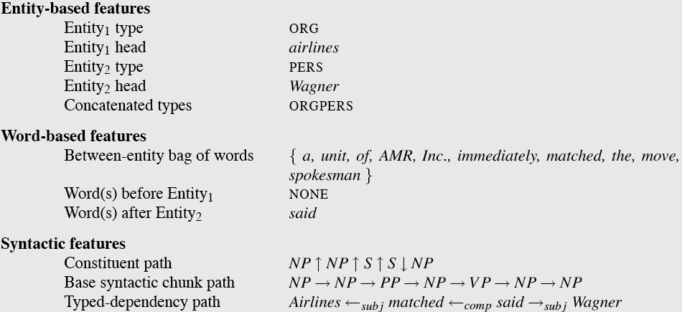
  American Airlines, a unit of AMR, immediately matched the move, spokesman Tim Wagner said.

Slide 34
Classifiers for supervised methods
Now you can use any classifier you like
  Naive Bayes
  Logistic Regression (MaxEnt)
  SVM
  ...
Train it on the training set, tune on the dev set, test on the test set

Slide 35
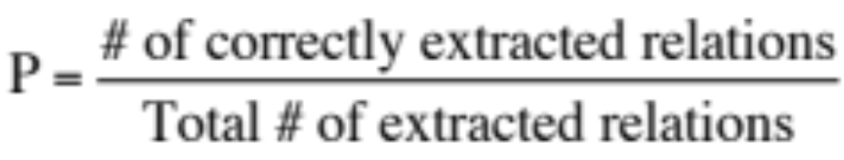
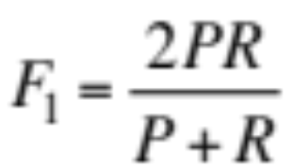
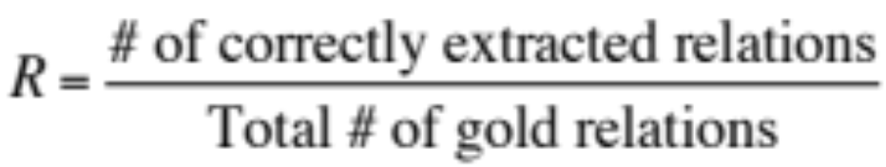
Evaluation of Supervised Relation Extraction
Compute P/R/F₁ for each relation

Slide 36
Summary: Supervised Relation Extraction
+ Can get high accuracies with enough hand-labeled training data, if test similar enough to training
- Labeling a large training set is expensive
- Supervised models are brittle, don’t generalize well to different genres

Slide 37
Learning Thesauruses and Knowledge Bases
Supervised relation extraction

Slide 38
Learning Thesauruses and Knowledge Bases
Semi-supervised relation extraction

Slide 39
Seed-based or bootstrapping approaches to relation extraction
No training set? Maybe you have:
  A few seed tuples or
  A few high-precision patterns
Can you use those seeds to do something useful?
  Bootstrapping: use the seeds to directly learn to populate a relation

Slide 40
Relation Bootstrapping (Hearst 1992)
Gather a set of seed pairs that have relation R
Iterate:
  Find sentences with these pairs
  Look at the context between or around the pair and generalize the context to create patterns
  Use the patterns for grep for more pairs

Slide 41
Bootstrapping
<Mark Twain, Elmira> Seed tuple
  Grep (google) for the environments of the seed tuple
  “Mark Twain is buried in Elmira, NY.”
    X is buried in Y
  “The grave of Mark Twain is in Elmira”
    The grave of X is in Y
  “Elmira is Mark Twain’s final resting place”
    Y is X’s final resting place.
Use those patterns to grep for new tuples
Iterate

Slide 42
Dipre: Extract <author,book> pairs
Brin, Sergei. 1998. Extracting Patterns and Relations from the World Wide Web.
Start with 5 seeds:
Find Instances:
  The Comedy of Errors, by William Shakespeare, was
  The Comedy of Errors, by William Shakespeare, is
  The Comedy of Errors, one of William Shakespeare's earliest attempts
  The Comedy of Errors, one of William Shakespeare's most
Extract patterns (group by middle, take longest common prefix/suffix)
  ?x , by ?y , ?x , one of ?y ‘s
Now iterate, finding new seeds that match the pattern
Author | Book
Isaac Asimov | The Robots of Dawn
David Brin | Startide Rising
James Gleick | Chaos: Making a New Science
Charles Dickens | Great Expectations
William Shakespeare | The Comedy of Errors

Slide 43
Snowball
E. Agichtein and L. Gravano 2000. Snowball: Extracting Relations
from Large Plain-Text Collections. ICDL
Similar iterative algorithm
Group instances w/similar prefix, middle, suffix, extract patterns
  But require that X and Y be named entities
  And compute a confidence for each pattern
Organization | Location of Headquarters
Microsoft | Redmond
Exxon | Irving
IBM | Armonk
.69
ORGANIZATION
{’s, in, headquarters}
LOCATION
.75
LOCATION
{in, based}
ORGANIZATION

Slide 44
Distant Supervision
Snow, Jurafsky, Ng. 2005. Learning syntactic patterns for automatic hypernym discovery. NIPS 17
Fei Wu and Daniel S. Weld. 2007. Autonomously Semantifying Wikipedia. CIKM 2007
Mintz, Bills, Snow, Jurafsky. 2009. Distant supervision for relation extraction without labeled data. ACL09
Combine bootstrapping with supervised learning
  Instead of 5 seeds,
    Use a large database to get huge # of seed examples
  Create lots of features from all these examples
  Combine in a supervised classifier

Slide 45
Distant supervision paradigm
Like supervised classification:
    Uses a classifier with lots of features
    Supervised by detailed hand-created knowledge
    Doesn’t require iteratively expanding patterns
Like unsupervised classification:
    Uses very large amounts of unlabeled data
    Not sensitive to genre issues in training corpus

Slide 46
Distantly supervised learning of relation extraction patterns
For each relation
For each tuple in big database
Find sentences in large corpus with both entities
Extract frequent features (parse, words, etc)
Train supervised classifier using thousands of patterns
Born-In
1
<Edwin Hubble, Marshfield>
<Albert Einstein, Ulm>
2
3
Hubble was born in Marshfield
Einstein, born (1879), Ulm
Hubble’s birthplace in Marshfield
4
PER was born in LOC
PER, born (XXXX), LOC
PER’s birthplace in LOC
5
P(born-in | f₁,f₂,f₃,…,f₇₀₀₀₀)

Slide 47
Distantly supervised learning of IS-A extraction patterns
Snow, Jurafsky, Ng 2005
1
For each X IS-A Y in WordNet
Find sentences in large corpus with X and Y
Extract parse path between X and Y
Represent each noun pair as a 70,000d vector with counts for each of 70,000 parse patterns
Train supervised classifier
<sarcoma, cancer>
<deuterium, atom>
2
an uncommon bone cancer called osteogenic sarcoma
in the doubly heavy hydrogen atom called deuterium.
3
N called N
4
P(IS-A,X,Y | f₁,f₂,f₃,…,f₇₀₀₀₀)
5

Slide 48
Using Discovered Patterns to Find Novel Hyponym/Hypernym Pairs
<hypernym> called <hyponym>
Learned from:
“sarcoma / cancer”: …an uncommon bone cancer called osteogenic sarcoma and to…
“deuterium / atom” ….heavy water rich in the doubly heavy hydrogen atom called deuterium.
Discovers new hypernym pairs:
“efflorescence / condition”: …and a condition called efflorescence are other reasons for…
“hat_creek_outfit / ranch” …run a small ranch called the Hat Creek Outfit.
“tardive_dyskinesia / problem”: ... irreversible problem called tardive dyskinesia…
“bateau_mouche / attraction” …local sightseeing attraction called the Bateau Mouche…

Slide 49
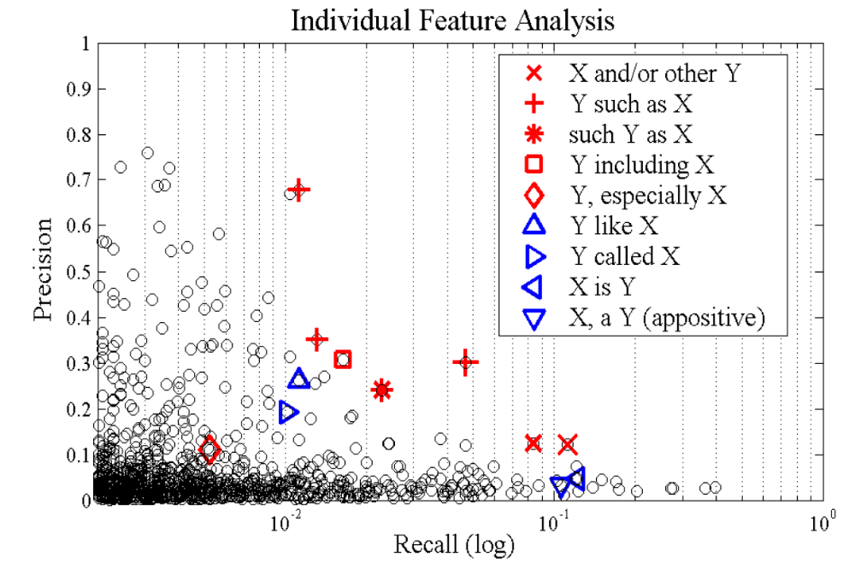
Precision / Recall for each of the 70,000 parse patterns considered as a single classifier
Snow, Jurafsky, Ng 2005

Slide 50
Can even combine multiple relations
IS-A (hypernym):
Learn by distant supervision
San Francisco IS-A city IS-A municipality IS-A populated area IS-A geographic region…
Co-ordinate term (co-hyponym)
  Learn by distributional similarity
  Chicago, Boston, Austin, Los Angeles, San Diego

Slide 51
Overcoming Hypernym Sparsity with Distributional Information
Snow, Jurafsky, Ng (2006)
Coordinate
Classifier:
“is similar to”
Hypernym
Classifier:
“is a kind of”
San Diego
What is the hypernym of San Diego?
San Diego
San Francisco
Denver
Seattle
Cincinnati
Pittsburgh
New york city
Detroit
Boston
Chicago
--------
city
--------
--------
--------
--------
--------
place, city
--------
city

Slide 52
Learning Thesauruses and Knowledge Bases
Semi-supervised relation extraction

Slide 53
Summary
Thesaurus Induction
  Hypernymy, meronymy
Mostly modeled as relation extraction
  Pattern-based
  Supervised
  Semisupervised and bootstrapping
Then combined with synonymy from distributional semantics

Slide 54
Computing Relations between Word Meaning:
Summary from Lectures 1-6
Word Similarity/Relatedness/Synonymy
  Graph algorithms based on human-built Wordnet (Lec 2)
  Learn from distributional/vector semantics (Lec 3,4)
Word Connotation (Lec 5)
  Human hand-labeled
  Supervised from Reviews
  Semisupervised from seed words
Hypernymy (IS-A) (Lec 6)
  Modeled as relation extraction
    Supervised, semisupervised

