Slide 1
Computational Extraction of Social and Interactional Meaning from Speech
Dan Jurafsky and Mari Ostendorf
Lecture 1: Sentiment Lexicons and Sentiment Classification
Dan Jurafsky
IP notice: many slides for today from Chris Manning, William Cohen, Chris Potts and Janyce Wiebe, plus some from Marti Hearst and Marta Tatu

Slide 2

Mari Ostendorf
University of Washington
(Lectures 5-8)

Slide 3
Scherer Typology of Affective States
Emotion: brief organically synchronized … evaluation of an major event as significant
  angry, sad, joyful, fearful, ashamed, proud, elated
Mood: diffuse non-caused low-intensity long-duration change in subjective feeling
  cheerful, gloomy, irritable, listless, depressed, buoyant
Interpersonal stances: affective stance toward another person in a specific interaction
  friendly, flirtatious, distant, cold, warm, supportive, contemptuous
Attitudes: enduring, affectively coloured beliefs, dispositions towards objects or persons
  liking, loving, hating, valueing, desiring
Personality traits: stable personality dispositions and typical behavior tendencies
  nervous, anxious,reckless, morose, hostile, jealous

Slide 4
Extracting social/interactional meaning
Emotion and Mood
  Annoyance in talking to dialog systems
  Uncertainty of students in tutoring
  Detecting Trauma or Depression
Interpersonal Stance
  Romantic interest, flirtation, friendliness
  Alignment/accommodation/entrainment
Attitudes = Sentiment (positive or negative)
  Movie or Products or Politics: is a text positive or negative?
  “Twitter mood predicts the stock market.”
Personality Traits
  Open, Conscienscious, Extroverted, Anxious
  Social identity (Democrat, Republican, etc.)

Slide 5
Overview of Course
http://www.stanford.edu/~jurafsky/lsa11/

Slide 6
Outline for Today
Historical Background on Identity:
  Authorship identification
Sentiment Analysis (Attitude Detection)
  Sentiment Tasks and Datasets
  Sentiment Classification Example: Movie Reviews
  The Dirty Details: Naïve Bayes Text Classification
  Sentiment Lexicons: Hand-built
  Sentiment Lexicons: Automatic

Slide 7
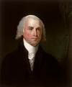


1: Author Identification (Stylometry)

Slide 8
Author Identification
Also called Stylometry in the humanities
An example of a Classification Problem
Classifiers:
  Decide which of N buckets to put an item in
  (Some classifiers allow for multiple buckets)

Slide 9
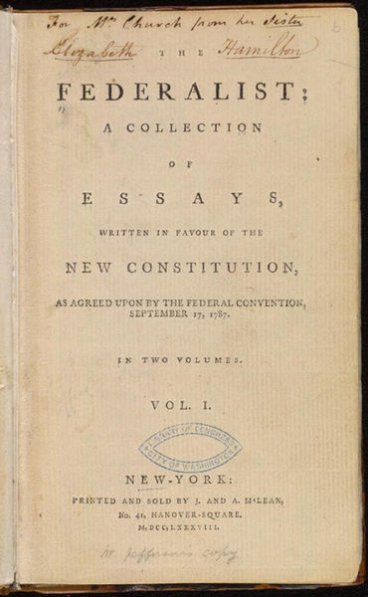
The Disputed Federalist Papers
In 1787-1788, Jay, Madison, and Hamilton wrote a series of anonymous essays to convince the voters of New York to ratify the new U. S. Constitution.
Scholars have consensus that:
  5 authored by Jay
  51 authored by Hamilton
  14 authored by Madison
  3 jointly by Hamilton and Madison
  12 remain in dispute … Hamilton or Madison?

Slide 10
Author identification
Federalist papers
  In 1963 Mosteller and Wallace solved the problem
  They identified function words as good candidates for authorships analysis
  Using statistical inference they concluded the author was Madison
  Since then, other statistical techniques have supported this conclusion.

Slide 11
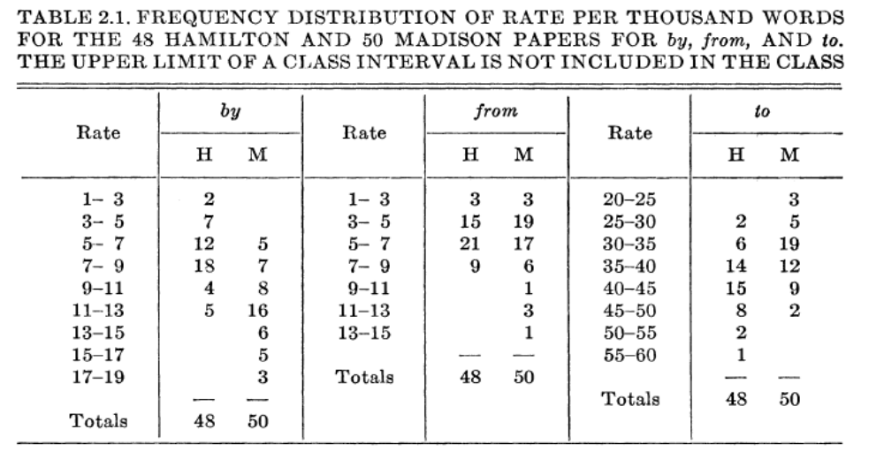
Function vs. Content Words
High rates for “by” favor M, low favor H
High rates for “from” favor M, low says little
High rats for “to” favor H, low favor M

Slide 12
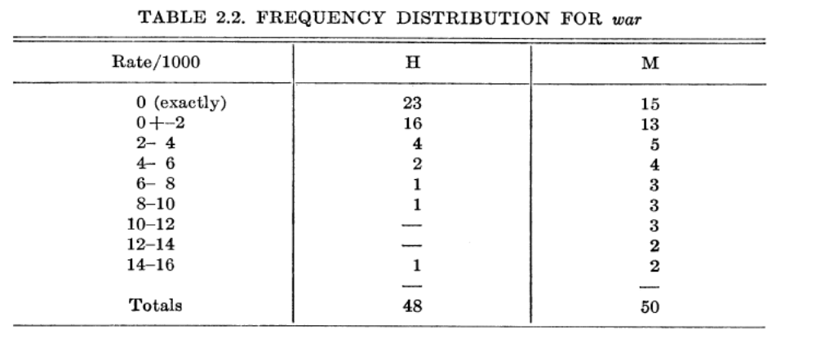
Function vs. Content Words
No consistent pattern for “war”

Slide 13
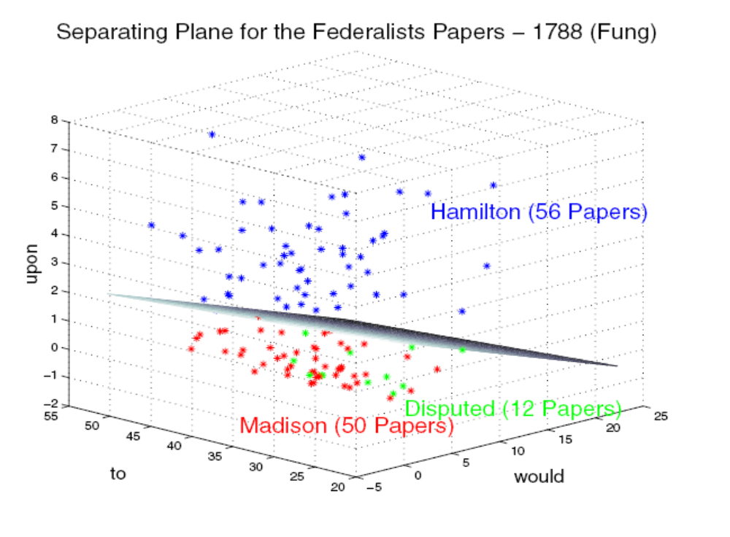
Federalist Papers Problem
Fung, The Disputed Federalist Papers: SVM Feature Selection
Via Concave Minimization, ACM TAPIA’03

Slide 14
Sentiment Analysis
Extraction of opinions and attitudes from text and speech
When we say “sentiment analysis”
  We often mean a binary or an ordinal task
    like X/ dislike X
    one-star to 5-stars

Slide 15
2: Sentiment Tasks and Datasets

Slide 16
IMDB
slide from Chris Potts

Slide 17
Amazon
slide from Chris Potts

Slide 18
OpenTable
slide from Chris Potts

Slide 19
TripAdvisor
slide from Chris Potts

Slide 20
Richer sentiment on the web
(not just positive/negative)
Experience Project
  http://www.experienceproject.com/confessions.php?cid=184000
FMyLife
  http://www.fmylife.com/miscellaneous/14613102
My Life is Average
  http://mylifeisaverage.com/
It Made My Day
  http://immd.icanhascheezburger.com/

Slide 21
  3: Sentiment Classification Example: Movie Reviews
Pang and Lee’s (2004) movie review data from IMDB
Polarity data 2.0:
  http://www.cs.cornell.edu/people/pabo/movie-review-data

Slide 22
Pang and Lee IMDB data
Rating: pos
  when _star wars_ came out some twenty years ago , the image of traveling throughout the starshas become a commonplace image .
  …
  when han solo goes light speed , the stars change to bright lines , going towards the viewer in lines that converge at an invisible point .
  cool .
  _october sky_ offers a much simpler image–that of a single white dot , traveling horizontally across the night sky .
  [. . . ]
Rating: neg
  “ snake eyes ” is the most aggravating kind of movie : the kind that shows so much potential thenbecomes unbelievably disappointing .
  it’s not just because this is a brian depalma film , and since he’s a great director and one who’s films are always greeted with at least some fanfare .
  and it’s not even because this was a film starring nicolas cage and since he gives a brauvara performance , this film is hardly worth his talents .

Slide 23
Pang and Lee Algorithm
Classification using different classifiers
  Naïve Bayes
  MaxEnt
  SVM
Cross-validation
  Break up data into 10 folds
  For each fold
    Choose the fold as a temporary “test set”
    Train on 9 folds, compute performance on the test fold
  Report the average performance of the 10 runs.

Slide 24
Negation in Sentiment Analysis
  They have not succeeded, and will never succeed, in breaking the will of this valiant people.
Slide from Janyce Wiebe
Notes:
Let’s consider this sentence from our corpus.

Slide 25
Negation in Sentiment Analysis
  They have not succeeded, and will never succeed, in breaking the will of this valiant people.
Slide from Janyce Wiebe
Notes:
Succeeding is good – that matches the prior polarity.

Slide 26
Negation in Sentiment Analysis
  They have not succeeded, and will never succeed, in breaking the will of this valiant people.
Slide from Janyce Wiebe
Notes:
Not succeeding is bad – so, negation obviously comes into play

Slide 27
Negation in Sentiment Analysis
  They have not succeeded, and will never succeed, in breaking the will of this valiant people.
Slide from Janyce Wiebe
Notes:
But when you look at the entire expression, ultimately the polarity is positive – not succeeding and never succeeding in breaking the will of a valiant people is good! So the label assigned in our corpus is Positive.

Slide 28
Pang and Lee on Negation
added the tag NOT to every word between a negation word (“not”, “isn’t”, “didn’t”, etc.) and the first punctuation mark following the negation word.
didn’t like this movie, but I
didn’t NOT_like NOT_this NOT_movie

Slide 29
Pang and Lee interesting Observation
“Feature presence”
  i.e. 1 if a word occurred in a document, 0 if it didn’t
worked better than unigram probability
Why might this be?

Slide 30
Other difficulties in movie review classification
What makes movies hard to classify?
  Sentiment can be subtle:
    Perfume review in “Perfumes: the Guide”:
      “If you are reading this because it is your darling fragrance, please wear it at home exclusively, and tape the windows shut.”
    “She runs the gamut of emotions from A to B”
      (Dorothy Parker on Katherine Hepburn)
Order effects
  This film should be brilliant. It sounds like a great plot, the actors are first grade, and the supporting cast is good as well, and Stallone is attempting to deliver a good performance. However, it can’t hold up.

Slide 31
4: Naïve Bayes text classification

Slide 32
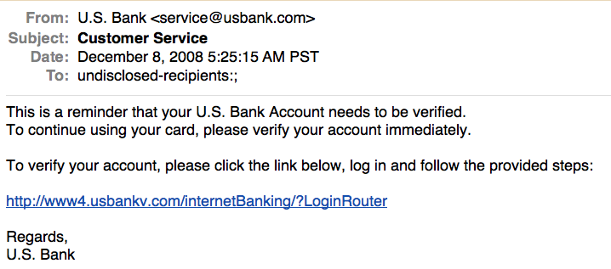
Is this spam?

Slide 33
More Applications of Text Classification
Authorship identification
Age/gender identification
Language Identification
Assigning topics such as Yahoo-categories
e.g., "finance," "sports," "news>world>asia>business"
Genre-detection
e.g., "editorials" "movie-reviews" "news“
Opinion/sentiment analysis on a person/product
e.g., “like”, “hate”, “neutral”
Labels may be domain-specific
e.g., “contains adult language” : “doesn’t”

Slide 34
Text Classification: definition
The classifier:
  Input: a document d
  Output: a predicted class c from some fixed set of labels c₁,...,c_{K}
The learner:
  Input: a set of m hand-labeled documents (d₁,c₁),....,(d_{m},c_{m})
  Output: a learned classifier f:d → c

Slide 35
Document Classification
“planning
language
proof
intelligence”
Test
Data:
(AI)
(Programming)
(HCI)
Classes:
ML
Planning
Semantics
Garb.Coll.
Multimedia
GUI
Training
Data:
learning
intelligence
algorithm
reinforcement
network...
planning
temporal
reasoning
plan
language...
programming
semantics
language
proof...
garbage
collection
memory
optimization
region...
...
...

Slide 36
Classification Methods:
Hand-coded rules
Some spam/email filters, etc.
E.g., assign category if document contains a given boolean combination of words
Accuracy is often very high if a rule has been carefully refined over time by a subject expert
Building and maintaining these rules is expensive

Slide 37
Classification Methods:
Machine Learning
Supervised Machine Learning
To learn a function from documents (or sentences) to labels
  Naive Bayes (simple, common method)
  Others
    k-Nearest Neighbors (simple, powerful)
    Support-vector machines (new, more powerful)
    … plus many other methods
  No free lunch: requires hand-classified training data
    But data can be built up (and refined) by amateurs

Slide 38
Naïve Bayes Intuition

Slide 39
Representing text for classification
f(
ARGENTINE 1986/87 GRAIN/OILSEED REGISTRATIONS
BUENOS AIRES, Feb 26
Argentine grain board figures show crop registrations of grains, oilseeds and their products to February 11, in thousands of tonnes, showing those for future shipments month, 1986/87 total and 1985/86 total to February 12, 1986, in brackets:
Bread wheat prev 1,655.8, Feb 872.0, March 164.6, total 2,692.4 (4,161.0).
Maize Mar 48.0, total 48.0 (nil).
Sorghum nil (nil)
Oilseed export registrations were:
Sunflowerseed total 15.0 (7.9)
Soybean May 20.0, total 20.0 (nil)
The board also detailed export registrations for subproducts, as follows....
)=c
simplest useful
?
What is the best representation for the document d being classified?

Slide 40
Bag of words representation
ARGENTINE 1986/87 GRAIN/OILSEED REGISTRATIONS
BUENOS AIRES, Feb 26
Argentine grain board figures show crop registrations of grains, oilseeds and their products to February 11, in thousands of tonnes, showing those for future shipments month, 1986/87 total and 1985/86 total to February 12, 1986, in brackets:
Bread wheat prev 1,655.8, Feb 872.0, March 164.6, total 2,692.4 (4,161.0).
Maize Mar 48.0, total 48.0 (nil).
Sorghum nil (nil)
Oilseed export registrations were:
Sunflowerseed total 15.0 (7.9)
Soybean May 20.0, total 20.0 (nil)
The board also detailed export registrations for subproducts, as follows....
Categories: grain, wheat

Slide 41
Bag of words representation
xxxxxxxxxxxxxxxxxxx GRAIN/OILSEED xxxxxxxxxxxxx
xxxxxxxxxxxxxxxxxxxxxxx
xxxxxxxxx grain xxxxxxxxxxxxxxxxxxxxxxxxxxxxxxxx grains, oilseeds xxxxxxxxxx xxxxxxxxxxxxxxxxxxxxxxxxxxx tonnes, xxxxxxxxxxxxxxxxx shipments xxxxxxxxxxxx total xxxxxxxxx total xxxxxxxx xxxxxxxxxxxxxxxxxxxx:
Xxxxx wheat xxxxxxxxxxxxxxxxxxxxxxxxxxxxxxxx, total xxxxxxxxxxxxxxxx
Maize xxxxxxxxxxxxxxxxx
Sorghum xxxxxxxxxx
Oilseed xxxxxxxxxxxxxxxxxxxxx
Sunflowerseed xxxxxxxxxxxxxx
Soybean xxxxxxxxxxxxxxxxxxxxxx
xxxxxxxxxxxxxxxxxxxxxxxxxxxxxxxxxxxxxxxxxxxxxxxxxxx....
Categories: grain, wheat

Slide 42
Bag of words representation
word
freq
xxxxxxxxxxxxxxxxxxx GRAIN/OILSEED xxxxxxxxxxxxx
xxxxxxxxxxxxxxxxxxxxxxx
xxxxxxxxx grain xxxxxxxxxxxxxxxxxxxxxxxxxxxxxxxx grains, oilseeds xxxxxxxxxx xxxxxxxxxxxxxxxxxxxxxxxxxxx tonnes, xxxxxxxxxxxxxxxxx shipments xxxxxxxxxxxx total xxxxxxxxx total xxxxxxxx xxxxxxxxxxxxxxxxxxxx:
Xxxxx wheat xxxxxxxxxxxxxxxxxxxxxxxxxxxxxxxx, total xxxxxxxxxxxxxxxx
Maize xxxxxxxxxxxxxxxxx
Sorghum xxxxxxxxxx
Oilseed xxxxxxxxxxxxxxxxxxxxx
Sunflowerseed xxxxxxxxxxxxxx
Soybean xxxxxxxxxxxxxxxxxxxxxx
xxxxxxxxxxxxxxxxxxxxxxxxxxxxxxxxxxxxxxxxxxxxxxxxxxx....
grain(s) | 3
oilseed(s) | 2
total | 3
wheat | 1
maize | 1
soybean | 1
tonnes | 1
... | ...
Categories: grain, wheat

Slide 43
Formalizing Naïve Bayes

Slide 44
Bayes’ Rule
Allows us to swap the conditioning
Sometimes easier to estimate one kind of dependence than the other

Slide 45
Deriving Bayes’ Rule

Slide 46
Bayes’ Rule Applied to Documents and Classes

Slide 47
The Text Classification Problem
Using a supervised learning method, we want to learn a classifier (or classification function ):
We denote the supervised learning method by:
  The learning method takes the training set D as input and returns the learned classifier .
Once we have learned , we can apply it to the test set (or test data).

Slide 48
Naïve Bayes Text Classification
The Multinomial Naïve Bayes model (NB) is a probabilistic learning method.
In text classification, our goal is to find the “best” class for the document:
The probability of a
document d being in class c.
Bayes’ Rule
We can ignore the denominator

Slide 49
Naive Bayes Classifiers
We represent an instance D based on some attributes.
Task: Classify a new instance D based on a tuple of attribute values into one of the classes c_{j} ∈ C
The probability of a
document d being in class c.
Bayes’ Rule
We can ignore the denominator

Slide 50
Naïve Bayes Classifier:
Naïve Bayes Assumption
P(c_{j})
  Can be estimated from the frequency of classes in the training examples.
P(x₁,x₂,…,x_{n}|c_{j})
  O(|X|^{n}•|C|) parameters
  Could only be estimated if a very, very large number of training examples was available.
Naïve Bayes Conditional Independence Assumption:
Assume that the probability of observing the conjunction of attributes is equal to the product of the individual probabilities P(x_{i}|c_{j}).

Slide 51
The Naïve Bayes Classifier
Flu
X₁
X₂
X₃
X₄
X₅
runnynose
sinus
cough
fever
muscle-ache
Conditional Independence Assumption:
  features are independent of each other given the class:

Slide 52
Using Multinomial Naive Bayes Classifiers to Classify Text:
Attributes are text positions, values are words.
Still too many possibilities
Assume that classification is independent of the positions of the words
  Use same parameters for each position
  Result is bag of words model (over tokens not types)

Slide 53
Learning the Model
C
X₁
X₂
X₃
X₄
X₅
X₆
Simplest: maximum likelihood estimate
  simply use the frequencies in the data

Slide 54
Problem with Max Likelihood
Flu
X₁
X₂
X₃
X₄
X₅
runnynose
sinus
cough
fever
muscle-ache
What if we have seen no training cases where patient had no flu and muscle aches?
Zero probabilities cannot be conditioned away, no matter the other evidence!

Slide 55
Smoothing to Avoid Overfitting
Laplace:
# of values of X_{i}
overall fraction in data where X_{i}=x_{i,k}
Bayesian Unigram Prior:
extent of
“smoothing”

Slide 56
Naïve Bayes: Learning
From training corpus, extract Vocabulary
Calculate required P(c_{j}) and P(w_{k} | c_{j}) terms
  For each c_{j} in C do
    docs_{j} ← subset of documents for which the target class is c_{j}
    Text_{j} ← single document containing all docs_{j}
    for each word w_{k} in Vocabulary
      n_{k} ← number of occurrences of w_{k} in Text_{j}

Slide 57
Naïve Bayes: Classifying
positions ← all word positions in current document which contain tokens found in Vocabulary
Return c_{NB}, where

Slide 58
Underflow Prevention: log space
Multiplying lots of probabilities, which are between 0 and 1 by definition, can result in floating-point underflow.
Since log(xy) = log(x) + log(y), it is better to perform all computations by summing logs of probabilities rather than multiplying probabilities.
Class with highest final un-normalized log probability score is still the most probable.
Note that model is now just max of sum of weights…

Slide 59
Naïve Bayes Generative Model for Text
spam
legit
spam
spam
Choose a class c according to P(c)
legit
legit
spam
spam
legit
Essentially model probability of each class as class-specific unigram language model
Category
Viagra
science
win
PM
!!
hot
!!
hot
!
computer
Friday
Nigeria
deal
deal
Then choose a word from that class with probability P(x|c)
test
homework
lottery
nude
March
score
Viagra
!
Viagra
May
$
exam
spam
legit
Slide from Ray Mooney

Slide 60
Naïve Bayes Classification
Win lotttery $ !
?? ??
spam
legit
spam
spam
legit
legit
spam
spam
legit
Viagra
science
Category
win
PM
hot
!!
computer
Friday
Nigeria
!
deal
test
homework
lottery
nude
March
score
!
Viagra
May
$
exam
spam
legit
Slide from Ray Mooney

Slide 61
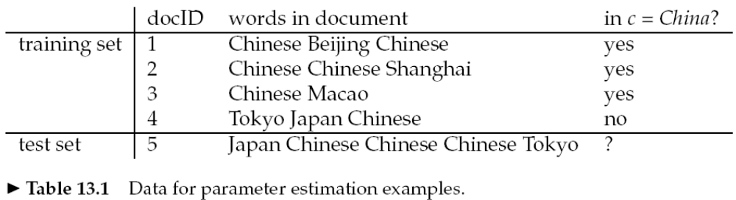
Naïve Bayes Text Classification Example
Training:
  Vocabulary V = {Chinese, Beijing, Shanghai, Macao, Tokyo, Japan} and |V | = 6.
  P(c) = 3/4 and P(~c) = 1/4.
  P(Chinese|c) = (5+1) / (8+6) = 6/14 = 3/7
  P(Chinese|~c) = (1+1) / (3+6) = 2/9
  P(Tokyo|c) = P(Japan|c) = (0+1)/(8+6)=1/14
  P(Chinese|~c) = (1+1)/(3+6)=2/9
  P(Tokyo|~c)=p(Japan|~c)=(1+1/)3+6)=2/9
Testing:
  P(c|d) 3/4 * (3/7)³ * 1/14 * 1/14
  ≈ 0.0003
  P(~c|d) 1/4 * (2/9)³ * 2/9 * 2/9
  ≈ 0.0001

Slide 62
Naïve Bayes Text Classification
Naïve Bayes algorithm – training phase.
TrainMultinomialNB(C, D)
V ← ExtractVocabulary(D)
N ← CountDocs(D)
for each c in C
do N_{c} ← CountDocsInClass(D, c)
prior[c] ← N_{c} / C
text_{c} ← ConcatenateTextOfAllDocsInClass(D, c)
for each t in V
do T_{ct} ← CountTokensOfTerm(text_{c}, t)
for each t in V
do condprob[t][c] ← (T_{ct}+1) / ∑(T_{ct’}+1)
return V, prior, condprob

Slide 63
Naïve Bayes Text Classification
Naïve Bayes algorithm – testing phase.
ApplyMultinomialNB(C, V, prior, condProb, d)
W ← ExtractTokensFromDoc(V, d)
for each c in C
do score[c] ← log prior[c]
for each t in W
do score[c] += log condprob[t][c]
return argmax_{c}score[c]

Slide 64
Evaluating Categorization
Evaluation must be done on test data that are independent of the training data
  usually a disjoint set of instances
Classification accuracy: c/n where n is the total number of test instances and c is the number of test instances correctly classified by the system.
  Adequate if one class per document
Results can vary based on sampling error due to different training and test sets.
  Average results over multiple training and test sets (splits of the overall data) for the best results.

Slide 65
Measuring Performance
Precision =
good messages kept
all messages kept
Recall =
good messages kept
all good messages
Trade off precision vs. recall by setting threshold
Measure the curve on annotated dev data (or test data)
Choose a threshold where user is comfortable
Slide from Jason Eisner

Slide 66
SpamAssassin: Naïve Bayes
Mentions Generic Viagra
Online Pharmacy
No prescription needed
Mentions millions of (dollar) ((dollar) NN,NNN,NNN.NN)
Talks about Oprah with an exclamation!
Phrase: impress ... girl
From: starts with many numbers
Subject contains "Your Family”
Subject is all capitals
HTML has a low ratio of text to image area
One hundred percent guaranteed
Claims you can be removed from the list
'Prestigious Non-Accredited Universities'
http://spamassassin.apache.org/tests_3_3_x.html

Slide 67
5: Sentiment Lexicons: Hand-Built
Key task: Vocabulary
The previous work uses all the words in a document
Can we do better by focusing on subset of words?
  How to find words, phrases, patterns that express sentiment or polarity?
Notes:
.

Slide 68
5: Sentiment/Affect Lexicons: GenInq
Harvard General Inquirer Database
  Contains 3627 negative and positive word-strings:
  http://www.wjh.harvard.edu/~inquirer/
  http://www.wjh.harvard.edu/~inquirer/homecat.htm
  Positiv (1915 words) versus Negativ (2291 words)
  Strong vs Weak
  Active vs Passive
  Overstated versus Understated
  Pleasure, Pain, Virtue, Vice
  Motivation, Cognitive Orientation, etc

Slide 69
5: Sentiment/Affect Lexicons: LIWC
LIWC (Linguistic Inquiry and Word Count)
  Pennebaker, Francis, & Booth, 2001
dictionary of 2300 words grouped into > 70 classes
    Affective Processes
      negative emotion (bad, weird, hate, problem, tough)
      positive emotion (love, nice, sweet)
    Cognitive Processes
      Tentative (maybe, perhaps, guess)
      Inhibition (block, constraint, stop)
    Bodily Proceeses
      sexual (sex, horny, love, incest)
    Pronouns
      1st person pronouns (I me mine myself I’d I’ll I’m…)
      2nd person pronouns
    Negation (no, not, never), Quantifiers (few, many, much), http://www.wjh.harvard.edu/~inquirer/homecat.htm.

Slide 70
Sentiment Lexicons and outcomes
Potts “On the Negativity of Negation”
Is logical negation associated with negative sentiment?
Pott’s experiment
  Get counts of the word not, n’t, no, never, and compounds formed with no
  In online reviews, etc
  And regress against the review rating

Slide 71
More logical negation in IMDB reviews which have negative sentiment

Slide 72
More logical negation in all reviews which have negative sentiment
Amazon, GoodReads, OpenTable, Tripadvisor

Slide 73
Voting no (after removing the word “no”)
a

Slide 74
6: Sentiment Lexicons:
Automatically Extracted
Adjectives
  positive: honest important mature large patient
    He is the only honest man in Washington.
    Her writing is unbelievably mature and is only likely to get better.
    To humour me my patient father agrees yet again to my choice of film
  negative: harmful hypocritical inefficient insecure
    It was a macabre and hypocritical circus.
    Why are they being so inefficient ?

Slide 75
Other parts of speech
Verbs
  positive: praise, love
  negative: blame, criticize
Nouns
  positive: pleasure, enjoyment
  negative: pain, criticism

Slide 76
Phrases
Phrases containing adjectives and adverbs
  positive: high intelligence, low cost
  negative: little variation, many troubles

Slide 77
Intuition for identifying polarity words
Assume that contexts are coherent
Fair and legitimate, corrupt and brutal
*fair and brutal, *corrupt and legitimate

Slide 78
Hatzivassiloglou & McKeown 1997
Predicting the semantic orientation of adjectives
Step 1
From 21-million word WSJ corpus
For every adjective with frequency > 20
  Label for polarity
Total of 1336 adjectives
  657 positive
  679 negative

Slide 79
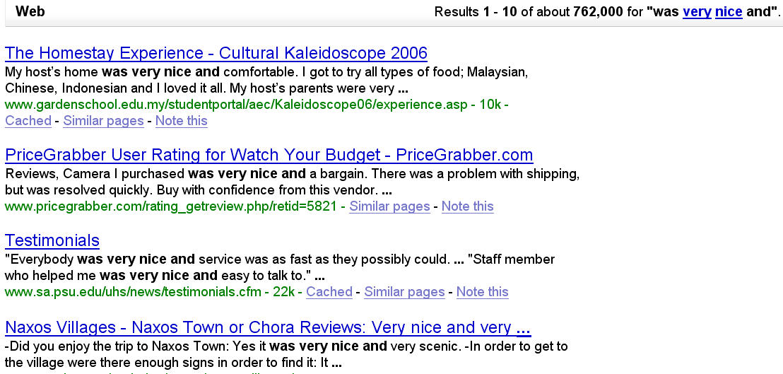
Hatzivassiloglou & McKeown 1997
Step 2: Extract all conjoined adjectives
nice and comfortable
nice and scenic
Slide adapted from Janyce Wiebe
79

Slide 80
Hatzivassiloglou & McKeown 1997
3. A supervised learning algorithm builds a graph of adjectives linked by the same or different semantic orientation
scenic
nice
terrible
painful
handsome
fun
expensive
comfortable

Slide 81
Hatzivassiloglou & McKeown 1997
4. A clustering algorithm partitions the adjectives into two subsets
+
slow
scenic
nice
terrible
handsome
painful
fun
expensive
comfortable

Slide 82
Hatzivassiloglou & McKeown 1997

Slide 83
Turney (2002): Thumbs Up or Thumbs Down? Semantic Orientation Applied to Unsupervised Classification of Reviews
Input: review
Identify phrases that contain adjectives or adverbs by using a part-of-speech tagger
Estimate the semantic orientation of each phrase
Assign a class to the given review based on the average semantic orientation of its phrases
Output: classification ( or )

Slide 84
Turney Step 1
Extract all two-word phrases including an adjective
 | First Word | Second Word | Third Word (not extracted)
1. | JJ | NN or NNS | Anything
2. | RB, RBR, or RBS | JJ | Not NN nor NNS
3. | JJ | JJ | Not NN nor NNS
4. | NN or NNS | JJ | Not NN nor NNS
5. | RB, RBR, or RBS | VB, VBD, VBN, or VBG | Anything

Slide 85
Turney Step 2
Estimate the semantic orientation of the extracted phrases using Pointwise Mutual Information

Slide 86


Pointwise Mutual Information
Mutual information: between 2 random variables X and Y
Pointwise mutual information: measure of how often two events x and y occur, compared with what we would expect if they were independent:

Slide 87
Weighting: Mutual Information
Pointwise mutual information: measure of how often two events x and y occur, compared with what we would expect if they were independent:
PMI between two words: how much more often they occur together than we would expect if they were independent

Slide 88
Turney Step 2
Semantic Orientation of a phrase defined as:
Estimate PMI by issuing queries to a search engine (Altavista, ~350 million pages)

Slide 89
Turney Step 3
Calculate average semantic orientation of phrases in review
  Positive: 
  Negative: 
Phrase | POS tags | SO
direct deposit | JJ NN | 1.288
local branch | JJ NN | 0.421
small part | JJ NN | 0.053
online service | JJ NN | 2.780
well other | RB JJ | 0.237
low fees | JJ NNS | 0.333
…
true service | JJ NN | -0.732
other bank | JJ NN | -0.850
inconveniently located | RB VBN | -1.541
Average Semantic Orientation |  | 0.322

Slide 90
Experiments
410 reviews from Epinions
  170 (41%) ()
  240 (59%) ()
  Average phrases per review: 26
Baseline accuracy: 59%
Domain | Accuracy | Correlation
Automobiles | 84.00% | 0.4618
Banks | 80.00% | 0.6167
Movies | 65.83% | 0.3608
Travel Destinations | 70.53% | 0.4155
All | 74.39% | 0.5174

Slide 91
Summary on Sentiment
Generally modeled as classification or regression task
  predict a binary or ordinal label
Function words can be a good cue
Using all words (in naïve bayes) works well for some tasks
Finding subsets of words may help in other tasks

Slide 92
Outline
Historical Background on Identity:
  Authorship identification
Sentiment Analysis (Attitude Detection)
  Sentiment Tasks and Datasets
  Sentiment Classification Example: Movie Reviews
  The Dirty Details: Naïve Bayes Text Classification
  Sentiment Lexicons: Hand-built
  Sentiment Lexicons: Automatic

