Slide 1
Lexicons for Sentiment, Affect, and Connotation
Lexicons for Sentiment, Affect, and Connotation

Slide 2
Affective meaning
Drawing on literatures in
  affective computing (Picard 95)
  linguistic subjectivity (Wiebe and colleagues)
  social psychology (Pennebaker and colleagues)
Can we model the lexical semantics relevant to:
  sentiment
  emotion
  personality
  mood
  attitudes

Slide 3
Why compute affective meaning?
Detecting:
  sentiment towards politicians, products, countries, ideas
  frustration of callers to a help line
  stress in drivers or pilots
  depression and other medical conditions
  confusion in students talking to e-tutors
  emotions in novels (e.g., for studying groups that are feared over time)
Could we generate:
  emotions or moods for literacy tutors in the children’s storybook domain
  emotions or moods for computer games
  personalities for dialogue systems to match the user

Slide 4
Connotation in the lexicon
Words have connotation as well as sense
Can we build lexical resources that represent these connotations?
And use them in these computational tasks?

Slide 5
Scherer Typology of Affective States
Emotion: brief organically synchronized … evaluation of a major event
  angry, sad, joyful, fearful, ashamed, proud, elated
Mood: diffuse non-caused low-intensity long-duration change in subjective feeling
  cheerful, gloomy, irritable, listless, depressed, buoyant
Interpersonal stances: affective stance toward another person in a specific interaction
  friendly, flirtatious, distant, cold, warm, supportive, contemptuous
Attitudes: enduring, affectively colored beliefs, dispositions towards objects or persons
  liking, loving, hating, valuing, desiring
Personality traits: stable personality dispositions and typical behavior tendencies
  nervous, anxious, reckless, morose, hostile, jealous

Slide 6
Scherer Typology of Affective States
Emotion: brief organically synchronized … evaluation of a major event
  angry, sad, joyful, fearful, ashamed, proud, elated
Mood: diffuse non-caused low-intensity long-duration change in subjective feeling
  cheerful, gloomy, irritable, listless, depressed, buoyant
Interpersonal stances: affective stance toward another person in a specific interaction
  friendly, flirtatious, distant, cold, warm, supportive, contemptuous
Attitudes: enduring, affectively colored beliefs, dispositions towards objects or persons
  liking, loving, hating, valuing, desiring
Personality traits: stable personality dispositions and typical behavior tendencies
  nervous, anxious, reckless, morose, hostile, jealous

Slide 7
What is a Lexicon?
A (usually hand-built) list of words that correspond to some meaning or class
Possibly with numeric values
Commonly used as simple classifiers, or as features to more complex classifiers

Slide 8
Lexicons for Sentiment, Affect, and Connotation
Lexicons for Sentiment, Affect, and Connotation

Slide 9
Lexicons for Sentiment, Affect, and Connotation
Emotion

Slide 10
Scherer’s typology of affective states
Emotion: relatively brief episode of synchronized response of all or most organismic subsystems in response to the evaluation of an event as being of major significance
  angry, sad, joyful, fearful, ashamed, proud, desperate
Mood: diffuse affect state …change in subjective feeling, of low intensity but relatively long duration, often without apparent cause
  cheerful, gloomy, irritable, listless, depressed, buoyant
Interpersonal stance: affective stance taken toward another person in a specific interaction, coloring the interpersonal exchange
  distant, cold, warm, supportive, contemptuous
Attitudes: relatively enduring, affectively colored beliefs, preferences predispositions towards objects or persons
  liking, loving, hating, valuing, desiring
Personality traits: emotionally laden, stable personality dispositions and behavior tendencies, typical for a person
  nervous, anxious, reckless, morose, hostile, envious, jealous

Slide 11
Two families of theories of emotion
Atomic basic emotions
  A finite list of 6 or 8, from which others are generated
Dimensions of emotion
  Valence (positive negative)
  Arousal (strong, weak)
  Control

Slide 12
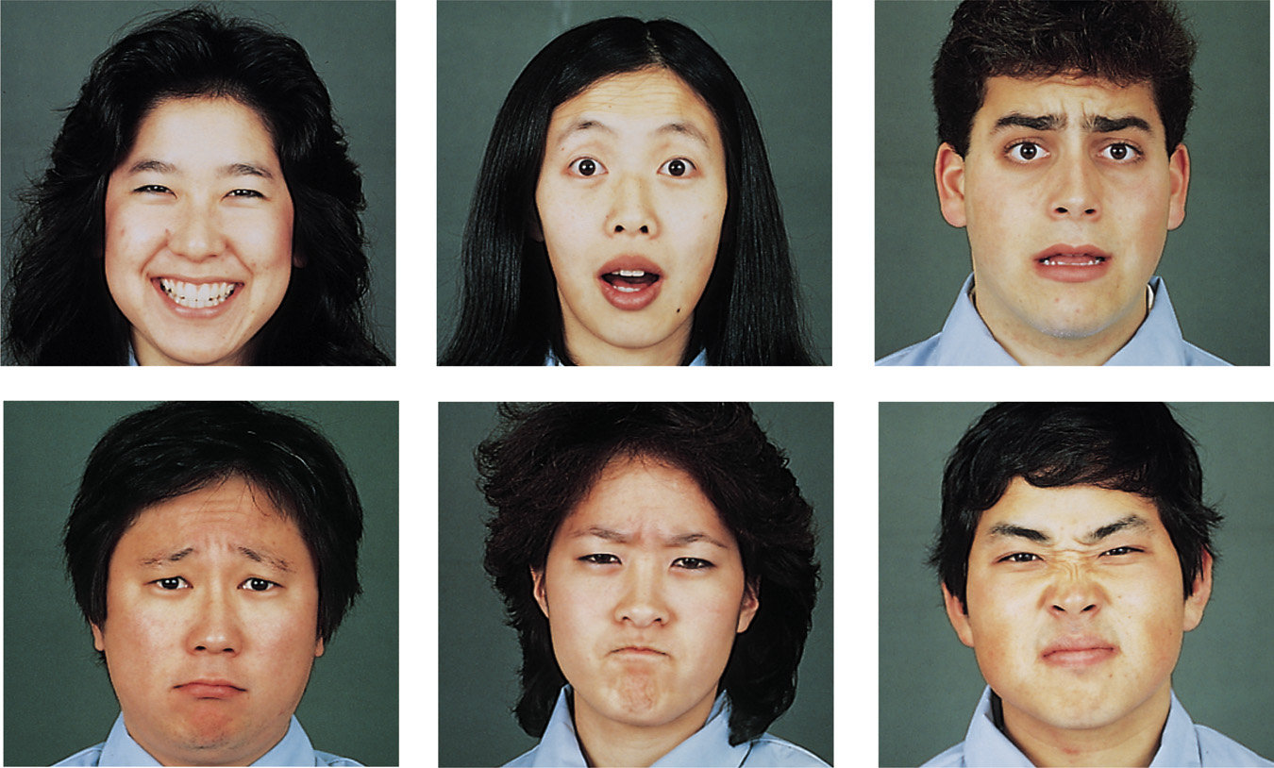
Ekman’s 6 basic emotions:
    Surprise, happiness, anger, fear, disgust, sadness
Ekman &
Matsumoto
1989

Slide 13
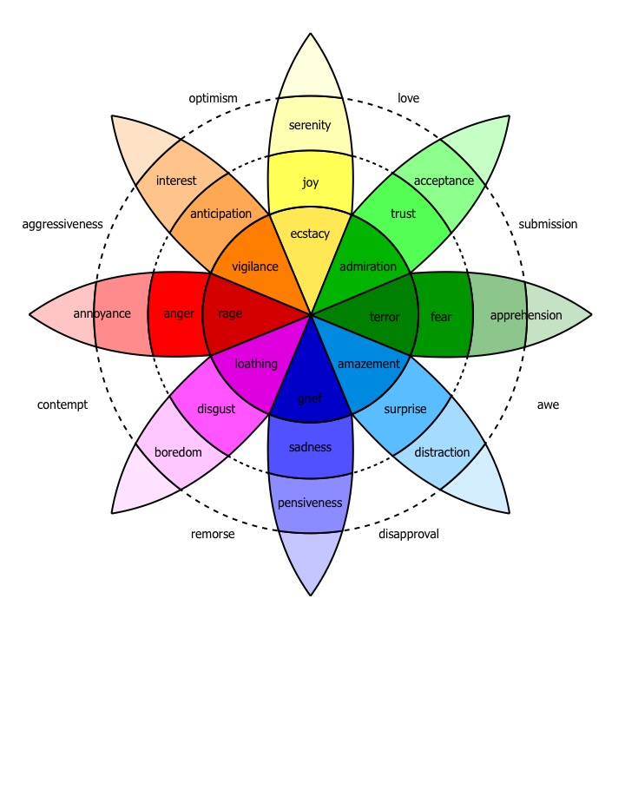
Plutchick’s wheel of emotion
8 basic emotions
in four opposing pairs:
  joy–sadness
  anger–fear
  trust–disgust
  anticipation–surprise
Wikipedia

Slide 14
Alternative: spatial model
An emotion is a point in 2- or 3-dimensional space
valence: the pleasantness of the stimulus
arousal: the intensity of emotion provoked by the stimulus
(sometimes) dominance: the degree of control exerted by the stimulus

Slide 15
Valence/Arousal Dimensions
High arousal, low pleasure High arousal, high pleasure
anger excitement
Low arousal, low pleasure Low arousal, high pleasure
sadness relaxation
arousal
valence

Slide 16
Simple sentiment lexicons

Slide 17
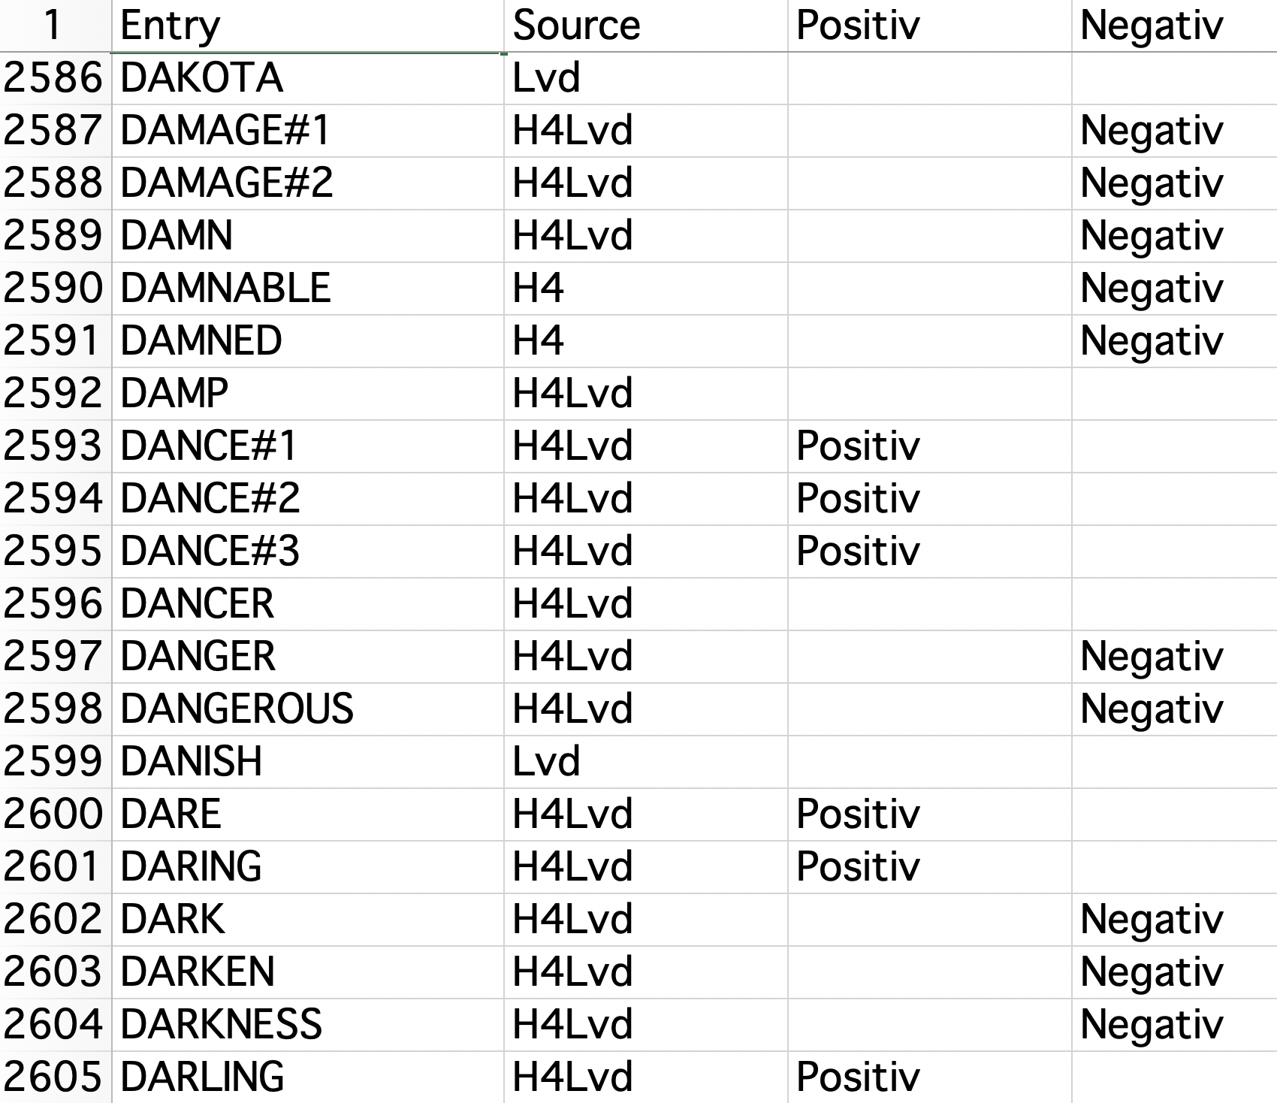
The General Inquirer
Philip J. Stone, Dexter C Dunphy, Marshall S. Smith, Daniel M. Ogilvie. 1966. The General Inquirer: A Computer Approach to Content Analysis. MIT Press
Positiv (1915 words)
Negativ (2291 words)

Slide 18
MPQA Subjectivity Cues Lexicon
Theresa Wilson, Janyce Wiebe, and Paul Hoffmann (2005). Recognizing Contextual Polarity in
Phrase-Level Sentiment Analysis. Proc. of HLT-EMNLP-2005.
Riloff and Wiebe (2003). Learning extraction patterns for subjective expressions. EMNLP-2003.
6885 words
Is a subjective word positive or negative?
  Strongly or weakly?
http://mpqa.cs.pitt.edu/lexicons/
GNU GPL

Slide 19
type=weaksubj len=1 word1=abandoned pos1=adj stemmed1=n priorpolarity=negative
type=weaksubj len=1 word1=abandonment pos1=noun stemmed1=n priorpolarity=negative
type=weaksubj len=1 word1=abandon pos1=verb stemmed1=y priorpolarity=negative
type=strongsubj len=1 word1=abase pos1=verb stemmed1=y priorpolarity=negative
type=strongsubj len=1 word1=abasement pos1=anypos stemmed1=y priorpolarity=negative
type=strongsubj len=1 word1=abash pos1=verb stemmed1=y priorpolarity=negative
type=weaksubj len=1 word1=abate pos1=verb stemmed1=y priorpolarity=negative

Slide 20
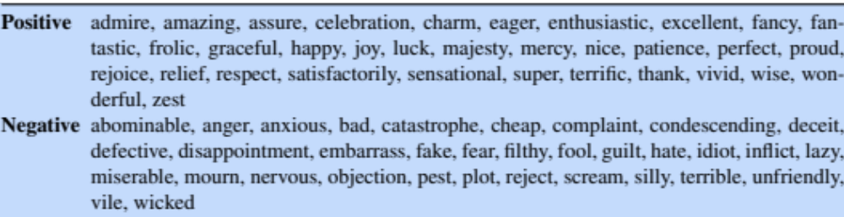
Words with consistent sentiment across lexicons

Slide 21
Let’s look at two emotion lexicons!
8 basic emotions:
  NRC Word-Emotion Association Lexicon (Mohammad and Turney 2011)
Dimensions of valence/arousal/dominance
  NRC Valence-Arousal-Dominance Lexicon (Mohammad 2018)

Slide 22
Plutchick’s wheel of emotion
8 basic emotions
in four opposing pairs:
  joy–sadness
  anger–fear
  trust–disgust
  anticipation–surprise
Wikipedia

Slide 23
NRC Word-Emotion Association Lexicon
Mohammad and Turney 2011
  amazingly anger 0
  amazingly anticipation 0
  amazingly disgust 0
  amazingly fear 0
  amazingly joy 1
  amazingly sadness 0
  amazingly surprise 1
  amazingly trust 0
  amazingly negative 0
  amazingly positive 1

Slide 24
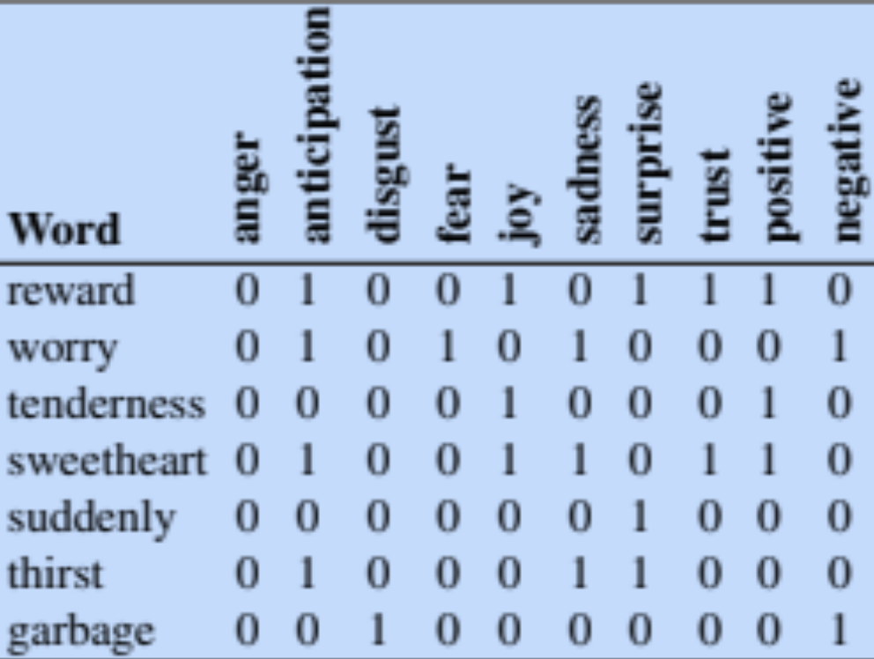
More examples

Slide 25
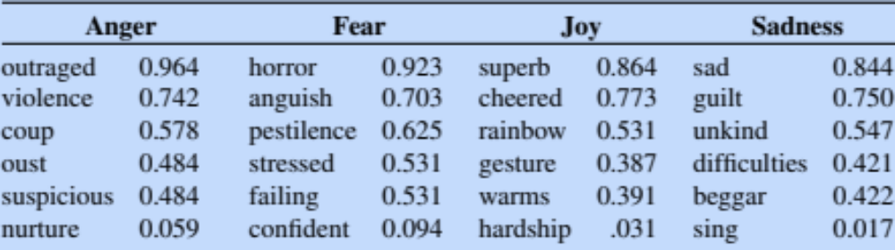
NRC Emotion/Affect Intensity Lexicon (Mohammad, 2018b); real values for 5814 words

Slide 26
Lexicons for Sentiment, Affect, and Connotation
Other Useful Lexicons

Slide 27
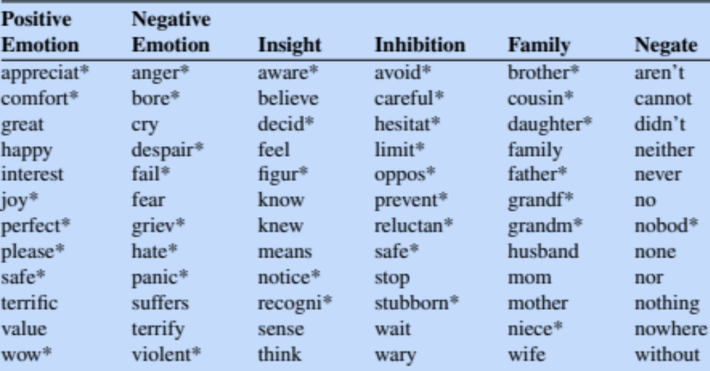
LIWC: Linguistic Inquiry and Word Count

Slide 28
LIWC (Linguistic Inquiry and Word Count)
  Pennebaker, J.W., Booth, R.J., & Francis, M.E. (2007). Linguistic Inquiry and Word Count: LIWC 2007. Austin, TX
http://www.liwc.net/
2300 words
>70 classes

Slide 29
The General Inquirer
Philip J. Stone, Dexter C Dunphy, Marshall S. Smith, Daniel M. Ogilvie. 1966. The General Inquirer: A Computer Approach to Content Analysis. MIT Press
  Home page: http://www.wjh.harvard.edu/~inquirer
  List of Categories: http://www.wjh.harvard.edu/~inquirer/homecat.htm
  Spreadsheet: http://www.wjh.harvard.edu/~inquirer/inquirerbasic.xls
Categories:
  Positiv (1915 words) and Negativ (2291 words)
  Strong vs Weak, Active vs Passive, Overstated versus Understated
  Pleasure, Pain, Virtue, Vice, Motivation, Cognitive Orientation, etc
Free for Research Use

Slide 30
Concreteness versus abstractness
The degree to which the concept denoted by a word refers to a perceptible entity.
Brysbaert, M., Warriner, A. B., and Kuperman, V. (2014) Concreteness ratings for 40 thousand generally known English word lemmas Behavior Research Methods 46, 904-911.
Supplementary data: This work is licensed under a Creative Commons Attribution-NonCommercial-NoDerivs 3.0 Unported License.
37,058 English words and 2,896 two-word expressions ( “zebra crossing” and “zoom in”),
Rating from 1 (abstract) to 5 (concrete)

Slide 31
Concreteness versus abstractness
Brysbaert, M., Warriner, A. B., and Kuperman, V. (2014) Concreteness ratings for 40 thousand generally known English word lemmas Behavior Research Methods 46, 904-911.
Supplementary data: This work is licensed under a Creative Commons Attribution-NonCommercial-NoDerivs 3.0 Unported License.
Some example ratings from the final dataset of 40,000 words and phrases
  banana 5
  bathrobe 5
  bagel 5
  brisk 2.5
  badass 2.5
  basically 1.32
  belief 1.19
  although 1.07

Slide 32
Lexicons for Sentiment, Affect, and Connotation
Building Lexicons using Human Labelers

Slide 33
Where do lexicons come from?
One method: crowdsourcing!!!
10,000 words
  Collected from earlier lexicons
Labeled by workers on Amazon Mechanical Turk
  “Turkers”
5 Turkers per hit

Slide 34
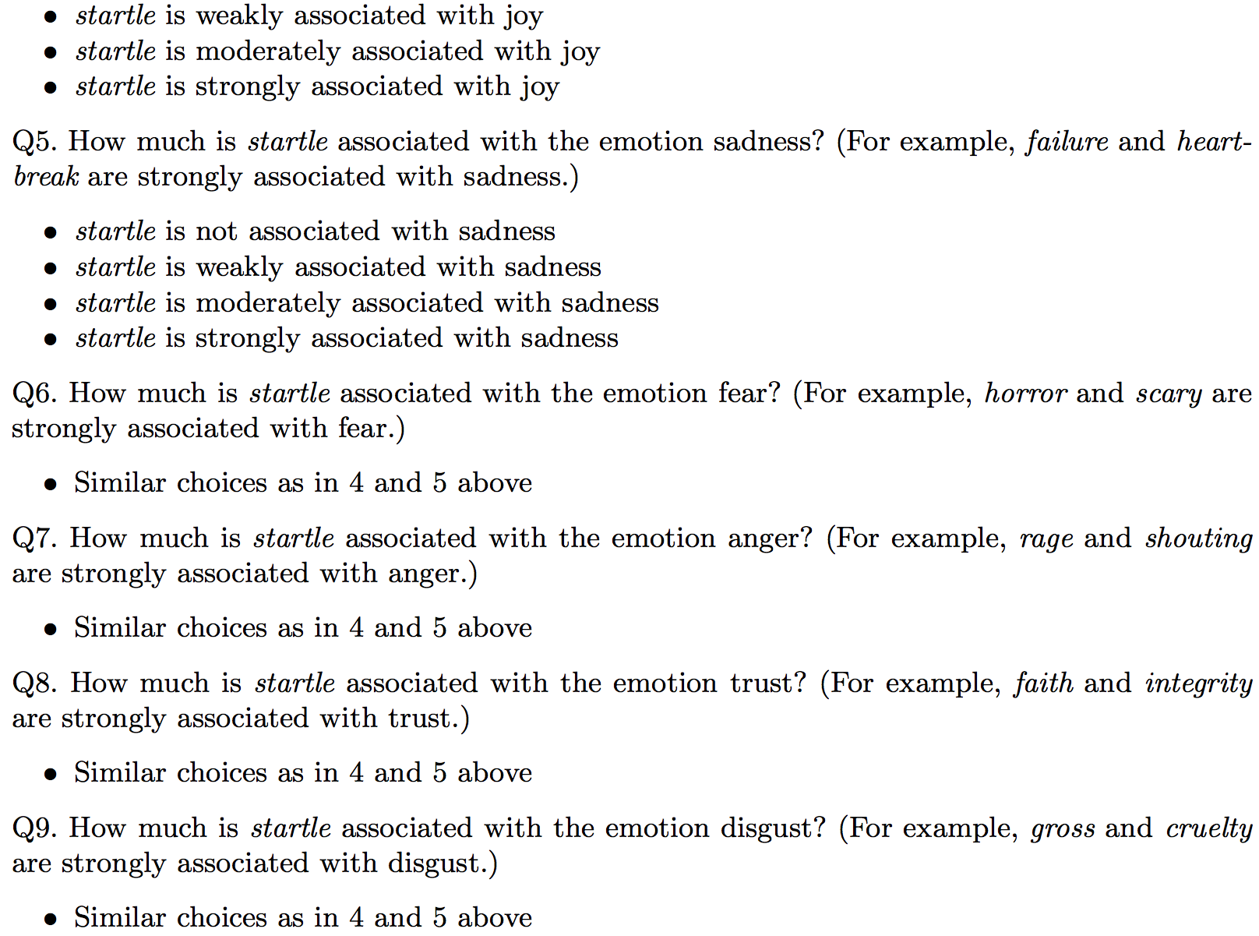
The AMT Hit
…

Slide 35
NRC Valence, Arousal, Dominance (VAD) lexicon
Mohammad (2018)
20,000 words, 3 emotional dimensions:
  valence (the pleasantness of the stimulus)
  arousal (the intensity of emotion provoked by the stimulus)
  dominance (the degree of control exerted by the stimulus)

Slide 36
Best-worst scaling: valence
Q1. Which of the four words below is associated with the MOST happiness / pleasure / positiveness / satisfaction / contentedness / hopefulness OR LEAST unhappiness / annoyance / negativeness / dissatisfaction / melancholy / despair?
vacation, consolation, whistle, torture
Q2. Which of the four words below is associated with the LEAST happiness / pleasure / positiveness / satisfaction / contentedness / hopefulness OR MOST unhappiness / annoyance / negativeness / dissatisfaction / melancholy / despair?

Slide 37
Lexicon of valence, arousal, and dominance
Valence |  | Arousal |  | Dominance
delightful | .918 | enraged | .962 | powerful | .991
vacation | .840 | party | .840 | authority | .935
whistle | .653 | organized | .337 | saxophone | .482
consolation | .408 | effortless | .120 | discouraged | .0090
torture | .115 | napping | .046 | weak | .045

Slide 38
Issues to keep in mind with crowdsourcing lexicons
Native (or very fluent) speakers
Making the task clear for non-linguists or non computer scientists
Paying minimum wage (fairwork.stanford.edu)

Slide 39
Lexicons for Sentiment, Affect, and Connotation
Building Lexicons using Human Labelers

Slide 40
Lexicons for Sentiment, Affect, and Connotation
Semi-supervised Induction of Affect Lexicons

Slide 41
Semantic Axis Methods
(An et al., 2018, Turney and Littman 2003)
Start with seed words like good or bad for the two poles
For each word to be added to lexicon
Compute a word representation
Use this to measure its distance from the poles
Assign it to the pole it is closer to

Slide 42
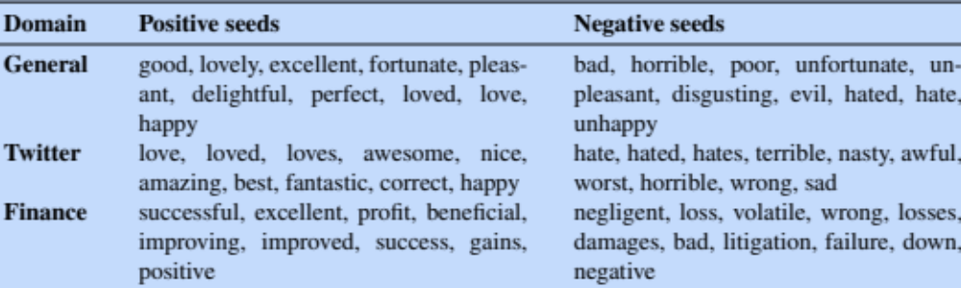
Initial seeds for different domains
Start with a single large seed lexicon and rely on the induction algorithm to fine-tune it to the domain
Choose different seed words for different genres:

Slide 43
Compute representation
Can just use off-the-shelf static embeddings
word2vec, GloVe, etc.
Or compute on a corpus
Or fine-tune pre-trained embeddings to a corpus

Slide 44


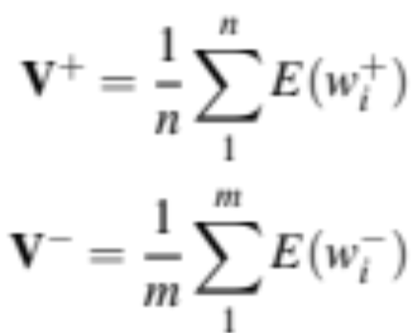
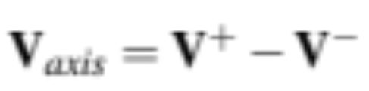
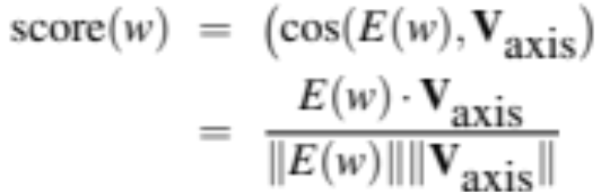
Represent each pole
Start with embeddings for seed words:
Pole centroids are:
Semantic axis is:
Word score is cosine with axis

Slide 45
Label Propagation Methods
Alternative to axis methods: propagate sentiment labels on word graphs
First proposed by Hatzivassiloglou and McKeown (1997)
Let's see method of Hamilton et al. 2016

Slide 46
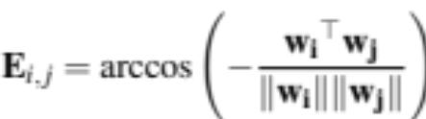
Label Propagation (Hamilton et al., 2016 version)
1. Define a graph: connecting each word with k nearest neighbor
2. Define a seed set (pos and neg words)
love, hate, etc

Slide 47
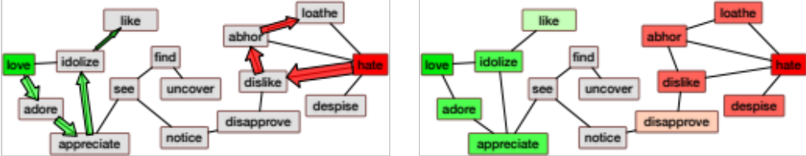
Label Propagation (Hamilton et al., 2016 version)
3. Propagate polarities from the seed set: randomly walk on the graph
Polarity score is proportional to probability of random walk landing on word

Slide 48
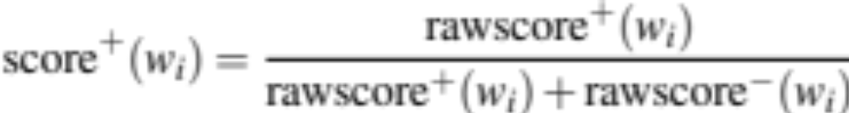
Label Propagation (Hamilton et al., 2016 version)
4. Create word scores:
Walking from positive and negative seedsets
  Gives rawscore⁺(w_{i}) and rawscore⁻(w_{i})
Combine into one score:

Slide 49
Label Propagation (Hamilton et al., 2016 version)
5. Assign confidence via bootstrap sampling:
Compute the propagation B times over random subsets of the positive and negative seed sets
The standard deviation of the bootstrap sampled polarity scores gives a confidence measure.

Slide 50
Other metrics besides cosine:
Vasileios Hatzivassiloglou and Kathleen R. McKeown. 1997. Predicting the Semantic Orientation of Adjectives. ACL, 174–181
Adjectives conjoined by “and” have same polarity
  Fair and legitimate, corrupt and brutal
  *fair and brutal, *corrupt and legitimate
Adjectives conjoined by “but” do not
  fair but brutal

Slide 51
Lexicons for Sentiment, Affect, and Connotation
Semi-supervised Induction of Affect Lexicons

Slide 52
Lexicons for Sentiment, Affect, and Connotation
Supervised Learning of Word Sentiment

Slide 53
Learn word sentiment supervised by online review scores
Potts, Christopher. 2011. On the negativity of negation. SALT 20, 636-659.
Potts 2011 NSF Workshop talk.
Review datasets
  IMDB, Goodreads, Open Table, Amazon, Trip Advisor
Each review has a score (1-5, 1-10, etc)
Just count how many times each word occurs with each score
  (and normalize)

Slide 54
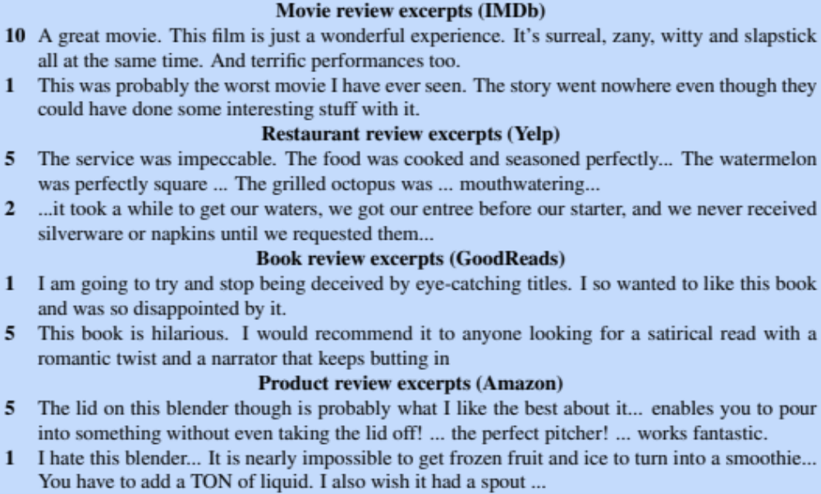
Online review data

Slide 55
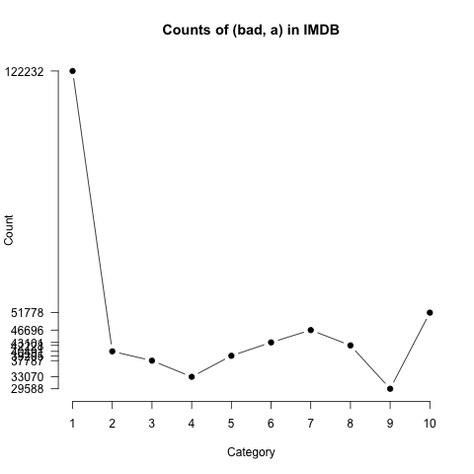
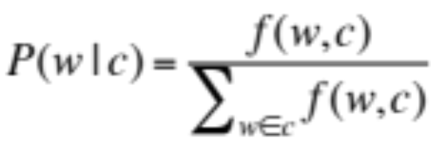
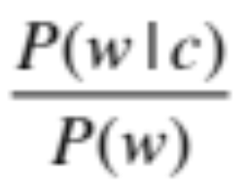
Analyzing the polarity of each word in IMDB
Potts, Christopher. 2011. On the negativity of negation. SALT 20, 636-659.
How likely is each word to appear in each sentiment class?
Count(“bad”) in 1-star, 2-star, 3-star, etc.
But can’t use raw counts:
Instead, likelihood:
Make them comparable between words
  Scaled likelihood:
Notes:
Thanks to Chris Potts for permission to use figure

Slide 56
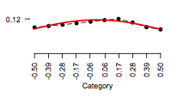
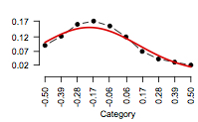
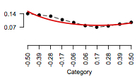
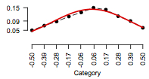
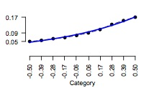
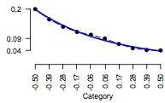
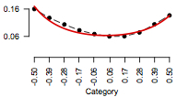
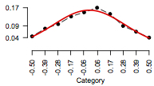
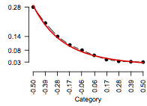
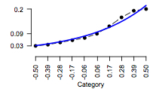
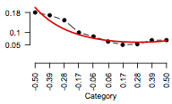
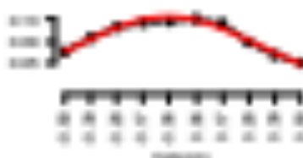
“Potts diagrams”
Potts, Christopher. 2011. NSF workshop on restructuring adjectives.
Positive scalars
Negative scalars
Emphatics
Attenuators
good
disappointing
somewhat
totally
absolutely
fairly
great
bad
excellent
pretty
terrible
utterly

Slide 57
Or use regression coefficients to weight words
Train a classifier based on supervised data
  Predict: human-labeled connotation of a document
  From: all the words and bigrams in it
Use the regression coefficients as the weights

Slide 58
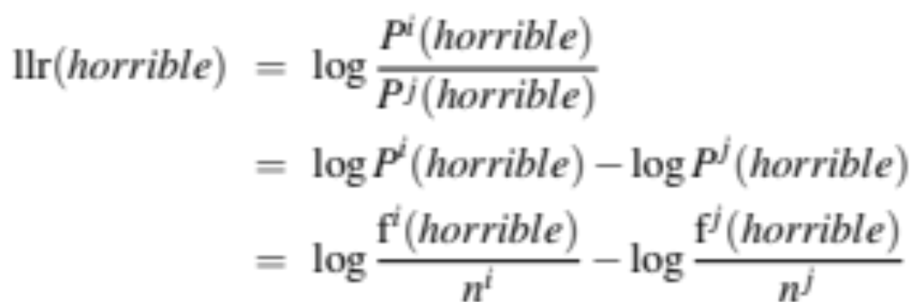
Log odds ratio informative Dirichlet prior
Monroe, B. L., Colaresi, M. P., and Quinn, K. M. (2008). Fightin’words: Lexical feature selection and evaluation for identifying the content of political conflict. Political Analysis 16(4), 372–403.
Log likelihood ratio: does “horrible” occur more % in corpus A or B?

Slide 59
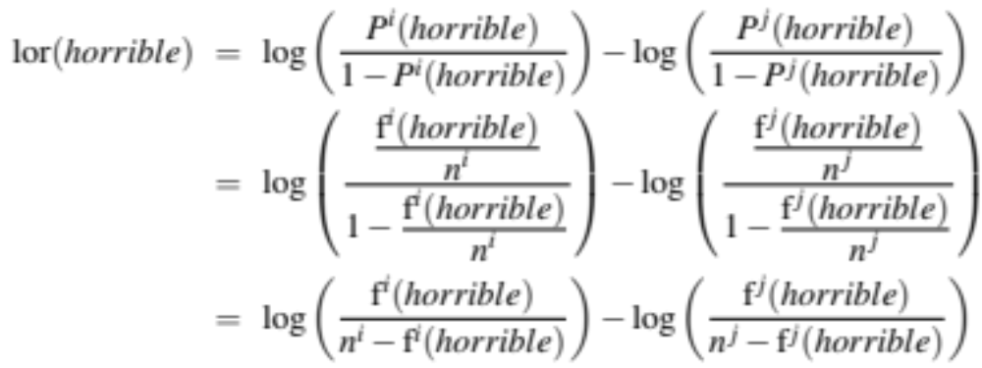
Log odds ratio informative Dirichlet prior
Monroe, B. L., Colaresi, M. P., and Quinn, K. M. (2008). Fightin’words: Lexical feature selection and evaluation for identifying the content of political conflict. Political Analysis 16(4), 372–403.
Log odds ratio: does “horrible” have higher odds in A or B?

Slide 60
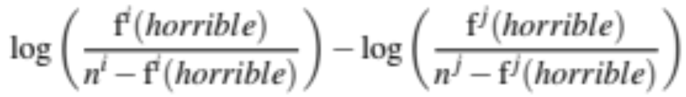
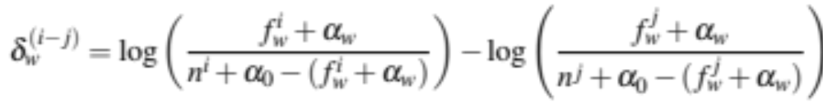
Log odds ratio with a prior
Monroe, B. L., Colaresi, M. P., and Quinn, K. M. (2008). Fightin’words: Lexical feature selection and evaluation for identifying the content of political conflict. Political Analysis 16(4), 372–403.
Log odds ratio from previous slide:
Now with a prior:
$n^{i}$ = size of corpus i, $n^{j}$ = size of corpus j, $f_{w}^{i}$ = count of word w in corpus i, $f_{w}^{j}$ = count of word w in corpus j, $α_{0}$ is the size of the background corpus, and $α_{w}$ =count of word w in the background corpus.)

Slide 61
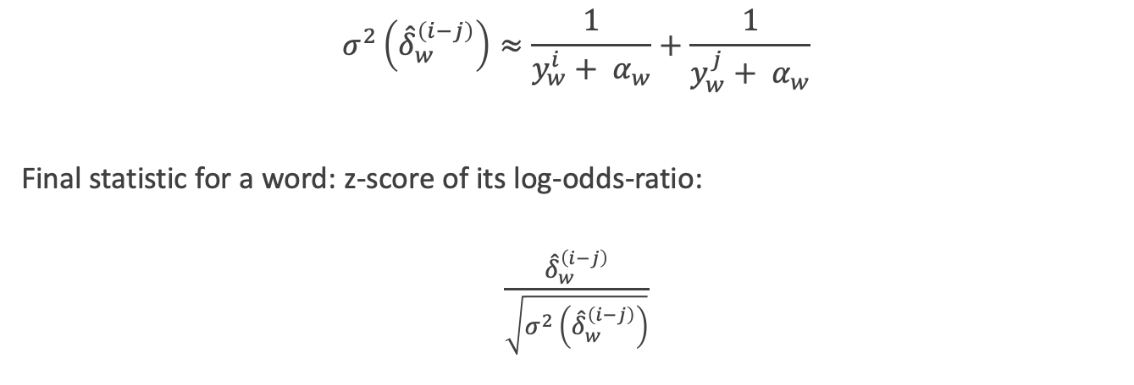
Log odds ratio informative Dirichlet prior
Monroe, B. L., Colaresi, M. P., and Quinn, K. M. (2008). Fightin’words: Lexical feature selection and evaluation for identifying the content of political conflict. Political Analysis 16(4), 372–403.
$$σ^{2}\left({\hat{δ}}_{w}^{\left(i−j\right)}\right)≈\frac{1}{y_{w}^{i}+ α_{w}}+\frac{1}{y_{w}^{j}+ α_{w}}$$
Final statistic for a word: z-score of its log-odds-ratio:
$$\frac{{\hat{δ}}_{w}^{\left(i−j\right)}}{\sqrt{σ^{2}\left({\hat{δ}}_{w}^{\left(i−j\right)}\right)}}$$

Slide 62
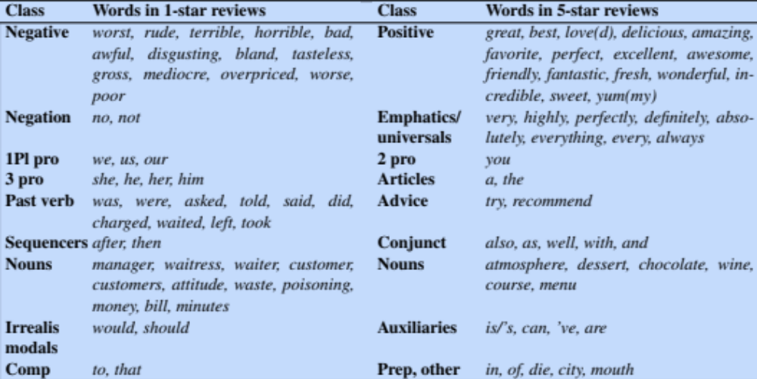
Top 50 words associated with bad (= 1-star) reviews by Monroe, et al. (2008) method
Jurafsky et al., 2014

Slide 63
Lexicons for Sentiment, Affect, and Connotation
Supervised Learning of Word Sentiment

Slide 64
Lexicons for Sentiment, Affect, and Connotation
Using the lexicons to detect affect

Slide 65
Lexicons for detecting document affect:
Simplest unsupervised method
Sentiment:
  Sum the weights of each positive word in the document
  Sum the weights of each negative word in the document
  Choose whichever value (positive or negative) has higher sum
Emotion:
  Do the same for each emotion lexicon

Slide 66
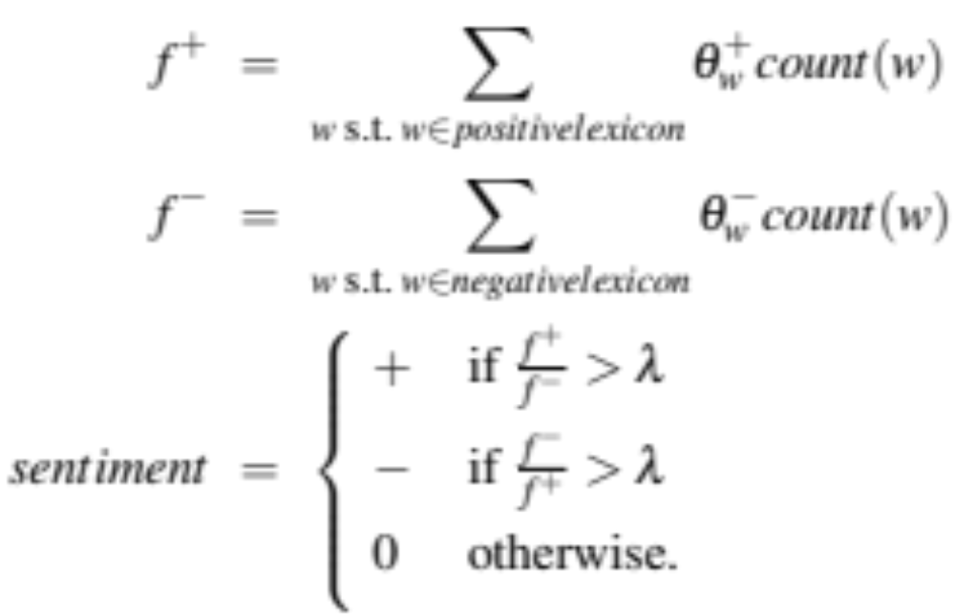
Lexicons for detecting document affect:
Simplest unsupervised method
Sentiment = + if f+ > f-

Slide 67
Lexicons for detecting document affect:
Slightly more complex unsupervised method

Slide 68
Lexicons for detecting document affect:
Simplest supervised method
Use the lexicons as features for a classifier
Given a training set
  Each observation has a label (review X has sentiment Y)
  Assign features to each observation
  Use “counts of lexicon categories” as a features
    NRC Emotion category “anticipation” had count of 2
      2 words in this document were in “anticipation” lexicon
    LIWC category “cognition” had count of 7

Slide 69
Lexicons for detecting document affect:
Simplest supervised method
Baseline
  Use counts of all the words and bigrams in the training set
    Like the naïve bayes algorithm
  This is hard to beat
  But “using all the words” only works if the training and test sets are very similar
  In real life, sometimes the test set is very different
    Lexicons are useful in that situation

Slide 70
Computing entity-centric affect
Suppose we want an affect score for an entity in a text (not the entire document)
Entity-centric method of Field and Tsvetkov (2019)

Slide 71
Entity-centric affect (Field and Tsvetkov 2019)
1: Train classifier to predict V/A/D from embeddings
For each word w in the training corpus:
Use off-the-shelf encoders (like BERT) to extract a contextual embedding e for each instance of the word.
Average over the e embeddings of each instance of w to obtain a single embedding vector for one training point w.
Use the NRC Lexicon to get V, A, and D scores for w.
Train (three) regression models on all words w to predict V, A, D scores from a word’s average embedding.

Slide 72
Entity-centric affect (Field and Tsvetkov 2019)
2: Assign scores to entity mentions
Given an entity mention m in a text, assign affect scores as follows:
Use the same pretrained LM to get contextual embeddings for m in context.
Feed this embedding through the 3 regression models to get V, A, D scores for the entity.

Slide 73
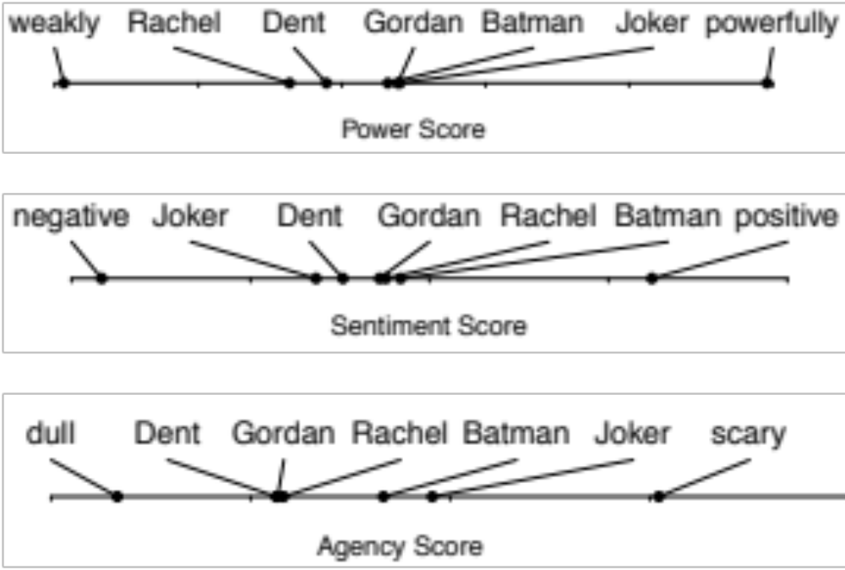
Entity-centric affect (Field and Tsvetkov 2019)
= dominance
= valence
= arousal

Slide 74
Lexicons for Sentiment, Affect, and Connotation
Using the lexicons to detect affect

Slide 75
Lexicons for Sentiment, Affect, and Connotation
Connotation frames

Slide 76
Connotation Frames intuition
A predicate expresses connotations about its arguments (Rashkin et al. 2016, Rashkin et al. 2017).
By using violate, author is sympathizing with B, and expressing negative sentiment toward A:
Country A violated the sovereignty of Country B
By using survive, author is saying that the bombing is negative, and sympathizing with teenager:
the teenager ... survived the Boston Marathon bombing”

Slide 77
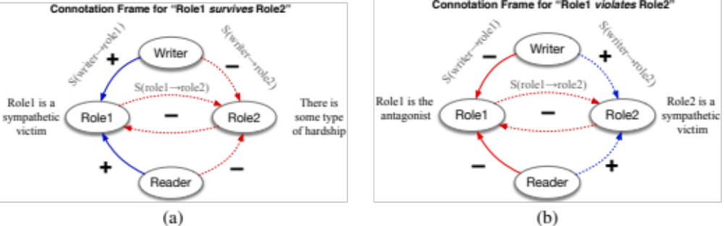
Connotation Frames
Rashkin et al., 2016, 2017

Slide 78
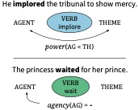
Connotation Frames can also mark power and agency
Sap et al. 2017

Slide 79
Lexicons for Sentiment, Affect, and Connotation
Connotation frames

