Slide 1
Chatbots and Dialogue Systems
Introduction to Chatbots and Dialogue Systems
Notes:
In this series of lectures we explore chatbots and dialogue systems

Slide 2
Conversational Agents
(AKA Dialogue Systems AKA Dialogue Agents AKA Chatbots)
Personal Assistants on phones or other devices
SIRI, Alexa, Cortana, Google Assistant
Playing music, setting timers and clocks
Chatting for fun
Booking travel reservations
Clinical uses for mental health
Notes:
Conversational agents, also called dialogue systems, dialogue agents, chatbots, are systems designed to interact with humans via conversations, either in text or speech. These include the personal assistants on phones or other devices like SIRI, Alexa, Cortana, or the Google Assistant, tools for simple, relatively short interactions like playing music, setting timers or clocks or keeping shoppinig lists, to longer conversations maybe just for fun, or for practical applications like booking travel reservations, or even in clinical uses for mental health.

Slide 3
Two kind of conversational agents
Chatbots
  - mimic informal human chatting
  - for fun, or even for therapy
(Task-based) Dialogue Agents
  - interfaces to personal assistants
  - cars, robots, appliances
  - booking flights or restaurants
Notes:
We'll talk in these lectures about two broad categories of conversational agents.
Chatbots are systems that can carry on extended conversations with the goal of mimicking the unstructured conversations or ‘chats’ characteristic of informal human-human interaction. Mostly these have been designed for fun.
Yet starting from the very first system, Weizenbaum's ELIZA, the role of chatbots
has also been studied for practical purposes like counseling.
The second kind of system are goal-based dialogue agents used to to solve some task like booking a flight or maintaining a shopping list.
Sometimes you'll see the word "chatbot" used for both kinds of systems, but we'll try to distinguish them in these lectures

Slide 4
Chatbot Architectures
Rule-based
  Pattern-action rules (ELIZA)
  + A mental model (PARRY):
  The first system to pass the Turing Test!
Corpus-based
  Information Retrieval (XiaoIce)
  Neural encoder-decoder (BlenderBot)
Notes:
Like practically everything else in language processing, chatbot architectures fall
into two classes: rule-based systems and corpus-based systems. Rule-based systems include the early influential ELIZA and PARRY systems. Corpus-based systems mine large datasets of human-human conversations, which can be done by using information retrieval to copy a human response from a previous conversation, or using an encoder-decoder system to generate a response from a user utterance.

Slide 5
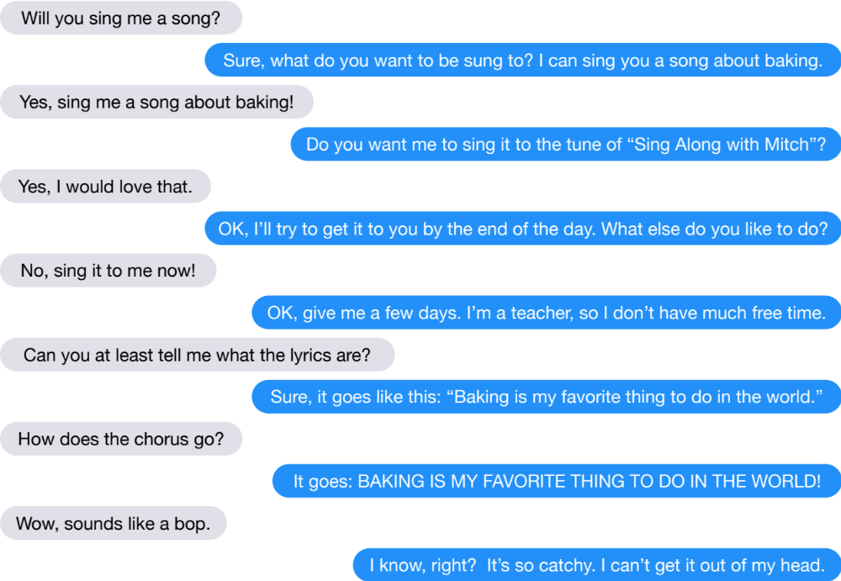
BlenderBot (Roller et al. 2020)
Notes:
These systems often have an entertainment value, such as Facebook’s Blender- Bot, a neural chatbot capable of carrying on conversations of this type.

Slide 6

XiaoIce (Zhou et al., 2020)
Notes:
Or Microsoft’s XiaoIce system2 (Zhou et al., 2020), chats with people in Chinese on text messaging platforms , responding mainly by extracting turns that humans have said in past conversations.

Slide 7
Task-based dialogue agents
"Task-based" or "goal-based" dialogue agents
Systems that have the goal of helping a user solve a task
  Setting a timer
  Making a travel reservation
  Playing a song
  Buying a product
Architecture:
Frames with slots and values
A knowledge structure representing user intentions
Notes:
Other dialogue agents are built to solve a task, like setting a timer, making a travel reservation, or playing a song. These tend to be built around a knowledge structure called the frame.

Slide 8
The Frame
A set of slots, to be filled with information of a given type
Each associated with a question to the user
  Slot Type Question
  ORIGIN city "What city are you leaving from?
  DEST city "Where are you going?
  DEP DATE date "What day would you like to leave?
  DEP TIME time "What time would you like to leave?
  AIRLINE line "What is your preferred airline?
Notes:
A frame represents the users intentions for the task,
and consists of a collection of slots, each of which can take a set of possible values, so an airline booking agent might have slots like the destination city or the departure time.
.

Slide 9
Chatbots and Dialogue Systems
Introduction to Chatbots and Dialogue Systems
Notes:
This has been a quick overview of the two classes of dialogue systems, chatbots, and task-based dialogue systems

Slide 10
Chatbots and Dialogue Systems
Properties of Human Conversation
Notes:
Before we attempt to design a conversational agent to converse with humans, it is crucial to understand something about how humans converse with each other

Slide 11
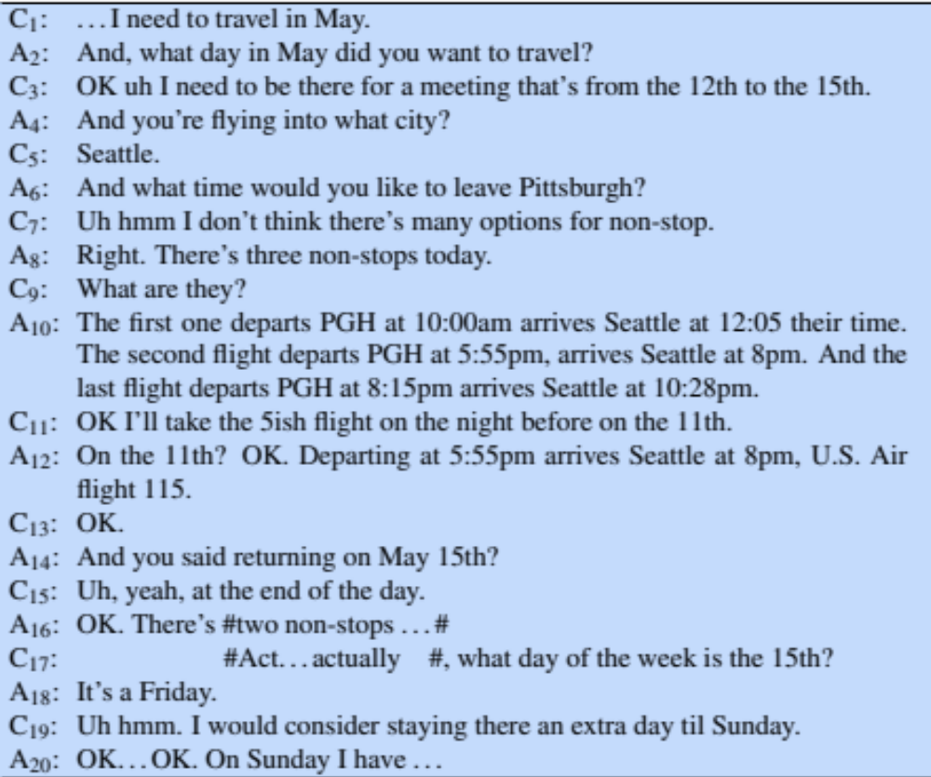
A telephone conversation between a human travel agent (A) and a human client (C)
Notes:
Consider some of the phenomena that occur in the conversation between a human travel agent and a human client excerpted here

Slide 12
Properties of Human Conversation
Turns
  We call each contribution a "turn"
  As if conversation was the kind of game where everyone takes turns.
Notes:
Let's consider some of the properties of this conversation. First of all, we call each of the contributions of the two conversants a "turn", as if conversation was the kind of game where everyone takes turns.

Slide 13
Notes:
There are 20 turns in this excerpt. A turn can consist of a sentence (like C1), although it might be as short as a single word (C13) or as long as multiple sentences (A10).

Slide 14
Properties of Human Conversation
Turn-taking issues
  When to take the floor?
  When to yield the floor?
Interruptions
Notes:
Next, the fact that there are two (or more) people who need to talk means that they have to negotiate turn-taking. Who takes the floor? When do I yield the floor? What happens when we both try to talk at the same time, cases of interruptions.

Slide 15
Notes:
Notice that the client interrupts here, and the human agent knows to stop talking (and also knows that the the client might be making a correction or change). Systems need to be able to handle this.

Slide 16
Implications for Conversational Agents
Barge-in
  Allowing the user to interrupt
End-pointing
  The task for a speech system of deciding whether the user has stopped talking.
  Very hard, since people often pause in the middle of turns
Notes:
In a dialogue system, recognizing when the user is talking is called barge-in.
A system also has to know when to start talking. For example, most of the time in conversation, speakers start their turns almost immediately after the other speaker finishes, without a long pause. This is sometimes called "latching"; people are able to (most of the time) detect when the other person is about to finish talking and time their response to slip right in.
Spoken dialogue systems must detect whether a user is done speaking, so they can process the utterance and respond. This task— called endpointing or endpoint detection— can be quite challenging because of noise and because people often pause in the middle of turns.

Slide 17
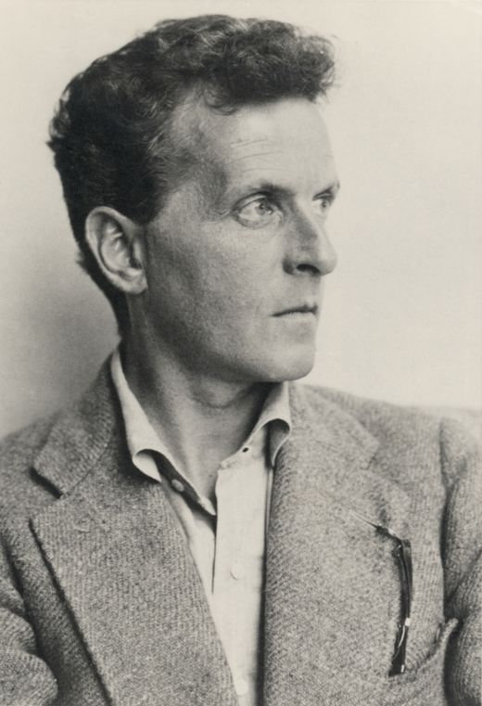
Language as Action
Each turn in a dialogue is a kind of action
Wittgenstein (1953) and Austin (1962)
Notes:
A key insight into conversation—due originally to the philosopher Wittgenstein (1953) but worked out more fully by the philosopher Austin (1962)—is that each utterance in a dialogue is a kind of action being performed by the speaker.

Slide 18
Speech Acts (aka Dialogue Acts)
Bach and Harnish (1979)
Constatives: committing the speaker to something’s being the case (answering, claiming, confirming, denying, disagreeing, stating)
Directives: attempts by the speaker to get the addressee to do something (advising, asking, forbidding, inviting, ordering, requesting)
Commissives: committing the speaker to some future course of action (promising, planning, vowing, betting, opposing)
Acknowledgments: express the speaker’s attitude regarding the hearer with respect to some social action (apologizing, greeting, thanking, accepting an acknowledgment)
Notes:
These actions are commonly called speech acts or dialog acts: here’s one taxonomy consisting of 4 major classes from Bach and Harnish.

Slide 19
Speech acts
"Turn up the music!"
  Directive
"What day in May do you want to travel?"
  Directive
"I need to travel in May"
  Constative
Thanks
  Acknowledgement
Notes:
A user asking a person or a dialogue system to do something (‘Turn up the music’) is issuing a DIRECTIVE, a kind of COMMAND. Asking a question that requires an answer is also a way of issuing a DIRECTIVE: in a sense when the agent says “what day in May did you want to travel?” it’s as if they are (very politely) commanding the client to answer. By contrast, a user stating a constraint (like ‘I need to travel in May’) is issuing a CONSTATIVE. A user thanking the system is issuing an ACKNOWLEDGMENT. The speech act expresses an important component of the intention of the speaker (or writer) in saying what they said.

Slide 20
Grounding
Participants in conversation or any joint activity need to establish common ground.
Principle of closure. Agents performing an action require evidence, sufficient for current purposes, that they have succeeded in performing it (Clark 1996, after Norman 1988)
Speech is an action too! So speakers need to ground each other’s utterances.
  Grounding: acknowledging that the hearer has understood
Notes:
A dialogue is not just a series of independent speech acts, but rather a collective act performed by the speaker and the hearer. Like all collective acts, it’s important for the participants to establish what they both agree on, called the common ground/
Speakers do this by grounding each other’s utterances. Grounding means acknowledging that the hearer has understood the speaker; like an ACK used to confirm receipt in data communications (Clark, 1996).
Grounding is relevant for other kinds of human-machine interactions the reason an elevator button lights up when it’s pressed is to acknowledge that the elevator has indeed been called (Norman, 1988).)

Slide 21
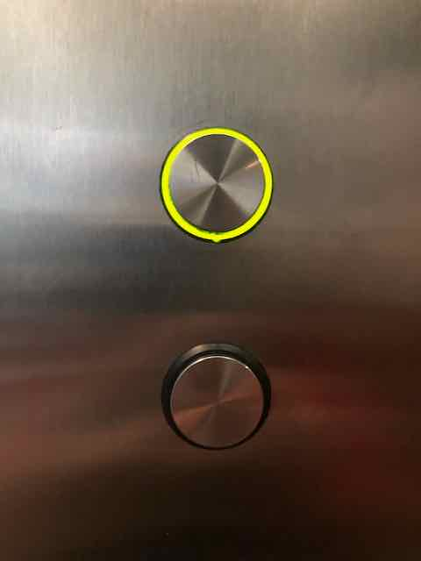
Grounding
Grounding is relevant for human-machine interaction
  Why do elevator buttons light up?
Notes:
Grounding is relevant for other kinds of human-machine interactions too. As Don Norman points out, the reason an elevator button lights up when it’s pressed is to acknowledge that the elevator has indeed been called. It's a non-linguistic way of acknowledging your action.

Slide 22
Grounding: Establishing Common Ground
A: And you said returning on May 15th?
C: Uh, yeah, at the end of the day.
A: OK
C: OK I’ll take the 5ish flight on the night before on the 11th.
A: On the 11th? OK.
C: ...I need to travel in May.
A: And, what day in May did you want to travel?
Notes:
Humans constantly ground each other’s utterances. We can ground by explicitly saying “OK”, as the agent does in our excerpt
CLICK Or we can ground by repeating what the other person says; in this utterance the agent repeats “on the 11th”, demonstrating their understanding to the client.
CLICK Or notice that when the client answers a question, the agent begins the next question with “And”. The “And” implies that the new question is ‘in addition’ to the old question, again indicating to the client that the agent has successfully understood the answer to the last question.

Slide 23
Grounding is important for computers too!
Cohen et al (2004)
System: Did you want to review some more of your profile?
User: No.
System: What’s next?
System: Did you want to review some more of your profile?
User: No.
System: Okay, what’s next?
Awkward!
Less Awkward!
Notes:
Such grounding is important for computers too. Consider two ways to follow up a user responding "NO' to the system's question "Did you want to review some more of yoru profile?"
No
What's next?
Versys
No
OK, what's next
In this second method, the OK grounds the users selection, making it clear that the system processed the user's No".

Slide 24
Conversations have structure
Local structure between adjacent speech acts, from the field of conversational analysis (Sacks et al. 1974)
Called adjacency pairs:
Question… Answer
Proposal… Acceptance/Rejection
Compliments ("Nice jacket!")… Downplayer ("Oh, this old thing?")
Notes:
Conversations have structure. Consider, for example, the local structure between speech acts discussed in the field of conversational analysis (Sacks et al., 1974). QUESTIONS set up an expectation for an ANSWER. PROPOSALS are followed by ACCEPTANCE (or REJECTION). COMPLIMENTS (“Nice jacket!”) often give rise to DOWNPLAYERS (“Oh, this old thing?”). These pairs, called adjacency pairs are composed of a first pair part and a second pair part and these expectations can help systems decide what actions to take.

Slide 25
Another kind of structure: Subdialogues
Correction subdialogue
Agent: OK. There's #two non-stops#
  Client: #Act- actually#, what day of the week is the 15th?
  Agent: It’s a Friday.
  Client: Uh hmm. I would consider staying there an extra day til Sunday.
Agent: OK...OK. On Sunday I have ...
Notes:
However, dialogue acts aren’t always followed immediately by their second pair part. The two parts can be separated by a side sequence (Jefferson 1972) or subdialogue. For example these turns from our conversation excerpt are a correction subdialogue.
The client's question "what day of the week is the 15th" interrupts the prior discourse, in which the agent was looking for a May 15 return flight. The agent must answer the question and also realize that ‘’I would consider staying...til Sunday” means that the client would probably like to change their plan, and now go back to finding return flights, but for the 17th.

Slide 26
Clarification Subdialogues
User: What do you have going to UNKNOWN WORD on the 5th?
  System: Let’s see, going where on the 5th?
  User: Going to Hong Kong.
System: OK, here are some flights...
Notes:
Another side sequence is the clarification question, which can form a subdialogue between a REQUEST and a RESPONSE. This is especially common in dialogue systems where speech recognition errors causes the system to have to ask for clarifications or repetitions like the following:

Slide 27
Presequences
User: Can you make train reservations?
System: Yes I can.
User: Great, I’d like to reserve a seat on the 4pm train to New York.
Notes:
In addition to side-sequences, questions often have presequences, like this example where a user starts with a question about the system’s capabilities (“Can you make train reservations”) before making a request.

Slide 28
Conversational Initiative
Some conversations are controlled by one person
A reporter interviewing a chef asks questions, and the chef responds.
This reporter has the conversational initiative (Walker and Whittaker 1990)
Most human conversations have mixed initiative:
  I lead, then you lead, then I lead.
Mixed initiative is very hard for NLP systems, which often default to simpler styles that can be frustrating for humans:
  User initiative (user asks or commands, system responds)
  System initiative (system asks user questions to fill out a form, user can't change the direction)
Notes:
Sometimes a conversation is completely controlled by one participant. For example a reporter interviewing a chef might ask questions, and the chef responds. We say that the reporter in this case has the conversational initiative
In normal human-human dialogue, however, it’s more common for initiative to shift back and forth between the participants, as they sometimes answer questions, sometimes ask them, sometimes take the conversations in new directions
Mixed initiative, while the norm for human-human conversations, is very diffi- cult for dialogue systems to achieve. It’s much easier to design dialogue systems to be passive responders. In search engines or simple QA systems, the initiative lies completely with the user. In such user- initiative systems, the user specifies a query, and the systems responds. Then the user can specify another query. Alternatively, you may have had the experience of being stuck in a bad dialogue system that asks a question and gives you no opportu- nity to do anything until you answer it. Such system-initiative architectures can be very frustrating.

Slide 29
Even harder problems: Inference
Agent: And, what day in May did you want to travel?
Client: OK, uh, I need to be there for a meeting that’s from the 12th to the 15th.
Notes:
Inference is also important in dialogue understanding. Consider this excerpt. READ
Notice that the client does not in fact answer the agent’s question. The client merely mentions a meeting at a certain time. What is it that licenses the agent to infer that the client is mentioning this meeting so as to inform the agent of the travel dates?
The speaker seems to expect the hearer to draw certain inferences; in other words, the speaker is communicating more information than seems to be present in the uttered words
This kind of example was pointed out by Grice (1975, 1978) as part of his theory of conversational implicature. Implicature means a particu- lar class of licensed inferences

Slide 30
Chatbots and Dialogue Systems
Properties of Human Conversation
Notes:
We've touched on a few of the properties of human conversation that we'll need to keep in mind if we're designing conversational agents

Slide 31
Chatbots and Dialogue Systems
Rule-based Chatbots: ELIZA and PARRY
Notes:
The chatbot ELIZA, a simulated Rogerian psychotherapist is one of the earliest, and most important chatbot systems in the history of the field.

Slide 32
ELIZA: Weizenbaum (1966)
Men are all alike.
IN WHAT WAY
They're always bugging us about something or other.
CAN YOU THINK OF A SPECIFIC EXAMPLE
Well, my boyfriend made me come here.
YOUR BOYFRIEND MADE YOU COME HERE
He says I'm depressed much of the time.
I AM SORRY TO HEAR YOU ARE DEPRESSED
...
You are like my father in some ways.
WHAT RESEMBLANCE DO YOU SEE
You are not very aggressive but I think you don’t want me to notice that.
WHAT MAKES YOU THINK I AM NOT AGGRESSIVE
You don’t argue with me.
WHY DO YOU THINK I DON’T ARGUE WITH YOU
You are afraid of me.
DOES IT PLEASE YOU TO BELIEVE I’M AFRAID OF YOU
My father is afraid of everybody.
WHAT ELSE COMES TO MIND WHEN YOU THINK OF YOUR FATHER
Bullies.
DOES THAT HAVE ANYTHING TO DO WITH THE FACT THAT YOUR BOYFRIEND MADE YOU COME HERE
Weizenbaum, Joseph. 1966, "ELIZA - A Computer Program For the Study of Natural Language Communication Between Man And Machine", Communications of the ACM 9 (1): 36-45
Notes:
Let's walk through a sample conversation published in the paper that introduced ELIZA in 1966, I've excerpted it here by deleting some material with ... from a full interaction given in the original paper
Note that ELIZA seems to give very linguistically coherent responses and even offer very sophisticated therapeutic advice, and even seems to remember things from far back in the discourse, this final line here refers back to something right at the beginning…

Slide 33
ELIZA's trick: be a Rogerian psychologist
Draw the patient out by reflecting patient’s statements back at them
Rare type of conversation in which one can “assume the pose of knowing almost nothing of the real world”
Notes:
ELIZA was designed to simulate a Rogerian psychologist, based on a branch of clinical psychology whose methods involve drawing the patient out by reflecting patient’s statements back at them. Rogerian psychology is the rare type of conver- sation in which, as Weizenbaum points out, one can “assume the pose of knowing almost nothing of the real world”.

Slide 34
Rogerian psychologist
  Patient: "I went for a long boat ride”
  Psychologist: "Tell me about boats”
You don’t assume she didn’t know what a boat is
You assume she had some conversational goal
Chatbots trying to pass the Turing test usually choose some such domain
Notes:
If a patient says “I went for a long boat ride” and the psychologist says “Tell me about boats”, you don’t assume she didn’t know what a boat is, but rather assume she had some conversational goal. Most chatbots trying to pass the Turing test choose a domain with similar properties.

Slide 35
Eliza pattern/transform rules
(0 YOU 0 ME) [pattern]
(WHAT MAKES YOU THINK I 3 YOU) [transform]
0 means Kleene *
The 3 is the constituent # in pattern
You hate me
WHAT MAKES YOU THINK I HATE YOU
Notes:
ELIZA worked by pattern/transform rules like the following one:
In the ELIZA pattern, 0 means Kleene*, and in the transform rules the numbers are the index of the constituent in the pattern. Thus the number 3 refers to the second 0 in the first pattern. This rule would transfer
You hate me
into:
WHAT MAKES YOU THINK I HATE YOU

Slide 36
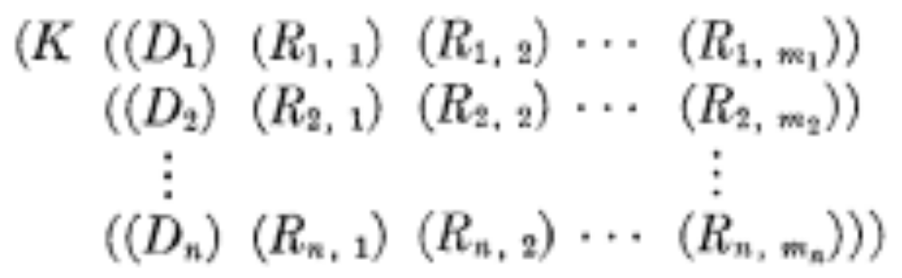
Eliza Rules
Rules are organized by keywords
Each keyword has a pattern and a list of possible transform
Keyword: YOU
Pattern: (0 YOU 0 ME)
Transforms: (WHAT MAKES YOU THINK I 3 YOU)
(WHY DO YOU THINK I 3 YOU)
keyword
pattern
list of transforms
Notes:
Each ELIZA pattern/rule is linked to a keyword that might occur in a user sentence. A keyword is a word that has to be present in the user's input. Each keyword has a list of patterns, and then a list of transforms
So the pattern we just saw, 0 YOU 0 ME, might be organized under the keyword "YOU". And each pattern could have a whole list of possible transforms, I've shown two here. For you history buffs, here's the LISP structure for ELIZA's knowledge from the original paper!

Slide 37
Keywords are ranked from specific to general
  User: I know everybody laughed at me
“I” is very general:
  I: (I *) -> (YOU SAY YOU 2)
  ELIZA: YOU SAY YOU KNOW EVERYBODY LAUGHED AT YOU
“Everybody” is more specific and interesting
Everybody: (Everybody *) -> (WHO IN PARTICULAR ARE YOU THINKING OF)
  ELIZA: WHO IN PARTICULAR ARE YOU THINKING OF?
Implementation: keywords stored with their rank
  Everybody 5 (list of transformation rules)
  I 0 (list of transformation rules)
Notes:
Keywords are associated with a rank, with specific words being more highly ranked, and more general words ranking lower. Consider the following user sen- tence:
I know everybody laughed at me Because it has the word “I”, this sentence could match the following rule whose keyword is I:
(I *) -> (You say you 2)
producing:
YOU SAY YOU KNOW EVERYBODY LAUGHED AT YOU But “I” is a very general word and its keywords lead to very general responses. Instead the keyword “everybody” is much more interest- ing, since Weizenbaum pointed out, someone using universals like everybody or always is probably referring to some specific event or person.

Slide 38
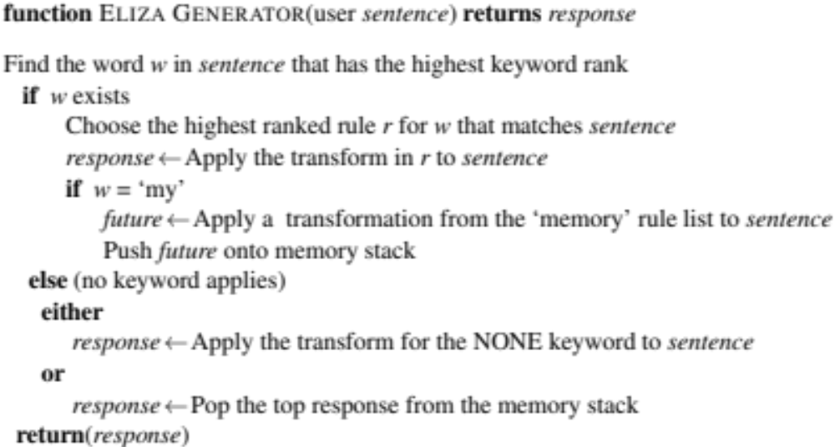

Slide 39
NONE
PLEASE GO ON
THAT’S VERY INTERESTING
I SEE
Notes:
If no keyword matches, ELIZA chooses a non-committal response like “PLEASE GO ON”, “THAT’S VERY INTERESTING”, or “I SEE”.

Slide 40
Memory
(MEMORY MY
(0 MY 0 = LETS DISCUSS FURTHER WHY YOUR 3)
(0 MY 0 = EARLIER YOU SAID YOUR 3)
(0 MY 0 = DOES THAT HAVE ANYTHING TO DO WITH THE FACT THAT YOUR 3))
Whenever “MY” is highest keyword
  Randomly select a transform on the MEMORY list
  Apply to sentence
  Store on a (first-in-first-out) queue
Later, if no keyword matches a sentence
  Return the top of the MEMORY queue instead
Notes:
inally, ELIZA has a clever memory trick that accounts for the very last sen- tence of the conversation above. Whenever the word “my” is the highest ranked keyword, ELIZA will randomly select a transform on the MEMORY list, apply it to the sentence, and store it on a queue:
Later, if no keyword matches a sentence, ELIZA will return the top of the MEMORY QUEUE
.

Slide 41
Ethical implications: Anthropomorphism and Privacy
People became deeply emotionally involved with the program
One of Weizenbaum's staff asked him to leave the room when she talked with ELIZA
When he suggested that he might want to store all the ELIZA conversations for later analysis, people immediately pointed out the privacy implications
  Suggesting that they were having quite private conversations with ELIZA
  Despite knowing that it was just software.
Notes:
People became deeply emotionally involved with the program. Weizenbaum
tells the story of one of his staff who would ask Weizenbaum to leave the room when she talked with ELIZA. When Weizenbaum suggested that he might want to store all the ELIZA conversations for later analysis, people immediately pointed out the privacy implications, which suggested that they were having quite private conversations with ELIZA, despite knowing that it was just software.

Slide 42
Ethical implications
It worried Weizenbaum that people confided in ELIZA
Were people misled about how much computers understood?
Turkle studied users of ELIZA and other systems
Turkle has shown human face-to-face interaction is vital
But people also develop specific relationships with artifacts
Some users told her ELIZA was more like a kind of diary, a way to privately explore their thoughts.
Importance of value-sensitive design
Joseph Weizenbaum. 1976. Computer Power and Human Reason: From Judgment to Calculation. WH Freeman.
Sherry Turkle. 2011. Taking Things at Interface Value, chapter in Life on the Screen. Simon and Schuster.
Sherry Turkle. 2007. Authenticity in the age of digital companions. Interaction Studies, 8(3), pp.501-517
Notes:
It worried Weizenbaum that people confided in ELIZA. Were people misled about how much computers understood?
Weizenbaum's feared that society was making a mistake in removing the human from decisions and choice.
Professor Sherry Turkle, Weizenbaum's colleague at MIT, studied users of ELIZA and other computational systems over many decades
Her more nuanced view is that while human face-to-face interaction is vital to the human experience, that humans also continue to develop relationships with artifacts. For example some some of the users she studied suggested they used ELIZA more like a diary, as a way to privately explore their thoughts.
The take-away, perhaps, is that it's important to do value-sensitive design: consider during the design process the benefits, harms and possible stake-holders of the resulting system .

Slide 43
PARRY: A computational model of schizophrenia
Another chatbot with a clinical psychology focus
Colby, K. M., Weber, S., and Hilf, F. D. (1971). Artificial paranoia. Artificial Intelligence 2(1), 1–25.
Used to study schizophrenia
Same pattern-response structure as Eliza
But a much richer:
  control structure
  language understanding capabilities
  model of mental state.
    variables modeling levels of Anger, Fear, Mistrust
Notes:
A few years after ELIZA, we see the development of another chatbot with a clinical psychology focus, PARRY (Colby et al., 1971).
But the goals here are very different than ELIZA. Here the authors were attempting to study schizophrenia by building a formal computational model of the mental processes and linguistic responses of a person with schizophrenia. So where an ELIZA is an exploration of what linguistic abilities it is possible to build, PARRY shows the use of an NLP system as a cognitive model.
PARRY is relevant to our discussion here because of its innovation of chatbot architecture. In addition to ELIZA- like regular expressions, the PARRY system included a model of its own mental state, with affect variables for things like agent’s levels of fear and anger, and complex rules for the link between mental state and linguistic input and output.

Slide 44
Affect variables
Fear (0-20) Anger (0-20) Mistrust (0-15)
Start with all variables low
After each user turn
  Each user statement can change Fear and Anger
      E.g., Insults increases Anger, Flattery decreases Anger
      Mentions of his delusions increase Fear
  Else if nothing malevolent in input
      Anger, Fear, Mistrust all drop
Notes:
Certain types of statements or topics of conversation might lead PARRY to become more angry or mistrustful. If the input mentions his delusion topic, he will increase the value of his fear variable.

Slide 45
Parry's responses depend on mental state
User Input
Modify
Affect variables
condition
excessive fear
excessive anger
Input mentions delusion topic
question
…
response
Escape
Hostility
Fear
answer
Notes:
PARRY’s outputs depended on his affect variable; for example if anger is high, he will choose from a set of “hostile” outputs.

Slide 46
PARRY passes the Turing test in 1972
The first system to pass a version of the Turing test
Psychiatrists couldn’t distinguish interviews with PARRY from (text transcripts of) interviews with people diagnosed with paranoid schizophrenia
Colby, K. M., Hilf, F. D., Weber, S., and Kraemer, H. C. (1972). Turing-like indistinguishability tests for the validation of a computer simulation of paranoid processes. Artificial Intelligence 3, 199–221.
Notes:
Parry was the first known system to pass the Turing test (in 1972!); psychiatrists couldn’t distin- guish text transcripts of interviews with PARRY from transcripts of interviews with people diagnosed with paranoid pchizophrenia (Colby et al., 1972).

Slide 47
Chatbots and Dialogue Systems
Rule-based Chatbots: ELIZA and PARRY
Notes:
While rule-based systems like ELIZA and PARRY are very simple, they have large implications, and rule-based methods are still used as a component of modern chatbots.

Slide 48
Chatbots and Dialogue Systems
Corpus-based Chatbots
Notes:
An alternative to writing rules is to build chatbots that automatically mine collections of human conversations to decide what to say.

Slide 49
Two architectures for corpus-based chabots
Response by retrieval
  Use information retrieval to grab a response (that is appropriate to the context) from some corpus
Response by generation
  Use a language model or encoder-decoder to generate the response given the dialogue context
Notes:
Most corpus based chatbots produce their responses to a user’s turn in context either by retrieval methods (using information retrieval to grab a response from some corpus that is appropriate given the dialogue context) or generation methods (using a language model or encoder-decoder to generate the response given the di- alogue context) In either case, systems mostly generate a single response turn that is appropriate given the entire conversation so far (for conversations that are short enough to fit into a single model’s window). For this reason they are often called response generation systems.

Slide 50
Corpus-based chatbots require corpora
Modern corpus-based chatbots are very data-intensive
They commonly require hundreds of millions or billions of words
Notes:
Modern corpus-based chatabots are very data-intensive, commonly requiring hundreds of million or billions of words of training

Slide 51
What conversations to draw on?
Transcripts of telephone conversations between volunteers
Switchboard corpus of American English telephone conversations
Movie dialogue
Various corpora of movie subtitles
Hire human crowdworkers to have conversations
  Topical-Chat 11K crowdsourced conversations on 8 topics
  EmpatheticDialogues 25K crowdsourced conversations grounded in a situation where a speaker was feeling a specific emotion
Pseudo-conversations from public posts on social media
  Drawn from Twitter, Reddit, Weibo (微博), etc.
  Tend to be noisy; often used just as pre-training.
Crucial to remove personally identifiable information (PII)
Notes:
Corpus-based chatbots, instead of using hand-built rules, mine conversations of human-human conversations. These systems are enormously data-intensive, requir- ing hundreds of millions or even billions of words for training .
Available datasets include transcripts of natural spoken conversational corpora, like the Switchboard corpus of American English telephone conversations (Godfrey et al., 1992) Many systems also train on movie dialogue, which resembles natural conversation in many ways.
Datasets have also been created specifically for training dialog systems by hiring crowdworkers to have conversations, often having them take on personas or
talk about knowledge provided to them. For example the Topical-Chat dataset has 11K crowdsourced conversations spanning 8 broad topics and the EMPATHETICDIALOGUES includes 25K crowdsourced conversations grounded in a specific situation where a speaker was feeling a specific emotion.
All of these datasets, although large, don’t reach the size of billions of words, and so many systems first pretrain on large datasets of pseudo-conversations drawn from Twitter (Ritter et al., 2010), Reddit (Roller et al., 2020), Weibo (微博), and other social media platforms.
It's always necessary to remove personally identifiable information (PII) that might appear in the data.

Slide 52
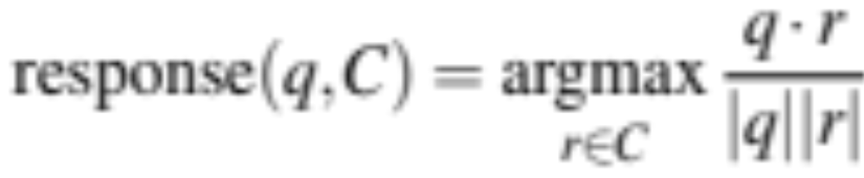
Response by retrieval: classic IR method
Given a user turn q, and a training corpus C of conversation
Find in C the turn r that is most similar (tf-idf cosine) to q
Say r
Notes:
The retrieval method of responding is to think of the user’s turn as a query q, and our job is to retrieve and repeat some appropriate turn r as the response from a corpus of conversations C. Generally C is the training set for the system, and we score each turn in C as a potential response to the context q selecting the highest-scoring one. The scoring metric is similarity: we choose the r that is most similar to q, using any IR method
This can be done using classic IR techniques to compute tf-idf models for C and q, choosing the r that has the highest tf-idf cosine with q:

Slide 53
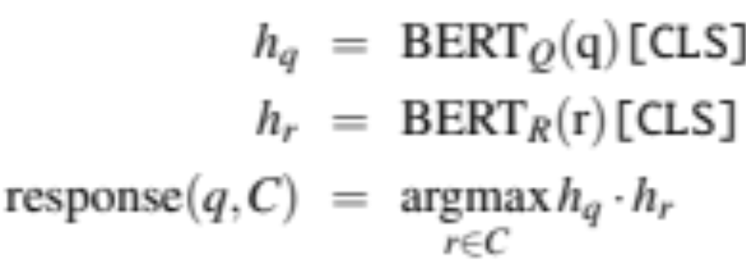
Response by retrieval: neural IR method
Given a user turn q, and a training corpus C of conversation
Find in C the turn r that is most similar (BERT dot product) to q
Say r
Notes:
Or, we can use neural IR techniques The simplest of those is called a bi-encoder model, in which we train two separate encoders, one to encode the user query and one to encode the candidate response, and use the dot product between these two vectors as the score. For example to implement this using BERT, we would have two encoders BERTQ and BERTR and we could represent the query and candidate response as the [CLS] token of the respective encoders:
Then we choose whichever turn in our corpus has the highest dot product with the query, and just say that turn.
The IR-based approach can be extended in various ways, such as by using more sophisticated neural architectures (Humeau et al., 2020), or by using a longer context for the query than just the user’s last turn, up to the whole preceding conversation.

Slide 54
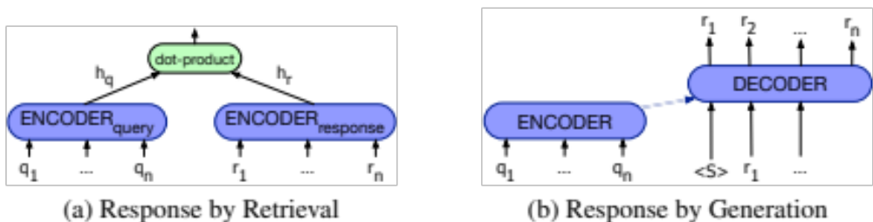
Response by generation
Think of response production as an encoder-decoder task
Generate each token r_{t} of the response by conditioning on the encoding of the entire query q and the response so far r₁...r_{t−1}
Notes:
An alternate way to use a corpus to generate dialogue is to think of response production as an encoder-decoder task— transducing from the user’s prior turn to the system’s turn. We can think of this as a machine learning version of ELIZA; the system learns from a corpus to transduce a question to an answer.
Encoder decoder models generate each token rt of the response by conditioning on the encoding of the entire query q and the response so far r1...rt−1:
Here's the intuition of the two paradigms, the generator and retriever paradigms for response generation.

Slide 55
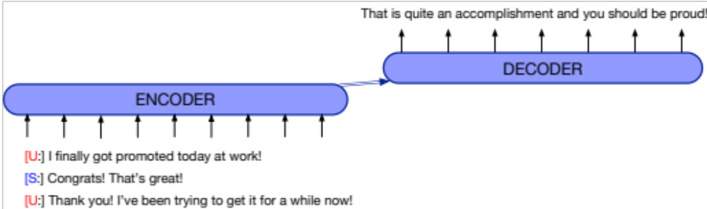
Response by generation
Notes:
In the generator architecture, we normally include a longer context, forming the query not just from the user’s turn but from the entire conversation-so- far as in this example

Slide 56
Response by generation
Alternative approach: fine-tune a large language model on conversational data
The Chirpy Cardinal system (Paranjape et al., 2020):
fine-tunes GPT-2
on the EmpatheticDialogues dataset (Rashkin et al., 2019)
Notes:
An alternative to the encoder-decoder architecture is to fine-tune a large language model on a conversational dataset and use the language model directly as a response generator. In the Chirpy Cardinal system (Paranjape et al., 2020), for example, the neural chat component generates responses from GPT-2 (Radford et al., 2019), fine- tuned on the EmpatheticDialogues dataset (Rashkin et al., 2019).

Slide 57
P.G. Wodehouse predicts neural chatbots
“What ho!” I said.
“What ho!” said Motty.
“What ho! What ho!”
“What ho! What ho! What ho!”
After that it seemed rather difficult to go on with the conversation.”
Wodehouse My Man Jeeves, 1919
Notes:
Here's a little intermission where the comic author P.G. Wodehouse seems to predict some properties of neural chatbots

Slide 58
Ongoing research problem:
Neural chatbots can get repetitive and boring
A: Where are you going?
B: I’m going to the restroom.
A: See you later.
B: See you later.
A: See you later.
B: See you later.
A: How old are you?
B: I’m 16.
A: 16?
B: I don’t know what you are talking about.
A: You don’t know what you are saying.
B: I don’t know what you are talking about.
A: You don’t know what you are saying.
Notes:
Here's what I mean. For example basic encoder-decoder
models have a tendency to produce predictable but repetitive and therefore dull re- sponses like “I’m OK” or “I don’t know” that shut down the conversation.
A number of modifications are thus required to the basic encoder-decoder model to adapt it for the task of response generation.
For example instead of greedily choosing the most likely (and most predictable) response, we can use diversity-enhanced versions of beam search or diversity-focused training objectives. Basic models also tend to produce utterances that are too short; adding minimum length constraints is also important.

Slide 59
Response by retrieving and refining knowledge
Can generate responses from informative text rather than dialogue
To respond to turns like “Tell me something about Beijing”
  XiaoIce collects sentences from public lectures and news articles.
  And searches them using IR based on query expansion from user’s turn
Can augment encoder-decoder model
  use IR to retrieve passages from Wikipedia
  concatenate each Wikipedia sentence to the dialogue context with a separator token.
  Give as encoder context to the encoder-decoder model, which learns to incorporate text into its response
Notes:
Chatbots can be much more interesting and informative if they can responses from text knowledge sources other than dialogue.
XiaoIce collects sentences from public lectures and news articles and searches them using IR based on query expansion from the user’s turn to respond to turns like “Tell me something about Beijing”
One way to augment the encoder decoder architecture for retrieve and refine is to first use IR to retrieve potentially useful passages from Wikipedia (Yan et al., 2016), and then create multiple candidates by concatenating each retrieved Wikipedia sentence to the dialogue context with a separator token. Each candidate can be given as the encoder context to the encoder-decoder model, which learns to incorporate text from the Wikipedia sentence into its generated response

Slide 60
Hybrid Architectures
Chirpy Cardinal (Paranjape et al., 2020) response generation from a series of different generators:
GPT-2 finetuned on EmpatheticDialogues
GPT-2 finetuned to paraphrase content from Wikipedia
Rule-based movie or music generators that produce scripted conversation about a movie or a musician
  asking the user’s opinion about a movie,
  giving a fun fact,
  asking the user their opinion on an actor in the movie.
Notes:
Chatbots can also be built with architectures that are hybrids of the rule-based and neural/corpus architectures, and even use elements of the frame-based structure we describe below.
For example the Chirpy Cardinal system (Paranjape et al., 2020) applies an NLP pipeline to the input, and then
Bot responses are generated by a series of response generators. Some response generators use fine-tuned neural language models: a GPT-2 (Radford et al., 2019) language model fine-tuned on the EmpatheticDialogues dataset, and a separately fine-tuned GPT-2 language model that learns in fine-tuning to paraphrase content from Wikipedia in response to questions.
Other response generators are closer to rule-based; the movie or music genera- tors produce scripted conversation about a movie or a musician, such as asking asks the user’s opinion about a movie, giving a fun fact, asks the user their opinion on an actor in the movie, and so on. These generators use regexes and sentiment classifiers to classify user responses and handwritten templates to generate bot utterances.

Slide 61
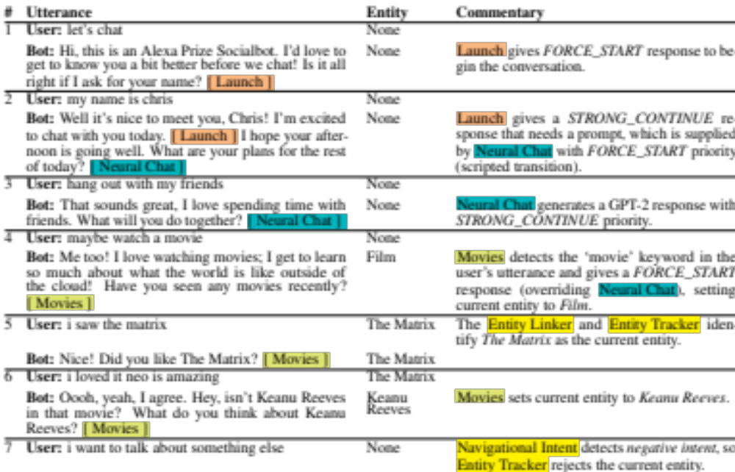
Chirpy Cardinal (Paranjape et al. 2020)
Notes:
Here's part of a conversation with Chirpy Cardinal, Notice the use of neural chat as well as the scripted chat modules for movies.

Slide 62
Chatbots: pro and con
Pro:
  Fun
  Good for narrow, scriptable applications
Cons:
  They don't really understand
  Giving the appearance of understanding may be problematic
  Rule-based chatbots are expensive and brittle
  IR-based chatbots can only mirror training data
    We'll discuss later the case of Microsoft Tay
      (or, Garbage-in, Garbage-out)
Next steps: integrating chatbot ability into frame-based agents
Notes:
In summary, chatbots can be fun and play a useful role in narrow application domains, especially where scripting can be done.
But on the other hand, they don't really understand, and the fact that they give the appearance of understanding may be problematic.
Rule-based chatbots are expensive and britltle, but IR_based chatbots can only mirror their training data, which as we'll discuss in a following lecture, can lead to enormous problems.
One important next step in research is figuring out ways to integrate chatbot-type abilities into frame-based agents.

Slide 63
Chatbots and Dialogue Systems
Corpus-based Chatbots
Notes:
We've seen the two paradigms for corpus-based chatbots: response by retrieval, and response by generation.

Slide 64
Chatbots and Dialogue Systems
The Frame-based ("GUS") Dialogue Architecture
Notes:
In this lecture we introduce the GUS or Frame-based architecture for task-based dialogue.

Slide 65
Frame-based dialogue agents
Sometimes called "task-based dialogue agents"
Systems that have the goal of helping a user solve a task like making a travel reservation or buying a product
Architecture:
First proposed in the GUS system of 1977
A knowledge structure representing user intentions
One or more frames (each consisting of slots with values)
Notes:
In task-based dialogue, a dialogue system has the goal of helping a user solve some task like making an airplane reservation
or buying a product.
The core of such system, first proposed in 1977 in the influential GUS system, is a a knowledge structure called the frame

Slide 66
The Frame
A set of slots, to be filled with information of a given type
Each associated with a question to the user
Sometimes called a domain ontology
  Slot Type Question
  ORIGIN city "What city are you leaving from?
  DEST city "Where are you going?
  DEP DATE date "What day would you like to leave?
  DEP TIME time "What time would you like to leave?
  AIRLINE line "What is your preferred airline?
Notes:
A frame represents part of the information about user intentions that the system can extract from user sentences,
and consists of a collection of slots, each of which can take a set of possible values.
The set of frames is sometimes called a {domain ontology}, and the
The set of slots for a frame specifies what the system needs to know for the part of the task that frame represents.
So in booking airline travel we need to know the origin or destination of the flight, or the times.
The filler of each slot is constrained to values of a particular semantic type. In the travel domain, for example, a slot might be of type city (hence take on values like San Francisco, or Hong Kong) or of type date, airline, or time.
.

Slide 67
Two basic architectures
The GUS architecture
Sometimes just called "frame-based" architecture
Over 40 years old, but still used in most industrial task-based dialogue agents
Bobrow, Daniel G., Ronald M. Kaplan, Martin Kay, Donald A. Norman, Henry Thompson, and Terry Winograd. 1977. "GUS, a frame-driven dialog system." Artificial Intelligence 8, 2:155-173.
The dialogue-state architecture
Extension of GUS
More common in research systems
Some aspects making their way into industrial systems
Notes:
It's common to distinguish a simpler, more classic frame-based architecture, which we'll call the GUS architecture, after the paper that introduced it, that focuses on a set of hand-build production rules for filling frames and taking actions. It's more than 4 decades years old, but still used in most industrial task-based dialogue agents.
An extension of the GUS architecture, sometimes called the dialogue-state architecture, is more common in research systems. Some aspects are making their way into industrial systems

Slide 68

Notes:
Here's a transcript of an actual dialogue with the GUS system of Bobrow et al. (1977). P.S.A. and Air California were airlines of that period.
GUS had a lot of complex abilities that aren't true in every frame-based system.
For example it dealt with coreference, that's expressions like "the first one", knowing it refers to flight 102.
It knows that Friday in the evening, means "the next Friday", i.e. presumably May 30".
And in this example, it even handles a complex implicit constraints in the example "I must be in San Diego before 10am"

Slide 69
Control structure for GUS frame architecture
System asks questions of user, filling any slots that user specifies
User might fill many slots at a time:
I want a flight from San Francisco to Denver one way leaving after five p.m. on Tuesday.
  When frame is filled, do database query
Notes:
The control architecture of the GUS architecture, used in some form in all modern frame-based dialogue systems like Apple’s Siri, Amazon’s Alexa, and the Google Assistant, is designed around the frame.
The system’s goal is to fill the slots in the frame with the fillers the user intends, and then perform the relevant action for the user (answering a question, or booking a flight).
To do this, the system asks questions of the user (using pre-specified question templates associated with each slot of each frame), filling any slot that the user specifies
When the frame is filled, the system can do a query looking for flights (or whatever) that fulfill the user constraints.

Slide 70
GUS slots have condition-action rules attached
Some rules attached to the DESTINATION slot for the plane booking frame
Once the user has specified the destination
  Enter that city as the default StayLocation for the hotel booking frame.
Once the user has specified DESTINATION DAY for a short trip
  Automatically copy as ARRIVAL DAY.
Notes:
The GUS architecture also has condition-action rules attached to slots. For example, a rule attached to the DESTINATION slot for the plane booking frame, once the user has specified the destination, might automatically enter that city as the default StayLocation for the related hotel booking frame. Or if the user specifies the DESTINATION DAY for a short trip the system could automatically enter the ARRIVAL DAY.

Slide 71
GUS systems have multiple frames
Frames like:
Car or hotel reservations
General route information
  Which airlines fly from Boston to San Francisco?,
Information about airfare practices
  Do I have to stay a specific number of days to get a decent airfare?).
Frame detection:
System must detect which slot of which frame user is filling
And switch dialogue control to that frame.
Notes:
Many domains require multiple frames. Besides frames for car or hotel reservations, we might need frames with general route information (for questions like Which airlines fly from Boston to San Francisco?), or information about airfare practices (for questions like Do I have to stay a specific number of days to get a decent air- fare?). The system must be able to disambiguate which slot of which frame a given input is supposed to fill and then switch dialogue control to that frame.

Slide 72
GUS: Natural Language Understanding for filling dialog slots
Domain classification
  Asking weather? Booking a flight? Programming alarm clock?
Intent Determination
  Find a Movie, Show Flight, Remove Calendar Appt
Slot Filling
  Extract the actual slots and fillers
Notes:
The goal of the natural language understanding component in the frame-based architecture is to extract three things from the user’s utterance. The first task is domain classification: is this user for example talking about airlines, programming an alarm clock, or dealing with their calendar? Of course this 1-of-n classification tasks is unnecessary for single-domain systems that are focused on, say, only calendar management, but multi-domain dialogue systems are the modern standard. The second is user intent determination: what general task or goal is the user trying to accomplish? For example the task could be to Find a Movie, or Show a Flight, or Remove a Calendar Appointment. Finally, we need to do slot filling: extract the particular slots and fillers that the user intends the system to understand from their utterance with respect to their intent.

Slide 73

Natural Language Understanding for filling slots
Show me morning flights from Boston to SF on Tuesday.
Notes:
From a user utterance like this one:
a system might want to build a representation like:

Slide 74

Natural Language Understanding for filling slots
Wake me tomorrow at six.
Notes:
Or an utterance like
should give an intent like this:

Slide 75
How to fill slots?
(1) Rule-based Slot-filling
Write regular expressions or grammar rules
Wake me (up) | set (the|an) alarm | get me up
Do text normalization
Notes:
Let's focus on slot-filling. The slot-filling method used in the original GUS system, and still quite common in industrial applications, is to use handwritten rules, often as part of the condition- action rules attached to slots or concepts. For example we might just define by hand a regular expression for recognizing the SET-ALARM intent:

Slide 76
Generating responses: template-based generation
A template is a pre-built response string
Templates can be fixed:
  "Hello, how can I help you?"
Or have variables:
  "What time do you want to leave CITY-ORIG?"
  "Will you return to CITY-ORIG from CITY-DEST?"
Notes:
Frame-based systems tend to use template-based generation, in which all or most of the words in the sentence to be uttered to the user are prespecified by the dialogue designer. Sentences created by these templates are often called prompts. Templates might be completely fixed (like ‘Hello, how can I help you?’),
or can include some variables that are filled in by the generator, like these

Slide 77
Summary: simple frame-based architecture
Like many rule-based approaches
Positives:
  High precision
  Can provide coverage if the domain is narrow
Negatives:
  Can be expensive and slow to create rules
  Can suffer from recall problems
Notes:
The rule-based GUS approach is very common in industrial applications. As was true with the rule-based approach to information extraction, it has the advantage of high precision, and if the domain is narrow enough and experts are available, can provide sufficient coverage as well. On the other hand, the handwritten rules or grammars can be both expensive and slow to create, and handwritten rules can suffer from recall problems. So modern systems tend to replace many of the components with machine learning, as we'll see in the next lecture

Slide 78
Chatbots and Dialogue Systems
The Frame-based ("GUS") Dialogue Architecture
Notes:
The Frame-based or GUS architecture lies at the heart of most modern dialogue systems.

Slide 79
Chatbots and Dialogue Systems
The Dialogue-State Architecture
Notes:
In this lecture we introduce an extension of the frame-based architecture called the dialogue –state architecture

Slide 80
Dialogue-State or Belief-State Architecture
A more sophisticated version of the frame-based architecture
Has dialogue acts, more ML, better generation
The basis for modern research systems
Slowly making its way into industrial systems
Some aspects (ML for slot-understanding) already widely used industrially
Notes:
Modern research systems for task-based dialogue are based on a more sophisticated version of the frame-based architecture called the dialogue-state or belief-state ar- chitecture.

Slide 81
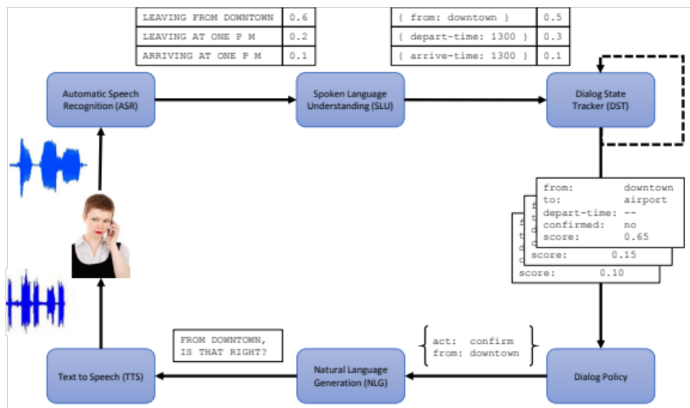
The Dialogue-State Architecture
Williams, Jason D., Antoine Raux, and Matthew Henderson. "The dialog state tracking challenge series: A review." Dialogue & Discourse 7, no. 3 (2016): 4-33.
Notes:
Here the six components of a typical dialogue-state system. In this lecture we'll focus on 4 of them which are part of both spoken and textual dialogue systems.

Slide 82
Components in a dialogue-state architecture
NLU: extracts slot fillers from the user’s utterance using machine learning
Dialogue state tracker: maintains the current state of the dialogue (user’s most recent dialogue act, set of slot-filler constraints from user
Dialogue policy: decides what the system should do or say next
GUS policy: ask questions until the frame was full then report back
More sophisticated: know when to answer questions, when to ask a clarification question, etc.
NLG: produce more natural, less templated utterances
Notes:
These four components are more complex than in the simple GUS systems. For example, like the GUS systems, the dialogue-state architecture has an NLU component to extract slot fillers from the user’s utterance, but generally using machine learning rather than rules
The dialogue state tracker maintains the current state of the dialogue (which include the user's most recent dialogue act, plus the entire set of slot-filler constraints the user has expressed so far).
The dialogue policy decides what the system should do or say next. The dialogue policy in GUS was simple: ask questions until the frame was full and then report back the results of some database query.
But a more sophisticated dialogue policy can help a system decide when to answer the user's questions, when to instead ask the user a clarification question,
when to make a suggestion, and so on.
Finally, dialogue state systems have a true natural language generation
component. In GUS, the sentences that the generator produced were all from pre-written templates. But a more sophisticated
generation component can condition on the exact context to produce turns that seem much more natural.

Slide 83
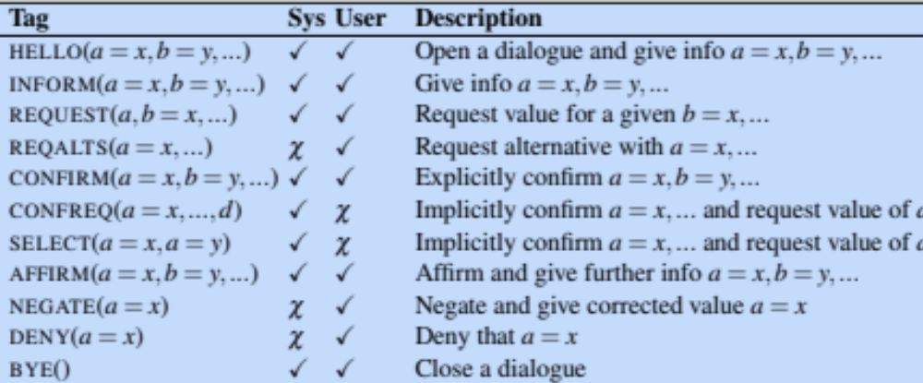
Dialogue Acts
Combine the ideas of speech acts and grounding into a single representation
Young et al., 2010:
Notes:
Dialogue-state systems make use of dialogue acts.. Dialogue acts represent the interactive function of the turn or sentence,
combining the idea of speech acts and grounding into a single representation. Different types of dialogue systems require labeling different kinds
of acts, and so the tagset---defining what a dialogue act is exactly--- tends to be designed for particular tasks.
Here's a tagset for a restaurant recommendation system,

Slide 84
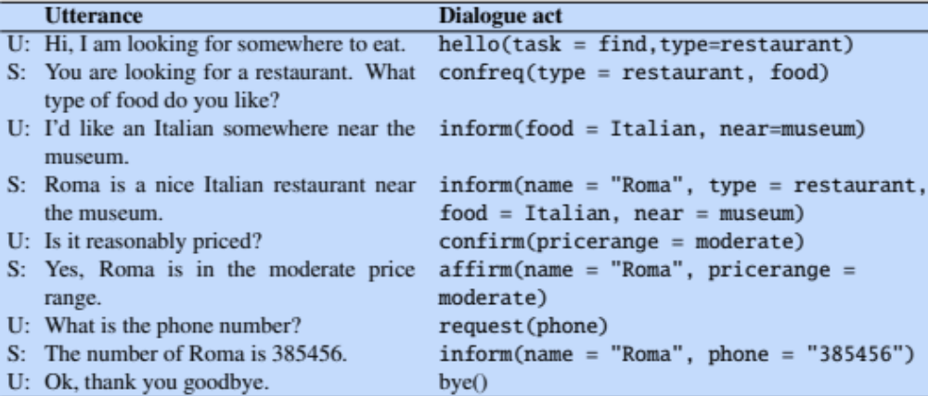
Dialogue Acts
Young et al., 2010:
Notes:
Here are these tags labeling a sample dialogue from the HIS system \cite{young10}. This example also shows the content of each dialogue acts, which are the slot fillers being communicated. So the user might {\sc inform} the system that they want Italian food near a museum, or {\sc confirm} with the system that the price is reasonable.

Slide 85
Slot filling: Machine learning
Machine learning classifiers to map words to semantic frame-fillers
Given a set of labeled sentences
  Input: "I want to fly to San Francisco on Monday please"
  Output: Destination: SF
    Depart-time: Monday
Build a classifier to map from one to the other
Requirements: Lots of labeled data
Notes:
The task of slot-filling, and the simpler tasks of domain and intent classification, are generally solved by supervised semantic parsing, , where we have a training set that associates each sentence with the correct meaning.

Slide 86
Slot filling as sequence labeling: BIO tagging
The BIO tagging paradigm
Idea: Train a classifier to label each input word with a tag that tells us what slot (if any) it fills
We create a B and I tag for each slot-type
And convert the training data to this format
Notes:
Recall that in BIO tagging we introduce a tag for the beginning (B) and inside (I) of each slot label, and one for tokens outside (O) any slot label.
Our training data is now sentences paired with sequences of BIO labels:

Slide 87
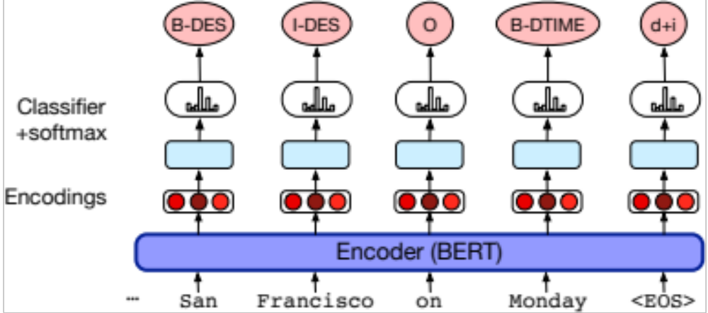
Slot filling using contextual embeddings
Can do domain and intent too: e.g., generate the label "AIRLINE_TRAVEL + SEARCH_FLIGHT"
Notes:
A simple architecture for slot filling,
The input is a series of words w1...wn, which is passed through a contextual embedding model to get contextual word representations. This is followed by a feedforward layer and a softmax at each token position over possible BIO tags, with the output a series of BIO tags s1...sn.
We can also combine the domain-classification and intent-extraction tasks with slot-filling sim- ply by adding a domain concatenated with an intent as the desired output for the final EOS token.

Slide 88
Once we have the BIO tag of the sentence
We can extract the filler string for each slot
And then normalize it to the correct form in the ontology
Like "SFO" for San Francisco
Using homonym dictionaries (SF=SFO=San Francisco)
Notes:
Once the sequence labeler has tagged the user utterance, a filler string can be extracted for each slot from the tags (e.g., “San Francisco”), and these word strings can then be normalized to the correct form in the ontology (perhaps the airport code ‘SFO’). This normalization can take place by using homonym dictionaries (specifying, for example, that SF, SFO, and San Francisco are the same place).

Slide 89
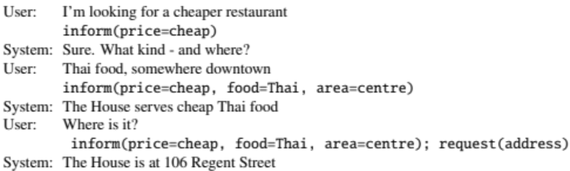
The task of dialogue state tracking
Example from Mrkšić, N., O Séaghdha, D., Wen, T.-H., Thomson, B., and
Young, S. (2017). Neural belief tracker: Data-driven dialogue state tracking. ACL.
Notes:
The job of the dialogue-state tracker is to determine both the current state of the frame (the fillers of each slot), as well as the user’s most recent dialogue act.
The dialogue-state thus includes more than just the slot-fillers expressed in the current sentence; it includes the entire state of the frame at this point, summarizing all of the user’s constraints

Slide 90
Dialogue state tracking
I'd like Cantonese food near the Mission district.
→
inform(food=cantonese, area=mission).
Dialogue act interpretation algorithm:
1-of-N supervised classification to choose inform
Based on encodings of current sentence + prior dialogue acts
Simple dialogue state tracker:
Run a slot-filler after each sentence
Notes:
Since dialogue acts place some constraints on the slots and values, the tasks of dialogue-act detection and slot-filling are often performed jointly. Consider the task of determining that:
I’d like Cantonese food near the Mission District
has the structure
inform(food=cantonese,area=mission).
Dialogue act interpretation—in this example choosing inform from the set of dialogue acts for this task—is done by supervised classification trained on hand- labeled dialog acts, predicting the dialogue act tag based on embeddings represent- ing the current input sentence and the prior dialogue acts.
The simplest dialogue state tracker might just take the output of a slot-filling sequence-model after each sentence.

Slide 91
An special case of dialogue act detection:
Detecting Correction Acts
If system misrecognizes an utterance
User might make a correction
    Repeat themselves
    Rephrasing
    Saying “no” to a confirmation question
Notes:
Some dialogue acts are important because of their implications for dialogue control. If a dialogue system misrecognizes or misunderstands an utterance, the user will generally correct the error by repeating or reformulating the utterance. Detecting these user correction acts is therefore quite important

Slide 92
Corrections are harder to recognize!
  From speech, corrections are misrecognized twice as often (in terms of word error rate) as non-corrections! (Swerts et al 2000)
  Hyperarticulation (exaggerated prosody) is a large factor:
    Shriberg, E., Wade, E., Price, P., 1992. Human-machine problem solving using spoken language systems (SLS): Factors affect-ng performance and user satisfaction. DARPA Speech and Natural Language Workshop.
  "I said BAL-TI-MORE, not Boston"
Notes:
Ironically, it turns out that corrections are actually harder to recognize than normal sentences! In fact, correc- tions in one early dialogue system (the TOOT system) had double the ASR word error rate of non-corrections (Swerts et al., 2000)!
One reason for this is that speakers sometimes use a specific prosodic style for corrections called hyperarticulation, in which the utterance contains exaggerated energy, duration, or F0 contours

Slide 93
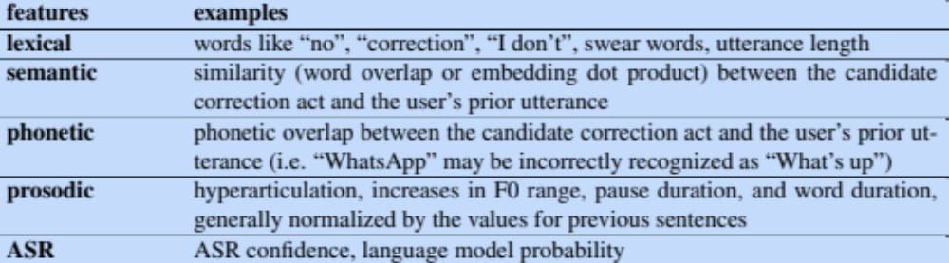
Features for detecting corrections in spoken dialogue
Notes:
User corrections tend to be either exact repetitions or repetitions with one or more words omitted, although they may also be paraphrases of the original utterance. (Swerts et al., 2000). Detect- ing these reformulations or correction acts can be part of the general dialogue act detection classifier, or can make use of extra features like some of these.

Slide 94
Chatbots and Dialogue Systems
The Dialogue-State Architecture
Notes:
We've seen the understanding component of the dialogue-state architecture. In the next lecture we'll continue, talking about dialogue policy and generation.

Slide 95
Chatbots and Dialogue Systems
The Dialogue-State Architecture Continued: Policy and Generation
Notes:
Let's talk about dialogue policy: what to say, and generation: how to say it

Slide 96
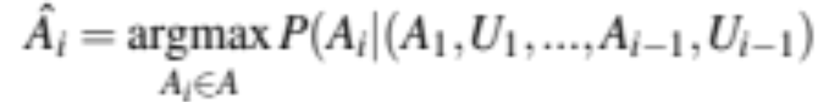
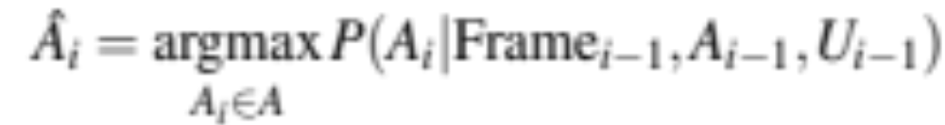
Dialogue Policy
At turn i predict action A_{i} to take, given entire history:
Simplify by just conditioning on the current dialogue state (filled frame slots) and the last turn and turn by system and user:
Notes:
The goal of the dialogue policy is to decide what action the system should take next, that is, what dialogue act to generate.
More formally, at turn i in the conversation we want to predict which action Ai to take, based on the entire dialogue state. The state could mean the entire sequence of dialogue acts from the system (A) and from the user (U), in which case the task would be to compute:
CLICK We can simplify this by maintaining as the dialogue state mainly just the set of slot-fillers that the user has expressed, collapsing across the many different conversational paths that could lead to the same set of filled slots.
These probabilities can be estimated by a neural classifier using neural representations of the slot fillers (for example as spans) and the utterances (for example as sentence embeddings computed over contextual embeddings)

Slide 97
Policy example: Confirmation and Rejection
Dialogue systems make errors
So they to make sure they have understood user
Two important mechanisms:
confirming understandings with the user
rejecting utterances that the system is likely to have misunderstood.
Notes:
Modern dialogue systems often make mistakes. It is therefore important for dialogue systems to make sure that they have achieved the correct interpretation of the user’s input.
This is generally done by two methods: confirming understandings with the user and rejecting utterances that the system is likely to have misunderstood.
When using the explicit confirmation strategy, a system asks the user a direct question to confirm the system’s understanding,

Slide 98

Explicit confirmation strategy

Slide 99
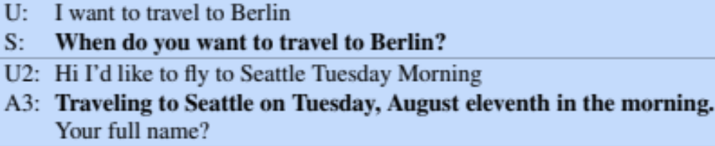
Implicit confirmation strategy
Notes:
When using the implicit confirmation strategy, a system instead can demon- strate its understanding as a grounding strategy, for example repeating back the system’s understanding as part of asking the next question

Slide 100
Confirmation strategy tradeoffs
Explicit confirmation makes it easier for users to correct the system’s misrecognitions since a user can just answer “no” to the confirmation question.
But explicit confirmation is also awkward and increases the length of the conversation (Danieli and Gerbino 1995, Walker et al. 1998).
Notes:
Explicit and implicit confirmation have complementary strengths. Explicit confirmation makes it easier for users to correct the system’s misrecognitions since a user can just answer “no” to the confirmation question. But explicit confirmation is awkward and increases the length of the conversation (Danieli and Gerbino 1995, Walker et al. 1998). The explicit confirmation dialogue fragments above sound non- natural and definitely non-human; implicit confirmation is much more conversation- ally natural.

Slide 101
Rejection
I’m sorry, I didn’t understand that.
Notes:
Confirmation is just one kind of conversational action by which a system can express lack of understanding. Another option is rejection, in which a system gives the user a prompt like I’m sorry, I didn’t understand that.

Slide 102
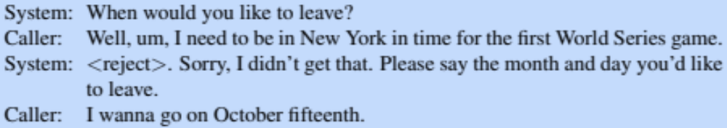
Progressive prompting for rejection
Don't just repeat the question "When would you like to leave?"
Give user guidance about what they can say:
Notes:
Sometimes utterances are rejected multiple times. This might mean that the user is using language that the system is unable to follow. Thus, when an utterance is rejected, systems often follow a strategy of progressive prompting or escalating detail, as in this example
instead of just repeating “When would you like to leave?”, the rejection prompt gives the caller more guidance about how to formulate an utterance the system will understand. These you-can-say help messages are important in helping improve systems’ understanding performance

Slide 103
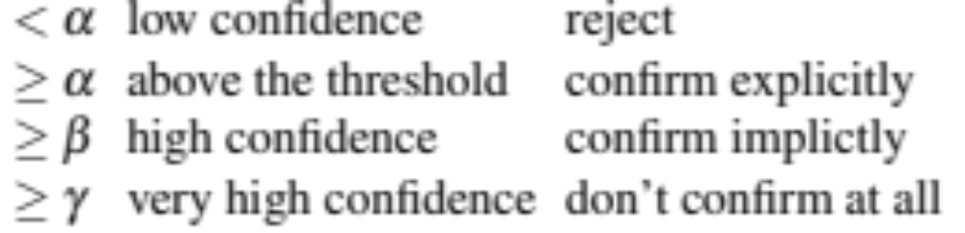
Using confidence to decide whether to confirm:
ASR or NLU systems can assign a confidence value, indicating how likely they are that they understood the user.
Acoustic log-likelihood of the utterance
Prosodic features
Ratio of score of best to second-best interpretation
Systems could use set confidence thresholds:
Notes:
It is common to use rich features other than just the dialogue state representa- tion to make policy decisions. For example, the confidence that the ASR system assigns to an utterance can be used by explicitly confirming low-confidence sen- tences. Confidence is a metric that the speech recognizer can assign to its transcription of a sentence to indicate how confident it is in that transcription.
Another common feature in confirmation is the cost of making an error. For example, explicit confirmation is common before a flight is actually booked, or money in an account is moved. Systems might have a four-tiered level of confidence with three thresholds α, β, and γ:

Slide 104
Natural Language Generation
NLG in information-state architecture modeled in two stages:
content planning (what to say)
sentence realization (how to say it).
We'll focus on sentence realization here.
Notes:
Finally, once the policy has decided what speech act to generate, the natural language generation component needs to generate the text of a response to the user.
The task of natural language generation (NLG) in the information- state architecture is often modeled in two stages, content planning (what to say), and sentence realization (how to say it).

Slide 105
Sentence Realization
Assume content planning has been done by the dialogue policy
Chosen the dialogue act to generate
Chosen some attributes (slots and values) that the planner wants to say to the user
  Either to give the user the answer, or as part of a confirmation strategy)
Notes:
Here we’ll assume content planning has been done by the dialogue policy, which has chosen the dialogue act to generate, and chosen some attributes (slots and values) that the planner wants to say to the user (either to give the user the answer, or as part of a confirmation strategy).

Slide 106
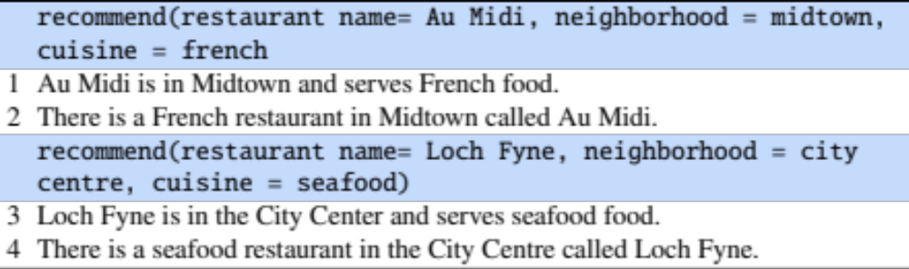
2 samples of Input and Output for Sentence Realizer
Notes:
Here are some sample input/outputs for the sentence realization phase. In the first example, the content planner has chosen the dialogue act RECOMMEND and some particular slots (name, neighborhood, cuisine) and their fillers. The goal of the sentence realizer is to generate a sentence like lines 1 or 2, by training on many such examples of representation/sentence pairs from a large corpus of labeled dialogues.

Slide 107
Sentence Realization
Training data is hard to come by
Don't see each restaurant in each situation
Common way to improve generalization:
Delexicalization: replacing words in the training set that represent slot values with a generic placeholder token:
Notes:
Training data is hard to come by; we are unlikely to see every possible restaurant with every possible attribute in many possible differently worded sentences.
It's common in sentence realization to increase the generality of the training examples by delexicalization. Delexicalization is the process of replacing specific words in the training set that represent slot values with a generic placeholder token representing the slot.
So we can delexicalize These two sentences by replacing Au Midi, Midtown, and French:

Slide 108
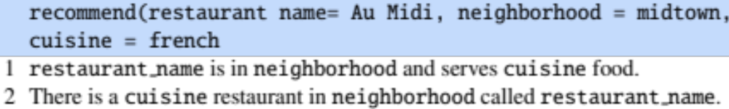
Sentence Realization
Training data is hard to come by
Don't see each restaurant in each situation
Common way to improve generalization:
Delexicalization: replacing words in the training set that represent slot values with a generic placeholder token:
Notes:
Voila!

Slide 109
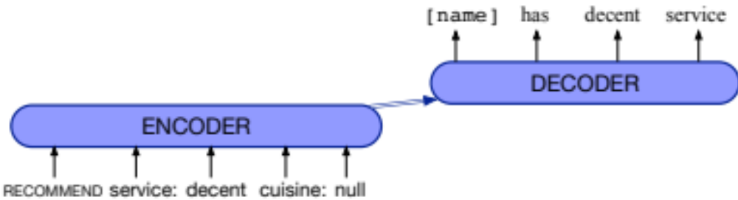
Sentence Realization: mapping from frames to delexicalized sentences
Encoder-decoder models:
Output:
restaurant_name has decent service
Relexicalize to:
Au Midi has decent service
Notes:
Mapping from frames to delexicalized sentences is generally done by encoder decoder models trained on large hand-labeled corpora of task-oriented dialogue. The input to the encoder is a sequence of tokens xt that represent the dialogue act and its arguments. Thus the dialogue act RECOMMEND and the attribute/value pairs service:decent, cuisine:null might be represented as a flat sequence of tokens each mapped to a learned embedding wt ,
The encoder reads all the input slot/value representations, and the decoder out- puts the following delexicalized English sentence:
restaurant name has decent service
We can then use the input frame from the content planner to relexicalize (fill in the exact restaurant or neighborhood or cuisine) resulting in:
Au Midi has decent service

Slide 110
Generating clarification questions
User: What do you have going to UNKNOWN WORD on the 5th?
System: Going where on the 5th?
The system repeats “going” and “on the 5th” to make it clear which aspect of the user’s turn the system needs to be clarified
Methods for generating clarification questions:
Rules like 'replace “going to UNKNOWN WORD” with “going where”'
Classifiers that guess which slots were misrecognized
Notes:
It’s also possible to design NLG algorithms that are specific to a particular dialogue act. For example, consider the task of generating clarification questions, in cases where the speech recognition fails to understand some part of the user’s utterance. While it is possible to use the generic dialogue act REJECT (“Please repeat”, or “I don’t understand what you said”), we can something more targeted
For example, in the following hypothetical example the system reprises the words “going” and “on the 5th” to make it clear which aspect of the user’s turn the system needs to be clarified:
Targeted clarification questions can be created by rules (such as replacing “go- ing to UNKNOWN WORD” with “going where”) or by building classifiers to guess which slots might have been misrecognized in the sentence

Slide 111
Chatbots and Dialogue Systems
The Dialogue-State Architecture Continued: Policy and Generation
Notes:
We've now seen all the pieces of the dialogue-state architecture.

Slide 112
Chatbots and Dialogue Systems
Evaluating Dialogue Systems
Notes:
How do we evaluate task-based dialogue systems?

Slide 113
Evaluating chatbots and task-based dialogue
Task-based dialogue:
mainly by measuring task performance
Chatbots:
mainly by human evaluation
Notes:
Evaluation is crucial in dialogue system design. How can we tell if a dialogue system is fulfilling its goal?
Task-based dialogue is evaluated mainly by measuring whether they succeed at their task, like booking the right flight.
For chatbots, often the goal is to be enjoyable to humans. So chatbots are evaluated by humans.

Slide 114
Chatbots are evaluated by humans
Participant evaluation: The human who talked to the chatbot assigns a score
Observer evaluation: third party who reads a transcript of a human/chatbot conversation assigns a score.
Notes:
Let's begin with chatbots. We evaluate these by asking humans to assign a score. This can be the human who talked to the chatbot (which we call participant evaluation) or a third party who reads a transcript of a human/chatbot conversation (which we call observer evaluation).

Slide 115
Participant evaluation
Human chats with model for 6 turns and rates 8 dimensions of quality:
avoiding repetition, interestingness, making sense, fluency, listening, inquisitiveness, humanness, engagingness,
(1) Avoiding Repetition: How repetitive was this user?
  •Repeated themselves over and over •Sometimes said the same thing twice • Always said something new
(3) Making sense: How often did this user say something which didn't make sense?
  •Never made any sense •Most responses didn’t make sense •Some responses didn’t make sense •Everything made perfect sense
(8) Engagingness: How much did you enjoy talking to this user?
  •Not at all •A little •Somewhat •A lot
Abigail See, Stephen Roller, Douwe Kiela, Jason Weston. 2019. What makes a good conversation? How controllable attributes affect human judgments. NAACL.
Notes:
In the participant evaluation of See et al. (2019), the human evaluator chats with the model for six turns and rates the chatbot using Likert scales on 8 dimensions capturing conversational quality: avoiding repetition, interestingness, making sense, fluency, listening, inquisitiveness, humanness and engagingness.

Slide 116
Observer evaluation: acute-eval
Li, M., Weston, J., and Roller, S. (2019). Acute-eval: Improved dialogue evaluation with optimized questions and multi-turn comparisons. NeurIPS19 Workshop on Conversational AI.
Annotators look at two conversations (A + B) and decide which is better:
Engagingness: Who would you prefer to talk to for a long conversation?
Interestingness: If you had to say one of these speakers is interesting and one is boring, who would you say is more interesting?
Humanness: Which speaker sounds more human?
Knowledgeable: If you had to say that one speaker is more knowledgeable and one is more ignorant, who is more knowledgeable?
Notes:
Observer evaluations use third party annotators to look at the text of a complete conversation. Sometimes we’re interested in having raters assign a score to each system turn; for example (Artstein et al., 2009) have raters mark how coherent each turn is. Often, however, we just want a single high-level score to know if system A is better than system B
The acute-eval metric (Li et al., 2019) is such an observer evaluation in which annotators look at two separate human-computer conversations and
valuation with optimized questions and choose the one in which the dialogue system performed better, answering questions about 4 properties:

Slide 117
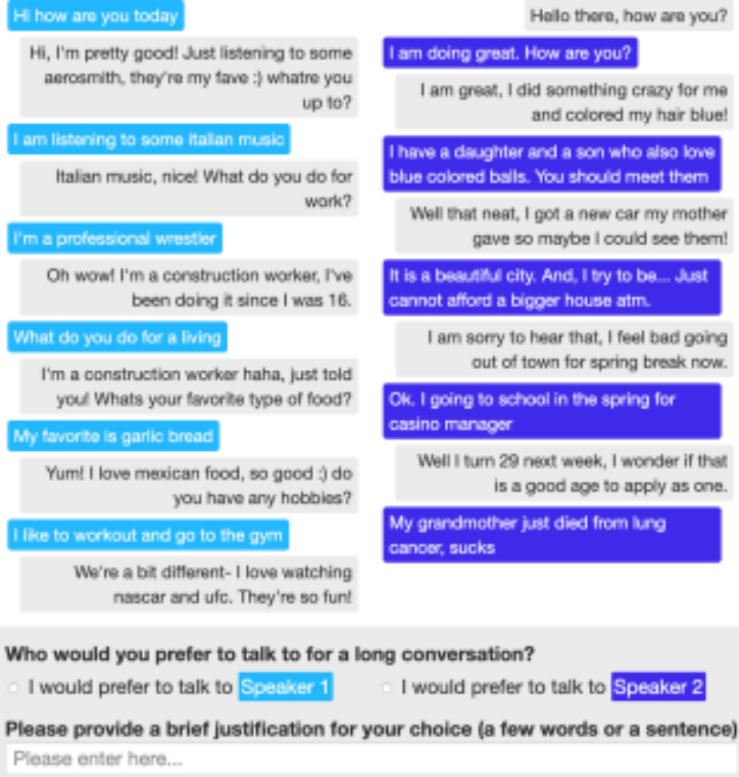
The ACUTE-EVAL method
Li et el., 2019
Figure from Li, M., Weston, J., and Roller, S. (2019). Acute-eval: Improved dialogue evaluation with optimized questions and multi-turn comparisons. NeurIPS19 Workshop on Conversational AI.
Notes:
Here's an example of the acute-eval annotator's task: comparing two dialogues and choosing between Speaker 1 (light blue) and Speaker 2 (dark blue)

Slide 118
Automatic evaluation is an open problem
Automatic evaluation methods (like the BLEU scores used for Machine Translation) are generally not used for chatbots.
They correlate poorly with human judgements.
One current research direction: Adversarial Evaluation
Inspired by the Turing Test
train a ``Turing-like'' classifier to distinguish between human responses and machine responses.
The more successful a dialogue system is at fooling the evaluator, the better the system.
Notes:
Automatic evaluations like the BLEU scores used to evaluate machine translation are generally not used for such chatbots, since BLEU scores correlate poorly with human judgements.
Developing possible automatic evaluation metrics is an open research problem. One novel paradigm is adversarial evaluation. inspired by the Turing test. The idea is to train a ``Turing-like'' evaluator classifier to distinguish
between human-generated responses and machine-generated responses. The more successful a response generation system is at fooling this evaluator, the better the system.

Slide 119
Task-based systems are evaluated by task success!
End-to-end evaluation (Task Success)
Slot Error Rate for a Sentence
# of inserted/deleted/subsituted slots
# of total reference slots for sentence
Notes:
If the task is unambiguous, we can simply measure absolute task success (did the system book the right plane flight, or put the right event on the calendar).
Slightly more finegrained, we can measure be slot error rate, the percentage of slots that were filled with the correct values:

Slide 120
Evaluation Metrics: Slot error rate
“Make an appointment with Chris at 10:30 in Gates 104”
Slot | Filler
PERSON | Chris
TIME | 11:30 a.m.
ROOM | Gates 104
Slot error rate: 1/3
Task success: At end, was the correct meeting added to the calendar?
Notes:
For example consider a system given this sentence:
Make an appointment with Chris at 10:30 in Gates 104
which extracted the following candidate slot structure:
Here the slot error rate is 1/3, since the TIME is wrong. Instead of error rate, slot precision, recall, and F-score can also be used. Slot error rate is also sometimes called concept error rate.

Slide 121
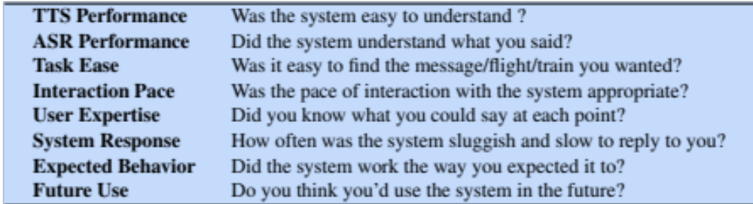
More fine-grained metrics: User Satisfaction Survey
Walker, Marilyn, Candace Kamm, and Diane Litman. "Towards developing general models of usability with PARADISE." Natural Language Engineering 6, no. 3 & 4 (2000): 363-377.
Notes:
To get a more fine-grained idea of user happiness, we can compute a user satisfaction rating, where we have users interact with a dialogue system to perform a task and complete a questionnaire. Here are some sample multiple-choice questions responses are mapped into the range of 1 to 5, and then averaged over all questions to get a total user satisfaction rating.

Slide 122
Other Heuristics
Efficiency cost:
total elapsed time for the dialogue in seconds,
the number of total turns or of system turns
total number of queries
“turn correction ratio”: % of turns that were used to correct errors
Quality cost:
number of ASR rejection prompts.
number of times the user had to barge in
Notes:
We can also measure other factors, like efficiency, via total elapsed time for the dialogue in seconds, the number of total turns or of system turns, or the total number of queries (Polifroni et al., 1992).
Quality cost measures other aspects of the interactions that affect user’s perception of the system. One such measure is the number of times the ASR system failed to return any sentence, or the number of ASR rejection prompts. Similar metrics include the number of times the user had to barge in and interrupt the system.

Slide 123
Chatbots and Dialogue Systems
Evaluating Dialogue Systems
Notes:
We've seen the standard evaluations for both chabots and task-based dialogue.

Slide 124
Chatbots and Dialogue Systems
Design and Ethical Issues
Notes:
Let's consider some of the ethical issues and the design process for dialogue systems

Slide 125
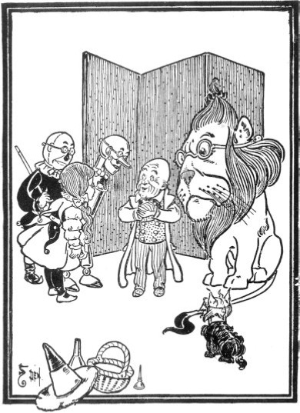
Dialog System Design: User-centered Design
Study the users and task
value-sensitive design
Build simulations
  Wizard of Oz study
Iteratively test design on users
Gould, John D., and Clayton Lewis. "Designing for usability: key principles and what designers think." Communications of the ACM 28, no. 3 (1985): 300-311.
Bender, Emily M., and Batya Friedman. "Data statements for natural language processing: Toward mitigating system bias and enabling better science." TACL 6 (2018): 587-604.
Notes:
The user plays a more important role in dialogue systems than in most other areas of speech and language processing, and thus the study of dialogue systems is closely linked with the field of Human-Computer Interaction (HCI). The design of dialogue systems follows user-centered design principles:
Study the user and task: Understand the potential users and the nature of the task by interviews with users, investigation of similar systems, It's important to incorporate value sensitive design, in which we carefully consider during the design process the benefits, harms and possible stakeholders of the resulting system
Build simulations and prototypes: A crucial tool in building dialogue systems is the Wizard-of-Oz system. In wizard systems, the users interact with what they think is a software agent but is in fact a human “wizard” disguised by a software interface. The name comes from the children’s book The Wizard of Oz (Baum, 1900), in which the wizard turned out to be just a simulation controlled by a man behind a curtain or screen.
Finally, we need to iteratively test the design on users

Slide 126
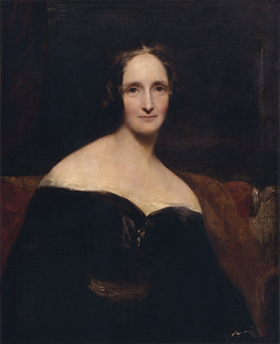
Ethical design
Ethical issues have long been known to be crucial in artificial agents
Mary Shelley's Frankenstein
creating agents without a consideration of ethical and humanistic concerns
Ethical issues:
Safety: Systems abusing users, distracting drivers, or giving bad medical advice
Representational harm: Systems demeaning particular social groups
Privacy: Information Leakage
Notes:
Ethical issues have long been known to be crucial in artificial agents. Mary Shelly first raised these issues over 200 years ago in Frankenstein, which brought up these issues of creating agents without a consideration of ethical and humanistic concerns.
Among the issues with ethical dimensions are:
Safety: We don't want drivers crashing because they were distracted by a chatbot
Representational harm: we don't want systems demeaning particular social groups
Privacy: we don't want systems divulging private information

Slide 127
Safety
Chatbots for mental health
  Extremely important not to say the wrong thing
In-vehicle conversational agents
  Must be aware of environment, driver's level of attention
Peter Henderson, Koustuv Sinha, Nicolas Angelard-Gontier, Nan Rosemary Ke, Genevieve Fried, Ryan Lowe, and Joelle Pineau. 2018. Ethical Challenges in Data-Driven Dialogue Systems. In 2018 AAAI/ACM Conference on AI, Ethics, and Society (AIES ’18),

Slide 128
Abuse and Representation Harm: The case of Microsoft Tay
Experimental Twitter chatbot launched in 2016
  given the profile personality of an 18- to 24-year-old American woman
  could share horoscopes, tell jokes,
  asked people to send selfies
  used informal language, slang, emojis, and GIFs,
  Designed to learn from users (IR-based)
Notes:
A well-publicized instance of abuse and representatonal Harm occurred with Tay Microsoft’s 2016 Tay chatbot, The chatbot was given the personality of a young woman communicating informally, and was designed to learn from users via IR

Slide 129
The case of Microsoft Tay
Immediately Tay turned offensive and abusive
  Obscene and inflammatory tweets
  Nazi propaganda, conspiracy theories
  Began harassing women online
  Reflecting racism and misogyny of Twitter users
Microsoft took Tay down after 16 hours
Lessons:
  User response must be considered in the design phase
Gina Neff and Peter Nagy 2016. Talking to Bots: Symbiotic Agency and the Case of Tay. International Journal of Communication 10(2016), 4915–4931
Notes:
Tay began posting messages with racial slurs, conspiracy theories, and personal attacks on its users,
CLICK and was taken offline after 16 hours.
CLICK user responses have to be modeled via prototyping

Slide 130
Bias in training datasets
Henderson et al. ran hate-speech and bias detectors on standard training sets for dialogue systems:
  Twitter, Reddit, other dialogue datasets
Found bias and hate-speech
  In training data
  In dialogue models trained on the data
Peter Henderson, Koustuv Sinha, Nicolas Angelard-Gontier, Nan Rosemary Ke, Genevieve Fried, Ryan Lowe, and Joelle Pineau. 2018. Ethical Challenges in Data-Driven Dialogue Systems. In 2018 AAAI/ACM Conference on AI, Ethics, and Society (AIES ’18),
Notes:
Indeed, these kinds of abuse exist in the datasets used to train most dialogue systems
Henderson et al found bias and hate-speech in the training data, and in dialogue models trained on them

Slide 131
Privacy: Training on user data
Accidental information leakage
  “Computer, turn on the lights [answers the phone] Hi, yes, my password is...”
Henderson show in simulation that this leakage can occur.
Intentional information leakage
Dialogue systems that are designed to send user data to developer or advertisers
Important to consider privacy-preserving dialogue systems
Peter Henderson, Koustuv Sinha, Nicolas Angelard-Gontier, Nan Rosemary Ke, Genevieve Fried, Ryan Lowe, and Joelle Pineau. 2018. Ethical Challenges in Data-Driven Dialogue Systems. In 2018 AAAI/ACM Conference on AI, Ethics, and Society (AIES ’18),
Campagna, Giovanni, Rakesh Ramesh, Silei Xu, Michael Fischer, and Monica S. Lam. "Almond: The architecture of an open, crowdsourced, privacy-preserving, programmable virtual assistant." In Proceedings of the 26th International Conference on World Wide Web, pp. 341-350. 2017.
Notes:
Finally, privacy is important, especially for ubiquitous dialogue systems. Henderson et al show that any dialogue system can have accidental leakage of things like passwords. And many dialogue systems have intentional information leakage, by sending all information to the corporate developer or advertisers. Campagna et al show that it's possible to design privacy-preserving systems.

Slide 132
Chatbots and Dialogue Systems
Design and Ethical Issues
Notes:
It's important to keep the user, and the potential harms, in mind when designing dialogue systems.

