Slide 1
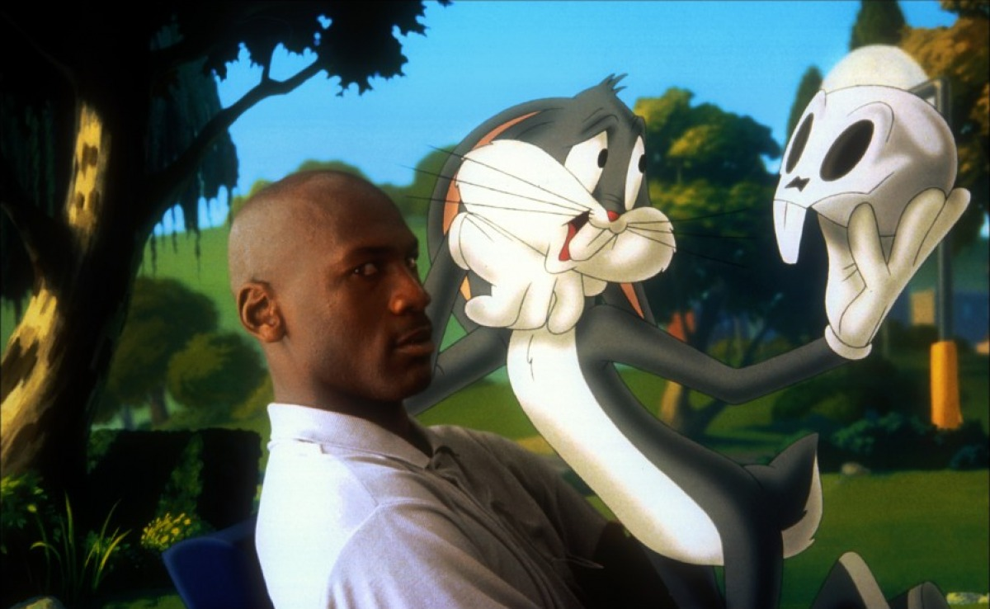
Real-time Non-photorealistic Viewfinder

Slide 2
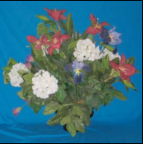
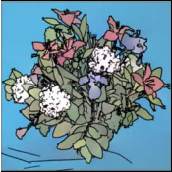
Real-time Non-photorealistic Viewfinder
Tony Hyun Kim and Irving Lin
CS478 Computational Photography
Dev. blog: cs478.blogspot.com
*
*Raskar, et. al. (2004)

Slide 3

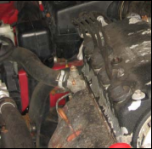
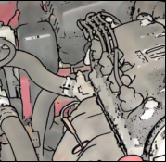
INTRODUCTION: NPR
*
Non-photorealistic rendering (NPR), or “stylization,” allows artistic interpretation of an image at the expense of photorealism.
Promotes simplicity and reduction of detail, better emphasizing the semantic content of the image.
Applications: visual communication, augmented virtual reality, image compression. Also, just looks interesting.
*Raskar, et. al. (2004)

Slide 4
OUR WORK: TOPICS TO BE DISCUSSED
Demonstration of NPR viewfinder
How it works:
  Details of the NPR algorithm
  GPU-based “backend” for image processing
Integration with tablet hardware (flash)

Slide 5
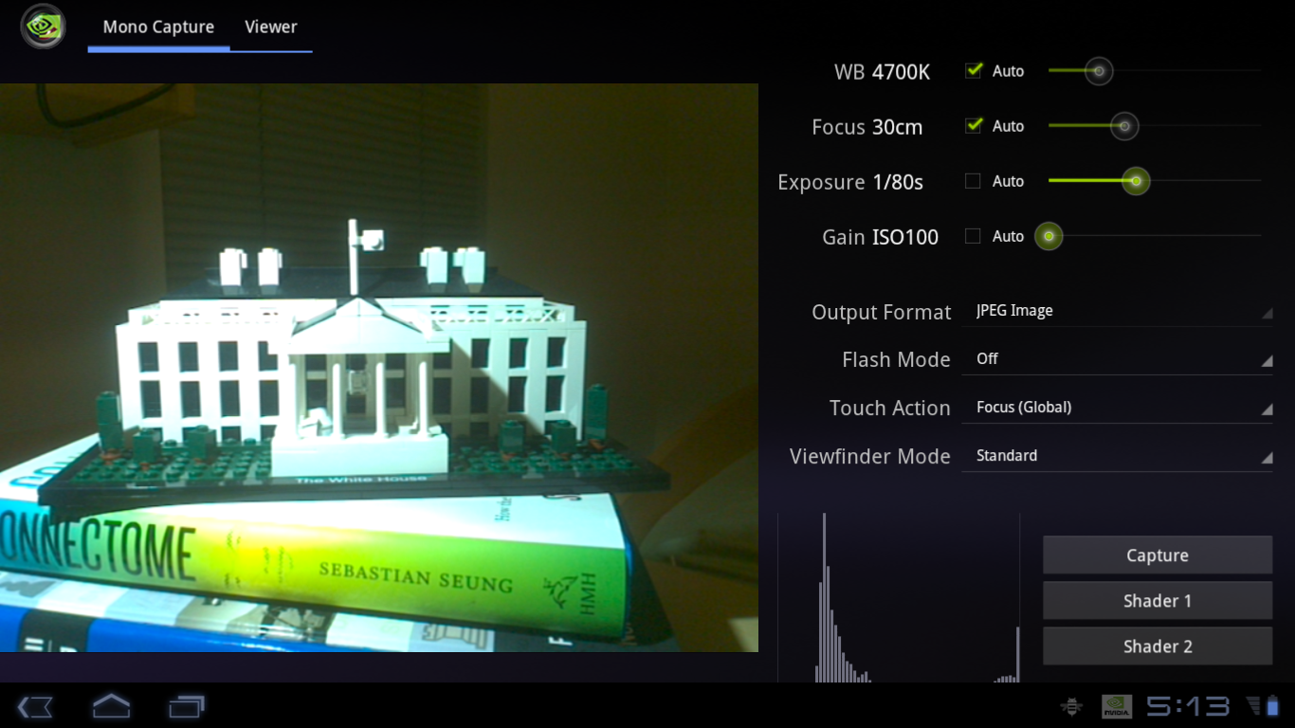
Our typical view of the world. Boring…

Slide 6
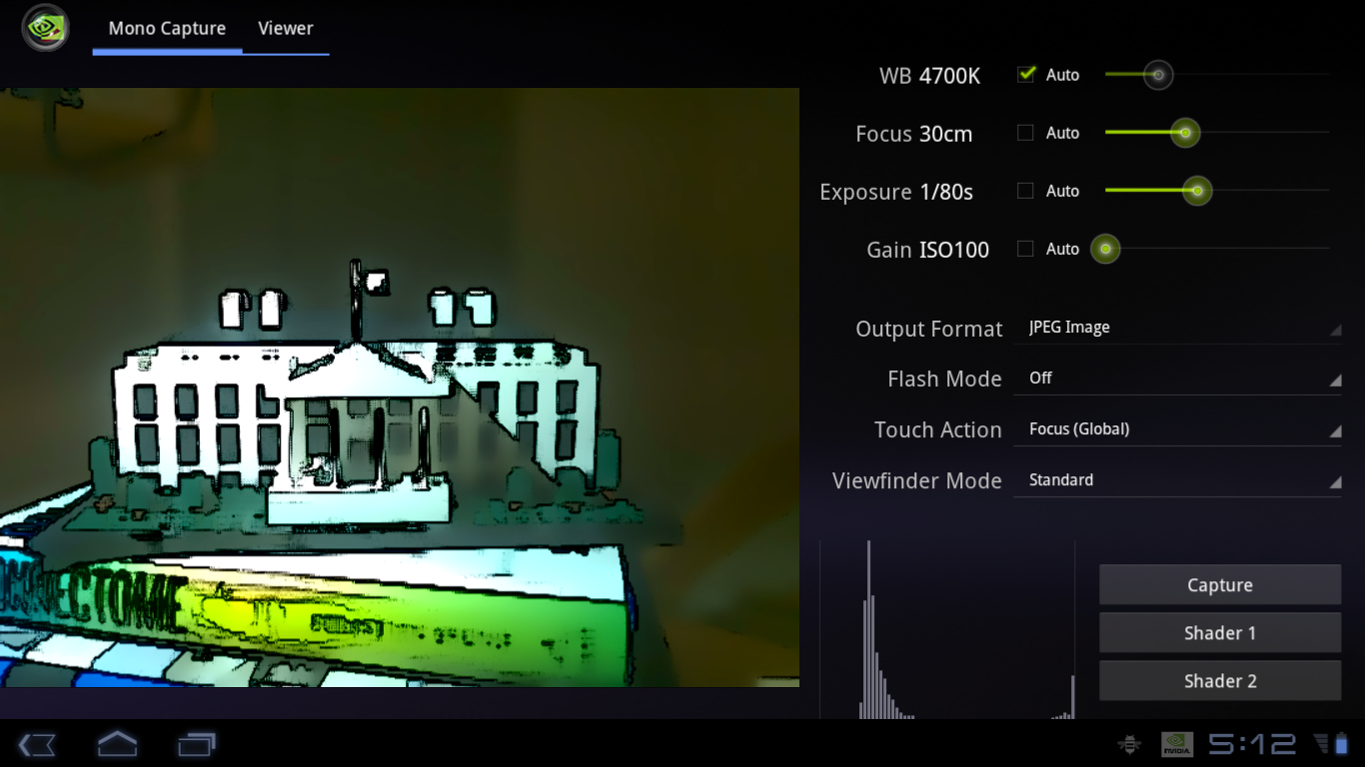
Let’s stylize our worldview!

Slide 7
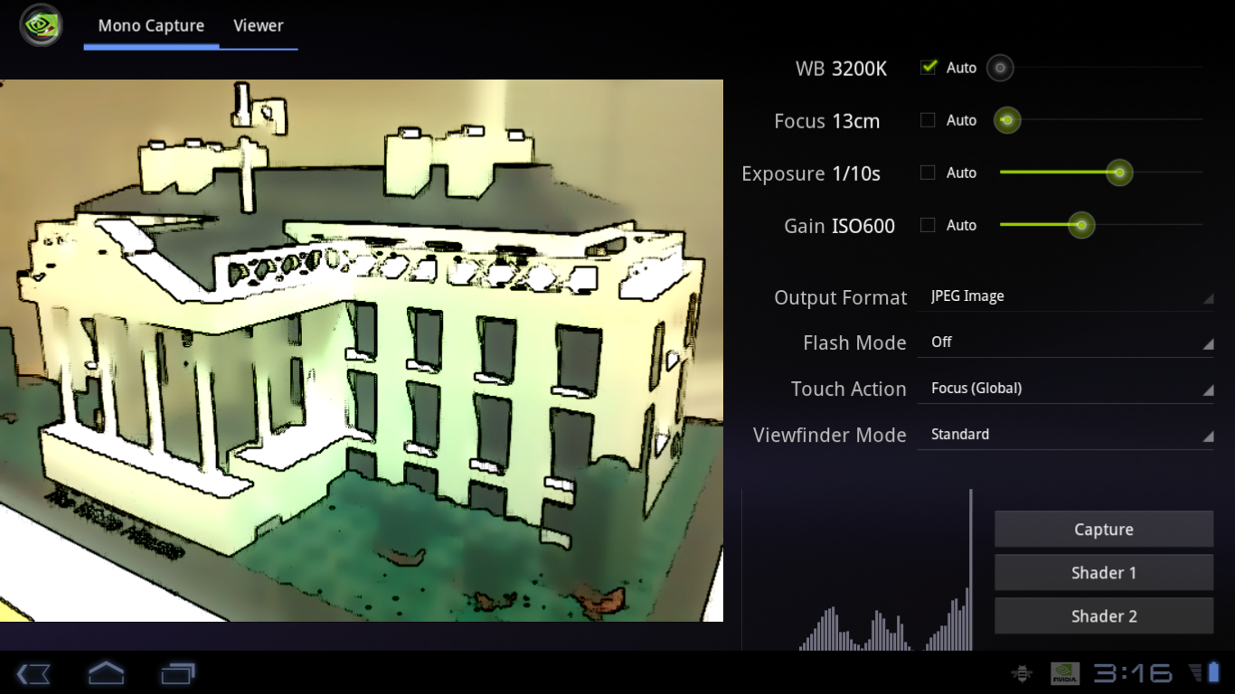
Another perspective…

Slide 8
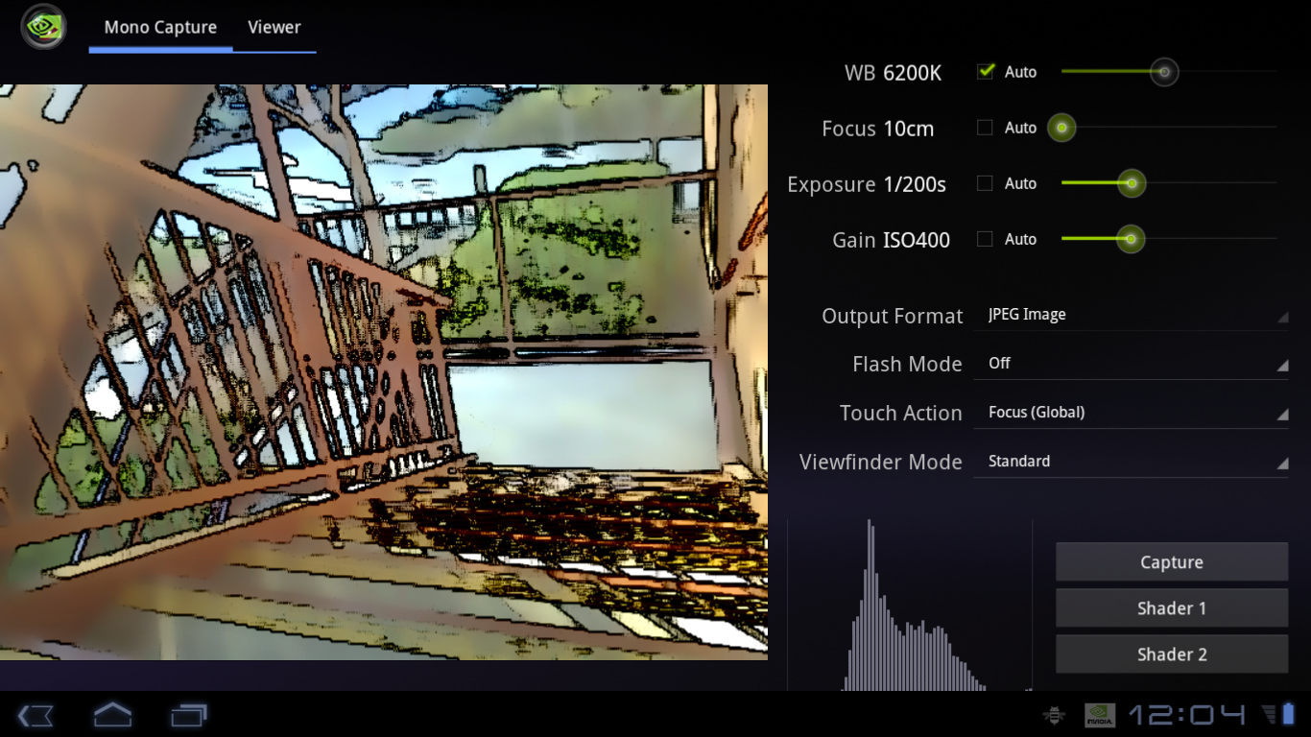
Let’s take it outside…

Slide 9
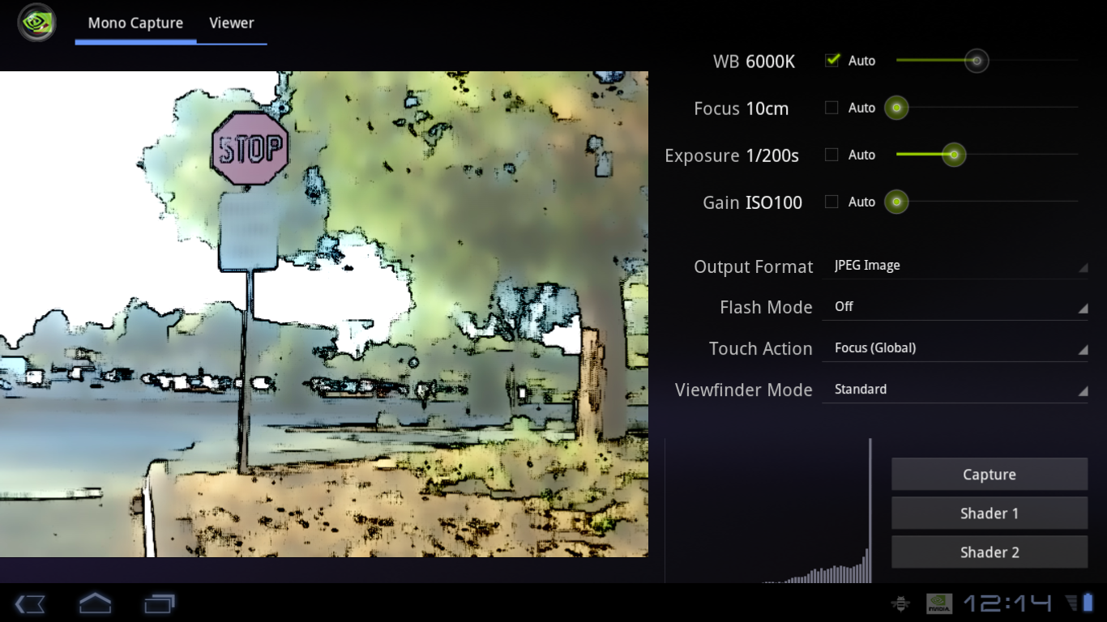
Going towards the university

Slide 10
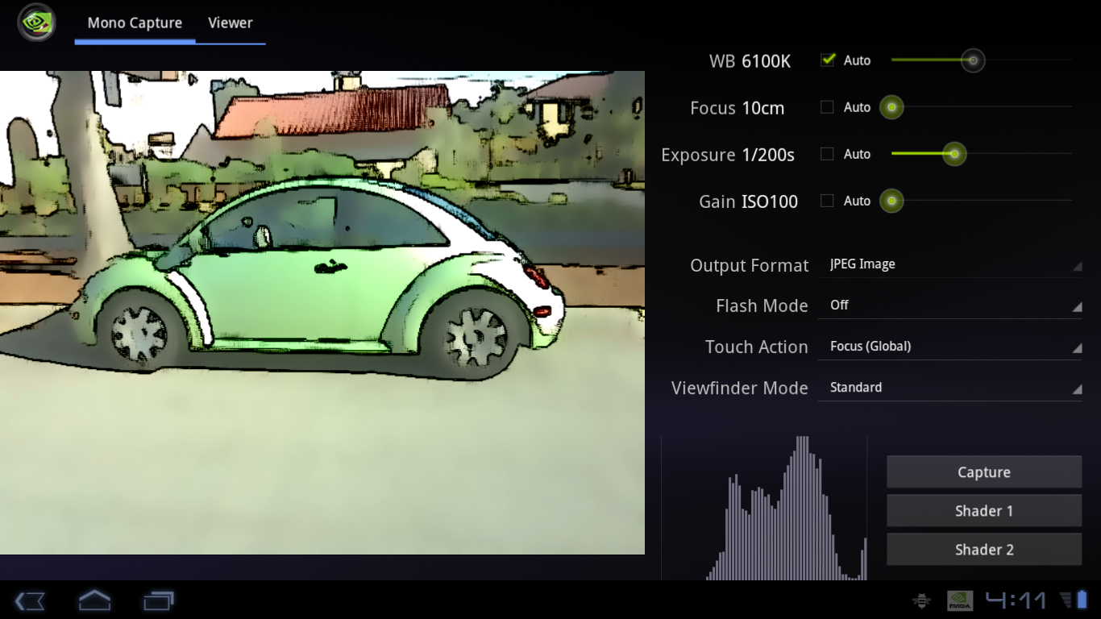
Cool car

Slide 11
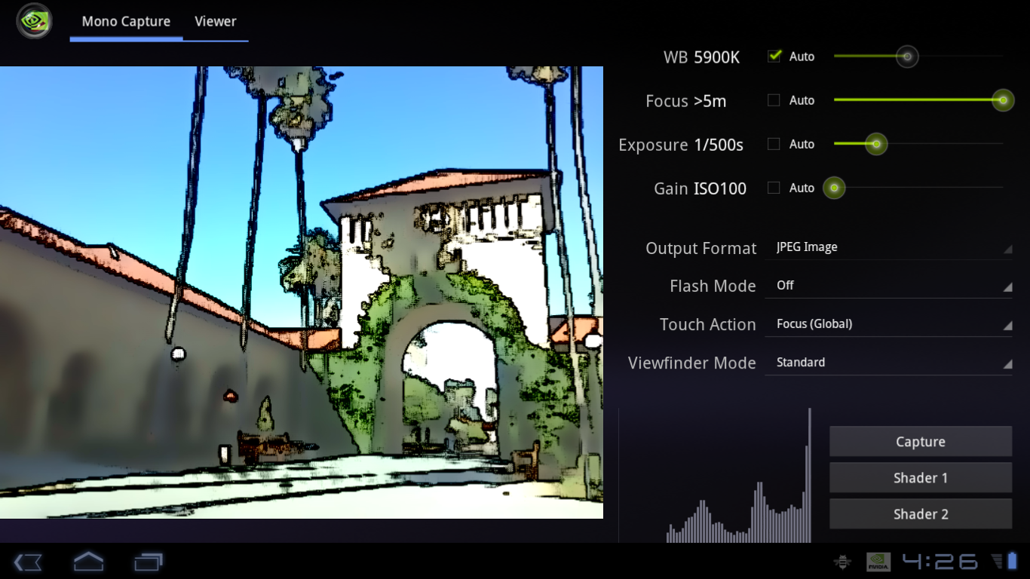
Going to the Quad…

Slide 12
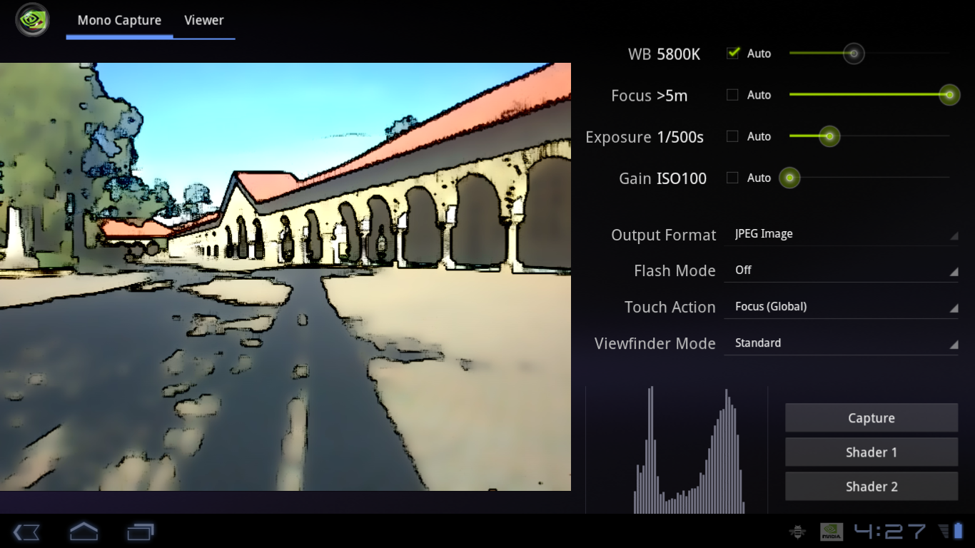
Cartoon pillars

Slide 13
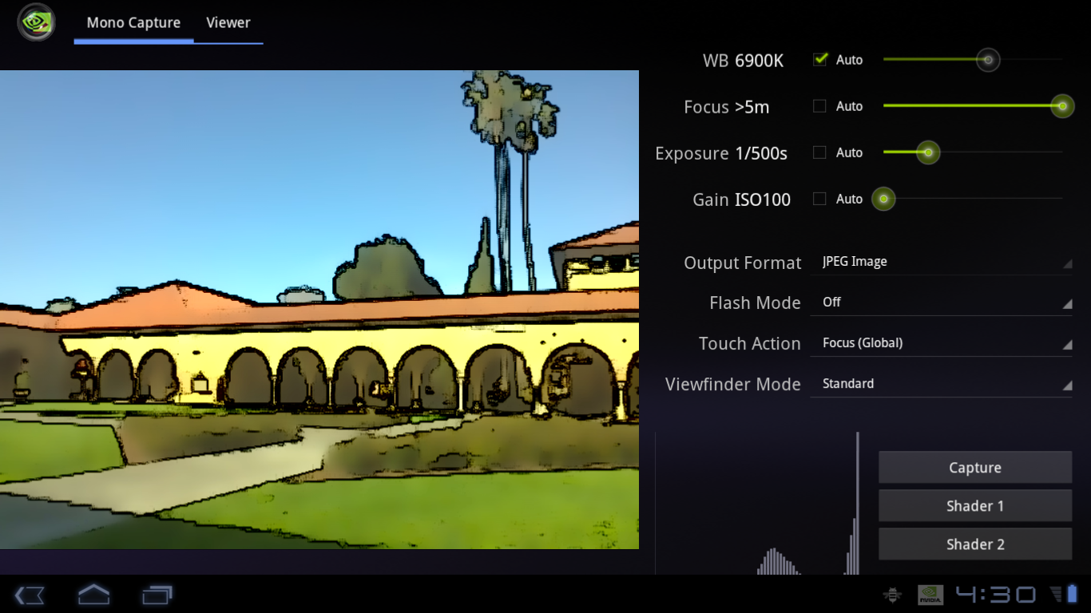
More cartoon pillars!

Slide 14
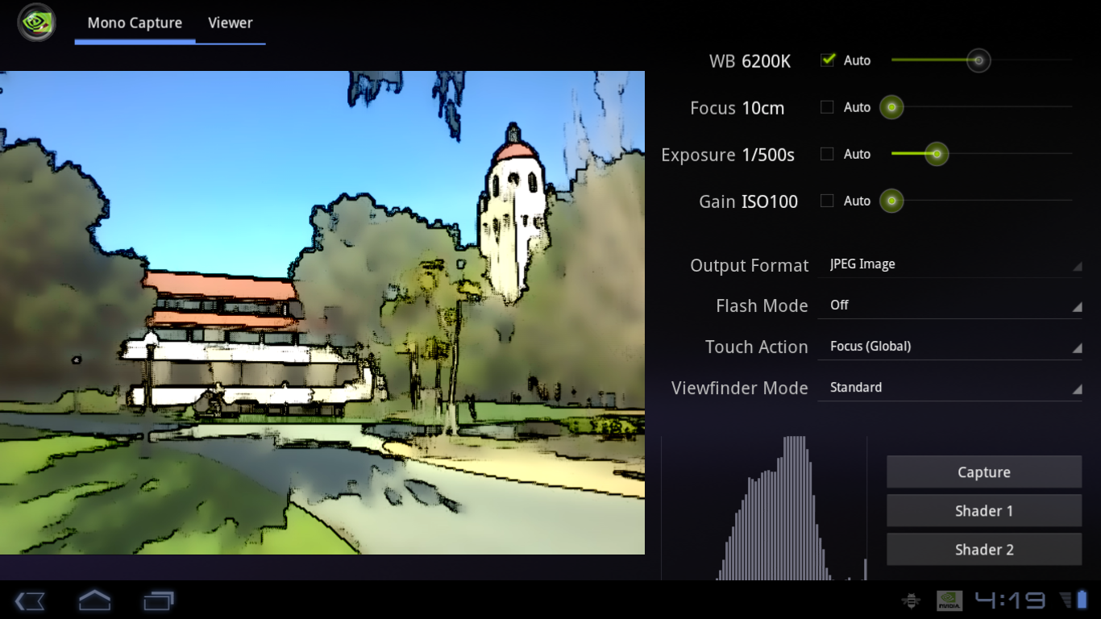
View of the Hoover tower

Slide 15
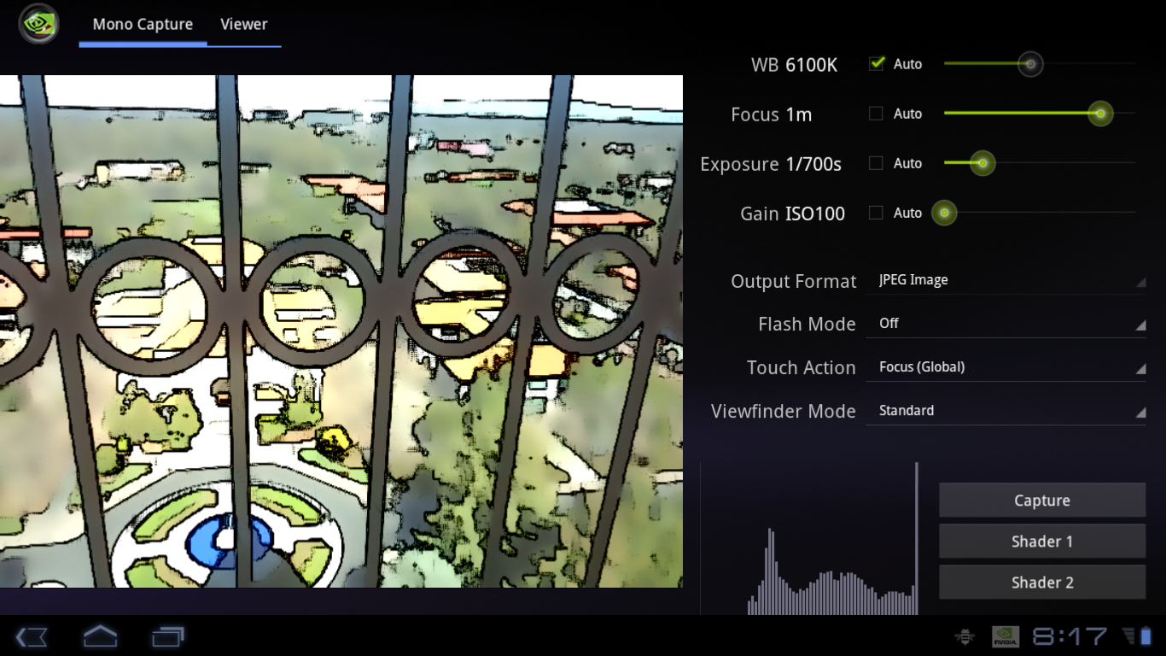
Now, in the Hoover tower

Slide 16
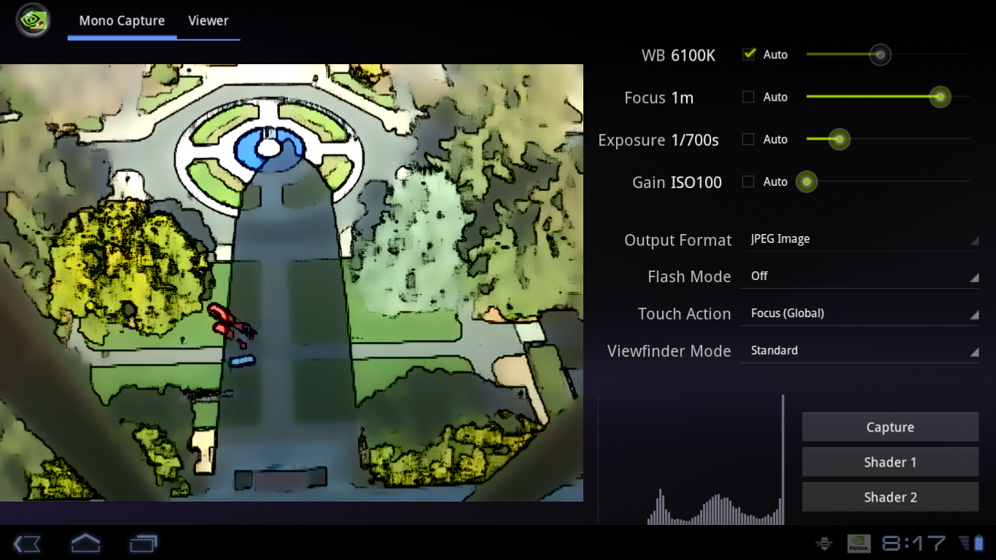
The tower’s shadow

Slide 17
HOW IT WORKS
NPR algorithm
Blah Blah Blah
The world looks “cartoony” with:
  Color simplification
  Edge enhancement
  Color quantization (optional)

Slide 18
HOW IT WORKS
NPR algorithm
Blah Blah Blah
The world looks “cartoony” with:
  Color simplification
  Edge enhancement
  Color quantization (optional)
Use a bilateral filter:
“Clustering” of nearby pixel colors
Number of approximations available
  Separable approx. (Pham, et. al. 2005)
  No spatial weight. (Fischer 2006)

Slide 19
HOW IT WORKS
NPR algorithm
Blah Blah Blah
The world looks “cartoony” with:
  Color simplification
  Edge enhancement
  Color quantization (optional)
Use neighbor gradients:
Just like the sharpness calculation in autofocus routine (“Hello Camera”)
Up-down-left-right gradients

Slide 20
HOW IT WORKS
NPR algorithm
Blah Blah Blah
The world looks “cartoony” with:
  Color simplification
  Edge enhancement
  Color quantization (optional)
Bucket the pixel value:
Quantization of Y → cell-shaded look
Quantization of U,V → funny colors

Slide 21
HOW IT WORKS
GPU-based backend
Blah Blah Blah
NPR algorithm is a sequence of image filters
  For example:
    Bilateral filtering (multiple rounds)
    Edge detection
For performance reasons, we perform all image processing on the GPU
  GPU-backend implemented in FCamAppThread

Slide 22
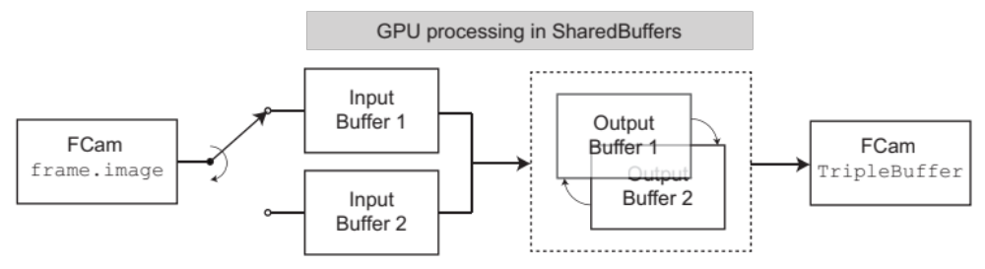
HOW IT WORKS
GPU-based backend
Blah Blah Blah
Inside of FCamAppThread…

Slide 23
HOW IT WORKS
GPU-based backend
Blah Blah Blah
Inside of FCamAppThread…
Get a single 640 x 480 viewfinder frame

Slide 24
HOW IT WORKS
GPU-based backend
Blah Blah Blah
Inside of FCamAppThread…
Copy frame data to “SharedBuffer”
Data is visible to both CPU and GPU

Slide 25
HOW IT WORKS
GPU-based backend
Blah Blah Blah
Inside of FCamAppThread…
Apply sequence of shaders in GPU

Slide 26
HOW IT WORKS
GPU-based backend
Blah Blah Blah
Inside of FCamAppThread…
Copy result back to FCam renderer

Slide 27
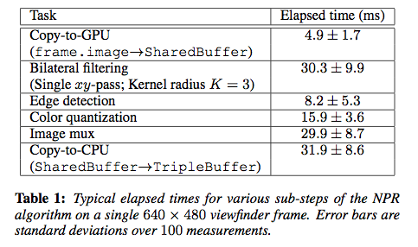
HOW IT WORKS
GPU-based backend
Blah Blah Blah
Typical perf: ~100 ms per frame (10 fps)

Slide 28
Switching gears…

Slide 29
FLASH-BASED SELECTIVE NPR
No-flash
Flash
Request a stream of alternating flash/no-flash video. Steer it to the right destination.
Use flash/no-flash pair to segment foreground and background (very naïve!)

Slide 30
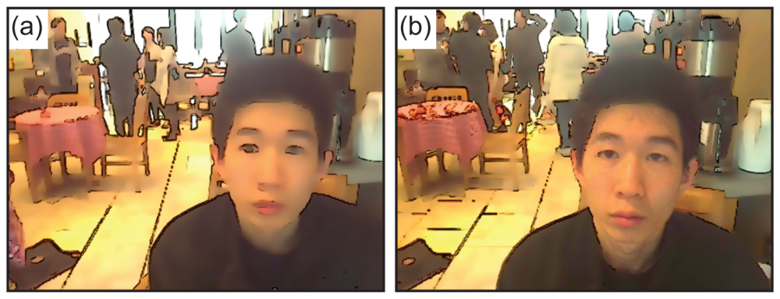
FLASH-BASED SELECTIVE NPR

Slide 31
CONCLUSIONS
Demonstration of NPR viewfinder
  Stylizes 640 x 480 video at 10 fps
  Bilateral filtering, edge detection, quantization
  See: cs478.blogspot.com for more results
Backend for GPU-based image processing:
  Generic, can be used with other filters
Proof-of-principle integration with hardware
  Flash-based, background-selective NPR

