Slide 1
Measurement of Young’s modulus via mechanical test of MEMS cantilevers
Tony Hyun Kim
April 23, 2009
6.152: MEMS Presentation

Slide 2
Topics to be discussed
Introduction
  MEMS Cantilevers, Fixed-fixed beams
  Theory of cantilever mechanics: Young’s modulus, etc.
Fabrication details
Experimental setup for mechanical test
Analysis and results
  Young’s modulus of SiNx
  Breaking point of the fixed-fixed beam
Sources of error
Conclusions

Slide 3
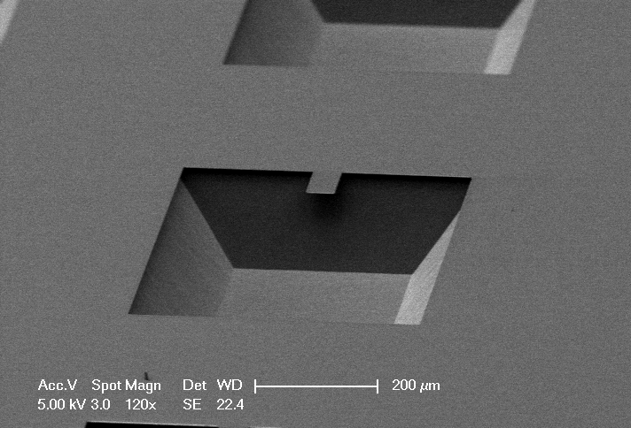
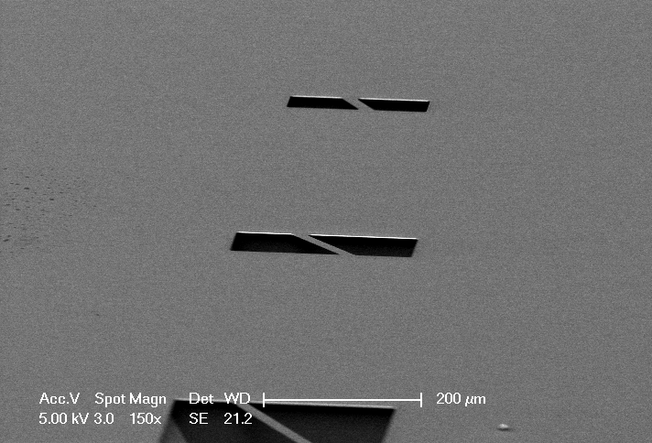
MEMS Cantilevers and Fixed-fixed beams
Most ubiquitous structure in MEMS
Starting point for many applications:
  Sensors
  Platform for material experiments
It’s easy to build and easy to use (in principle).
Image source: Hayden, Taylor. “MEMS Analysis 2” (On 6.152 Stellar)

Slide 4
MEMS Cantilevers and Fixed-fixed beams
Most ubiquitous structure in MEMS
Starting point for many applications:
  Sensors
  Platform for material experiments
It’s easy to build and easy to use (in principle).
Our experimental goals:
Build an array of MEMS cantilevers and fixed-fixed (FF) beams.
Perform optical and mechanical verification of the devices.

Slide 5
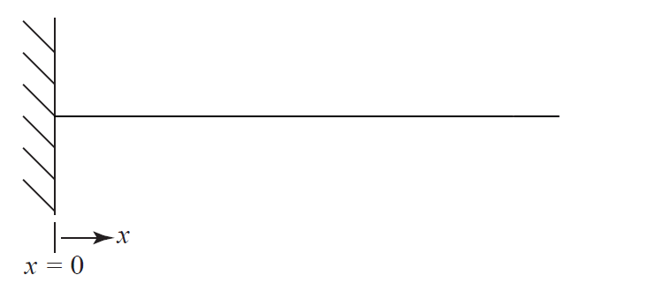
Theory of cantilever mechanics
Once the structure is built, we want to test it.
  i.e. perform consistency checks against literature
Image source: Schwartzman, Alan. “MEMS Analysis 1” (On 6.152 Stellar)

Slide 6
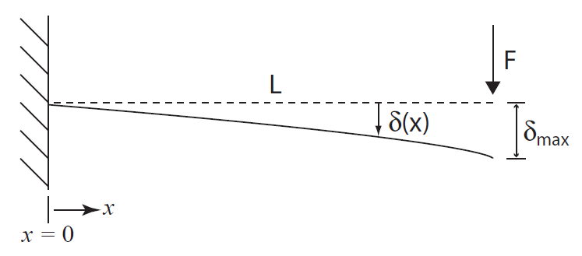
Theory of cantilever mechanics
The deflection of the target point (at distance L from fixed end):
Young’s modulus (E) is a material property measuring stiffness.

Slide 7
Fabrication details (1)
Silicon wafer
SiN_{x}
Silicon nitride was deposited on wafer by Scott.
Thickness was measured by ellipsometry:

Slide 8
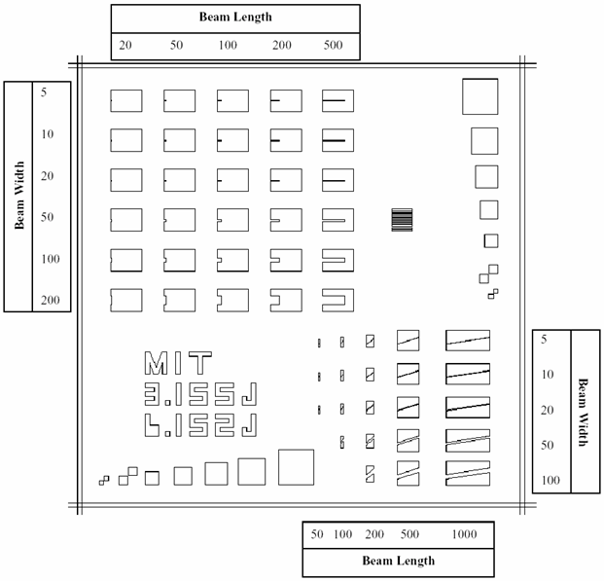
Fabrication details (2)
Silicon nitride patterned according to mask on left.
Pattern transferred by contact lithography.
The nitride was etched by SF₆/plasma.

Slide 9
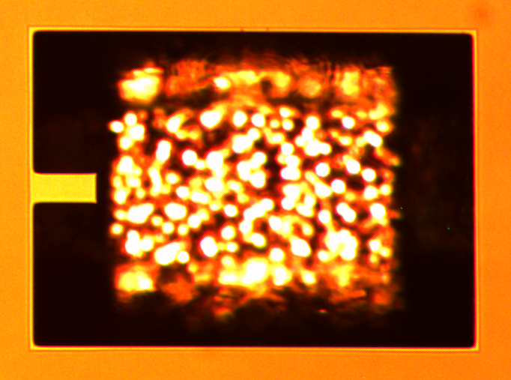
Fabrication details (3)
Finally, an anisotropic etch (KOH) was utilized to etch the Si bulk.
  Two hour etch in 80ºC KOH bath.
The <111> orientation is stable against KOH →
  Allows for the material below the bridge to be removed first.

Slide 10
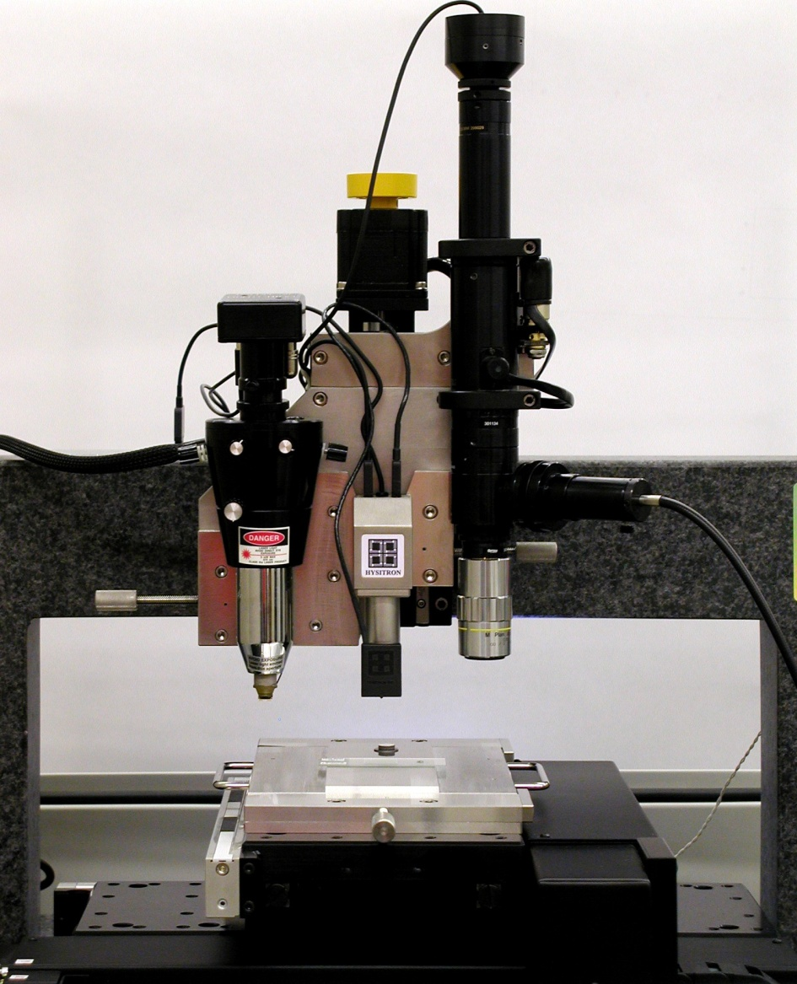
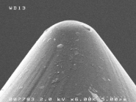
Experimental Setup: Mechanical test
“TriboIndenter” in the NanoLab
Optical microscope:
  Position target.
Force-displacement transducer:
  With a blunt tip.

Slide 11
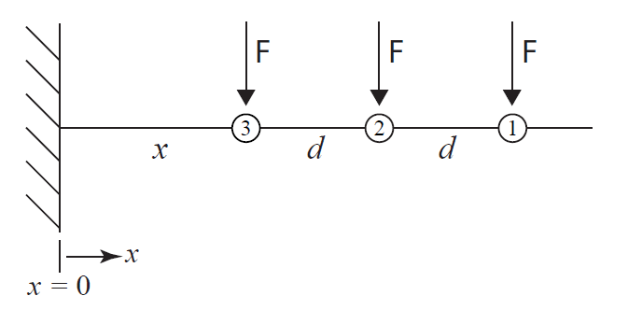
Experimental Setup: Mechanical test
The spring constant is dependent on the point of application of force, L:
Can deduce Young’s modulus without L, by the above scheme

Slide 12
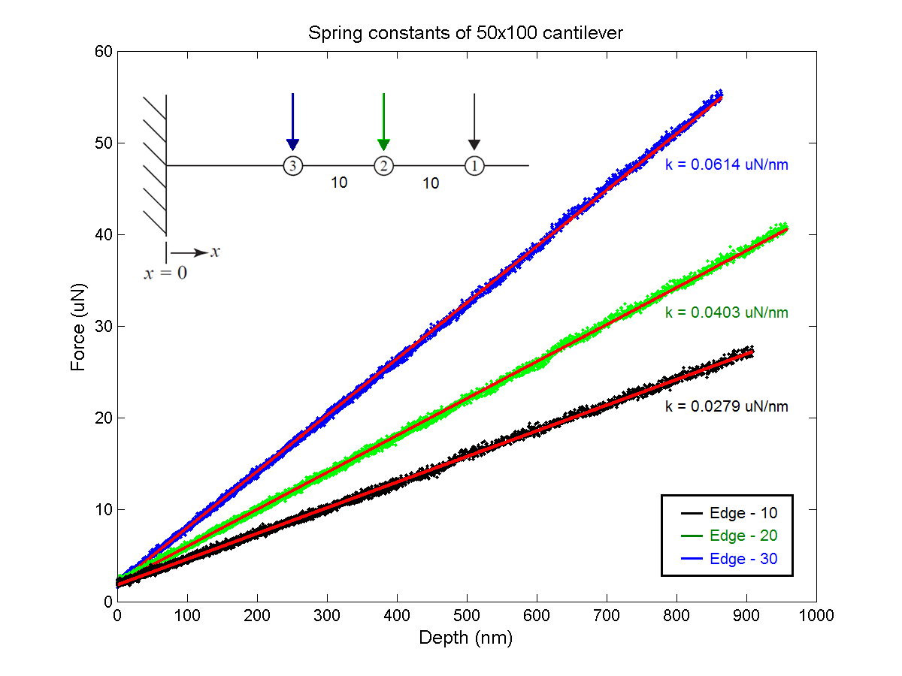

Slide 13
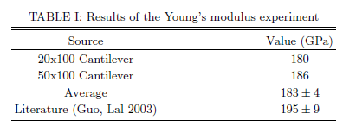
Results: Young’s modulus
The Young’s modulus was computed using the following:
  “b” is the slope of k^{-1/3} vs. L
  Optically measured width (W); thickness (t) from ellipsometry
Our results are within 1 std. of published values.

Slide 14
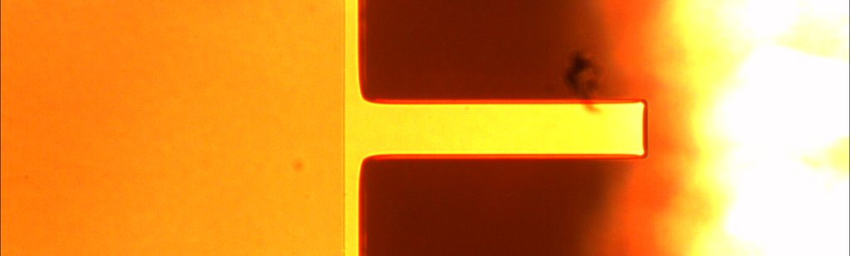
Sources of error in Young’s modulus determination
Geometric complications
  Sloped cantilevers → “Effective” width smaller
  Undercut below the fixed-end

Slide 15
Conclusions
Constructed MEMS cantilevers (and fixed beams)
Performed a mechanical experiment using the cantilevers
  Provides consistency check:
  Also verifies MEMS as useful platform for doing material studies.

Slide 17
Fixed-fixed beam analysis
Model is:
Young’s modulus is directly related to the cubic coefficient.

Slide 18
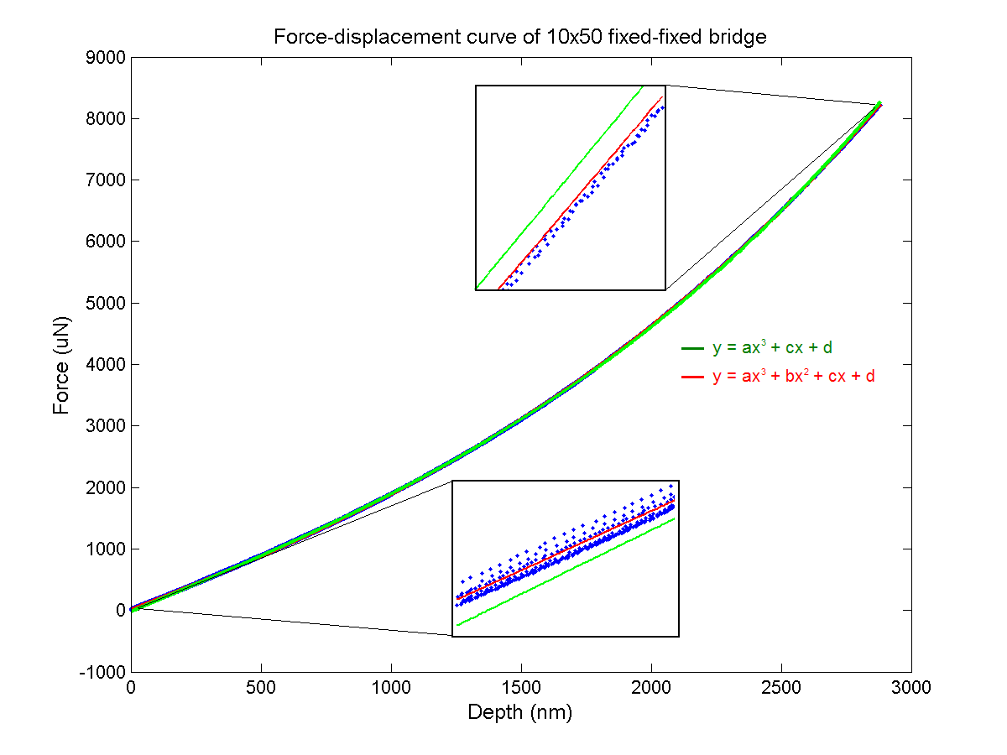

Slide 19
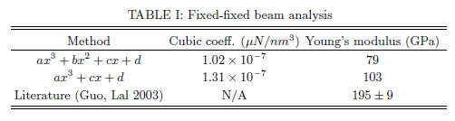
Fixed-fixed beam analysis
Young’s modulus through the cubic coefficient a:
Significant deviation from published values.

Slide 20
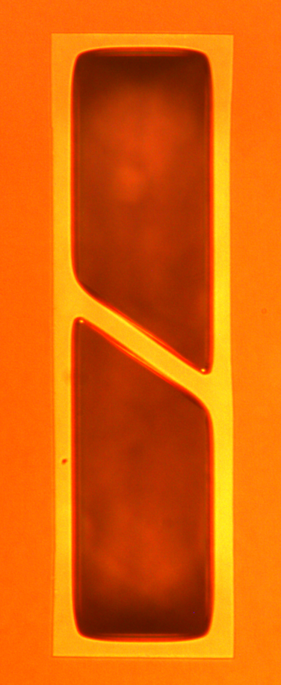
Fixed-fixed beam analysis
Possible sources of errors to consider:
  Sloped edges have huge effect on width: 6 vs. 9 um.
  Bridge is slanted
Force-displacement profile prefers quadratic term.

