Slide 1
Frequency Doubling with Nd:YAG laser
Tony Hyun Kim, Ilan F. Almog
12/9/2008
6.161 Modern Optics Lab Project

Slide 2
Topics to be discussed
Nd:YAG laser restoration
  Principles of operation
  Repair of the cooling system, replacement of filter
  Fixing the deionizer cartridge
  Replacement of pumping lamp
Frequency-doubling experiment
  Brief theory
  Experimental setup; sources of error
  Results and conclusion

Slide 3
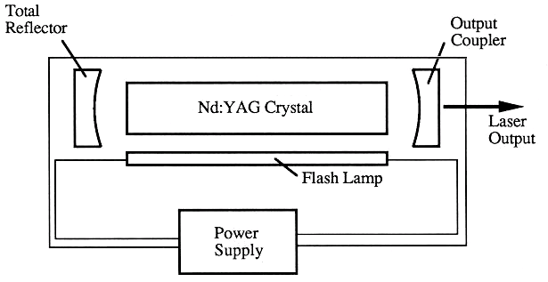
Nd:YAG – Principles of operation
Nd:YAG crystal has infrared (1064nm) line.
Inversion achieved by Kr flash lamp.
System (lamp) must be water cooled.

Slide 4
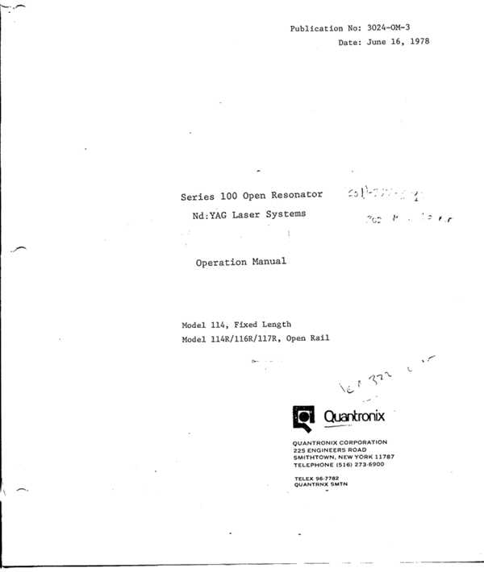
Our Nd:YAG, the Quantronix 116
Insights from previous repair attempts…
Plumbing issues:
  Various leaks
  Water filter too old
Laser head:
  Lamp malfunction

Slide 5
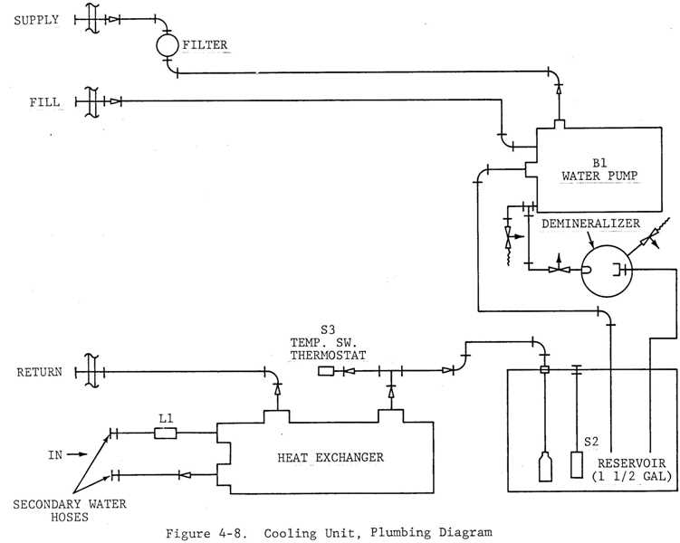
6.162: Modern Plumbing Laboratory

Slide 6
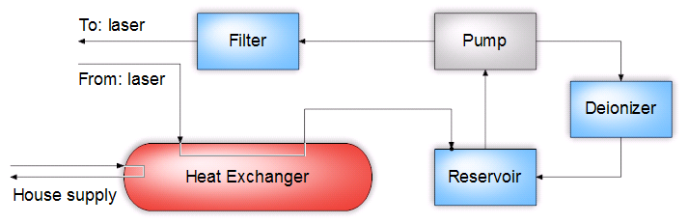
6.162: Modern Plumbing Laboratory
Two system-side (water) circuits:
  Left: Cools the laser
  Right: Self-cleans the water supply
Water filter was easily replaced, but…

Slide 7
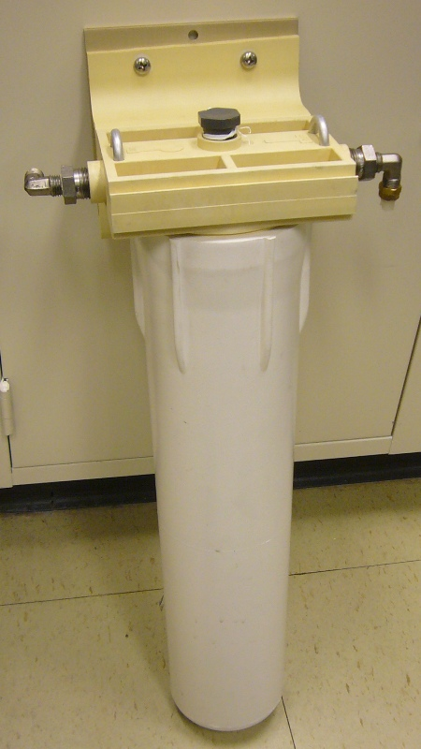
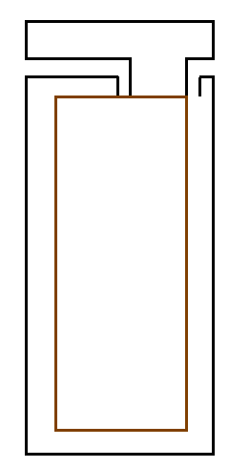
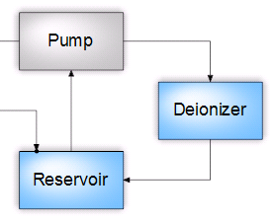
Deionizer cartridge fiasco
To
Reservoir
From
Pump

Slide 8
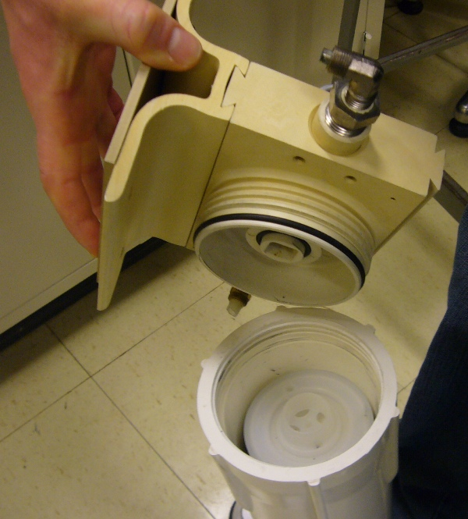
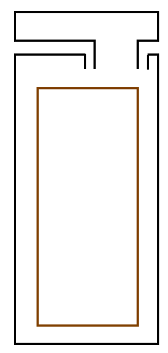
Deionizer cartridge fiasco

Slide 9
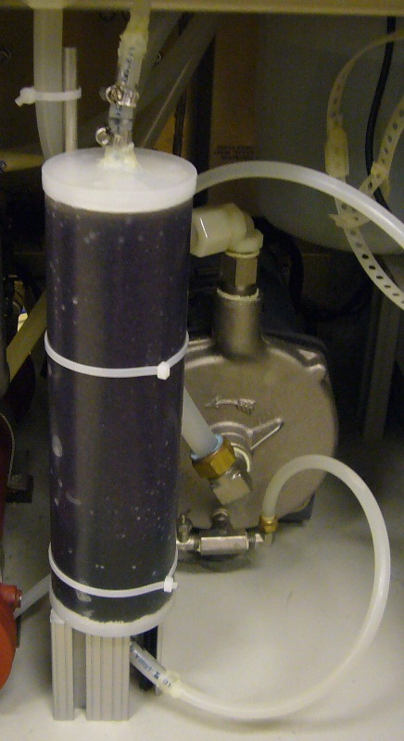
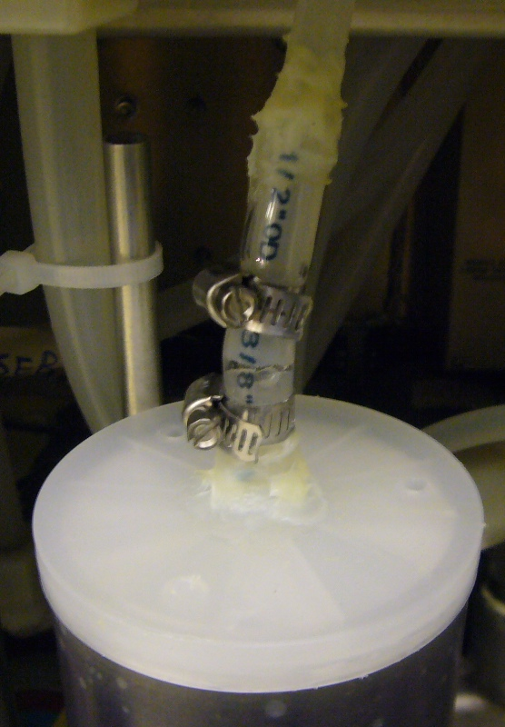
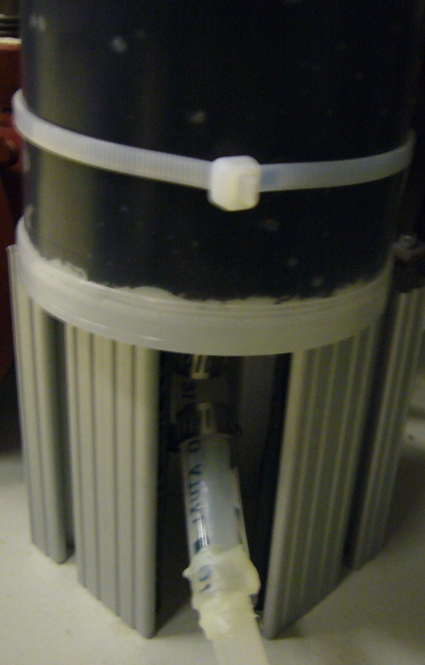
Deionizer cartridge: Solution
Tubes, clamps and epoxy → No leaks; perfect operation

Slide 10
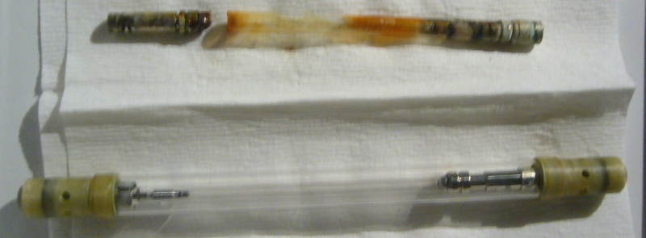
Replacement of the pump lamp
Suspicion of malfunctioning lamp confirmed
With plumbing and lamp fixed, laser operates!

Slide 11
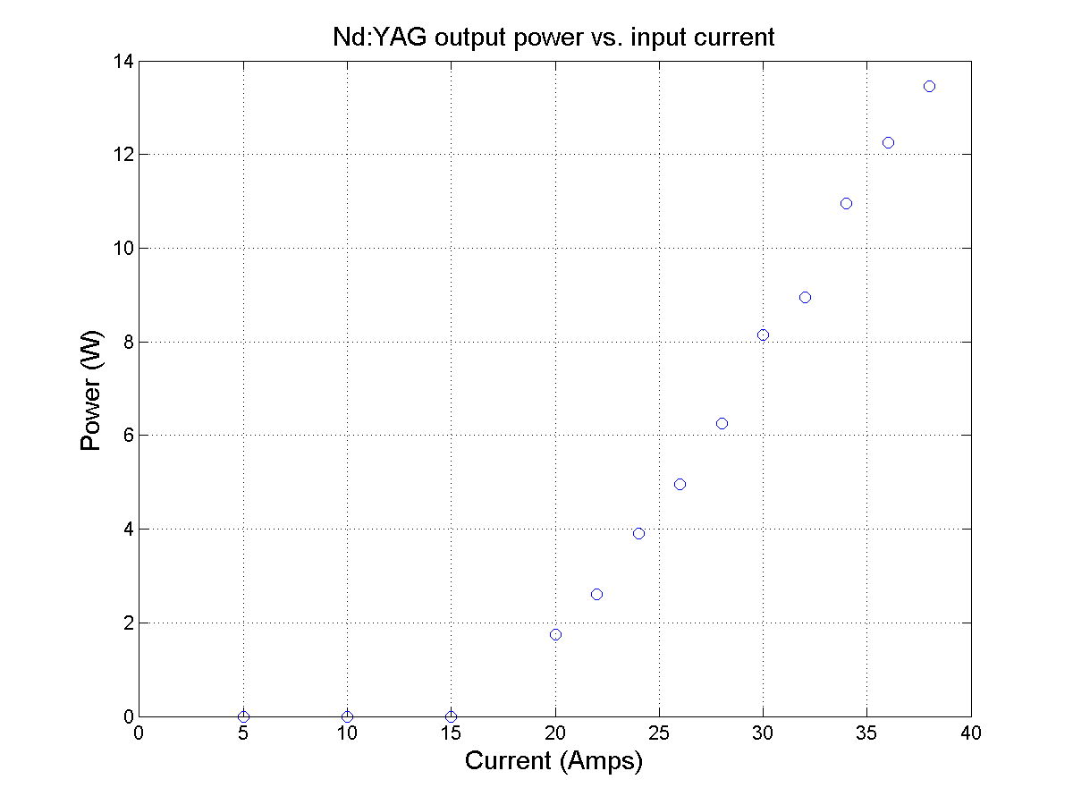

Slide 12
Conclusions (Nd:YAG repair)
No known leaks.
Have established protocols for maintenance:
  Refilling the reservoir.
  Wetting the pump for initial run.
  Pump electrical reset, and…
Observed up to 14W of IR power

Slide 14
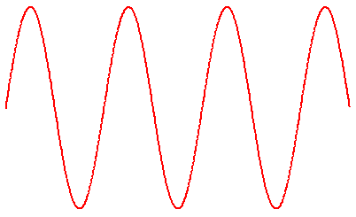
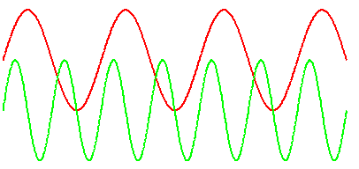
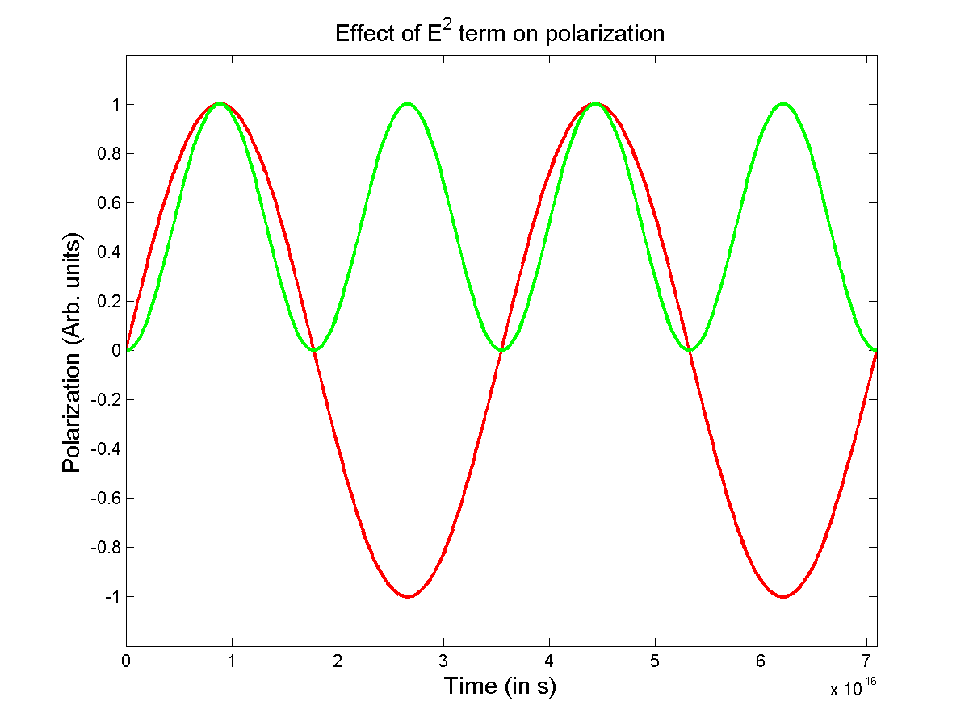
Freq. doubling introduction
Nonlinear crystal
Incident IR
E² term in polarizability (e.g. KDP crystal)
Double 1064nm (IR) → Obtain 532nm (green)
Our experiment: Characterize the conversion efficiency as a function of input power.

Slide 15
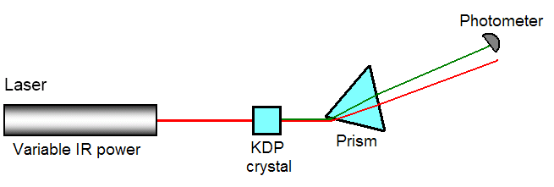
Experimental setup
Use dispersion of glass to achieve separation of IR (shown red) and green beams;
Can measure power of green beam only!

Slide 16
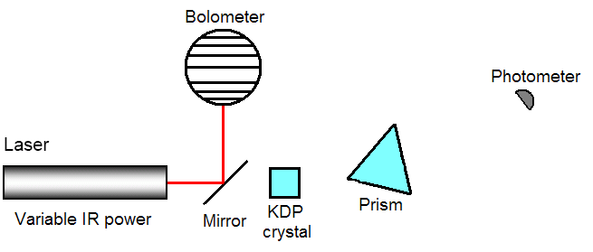
Experimental setup
Use pick-off mirror to measure input IR power without disturbing other optics

Slide 17
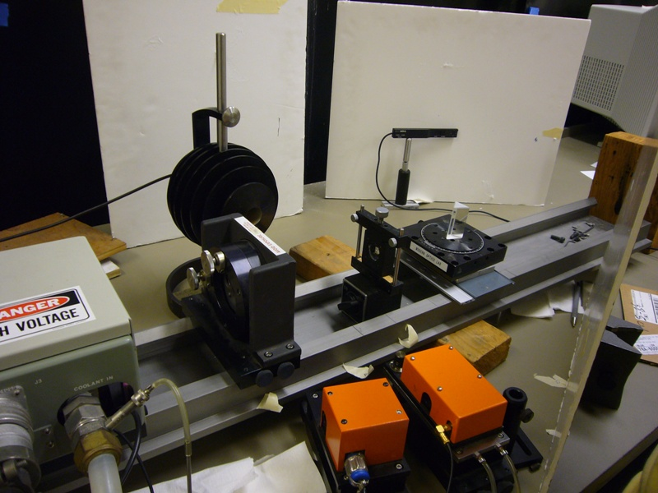
Experimental setup

Slide 18
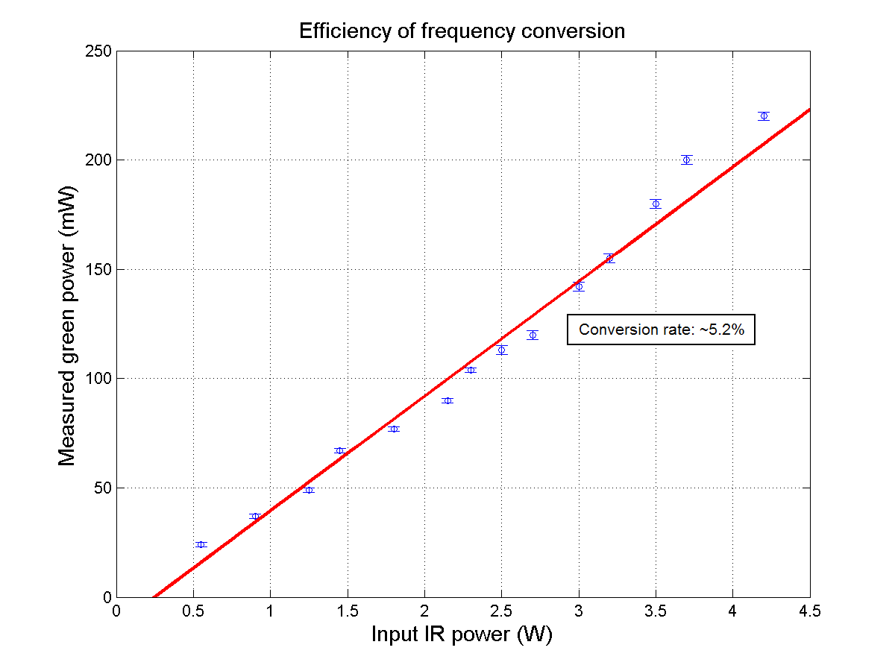
Generation of green light by freq. doubling with Quantronix 116

Slide 19
Conclusions (Freq. doubling)
Observed frequency doubling using the newly-repaired Quantronix Nd:YAG laser.
Based on our alignment, obtained ~5.2% conversion efficiency.
  Efficiency independent of input IR power

Slide 20
Concluding remarks
Showed that Nd:YAG system and KDP crystal are functional. Opens possibilities for future experiments.

Slide 21
Acknowledgments
Mike the plumber;
Dave the optics guy;
The folks who shared the optics lab with us
  That is: Americo, Amrita, Matt, (Raymond);
And, of course, Bill (and Prof. Warde)

Slide 22
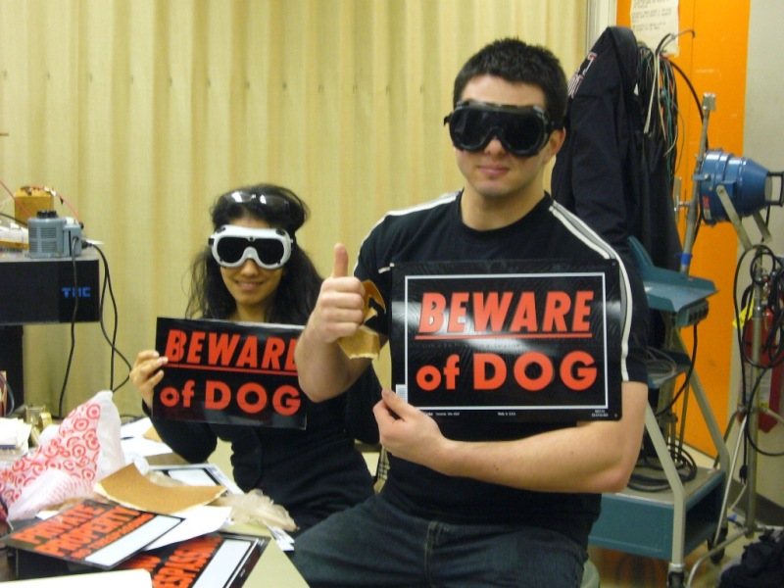

Slide 23
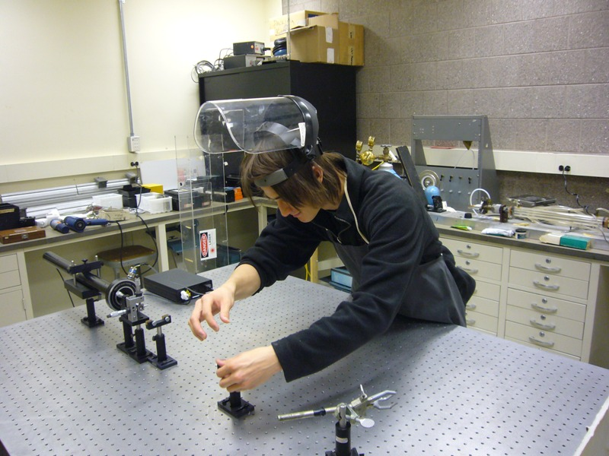

Slide 24
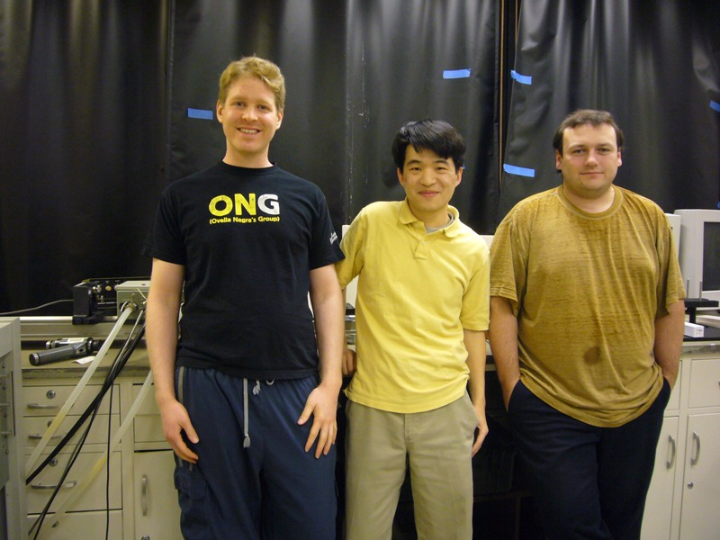

Slide 25
