Slide 1

Reflection and Refraction
Tony Hyun Kim
9/22/2008
6.161: Lab 1

Slide 2
Topics to be discussed
Geometric reflection and refraction, Snell’s law
    (Experiment 1.6)
Polarization dependent reflectivity, R
    (Experiment 1.5)
Explanation of the angular dependence of R

Slide 3
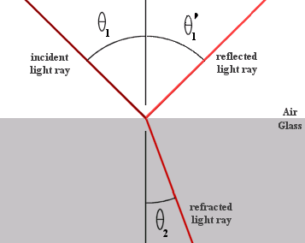
Reflection and refraction at a boundary
Incident angle = Reflected angle: θ₁ = θ₁’
Refracted angle obeys Snell’s law: sin θ₁ = n sin θ₂

Slide 4
Analysis of prism (Expt. 1.6)
Can calculate the index of refraction, n:

Slide 5
Analysis of prism (Expt. 1.6)
Tilt prism →output beam grazes hypotenuse
(Analysis yields that n = 1.54)

Slide 6
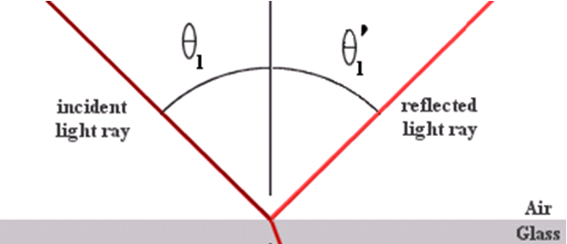
More detailed analysis of reflection
The reflected angle is simple:
However, intensity of reflected beam is complicated!

Slide 7
Reflectivity depends on polarization of light
Electric field
“Transverse magnetic”
(“Horizontal”)
“Transverse electric”
(“Vertical”)

Slide 8
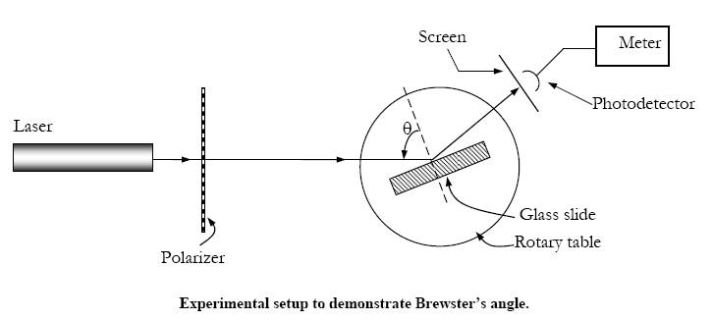
Experimental setup

Slide 9
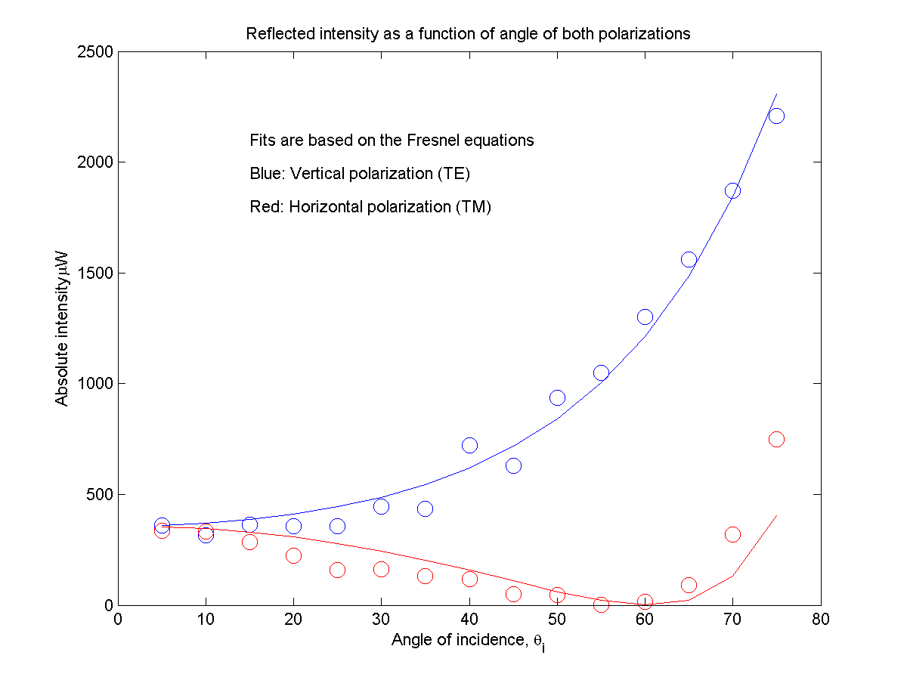
“Brewster’s angle”

Slide 10
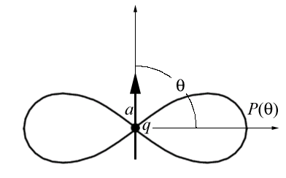
Explanation of the angular dependence
The full treatment involves Maxwell’s equations applied to an interface.
Dipole oscillations can give qualitative intuition for Brewster’s angle.

Slide 11
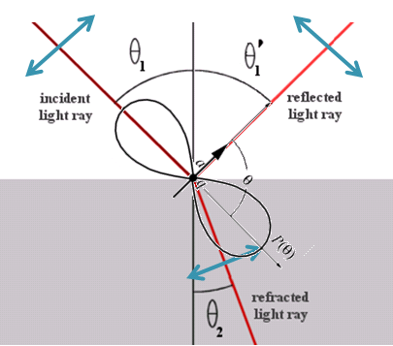
Brewster’s angle

