Slide 1
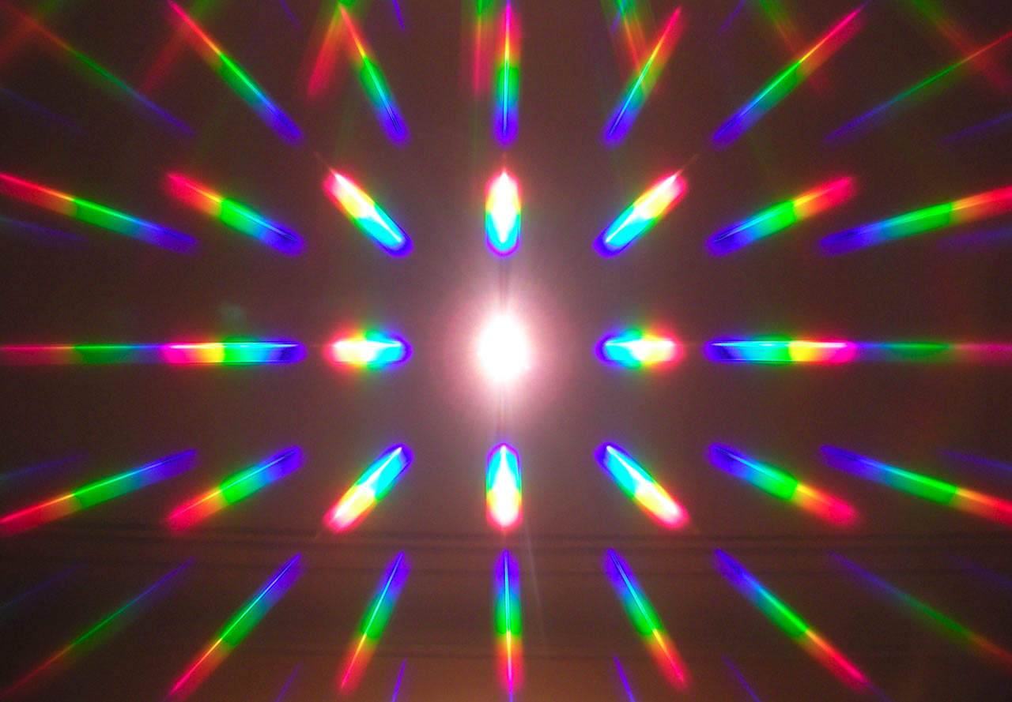
Diffraction (6.161 Lab3)
Tony Hyun Kim
10/21/2008

Slide 2
Topics to be discussed
Introduction
  Diffraction theory
  Fraunhofer diffraction integral
Experimental setup
Patterns from apertures
  Single-slit
  Double-slit
  Rectangular aperture
  Rectangular grid
Conclusions

Slide 3
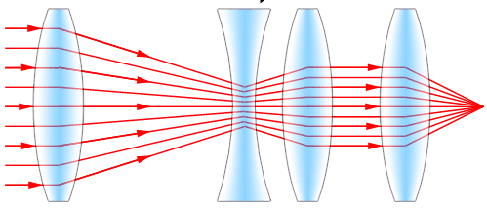
Diffraction = Wave - Ray
Although ray optics is intuitive…
Light is a wave phenomenon

Slide 4
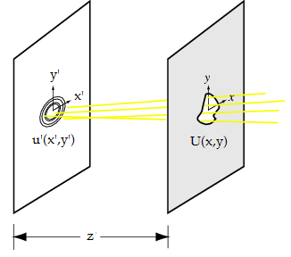
Fraunhofer diffraction integral

Slide 5
Fraunhofer intensity pattern

Slide 6
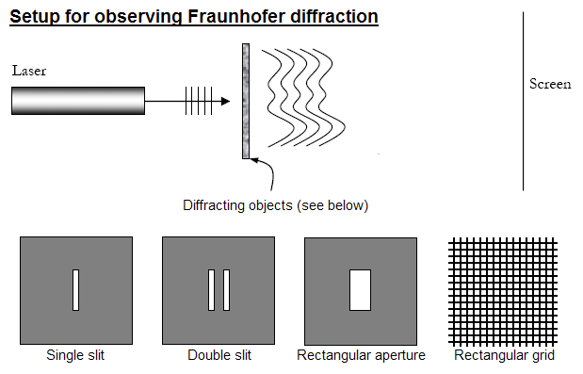
Setup to observe diffraction

Slide 7
Patterns from apertures
We’ll present and analyze (Topic set 1):
  Single-slit
  Double-slit
  Rectangular aperture
  Rectangular grid

Slide 8
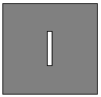
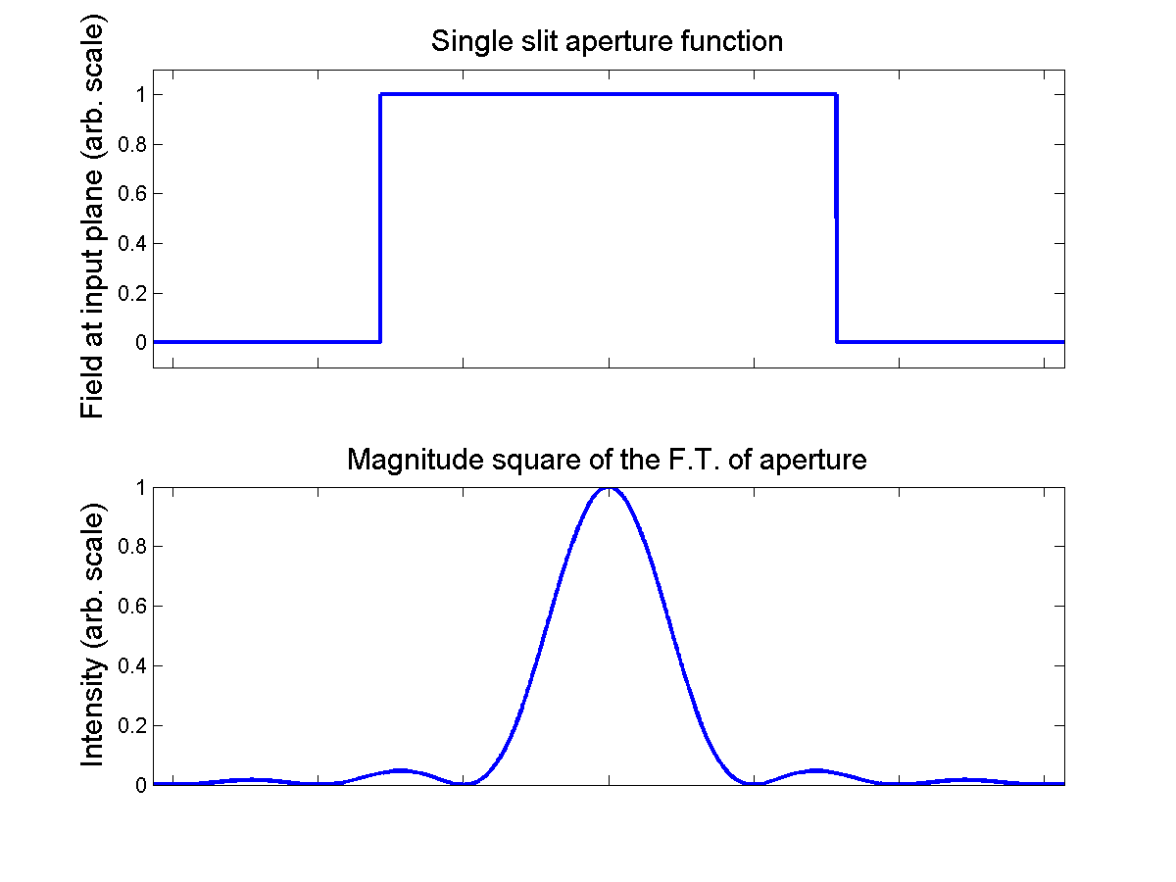

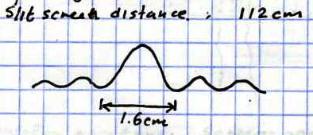
Single slit
Note Fourier reciprocity in characteristic lengths
Calculate slit width from pattern: b = 89 microns

Slide 9
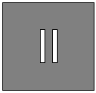
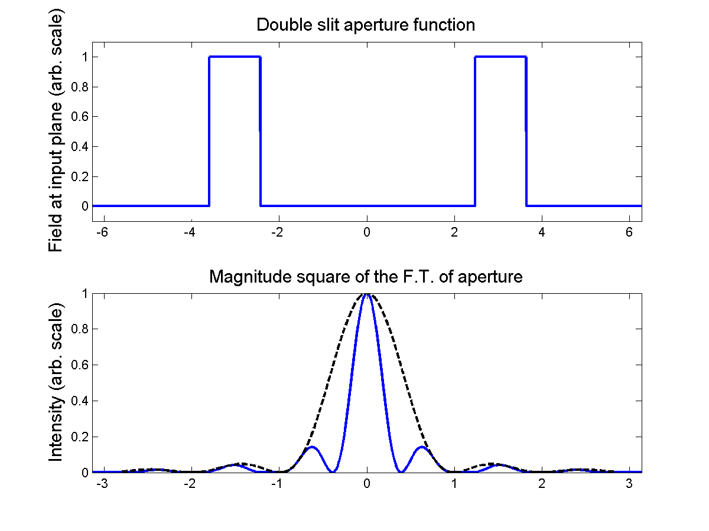

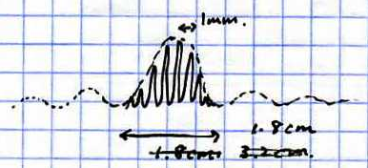
Double slit
Periodicity in aperture produces localization in pattern
Calculate inter-slit distance: D = 6.5 mm

Slide 10
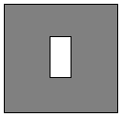
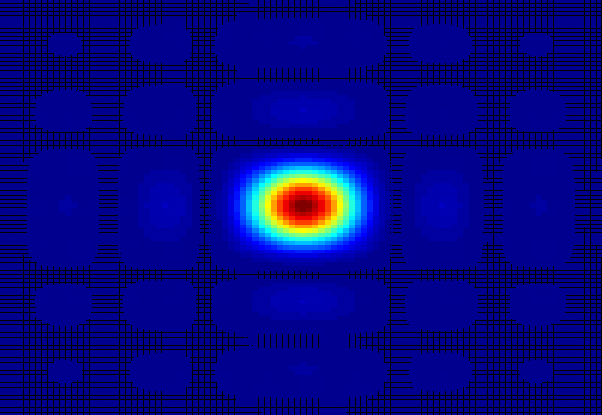
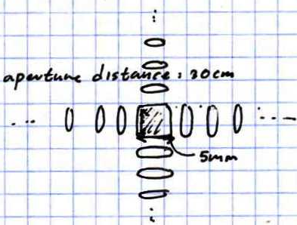
Rectangular aperture
Just a slit in two dimensions
Calculate aperture dimensions: b = 76 microns

Slide 11
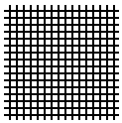
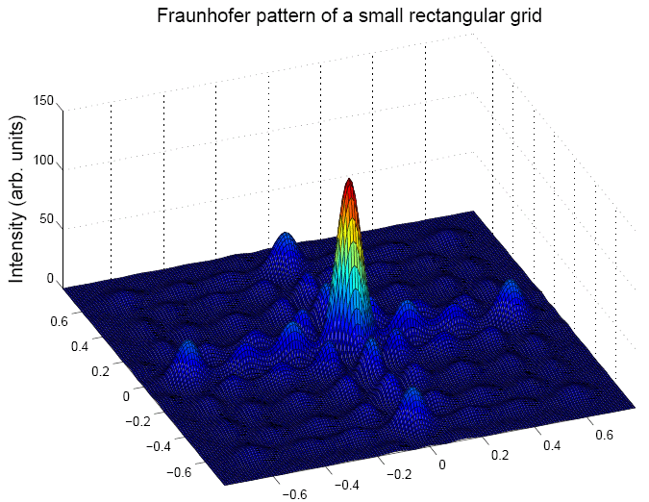
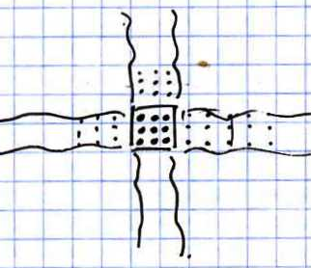
Rectangular grid
Again, periodicity → localization

Slide 12
Concluding remarks
Verified Fraunhofer diffraction in lab
General lessons:
  “Fourier pairing” between aperture and pattern
  Reciprocity in characteristic lengths.
  Periodicity of aperture → Localization of pattern
Possibilities for metrology

Slide 13
Sources of images
Lens system: http://www.trustedreviews.com/images/article/inline/4778-ZoomOut500.gif
Fraunhofer planes: http://scienceworld.wolfram.com/physics/FraunhoferDiffraction.html
Experimental setup: 6.161 Lab guide

