Slide 2
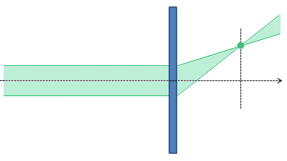
Holographic
Optical
Element
10 cm
2 mm
20 cm

Slide 4
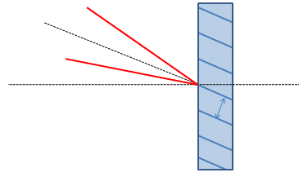

Slide 5
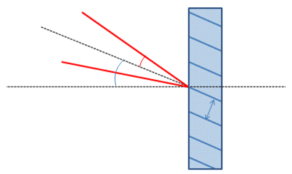

Slide 6
Geometry
Pattern parameters
A
Ref. beam
A
10cm
1mm
B
20cm
B
Object beam

Slide 7
New ref. beam
(slightly divergent!)
A
9.5694cm
1mm
B
16.7679cm
New object beam

