Slide 1
What Atomic Physics has to offer for Quantum Computing
Tony Hyun Kim
6.UAT Proposal Talk
Spring 2008

Slide 2
Quantum Computing: (Brief) Inspiration
Modern computing devices are based on classical mechanics (CM).
But CM is a special limit of quantum mechanics.
  Conclusion: Quantum devices can only have greater computational power than classical ones.

Slide 3
Quantum Computing: (Brief) Inspiration
By a standard “complexity measure”…
Task | Quantum computational gains
Functional Iteration f(f(…f(x)…))) | Not sped up at all!
Locating an entry in a database of N entries | O(N) → O(N^{0.5})
Prime factorization | Apparently, sped up exponentially!

Slide 4
Outline
Requirements for a quantum computer
Why atomic physics?
      Dilute gases in optical lattices
      Atom cooling
The next challenge.
Plan of action for our group.

Slide 5
Basic Requirements for a Quantum Computer
Scalable physical system with well-characterized qubits
The ability to initialize the state of the qubits
Long decoherence times
Universal set of quantum gates
A qubit-specific measurement capacity
Ability to transport qubits
Source: DiVincenzo, David P. “The Physical Implementation of Quantum Computation.” Fortschritte der Physik.

Slide 6
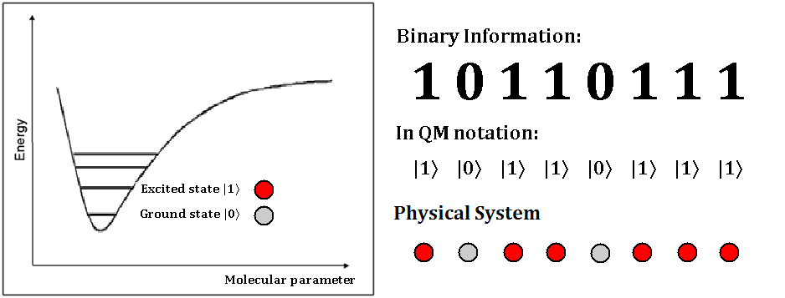
1) “Scalable physical system with well-characterized qubits”
Qubit: A two-level physical system.
  e.g. ground and excited states of an atom.
Use two-level system to encode binary information.

Slide 7
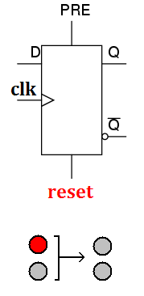
2) “Ability to initialize the state of the qubits”
Clearly necessary for information processing.
For example, suppose we want to reset all qubits.
  Physically, we need a way to manipulate many qubits en masse.

Slide 8
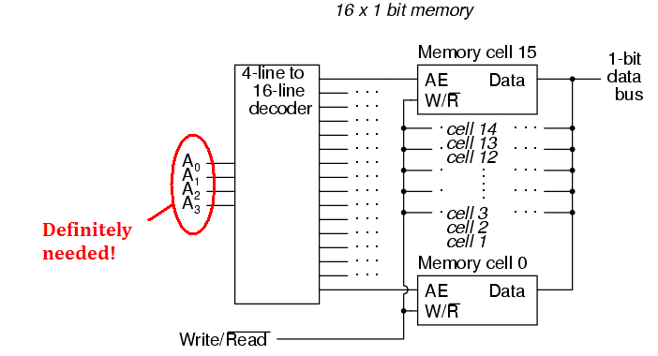

3) “A qubit-specific measurement capacity”
Need a reliable way to access information.
Must allow for specific addressing of the physical element.
“Address”

Slide 9
Summary of the Problem
Quantum computing demands:
  A scalable physical system with two states
  Ability to initialize the macroscopic system
  Qubit-specific measurement capacity
Proposal:
  Dilute gases found in atomic physics labs are an ideal system meeting the above requirements.

Slide 10
Outline
Requirements for a quantum computer
Why atomic physics?
      Dilute gases in optical lattices
      Atom cooling
The next challenge.
Plan of action for our group.

Slide 11
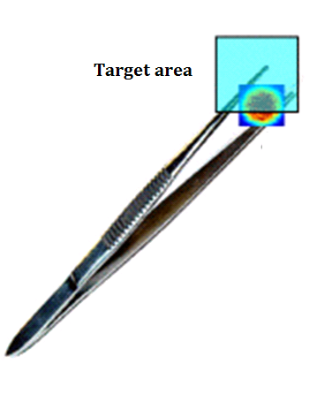
Why atomic physics?
Precision.
An optical “tweezer”

Slide 12
Atomic physics: an illustrious recent history
Development of precise, atomic physics techniques have led to several recent Nobel prizes.
  1997 – Chu, Cohen-Tannoudji, Phillips: “For development of methods to cool and trap atoms with laser light.”
  2001 – Cornell, Ketterle, Wieman: “For the achievement of Bose-Einstein condensation in dilute gases of alkali atoms…”
  2005 – Hall, Haensch: “For their contributions to the development of laser-based precision spectroscopy, including the optical frequency comb technique.”

Slide 13
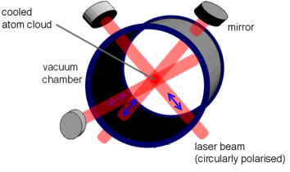
Dilute gases in an optical lattice
Chu, C-T, Phillips (1997)
  Begin by setting up a standing wave

Slide 14
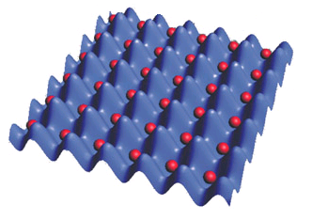
Dilute gases in an optical lattice
Neutral atoms are attracted to regions of high oscillating electric field (“ac Stark effect”).

Slide 15
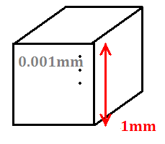
Dilute gases in an optical lattice: Typical numbers
We routinely produce: ~1 million atoms per run.
Our optical lattice is based on infrared laser: λ = 1000 nm
The overlap volume of the lattice beams is: ~(1mm)³
So, one atom per site is a realistic scenario!
Number of sites:
N = 1,000,000
Approximately one atom per site!

Slide 16
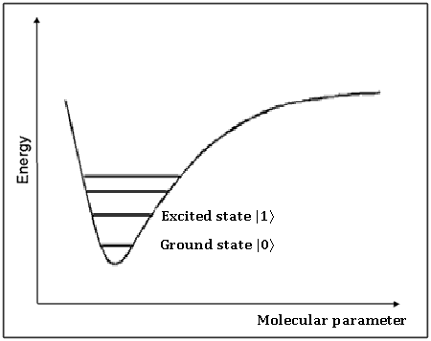
A Scalable QM System
Atomic physics quantum computer:
  Excited atomic/molecular states in optical lattice
  As of now, we can create such experimental setups routinely.
    We possess dual-species oven: sodium and lithium

Slide 17
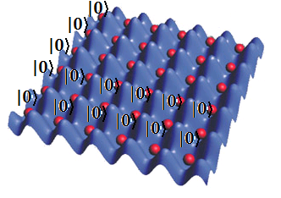
Resetting all qubits: atom cooling
Decades of experience in cooling atoms
  Remove thermal energy → Favor the ground state.

Slide 18
Summary of Previous Work
The current state of atomic physics gives:
  A readily scalable platform for qubits. (Requirement 1)
  Easy to initialize to the “reset state.” (Requirement 2)

Slide 19
Outline
Requirements for a quantum computer
Why atomic physics?
      Dilute gases in optical lattices
      Atom cooling
The next challenge.
Plan of action for our group.

Slide 20
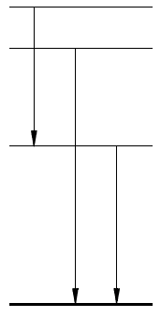
A qubit-specific measurement capacity
We now have qubits in a known geometry.
How to manipulate individual qubits?
Proposal:
  Use light-induced transitions.

Slide 21


Light induced transitions in an optical lattice
Consider the 1D array of qubits:
  With a fixed wavelength laser source, tuned to atomic transition
Fixed frequency laser source

Slide 22
Light induced transitions in an optical lattice
Laser frequency is fixed.
  Instead, tune the atoms → Modify the atomic energy spacing.
Fixed frequency laser source
Capacitor with
controlled voltage

Slide 23
What needs to be done
E-Field modification of energy levels depends on electric dipole of the qubit.
Our task:
  Produce a molecule with a permanent dipole moment.
  For our group, that means:
  Production of sodium-lithium molecule.

Slide 24
Outline
Requirements for a quantum computer
Why atomic physics?
      Dilute gases in optical lattices
      Atom cooling
The next challenge.
Plan of action for our group.

Slide 25
Calendar
Early summer 2008:
  Installation of the optical lattice chamber.
Summer 2008:
  Settle the lab’s temperature problem.
  Reinstallation of the optics/electronic equipment.

Slide 26
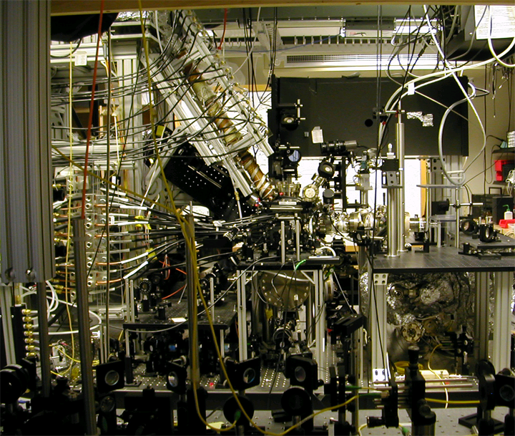

Slide 27
Calendar (continued)
Fall 2008:
  Association of lithium and sodium atoms.
Sometime further on:
  Attain deeply bound lithium and sodium atoms.

