Slide 1
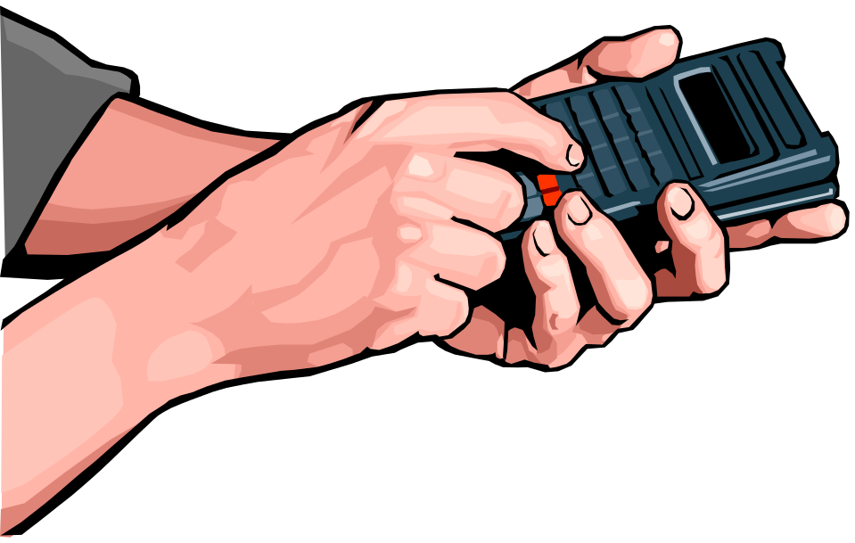
Wireless control:
Sending and receiving electromagnetic waves
Tony Hyun Kim
Spring 2008, 6.UAT

Slide 2
Objectives
Explain the basic physics of wireless control.
  Focus on ELECTROMAGNETIC WAVES
Demonstrate the physics with early 20th century technology.

Slide 3
Objectives
Explain the basic physics of wireless control.
  Focus on ELECTROMAGNETIC WAVES
Demonstrate the physics with early 20th century technology.
Basic principle:
Sudden charge motion emits EM waves

Slide 4
The Basics:
Electric field of a stationary charge
+q

Slide 5

The Basics:
Electric field of a stationary charge
+q

Slide 6
The Basics:
Electric field of a stationary charge
+q
Boring: The field is static, and radial

Slide 7
The Basics:
Electric field of a stationary charge
+q
Question:
How does this picture change, when we move the charge?

Slide 8
Two basic physical facts
“Information transfer” is NOT instantaneous.
  For electric phenomena, the “transfer rate” is c = 300,000,000 m/s = 3 x 10⁸ m/s
In “free space,” field lines don’t disappear.
Notes:
Field lines don’t cross

Slide 9
E-Field of an ACCELERATED charge
Y
X
t = 0 second

Slide 10

E-Field of an ACCELERATED charge
Y
t = 1 second
1 cm
X

Slide 11
E-Field of an ACCELERATED charge
Y
X
t = 0 second

Slide 12
E-Field of an ACCELERATED charge
Y
X
t = 0 second

Slide 13
E-Field of an ACCELERATED charge
Y
?
X
t = 1 second

Slide 14
E-Field of an ACCELERATED charge
Y
Radius = c * (1 sec) = 3 x 10⁸ m
X
t = 1 second

Slide 15
E-Field of an ACCELERATED charge
Y
Radius = c * (1 sec) = 3 x 10⁸ m/s
X
t = 1 second

Slide 16
E-Field of an ACCELERATED charge
Y
X
t = 2 second

Slide 17
E-Field of an ACCELERATED charge
Y
X
?
t = 2 second
Notes:
Red lines

Slide 18
E-Field of an ACCELERATED charge
Y
X
t = 2 second

Slide 19
E-Field of an ACCELERATED charge
Y
X
t = 2 second

Slide 20
E-Field of an ACCELERATED charge
Y
X
t > 2 second

Slide 21
Let’s see that again

Slide 22
E-Field of an ACCELERATED charge
Y
“Transverse”
Electric field!
X
t = 2 second

Slide 23
E-Field of an ACCELERATED charge
Y
And it moves out!
X
t > 2 second

Slide 24
That’s how electric fields are radiated!

Slide 25
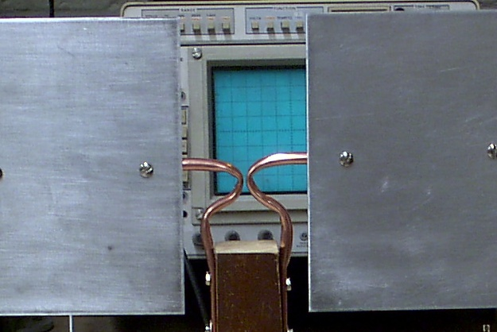
Can we arrange for sudden charge motion?
Use a relic from the previous century:
  A “spark gap transmitter”
Basic Idea:
  High voltage
  Build-up of charge
  Breakdown: Sudden discharge across junction
Focus here!

Slide 26
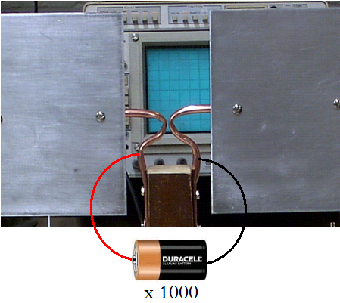
Spark gap transmitter: 1. High voltage

Slide 27
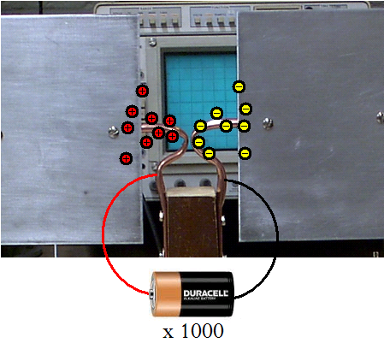
Spark gap transmitter: 2. Charge buildup

Slide 28
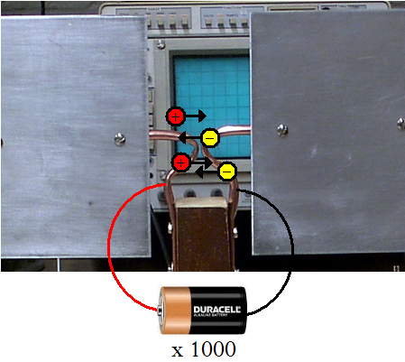
Spark gap transmitter: 3. Breakdown

Slide 29

Spark gap transmitter
Y
The apparatus is a realization of the sudden charge motion we described earlier.
t > 0 second
Top down view of the transmitter
X

Slide 30
Wireless control of LEDs
Want to take advantage of the basic physics to do something useful.
Use a device that responds to electric fields:
  A “coherer”: a circuit with an antenna

Slide 31
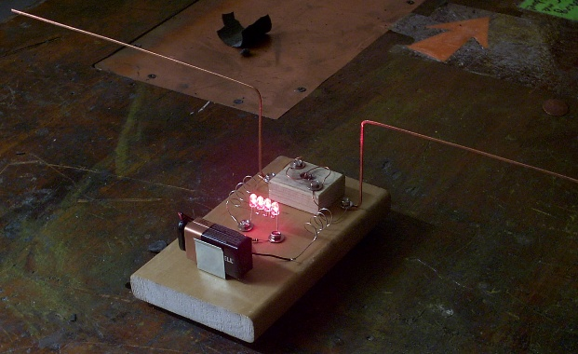
Coherer

Slide 32
Conclusion
Accelerated charges radiate electromagnetic waves.
Described and demonstrated a simple experimental setup to accelerate charges.
Used this physics to control LEDs wirelessly.
Acknowledgements: Robert Moffatt (Physics ’09)

