Slide 1
Compton Scattering:
Observation of the Compton wavelength shift
Tony Hyun Kim
(Partner: Connor McEntee)
12/1/2008
8.13 MW2-5 Prof. Roland

Slide 2
Topics to be discussed
Introduction
  Classical EM vs. Compton scattering
  Compton wavelength shift
  Compton scattering (Klein-Nishina) cross-section
Experimental setup
  Compton A vs. Compton B
Analysis and Results
  Fitting the lineshape
  Measured Compton shifts
Conclusions
  Observation of wavelength shift in light scattering

Slide 3
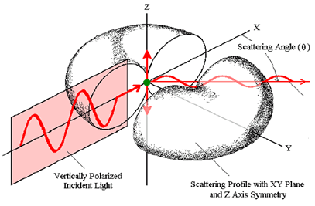
Classical (Rayleigh) scattering
Scattering is dipole radiation from a driven dipole oscillator.
Governed by Maxwell’s equations.
Linear physics: frequency and wavelength are invariant.

Slide 4
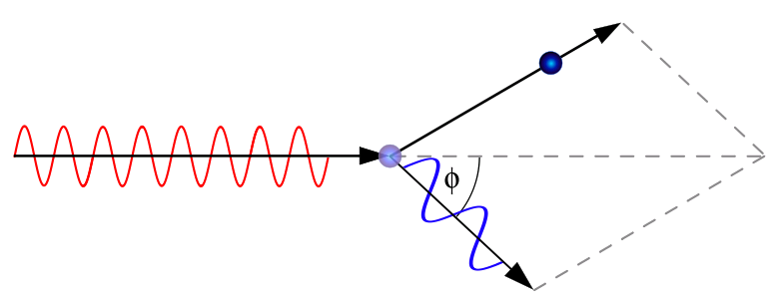
Compton scattering
Modern picture of light: photons
Basic results of QM and relativity: E = hc/ λ ; p = h/λ
Usual conservation laws yield:

Slide 5
Compton scattering
Modern picture of light: photons
Basic results of QM and relativity: E = hc/ λ ; p = h/λ
Usual conservation laws yield:

Slide 6
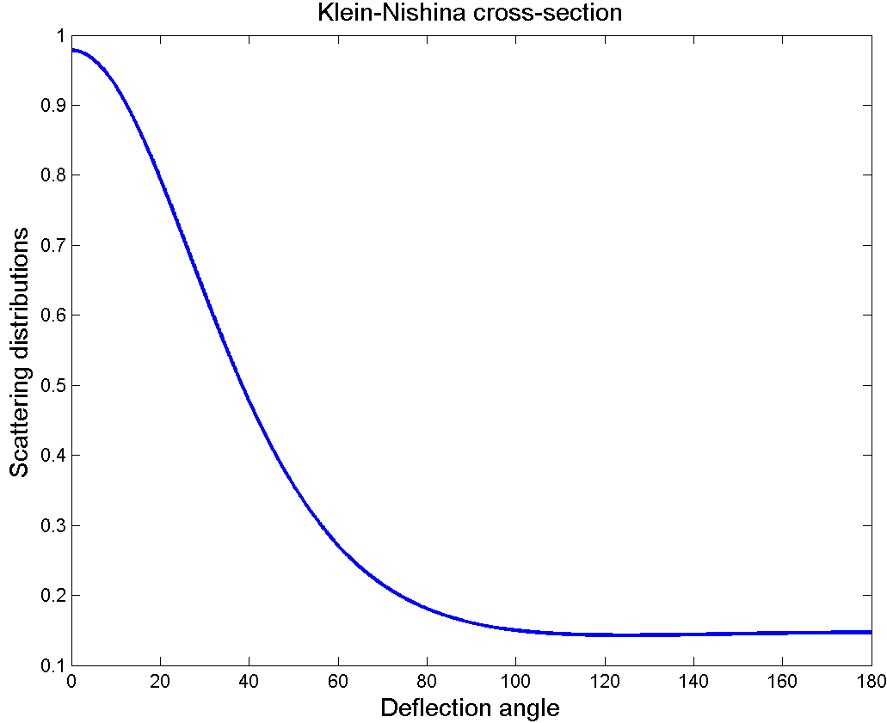
Compton scattering cross-section

Slide 7
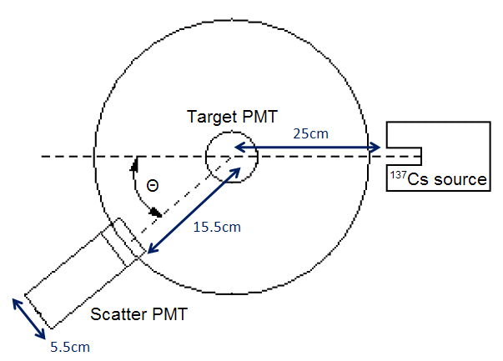

Experimental setup (Compton A)

Slide 8
Complications: Geometry
Angular spread (FWHM) of the beam ~12°

Slide 9
Complications: Electronic
Arbitrary discriminator level w.r.t. Target PMT

Slide 10
Comparisons between Compton A, B
Due to these complications, high-angle measurements are preferred.
Source in Compton B is 2.4 times more intense than Compton A.
  Fatal flaw: Compton A does not yield signal beyond ~70°
Longer lever arm in Compton B: better angular specificity. (Approx. 12.5° vs. 20.8°)

Slide 11
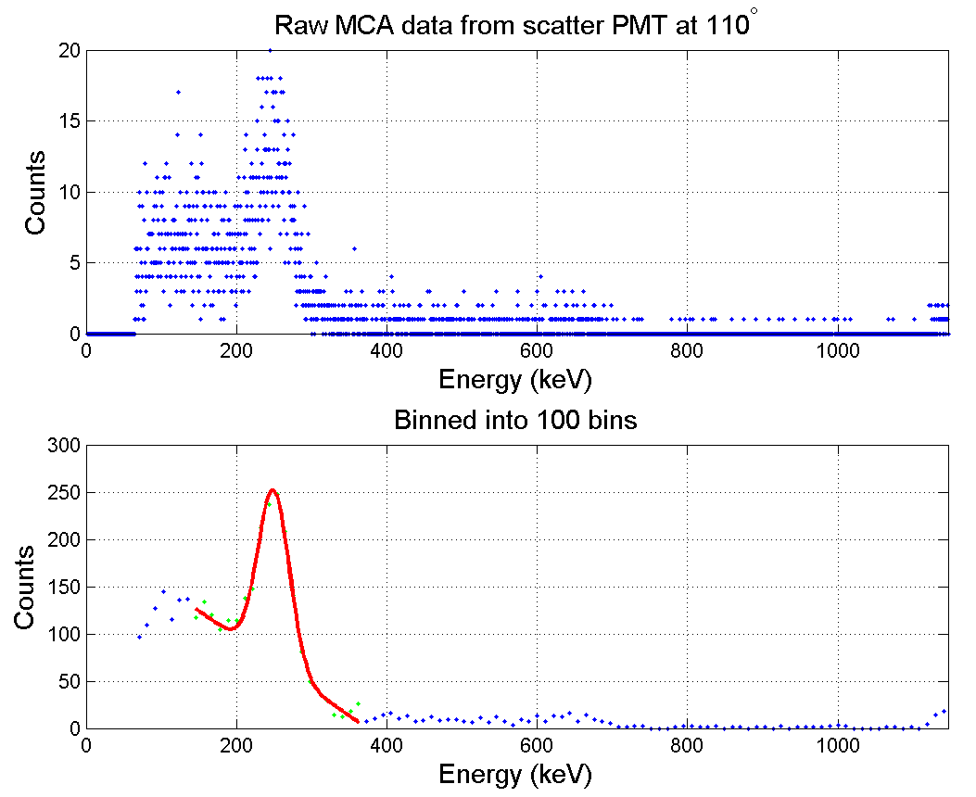
Typical MCA data (Scatter PMT 110°)

Slide 12
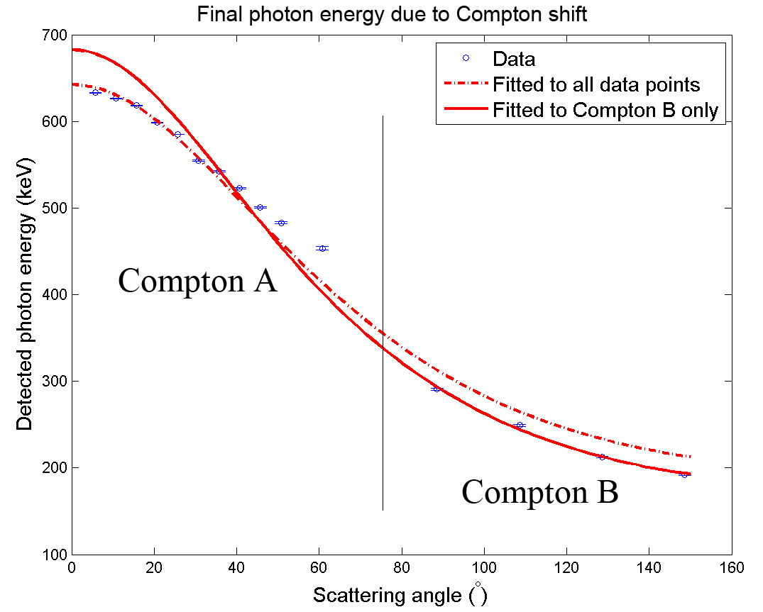

Slide 13
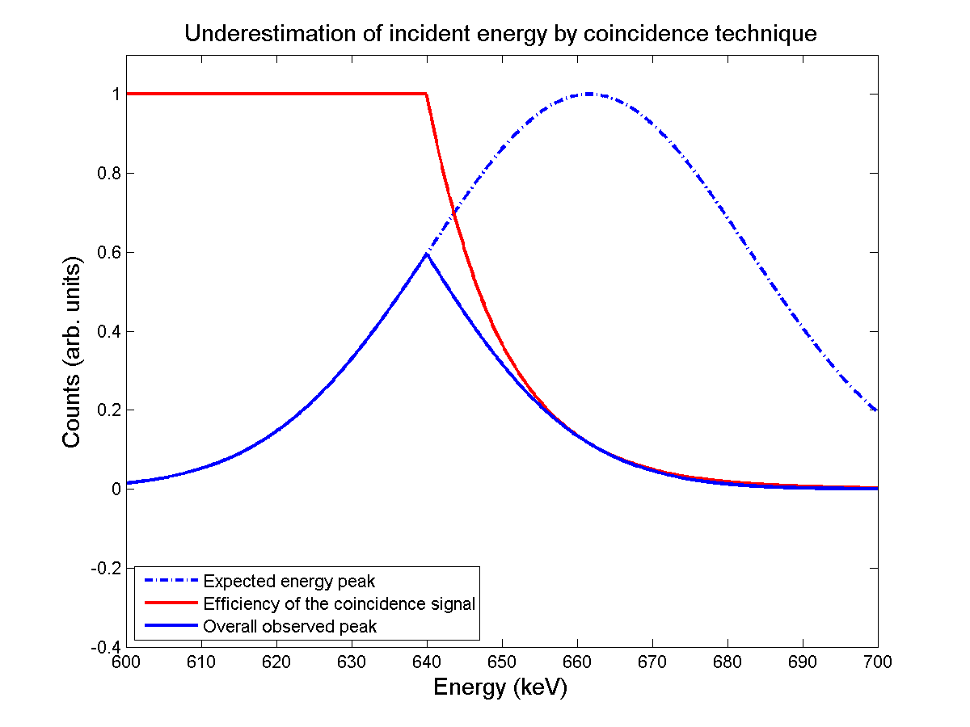
Compton shift results
Low angle measurements underestimate the Compton shift, as predicted by geometry.
Compton A underestimates incident energy at E = 635keV. Possibly caused by the set-point complication.

Slide 14
Compton shift results (cont.)
Wavelength variation observed → Rayleigh picture is inadequate.
Fit to Compton B yields:
  Incident energy:
  Electron rest mass:
  Goodness of fit:

Slide 15
Conclusions
Observed the wavelength shift in light scattering. Unexplained by classical scattering.
Obtained 4 large-angle data points on Compton B, showing good agreement to Compton shift formula. Fit yields:
  Incident energy:
  Electron rest mass:

