Slide 1
Pulsed NMR:
Relaxation times vs. viscosity and impurities
Tony Hyun Kim
(Partner: Connor McEntee)
11/17/2008
8.13 MW2-5 Prof. Roland

Slide 2
Topics to be discussed
Introduction
  Relaxation times (T₁, T₂)
  Theory of NMR
  Carr-Purcell sequence for T₂ measurement
Experimental setup
Analysis and results
  Processing of Carr-Purcell data
  Relaxation times as function of viscosity
  Relaxation times as function of impurities
Sources of error; possible improvements
Conclusions
  More microscopic interaction → faster relaxation
  Verify Bloembergen’s inverse-law relationship.

Slide 3
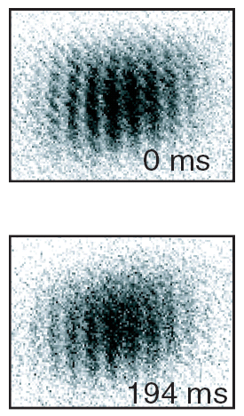
Relaxation times in current research
Modern applications of quantum mechanics (e.g. quantum computing) limited by relaxation times.
Relaxation time is the timescale for which the system remains under coherent control by experimenter.
Investigate dynamics of spin ensemble as prototype of the relaxation phenomenon.

Slide 4
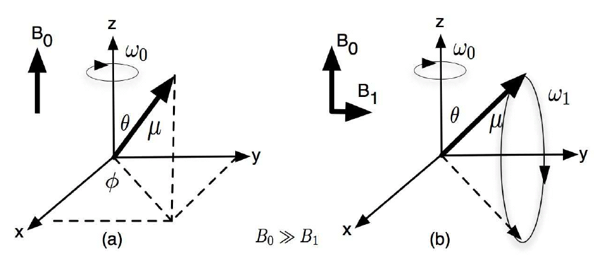
Coherent manipulation of spin ensemble
Standard NMR technique:
  Strong bias field B₀ = 1770 gauss;
  Small, oscillating field B₁ at w = w_{L} (Larmor freq.);
“Macroscopic” Hamiltonian:
  Coherent dynamics in static field: Precession of magnetic moment
  Can manipulate the spin vector via proper “pulsing” of B₁

Slide 5
T₂ measurement: General theory
Reasons for loss of transverse magnetization (without collapse to axis):
  Spin-spin interactions,
  Bias field inhomogeneity;
  Diffusion of spins through volume;
  …

Slide 6
T₂ measurement: General theory
Reasons for loss of transverse magnetization (without collapse to axis):
  Spin-spin interactions,
  Bias field inhomogeneity;
  Diffusion of spins through volume;
  …
Intuition:
  More microscopic interactions (viscous, impurities) should lead to faster relaxation.

Slide 7
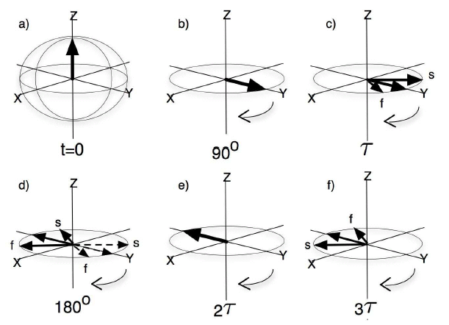
T₂ measurement: Spin echo technique
Eliminate field inhomogeneity effect;
Choose small τ → Overcome diffusion effects;

Slide 8
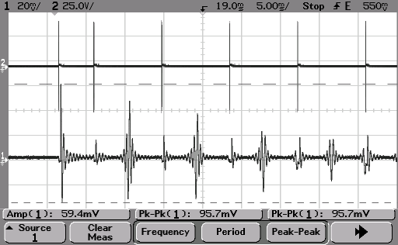
T₂ measurement: Carr-Purcell sequence
180°
180°
180°
…
90°
Applied RF →
Spin response →
Initial 90°: Initiate precession
Repeated 180°: Produce spin echoes

Slide 9
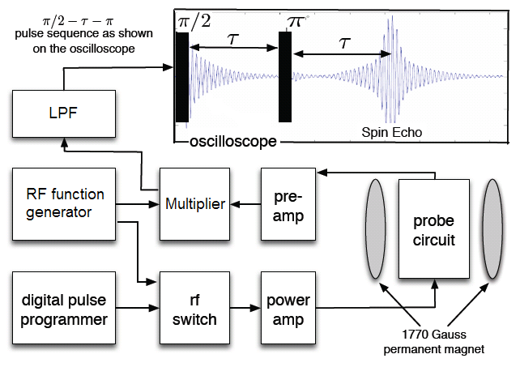

Experimental setup

Slide 10
Experimental setup: Drawbacks
(1) Provides timing resolution of 1 microsecond. Insufficient to provide ideal 180° pulses.

Slide 11
Experimental setup: Drawbacks
(2) Forces us to run the system off resonance (~kHz).

Slide 12
Experimental setup: Drawbacks
(3) Sampling errors in the acquisition (aliasing). Quantization errors in A-D conversion.

Slide 13
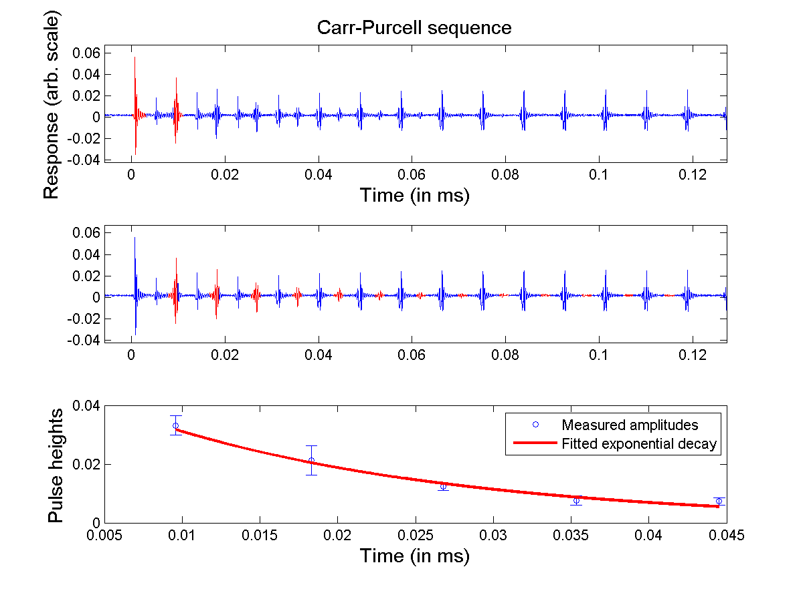
Typical Carr-Purcell data (98% glycerine)

Slide 14
Typical Carr-Purcell data (98% glycerine)
Error bars computed by taking the std of N neighboring points about maximum. (Will discuss later)

Slide 15
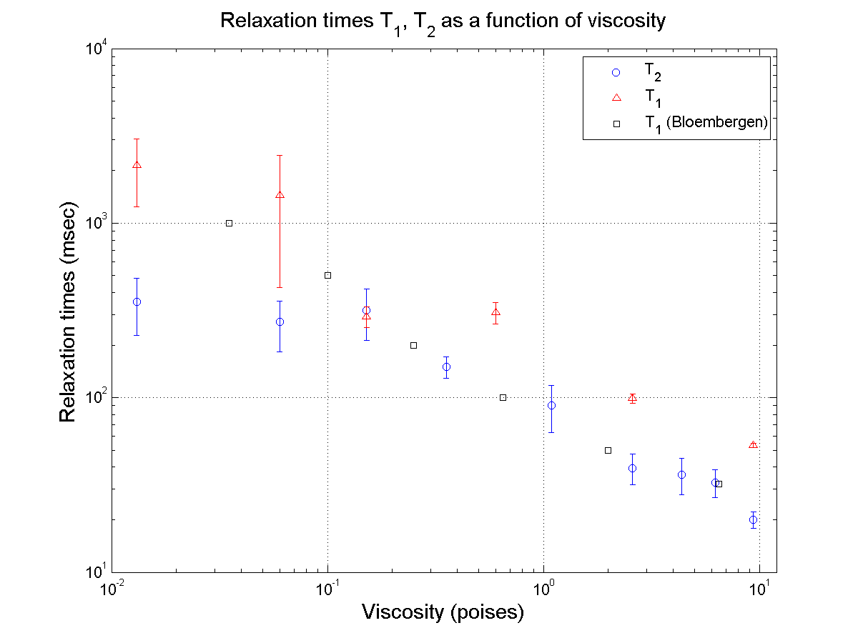
Relaxation times as function of viscosity

Slide 16
Relaxation times as function of impurities

Slide 17
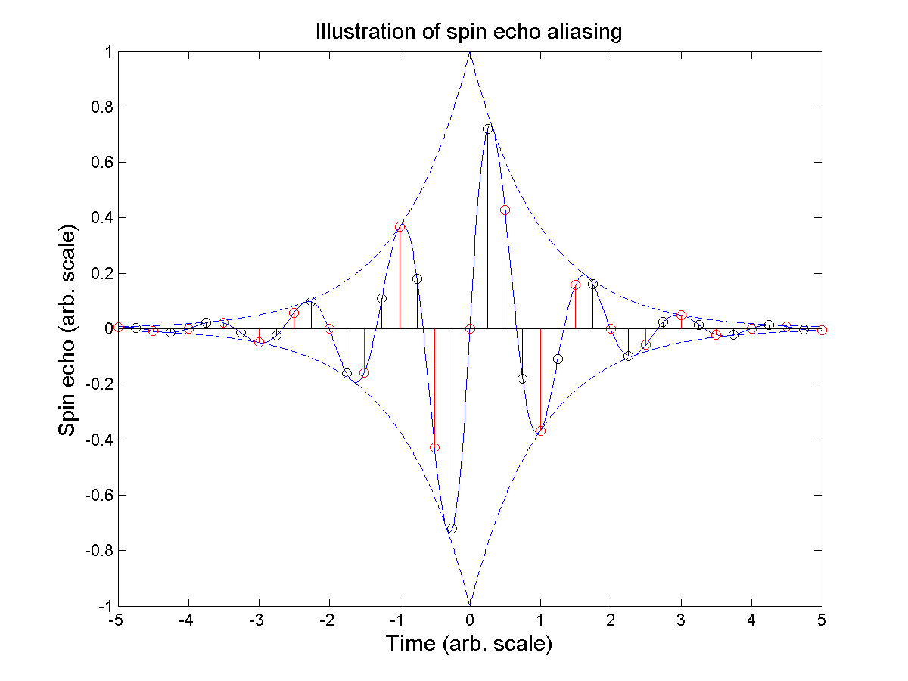
Sources of error; possible improvements
Several instrumental drawbacks already discussed.
T₂ echo height estimation is susceptible to aliasing.
  T₁ analysis technique is sensitive to phase;
  Two methods have shown up to ~100ms discrepancy.
Accommodated the aliasing error by using neighborhood of the point for error estimation.
Such errors ~ 0.005; c.f. quantization error = 0.0006;

Slide 18
Conclusions
Investigated relaxation times as a function of:
  Sample viscosity:
    Verified the inverse-law relationship observed by Bloembergen.
  Paramagnetic ion concentration:
    Unclear results; need more samples in the range 10¹⁷-10²¹ ions/cc.
    Possible threshold effect ~ 10¹⁷.
In general: More interactions → Increased relaxation rates.

