Slide 1
Optical Spectroscopy of Hydrogenic Atoms:
Rydberg fits of ¹H and ²H, and Determination of the mass ratio
Tony Hyun Kim
(Partner: Connor McEntee)
10/31/2008
8.13 MW2-5 Prof. Roland

Slide 2
Topics to be discussed
Introduction
  Historical context
  Quantum mechanics of atomic emission
Experimental setup
Analysis and Results
  Fitting the lineshape
  Mercury calibration
  Hydrogen and deuterium fits
Sources of Error; Possible improvements
Conclusions
  Verification of the hydrogen Rydberg
  Estimate of the hydrogen-deuterium mass ratio

Slide 3


Atomic spectra: a historical context
By 19th century, tremendous amounts of atomic spectral data collected.
What are the underlying mathematical patterns and the physical explanations?

Slide 4
Atomic spectra: a historical context
By 19th century, tremendous amounts of atomic spectral data collected.
What are the underlying mathematical patterns and the physical explanations?

Slide 5
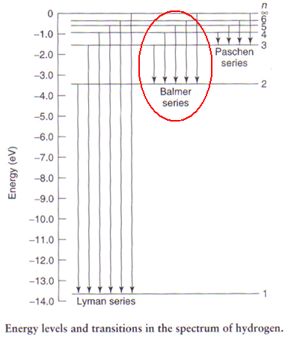
QM of the optical electron
Reduced, one-body SE yields eigenenergies:
Light emitted when electron undergoes transition: n_{i} → n_{f}

Slide 6
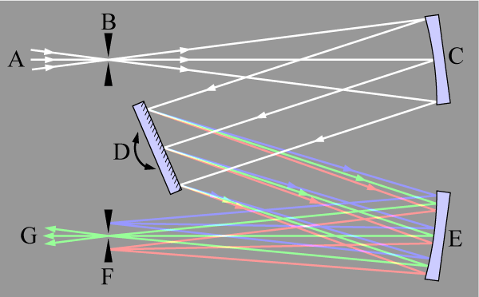
Experimental setup: Basic principles
Used JY1250M monochromator (R ~ 10⁴ → 0.03 A step size!)
Counter indicates the orientation of grating

Slide 7
Experimental setup parameters
Slit sizes: quality of lineshape vs. signal size
Integration time: -error vs. patience

Slide 8
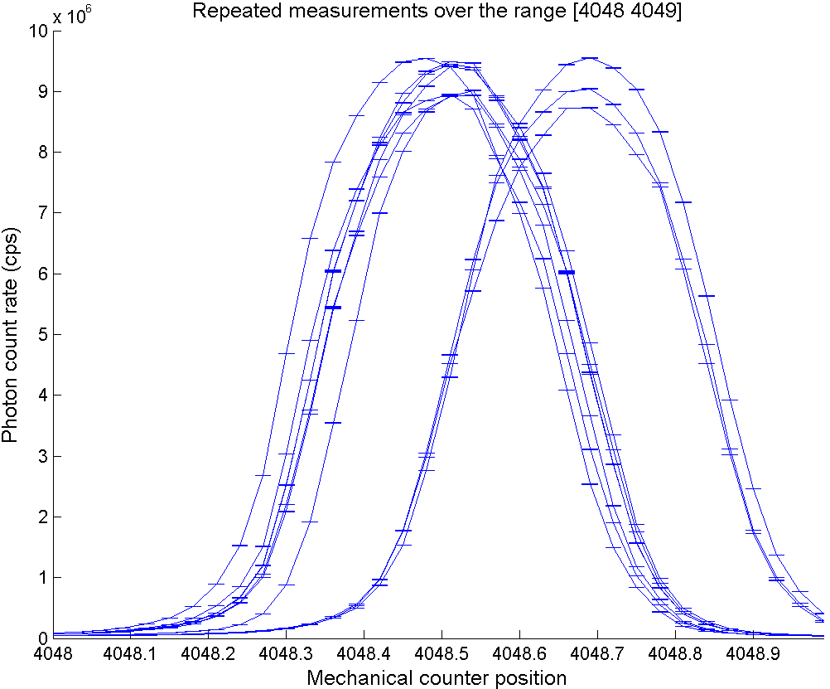
Experimental setup parameters
Slit sizes: quality of lineshape vs. signal size
Integration time: -error vs. patience
Most important:
Shot-to-shot repeatability!
0.17 A

Slide 9
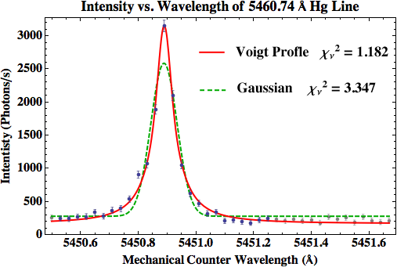
Typical monochromator data
Voigt gives better fit than Gaussian, but the means agree!
Typical errors in fitted mean: ~0.001 A

Slide 10
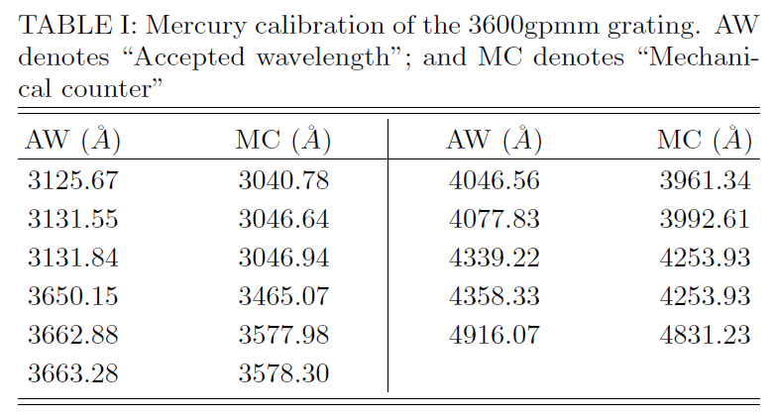
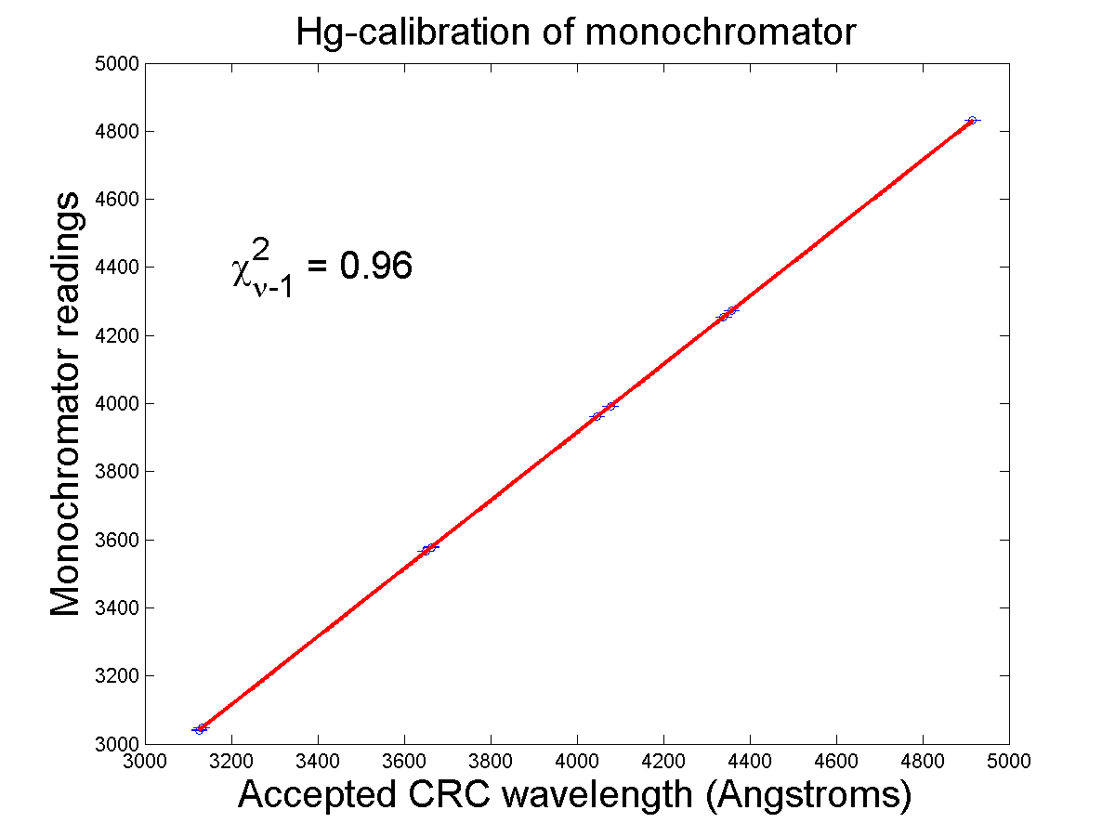
Mercury calibration
Monochromator’s counter is not physically accurate
Produced quadratic conversion function:

Slide 11
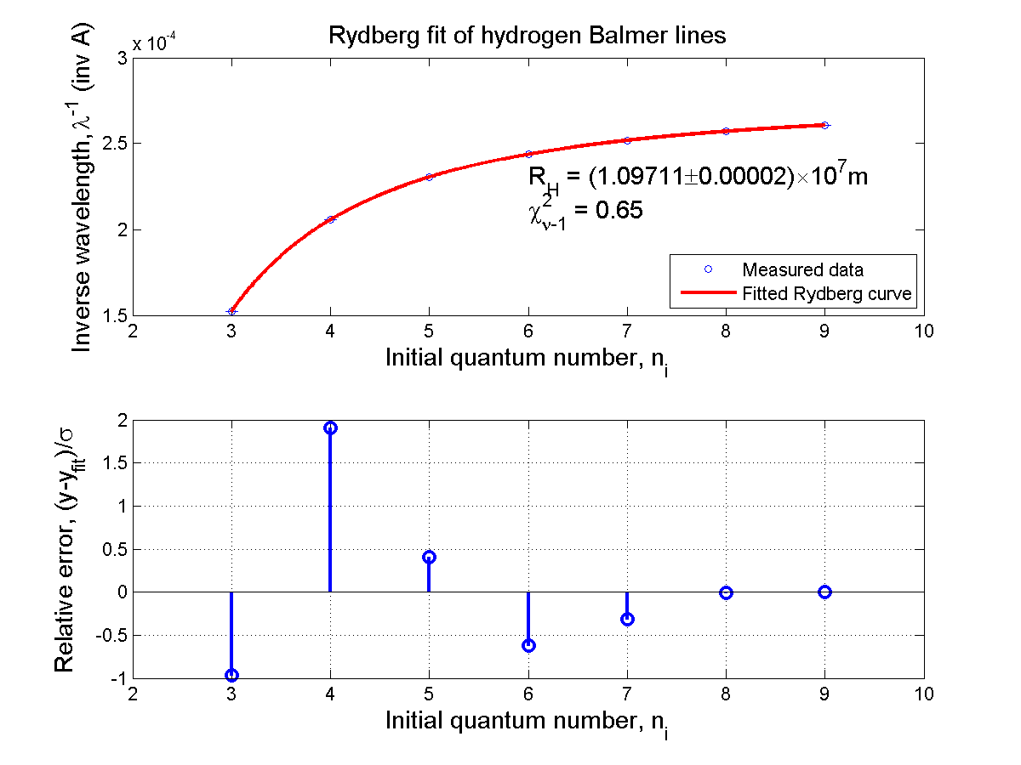

Slide 12
Results: Hydrogen Rydberg
Published value of Rydberg constant:
Our measured value:
Correct for index of refraction of air (n = 1.0003)

Slide 13
Results: ¹H/²H mass ratio
From …
  Compute m_{D} using known values of m_{e}, m_{p} (NIST)
  Published value:

Slide 14
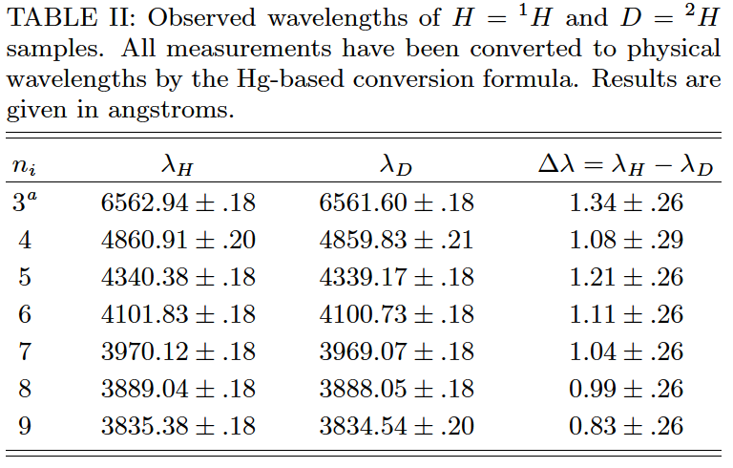
An improved optical setup
Since we regard the Hg-lines as “ruler”…
Scheme for circumventing the 0.17A mechanical error:
Especially useful for isotope shift measurement
Superimpose sources
Monochromator
Input

Slide 15
Conclusions
Performed spectroscopy of ¹H/²H
The Rydberg formula for hydrogen was confirmed. Remarkable agreement with published values:
Ratio of Rydberg constants was used to deduce mass ratio:

