Slide 1
Rutherford scattering:
Angular dependence of the scattering rate
Tony Hyun Kim
(Partner: Connor McEntee)
10/17/2008
8.13 MW2-5 Prof. Roland

Slide 2
Topics to be discussed
Introduction
  Historical context
  Atomic structure and differential cross-section
Experimental setup
Analysis and results
  Interpretation of MCA histogram
  Angular spread of the α-particle beam
  Rutherford vs. Thomson model
Sources of error
Conclusion
  Verification of the Rutherford hypothesis

Slide 3
Context of our experiment in 1909
Discovery of the electron. Properties:
  Negatively charged
  Subatomic mass
Question: What is the structure of the compensating positive charge?
Prominent diffuse-charge model by Thomson
Idea: Use scattering experiments to probe the atomic structure.

Slide 4
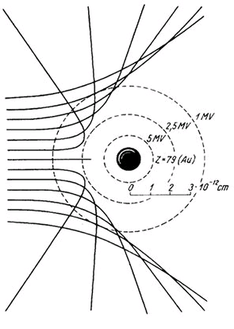
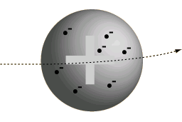
What is the relationship between scattering and atomic structure?
Thomson scattering
Rutherford scattering

Slide 5

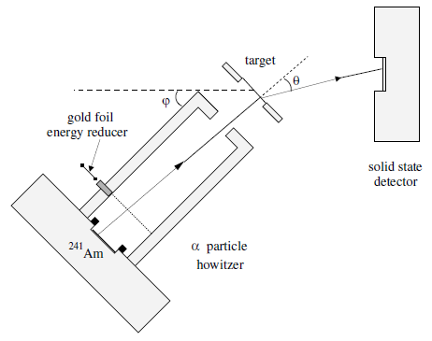
Experimental setup
MCA provides
counts over energy
Vacuum (< 80 microns)

Slide 6
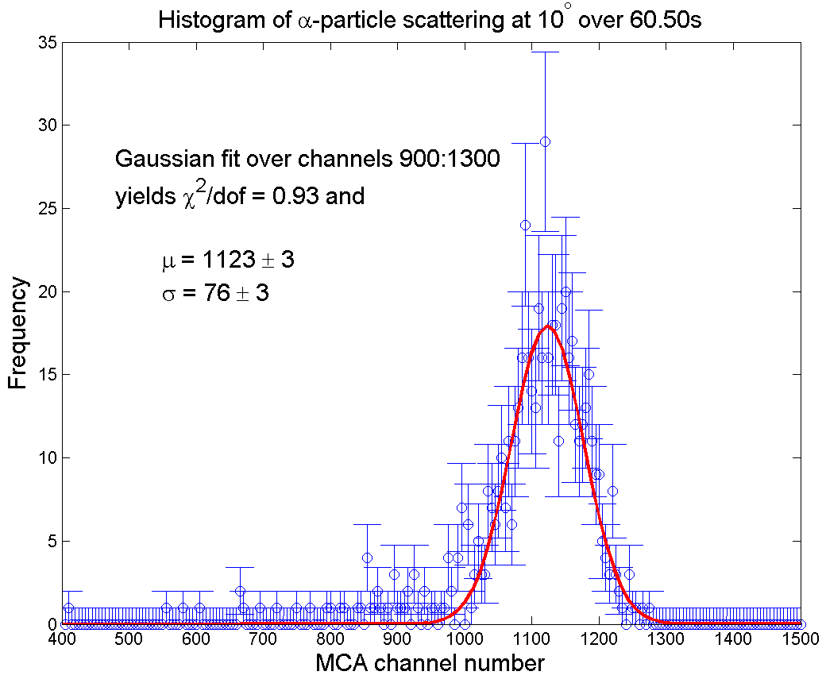
Typical data obtained from MCA

Slide 7
Typical data obtained from MCA
A range of “valid-channels” constructed by looking at two std. deviations from the mean.

Slide 8
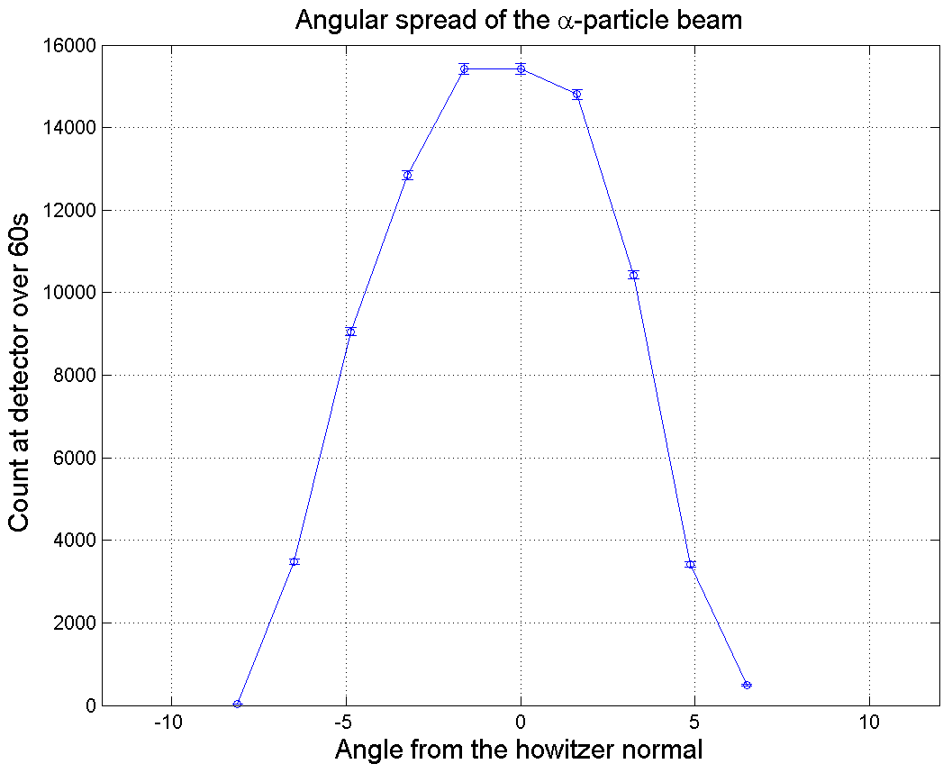
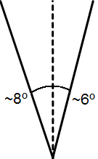
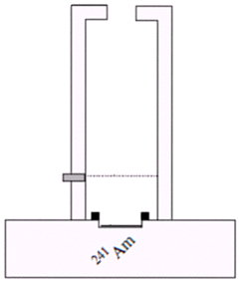
Apparatus has poor angular resolution

Slide 9
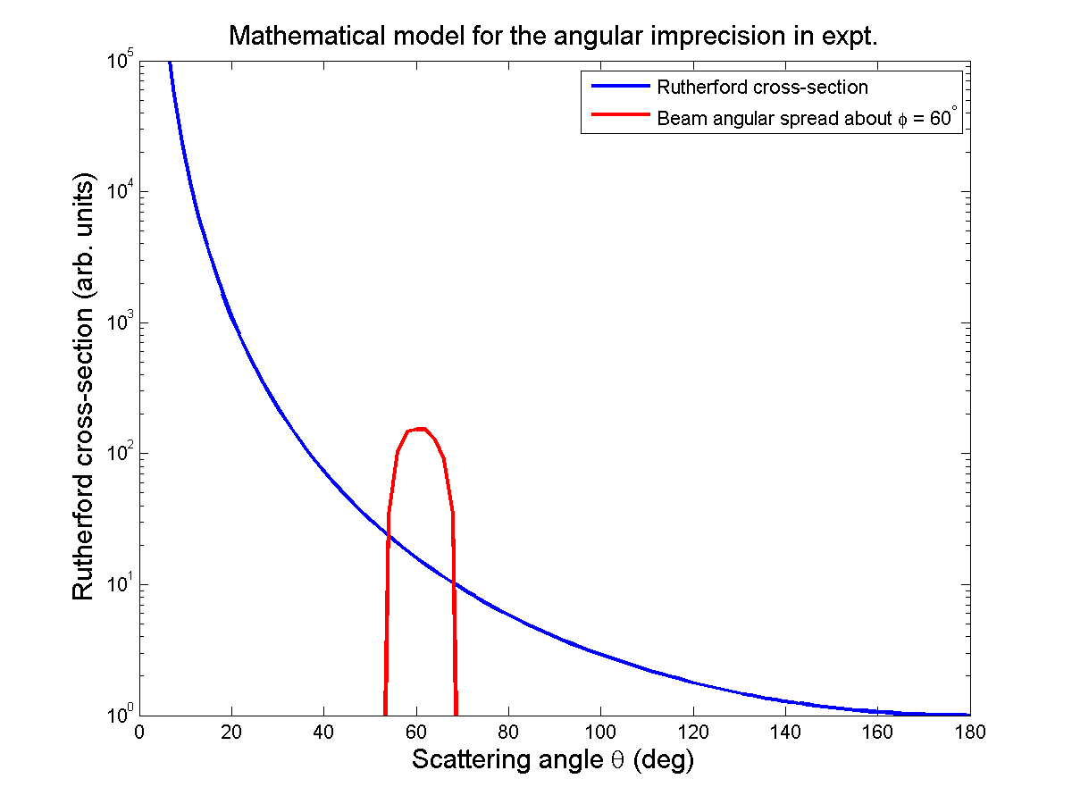
Need to “smear” the cross-section
At any howitzer angle, range of scattering angles possible.

Slide 10
Need to “smear” the cross-section
At any howitzer angle, range of scattering angles possible.
Model for angular imprecision:

Slide 11
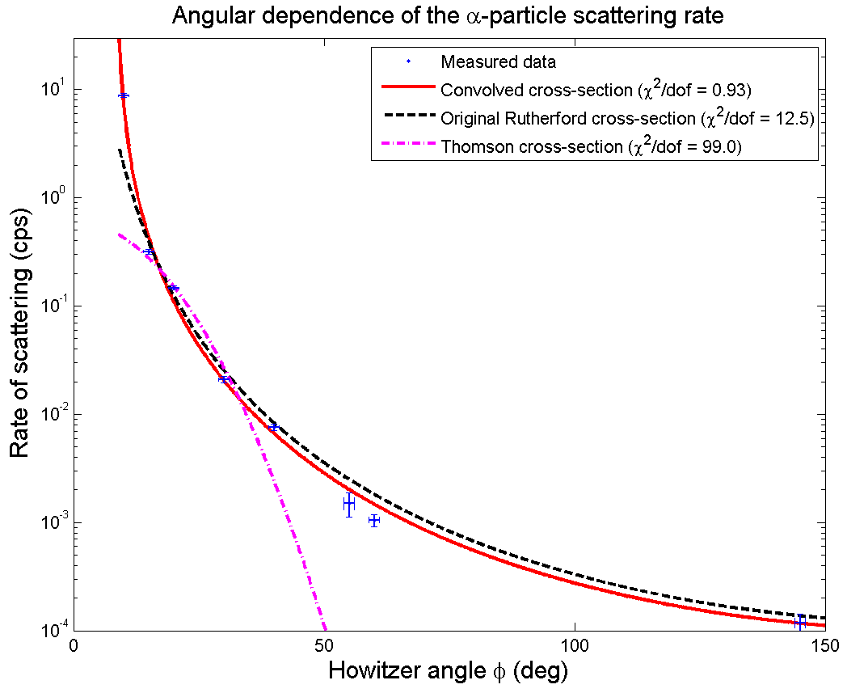

Slide 12
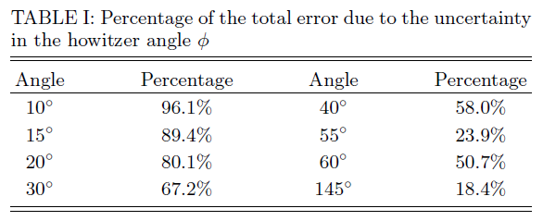
Inaccuracy in howitzer angle
Can dramatically improve expt. by increasing the accuracy of howitzer angle.

Slide 13
Conclusions
Performed α-particle scattering from gold foils.
Excellent agreement to Rutherford cross section.
  Obtained (χ²/dof = 0.95) ➔ χ² prob. = 0.4662
  26 instances of back-scattering at 145 degrees.
Thomson model is completely rejected.
  Obtained (χ²/dof = 99) ➔ χ² prob. = 0!
Verification of the nuclear hypothesis

Slide 14
Sources of various images
Thomson scattering (slide 4): http://hyperphysics.phy-astr.gsu.edu/hbase/Nuclear/rutsca3.html
Rutherford scattering (slide 4): http://www.atomeromu.hu/tortenelem/kepek/rutherford-e.jpg
Apparatus (slide 5): http://web.mit.edu/8.13/www/15.shtml
PC Icon (slide 5): http://grafikdesign.files.wordpress.com/2007/10/desktop-20pc-20icon.jpg

