Slide 1
Poisson statistics:
Measurement of gamma radiation from ¹³⁷Cs source
Tony Hyun Kim
9/26/2008
8.13 MW2-5

Slide 2
Topics to be discussed
Probability theory
    Independent events
    Poisson distribution
Experimental setup
Results
    Comparison to Matlab-generated Poisson data sets
Discussion of errors
Conclusions

Slide 3
Independent events
Occurrence of one event does not affect the likelihood of others.
Radioactive emission of photons by sample of ¹³⁷Cs

Slide 4
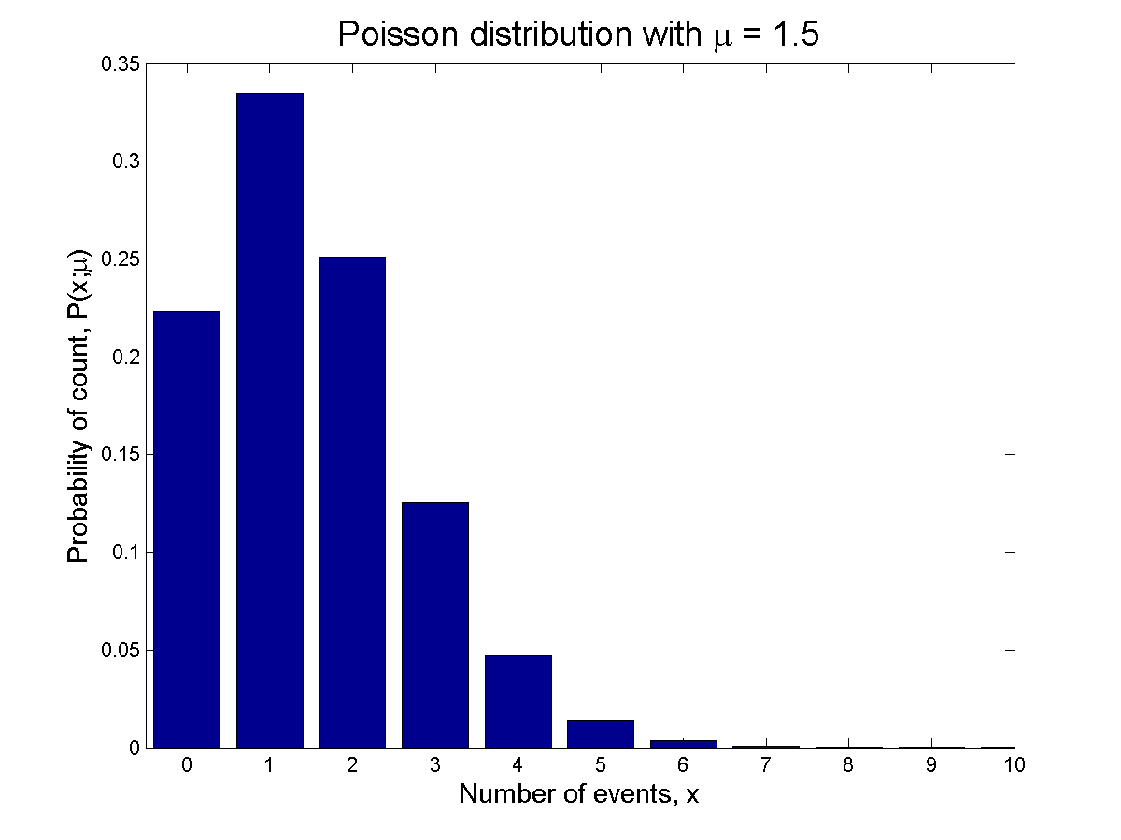
Poisson distribution
A process involving independent events with “mean rate”: λ
Observation period: T
Expected number of events (“on average”): μ = λT

Slide 5
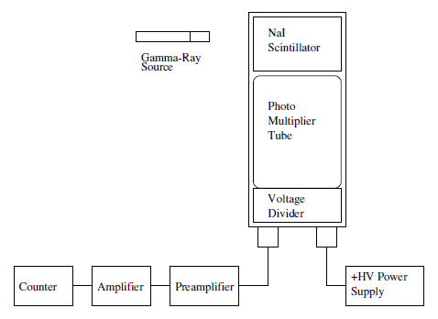
Experimental details
Main “knobs”:
  Source-detector distance
  Amplifier gain
Configured for counting rates of 1, 4, 10, 100 sec⁻¹
Took 100 one-second measurements.

Slide 6
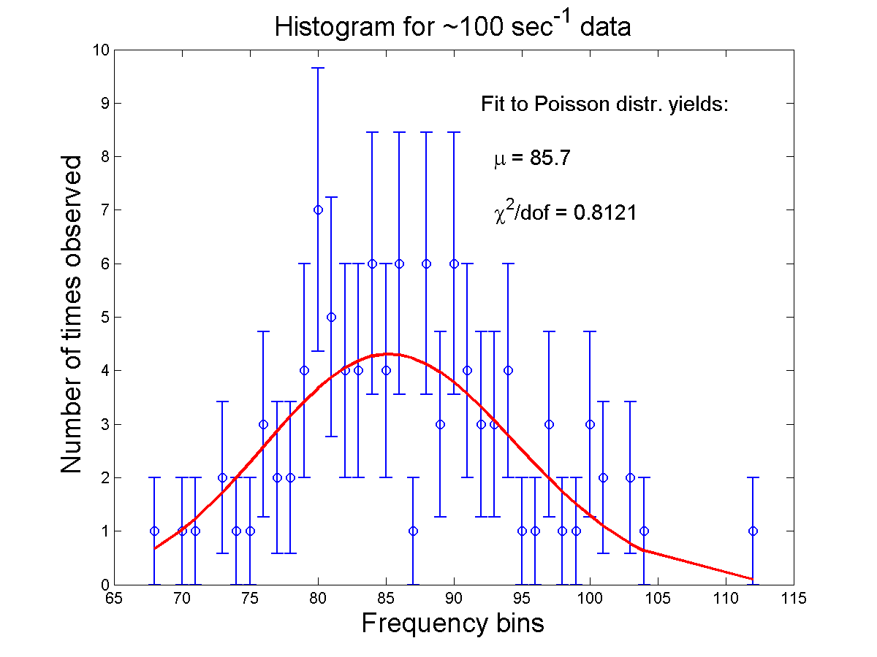

Slide 7
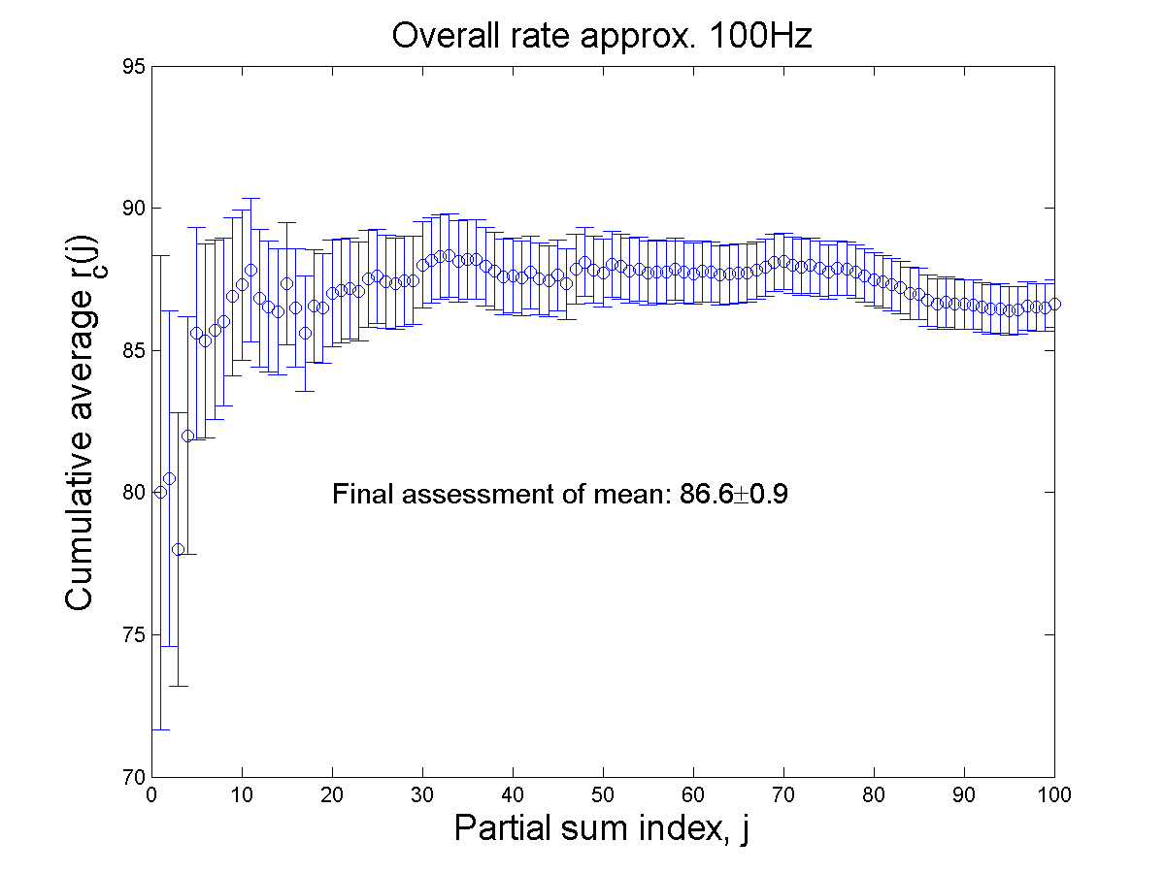
What is the characteristic of the parent distribution?
The long 100-s measurement yields: λ = 87.5 sec⁻¹
Confirmed by cumulative averages of 1-second data
Final assessment of mean:

Slide 8
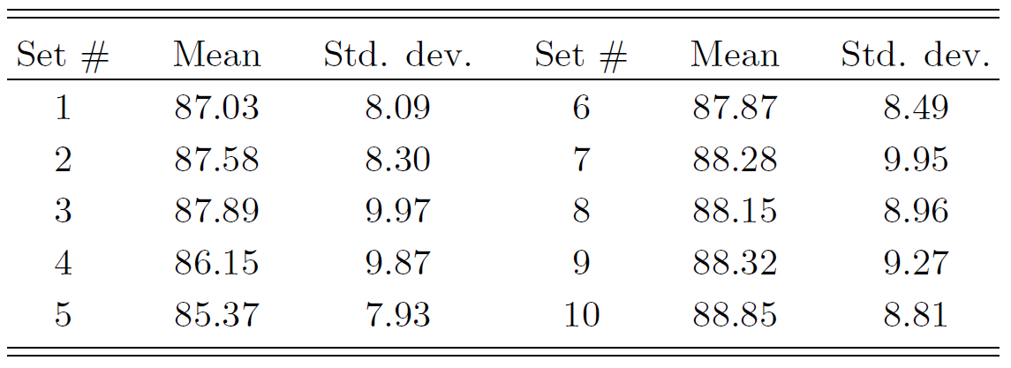
Matlab generated Poisson sets
Measured data set is characterized by:
Reasonable? Given parent Poisson distr:
Generated 100-element Poisson data sets, to find statistical fluctuations on

Slide 9
Does Poisson fit?
Is of the measured set typical?
  Measured set:
  Simulated set:
Does ?
  Measured set:
  Simulated set:

Slide 10
Brief error analysis
Our expt. and analysis are robust against “hidden sources”
Other sources

Slide 11
Conclusions
Counting experiments of emission from Cs.
Direct fit shows that Poisson distr. describes data well.
Comparison with Matlab-generated sets show:
  Data set parameters within statistical fluctuations
  The relation holds for data

