Slide 1
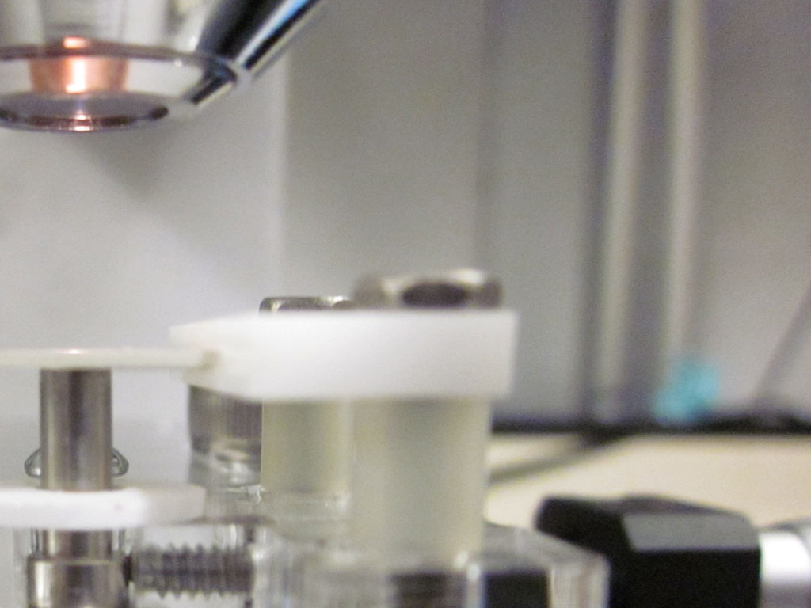
Surface-electrode ion trap with integrated light source
Tony Hyun Kim
Chuang group
2011 April 5

Slide 2
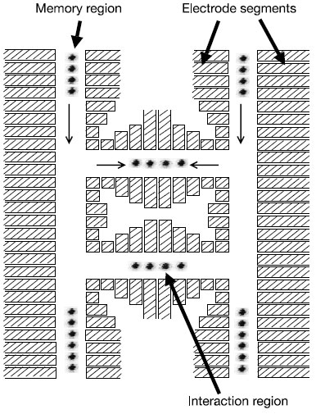
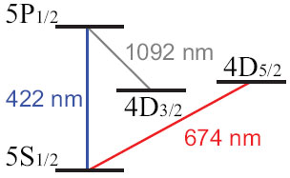
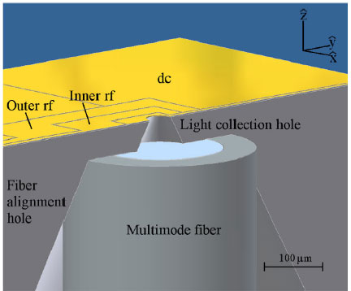
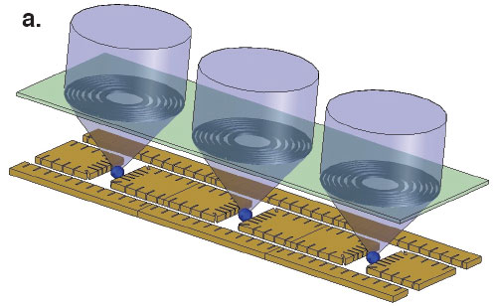
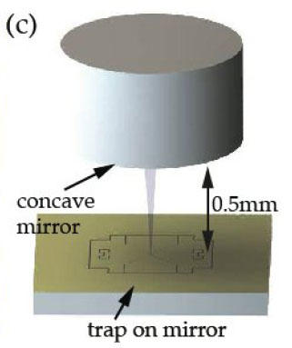
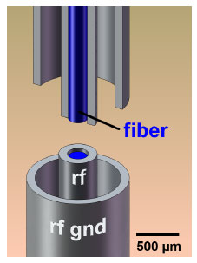
Optics integration in ion traps
QIP with 10s and 100s of qubits
Quantum light-matter interface (cQED)
[1]
[2]
[3]
[4]
[5]
[1] D. Kielpinski, C. Monroe, D.J. Wineland. Nature 6890, 709-771 (2002)
[2] A. VanDevender, Y. Colombe, J. Amini, D. Leibfried, D.J. Wineland. PRL 105, 023001 (2010)
[3] E. Streed, B.G. Norton, A. Jechow, T.J. Weinhold, D. Kielpinski. PRL 106, 010502 (2011)
[4] P.F. Herskind, S.X. Wang, M. Shi, Y. Ge, M. Cetina, I.L. Chuang. arXiv: 1011:5259 (2010)
[5] A. Wilson, et al. arXiv: 1101.5877 (2011)

Slide 3
Optics integration in ion traps
QIP with 10s and 100s of qubits
Quantum light-matter interface (cQED)
[1]
[2]
[3]
Challenges:
Perturbation of trapping fields,
Dielectric charging [6],
Overlap of ion and mode.
[4]
[5]
[1] D. Kielpinski, C. Monroe, D.J. Wineland. Nature 6890, 709-771 (2002)
[2] A. VanDevender, Y. Colombe, J. Amini, D. Leibfried, D.J. Wineland. PRL 105, 023001 (2010)
[3] E. Streed, B.G. Norton, A. Jechow, T.J. Weinhold, D. Kielpinski. PRL 106, 010502 (2011)
[4] P.F. Herskind, S.X. Wang, M. Shi, Y. Ge, M. Cetina, I.L. Chuang. arXiv: 1011:5259 (2010)
[5] A. Wilson, et al. arXiv: 1101.5877 (2011)
[6] M. Harlander, M. Brownnutt, W. Hansel, R. Blatt. NJP 12, 093035 (2010)

Slide 4
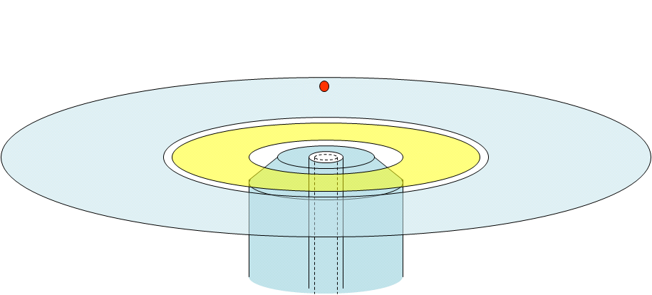
Fiber integration for light delivery
Single-mode for 674nm (and 422nm)
Mode waist at ion of ~50 micron
~50 micron waist
GND
RF
674nm SM fiber
GND

Slide 5
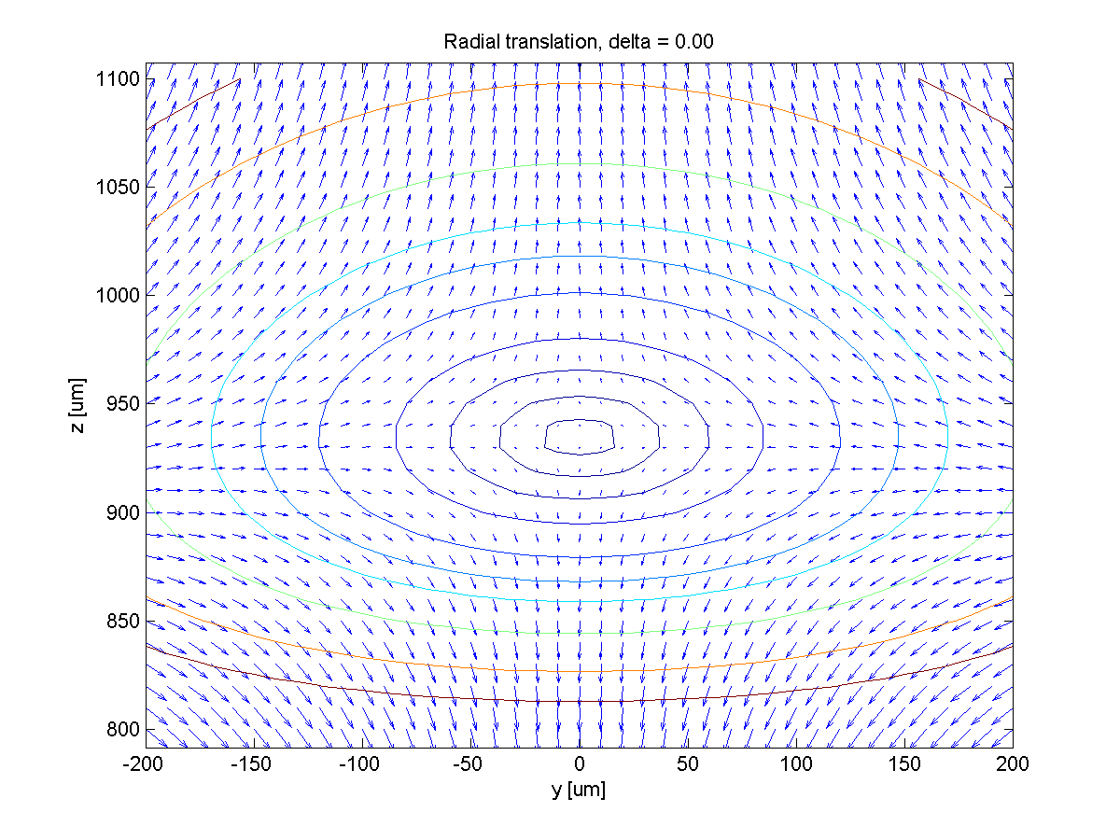
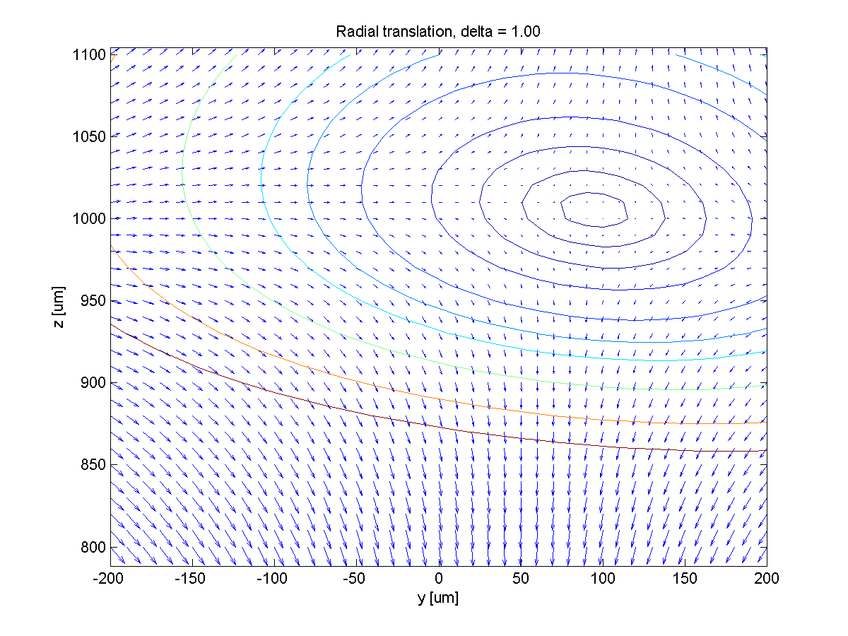
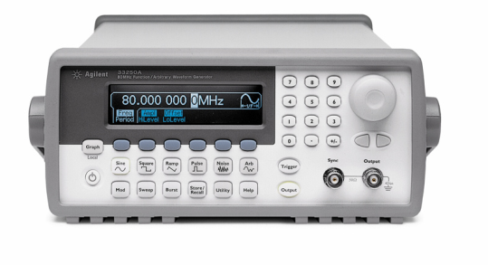
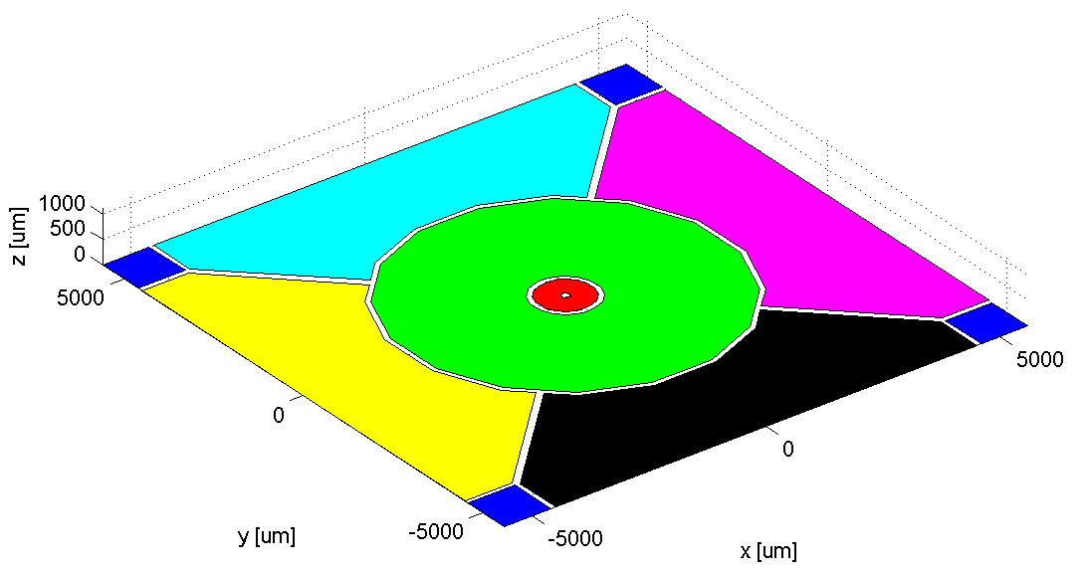
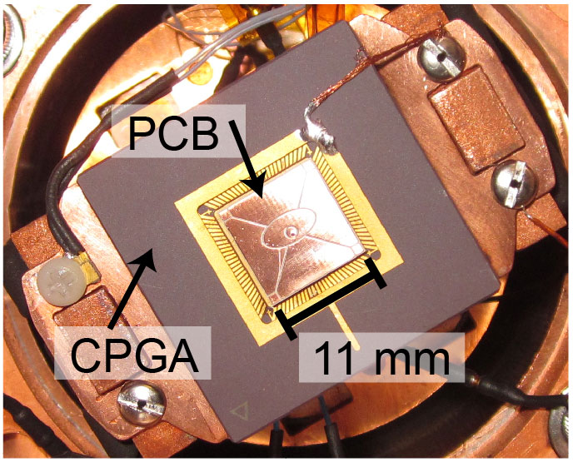
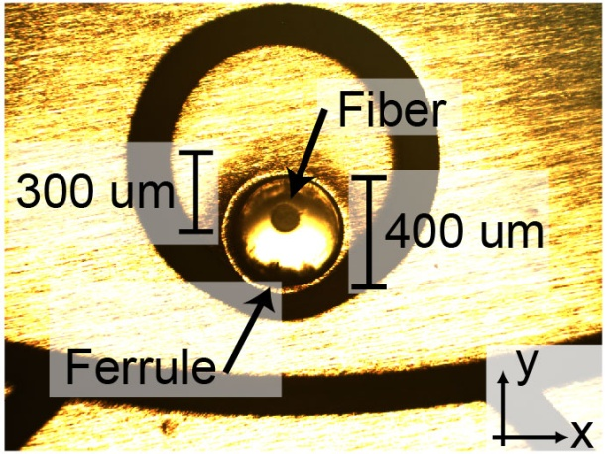
Trap design and fabrication
Ion translation by multiple RF sources [7]
Coarse alignment under microscope
RF1
RF2
[7] T.H. Kim, P.F. Herskind, T. Kim, J. Kim, I.L. Chuang. PRA 82, 043412 (2010)

Slide 6
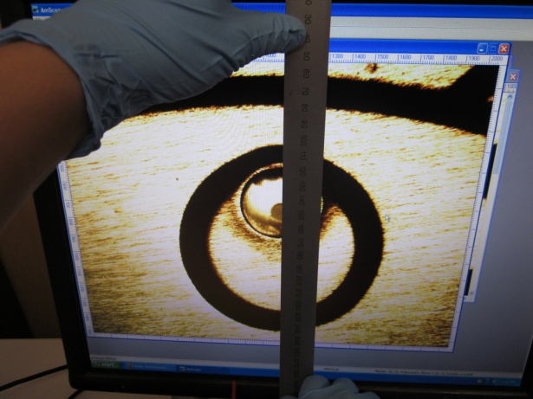
Trap design and fabrication
Ion translation by multiple RF sources [7]
Coarse alignment under microscope
RF1
RF2
[7] T.H. Kim, P.F. Herskind, T. Kim, J. Kim, I.L. Chuang. PRA 82, 043412 (2010)

Slide 7
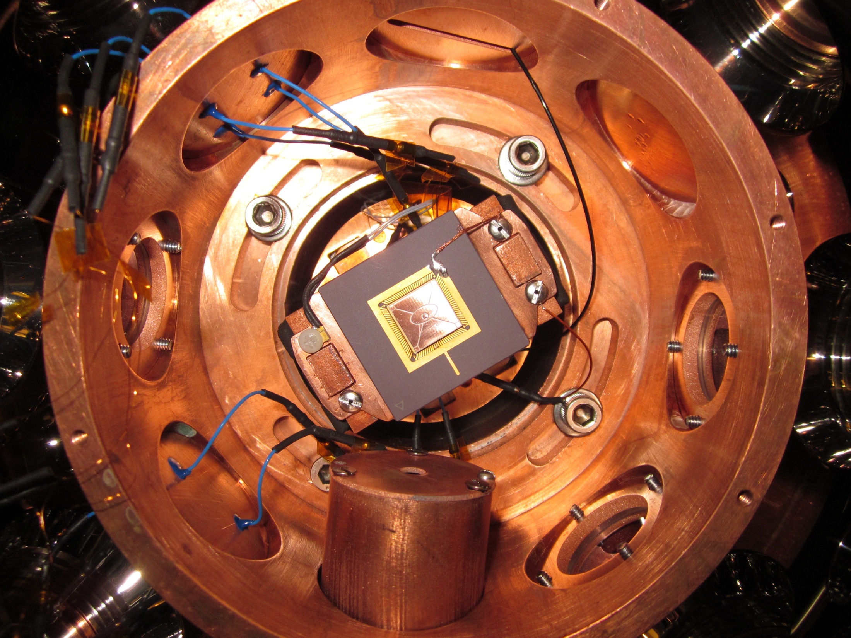
Cryogenic experiment
4x RF
„Conventional“ beam delivery
8K
Fiber
2x RF
40K
Sr oven

Slide 8
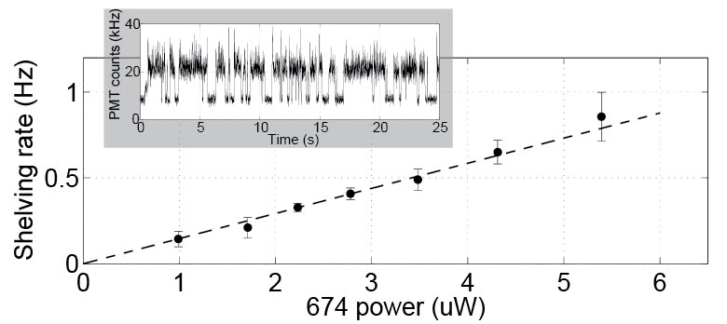
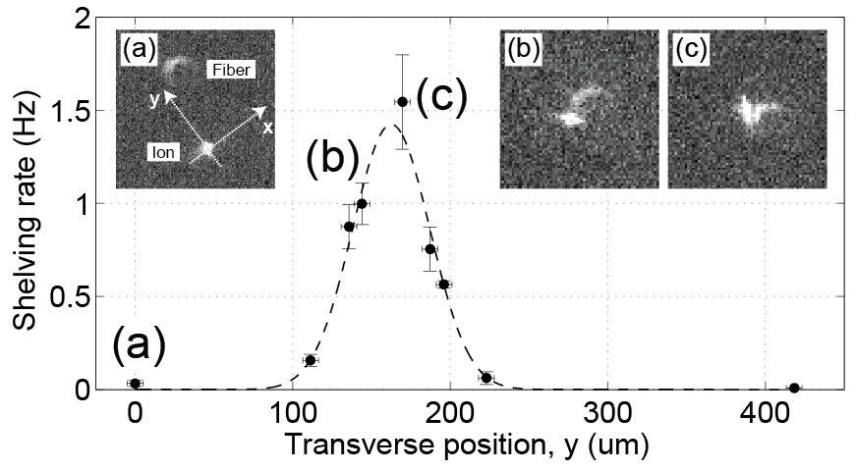
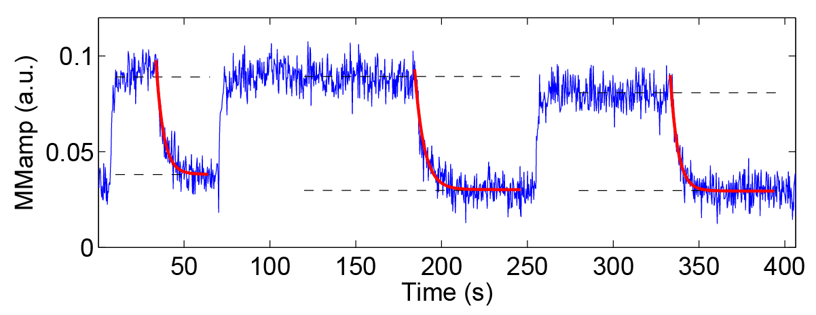
Results
Stable trapping and ion-fiber interaction
Fiber-induced charging dynamics
Measured fiber mode using ion as a probe
(1)
(3)
(2)
~100mV
~5s discharge rate
T.H. Kim, P.F. Herskind, I.L. Chuang. arXiv:1103.5256 (2011)

Slide 9
Summary
Demonstration of integrated (SM) fiber-trap:
  No dramatic charge buildup during trap operation
Quantified fiber-induced stray fields:
  Large (10~100mV) but slow (seconds)
Micromotion-free RF translation of ion:
  Significant range; tuned to mode ~150um away
  General technique for tuning ion-mode overlap, use of ion as sensor
T.H. Kim, P.F. Herskind, I.L. Chuang. arXiv:1103.5256 (2011)

