Slide 1
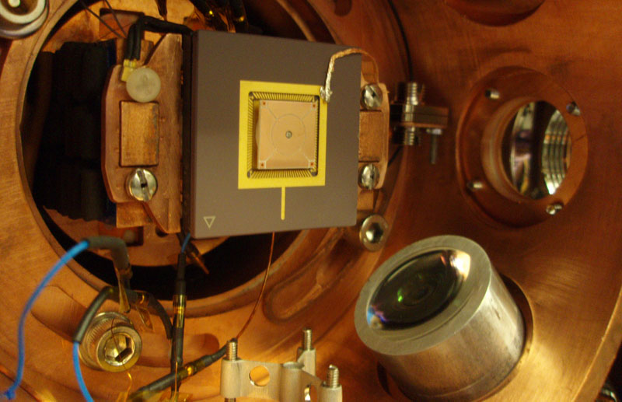
Point Paul trap:
Fiber integration and height variation
Tony Hyun Kim
Chuang group, MIT

Slide 2


Topics to be discussed
Ion trap design (“point Paul trap”) for optical fiber integration
  Perturbation of trapping fields?
  Effect of dielectric beneath the ion?
In situ variation of ion distance to electrodes
Outlook
  Point Paul trap ideal for systematic study of anomalous heating

Slide 3
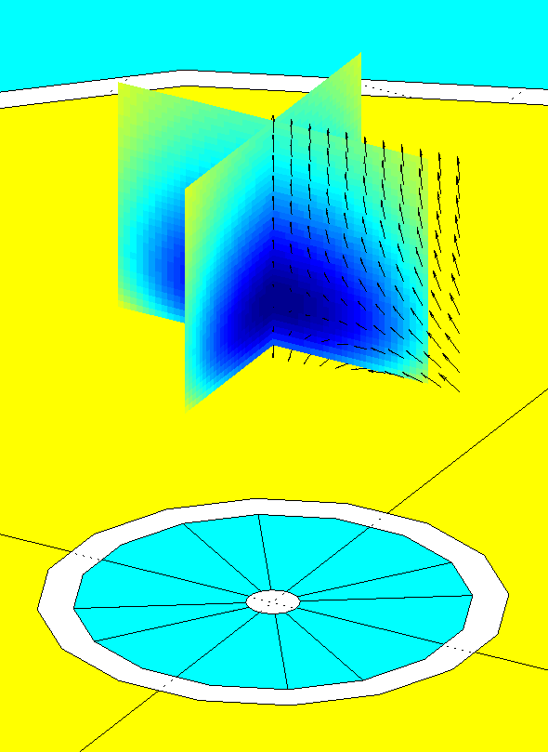
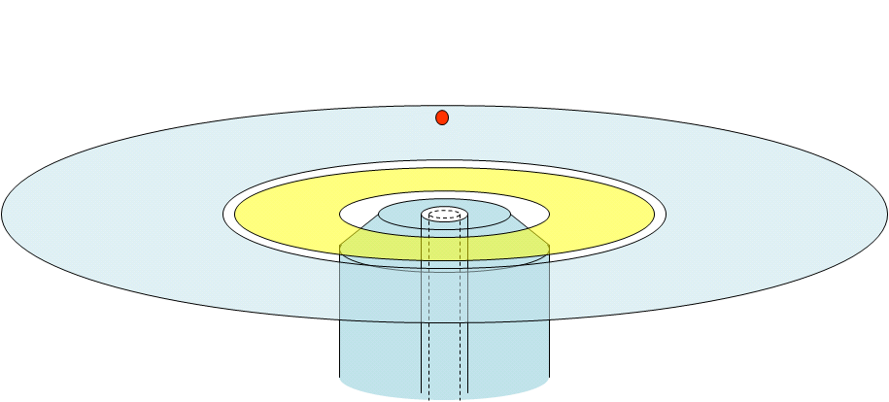
Fiber-integrated point Paul trap
Idea: cylindrically symmetric surface-electrode trap with integrated optical fiber on axis
Issues:
  Perturbation of trapping fields
  Trap assembly
  Ion positioning relative to fiber
Beam diameter: 70um
Ion height: ~1mm
GND
RF
Single-mode fiber for qubit (674nm) and Doppler cooling (422nm) transitions of ⁸⁸Sr⁺.
GND

Slide 4
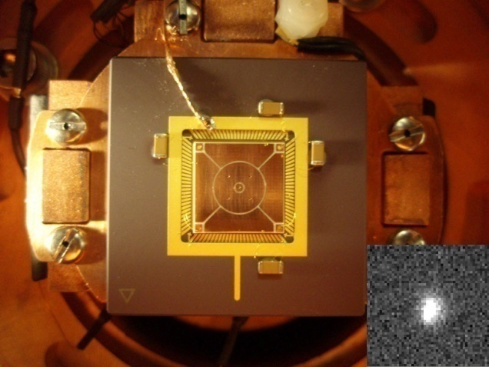
Basic point Paul trap
Ion confinement through single RF
  No DC fields required for trapping
Analytic formulas for all trapping parameters
  Can optimize different parameters (e.g. trap depth, etc)
Typical RF drive 300V, 8MHz
  200meV trap depth
  ~0.5MHz trap frequency
12mm
Kim, Herskind, Kim, Kim and Chuang. Accepted PRA. arXiv/1008.1603 (2010)

Slide 5
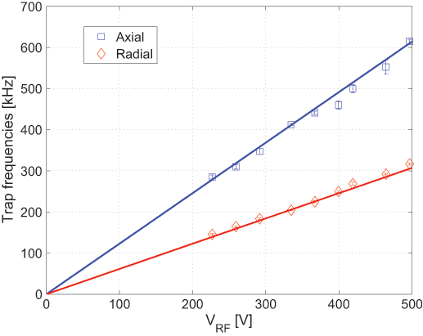
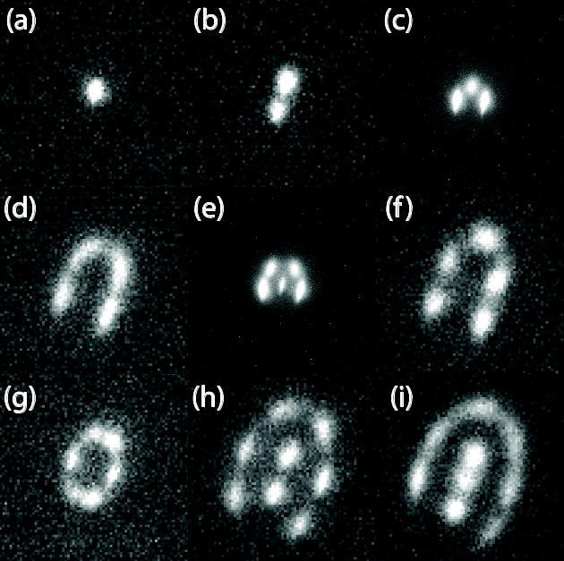
Basic Point Paul trap: Characterization
Ion confinement through single RF
  No DC fields required for trapping
Analytic formulas for all trapping parameters
  Can optimize different parameters (e.g. trap depth, etc)
Typical RF drive 300V, 8MHz
  200meV trap depth
  ~0.5MHz trap frequency
12mm
Lines: theory
(Each panel: 40um×40um)

Slide 6
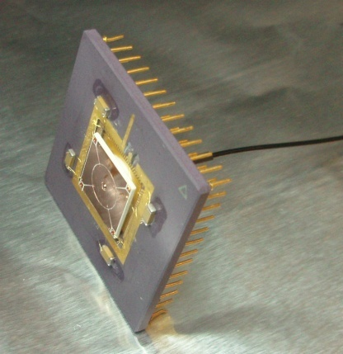
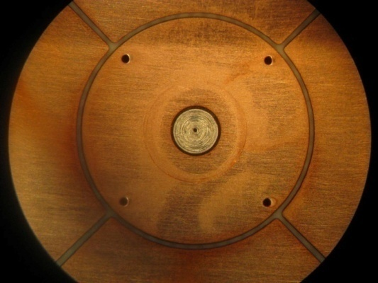
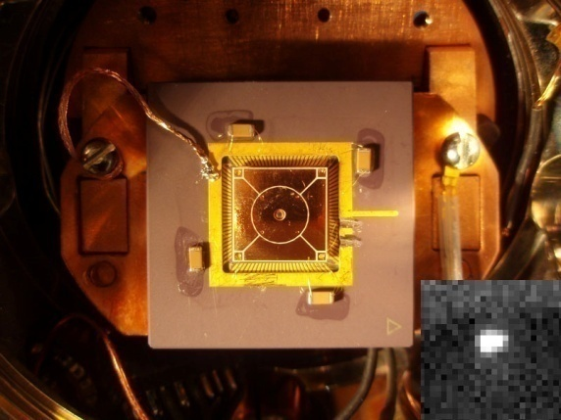
Fiber-integrated trap: Fabrication
Fiber and optical ferrule (stainless) polished as in conventional fiber connectorization.
Macroscopic assembly at ~25um precision.
Different fabrication options considered, such as:
  Metallization of ceramic optical ferrule.
  Self-aligned fab process by exposing PR through fiber itself.
1.25mm
Fiber introduced through the center of innermost electrode (actually an optical ferrule).

Slide 7
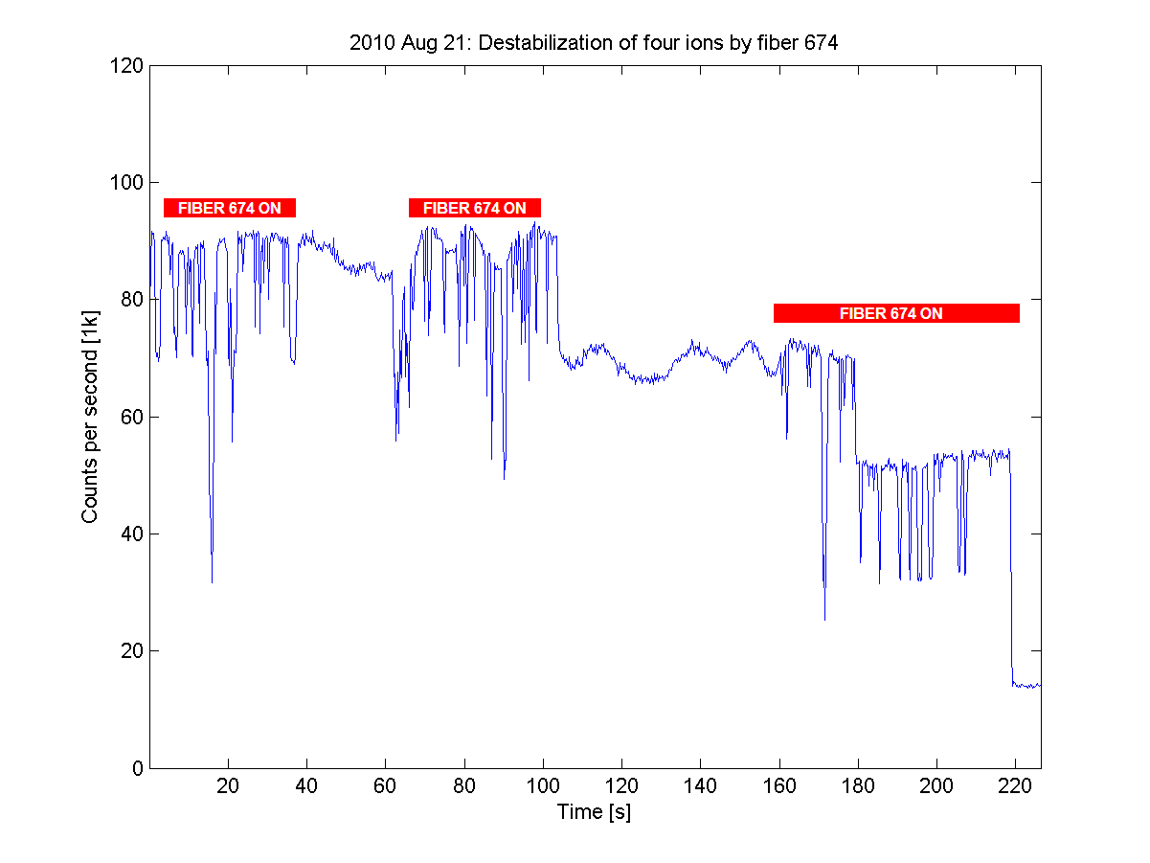
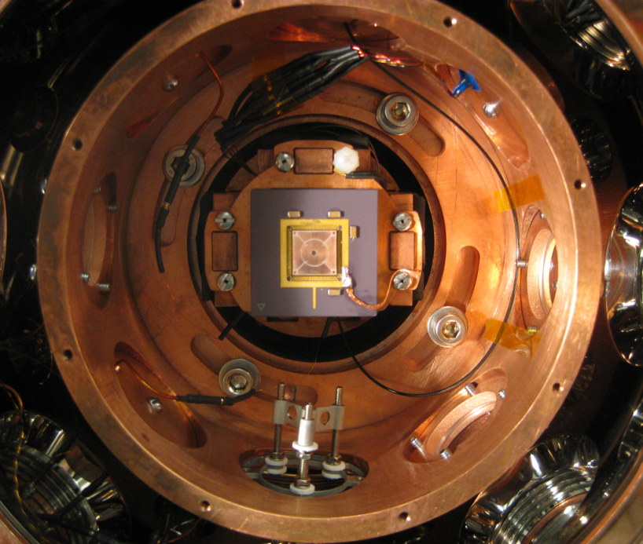
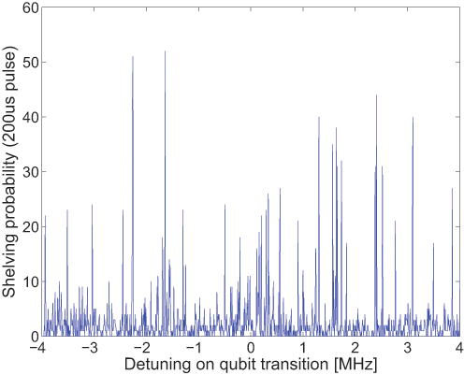
Fiber-integrated trap: Prelim results
Basic fiber-ion overlap observed in shelving of trapped ions
Improvements expected by miniaturization of trap, i.e. to increase trap frequencies (LD regime)
RF1
DC electrodes
Preliminary qubit spectroscopy through the fiber:
Numerous sidebands indicate insufficient ion cooling or too large trap frequency
Free-space
beam delivery
Fiber
RF2
Oven
40K chamber (5” diameter) of cryostat.
Trap mount is at ~10K

Slide 8
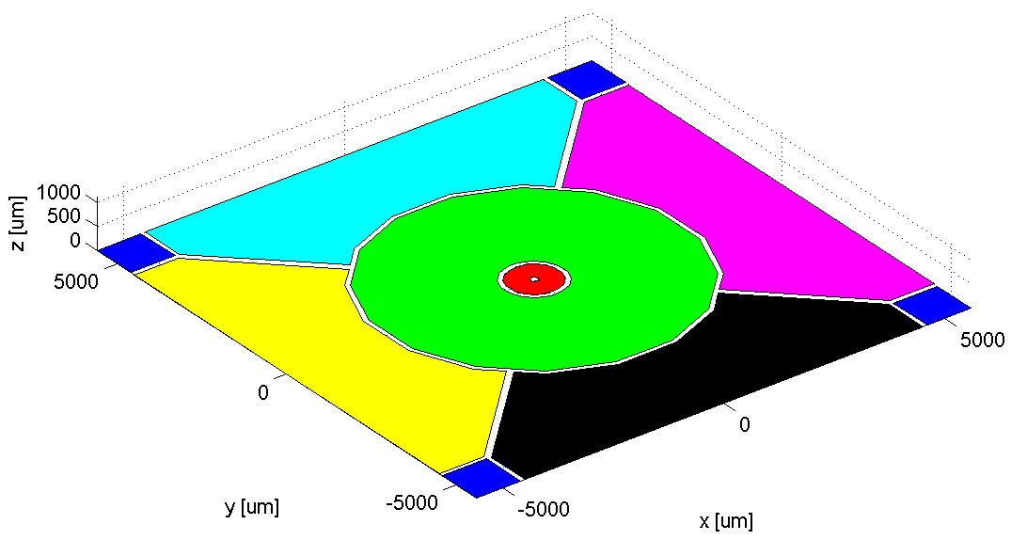
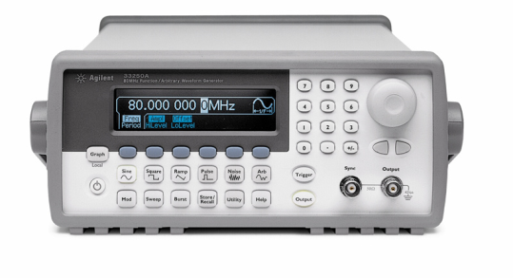
Height variation in point Paul trap
Idea: RF confinement without DC fields allows for more complicated drive schemes
Implication:
  Order of magnitude variation in ion height in situ is possible
  More generally, ion can be positioned with respect to trap.
RF1
RF2

Slide 9
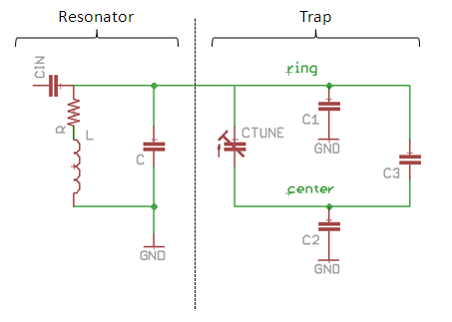
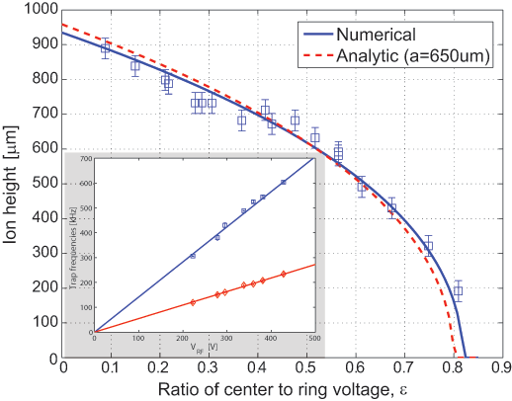
Height variation in point Paul trap
Applying second RF on the center electrode translates the quadrupole node vertically.
  Implementation with single trimcap
  Works with both:
    fiber (400~1000um)
    PCB (200~1000um)
Height variation compared against analytic theory and numerical simulations

Slide 10
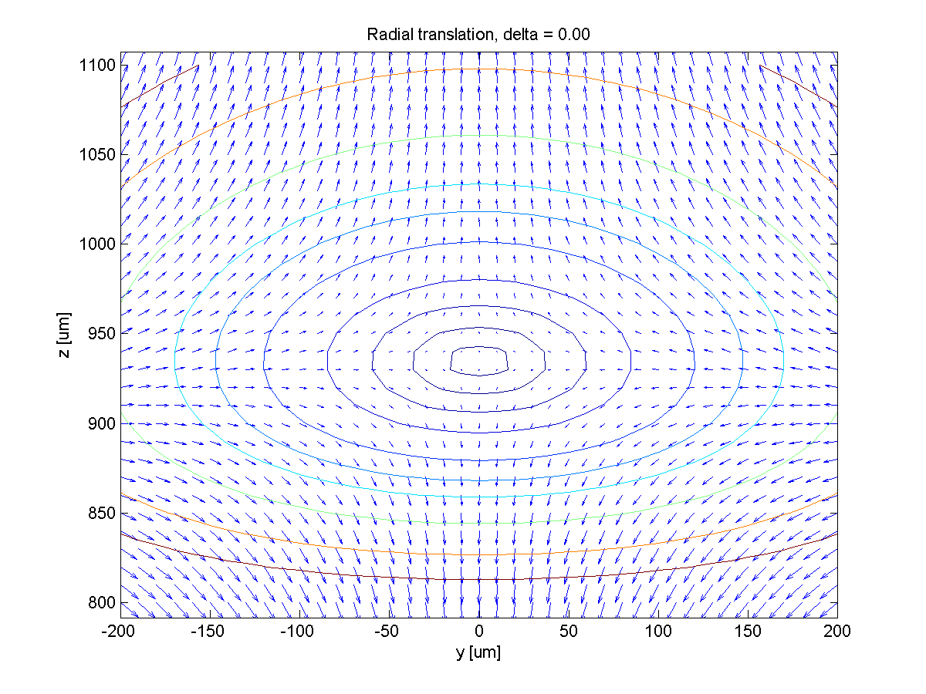
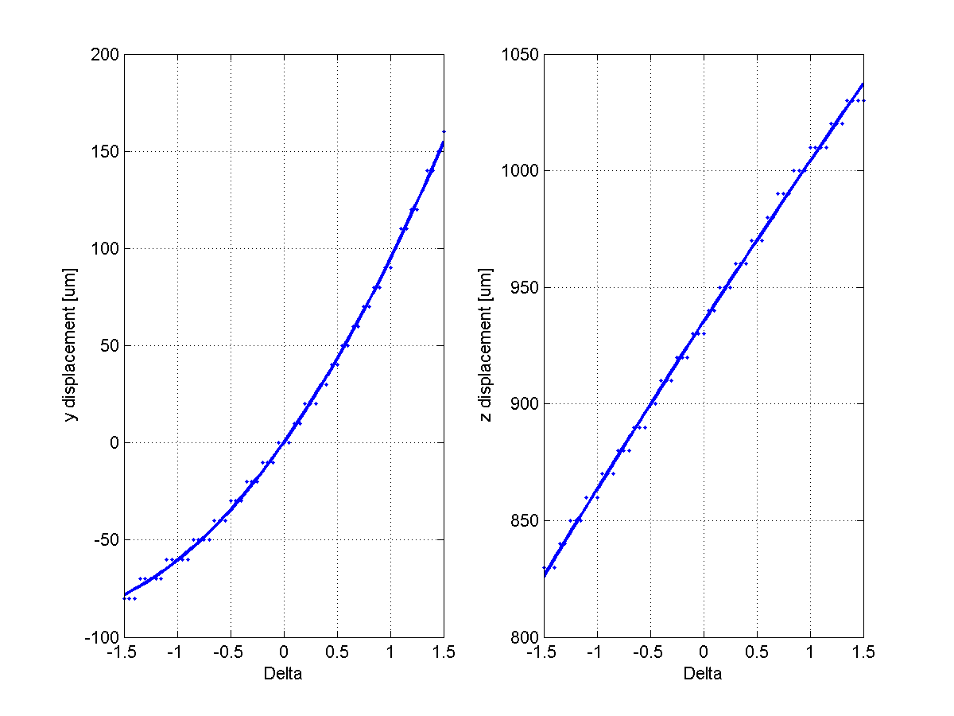
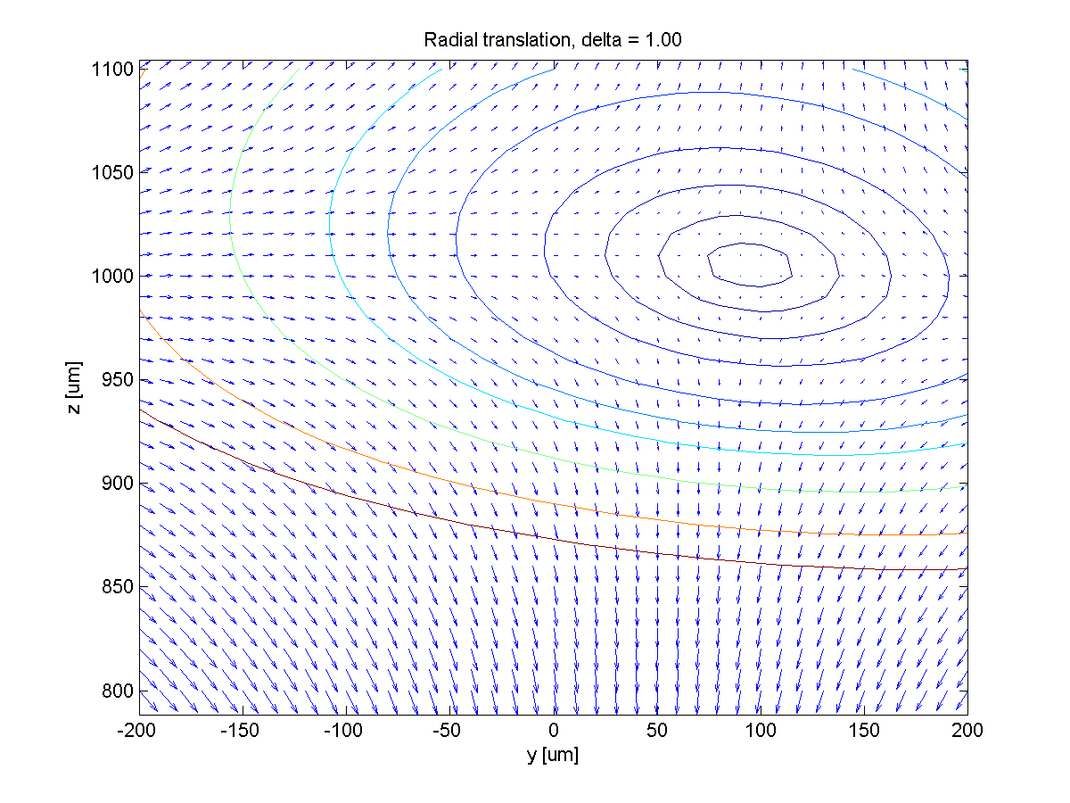
Ion positioning
In general, applying RF to side electrodes will also translate the ion.
  1:1 ring:side voltage ratio moves ion radially ~100um
  Immediate application in ion-fiber overlap control

Slide 11
Summary and Outlook
Fiber integration gives access to a typically inaccessible axis of a surface-electrode ion trap.
Point Paul traps allows in situ variation of ion height by almost an order of magnitude in a single trap.

Slide 12
Summary and Outlook
Fiber integration gives access to a typically inaccessible axis of a surface-electrode ion trap.
Point Paul traps allows in situ variation of ion height by almost an order of magnitude in a single trap.
Ingredients for a systematic study of anomalous ion heating
What is the correct scaling law for ion heating as a function of distance to trap surface?
How does anomalous heating effect the ion motion normal to the trap and parallel to the trap?
The point Paul trap is an ideal system in which to study these questions…

Slide 13
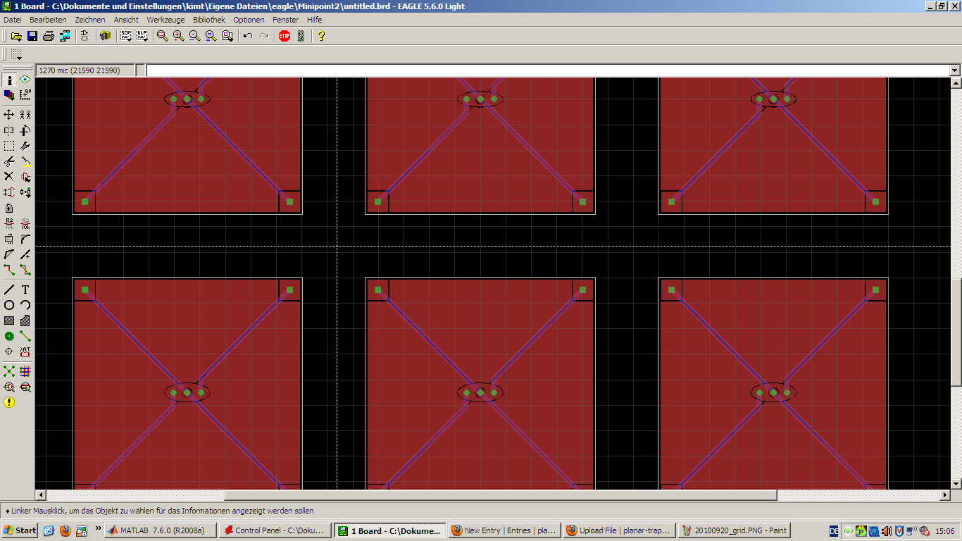
Next up

